Slide 1



The Palestinian Race Track
Respondent: Oday Derbas
Ibrahim Khalid
Instructor: Dr. Khalid Al-Sahili

Slide 2
1
Introduction

Slide 3
Introduction
The Palestinian Race Track, is the first race track designed in Palestine. As the sports world in developed and getting expand, it will be a good attempted to inter this field. Drivers recently getting more interested to the races and the motorcycle sport, due to the car accessories and the changes on cars. But there was an issue, which is the available places to do this sport.
First, we went to Ramallah to see the yard used to race (Sarsour Karting). Interview with the owner and the worker there to get information about the karting yard. With some tires, they could made a different shapes of track.

Slide 4
Steps
Investigation
Planning
3D Model
Idea
Codes
Design

Slide 5
2
Methodology

Slide 6

Idea

Slide 7
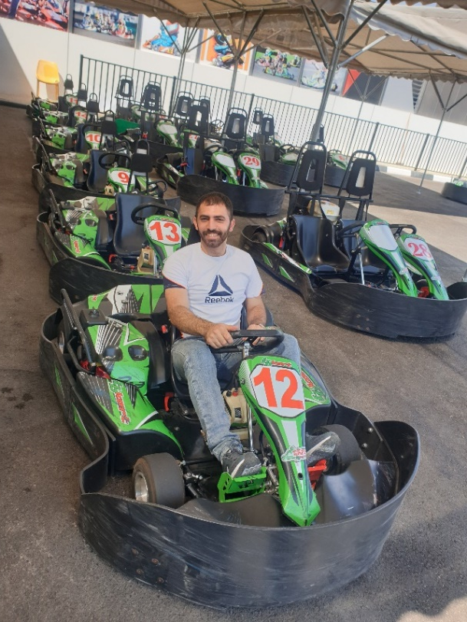
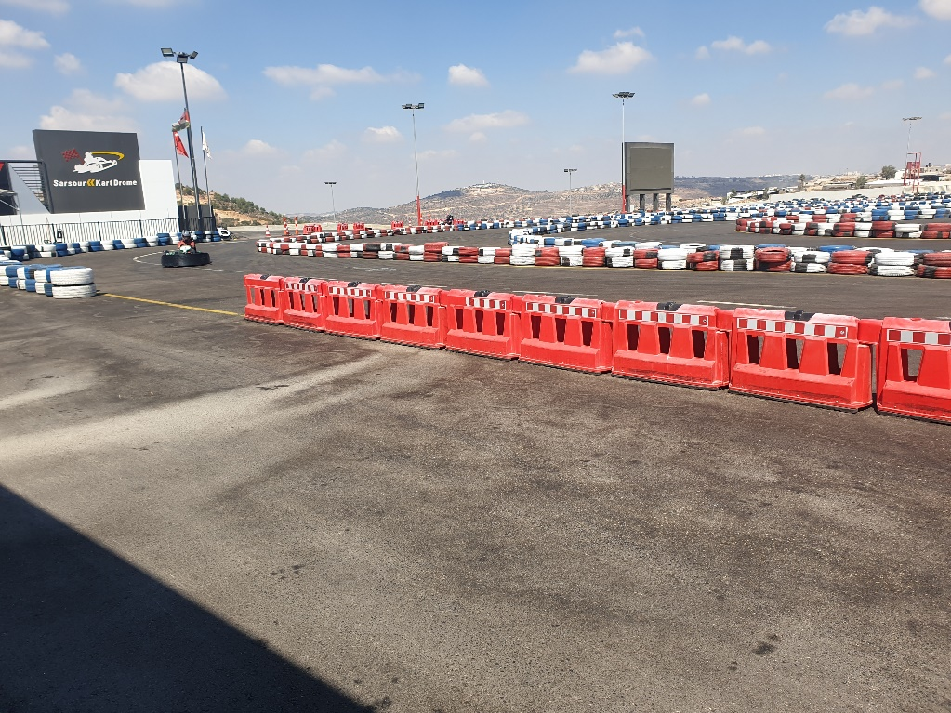
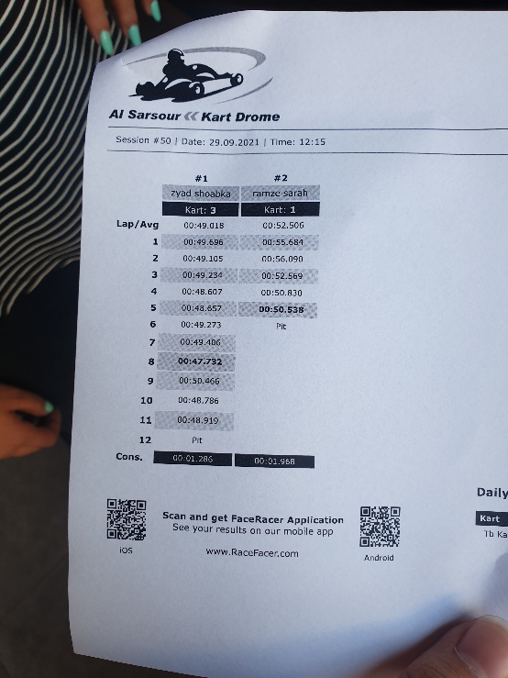
Investigation

Slide 8
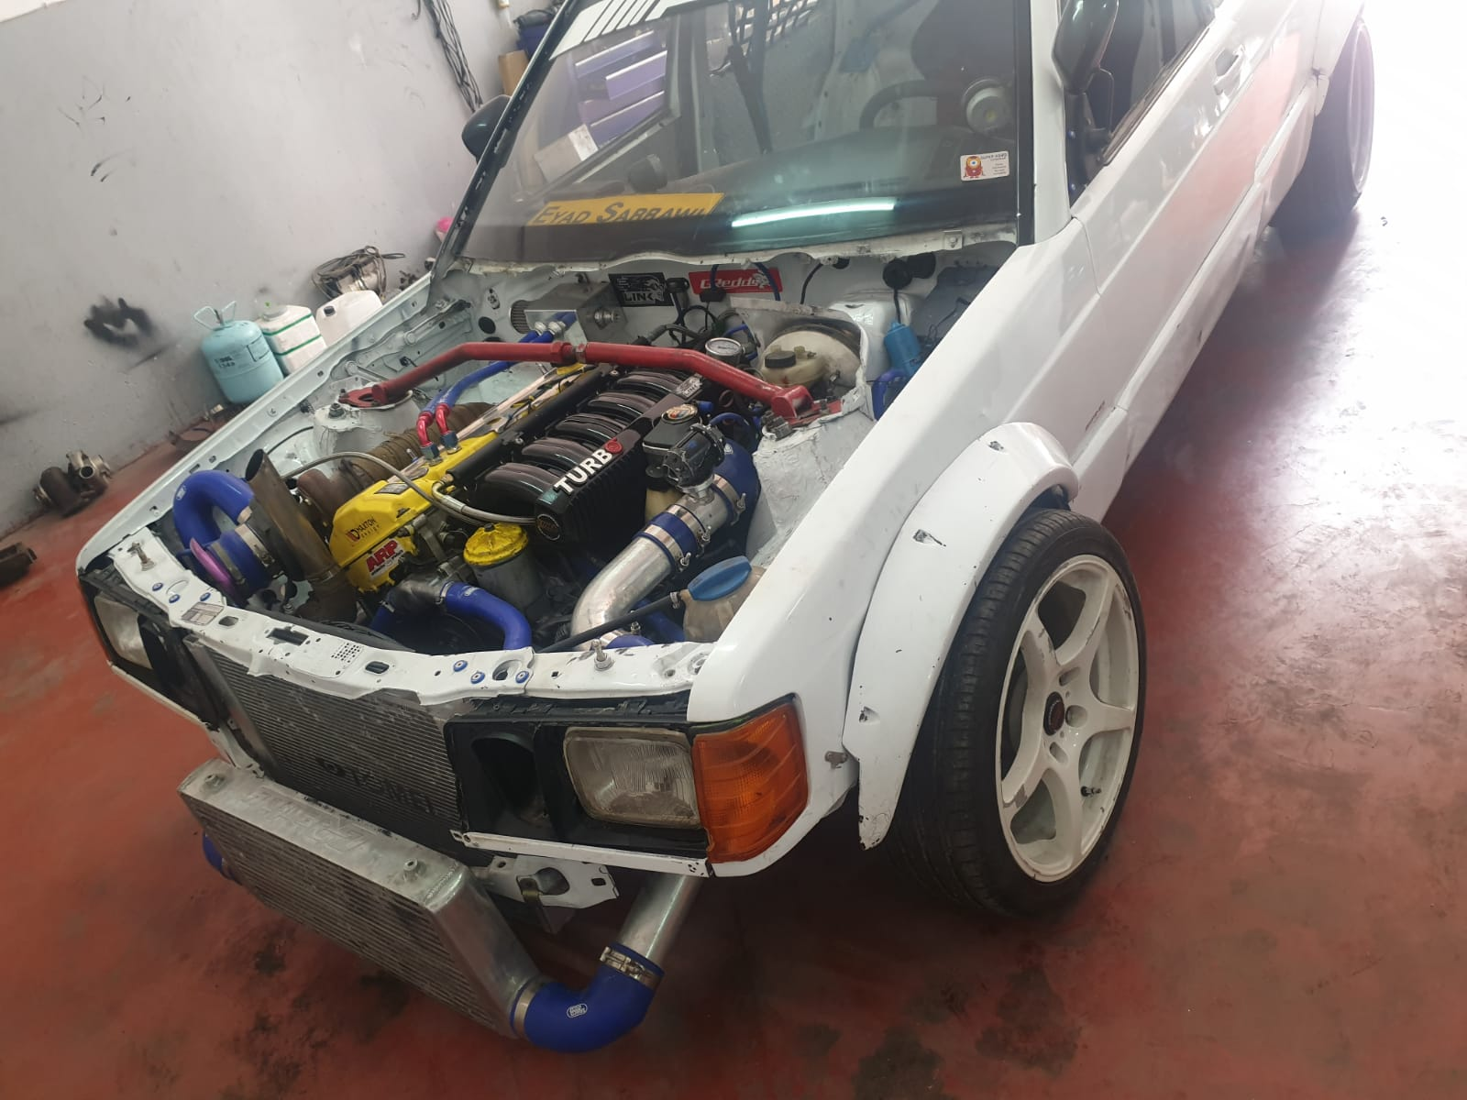
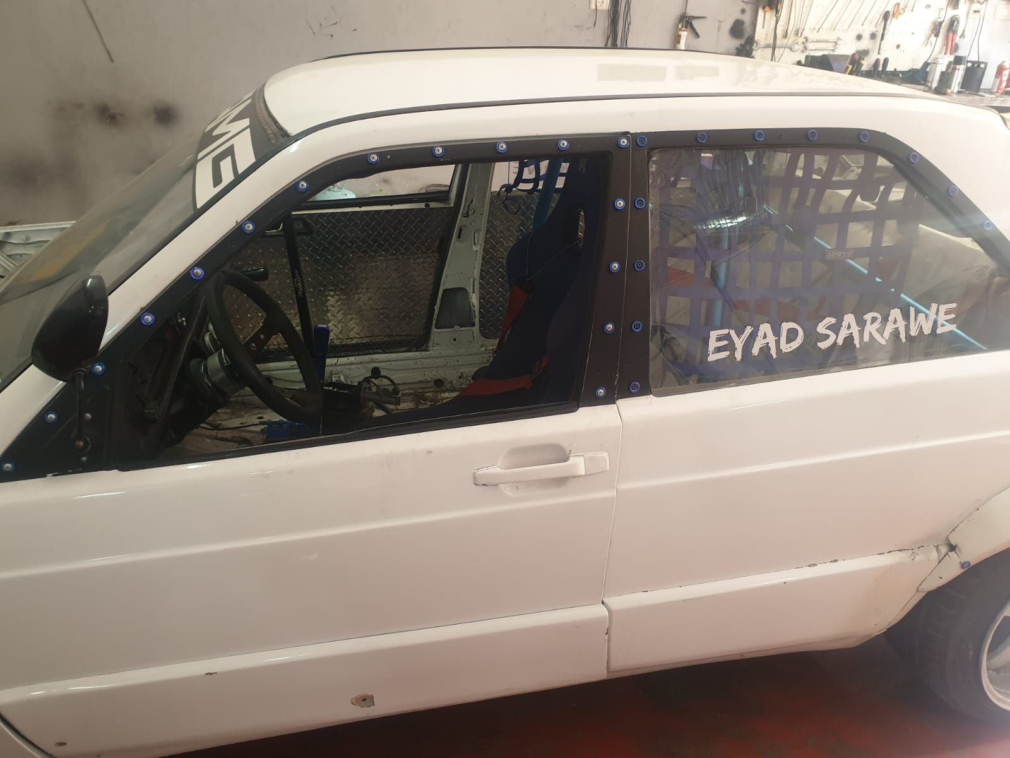
Investigation

Slide 9
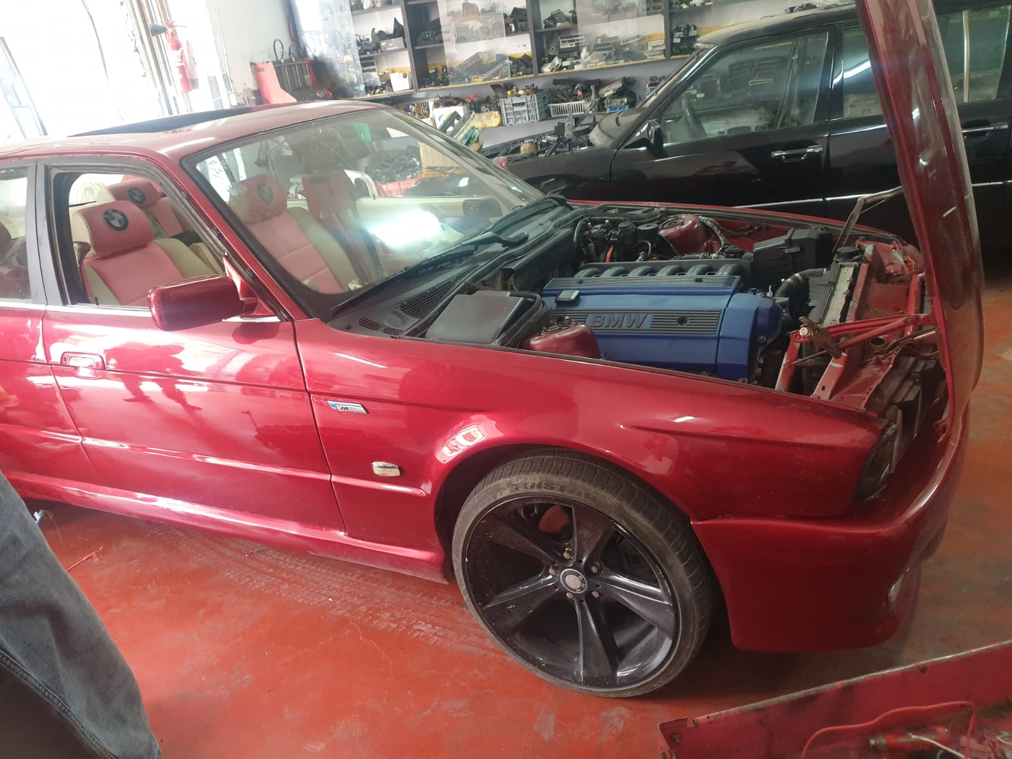
Investigation

Slide 10

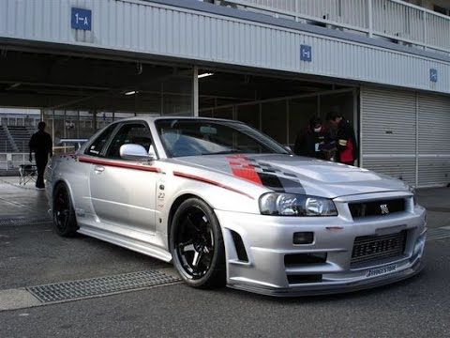
Investigation
Visiting the PMSMF to get some advices, reaching the needed type of tracks. Which were related to the car type and specifications. There were few types of cars to chose one type, the tuning cars is much required in the sport field.
The choice type of cars for the race track, The tuned cars, as it be build by the owner or even stock cars. Reason of that is the market value of it, also no sport cars available.

Slide 11


Codes
AASHTO is like a bedrock of the race track, as it specialize at the entrance, exit, bus lane, parking and
From much point of view, the FIA take the cars safety and readiness very seriously. To achieve a best performance.
So the FIA were the second reference for the designing.

Slide 12
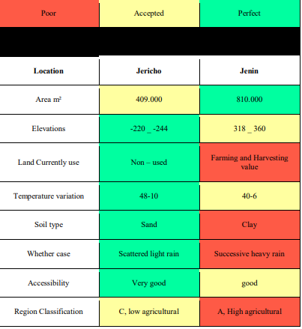
Land Chose
As we talk about Racing, a large land is needed, far from the urban area, good soil, low Agricultural value and the high accessibility. For this reason a compare between two land were done, first in Jericho and second in Jenin.

Slide 13
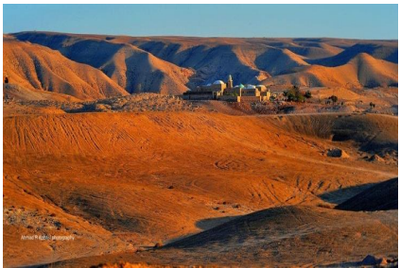
Land Chose
The chosen land were in Jericho, for more than one point. First the type of soil and nature of land, secund the low Agriculture value of it, third the type area, forth the temperature and wither conditions.

Slide 14
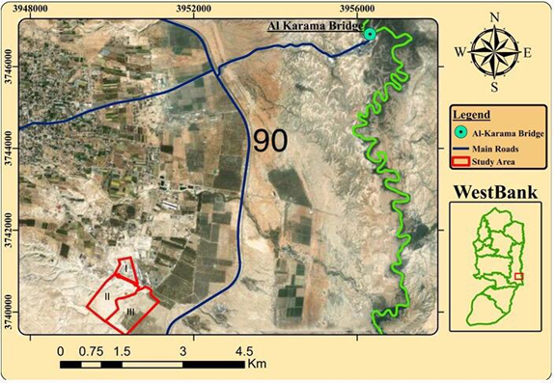
Planning

Slide 15
3
Design

Slide 16
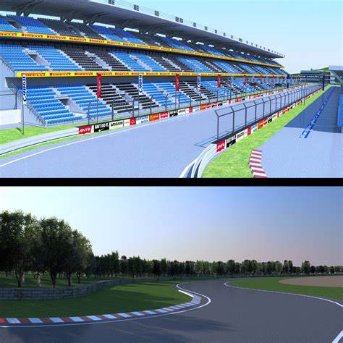
Design
Design Stage
First, find the a good shape, that achieve the comfort level.
Second, use the AASHTO and FIA codes to make a balance, between safety and comfortable at high speeds.
Third, make a 3D output, to get a realistic lock to the project as all.
Fourth, make a simulation by using the Asseto Corsa game.

Slide 17
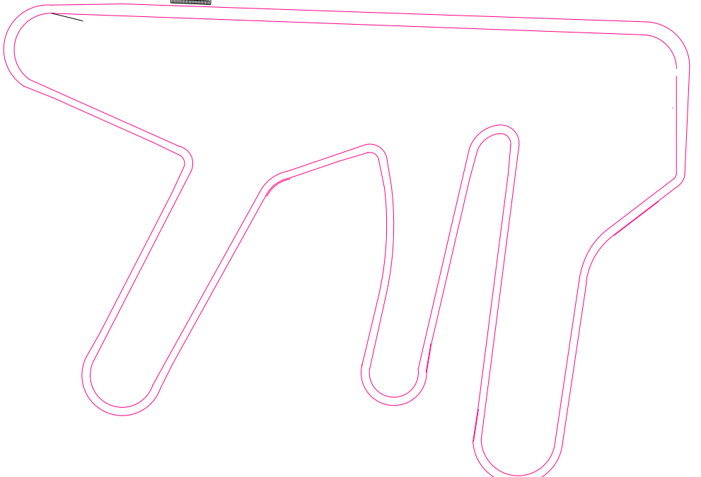
Layout

Slide 18
Location

Slide 19
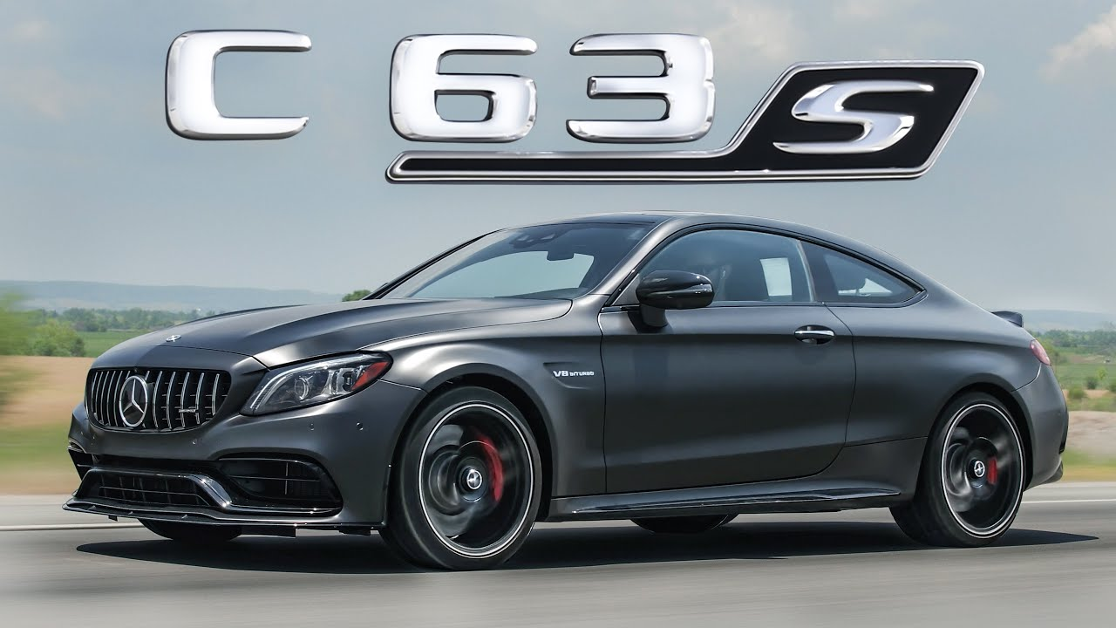
The Car
Mercedes Benz C63 AMG

Slide 20
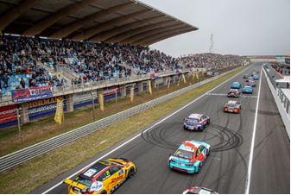
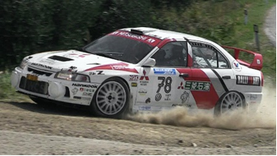
Race Type

Slide 21
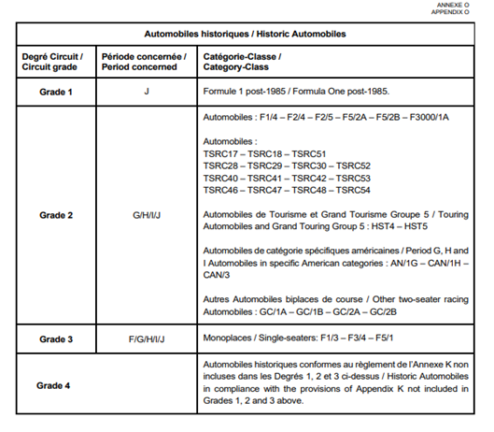
Circuit Grade

Slide 22
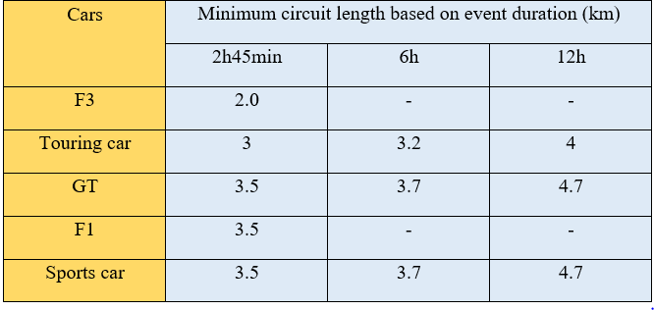
Duration & Track Length

Slide 23
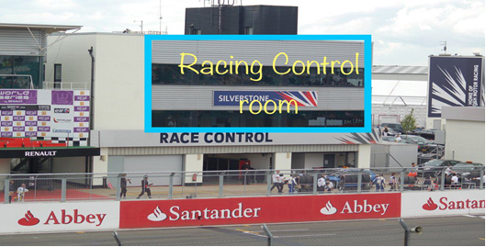
Structures

Slide 24
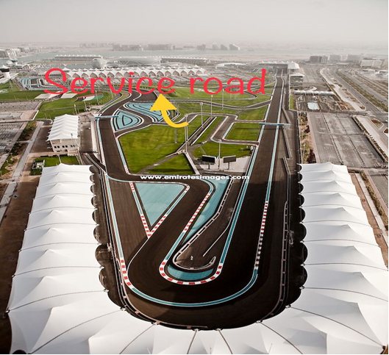
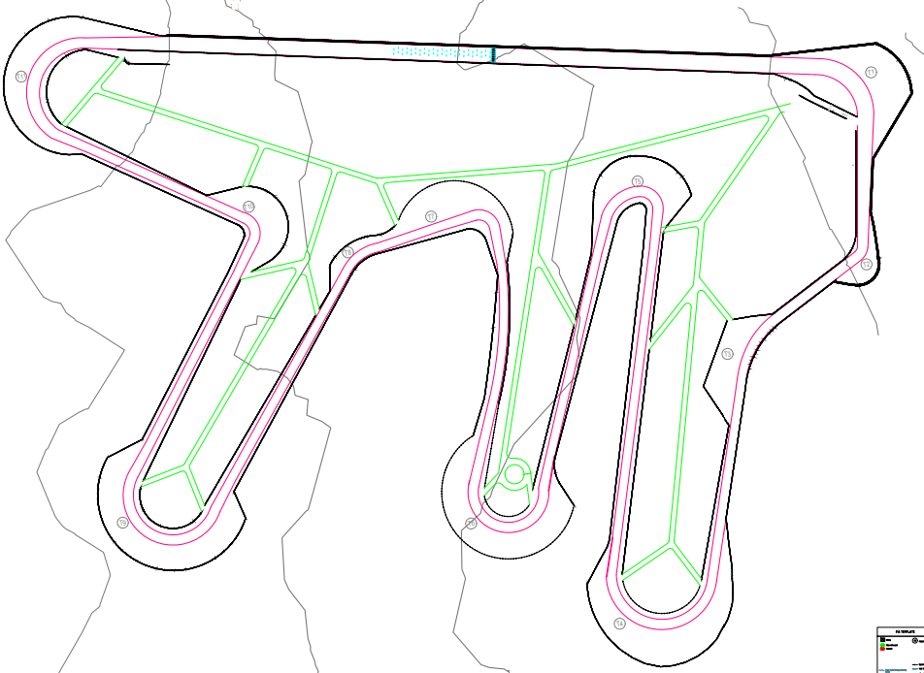
Inner Roads

Slide 25
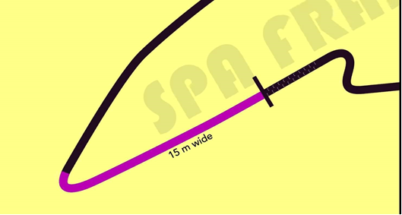
Width

Slide 26
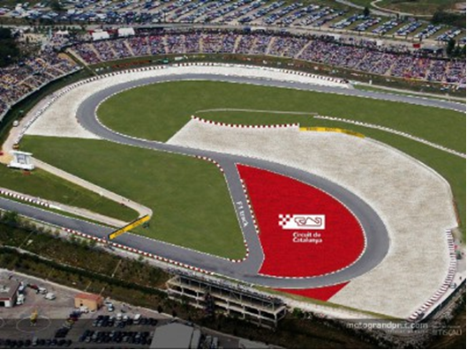
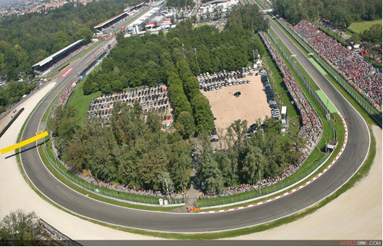
Corners

Slide 27
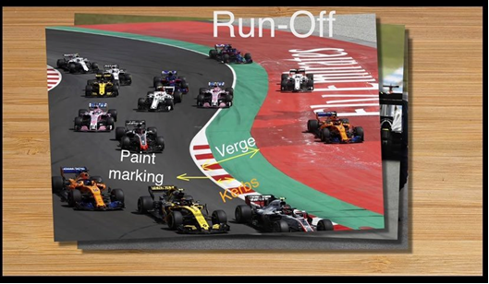
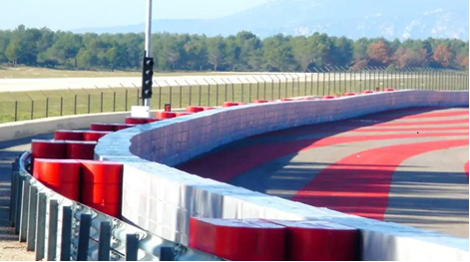
Safety

Slide 28
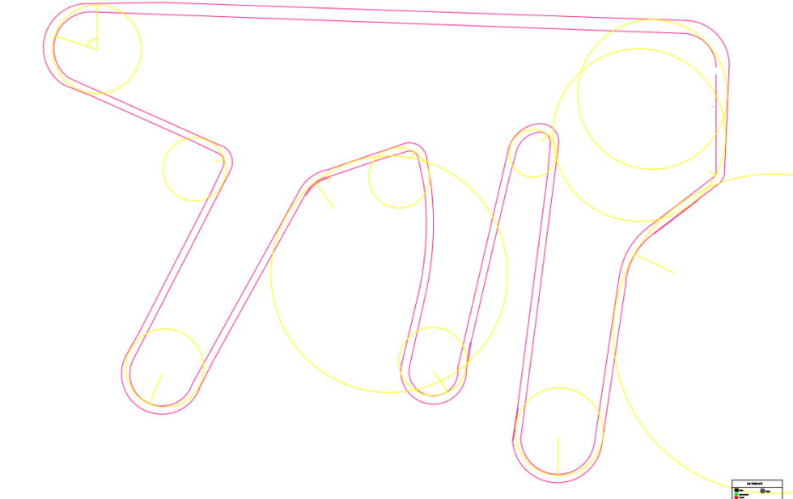
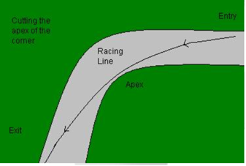
Racing Line

Slide 29
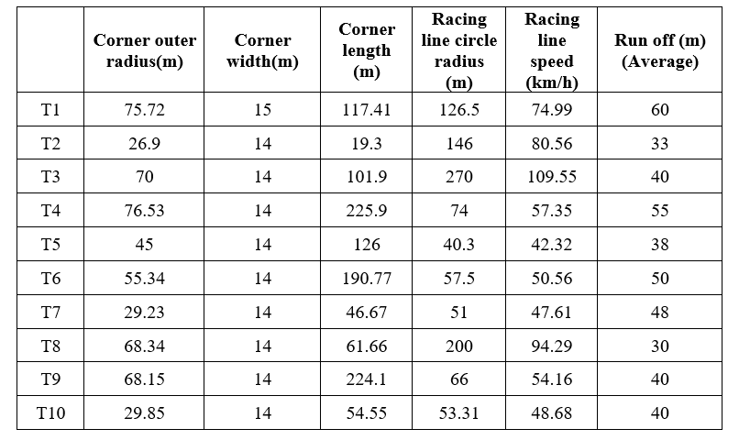
Speed

Slide 30
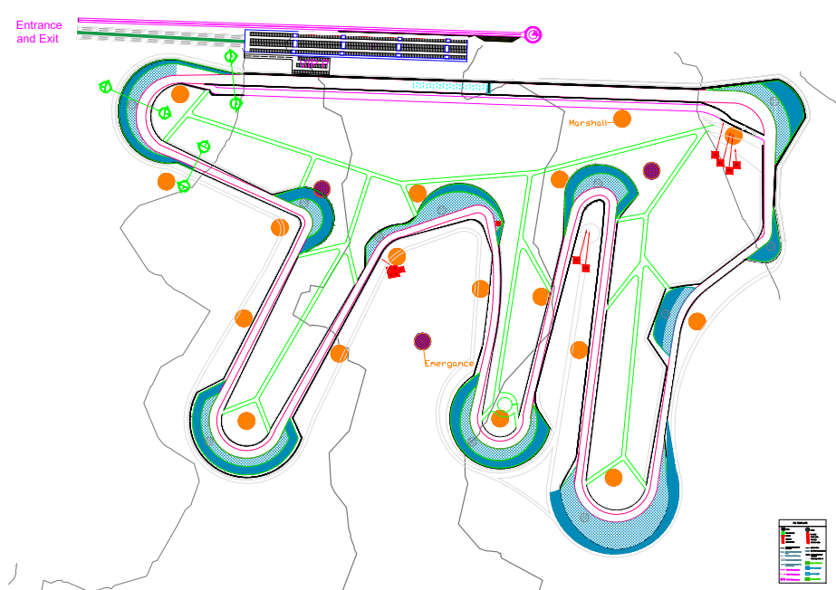
Layout

Slide 31
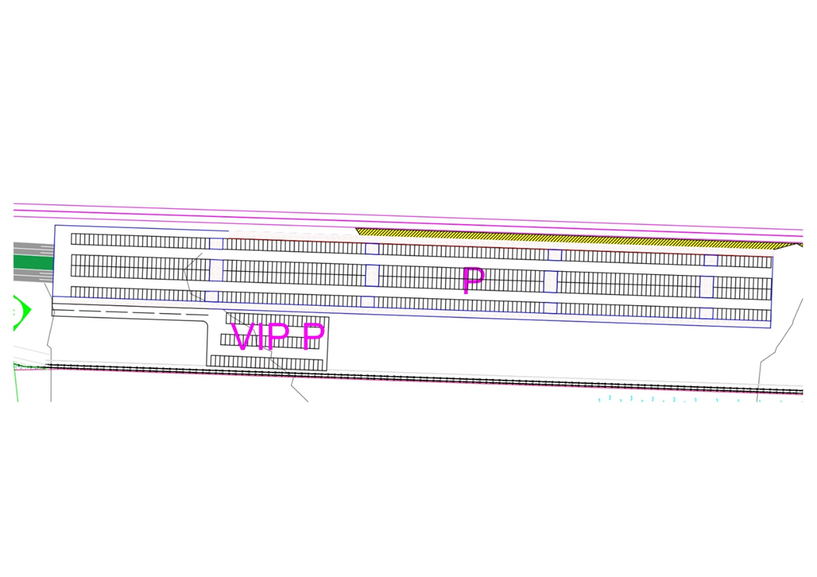
Parking

Slide 32
4
3D Model

Slide 33
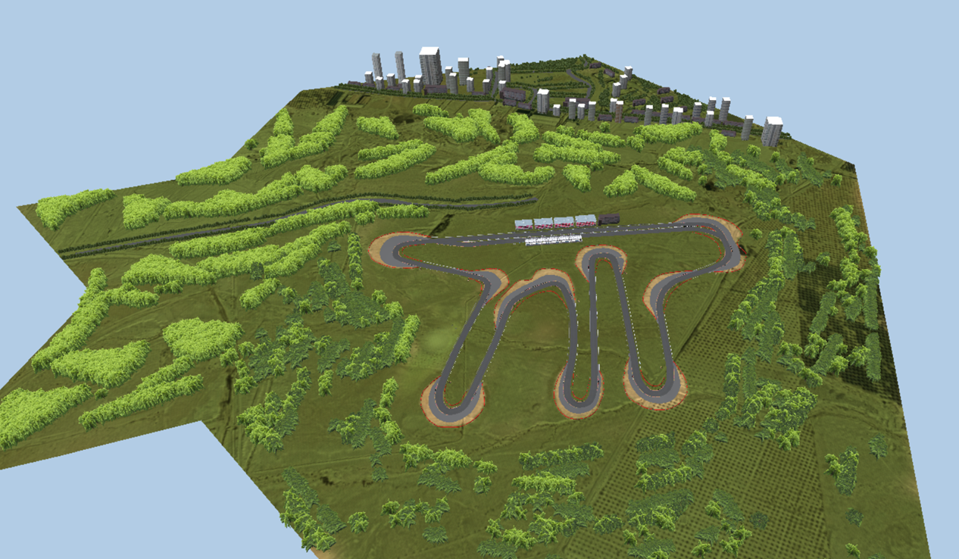

Slide 34
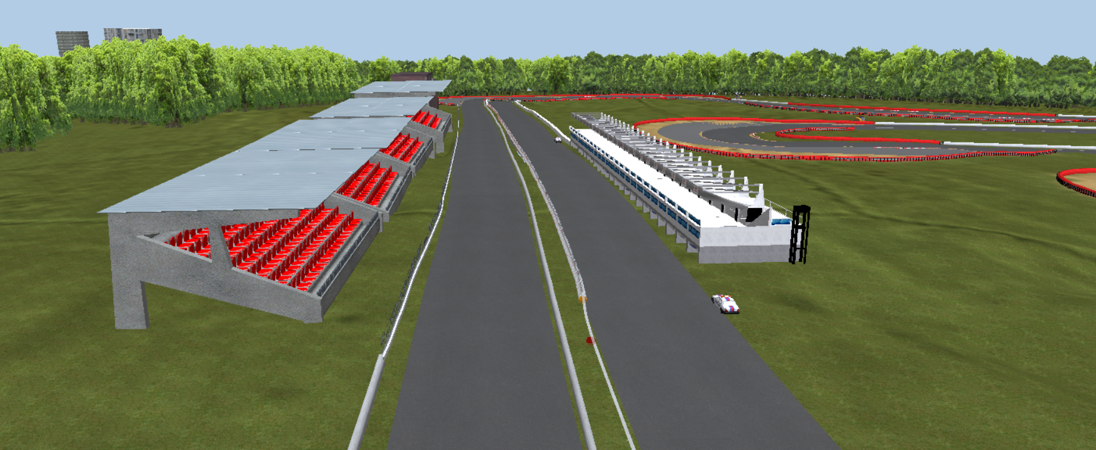
ADD TITLE

Slide 35
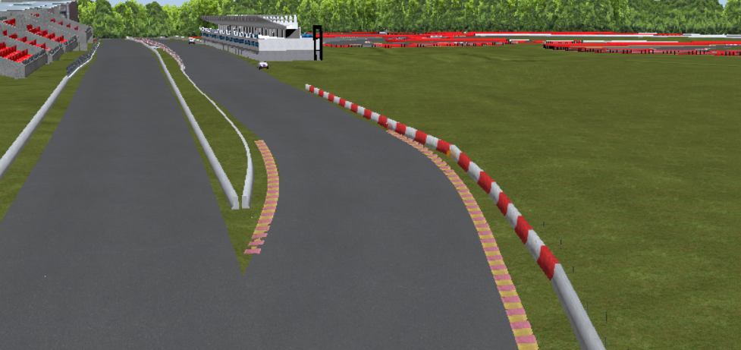
Pit Entry

Slide 36
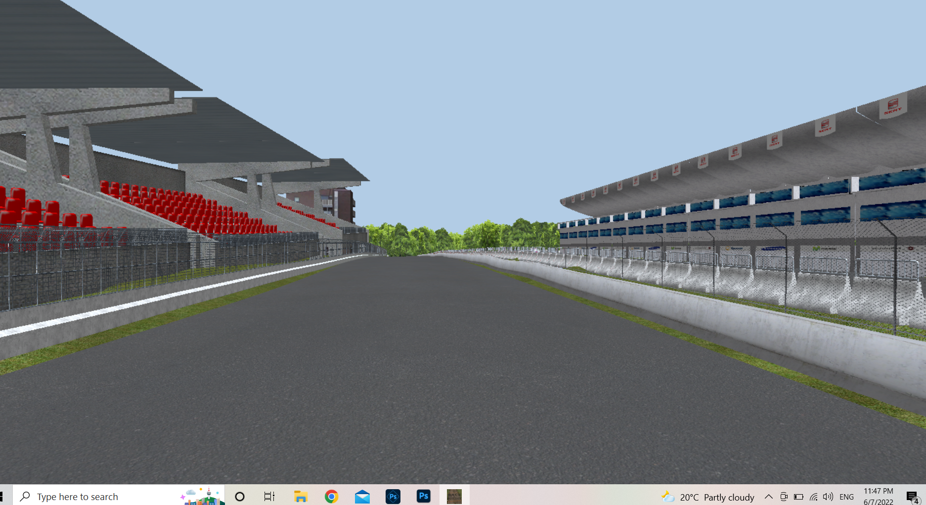
STARTING STRIGHT

Slide 37
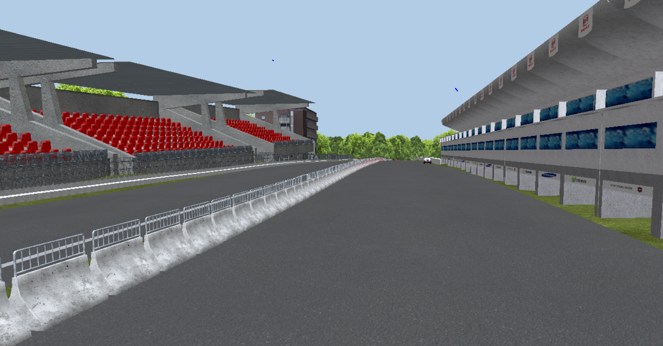
PIT LANE

Slide 38
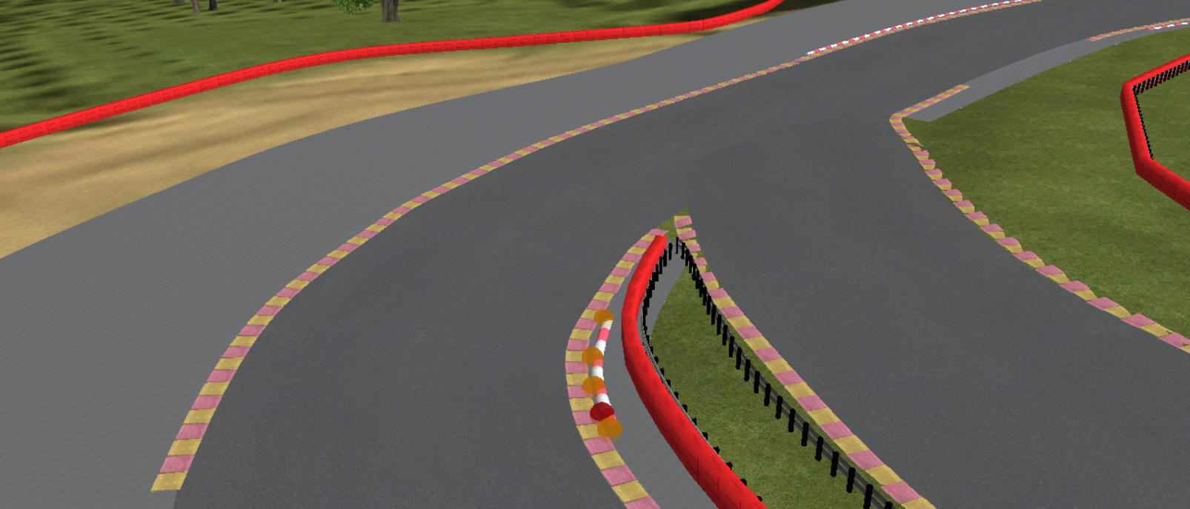
Pit Exit

Slide 39
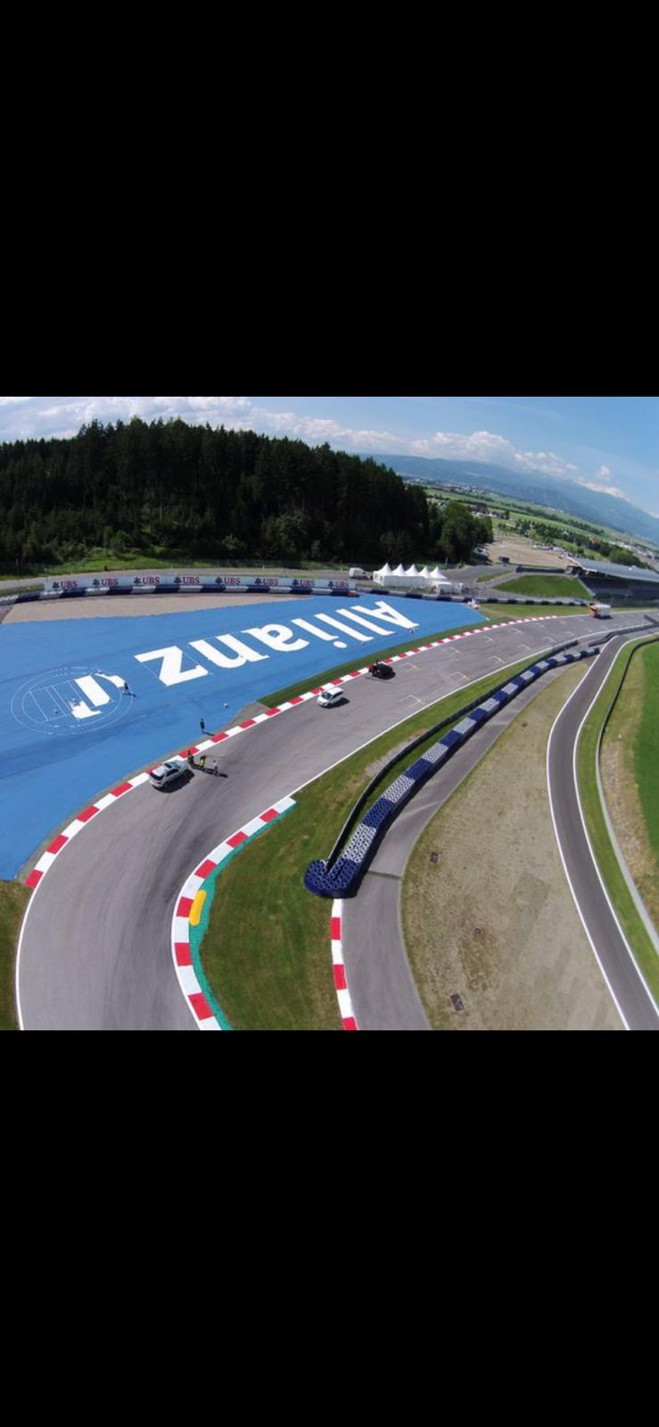
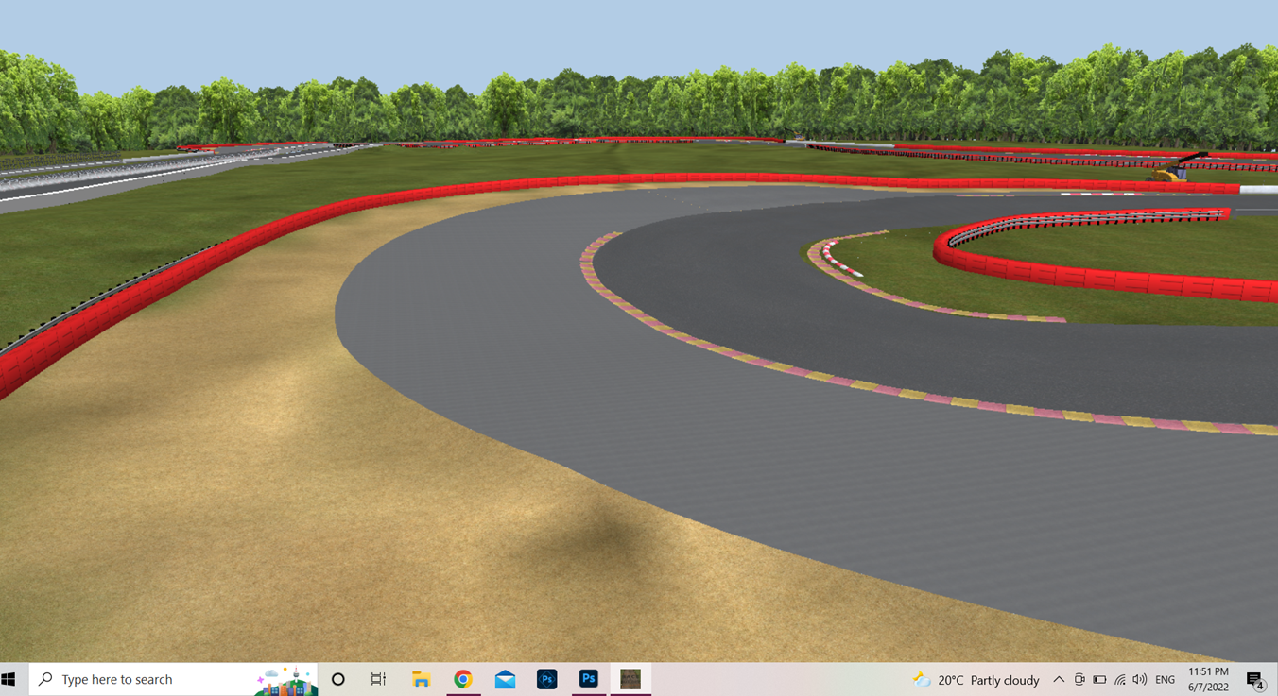
Corners

Slide 40
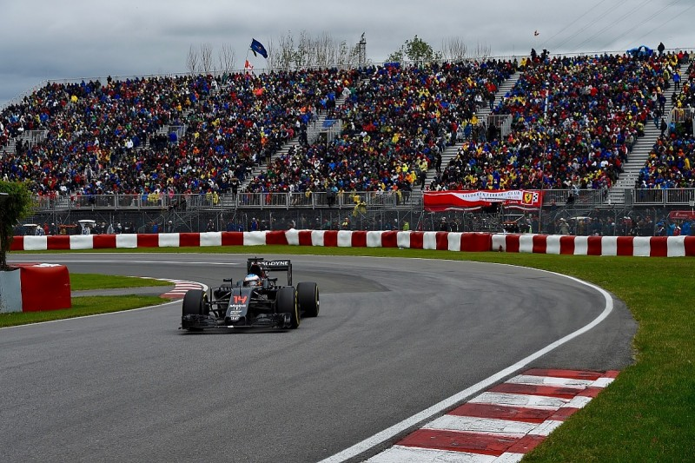
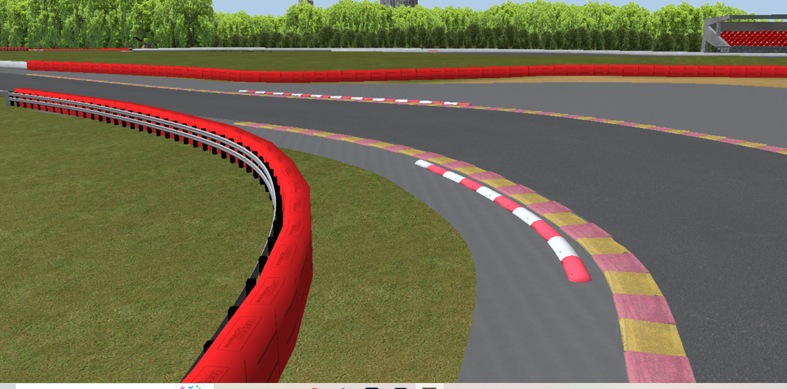
Corners

Slide 41
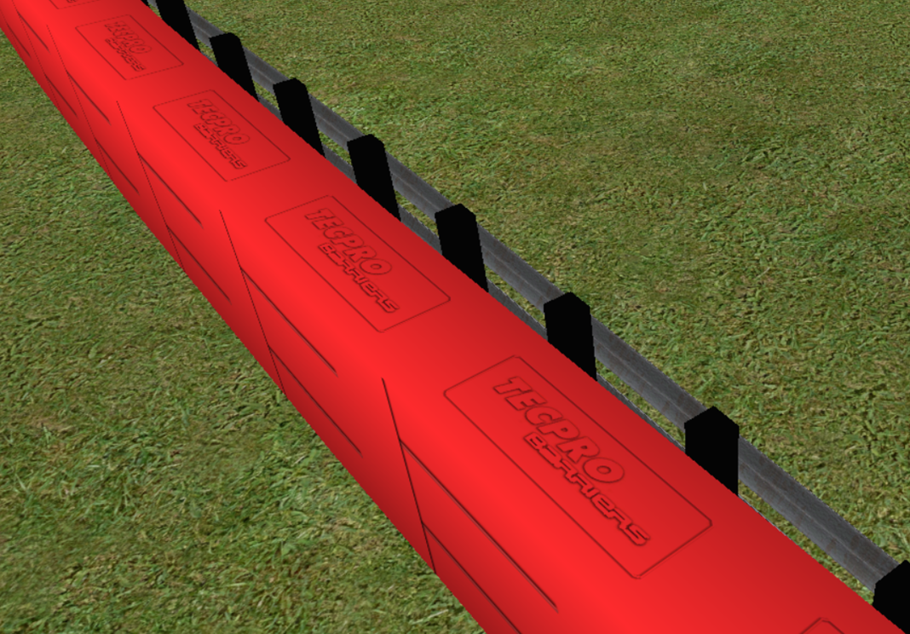


Slide 42
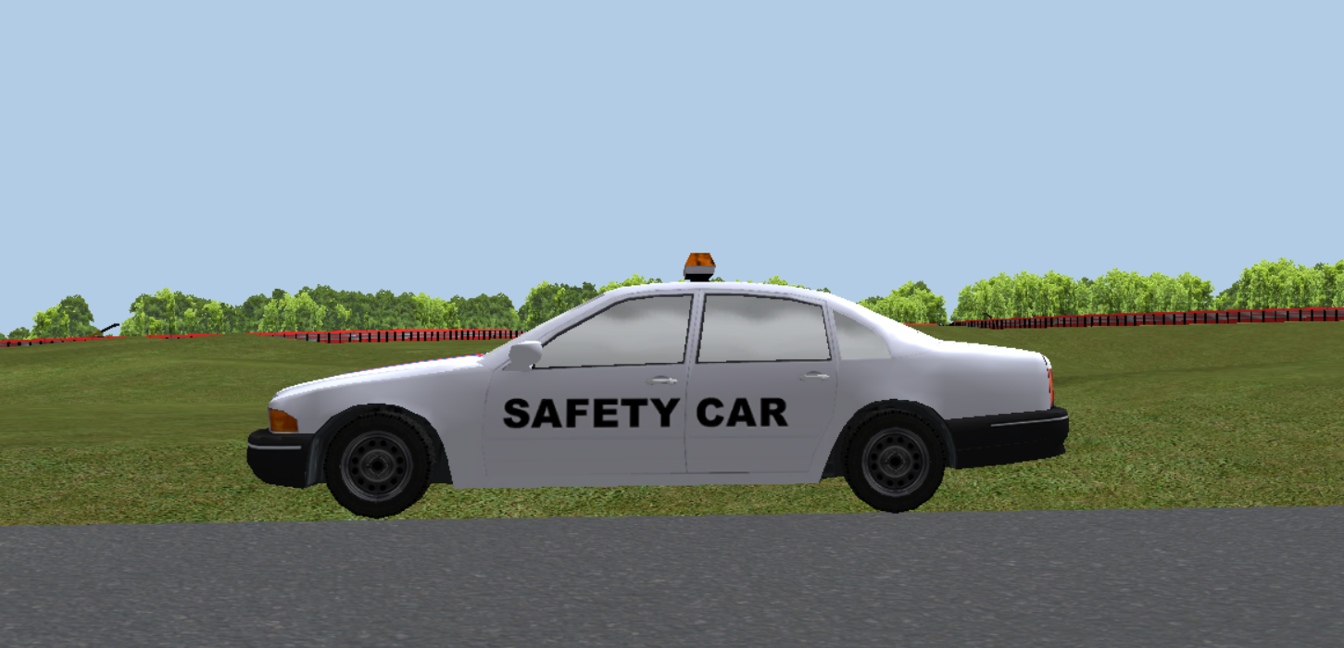
Safety Car

Slide 43
THANK YOU
Respondent: Oday Derbas
Ibrahim Khalid
Instructor: Dr. Khalid Al-Sahili
The Palestinian Race Track

