Slide 1
DESIGN OF
NORTHERN ELECTRICAL TRANSMISSION NETWORK
IN WEST BANK
By
Rabei Hendyeh
Hamza Hinnawi
Mohammed Burghal
Supervised by:
Dr. Maher Khmmash

Slide 2
Introduction
Our project is to design transmission network in the Northern West Bank, we will use high voltage such as 161 kV which is taken directly from IEC. So that we can skip some of huge transformers in the network which are very costly.
We have 2 connection points, Sara and Al-Jalamah which is swing bus, with 135 MW capacity for each one. So our project is to make the best configuration technically and economically to perform our network.

Slide 3
Methodology
1
Data collection
Power calculation
2
Suggest configuration
3
Select bests configurations
Select transmission lines
Estimation of power and voltage level

Slide 4
Methodology
4
Select transformers
5
Economical calculation
6
Future works
Switch gear
Load flow calculations
Conclusion

Slide 5
Current situation
The cities of west bank is fed by several small connection points from IEC side distributed around main cities at 33 kv or fed directly from Israel at 161 kv like Tulqarem and Qalqilya or fed form near settlements for more than 125 SPS feeding 130 MVA especially for villages .
Tulqarem and Qalqilya regions have 22KV systems, and the Northern electrical systems are operated at 33KV.

Slide 6
Importance of the project
Reduce energy cost ($/kwh) which Facilitate investment and industrial and urban development.
Reduce maintenance cost .
Increase the expansion possibility.
Reduce the installed capacity of the network due to diversity factor between cites.
Encourage investments in generation sectors.
Use other sources to satisfy the increasing demand.

Slide 7
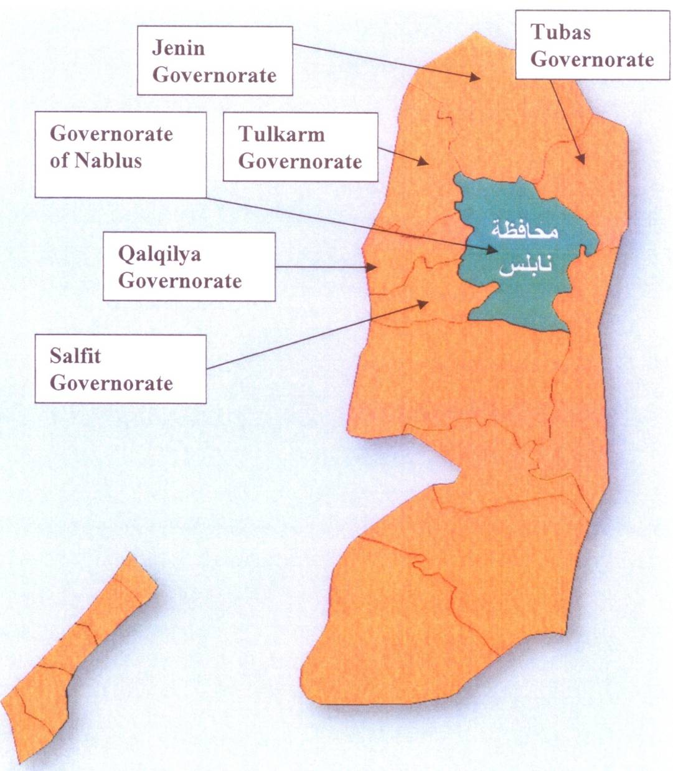
Data collection
There are 6 cities in the North. Nablus is the main city and it is at the center of the loads . The following data is provided from NEDCO.

Slide 8
The following table shows cities loads for 2012
number | city | P (M W) | PF
1 | Jenin | 53.27 | 0.8
2 | Tubas | 14.81 | 0.85
3 | Nablus | 81.07 | 0.85
4 | Tulkarm | 49.5 | 0.8
5 | Qalqilya | 18.5 | 0.8
6 | Salfit | 7.3 | 0.85
 | North total | 224.45 | 0.823

Slide 9
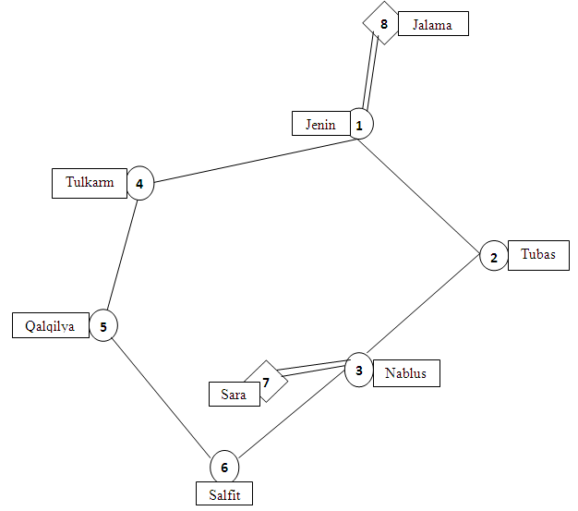
The following table shows distances between cities
cities | distance (km) | cities | distance (km)
1--2 | 29 | 7--1 | 42
2--3 | 20 | 7--5 | 20
1--4 | 28 | 7--6 | 15
4--5 | 25 | 7--3 | 8
5--6 | 20 | 8--1 | 5
3--6 | 20 | 8--2 | 33
1--3 | 38 | 8--4 | 34
3--4 | 25 | 2--4 | 34
1--6 | 50 | 6--4 | 35
3--5 | 28 | 1--5 | 45
2--6 | 40 | 7--4 | 18

Slide 10
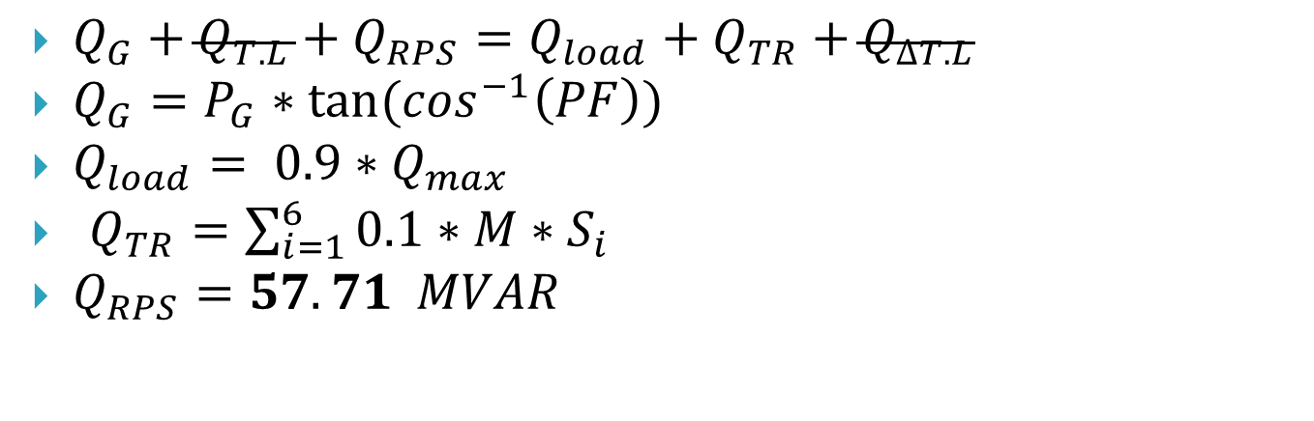
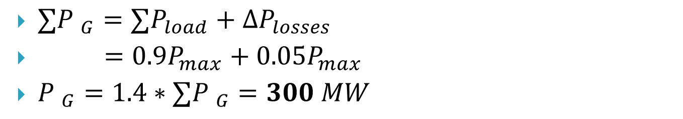
Balance of active and reactive power
Balance of real power
$∑{P }_{G}=∑P_{load}+∆P_{losses}$
$=0.9P_{max}+0.05P_{max}$
${P }_{G}=1.4∗∑{P }_{G}=300 MW$
Balance of reactive power
$Q_{G}+Q_{T.L}+Q_{RPS}=Q_{load}+Q_{TR}+Q_{∆T.L}$
$Q_{G}=P_{G}∗tan⁡(\cos^{−1}\left(PF\right))$
$Q_{load}= 0.9∗Q_{max}$
$Q_{TR}=\sum_{i=1}^{6}{0.1∗M∗S_{i} }$
$Q_{RPS}=57.71 MVAR$

Slide 11
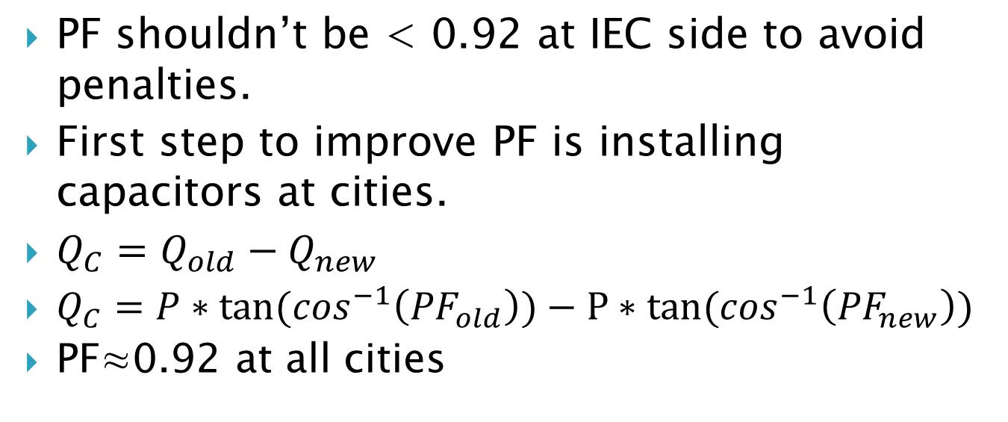
Power factor correction
PF shouldn’t be < 0.92 at IEC side to avoid penalties.
First step to improve PF is installing capacitors at cities.
$Q_{C}=Q_{old}−Q_{new}$
$Q_{C}=P∗\tan{(\cos^{−1}\left({PF}_{old}\right))}−P∗tan{(\cos^{−1}\left({PF}_{new}\right))}$
PF≈0.92 at all cities

Slide 12
The following table shows Qc needed to improve the PF
city | Q _{old} (MVAR) | PF old | Qc (MVAR) | Q new (MVAR) | PF new
Jenin | 39.95 | 0.8 | 18 | 21.95 | 0.92
Tubas | 9.18 | 0.85 | 3 | 6.18 | 0.92
Nablus | 50.24 | 0.85 | 15 | 35.24 | 0.92
Tulkarm | 37.13 | 0.8 | 15 | 22.13 | 0.91
Qalqilya | 13.88 | 0.8 | 6 | 7.88 | 0.92
Salfit | 4.52 | 0.85 | 0 | 4.52 | 0.85
North total | 154.9 | 0.823 | 57.00 | 97.9 | 0.917

Slide 13
Configurations suggestion
We involved in our configurations the following criteria :
1. Achieve minimum distance between cities
2. Ensure delivering the load from 2 different sources to increase the reliability of the system

Slide 14
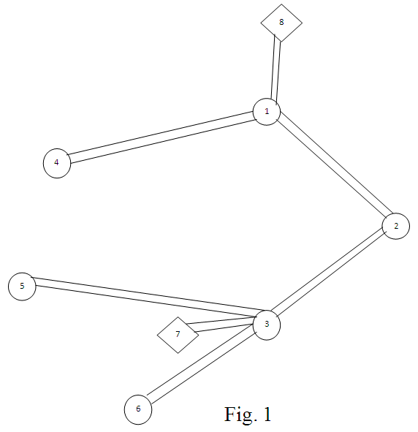
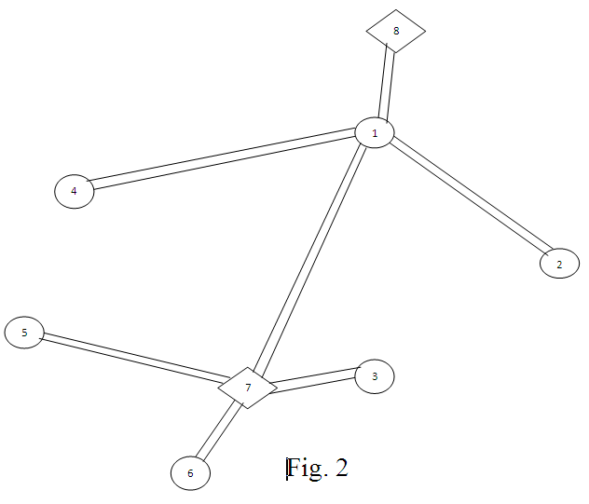
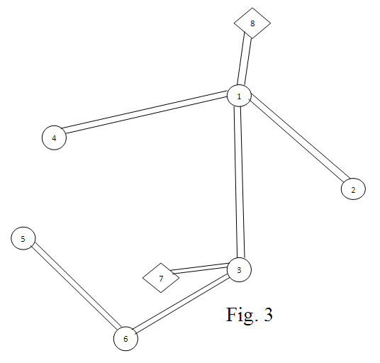
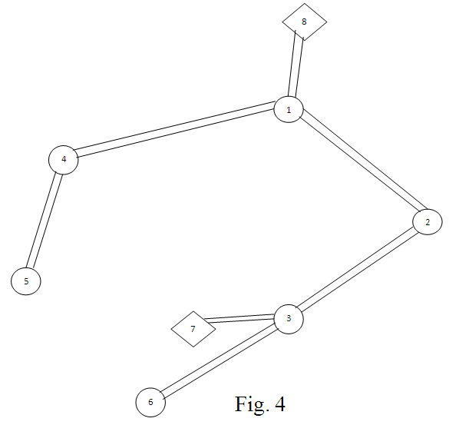

Slide 15
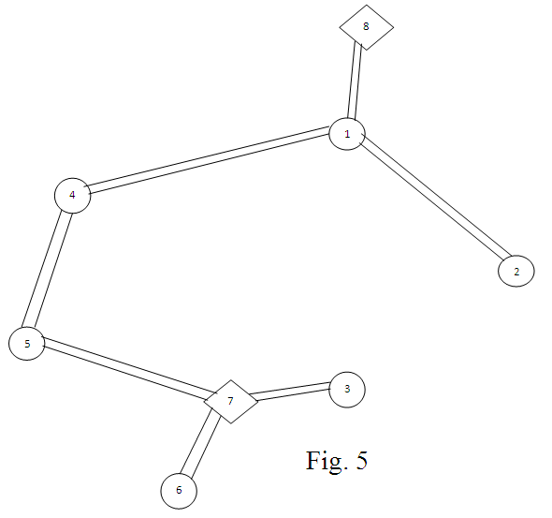
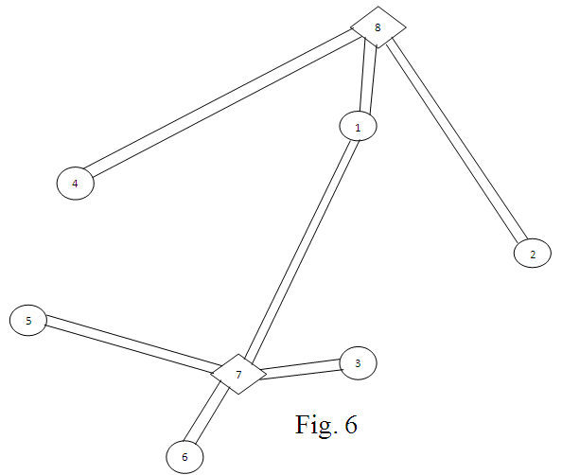
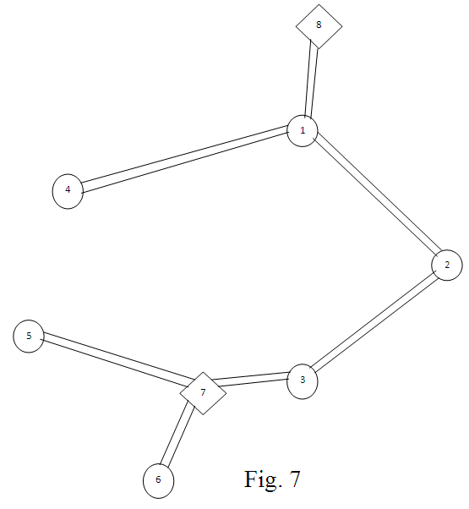
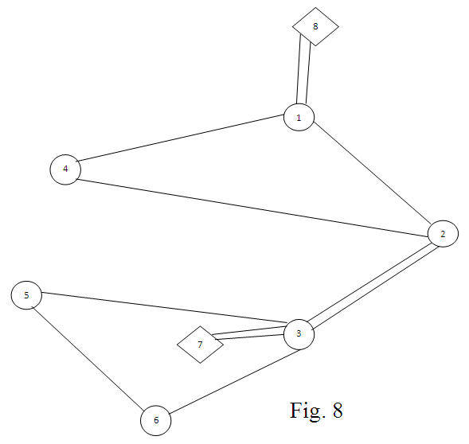

Slide 16
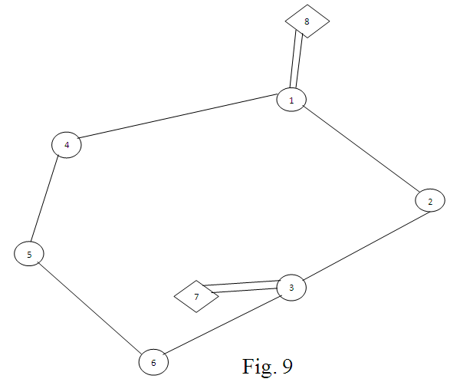
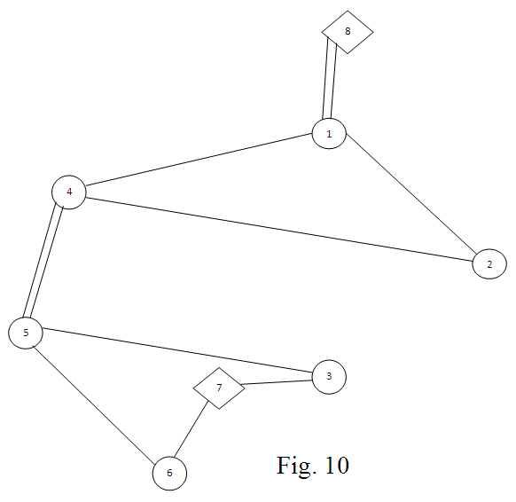
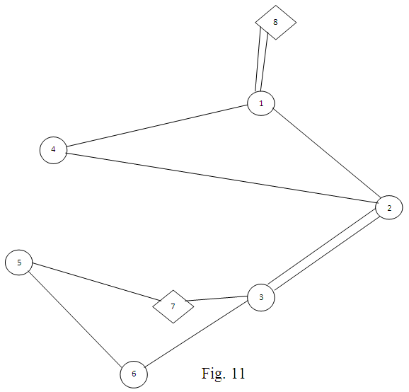
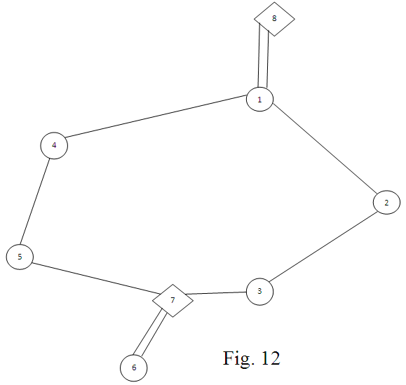

Slide 17
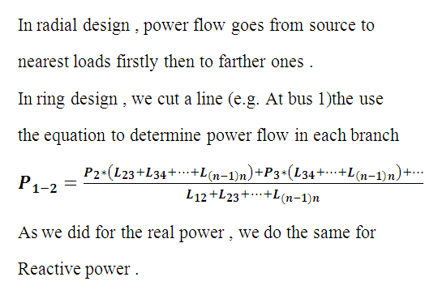
Estimation of power and voltage level
Real & reactive power calculations

Slide 18
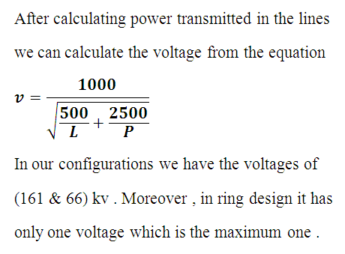
Voltage calculations

Slide 19
Best configurations selection
After satisfying technical issues, the criteria of primary choosing of best configurations depends on economical issues like :
1_ The number of 3-winding transformers
2_ T.L’s lengths
3_ The number of 2-winding transformers
We chose configurations 4&6 for redial design and configurations 8&9 for ring designs .

Slide 20
The following table summarize the previous 12 configurations
Network number | length of T.L’s (km) | voltage levels (kv) | number of 2-winding transformer | number of 3-winding transformer | ratio of 3-winding transformer
1 | 276 | 161,66 | 3 | 3 | 161/66/33
2 | 294 | 161,66 | 6 | 1 | 161/66/33
3 | 296 | 161,66 | 4 | 2 | 161/66/33
4 | 270 | 161,66 | 4 | 2 | 161/66/33 161/66/22
5 | 260 | 161,66 | 5 | 2 | 161/66/33 161/66/22
6 | 314 | 161,66 | 7 | 1 | 161/66/33
7 | 250 | 161,66 | 5 | 2 | 161/66/33
8 | 225 | 161 | 6 | 0 | -
9 | 168 | 161 | 6 | 0 | -
10 | 222 | 161 | 6 | 0 | -
11 | 209 | 161 | 6 | 0 | -
12 | 170 | 161,66 | 7 | 0 | -

Slide 21
The following table shows the chosen configurations

Slide 22
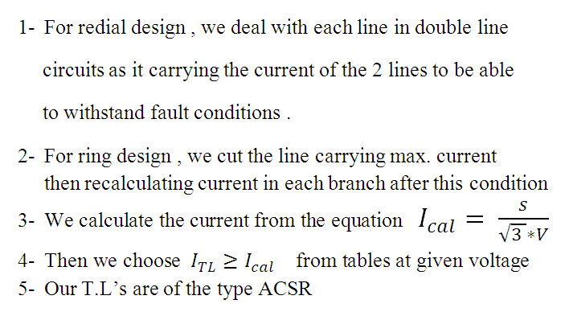
Selection of transmission lines

Slide 23
Selection of transformers
The rating depends on loads are fed.
For reliability, 2 transformers at each substation
Load factor=70% for maximum efficiency
S_{transformer} ≥ S_{calculated}
We pick the transformer rating from standard tables at a given voltage ratio , these tables may differ from manufacturer to another .

Slide 24
Selection of switch gears
Switch gear is an important device which contains bus-bars, transformers, measuring and protection devices.
Selection depends on
Voltage level
Number of lines
Location of substation
Possibility of expansion
All switch gears are outdoor ones.

Slide 25
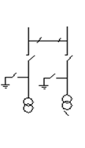
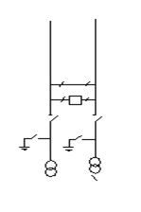
This table illustrate types of switch gears used:
Type | Figure | Properties
4 |  | Used at terminals of the network. Two inputs and two outputs From 35-220 kV
5 |  | Used at terminals of the network. Two inputs and two outputs. More safety with extra C.B. From 35-220 kV

Slide 26
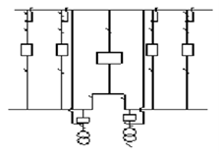
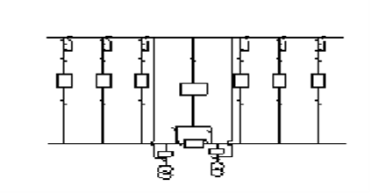
Type | Figure | Properties
11 |  | Used at the middle of the network. From 2-4 inputs and outputs. From 66-220 kV
12 |  | Used at the middle of the network. From 4-16 inputs and outputs. From 66-220 kV.

Slide 27
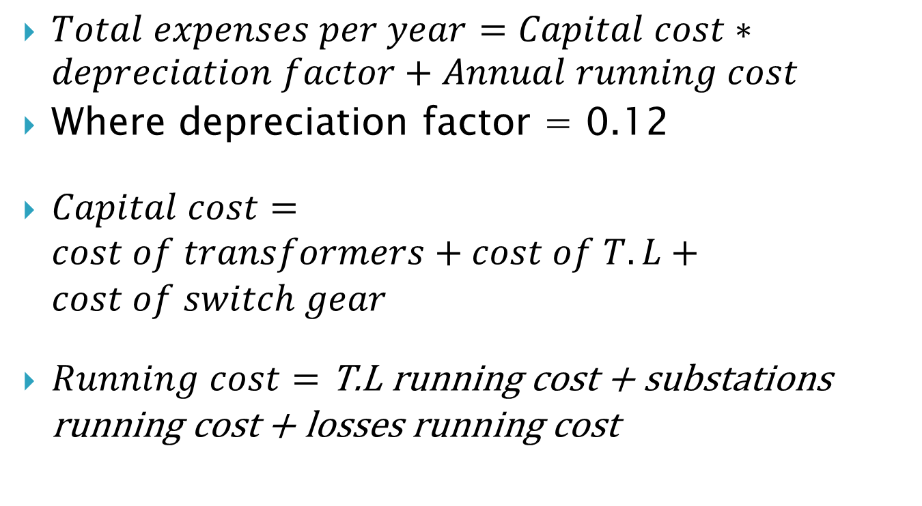
Economical calculations
$Total expenses per year=Capital cost∗depreciation factor+Annual running cost$
Where depreciation factor = 0.12
$Capital cost=cost of transformers+cost of T.L+cost of switch gear$
$Running cost=\text{T}\text{.}\text{L} \text{running} \text{cost}\text{ + }\text{substations} \text{running} \text{cost}\text{ + }\text{losses} \text{running} \text{cost}$

Slide 28
Capital cost
element | Capital cost depends on:
transformer | The rated capacity in MVA The rated voltage in kV The type of transformer either 2 or 3 winding
T.L | Length Cross sectional area The operating voltage
switch gear | Its type Number of C.B’s Operating voltage Number of switch gear in each design

Slide 29
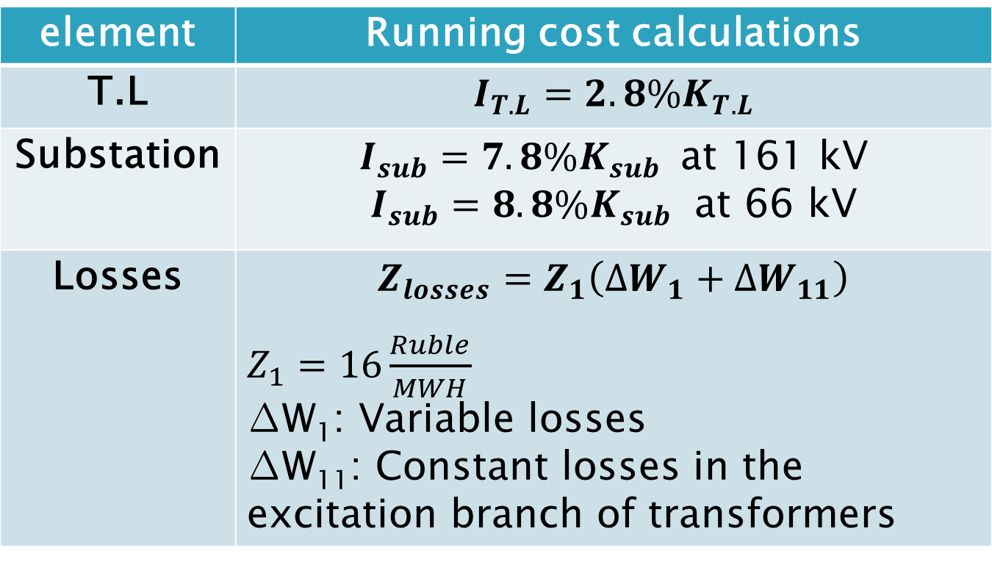
Running cost
element | Runningcost calculations
T.L | $$I_{T.L}=2.8\%K_{T.L}$$
Substation | $I_{sub}=7.8\%K_{sub }$at 161 kV $I_{sub}=8.8\%K_{sub}$ at 66 kV
Losses | $$Z_{losses}=Z_{1}\left({∆W}_{1}+{∆W}_{11}\right)$$ $Z_{1}=16\frac{Ruble}{MWH}$ ∆W₁: Variable losses ∆W₁₁: Constant losses in the excitation branch of transformers

Slide 30
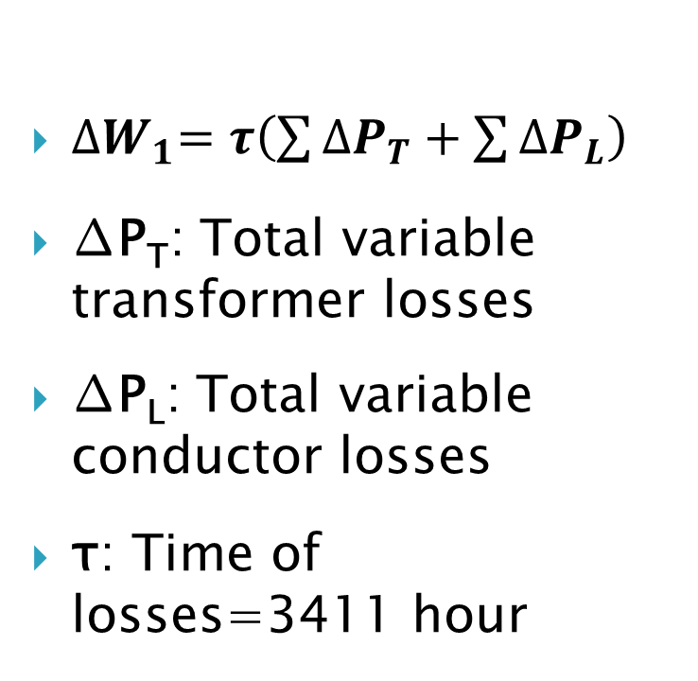
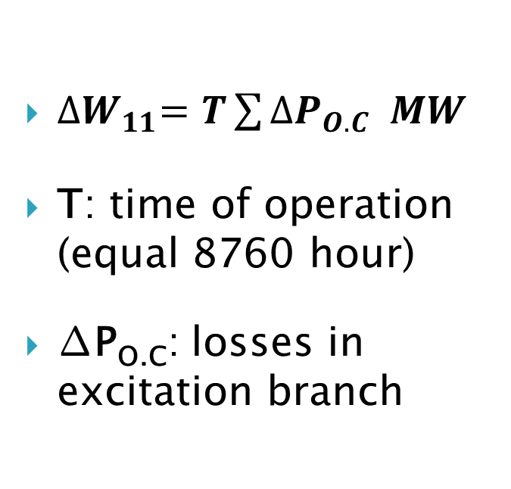
Running cost
Constant losses (∆W₁₁)
variable losses (∆W₁)
${∆W}_{11}=T\sum{{∆P}_{O.C} MW}$
T: time of operation (equal 8760 hour)
∆P_{O.C}: losses in excitation branch
${∆W}_{1}=τ\left(\sum{{∆P}_{T}}+\sum{{∆P}_{L}}\right)$
∆P_{T}: Total variable transformer losses
∆P_{L}: Total variable conductor losses
τ: Time of losses=3411 hour

Slide 31
Total annual expenses for each configuration
Design | Total cost (Ruble)
4 | 1744669
6 | 1731369
8 | 1443459
9 | 1209958

Slide 32
As we have seen in previous table it’s obvious that Fig. 9 has the min. annual expenses, so we chose it.

Slide 33
Load flow study
Maximum load flow study
Minimum load flow study
After fault state
Load forecasting study
The problem of lack in generation

Slide 34
1. Max. load flow study
Al-Jalama is swing bus
Sara is swing bus
2 connection points
$$∆P=1.03\% , with ∆V_{max}=5.4\%$$
∆𝑃=1.03% , 𝑤𝑖𝑡ℎ ∆𝑉_𝑚𝑎𝑥=5.4%
$$∆P=1.13\% , with ∆V_{max}=5.5\%$$
∆𝑃=1.13% , 𝑤𝑖𝑡ℎ ∆𝑉_𝑚𝑎𝑥=5.5%
$$∆P=0.92\% , with ∆V_{max}=5.35\%$$
∆𝑃=0.92% , 𝑤𝑖𝑡ℎ ∆𝑉_𝑚𝑎𝑥=5.35%

Slide 35
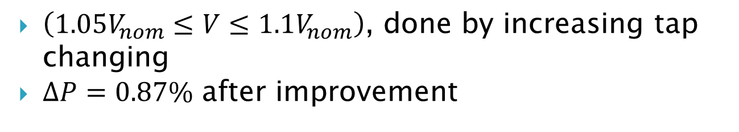
Improving max. load state
PF improvement
Bus | City | V (kV) | MVAR
1 | Jenin | 33 | 3
3 | Nablus | 33 | 9
Main SP’s | PF old | PF new
Sara | 89.9 | 92.38
Al-Jalama | 91.72 | 92.79
$S.P.B.P=\frac{Investment}{Saving (years)}=139 days$
Voltage improvement
$\left(1.05V_{nom}≤V≤1.1V_{nom}\right)$, done by increasing tap changing
$∆P=0.87\%$ after improvement

Slide 36
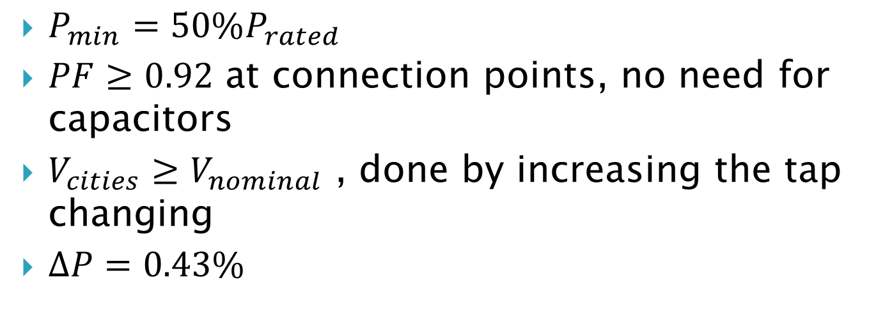
2. Min. load flow study
$P_{min}=50\%P_{rated}$
$PF≥0.92$ at connection points, no need for capacitors
$V_{cities}≥V_{nominal}$ , done by increasing the tap changing
$∆P=0.43\%$

Slide 37
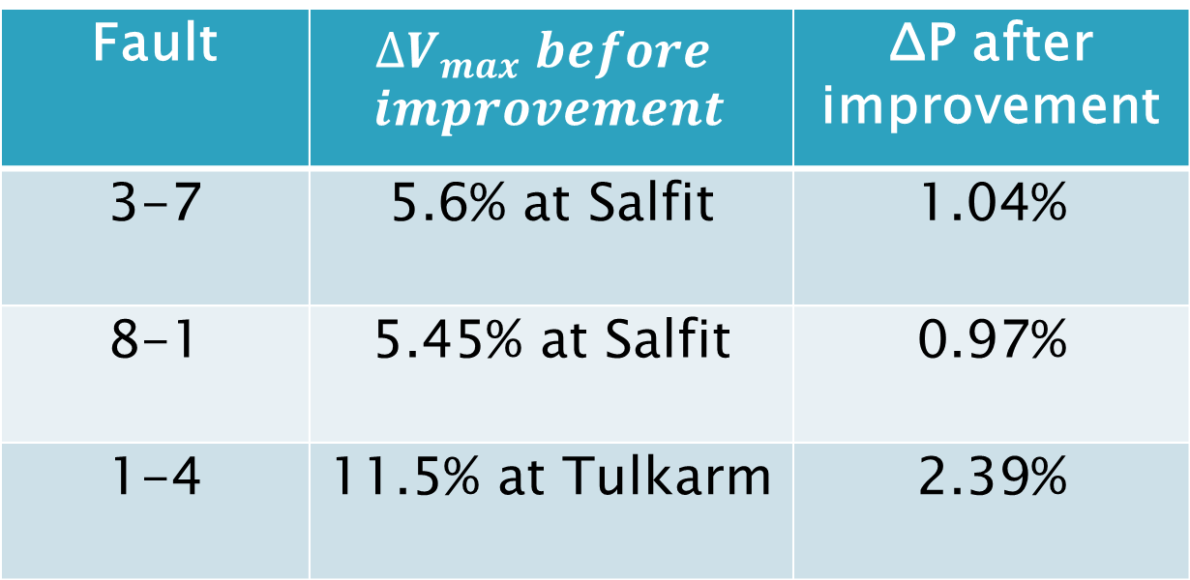
3. After fault state
We aim to reach V_{nom} at loads.
Fault | $$∆V_{max} before$$ $$improvement$$ | ΔP after improvement
3-7 | 5.6% at Salfit | 1.04%
8-1 | 5.45% at Salfit | 0.97%
1-4 | 11.5% at Tulkarm | 2.39%

Slide 38
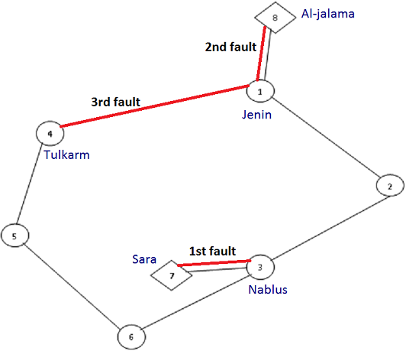

Slide 39
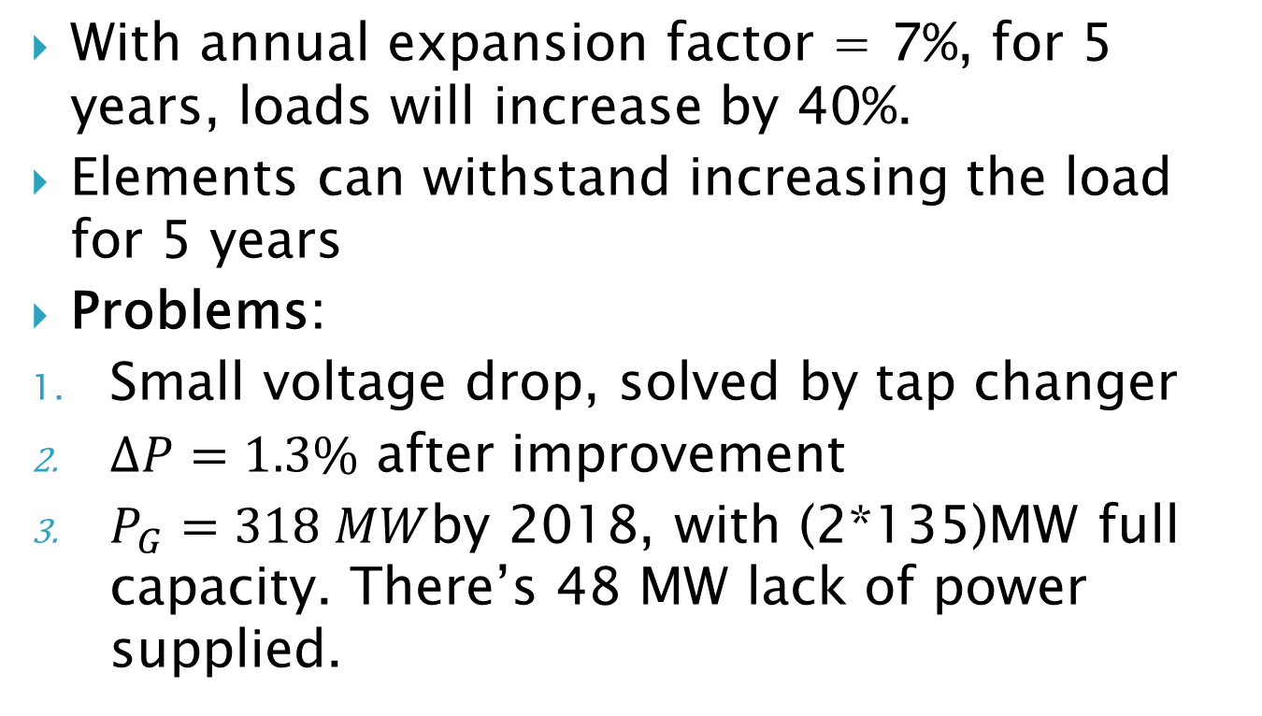
4. Load forecasting study
With annual expansion factor = 7%, for 5 years, loads will increase by 40%.
Elements can withstand increasing the load for 5 years
Problems:
Small voltage drop, solved by tap changer
$∆P=1.3\%$ after improvement
$P_{G}=318 MW$by 2018, with (2*135)MW full capacity. There’s 48 MW lack of power supplied.

Slide 40
5. The problem of lack in generation power
Scenario I: Sara increased by 50MW

Slide 41
5. The problem of lack in generation power
Scenario II: Al-Jalama station

Slide 42
5. The problem of lack in generation power
Scenario III: Tulkarm-Qalqilya connection point

Slide 43
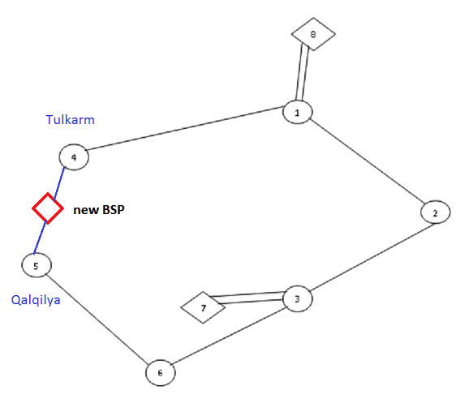

Slide 44
Conclusion
The present grids suffer from fragmentation, high losses, low reliability, high energy prices, low maintenance, and disability to handle the future demand.
In order to achieve electricity independency from IEC side the first step is build an unified transmission structure, then give chance for investments in generation sector .
In our design we followed technical and economical issues to create a transmission network to achieve min. losses, reliability and efficiency of delivered power.

Slide 45
Conclusion
Technical issues like voltage level, PF are satisfied. Moreover losses ≤1%.
Age of network is 5 years. To cover supply gap; best scenario to create new connection point between Tulkarm-Qalqilya by 2016.
Al-Jalama station can be replaced by its connection point by 2020.

Slide 46
Future work
Protection system can be done
A connection to the transmission networks of middle and south of West Bank can be done, to create a uniform transmission system for whole West Bank. This connection can easily be done at Salfit substation or Sarra substation .

Slide 47
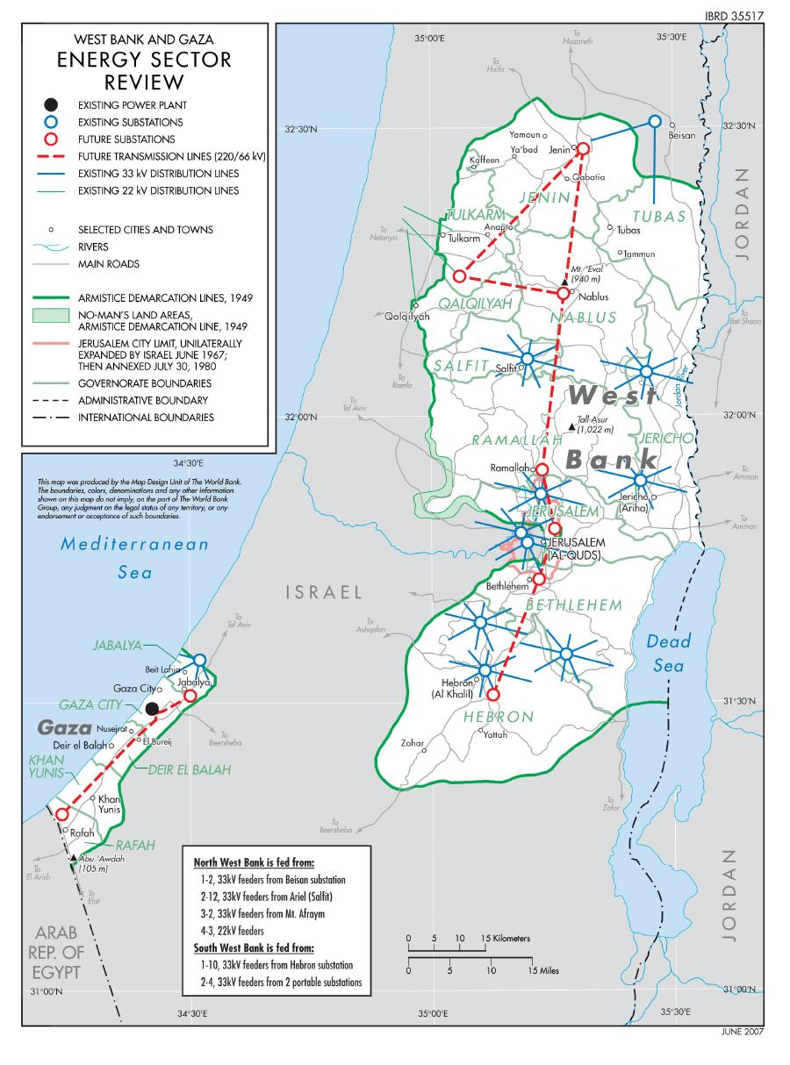

Slide 48


