Slide 1

An-Najah National University
Faculty of Engineering & Information Technology
Graduation Project
Hydraulic Modeling of the Water Supply Network in Yasid Village
By:
Anas Thaher
Qusai Hamdan
Yahya Abo Saleh
Qusai Abo Murad
Supervisor:
Dr. Hafez Shaheen

Slide 2
Objective
Collecting data on the population census, population growth rate and urban sprawl areas.
Hydraulic analysis of the water network to meet the requirements for the next 30 years .

Slide 3
METHODOLOGY:
Data collection .
Theories and principles
Design by Water CAD .

Slide 4
DATA COLLECTION:
Road network
Contour map
Boundary of study area
Population number and population growth rate
Reservoir location

Slide 5
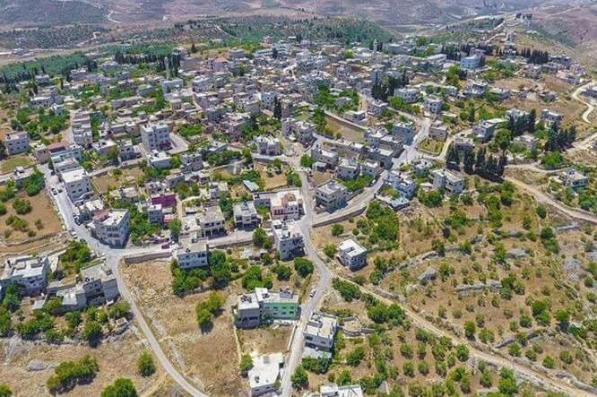
Study Area
Yasid is located north of Nablus, about 15 km away in northern West Bank.
Yasid is bordered by Wadi al Far’a to the east, the village of Siris to the north, Beit Imrin and Jaba’ to the west, and Talluza and ‘Asira ash Shamaliya towns to the south.
The total area of Yasid village is about 9.5 km2 . According to the PCBS, Yasid Villgae has an estimated population of 2732 in 2022.

Slide 6
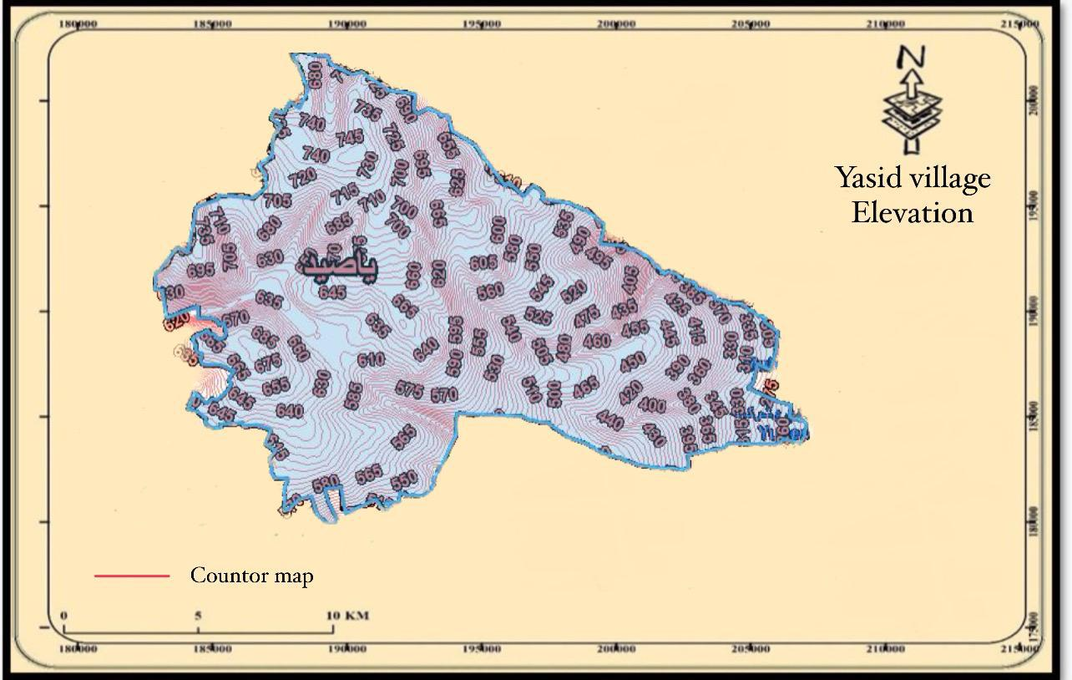

Slide 7
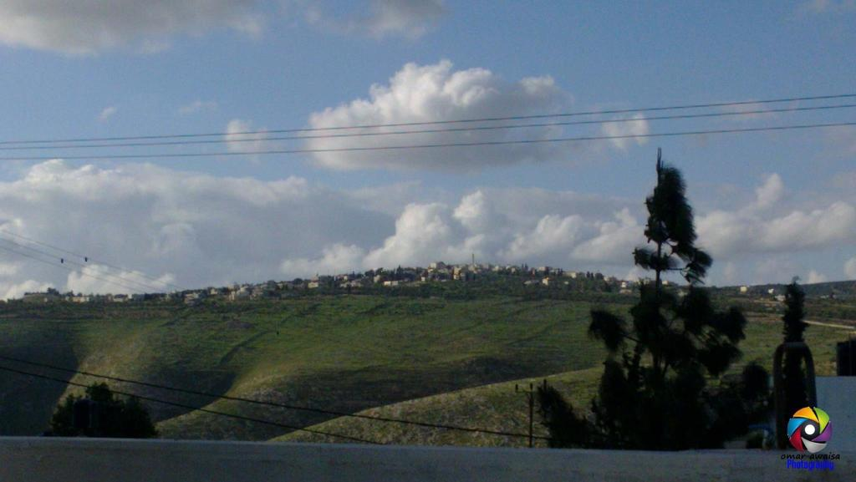
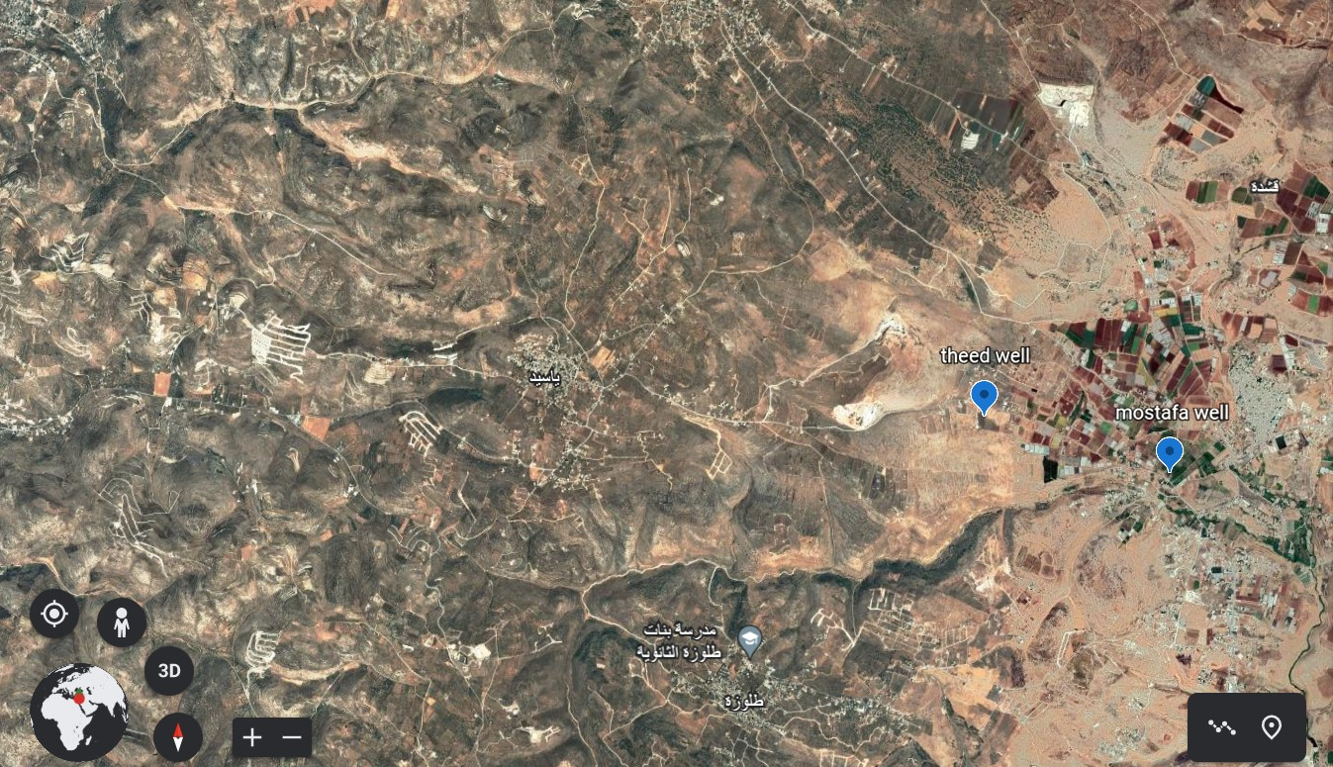
Water Resources
Yasid is fed with water from two ground water wells and from rain that is collected in cisterns . The village depends on one production well and the other well is a reserve.
164250 Cubic meters of water per year is the water supply from :
Theeb Mashaqi Well
Mostafa Mashaqi Well (reserve well )

Slide 8
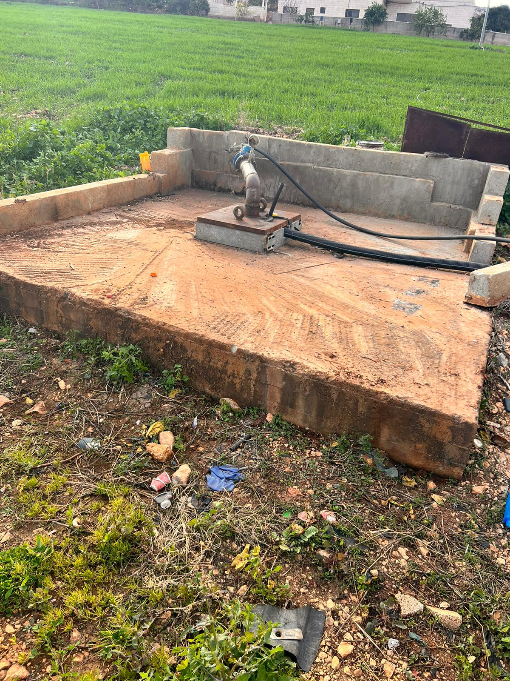
Water Resources
Production Wells Characteristics
Well Location | Well Name | Year of Construction | Elevation (m) | Depth (m) | Pump Setting (m) | Water Level (m) | Well productivity (m3/h) | Diameter (in)
Al-Far’a | Theeb Mashaqi Well | 2010 | 290 | 420 | 390 | 220 | 70 | 18
Al-far’a | Mostafa Mashaqi Well | 2009 | 195 | 320 | --- | 130 | 28 | 18

Slide 9
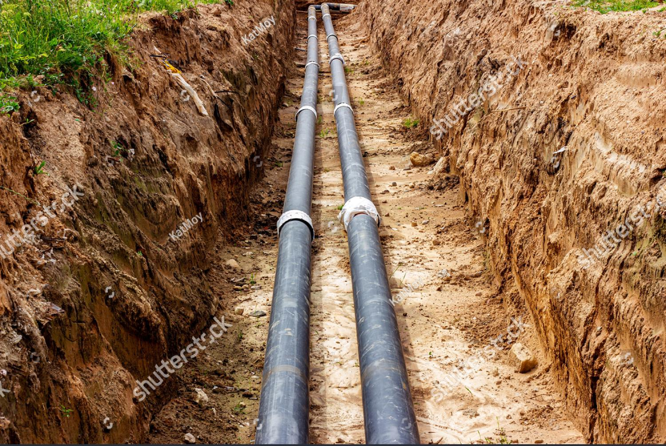
Conveyance Lines
In Yasid there are one conveyance line divided to three transmission line transport from Theeb Mashaqi well to a storage tank I then to the storage tank connected to the booster station and was a purification facilities then the water is pump to the elevated tank.
The total length of these lines is about 5 Km. The pips are of different materials such as steel, ductile .
The main transmission pipes are (4) inches in diameter.

Slide 10
Conveyance Lines
Characteristics of conveyance lines in The YVWSS Zone
No. | From | to | Diameter (in) | Material (m) | Length (m) | Date of Construction
L1 | Theeb Mashqi well | Storage Tank I | 4 | HDPE | 70 | 2020
L2 | Storage Tank I | Storage Tank II | 4 | ductile | 3500 | 2008
L3 | Storage Tank II | Elevated Tank | 4 | ductile | 1500 | 2013

Slide 11
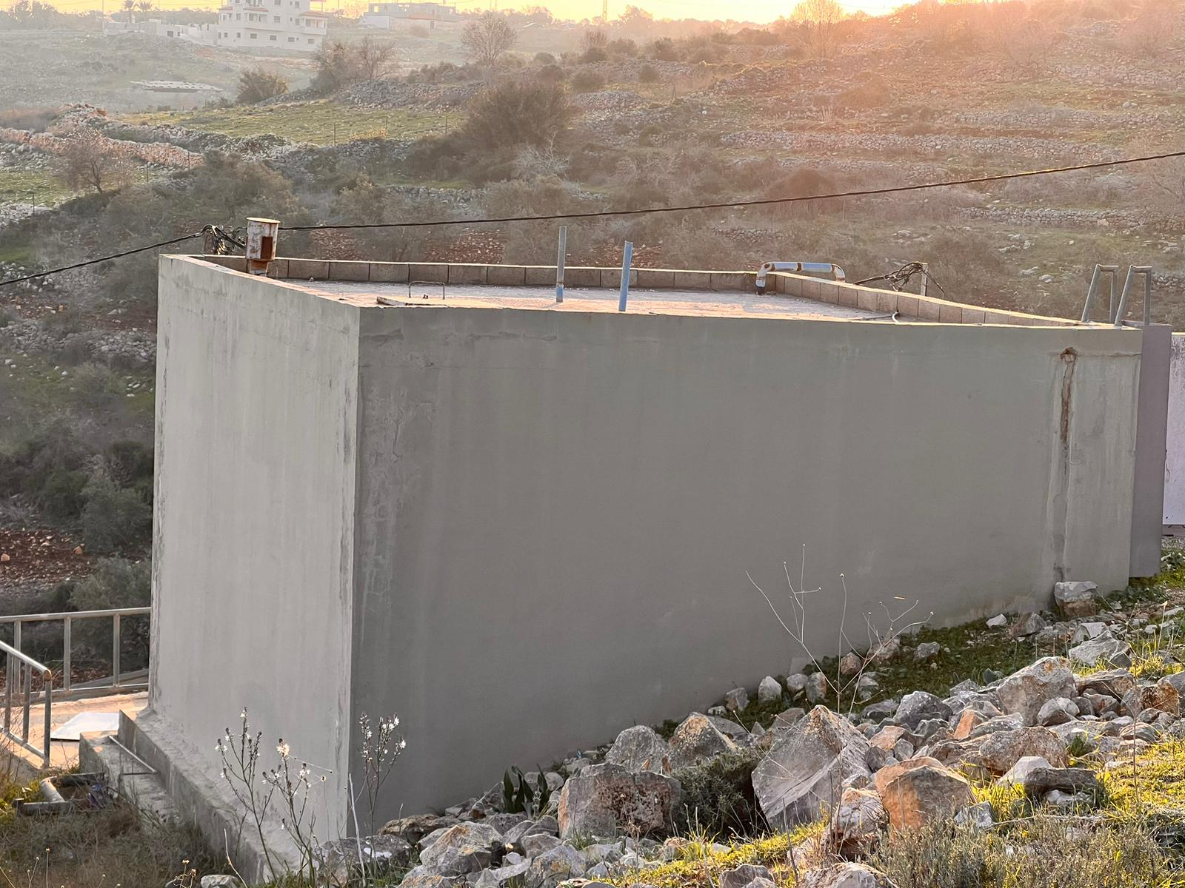
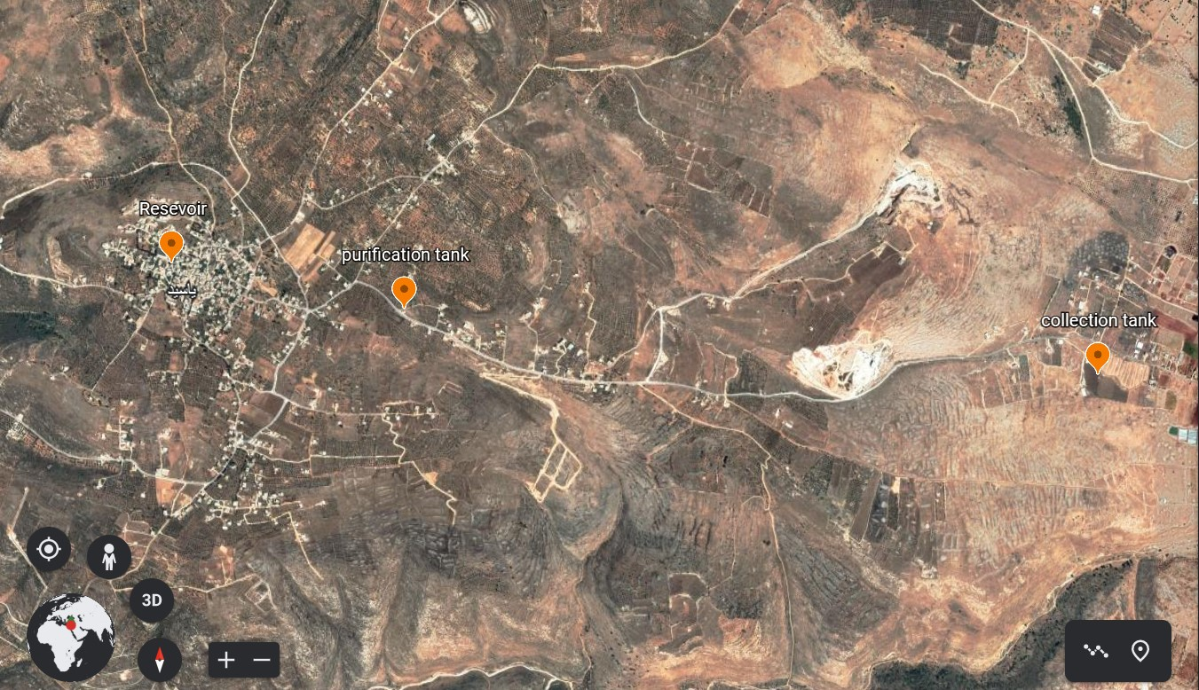
Storage Facilities in the YVWSS System
In Yasid, there are three water tanks with different capacities, heights, and different functions .
Storage tank(I) in Al-Far’a.
Storage tank(II) connected to the booster station and was a purification facilities.
Elevated tank in Yasid village.
The capacity of these storage facilities is 400 , 150 , 350 m³ respectively .

Slide 12
Storage Facilities in the YVWSS System
Characteristics of Reservoirs and Tanks YVWSS Zone
No. | Name | Location | Elevation* (m) | Height (m) | Capacity (m³) | Operation Mode | Date of Construction
T1 | Storage tank I | Al-Far’a village | 290 | 3 | 400 | Storage | 2010
T2 | Storage tank II | Yasid village | 600 | 4 | 150 | Service | 2010
T3 | Elevated Tank | Yasid village | 710 | 4.10 | 350 | Distribution | 2013

Slide 13
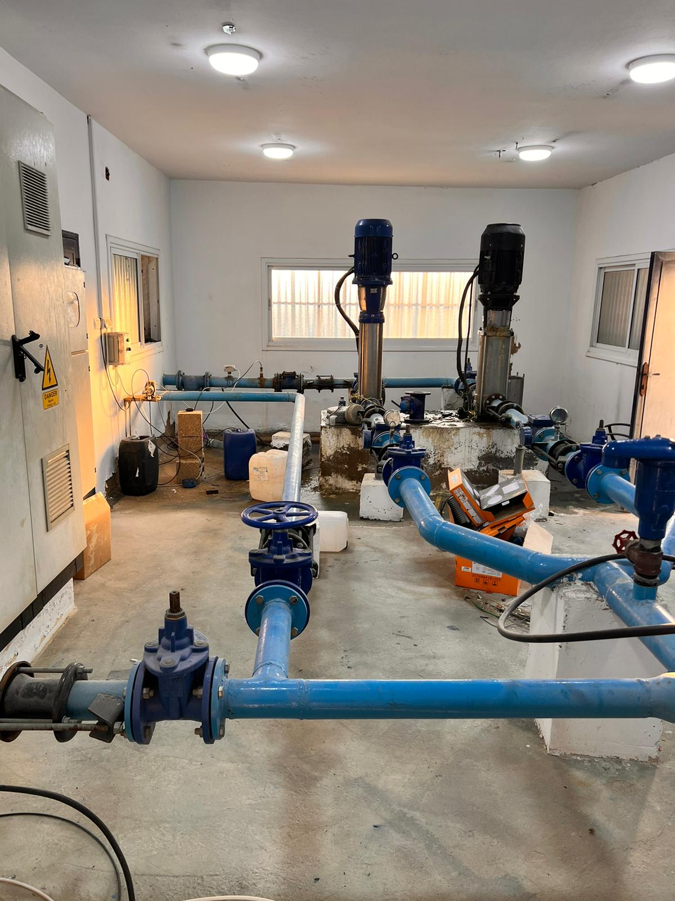
Main Pumping and Booster Stations
Main pump station, which mainly pumps water from the well to the storage tank I located near the well .
Two boosters working alternate, which mainly pump water to the elevated water tank.
There is one main pump station:
Theeb Mashaqi main pump station
Yasid booster pump station
which includes two boosters

Slide 14
Main Pumping and Booster Stations
Yasid Main Pump station.
Pump NO. | Location | Impeller type | Placement configuration | Flow m³/h | Elevation | Head (m)
B1 | Storage Tank I | Centrifugal | vertical | 45 | 300 | 400
Yasid Booster Pump Station
Pump NO. | Location | Status | Impeller type | Placement configuration | Flow m³/h | Elevation | Head (m)
B1 | Yasid Booster Station | Working Alternate | Centrifugal | Horizontal | 20 | 600 | 133
B2 | Yasid Booster Station | Working Alternate | Centrifugal | Horizontal | 20 | 600 | 133

Slide 15
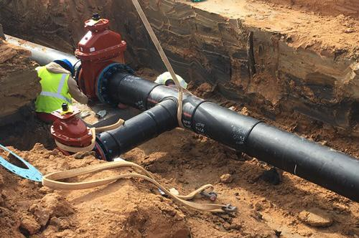
Water Networks
The total length of the network is about 14 Km
Water Network that is under the operation of YVWSS:
Yasid water network.
Main connection: 2 inches → 3000 m 3 inches → 5000 m | house connection: 0.5 inch → 4000 m 1 inch → 2000 m
Main pipes (4 inch) are made of steel or ductile iron .
Distribution pipes (3, 2, 1, 0.5) inches are made of Ductile Iron .

Slide 16
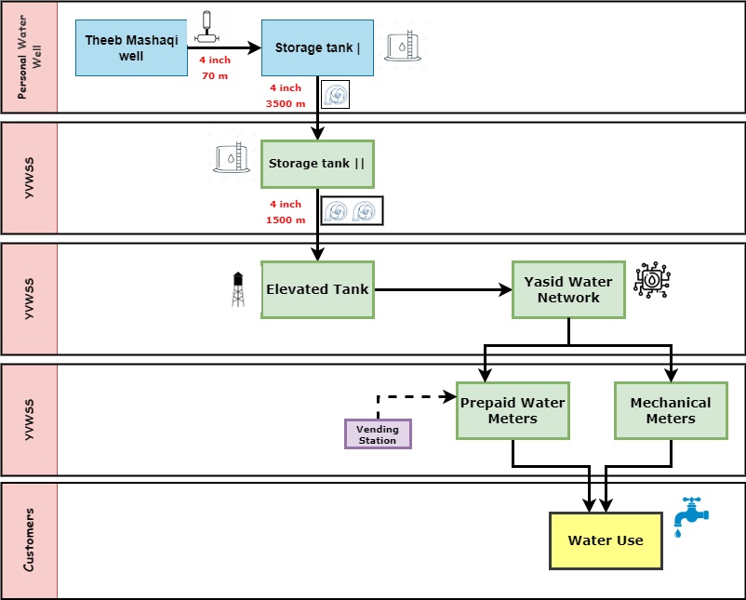

Slide 17
Water Networks
Problems experienced by the Yasid water network include:
After the establishment of the network, the residential area of Yasid expanded to include areas at high elevation that are more than the height of the elevated water tank distributed and feeding the network, which led to the difficulty of delivering water to these areas and the need for adding pumps.
A noticeable increase in the water loss, which amounts to 30%, due to leaks and malfunctions in the network, or due to illegal theft of water.
Excessive use of mechanical meters, which leads to the accumulation of debts and non-payment of bills on time.
The large number of local losses due to the structure of the network in which there are many elbows of water, this leads to a great burden on the pumps and the need for higher electrical energy to operate them.

Slide 18
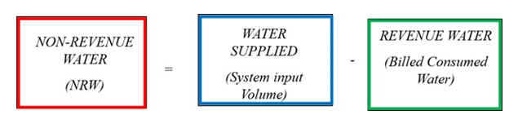
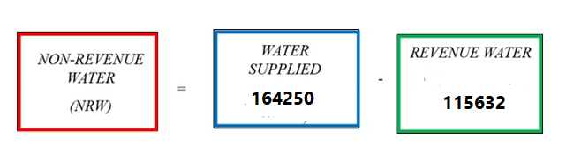
NON-REVENUE WATER (NRW) :
Defined as the difference between system input volume and billed authorized consumption.
In 2022
System Input volume = 164250 m³
Revenue water = 115632 m³
NRW = 48618 m³ → 30% of total water supplied
Water (m³) | 0-9 | 10-19 | 20-29 | 30 and more
Price (NIS) | 6 | 7.5 | 9 | 12
The average selling price of water in Yasid (about 7 NIS /m³)
That means YVWSS loss about 340,000 NIS in potential revenue of water in year 2022

Slide 19
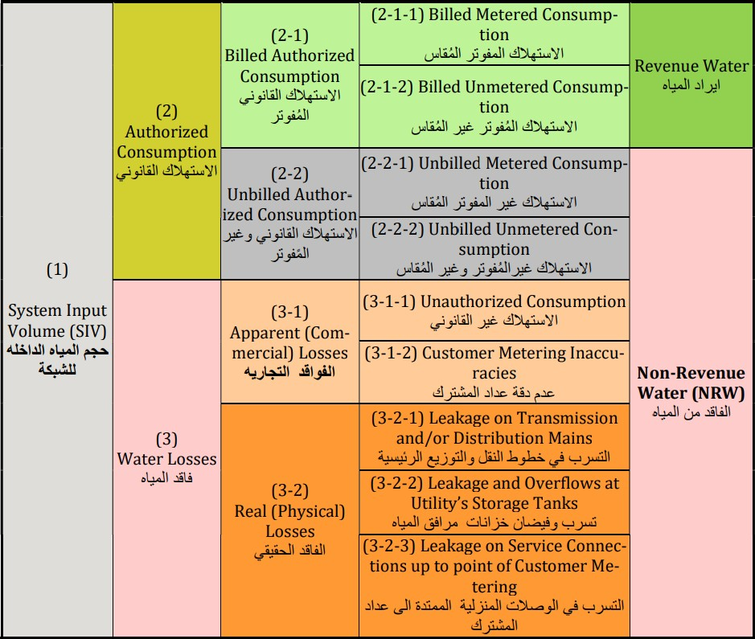
NON-REVENUE WATER (NRW) causes:
International Water Association (IWA) standard water Balance

Slide 20
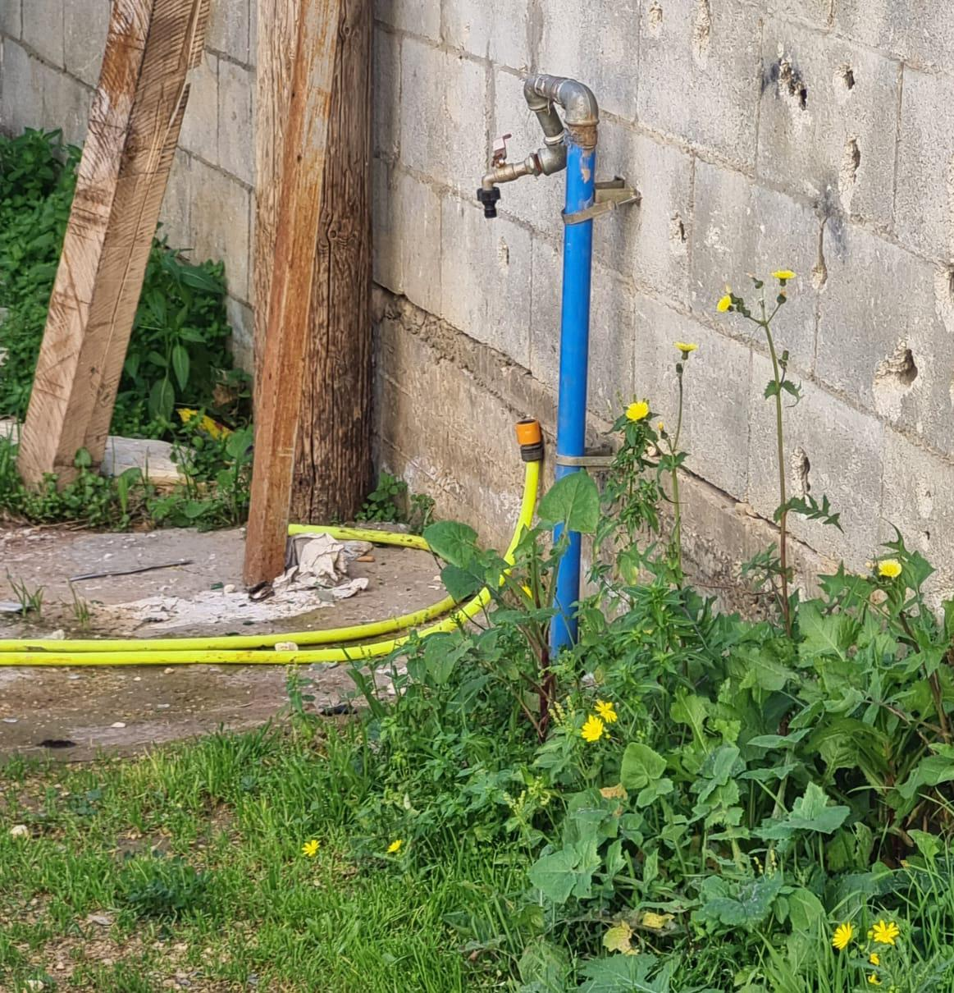
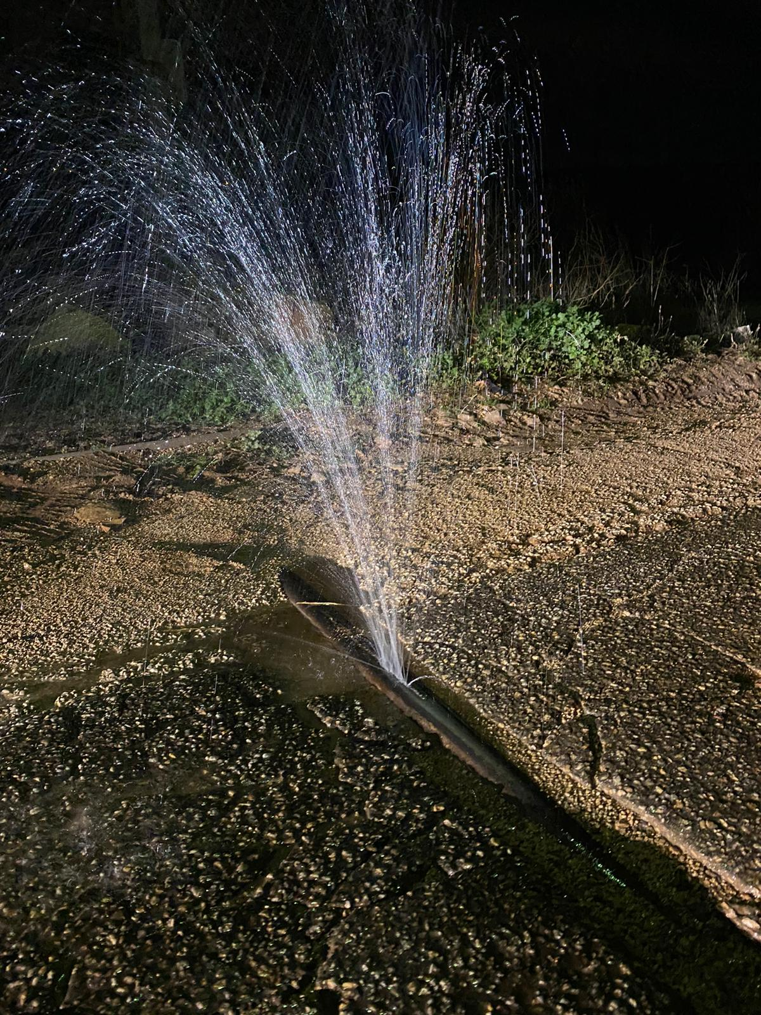
NON-REVENUE WATER (NRW) causes:
Apparent losses (unauthorized consumption)
Physical losses (Leakage in Conveyance line)

Slide 21

NON-REVENUE WATER (NRW) :
Examples of IWA Standard Water Balance components from YVWSS
 |  | Billed Author.Cons. (BAC) | Billed meterd (BMC) | Revenue Water (RW)
 |  | الاستهلاك المصرح به المفوتر | 115632 m³ 70.4% | المياه المحاسب عليها
 | Authorized Consumption (AC) | 115632 m³ | Billed Unmetered (BUC) | 115632 m³
System Input Volume (SIV) | الاستهلاك المصرح به | 70.40% | 0 m³ 0.00% | 70.40%
 | = | Unbilled Author. Cons. (UAC) | Unbilled metered (UMC)
كمية المياه المدخلة للنظام المائي | 115,632 m³ | الاستهلاك المصرح به غير المفوتر | 0 m³ 0.00%
= | 70.40% | 0 m³ | Unbilled Unmetered (UUC) | Non-Revenue Water (NRW)
164,250 m³ |  | 0.00% | 0 m³ 0.00% | المياه غير المحاسب عليها
100% |  | Apparent Losses (AL) | Unauthorized Consumption (UC)
 | Total Losses (WL) | الفاقد التجاري (الظاهري) | 40.75 m³ 1.37% | 48618 m³
 | الفاقد الكلي | 2975 m³ | Metering Inaccuracies (MI) | 29.60%
 | = | 6.12% | 2934 m³ 4.75%
 | 48618 m³ | Real Losses (RL) | Leakage and Overflows at Utility's Storage
 | 29.60% | الفاقد الحقيقي (تسرب) | 0 m³ 0.00%
 |  | 45643 m³ | Leakage on Transmission Mains/Distribution Pipes and Service Connections up to point of Customer metering
 |  | 23.48% | 45643 m³ 23.48%

Slide 22
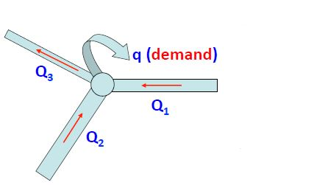
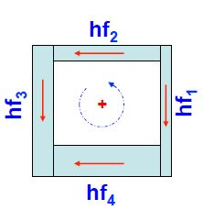
Theories and principles
continuity:
Q1 + Q2 = Q3 + demand
Energy conservation:
hf2+hf3=hf4+hf1

Slide 23
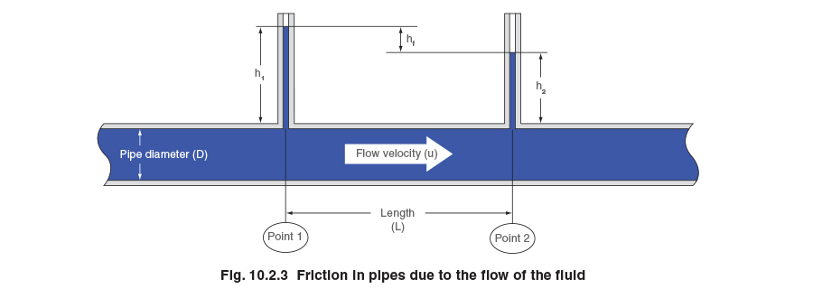
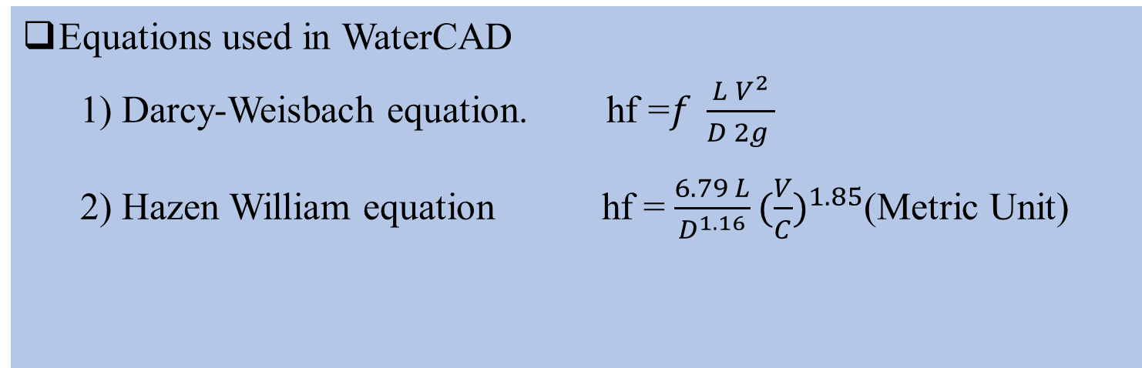
Theories and principles
Equations used in WaterCAD
1) Darcy-Weisbach equation. hf =$f \frac{L V^{2}}{D 2g }$
2) Hazen William equation hf = $\frac{6.79 L}{D^{1.16}}{(\frac{V}{C})}^{1.85}$(Metric Unit)
In our project we used Hazen-William equation

Slide 24
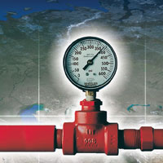
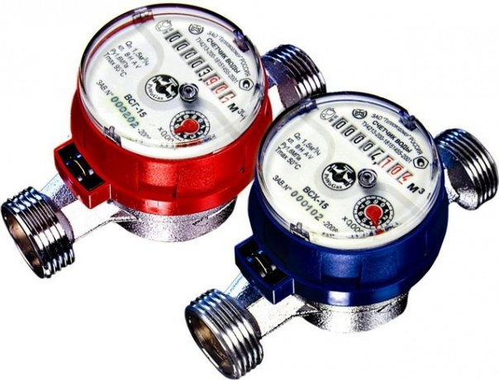
Criteria’s that we considered in the project
Average pressure between ( 20 – 100 ) m H2O
Average velocity between ( 0.3 – 3.0 )m/s

Slide 25
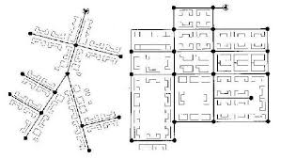
Design alternatives
Finding the demand of nodes:
1- Thiessen polygon method.
2- Manual method.
Type of network:
1- Branched.
2- Looped
3- Combination of both.
In our design we use a branched system.

Slide 26
Design
Preparation of data .
Demand forecasting.
Design modeling.

Slide 27
POPULATION
Yasid Population for the years 2017-2053
Name | Code | 2017 | 2018 | 2019 | 2020 | 2021 | 2022 | 2023 | 2033 | 2043 | 2053
Yasid | 150695 | 2483 | 2531 | 2580 | 2630 | 2681 | 2732 | 2784 | 3370 | 4080 | 4848

Slide 28
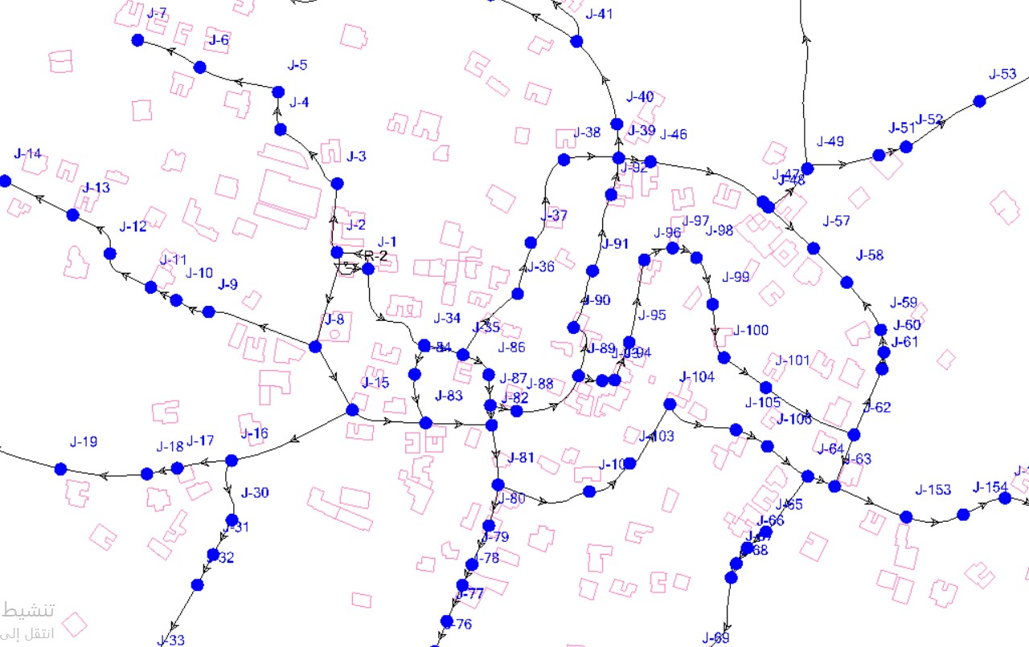
PREPARATION OF DATA

Slide 29
PREPARATION OF DATA
Population forecasting using constant growth rate equation
Growth rate = 0.0193
Future population ( 2053 ) = 4848 capita

Slide 30
PREPARATION OF DATA
Calculating average daily flow :
Assume that consumption per capita is equal to 120 L/d
Assume maximum daily factor is equal 1
Assume Peak hourly factor equal 2.3
Q = 1338 m³/day

Slide 31
Demand Forecasting:
We calculate the demand for each node by distribute average daily demand using Thiessen Polygon for demand area.

Slide 32
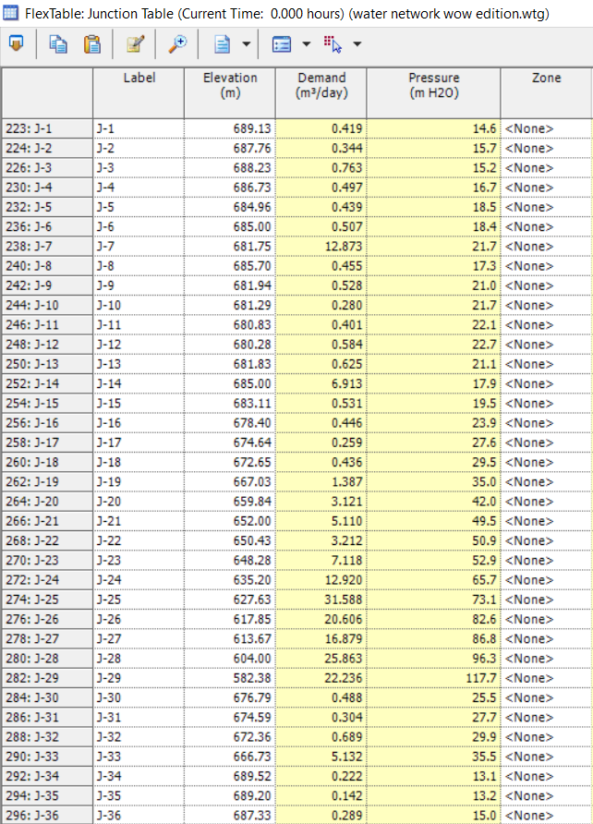
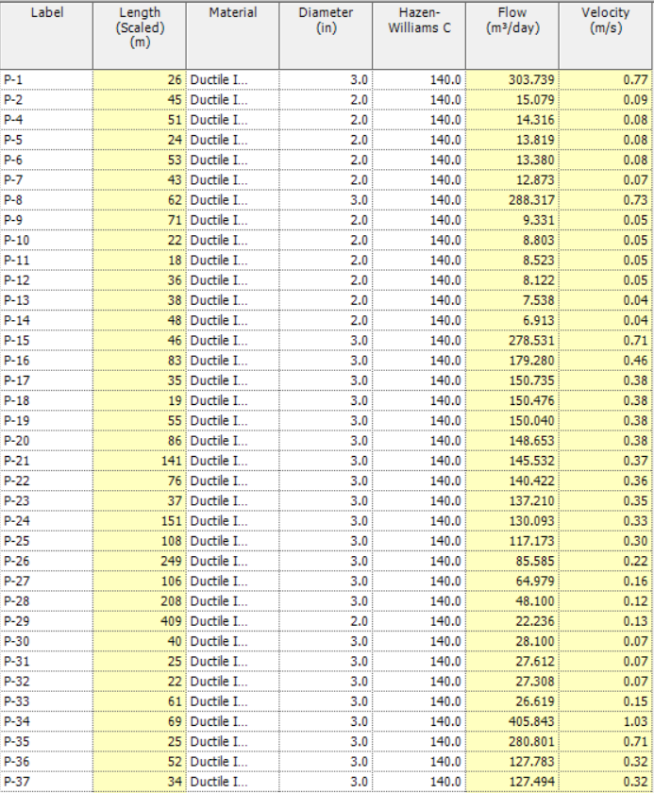
Demand Forecasting:

Slide 33
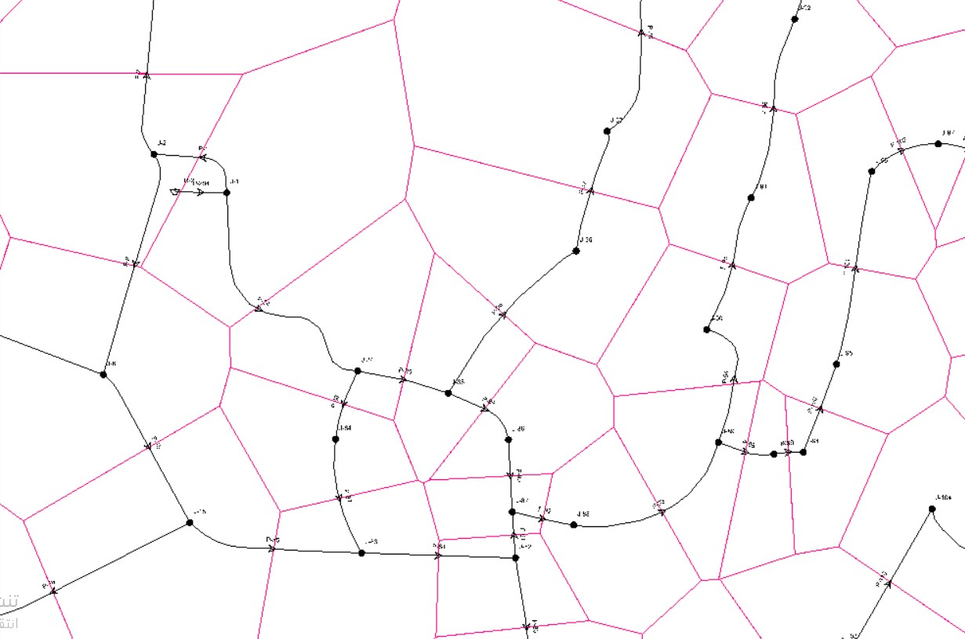
Design modeling

Slide 34
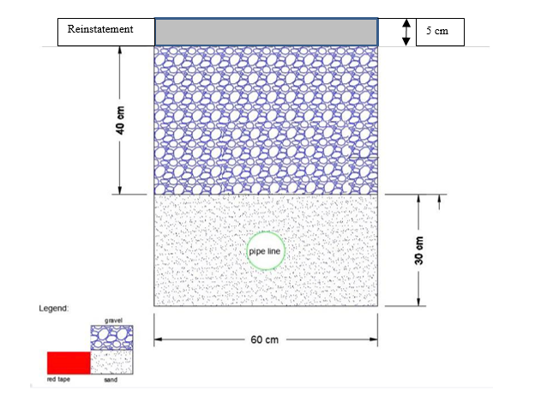
Quantities
Total length of pipelines = 13551 m
Resources | quantity / 1m | Total quantities
Excavation | 0.42 m³ | 5691.42 m³
sand | 0.18 m³ | 2439.18 m³
Agg. | 0.24 m³ | 3252.24 m³
Reinstatement | 0.03 m³ | 406.53 m³
cross section of the trench

Slide 35
Costs estimate
Resources | Units | Price $ | quantity / 1m | Total quantities
Excavation | m³ | 7 | 0.42 m³ | 5691.42 m³
sand | m³ | 27 | 0.18 m³ | 2439.18 m³
Agg. | m³ | 18 | 0.24 m³ | 3252.24 m³
Reinstatement | m³ | 175 | 0.03 m³ | 406.53 m³
labor | $/m | 27 | 1 m | 365877 $
pipe | m | 32 | 1 m | 13551 m

Slide 36
Costs estimate
Total length of pipelines = 13551 m
+
Total direct cost for 1m = 76.43 $
Operating overhead cost = 0.03 * (76.43 + 7.643) = 2.523 $
Job overhead cost = 0.1 * 76.43 = 7.643 $
+
+
Total cost = 76.43 +7.643 + 2.523 = 86.595 $/m
=
Profit = 0.15 * 86.595 = 12.989 $/m
Total price of the 1m = 86.595 + 12.989 = 100 $/m
Total price of the network = 1355100 $.

Slide 37
CONCLUSION AND RECOMMENDATION
Our design is applicable and serviceable for the selected design period of 30 years.
As we notice if we decrease the diameter of the pipe the velocity increase and the pressure decrease, so we did many trials to adjust the value of pressure and velocity within the allowable ranges as follow:
Allowable pressure range [ 20 - 100 ] m H2O.
Allowable velocity range [ 0.3 - 3 ] m/s .
  Prepaid meters were installed to solve the problem of Non-Revenue water, in addition to adding manholes on each main branch to read the amount of water entering and assist in maintenance work.
This village contains topographic differences, so we use pressure reducing valves in this village, in addition to taking urban expansion in areas higher than the level of the reservoir. It is recommended to use a pump to supply water to these areas or replace the current reservoir with a reservoir of a higher level.
Noticed that a few number of junction has a small velocity that lower than lower limit (0.3 m/s) that might because low demand in the junction that are joined with these pipes, although it still acceptable, but in future if the velocity become as obstacle this problem could be solved by using booster pumps to increase the velocity, but it’s very expensive solution compare with its benefits.

Slide 38


