Slide 1

An-Najah National University
Engineering College
Civil Engineering Department
Graduation Project
Structural Design of Al-Emara building
Under supervision of: Dr. Wael AbuAssab

Slide 2
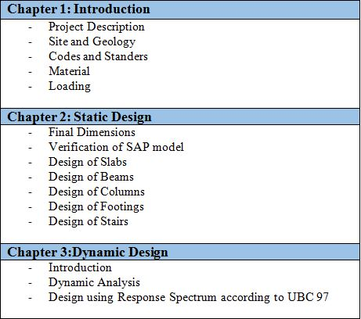
Outline

Slide 3
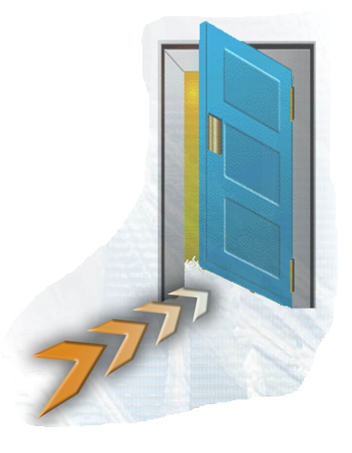
Chapter 1 : Introduction

Slide 4
1) Project Description
Al- Emara building lies in Rafedia Village
- Number of stories = 16
- Building height = 55 meter
The following table shows floors of building with own function and net area
Net Area(m2) | Function | Floors
615.8 | Garages | Basement 1
615.8 | Garages | Basement 2
615.8 | Storage | Ground
615.8 | Offices & Storage | 1st & 2nd
397.8 | Residential | 3rd - 16th

Slide 5
2) Site and Geology
The structure will be built on a hard stone layer which has a bearing capacity 350 KN/m2.
3) Codes and standards
● ACI 318-08: American Concrete Institute provisions for reinforced concrete structural design
● IBC-2009: International Building Code
● ASCE 7-05: American Society of Civil Engineers

Slide 6
4) Materials
Concrete :
fc=(32 MPa)for columns and shear walls
fc=( 28 MPa) for others
Reinforcing Steel: The yield strength of steel is equal to (420 MPa).
Others :
γ(KN/m³) | Material
25 | Reinforced concrete
23 | Plain concrete (mortar & plastering
18 | Aggregate
12 | Blocks
27 | Masonry stone
25 | Tile

Slide 7
5) Loading
Gravity loads
Dead load : consists of own weight of the structural elements.
Superimposed dead load = 4 KN/m2
Wall weight =21 KN/m
Lateral loads
Mainly Earthquake which will be discussed in dynamic design

Slide 8
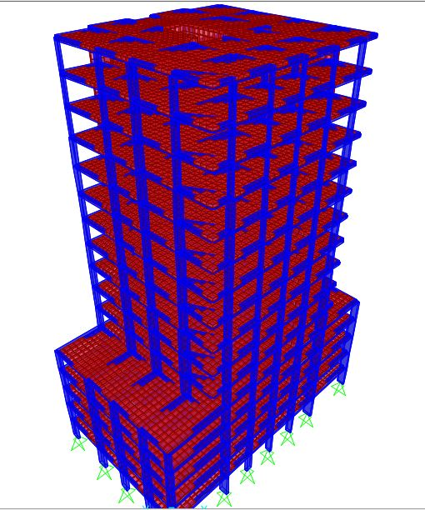
Chapter Two : Static Design

Slide 9
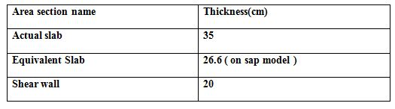
1) Final Dimensions :

Slide 10
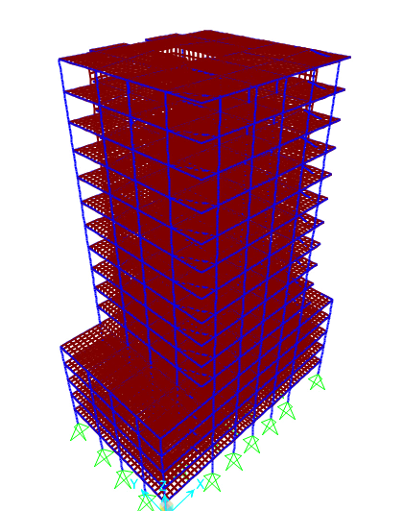
2) Verification of SAP Model
Compatibility Check

Slide 11
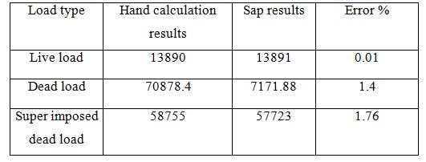
Equilibrium Check

Slide 12
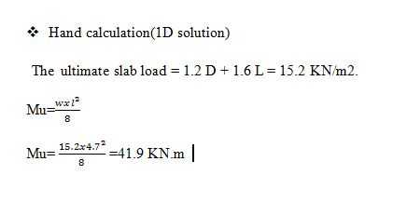
Stress Strain Check
Stress Strain Check for Slab moment :

Slide 13
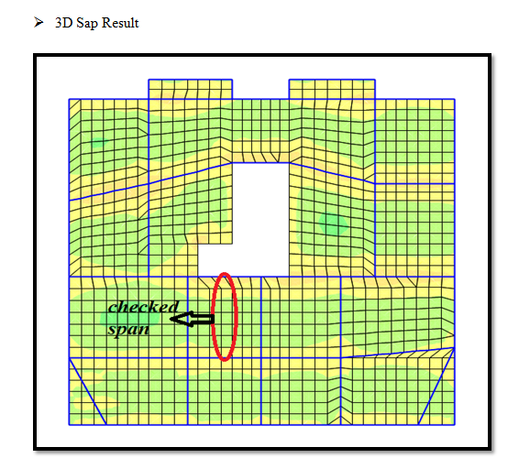
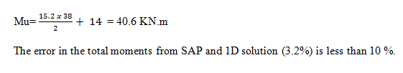

Slide 14

3- Design of Slab
1- Check for shear
Hand Calculation :
Sap Result

Slide 15
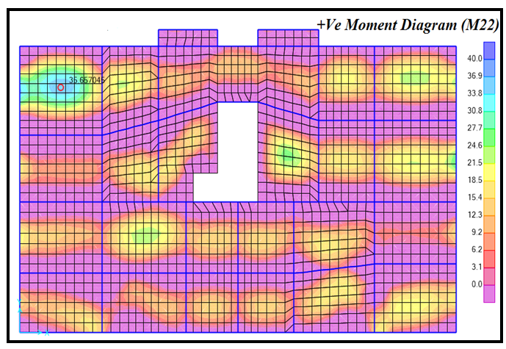
2- Design for Bending Moment

Slide 16
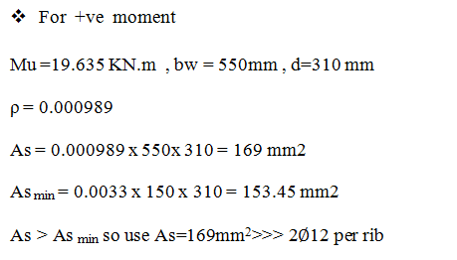

Slide 17
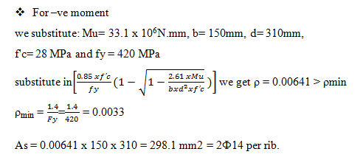

Slide 18
3- Deflection check for slab
-
Actual beams deflection = total beam deflection - axial deformation of near columns.
-
Actual floor deflection = total deflection - the avg.axial deformation of columns
-
Actual slab deflection = Actual floor deflection - the avg. Actual beams deflection

Slide 19
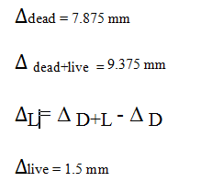
we are going to calculate the long term deflection then to be compared with allowable value ,We take the maximum deflection obtained in the 15th floor and The slab deflection is calculated as follow

Slide 20





Slide 21
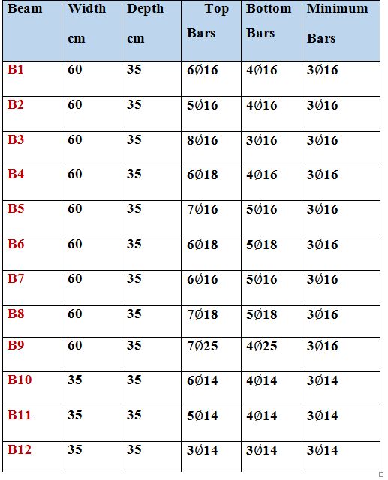
4- Design for Beams

Slide 22
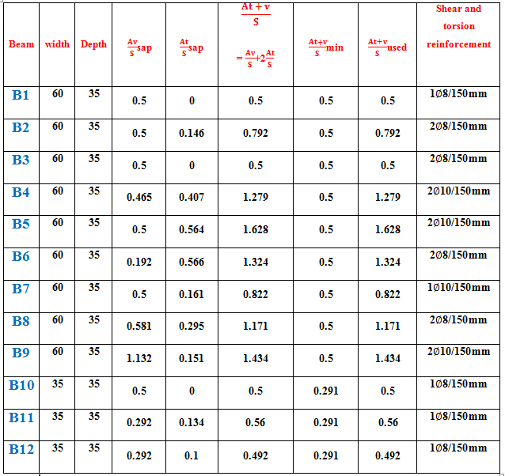

Slide 23
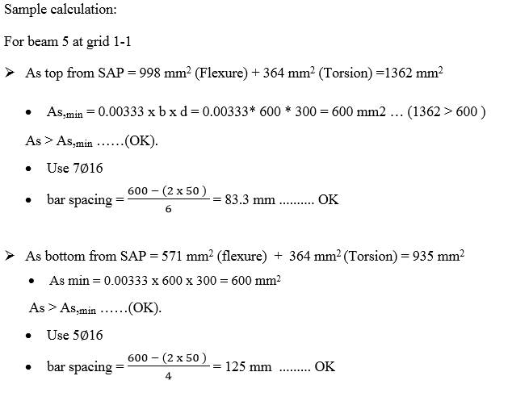

Slide 24
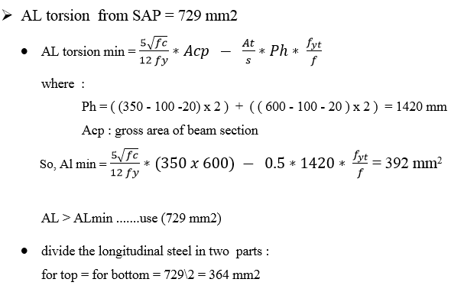

Slide 25
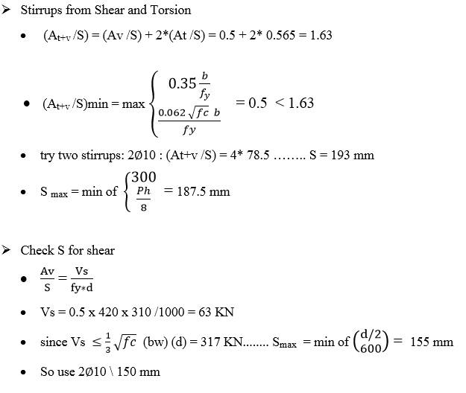

Slide 26
5- Design of Columns :
Floor #
Base 2 -2nd floor
3 - 6
7 - 11
12 - 14
C1 |  | C2 |  | C3 |  | C4
dimension | # of bars | dimension | # of bars | dimension | # of bars | dimension | # of bars
800 x 300 | 12∅16 | 1000x300 | 16c16 | 1100 x 350 | 16∅18 | 1250 x 350 | 18∅18
600 x 300 | 9∅16 | 800 x 300 | 12∅16 | 950 x 300 | 12∅18 | 1100 x 300 | 18∅16
300 x 400 | 6∅16 | 500 x 300 | 8∅16 | 700 x 300 | 12∅16 | 800 x 300 | 12∅14
300 x 200 | 6∅14 | 400 x 200 | 6∅14 | 500 x 200 | 8∅14 | 600 x 200 | 8∅14
C5
dimension | # of bars
1300*400 | 22∅18
1300x300 | 16∅18
900x300 | 14∅14
700 x 200 | 8∅14

Slide 27
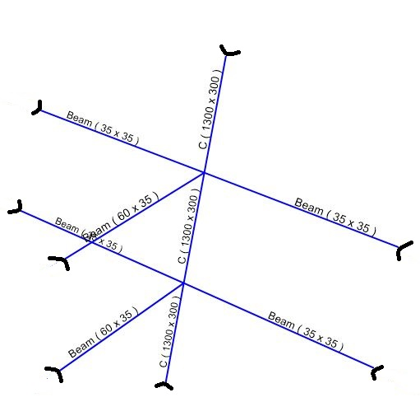
Check slenderness ratio for column C5 at grid (4-4)
For the column in the basement one can be considered unbraced.

Slide 28
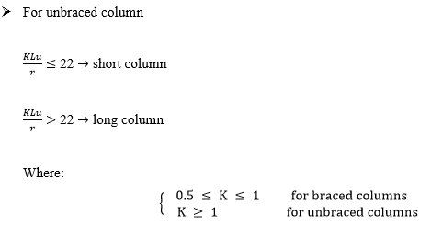
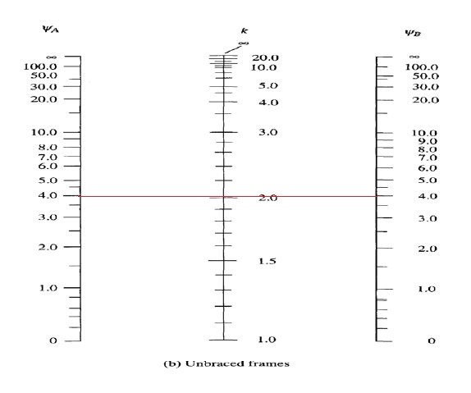
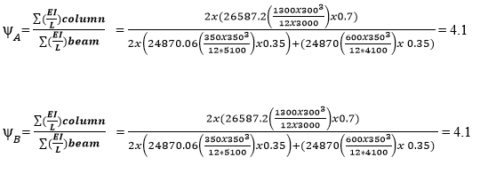
From the graph ـــ> K =2

Slide 29

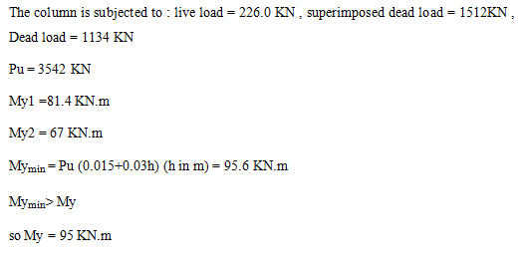


Slide 30
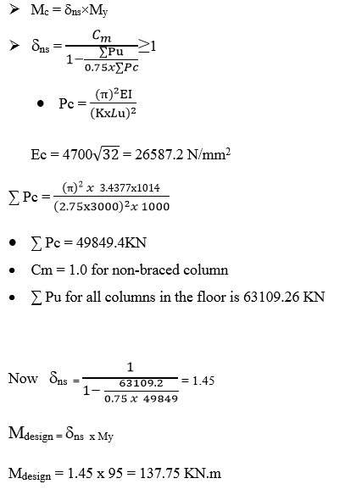

Slide 31
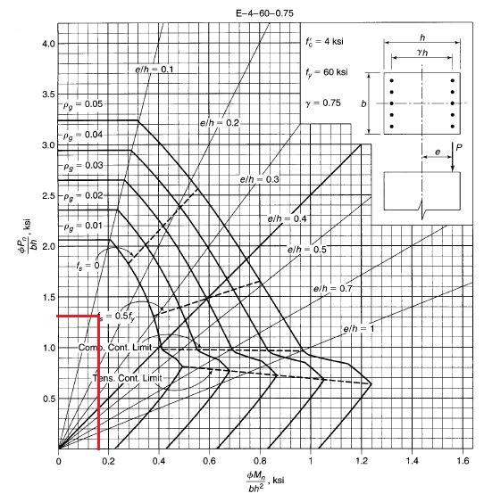
See interaction diagram:
From the figure ρ< 1% use minimum steel ratio ρ=1%
As= 0.01 *Ag = 0.01 x 1300 x 300 = 3900 mm²

Slide 32
Design of stirrups
Use 2Ø8mm stirrups
Vertical spacing between stirrups
S ≤ 16d_{b}: longitudinal bars S= 288 mm for d_{b}=18 mm.
S ≤ 48 d_{s} : for tie bar S=384 mm
S ≤ least lateral dimension of column S=300 mm
The spacing between stirrups is 280 mm for db=18 mm ➔ C5

Slide 33
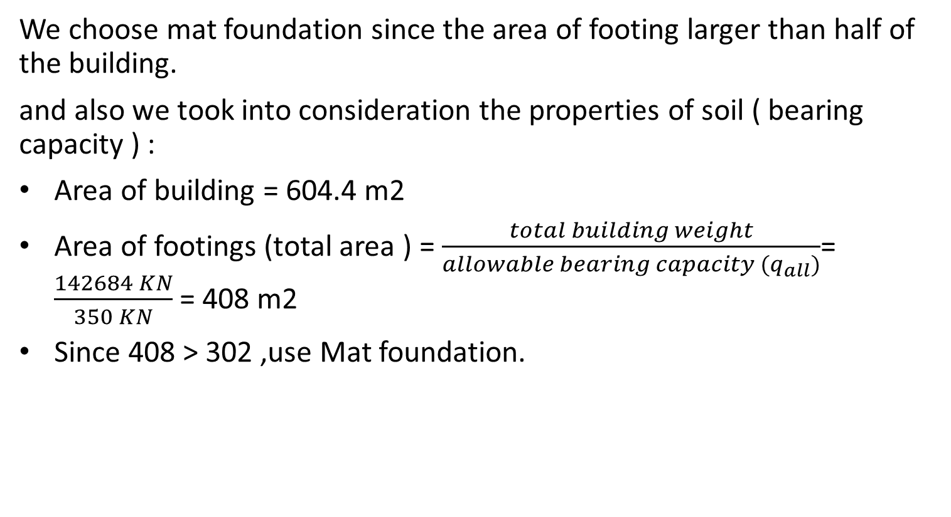
Design of footing
We choose mat foundation since the area of footing larger than half of the building.
and also we took into consideration the properties of soil ( bearing capacity ) :
Area of building = 604.4 m2
Area of footings (total area ) = $\frac{total building weight}{allowable bearing capacity (q_{all})}$= $\frac{142684 KN}{350 KN}$ = 408 m2
Since 408 > 302 ,use Mat foundation.

Slide 34
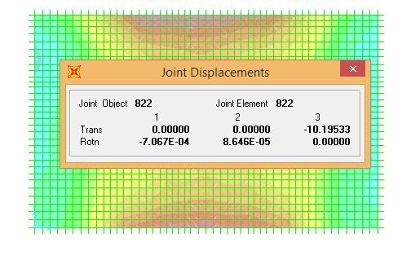
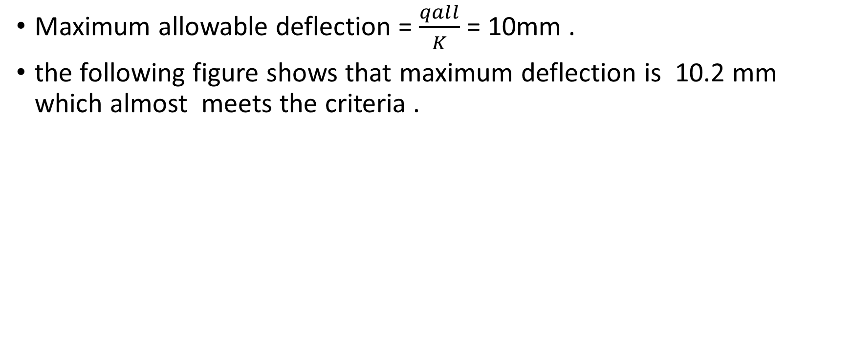
Deflection check
Maximum allowable deflection = $\frac{qall}{K}$ = 10mm .
the following figure shows that maximum deflection is 10.2 mm which almost meets the criteria .

Slide 35
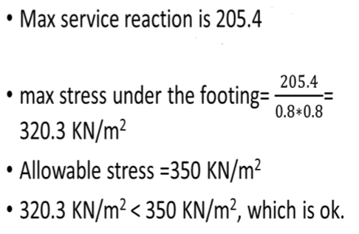
Allowable stress check

Slide 36
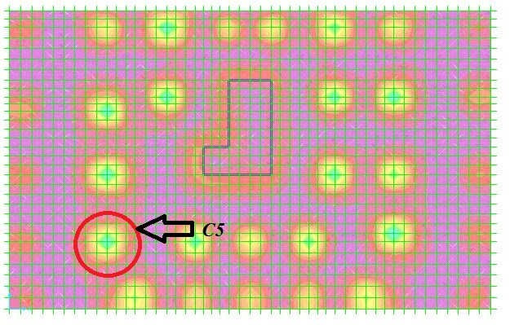
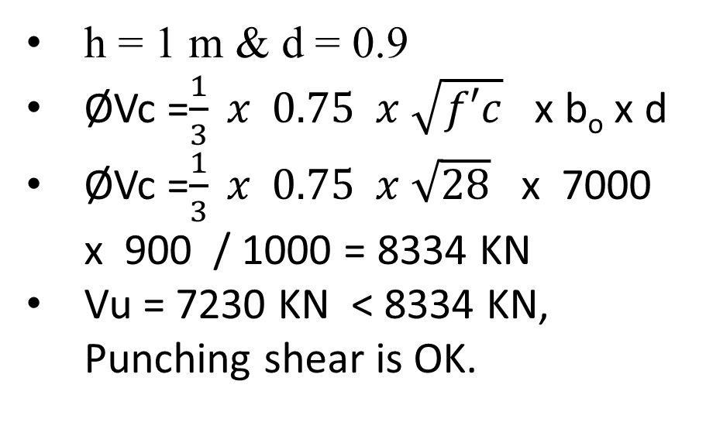
Punching shear check for the critical column
h = 1 m & d = 0.9
ØVc =$\frac{1}{3} x 0.75 x \sqrt{f′c}$ x b_{o} x d
ØVc =$\frac{1}{3} x 0.75 x \sqrt{28}$ x 7000 x 900 / 1000 = 8334 KN
Vu = 7230 KN < 8334 KN, Punching shear is OK.

Slide 37
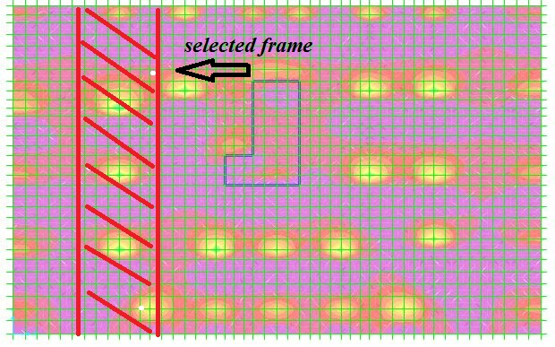
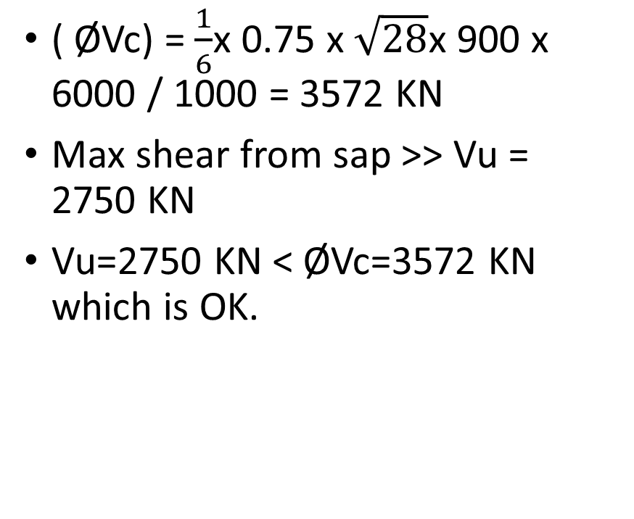
Wide beam check
( ØVc) = $\frac{1}{6}$x 0.75 x $\sqrt{28}$x 900 x 6000 / 1000 = 3572 KN
Max shear from sap >> Vu = 2750 KN
Vu=2750 KN <ØVc=3572 KN which is OK.

Slide 38
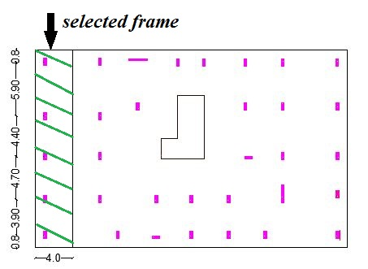
Flexure design
we selected a frame in the y-direction with width = 4 m

Slide 39
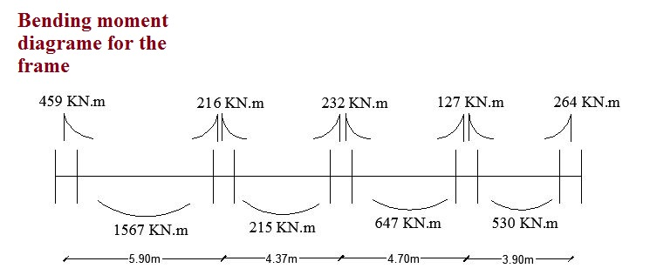
Bending Moment diagram for the selected frame

Slide 40
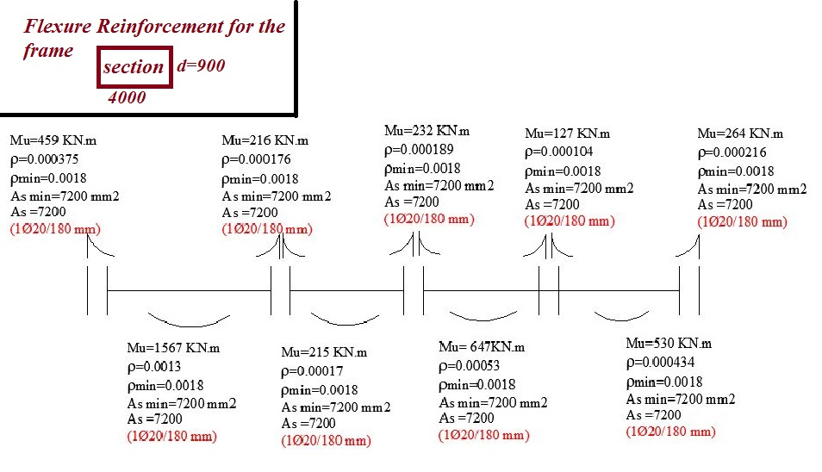
Flexure reinforcement for the selected frame

Slide 41
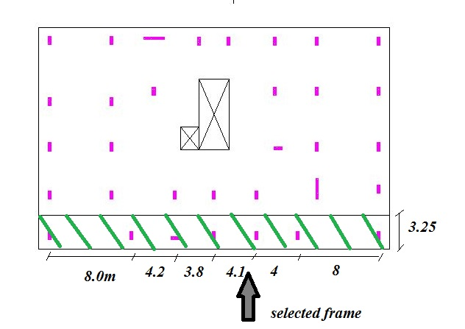
We selected another frame in the x-direction

Slide 42
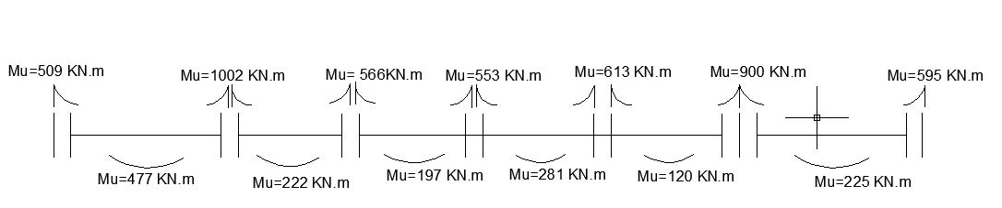
Bending Moment diagram for the selected frame

Slide 43
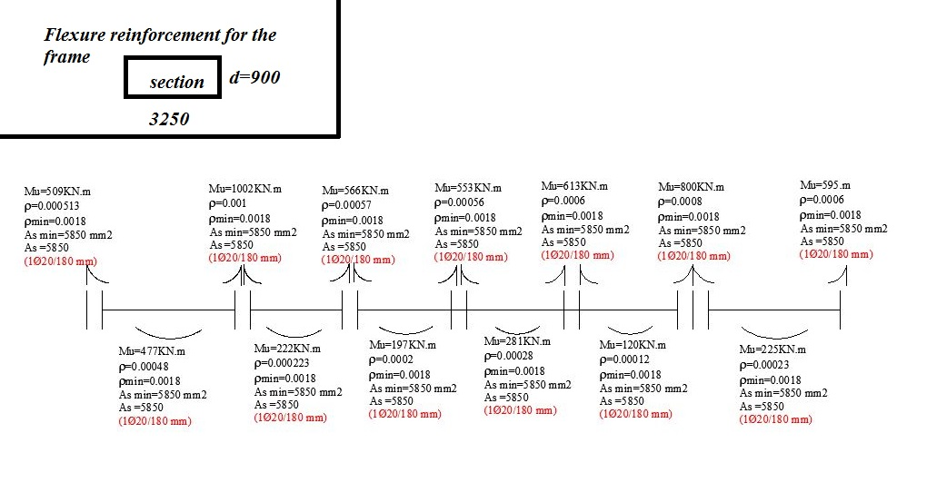
Flexure reinforcement for the selected frame

Slide 44
Design of stairs
h min=𝑙/20=3.35=0.167m⇒Use h=0.20m.
Thickness of stair and threshold areas=0.20 m,

Slide 45
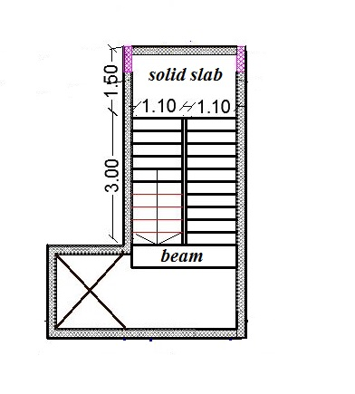
Plan view of the stairs
As shown, the stairs are surrounded by 3 shear walls which mean fixation from three sides.

Slide 46
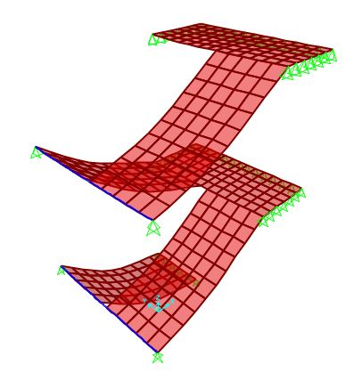
3D Model of the stairs for two stories.

Slide 47
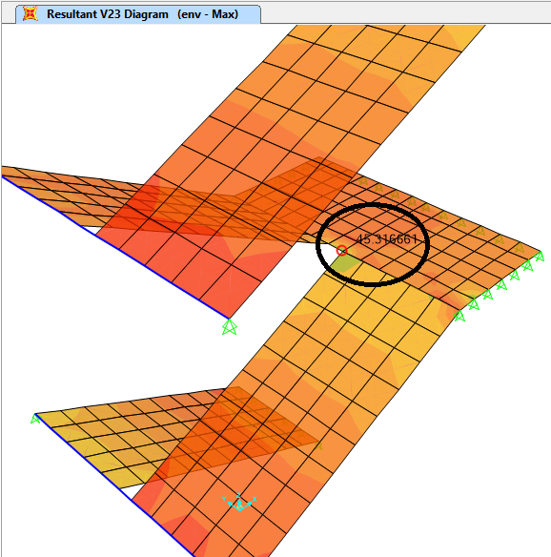
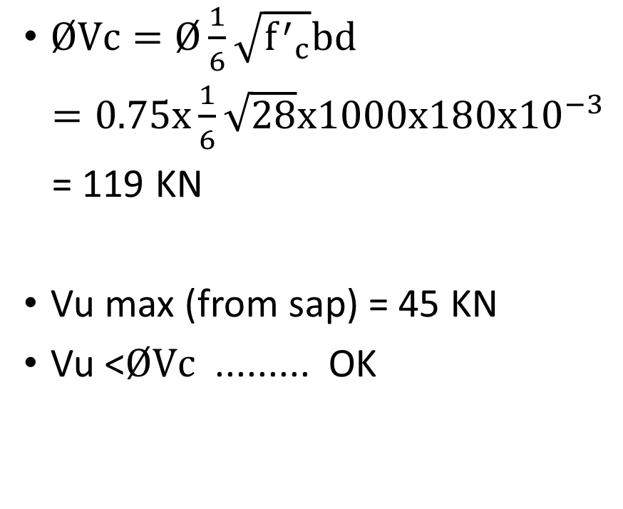
Shear Check
$ØVc=Ø\frac{1}{6}\sqrt{{f^{′}}_{c}}bd$
$=0.75x\frac{1}{6}\sqrt{28}x1000x180x{10}^{−3}$
= 119 KN
Vu max (from sap) = 45 KN
Vu <$ØVc$ ......... OK

Slide 48
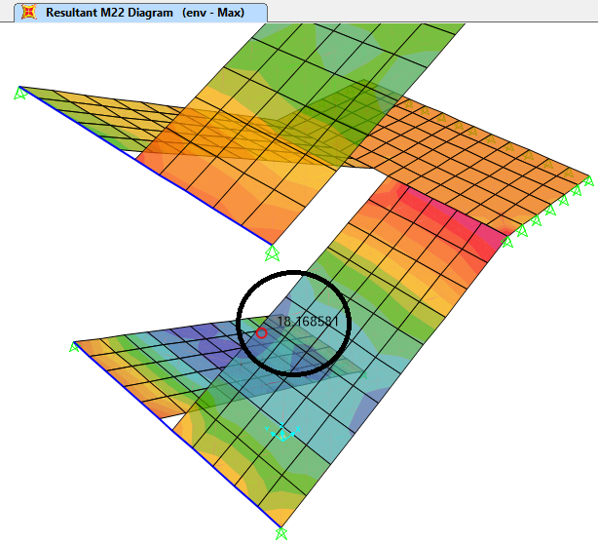
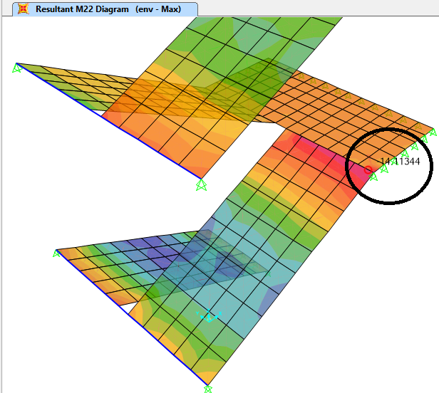
Bending moment diagram from SAP
M+ = 18.1 KN.m M - = 14.1 KN.m

Slide 49
Flexural reinforcement
Take max Mu = 18.16 KN.m
ρ = 0.0015
As = ρ x b xd= 0.0015 x 1000 x180 = 268.22 mm²
As_{min} = 0.0018x b x h=0.0018x 1000 x 200 = 360 > 268.22 mm²
Use As_{min}= 360 (4ϕ 12/m) (bottom) and (top ) .

Slide 50
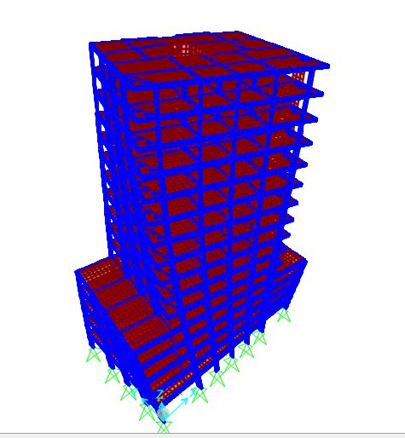
Chapter Four :Dynamic Design

Slide 51
a- Dynamic Analysis
We are going to analyze the building for modal response and compare the results between manual (Rayleigh method) and SAP program.

Slide 52
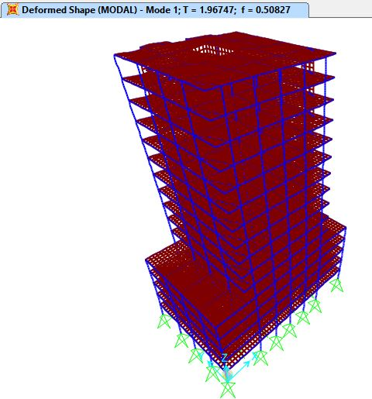
In x-direction :
Period (T) from sap in the x-direction = 1.97 sec

Slide 53
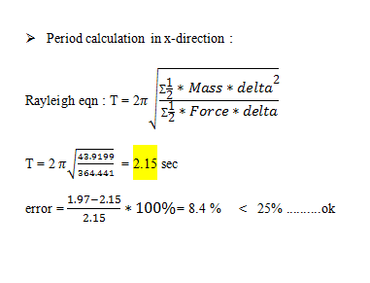
Manual calculation "Rayleigh method"

Slide 54
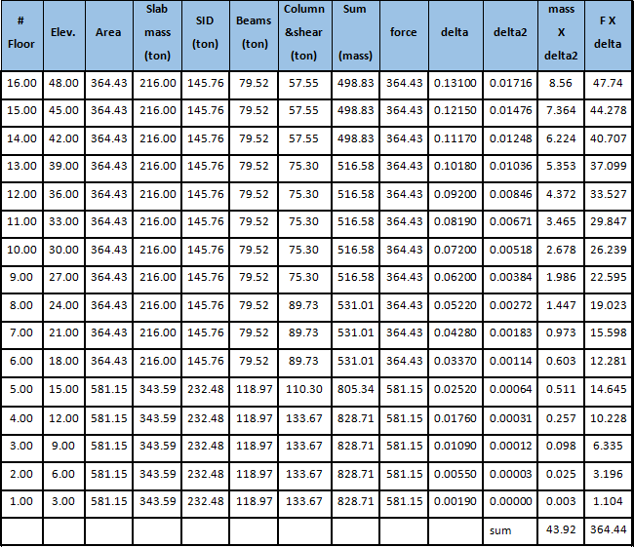

Slide 55
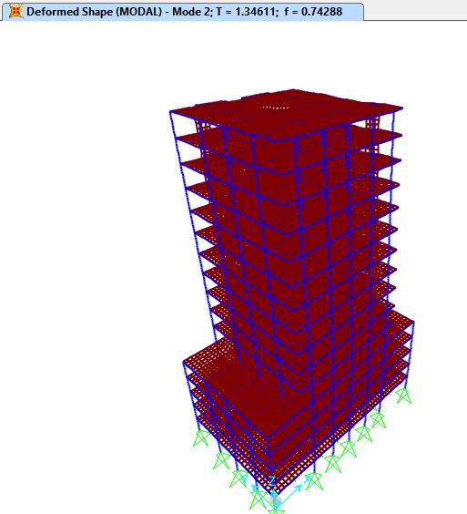
In y-direction :
Period (T) from sap in the y-direction = 1.35 sec

Slide 56


Slide 57



Slide 58

b- Design using Response spectrum according to UBC 97 Code
1) Seismic zone factor '' Z ''
For Nablus city (Zone 2B)
Z= 0.2

Slide 59

2)Soil factor
Soil type =S_{B}

Slide 60

3)''R'' factor
R = 3.5 ( ordinary moment - resisting frame )

Slide 61
4)Importance factor ''I''
For residential and commercial building importance factor ''I'' = 1
5) Acceleration seismic coefficient '' Ca '‘=0.2
6) Velocity seismic coefficient '' Cv “=0.2

Slide 62

7) Function Input

Slide 63

8) Load Cases in x-direction

Slide 64

In –y-direction

Slide 65

9)Base Shear :

Slide 66
10) Design for Columns
For static design the percent of steel for all columns equal 1% after earthquake load the percent of steel remain 1% so the static design is OK for all columns
11) Design of slabs
We found that the area of steel for gravity loads and the lateral steel is the same .

Slide 67

12) Design for beams

Slide 68

13) Design of Shear walls
The following table shows the reinforcement of shear walls:

Slide 69

Hand Calculation for Shear wall 1
Once shear wall is analyzed, 5 internal ultimate forces can be computed; namely, P, Vx, Vy, Mx and My

Slide 70

1- Check Shear in X-direction:
2- Design Shear in Y-direction
Vuy = 2026 KN
needed stirrup :
1Ø12 / 250 mm

Slide 71



Slide 72

To find interaction diagram for this shear, wall simple 3-D model was made by Sap2000 program and we assumed area of steel to be
As = 0.0025 * 4700 * 300 = 3525 mm2

Slide 73
Since he point is inside the interaction diagram so the area of steel provided is enough
Total area of steel needed for axial load and moment = 3525 mm2 +(2*104) mm2= 3733mm2 ....... (25Ø14)

Slide 74


