Slide 1

Simulated Penetration Testing And Attack Automation
Using Deep Reinforcement Learning
Students :
Ismael Jabr
Yanal Salman
Motasem shqair
Supervisor : Dr.Amjad Hawash

Slide 2
Problem statement
Manual penetration testing
Relying on experience of penetration tester
Not aware of all potential risks

Slide 3
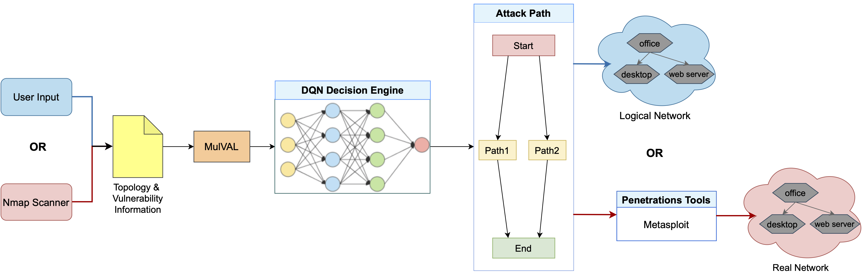
Overview
MulVAL : (Multi-host, Multi-stage Vulnerability Analysis Language)
DQN : Deep Q-Network

Slide 4
The Common Vulnerability Scoring System (1)
Basic Metric Group
Exploitability Metrics
Attack Vector
Scope
Impact Metrics
Confidentiality Impact
Scope
Attack Complexity
Privileges Required
User Interaction
Integrity Impact
Availability Impact

Slide 5
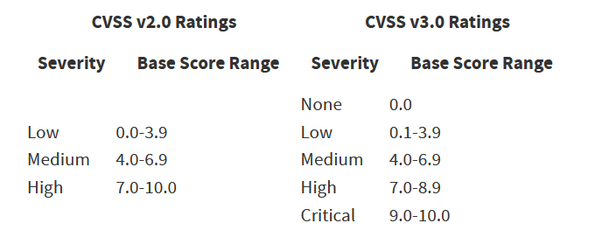
The Common Vulnerability Scoring System (2)

Slide 6
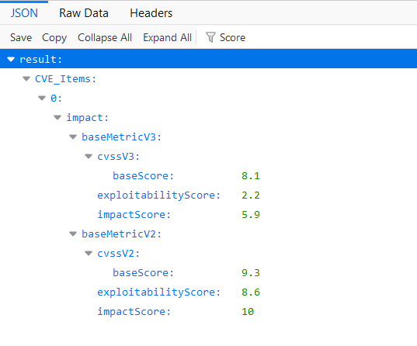
Dataset (National Vulnerability Database)
API : https://services.nvd.nist.gov/rest/json/cve/1.0/`cveNumber`
Ex : https://services.nvd.nist.gov/rest/json/cve/1.0/CVE-2017-0143

Slide 7
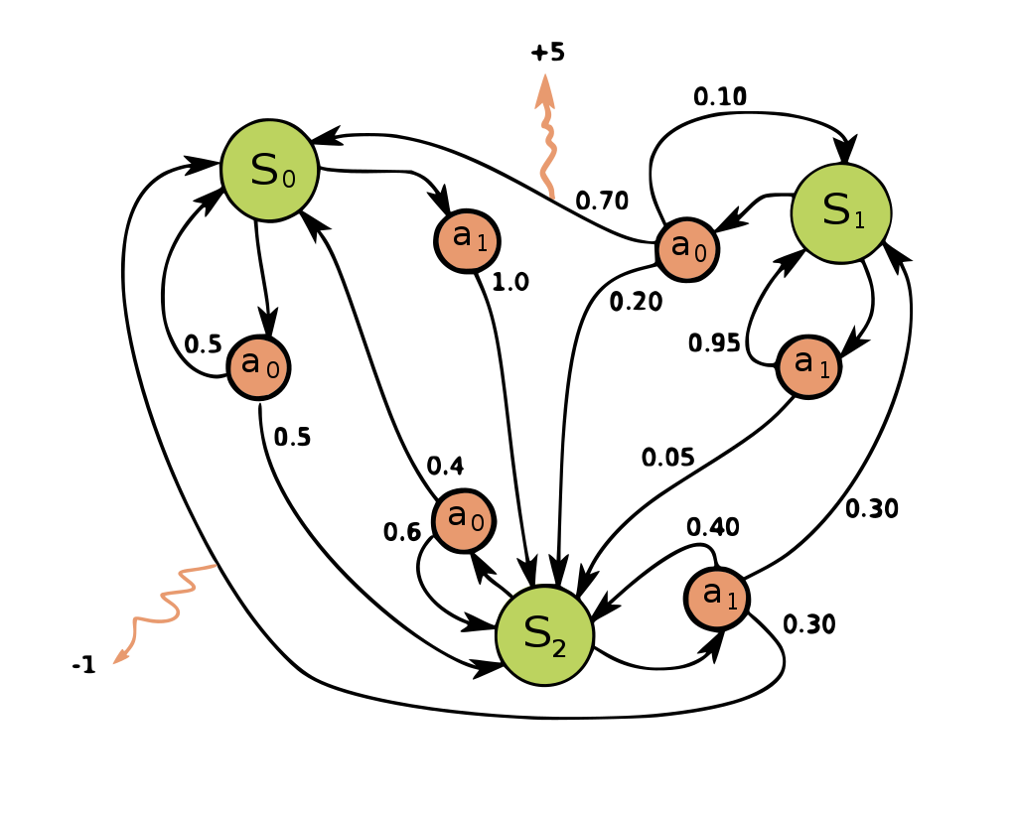
Deep Reinforcement Learning
Markov decision process

Slide 8

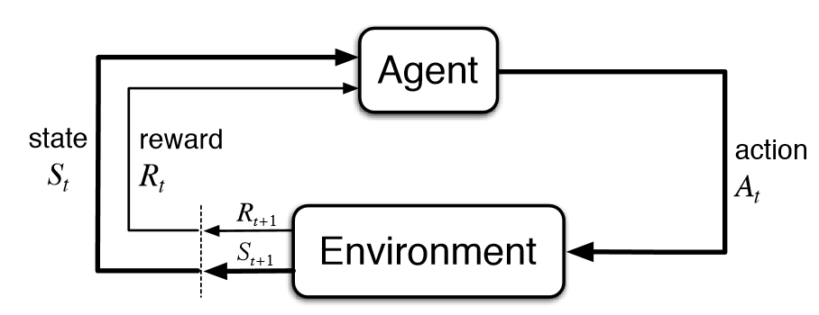
DQN Algorithm
ScoreVuln = Base Score * (exploitability Score /10)

Slide 9
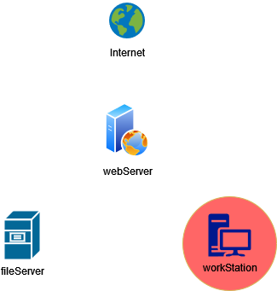
Experiment

Slide 10
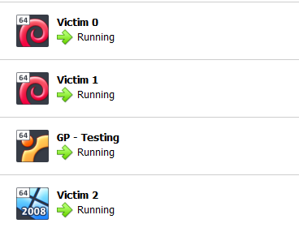
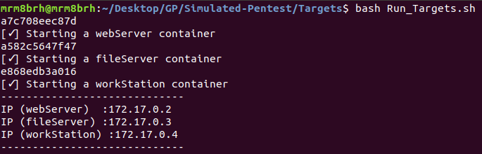
Virtualization
  Virtual box
  Docker

Slide 11
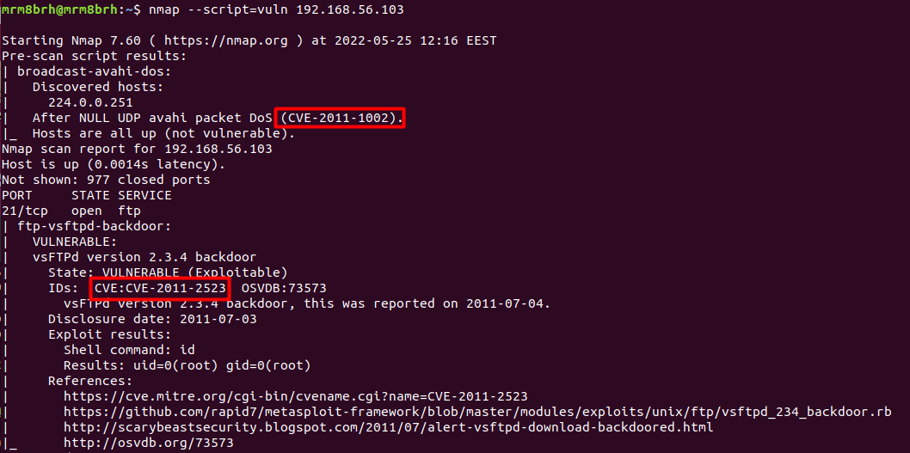
Information gathering
Nmap

Slide 12
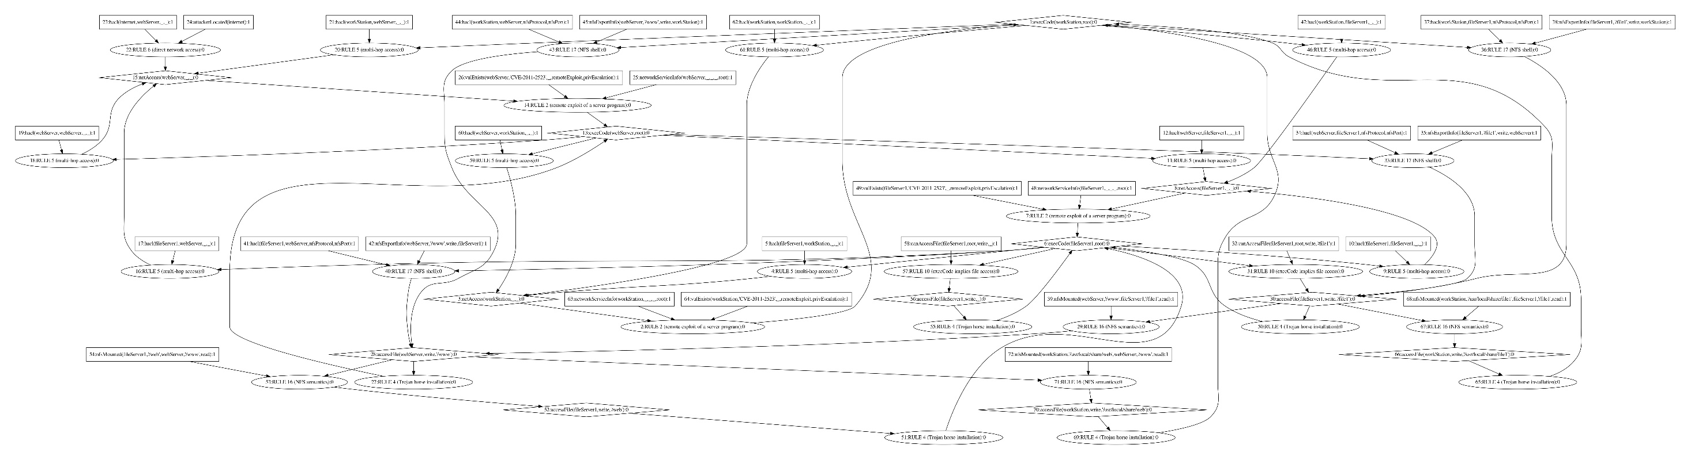
Attack Model
Attack Graph
MulVAL (Multi-host, Multi-stage Vulnerability Analysis Language)

Slide 13
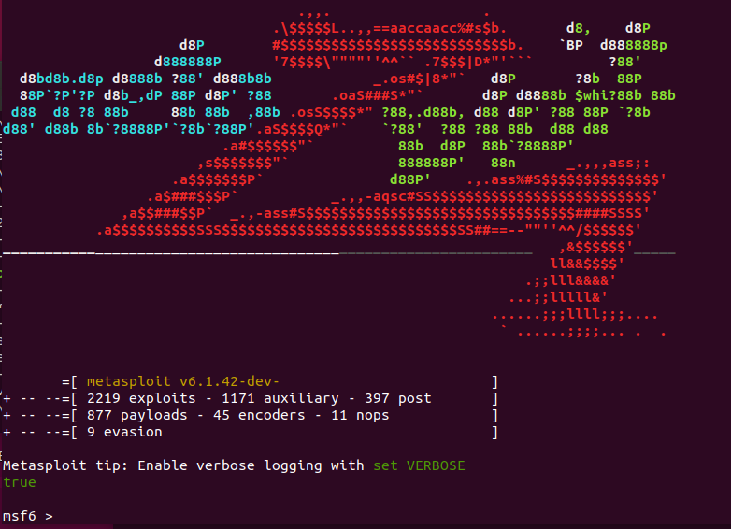
Attack automation

Slide 14
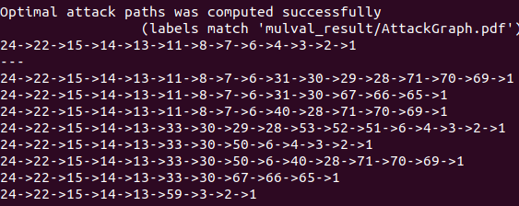
Results

Slide 15
Live Demo

Slide 16
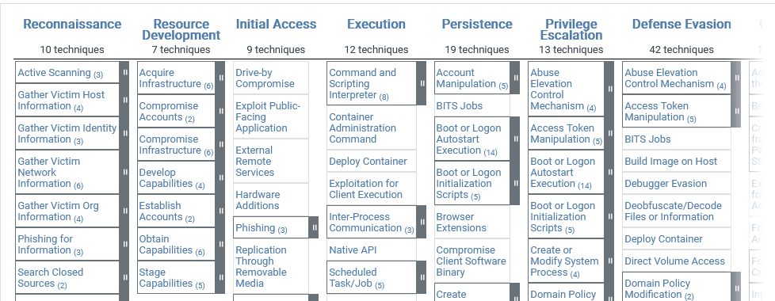
Future work
Improve Attack Automation
Forecasting Zero-Day Vulnerability
MITRE Attack

Slide 17
Thank You

