Slide 1
Double Emulsion using premix membrane emulsification
Group members
Wisal Khderat
Raya Bsharat
Hiba Qassrawi
Aseel Qaffaf
Submitted to:
Dr.Hassan Sawalha

Slide 2
project Outline
Introduction
What is double emulsion?
Where we can apply Double Emulsion?
Experimental work
Results and discussion
Conclusion

Slide 3
What is Emulsion?
An emulsion is a mixture of two immiscible phases of which one (i .e. oil) is dispersed in another (i.e. water) which is stabilized by a surfactant.

Slide 4
Types of Emulsion
Single emulsion

Slide 5
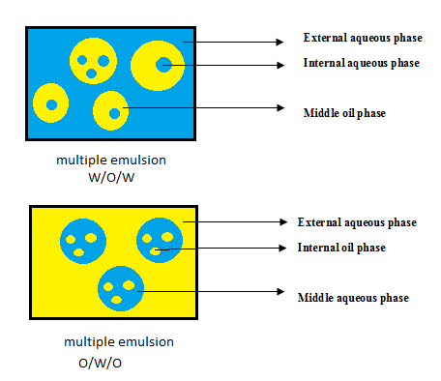
Multiple (complex) emulsions

Slide 6
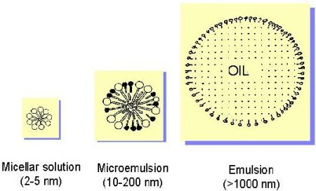
Micro emulsion

Slide 7
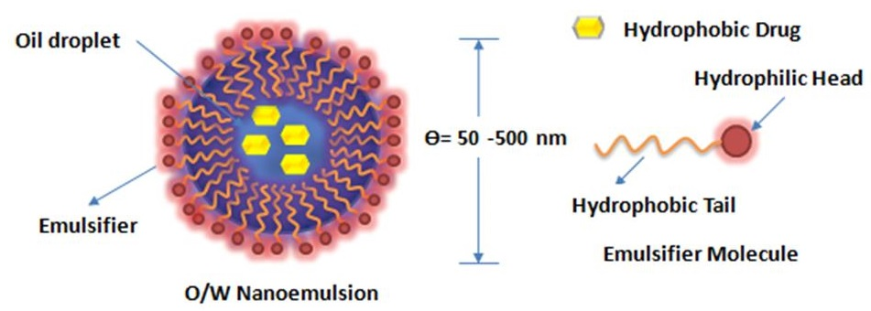
Nano emulsions

Slide 8
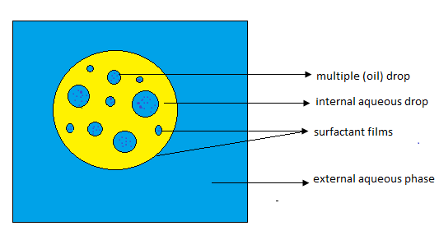
What is Double Emulsion?
DE involve the preliminary emulsification of two phases, followed by a secondary emulsification into a third phase leading to a three phase mixture.

Slide 9
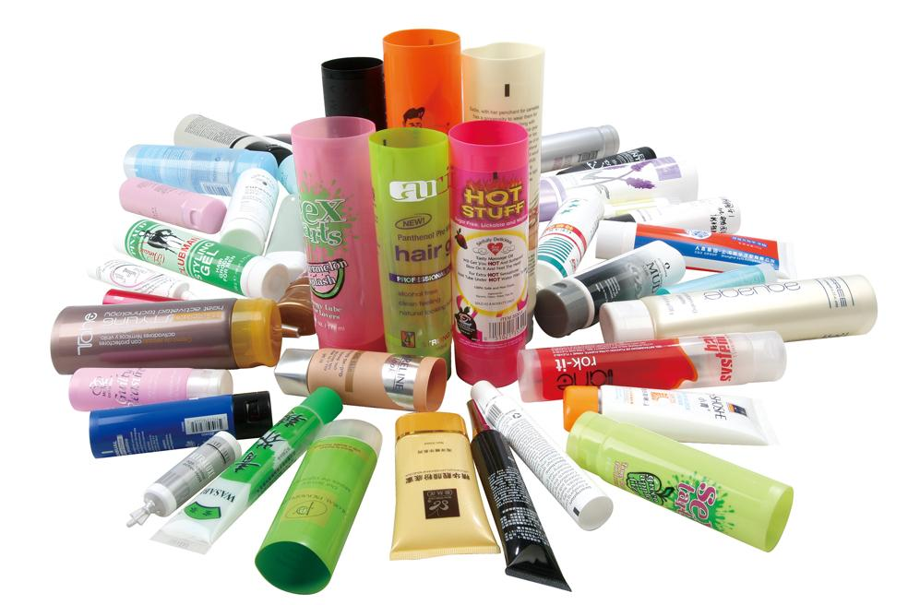
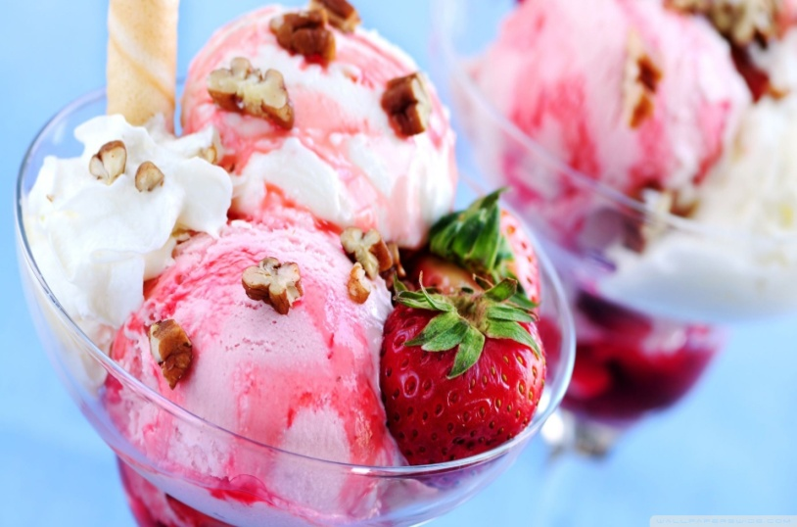
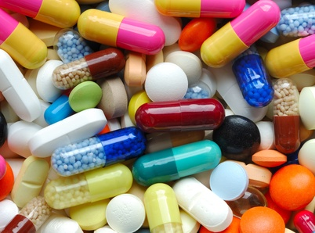
Double Emulsion Application
food industry
cosmetics industry
pharmaceutical industry

Slide 10
Emulsification method
Traditional method
pressure Homogenizer
Colloid mill
Mechanical strring
+
mixing
Oil
water
w/o/w

Slide 11
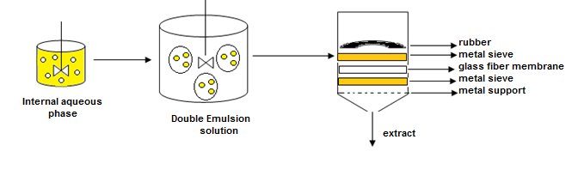
Membrane emulsification.

Slide 12
EXPERIMENTAL WORK
Materials
water+span80+sugar or ethanol
Oil+tween20
NaCl+ water

Slide 13
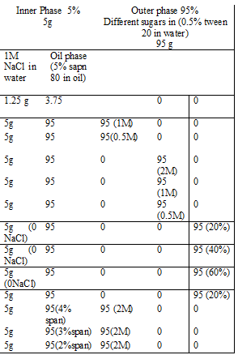
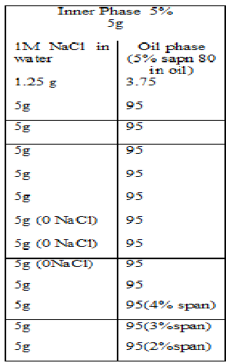
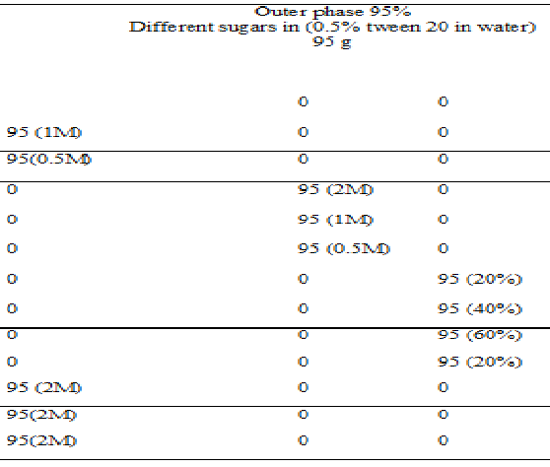

Slide 14
Solution preparation
+
mixing
+
Water+NaCl
Oil+ span80
W/O
Water+sugar+tween 80
mixing
w/o/w

Slide 15
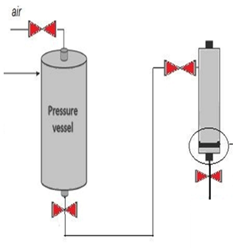
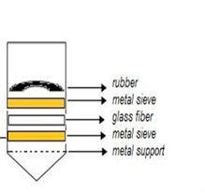
DE
Test sample

Slide 17
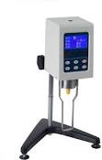
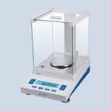
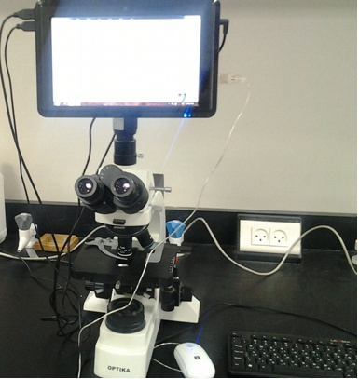
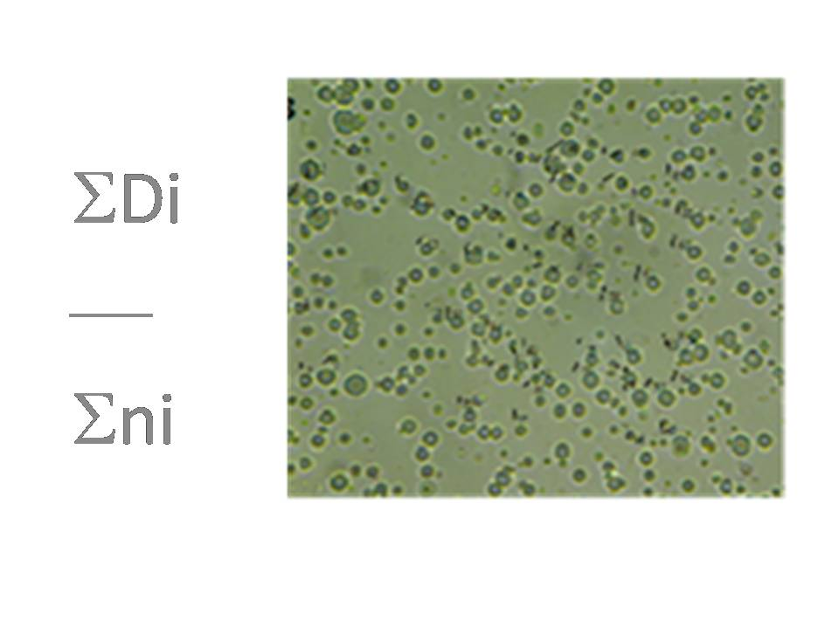
Test measurements
NaCl release test
Viscosity test
Density test
Particle size test

Slide 18
Parameters to study
Effect of trans-membrane pressure
Effect of passes’ number
Effect of viscosity
Effect of ingredients’ concentration
Effect of span percentage

Slide 19
Results and discussion
Effects on droplets’
size

Slide 20
Effect of trans-membrane pressure

Slide 21
Effect of passes’ number

Slide 22
Effect of viscosity

Slide 23
Effect of ingredients

Slide 24
Effect of span percentage

Slide 25
Effects
on NaCl release

Slide 26
Effect of trans-membrane pressure

Slide 27
Effect of ingredients

Slide 28
A problem
How to combine all previous parameter in one??

Slide 29
The solution
Re
ρ*v*dp
μ

Slide 30
Reynolds number vs. d/dp

Slide 31
Conclusion
Many methods are used to get double emulsion with premix membrane emulsification as the best one.
Three different types of continuous phase were used with different concentrations.
Fructose gave the best results and it was the most stable one.
All the studied parameters were combined in one dimensionless relation.

Slide 32
Take home message
Less than 1micron in diameter was
obtained in this study in which it is the
smallest size obtained in the literature

Slide 33
Thank you ^_^

