Slide 1

FDM-3D printer
An-Najah National University – Nablus
Faculty of Engineering
Ulti-XY system
Submitted By : Supervisor :
1. Ibraheem Abdo. Eng.Baha’a Shaqour
2. Motasem Darghma
3. Sohaib Zahran

Slide 2

Outline
Introduction
FDM-printer
Feeder Mechanism
XY- Mechanism
Z- Mechanism
Control & Calibration
Our Vision
Conclusion

Slide 3
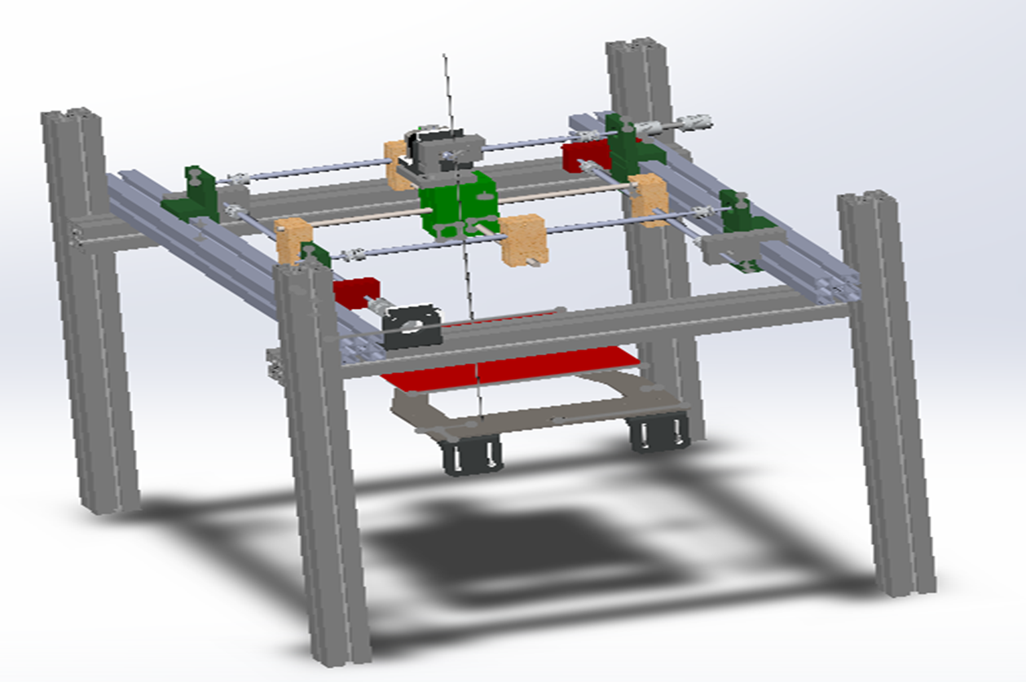
Introduction

Slide 4
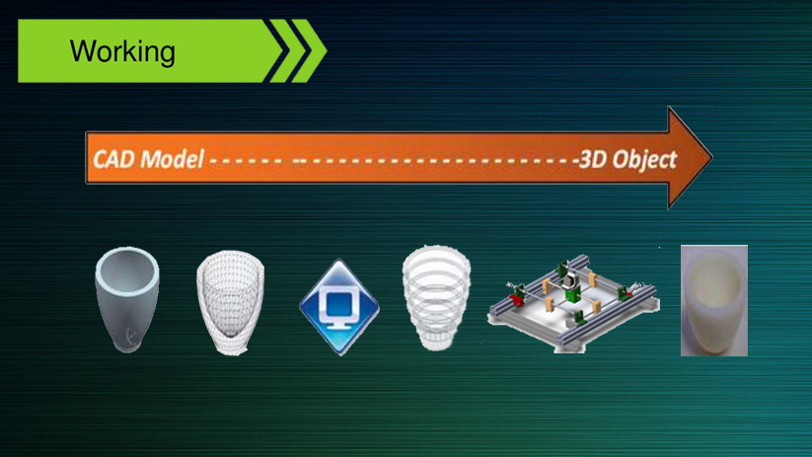
3D Cad
Model
STL
File
Slicing
Software
Layer Slices& Tool Path
3D Printer
3D Object

Slide 5
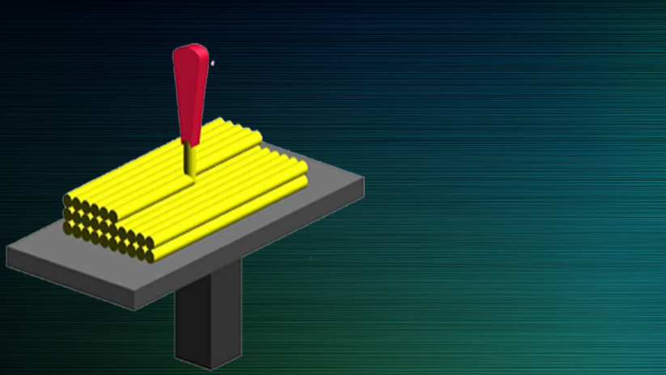
FDM
Fused deposition molding (FDM) : is an additive manufacturing technology commonly used for modeling ,prototyping and production application

Slide 6
Start
FDM
Layer of powder deposit automatically
Print head applies resin to powder layer
Powder layer dries almost immediately
Add another layer?
Yes
No
Remove completed model
Finish

Slide 7
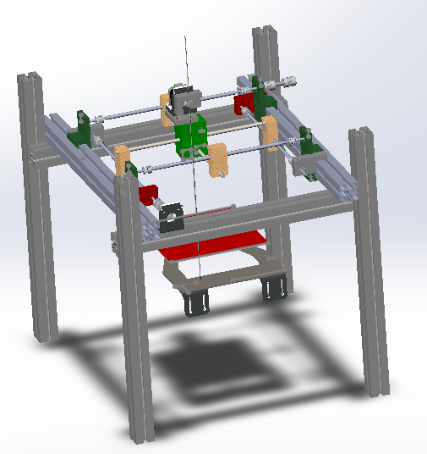
Design

Slide 8
Design
Feeder Mechanism :
it is one of the most important components on a 3D printer. It is responsible for sending the correct amount of filament to the hot end where it’s melted and extruded down in thin layers to make your part.

Slide 9
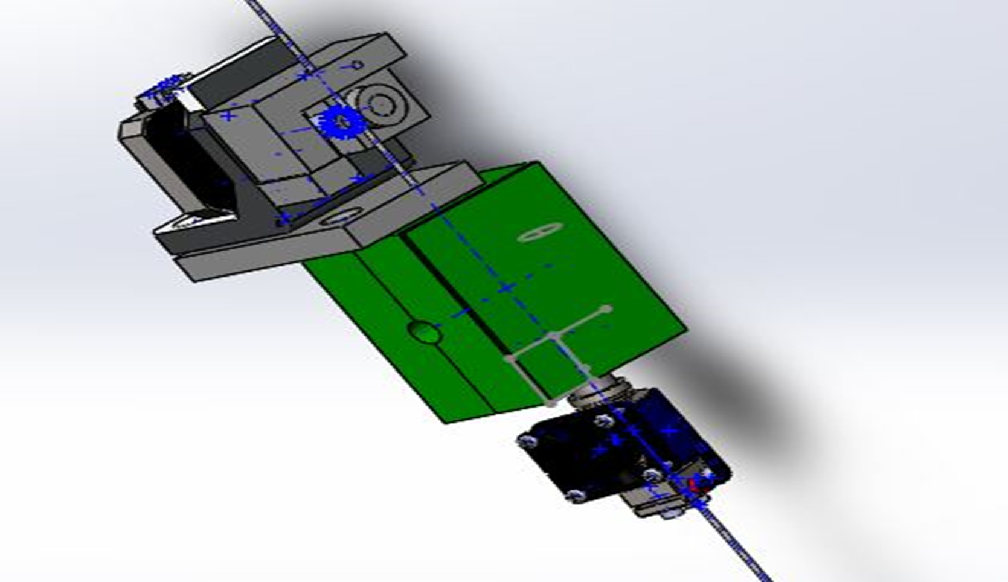
Design
Feeder Mechanism

Slide 10
Design
XY- Axis

Slide 11
Design
Z-Axis

Slide 12
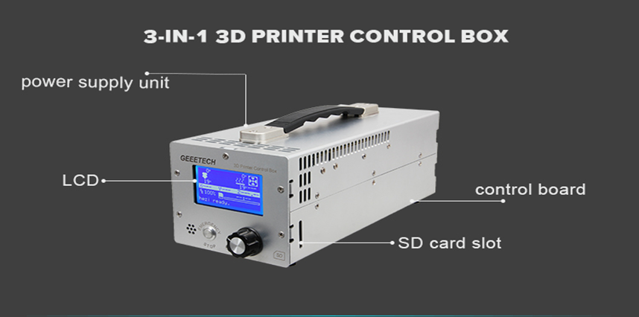
Control & Calibration
The specification for this controller “3-in-1 3D printer control box” it takes a Power input: 110V/220V, and Power output: 12V, 20A, LCD display: 12864, LCD background colour: blue, SD card support Dimension: 290x120x115mm, Weight: 2kg and Control board: GT2560

Slide 13

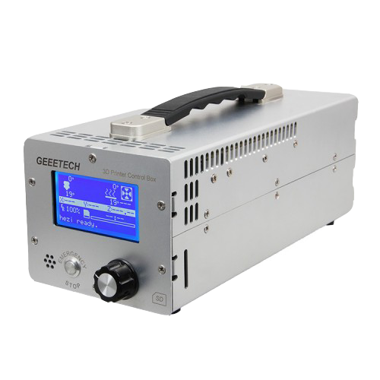

Control & Calibration
Extruder
X-Motor
X-axis
Motor Driver
Y-Motor
Y-axis
Marlin
Level shifter
Z-Motor
Heated Bed
Z-axis

Slide 14
Control & Calibration
For accurately make prints, this process includes verifying:
Movement of each axis.
Heating the extruder
Extruding the plastic.
Testing the end stops.
Calibration
Marlin
Repeteir
Slicer

Slide 15
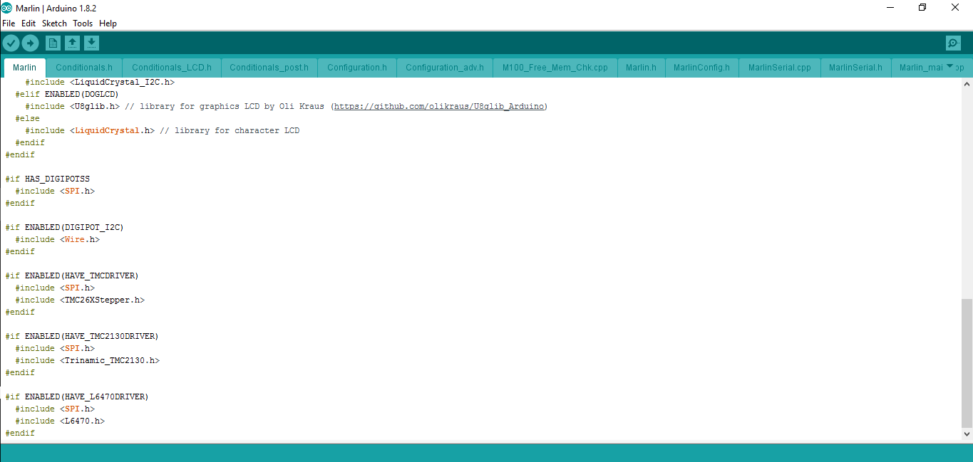
Control & Calibration
Marlin firmware

Slide 16
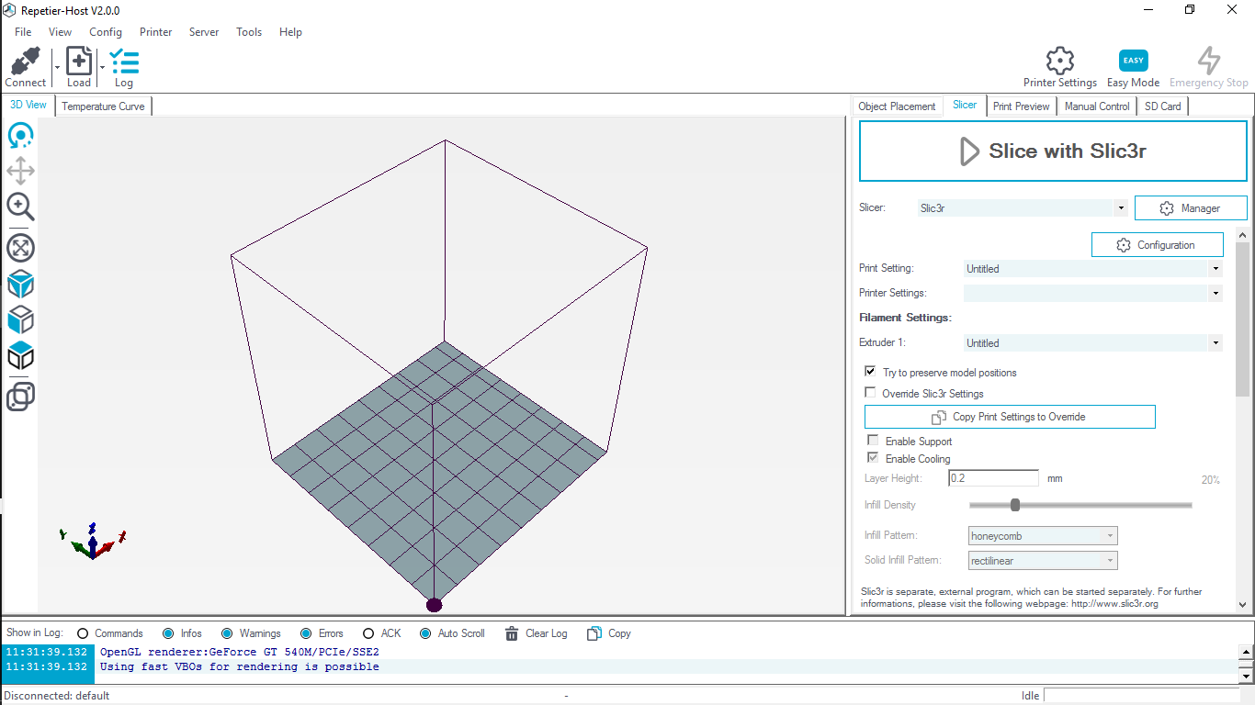
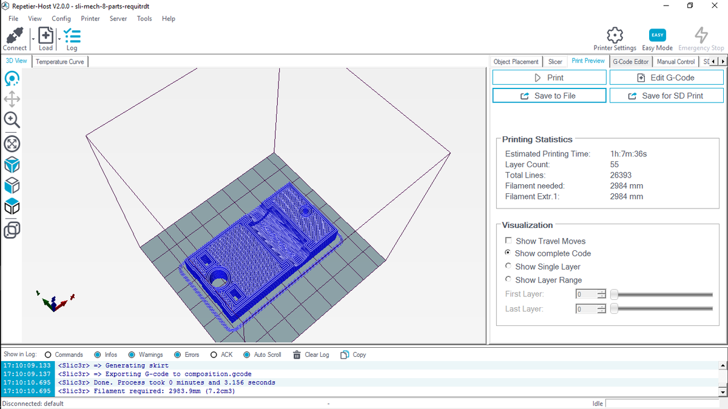
Control & Calibration
Slicer
Repeatier

Slide 17
Specifications
صورة لل ماكنة موضح الابعاد عليها
Build Envelope | Size and weight | Layer Thickness
Modeling martial | Support martial | Price

Slide 18
Challenges

Slide 19
Our Vision

Slide 20
Conclusion
3D printing technology could revolutionize and re-shape the world .
3D printing technology can significantly change and improve the way we manufacture products and produce good world wide

Slide 21
Thank you
for your attention
Do you have any questions?

