Slide 1


PalHands
من أهلِ البَلد.. لأهل البَلد

Slide 2
Table of contents
01
02
03
Introduction
Our Solution
The challenge we addressed
04
05
Architecture
Our platform

Slide 3
Our project
We developed PalHands, a digital platform that connects people with home-based service providers across Palestine. Our goal is to make it easy for clients to discover and book reliable services, for providers to manage their offerings professionally, and for administrators to oversee the system. The platform runs on both web and mobile, with full bilingual support in Arabic and English.

Slide 4
The challenge we addressed
Amid difficult economic conditions and limited job opportunities, many people in Palestine are looking for alternative sources of income to support themselves and their families. At the same time, essential services we rely on every day — such as childcare or household assistance — remain hard to find in an organized way.
Many homemakers and students have valuable skills that could generate extra income, but they lack a structured platform to showcase their services and reach those who need them.
PalHands was designed to close this gap: a platform that connects skilled individuals with clients seeking everyday services, making access easier while creating new income opportunities and supporting our community in its daily challenges.

Slide 5
Our Solution
PalHands introduces three clearly defined roles: clients, providers, and administrators. Each role has its own dashboard tailored to its responsibilities. Clients can search and book services, providers can manage schedules and earnings, and administrators can ensure quality and security. Together, these roles form a complete ecosystem for local service management.

Slide 6
How We Built It (Architecture)
Node.js backend
MongoDB
Flutter frontend
OpenStreetMap
implemented JWT authentication
for scalable data management
cross-platform delivery on web and mobile.
ensuring a unified and cost-effective experience without dependency on external licensing.

Slide 7
Capabilities Across Roles
Providers
Clients
Administrators
We designed distinct but complementary capabilities for each role:
1
2
3
can publish services, set availability, manage bookings, track earnings, and respond to feedback.
can explore services by category, view providers on the map, make bookings, process payments, and leave reviews.
an monitor the platform, manage user accounts, oversee services, and intervene when necessary.

Slide 8
Authentication
Log In
Change Password.
Forgot Password.
Sign Up as Client.
Sign Up as Provider

Slide 9
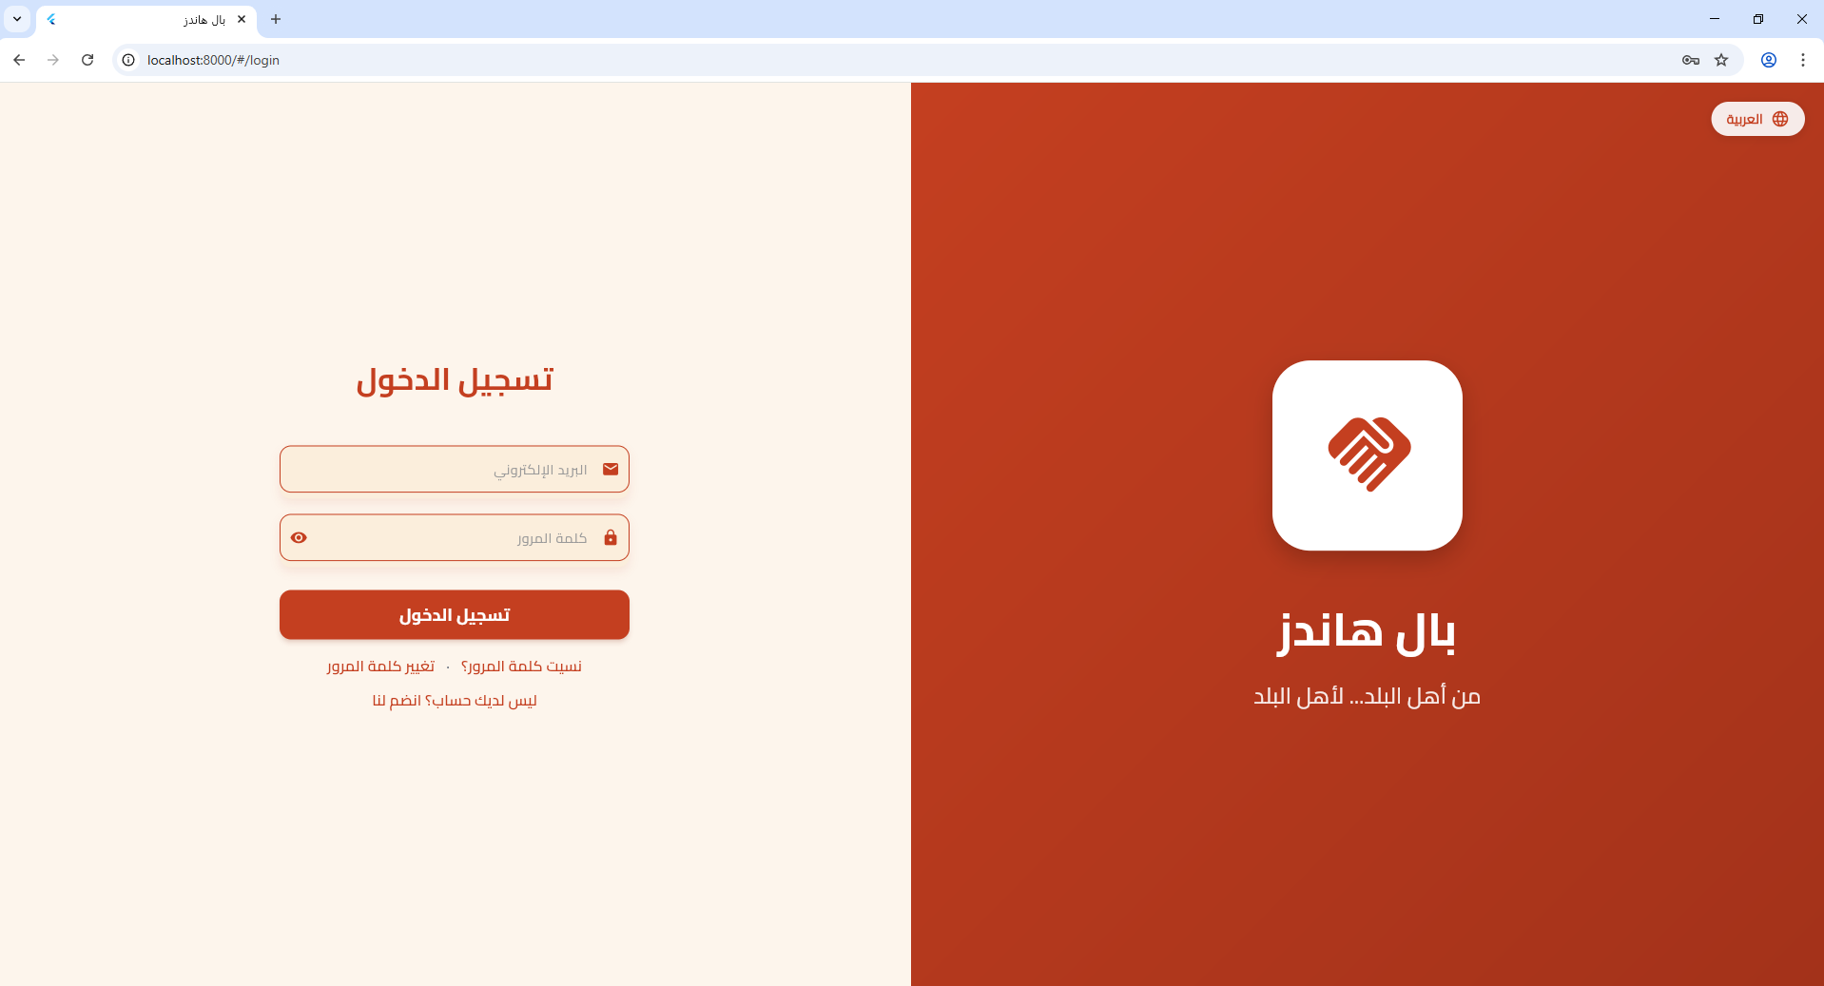
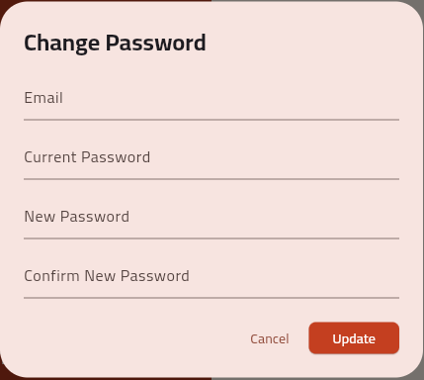

Slide 10
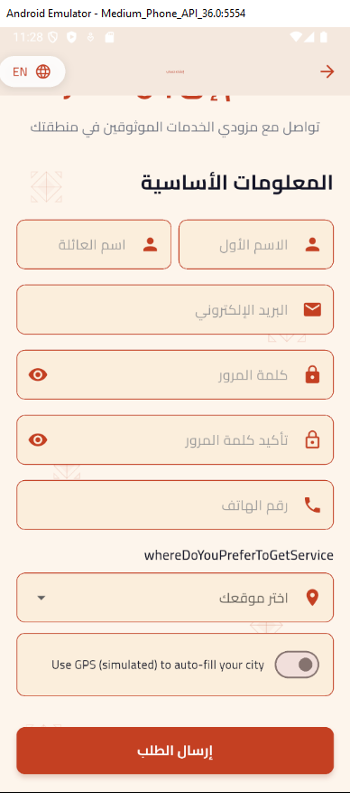
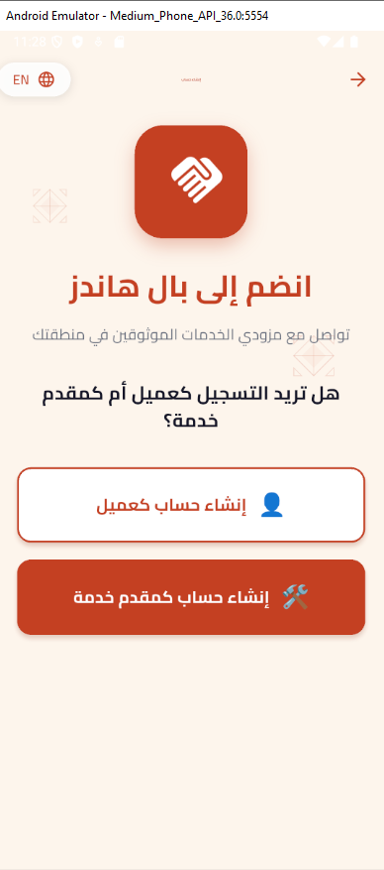
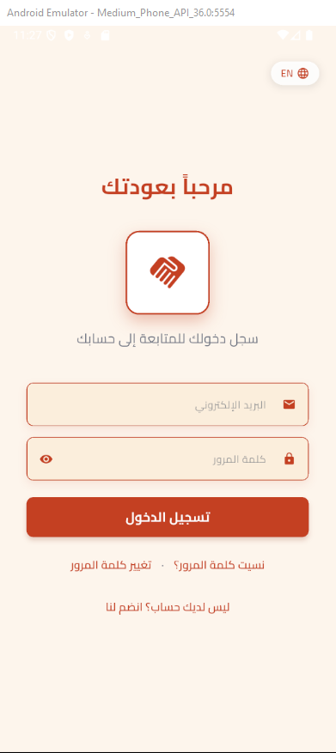


Slide 11
Our main taps
Home | Overview of platform and features
About Us | Background, vision, and objectives
Our Services | Catalogue of offered services
FAQs | Frequently asked user inquiries
Contact Us | Communication and support channels

Slide 12
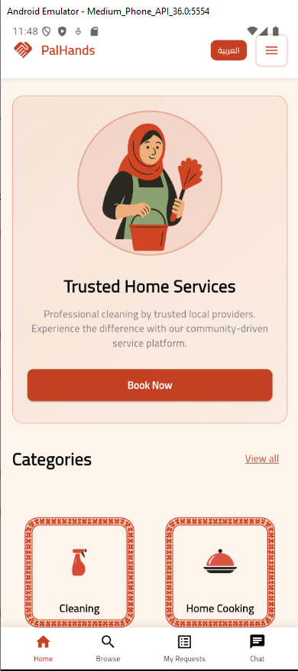
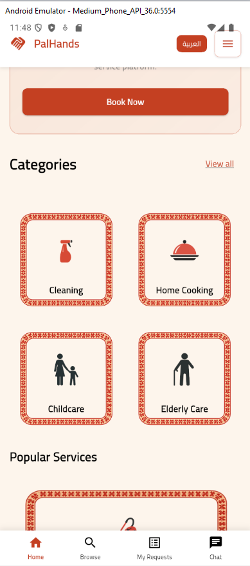
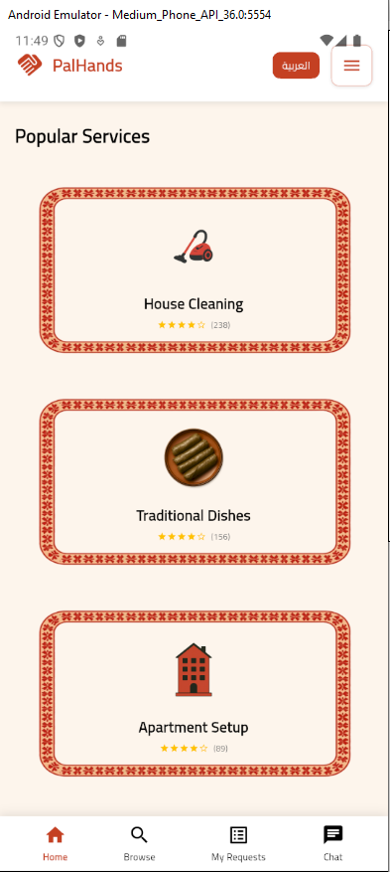

Slide 13
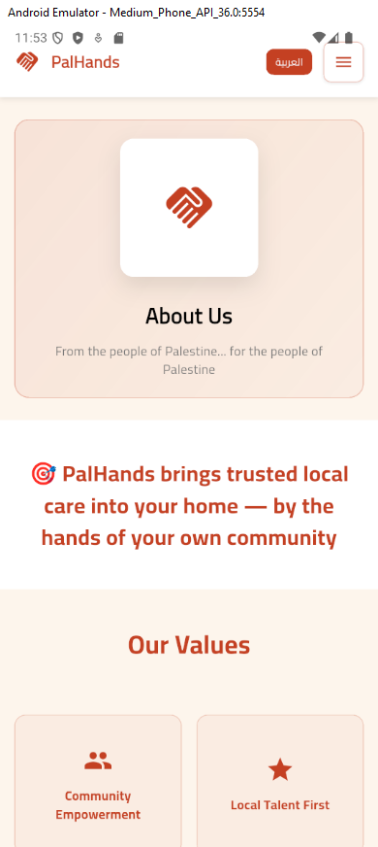
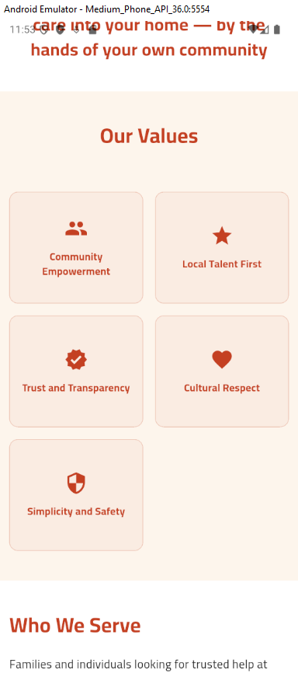
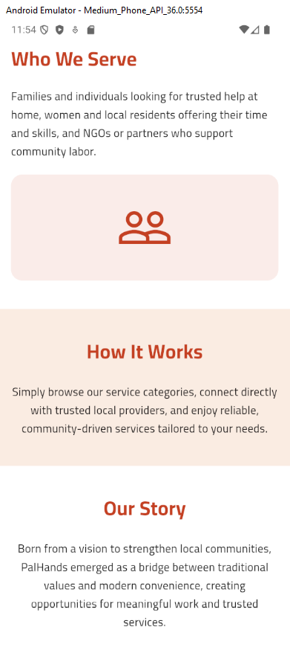

Slide 14
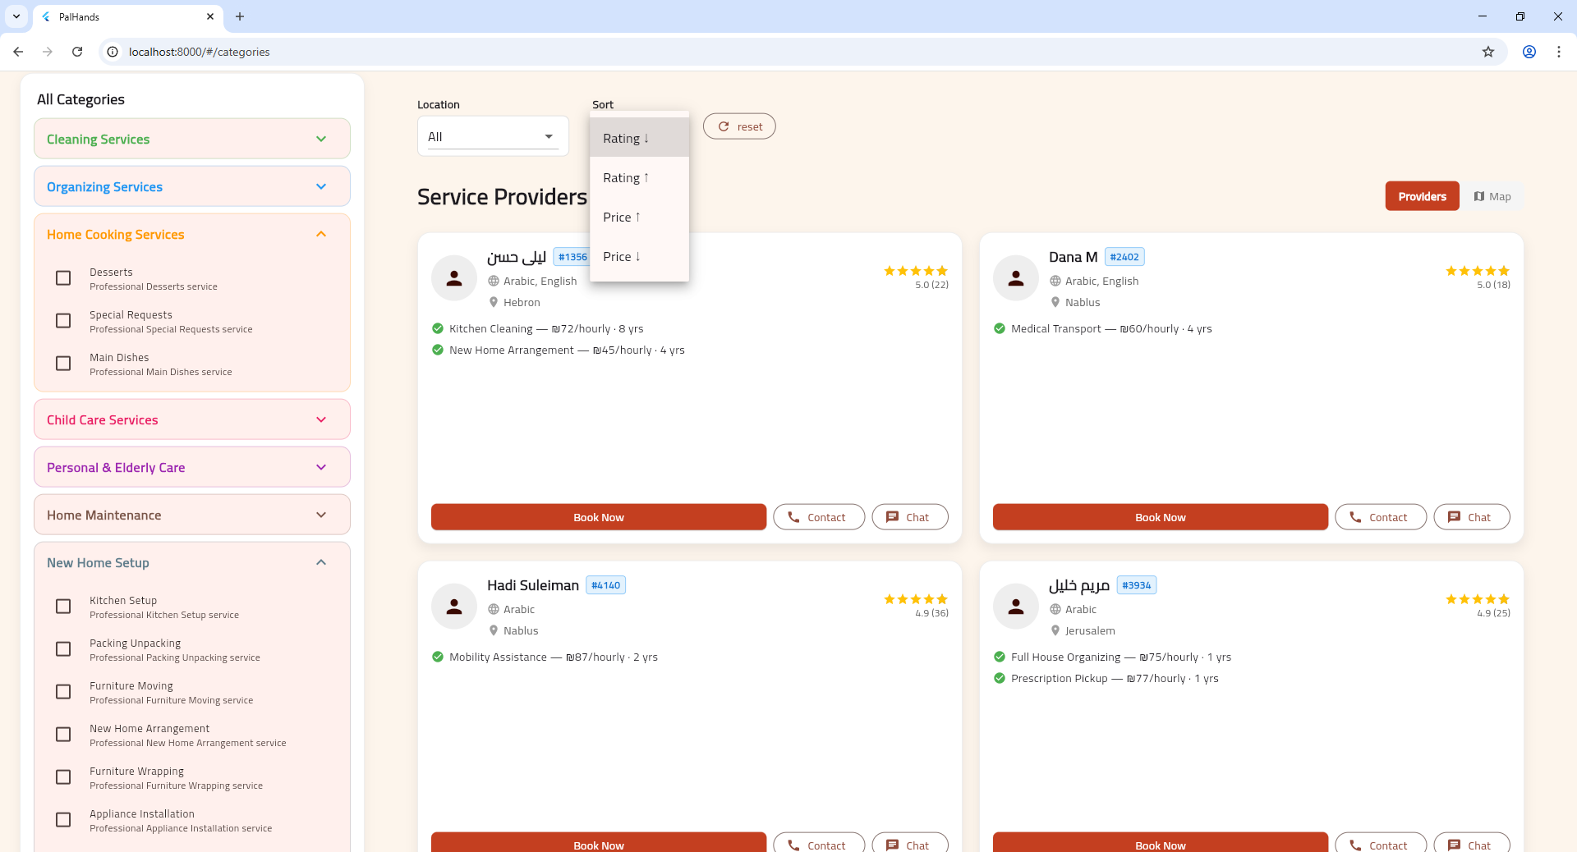

Slide 15
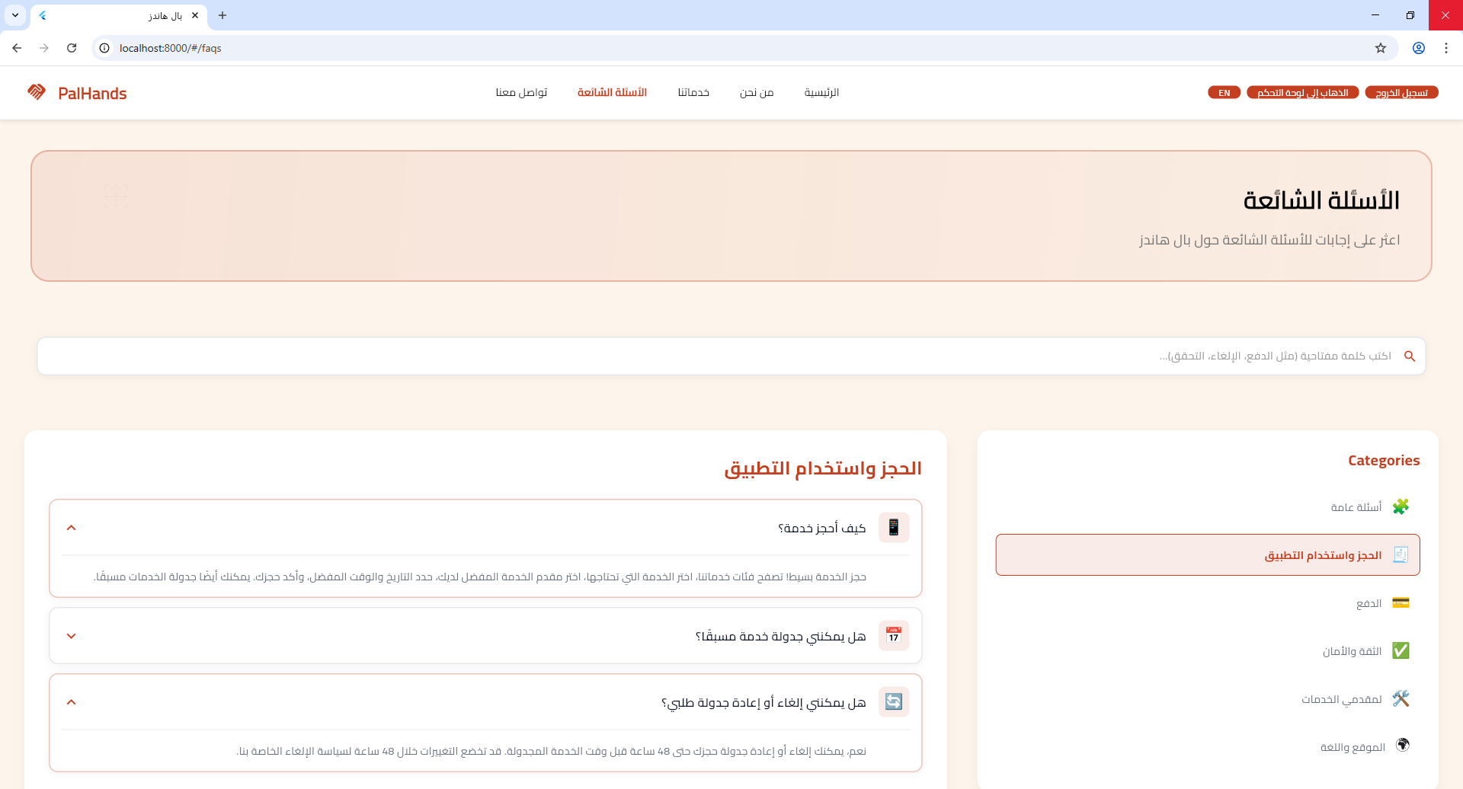

Slide 16
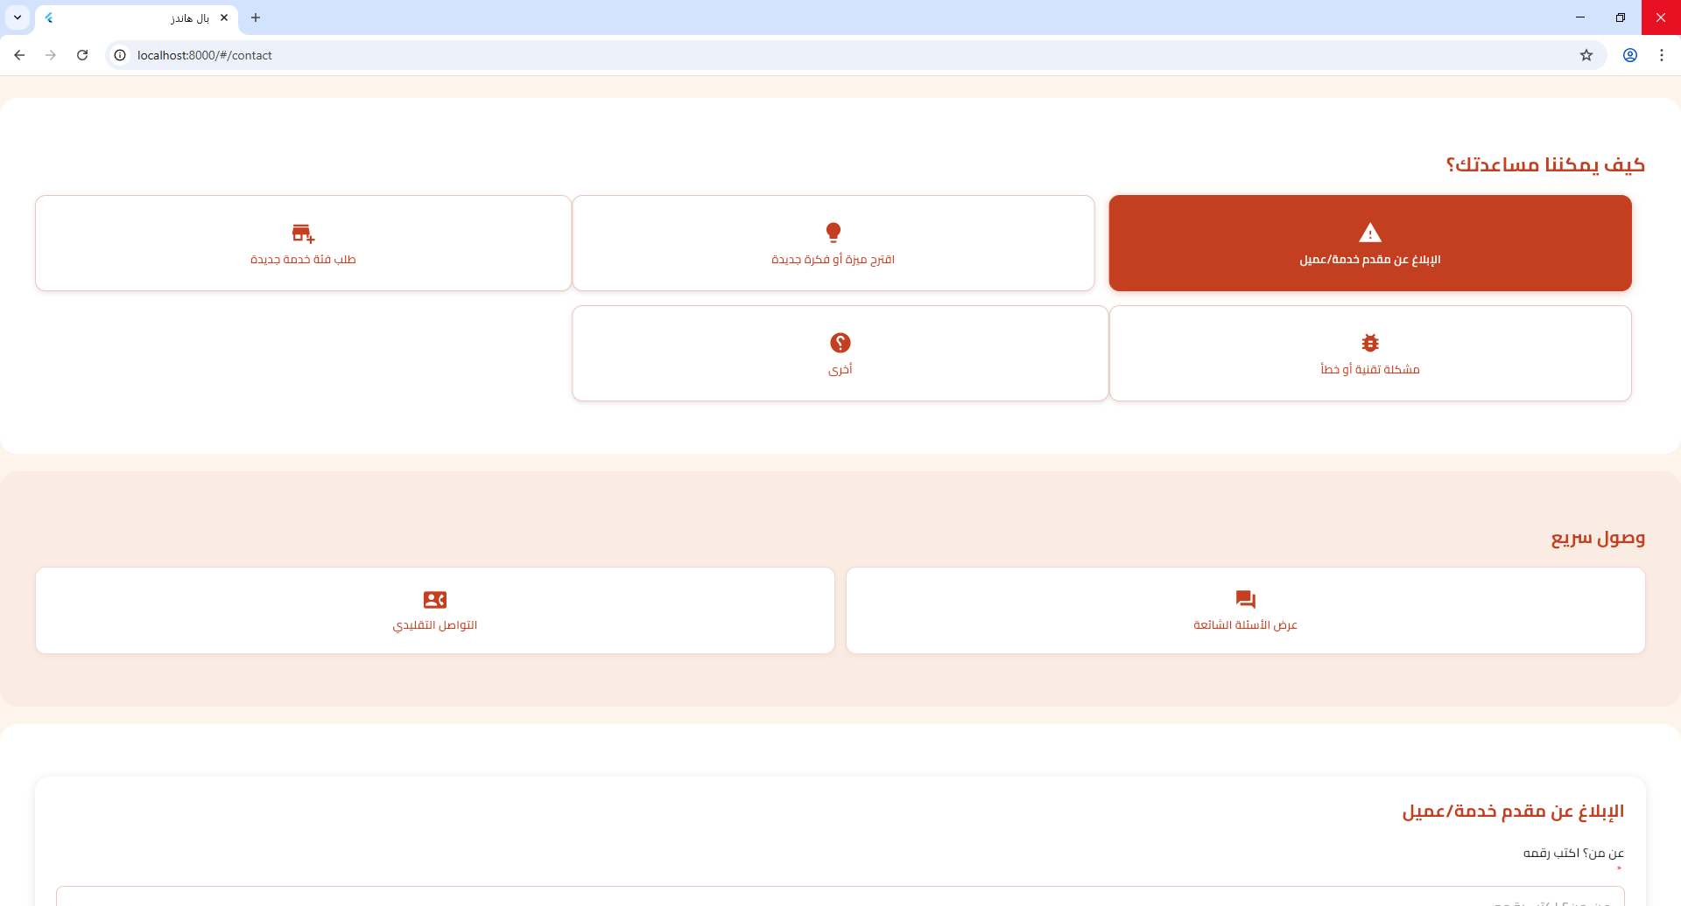

Slide 17
Provider side
My Services.
My Client Bookings.
My Bookings.
Chat.
Profile Settings.

Slide 18
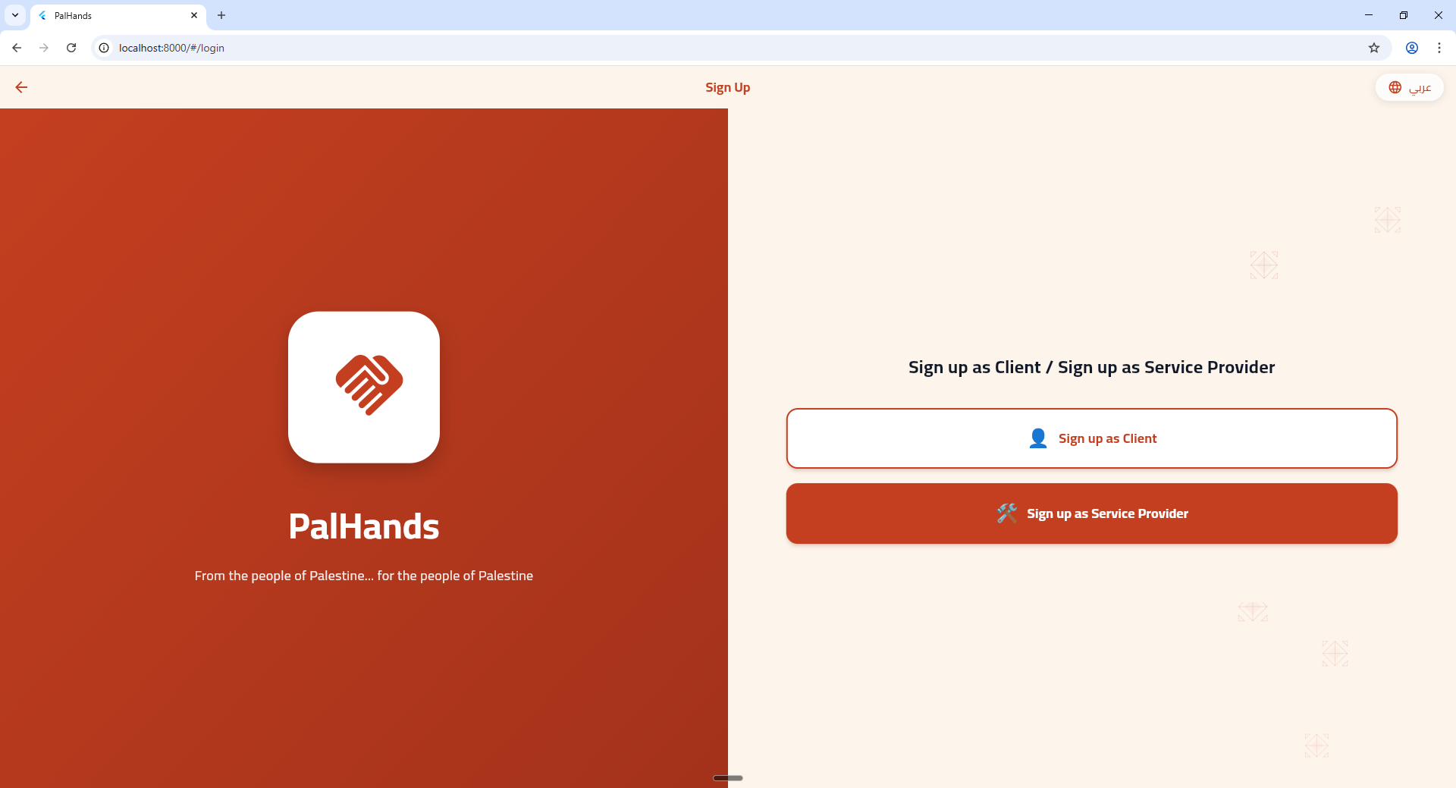

Slide 19
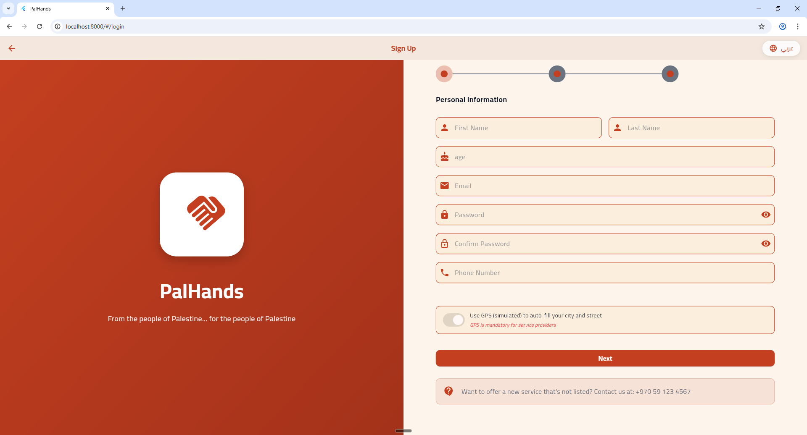

Slide 20
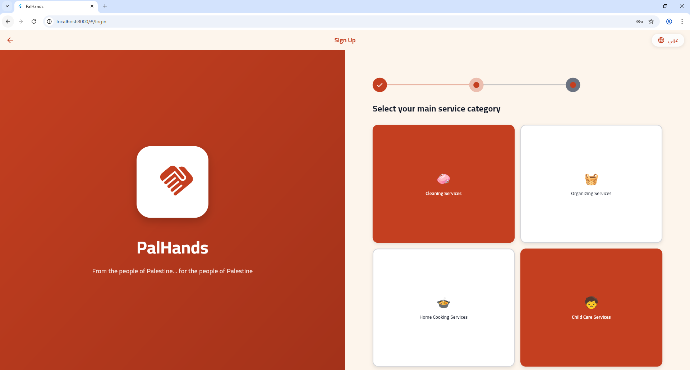

Slide 21
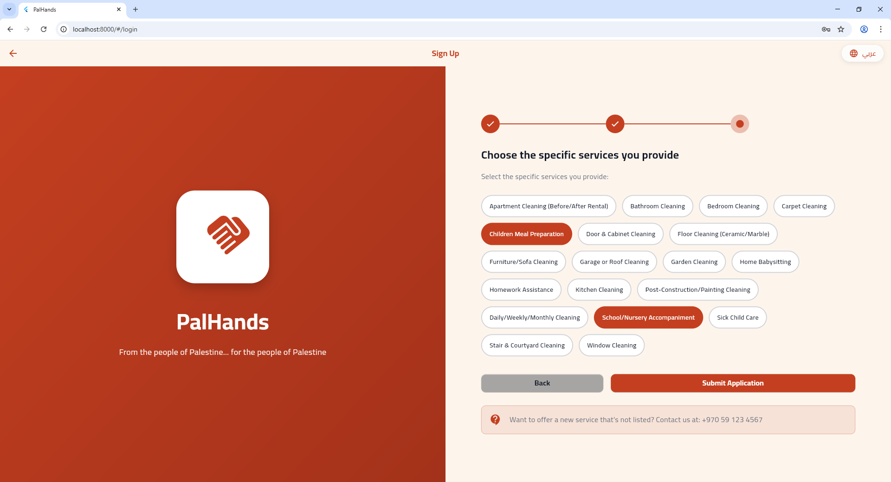

Slide 22
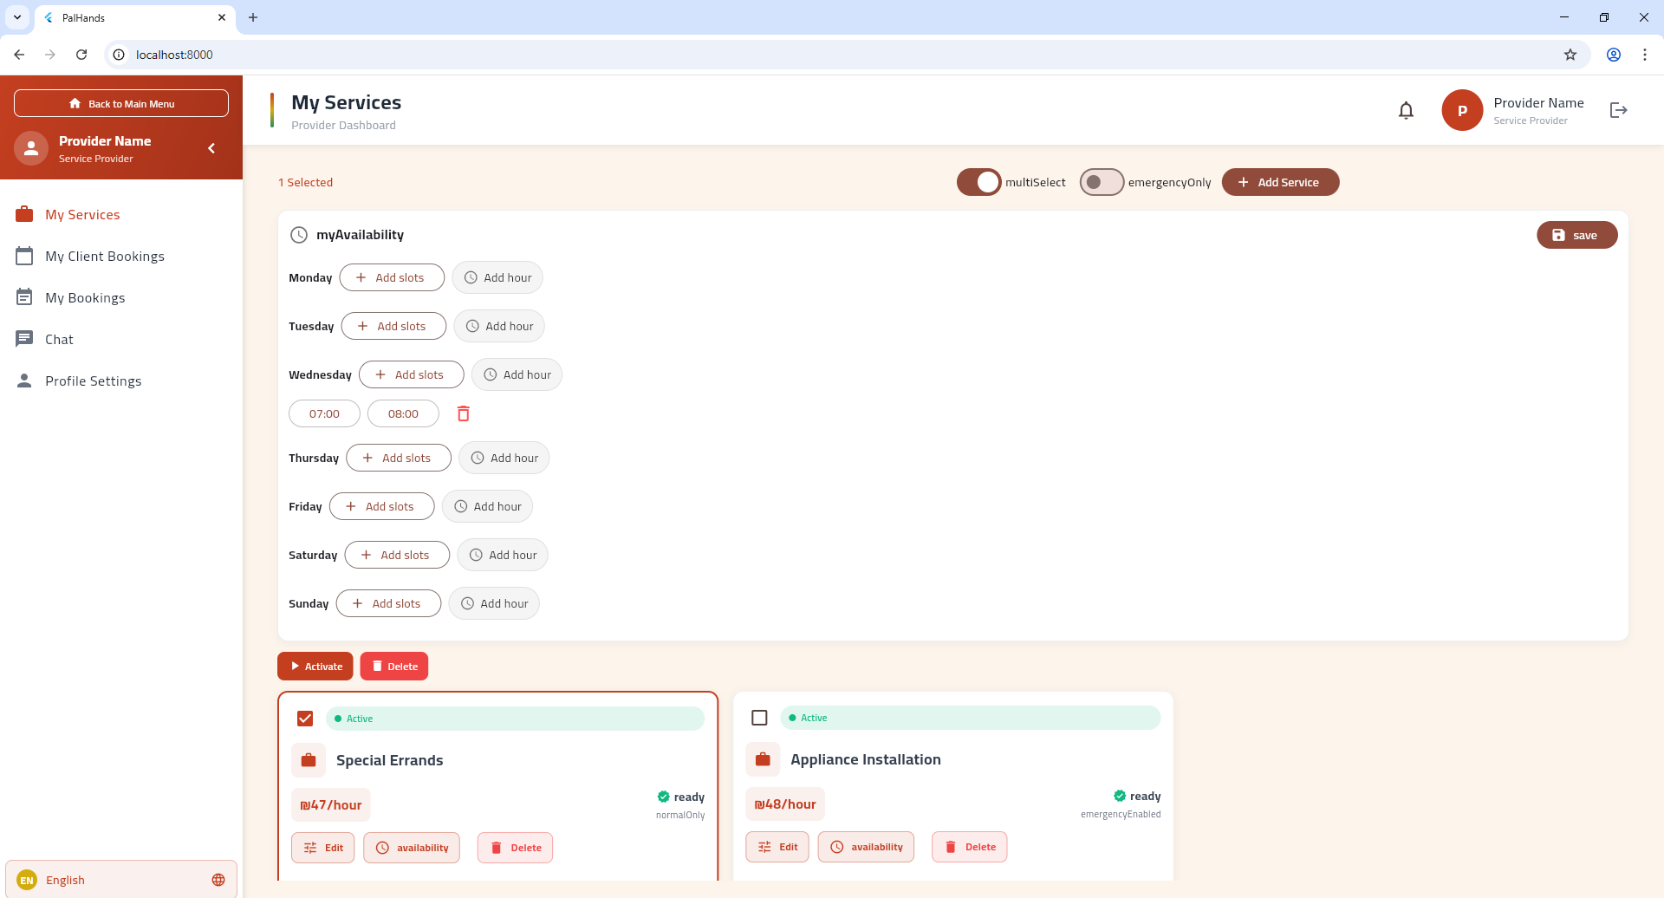
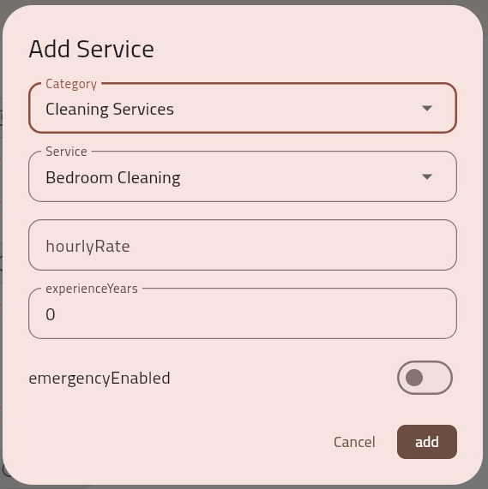
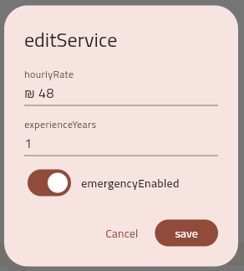

Slide 23
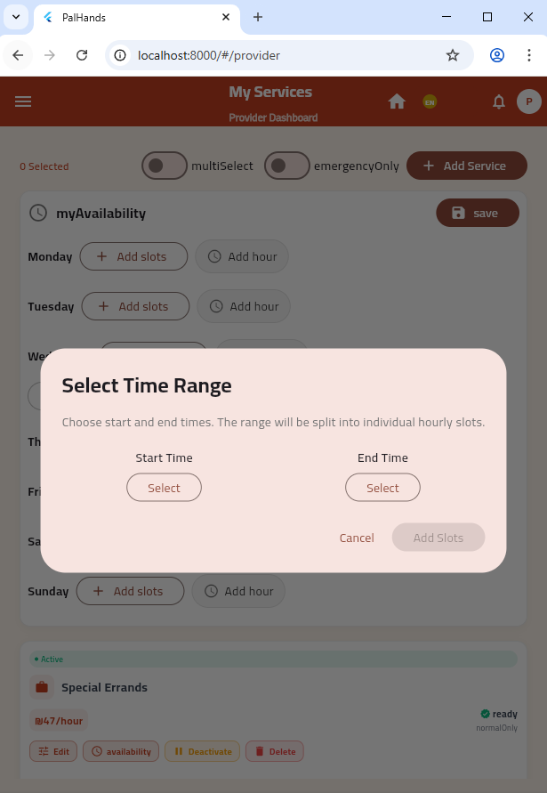
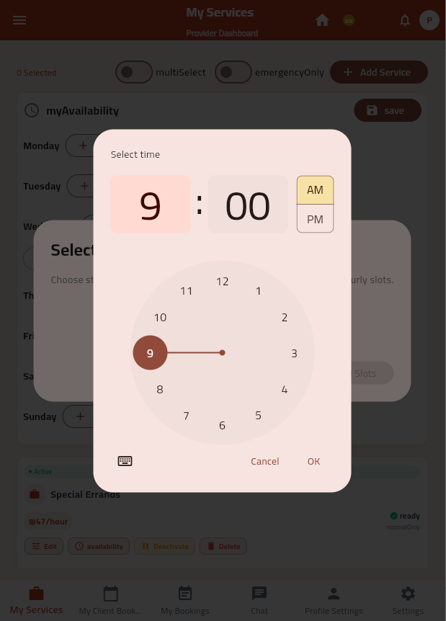

Slide 24
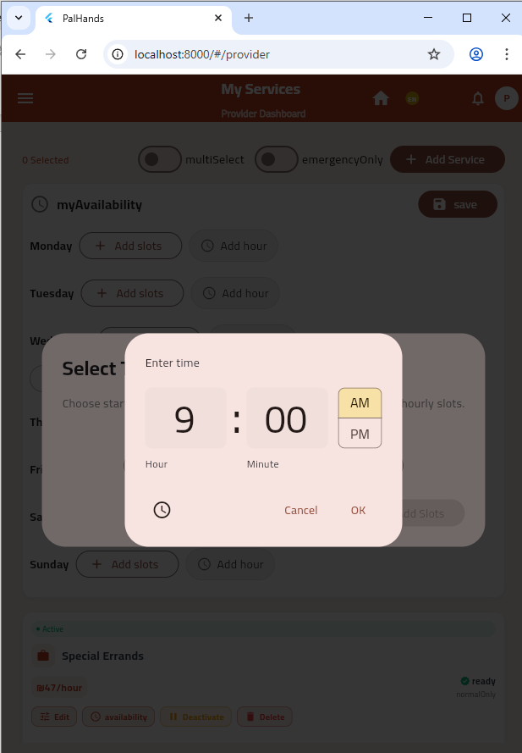
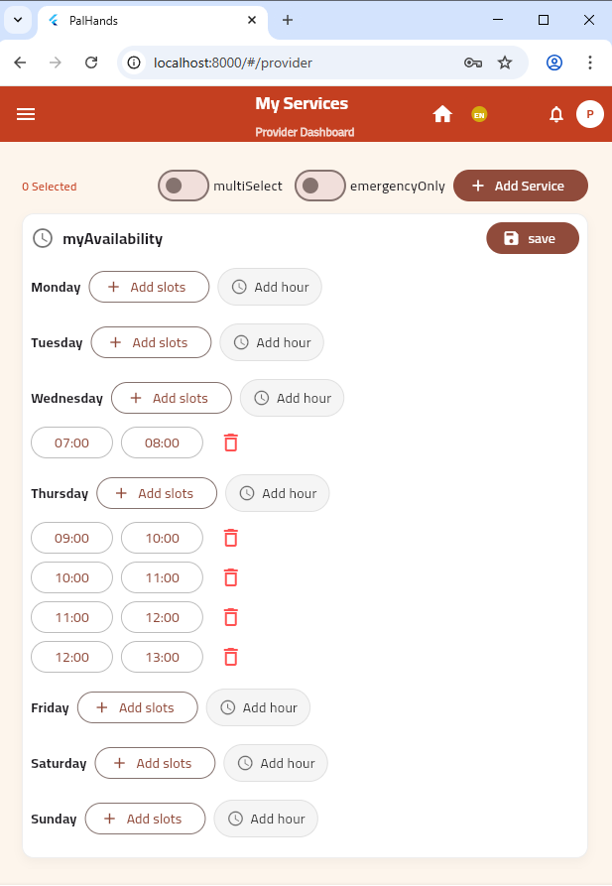

Slide 25
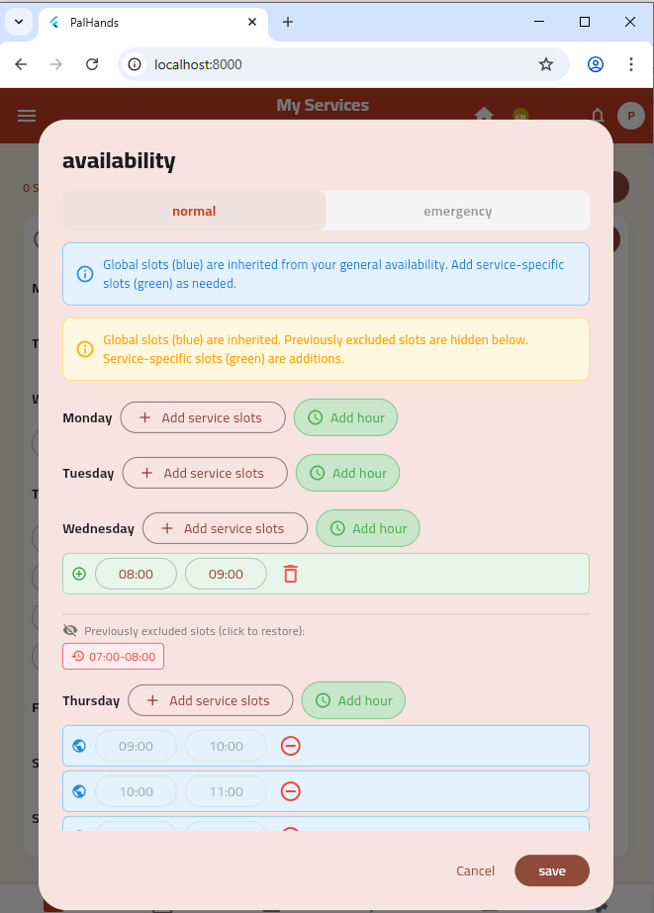
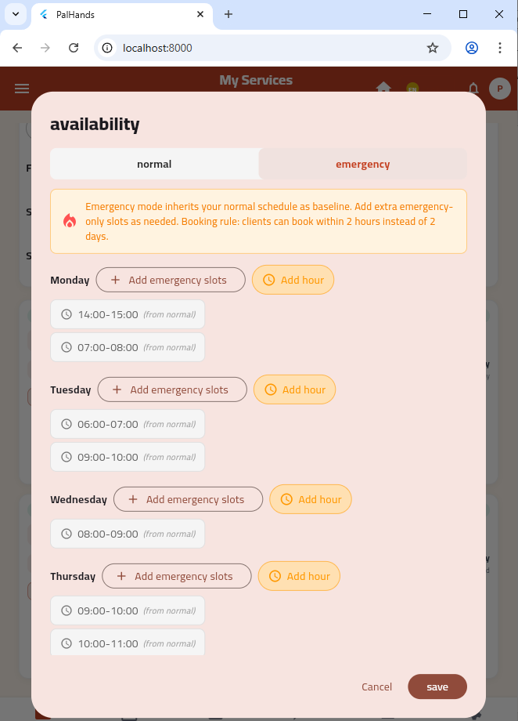
First service
Second service

Slide 26
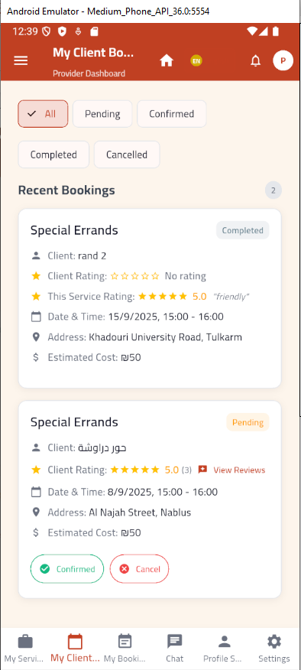
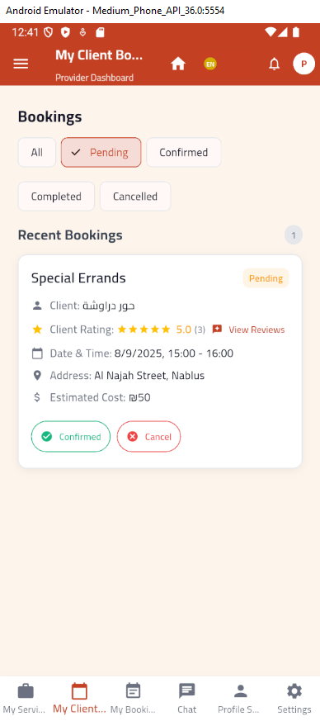
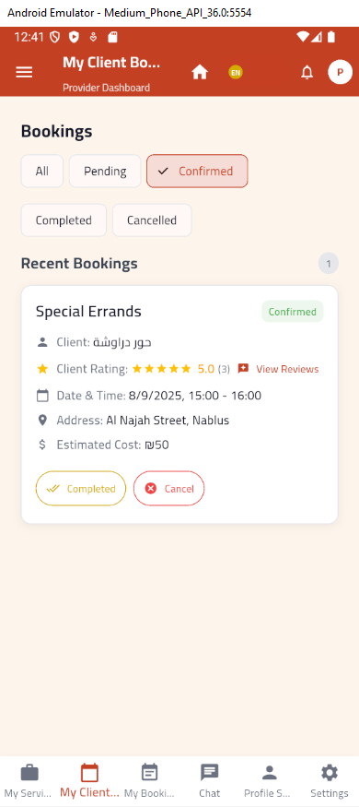
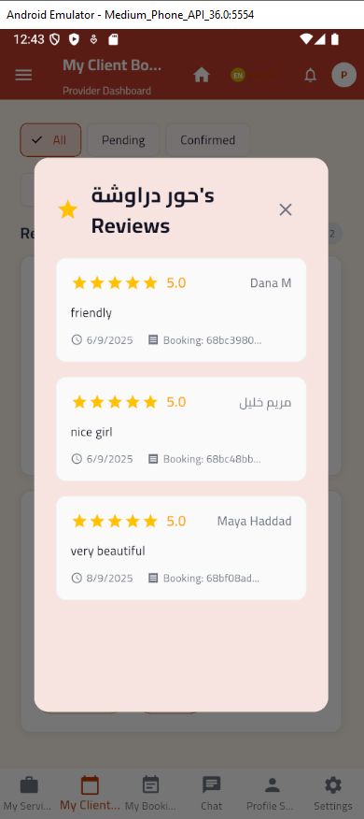

Slide 27
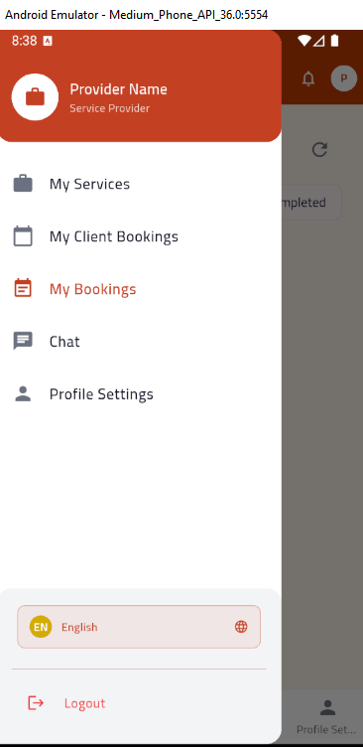
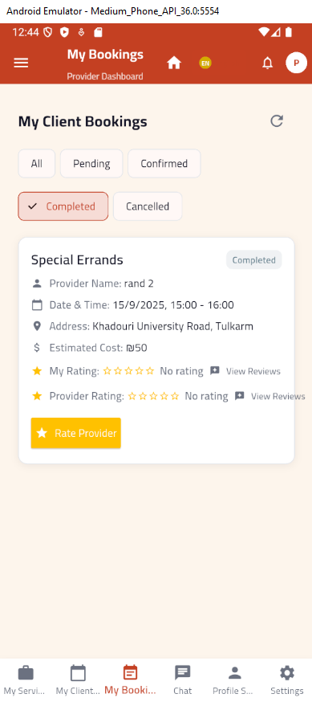
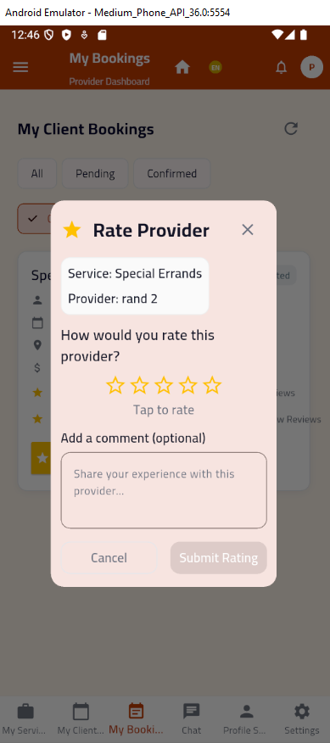

Slide 28
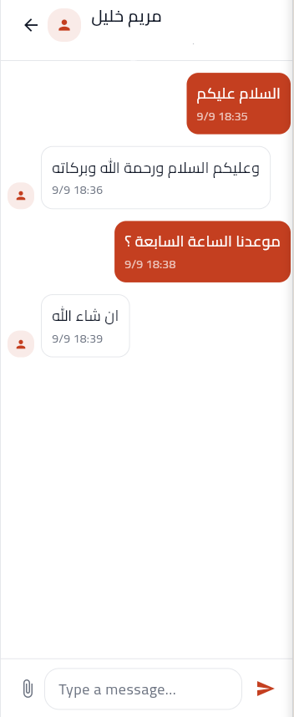
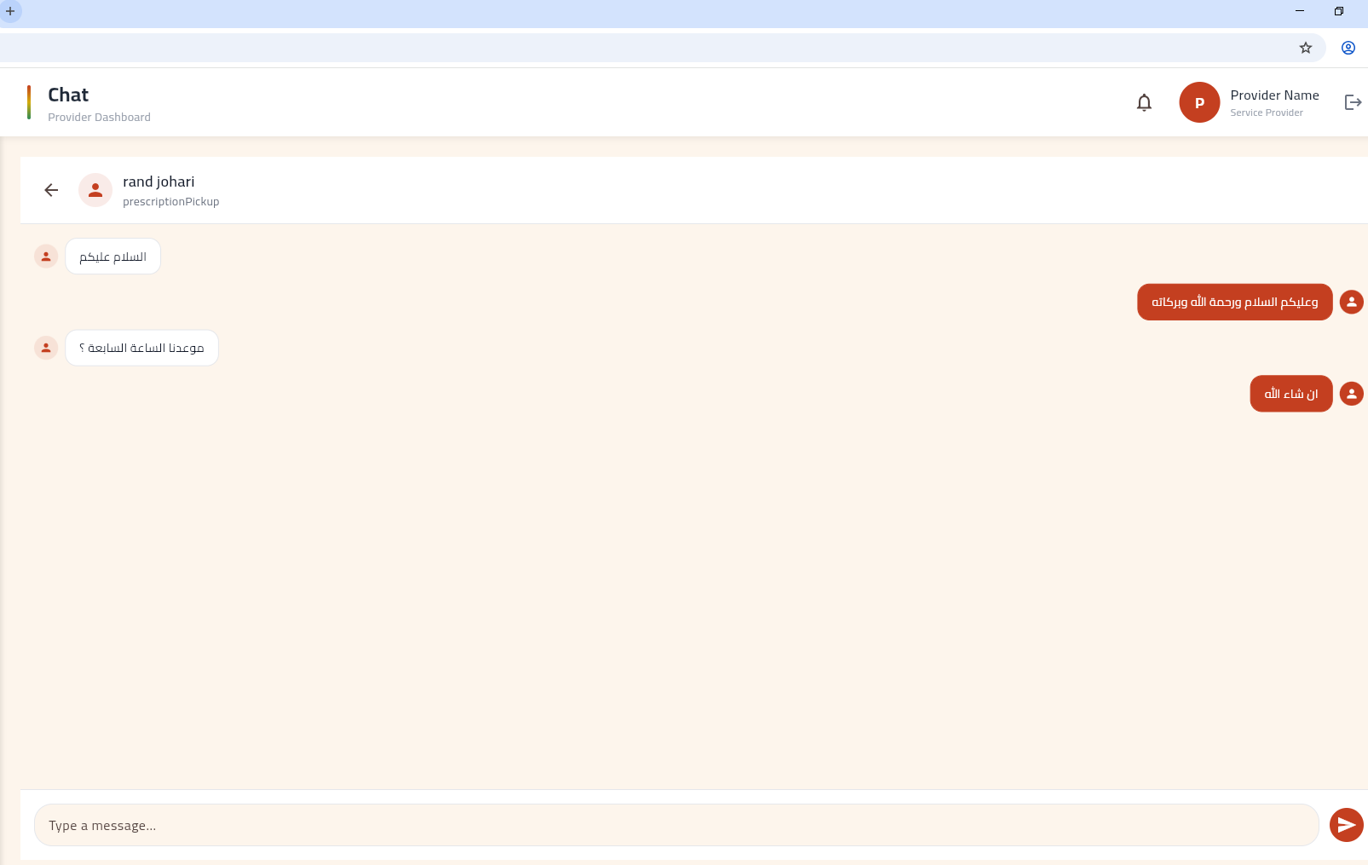
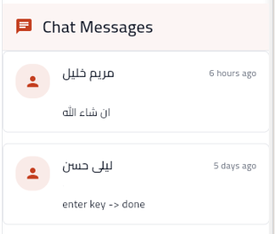

Slide 29
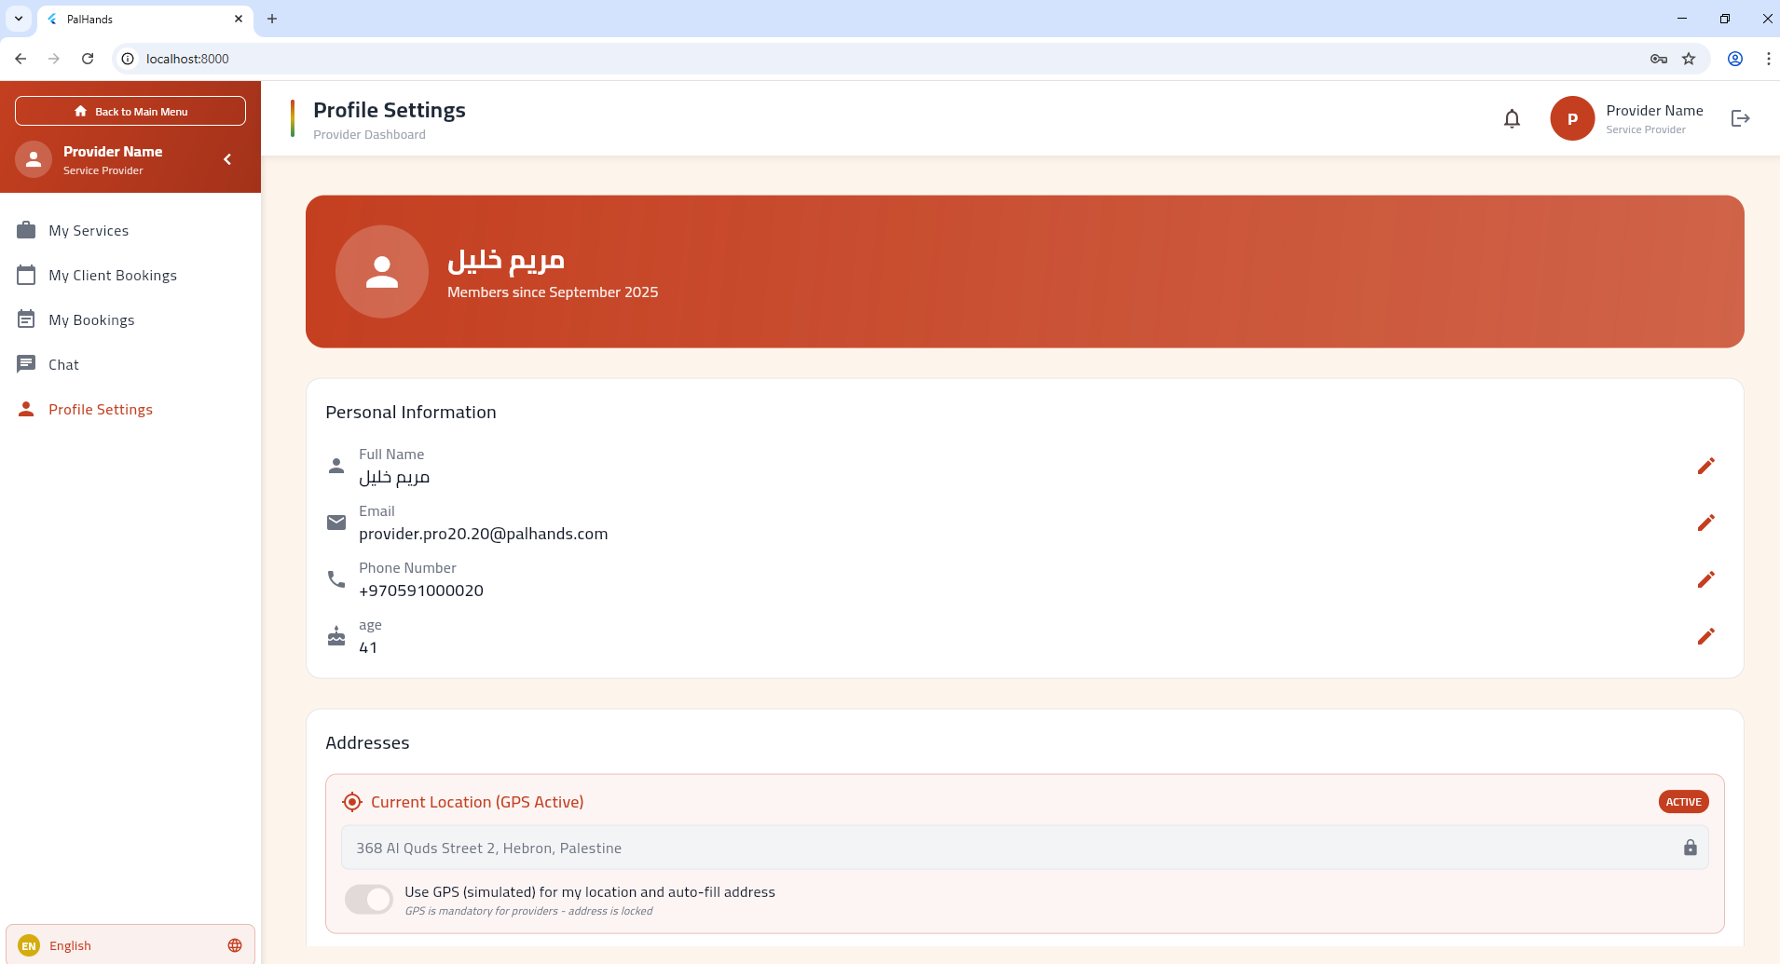

Slide 30
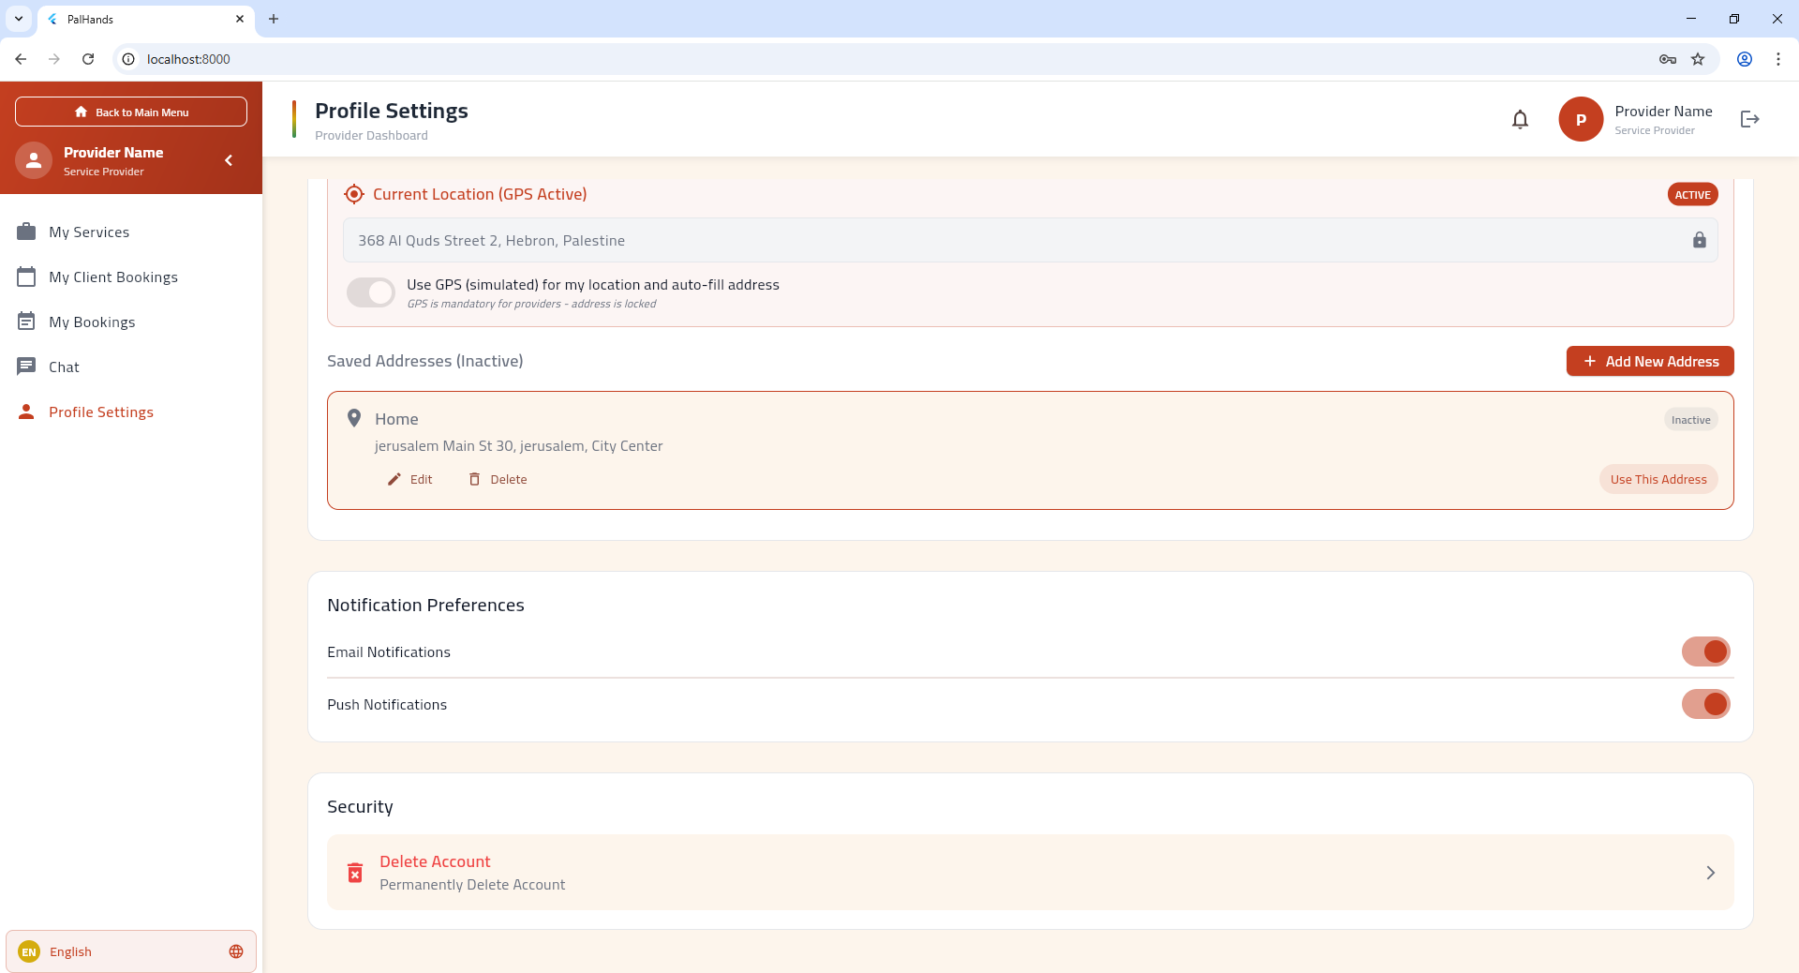

Slide 31
Client side
My Bookings.
Chat.
Profile Settings.
Saved Providers.

Slide 32
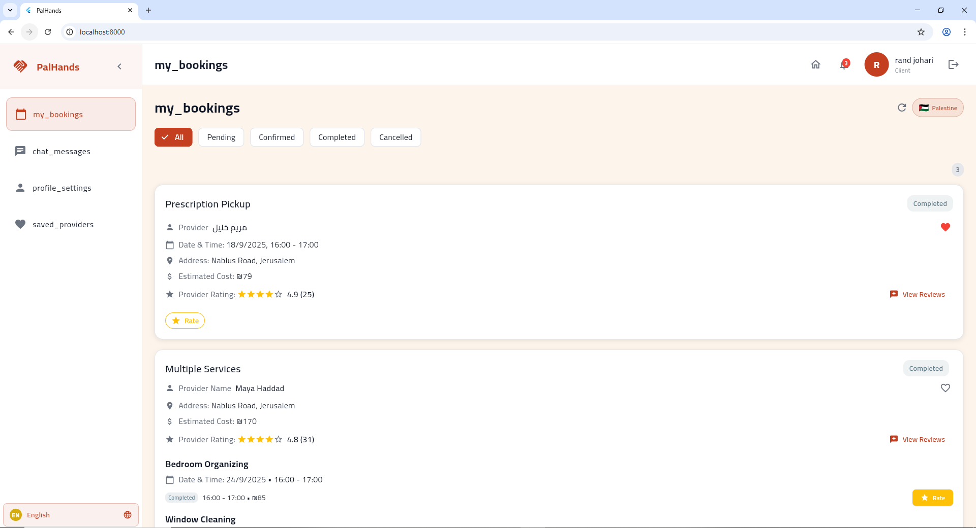

Slide 33
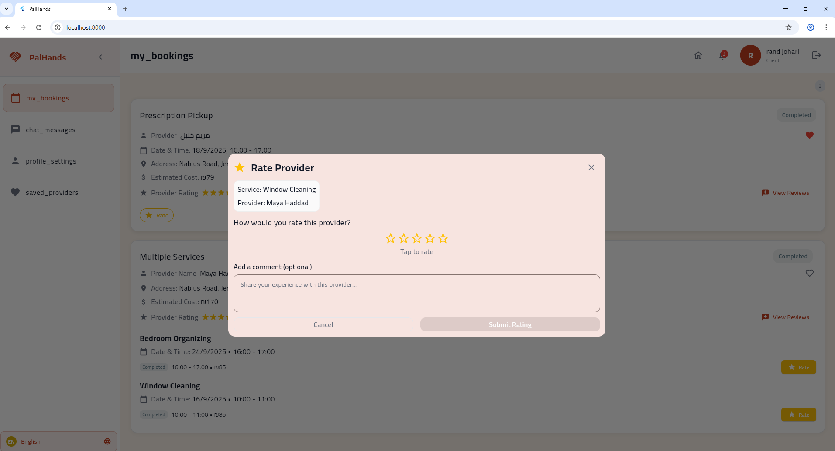

Slide 34
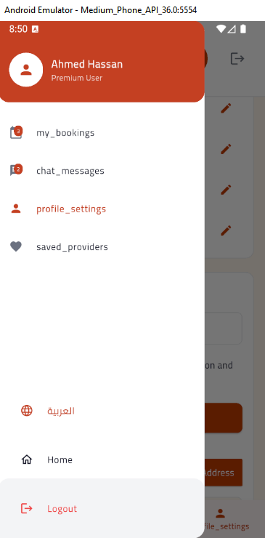
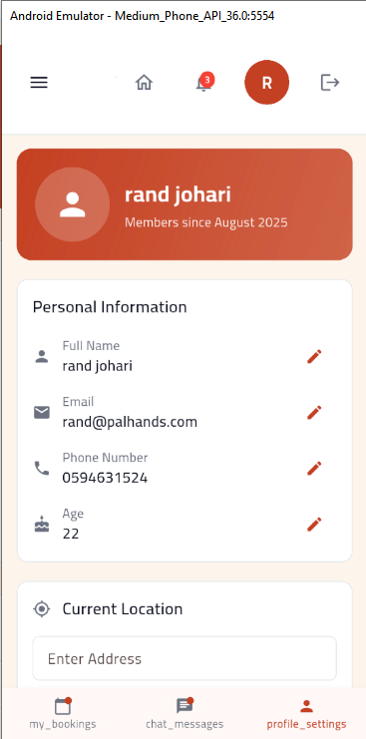

Slide 35
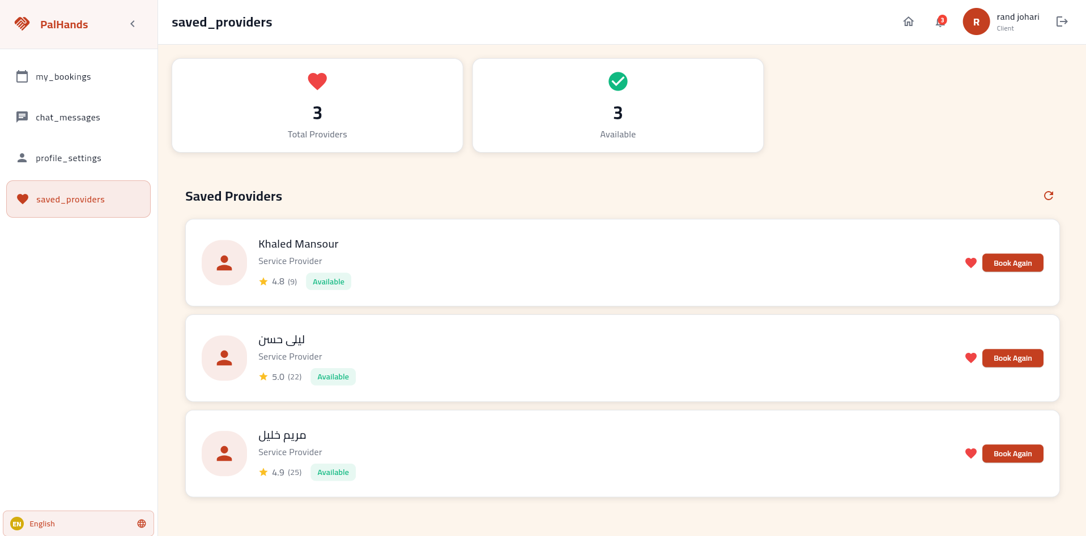

Slide 36
Booking
GPS/Map
Notification

Slide 38
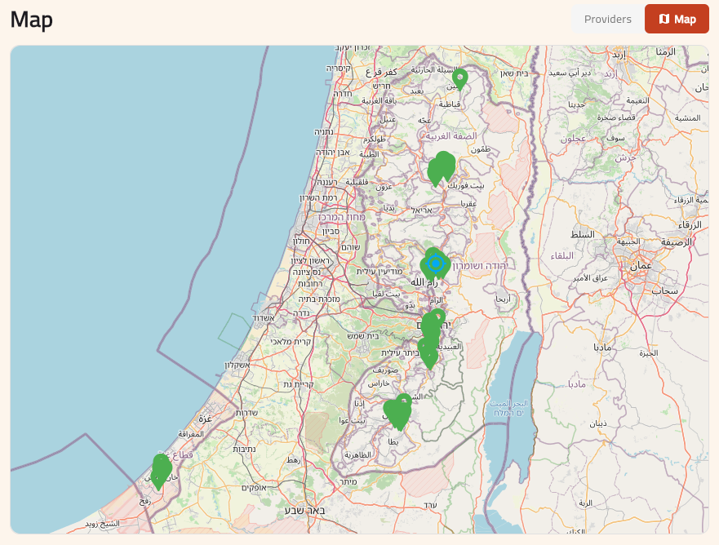

Slide 39
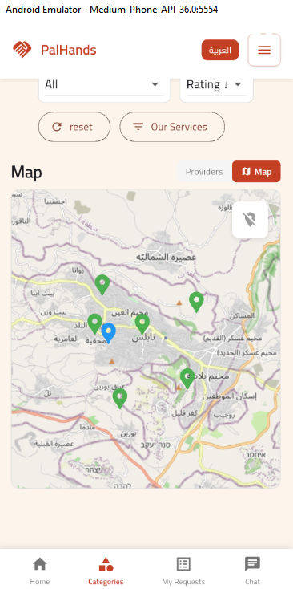
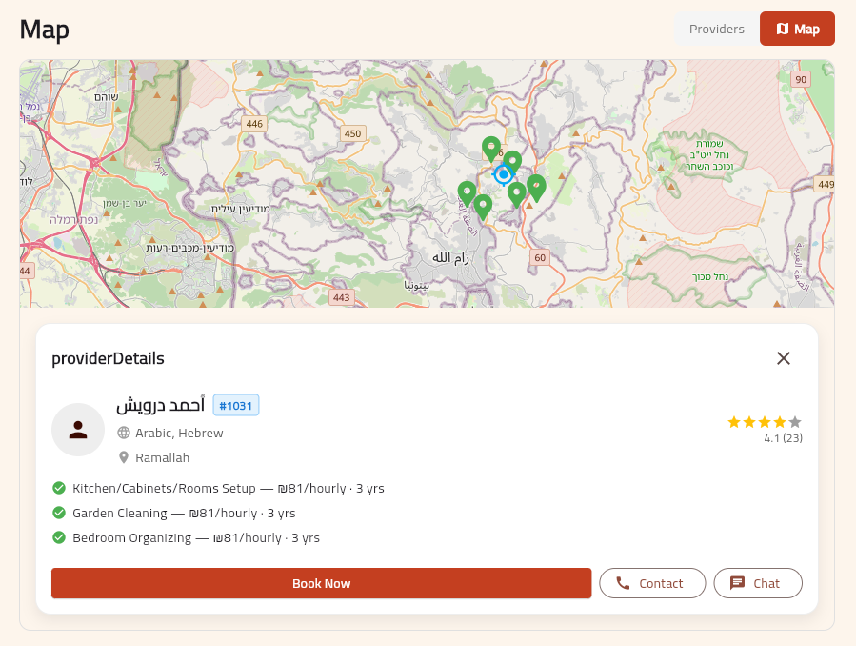

Slide 40
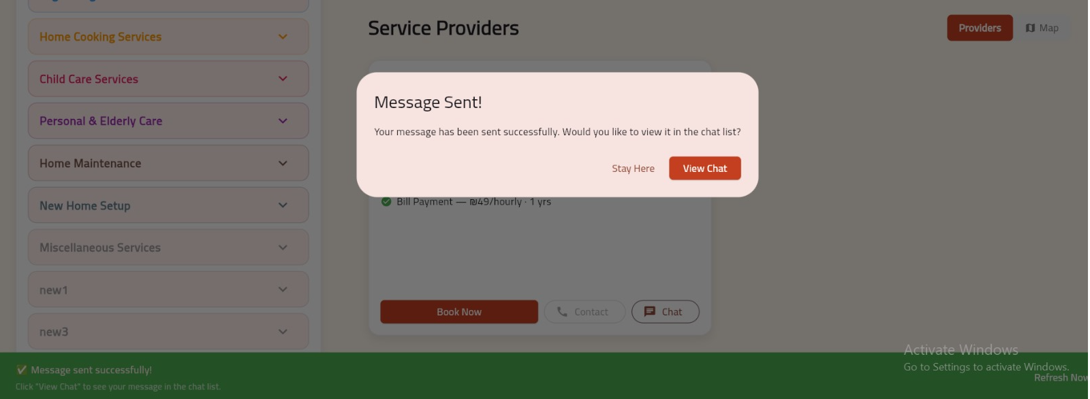

Slide 41
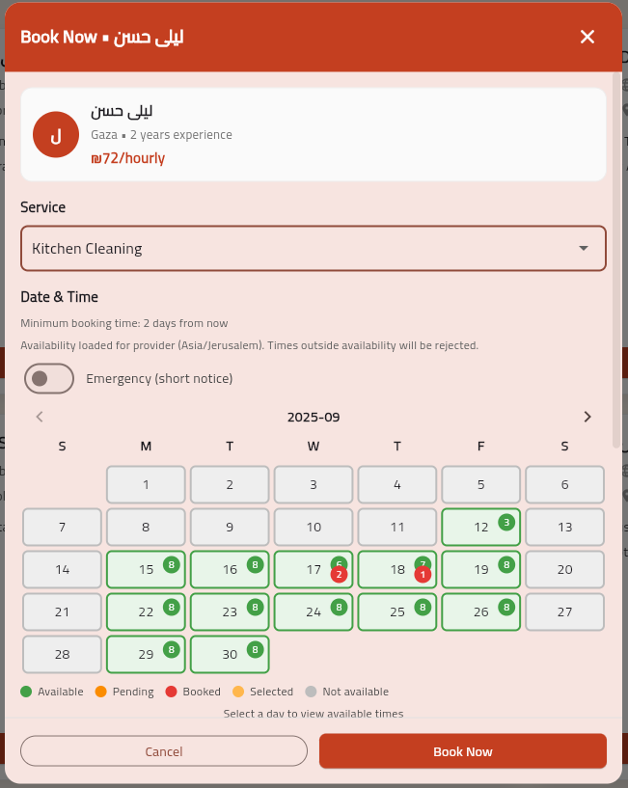
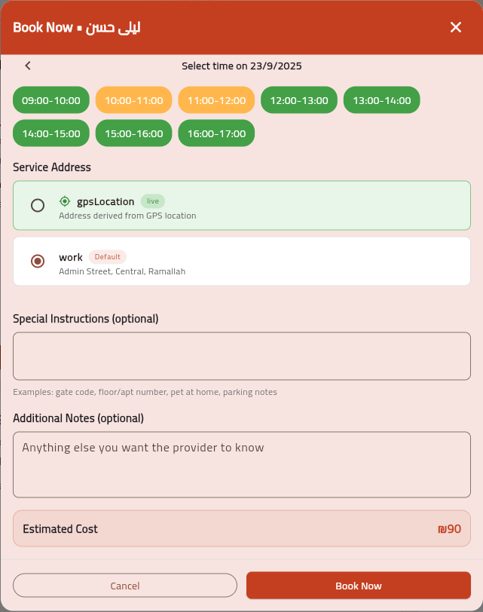

Slide 42




Slide 43
Admin side
User Management.
Service Management.
Booking Monitoring.
My Bookings.
Reports & Disputes.
Profile Settings

Slide 44


Slide 45





Slide 46


Slide 47



Slide 48




Slide 49


Slide 50


Slide 51



Slide 52



Slide 53


Slide 54




Slide 55


Slide 56
Thank you for your time and attention.

