Slide 1
BET Surface Area Analyzer Design
Chemical Engineering Department
By : Rafeeq K. Tanbour
Under the Supervision of:
Prof. Amer El-Hamouz & Prof. Hikmat Hilal

Slide 2
What I want to present today is what is BET and how we apply it to design and build up an analyzer to measure the surface area of soild particles.
How we design, and commissioning our design to have the best results when use the analyzer to test samples, and finally to discuss our experiments and results

Slide 3
Objectives
Design and build up a surface area analyzer depending on BET theory.
Use the analyzer to make tests many types of adsorbents.
3

Slide 4
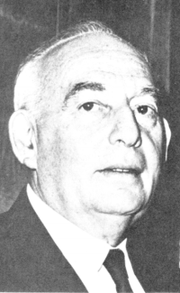
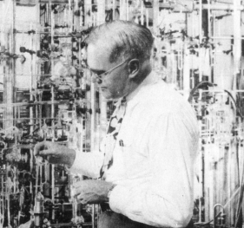
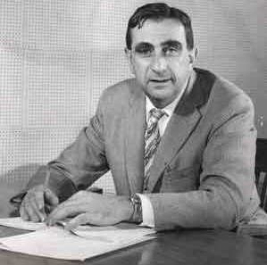
Revision
BET theory suggested by Brunauer, Emmett and Teller in 1938 which explained that multilayer is formed in physical adsorption when gas was adsorbed on solids.
Brunauer, Emmett and Teller.
Adsorption is the ability of solid surfaces to stick atoms, ions, molecules of gas, liquid, or dissolved solids on its surface.

Slide 5
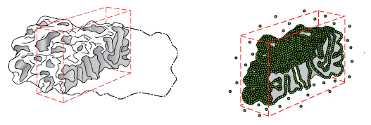
Surface area can be described as the interior surface area of a solid include surface due to pores.
The surface area of catalysts which give a picture about the activities of them.

Slide 6
Steps for design
Theories
Choose
Design
Commissioning
Modification
Experiments

Slide 7
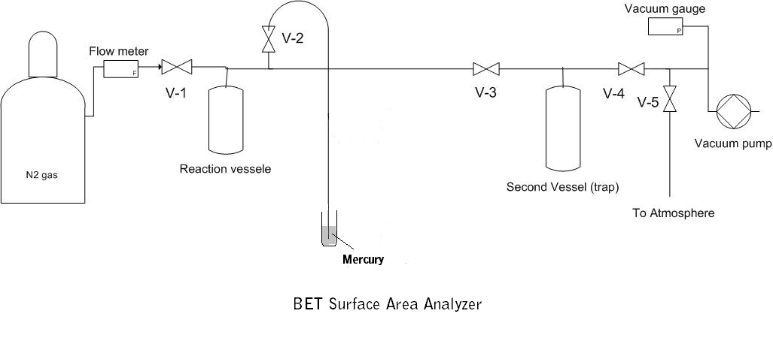
Design

Slide 8
Commissioning
Test of a known surface area sample.
Manometer diameter.
Reaction vessel diameter.
Coolant.
Effect of cooling on results.
Leakage test.

Slide 9
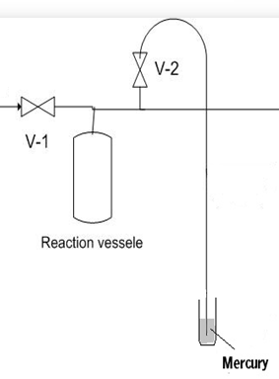
Commissioning
Effect of cooling
N₂
N₂
2
1
8 mm
Manometer

Slide 10
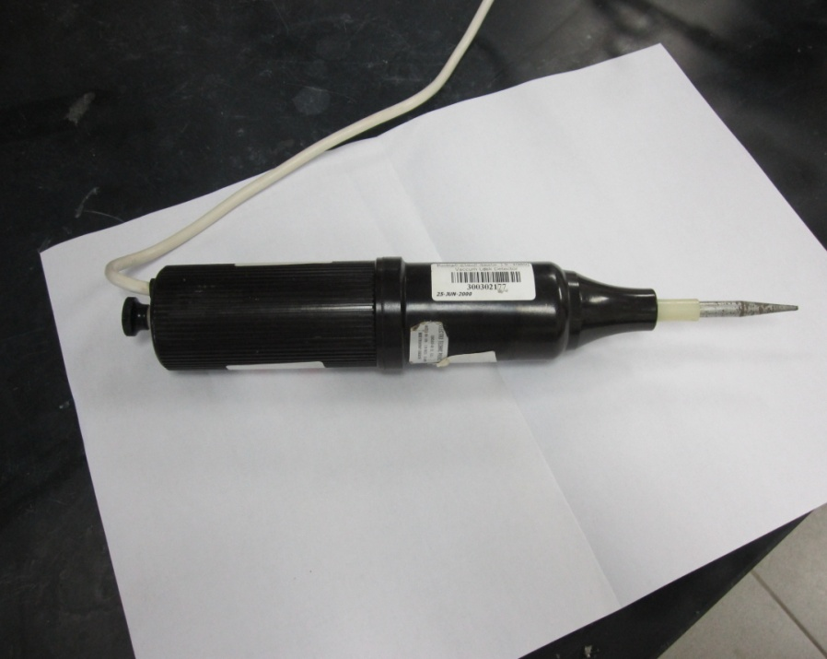
SOP
Leakage test.

Slide 11
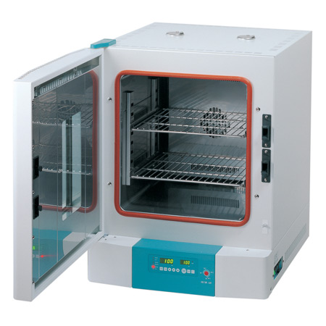
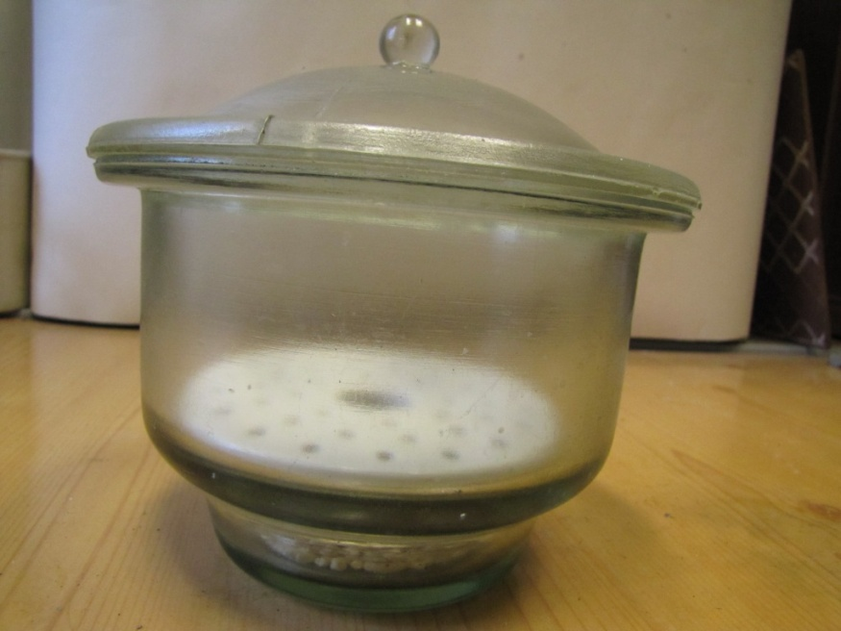
Sample Preparation.
Oven
Desiccator

Slide 12
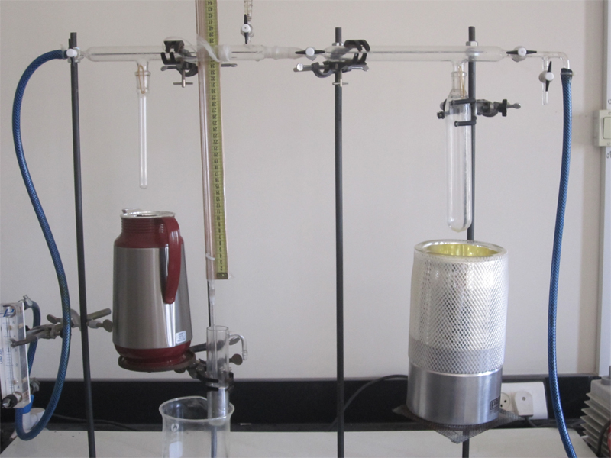
BET test.
1
4
2
3

Slide 13
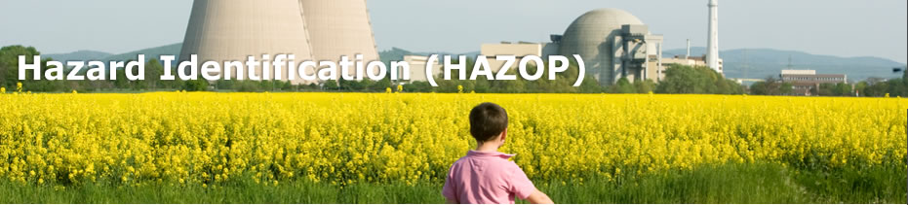
HAZOP study
Hazardous and Operability study (HAZOP) is a technique used to identify hazards in chemical process systems. This process is preferably to be taken during commissioning of a process. Therefore, HAZOP is an effective tool in identifying hazards and solve any problem can happen in the systems.

Slide 14
HAZOP Table

Slide 15
Modification applied
Liquid nitrogen coolant was used instead of dry ice.
The inside diameter of reaction vessel was reduced to 12 mm.
Operating under low relative pressure Pr, preferable less than 0.3.
In sample preparation, sample was heated in an oven for not less than 2 hrs.

Slide 16
Results
Set 1 ( 3 experiments ) – Silica Jel ( surface area from literature is 500 m²/g).
Set 2 ( 3 experiments ) – Commercial activated carbon ( surface area from literature is from 600 - 1500 m²/g).
Set 3 ( 5 experiments ) – Jift activated carbon (produced in university)

Slide 17
Set 1 – Silica Jel
Exp. 1
Rejected

Slide 18
Exp. 2
surface area was found to be 418.81 (m²/g)

Slide 19

Experiments analyze
BET equation is given by
Straight line equation, find V_{m} to use it to find the surface area

Slide 20
P_{initial} & P_{final} >> from manometer
V_{initial} & V_{final} >> for nitrogen gas
Number of moles >> PV=nRT
Volume adsorbed.

Slide 21
Slope = 0.0172
Intercept = 0.00003 .
V_{m} = 58.038 cm³
By using the surface area of one molecule of nitrogen and using Avogadro's number, then the surface area can be found
surface area = 418 m²/g

Slide 22
Exp. 3
surface area was found to be 519.1 (m²/g)
22

Slide 23
Set 2 – Commercial A. Carbon
surface area = 1280 (m²/g)
1
surface area = 1672 (m²/g)
2

Slide 24
surface area = 1182 (m²/g)
3

Slide 25
Set 3 – JIFT A. Carbon
Test number | How it is made | Surface area (m²/g)
1 | A.C. (ZnCl2) with oil 450 ⁰C | 610
2 | A.C. (ZnCl2) with oil 600 ⁰C | 675
3 | A.C. (ZnCl2) 600 ⁰C | 926
4 | A.C. (ZnCl2) 750⁰C | 3790
5 | A.C. (ZnCl2) 450 ⁰C | 2335

Slide 26
Discussion
1
Modification.
2
Tests and results.
*
Silica Jel & Commercial A.C.
JIFT A.C.

Slide 27
Conclusions
Experiment | adsorbent | Literature surface area | Calculated surface area
1 | Silica jel | 500 | Out of range
2 | Silica jel | 500 | 419
3 | Silica jel | 500 | 519
4 | Commercial A. Carbon | 600 -1500 | 1280
5 | Commercial A. Carbon | 600 -1500 | 1672
6 | Commercial A. Carbon | 600 -1500 | 1182
7 | A.C. (ZnCl2) with oil 450 ⁰C | 600 | 610
8 | A.C. (ZnCl2) with oil 600 ⁰C | Not calculated | 675
9 | A.C. (ZnCl2) 600 ⁰C | Not calculated | 926
10 | A.C. (ZnCl2) 750⁰C | 600 | 3790
11 | A.C. (ZnCl2) 450 ⁰C | 1500 | 2335

Slide 28
Recommendations
On apparatus
valves
pressure
Computerize
In addition >> More runs are needed for other types of adsorbents using the apparatus to support our experimental results.

Slide 29
Thanks For Listening

