Slide 1
{Analyzing and Re-Designing of Foundation System for Asal Building }
Graduation Project Report II
By :
Mostafa Al-araj -Reg.No :11819246
Osaid Abo Asal –Reg.No : 11820845
Mohammad Assiada -Reg.No: 11822266
Samah Mlitat - Reg.No : 11821460
Saja Abu Taleb -Reg.No : 11820673
Under supervision of : Dr. Mohammad Ghazal

Slide 2

project is an analysis of the foundation system for residential and office buildings (Asal Building) and the redesign of its foundations in the (Al Basateen) area.

Slide 3
The building is consists of (12) floors and roof a surface area of 14,423 square meters.
In graduation project 1 we determined all loaded in each column.
- Live Load
-Dead Load
-Earthquake Load
For external column PE=0.35(PD+PL)
For internal column PE=0.15(PD+PL)
At the end of project 1 the type foundation for the building is mat foundation

Slide 4
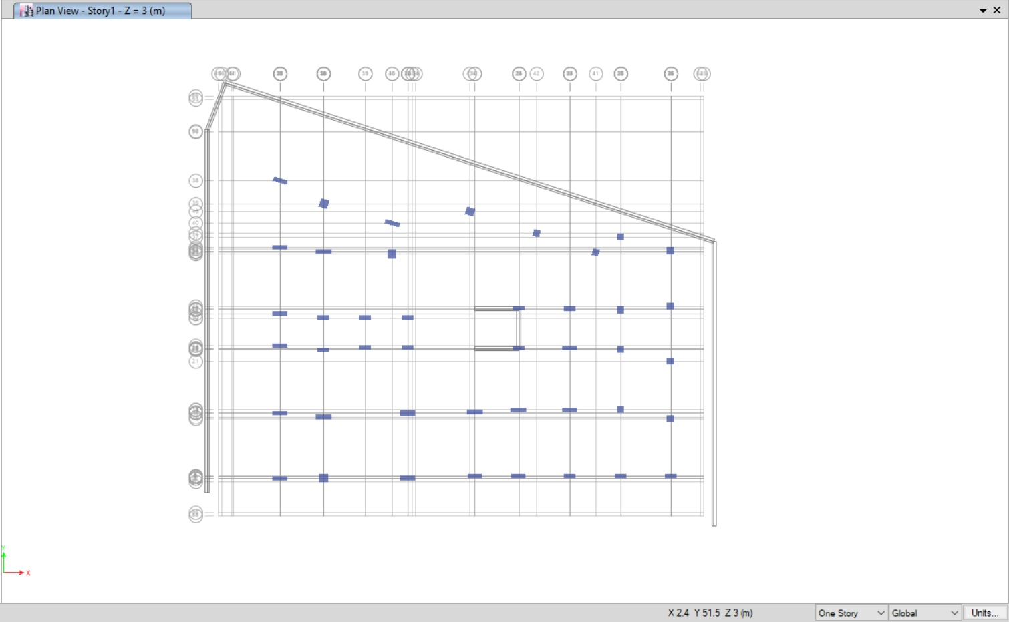
For This project, MAT foundation was used in both designs, since the bearing capacity of the soil is 200 kN/m2. However, all the assumptions, dimensions, and structural details will be discussed. All the steps are analyzed use ETABS software.
the layout of the foundation

Slide 5
Preliminary thickness of MAT
Assume the initially thickness of foundation = 1000 mm.
Materials
Reinforced Concrete
Material used has compressive strength, f’c = 28 MPa
Modulus of elasticity, E = 4700*√𝑓′𝑐 = 24870 Mpa
Weight per unit volume, 𝛾 = 25 kN/m2 provided from ASTM
Springs (Soil Subgrade) Subgrade modulus = 100* Bearing capacity = 100*200 = 20000 kN/m/m2

Slide 6
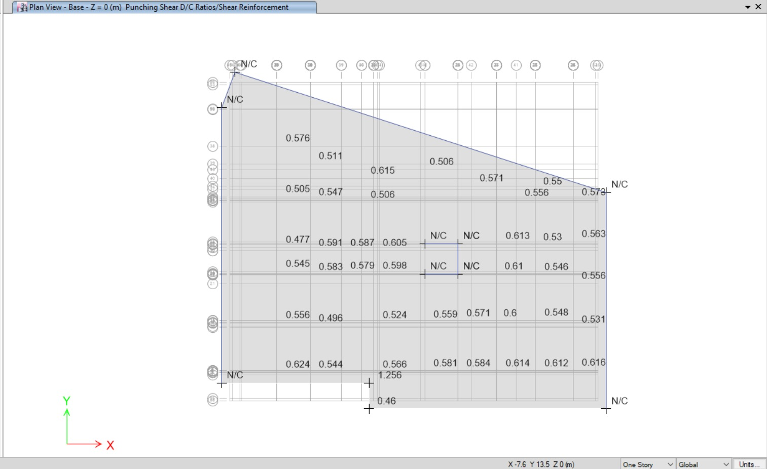
Evaluation of preliminary dimensions
punching shear check : the value of punching shear ratio must be less than 1 for the depth
As shown in figure above, the punching shear check is smaller than 1. Knowing that the thickness of the foundation is 1000 mm so this thickness would be sufficient and there would be no punching shear.

Slide 7

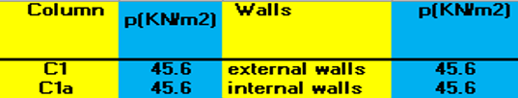
Design of Mat Foundations Under Gravity Loads Effect Only
The services loads for each column = 33.5 kN/m²
The services loads for internal and external walls = 33.5kN/m²
The ultimate loads for each column = 45.6 kN/m²
The ultimate loads for internal and external walls = 45.6 kN/m²

Slide 8
Design Checks on Mat Foundation under gravity loads only
punching shear check : As mentioned earlier the depth of the footing is 100 cm , Punching designed safely
Bearing Capacity Check (Soil pressure) : all the values should be less than the allowable bearing capacity of the soil
which is 266 kN/m2
The maximum value of pressure is 228 kN/m2 < 266 kN/m2 , So the check is ok
Settlement Check (Deflection) : The deflection of the footing should less than 10 mm from service loads
The maximum value of deflection is 9.6 mm < 10 mm, So the check is ok.

Slide 9
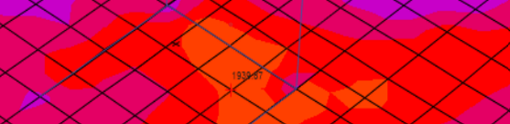
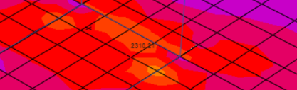
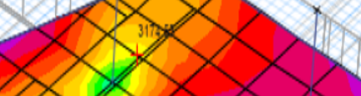
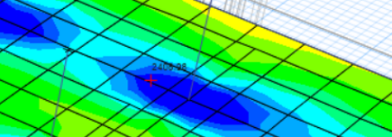
Steel Reinforcement of the Mat Foundation
Flexural Design
Minimum area of steel of the footing As min per in code ACI-2014 is As min = 0.0018 b h As min = 0.0018 * 1000 * 1000 = 1880 mm2 / m
Top Reinforcement of mat foundation in y → AS = 1939.57
Top Reinforcement of mat foundation in x → AS = 2310.21
Bottom Reinforcement of mat foundation in y → AS = 3174.65
Bottom Reinforcement of mat foundation in x → AS= 3174.65

Slide 10


Shear Design
Vu should be less than ΦVc
ΦVc = 0.66 * 0.75 * √𝑓𝑐 * ρw^1/3 *b * d* ,, where d = h – 50 mm
ΦVc = 0.66 * 0.75 * √28 * 950*(0.002)^1/3*1000/1000= 313.5 kN / m
- The shear values for mat foundation in x direction
Vu from ETABS = 9399/47.47 = 197.99
197.99 < 313.5 So no need for shear reinforcement
The shear values for mat foundation in y direction
Vu from ETABS = 3836.66/36 = 106.75
106.75 < 313.5 So no need for shear reinforcement
* This means that we do not need steel stirrups

Slide 11
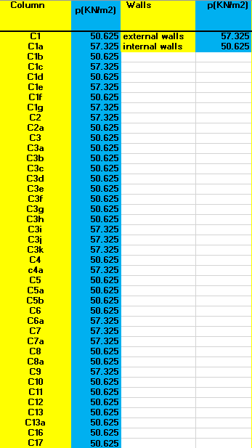
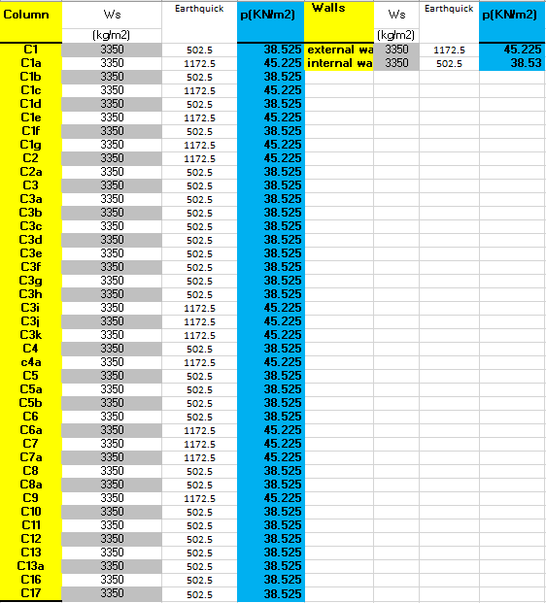
Design of Mat Foundations Under Gravity Loads Effect and Lateral Loads.
The ultimate loads for group of columns = 50.625 kN/m²
The ultimate loads for another group of columns = 57.325 kN/m²
The ultimate loads for external walls = 57.325 kN/m²
The ultimate loads for internal walls = 50.625 kN/m²
The services loads for group of columns = 38.525 kN/m²
The services loads for another group of columns = 45.225 kN/m²
The services loads for external walls = 45.225 kN/m²
The servises loads for internal walls = 38.53 kN/m²

Slide 12
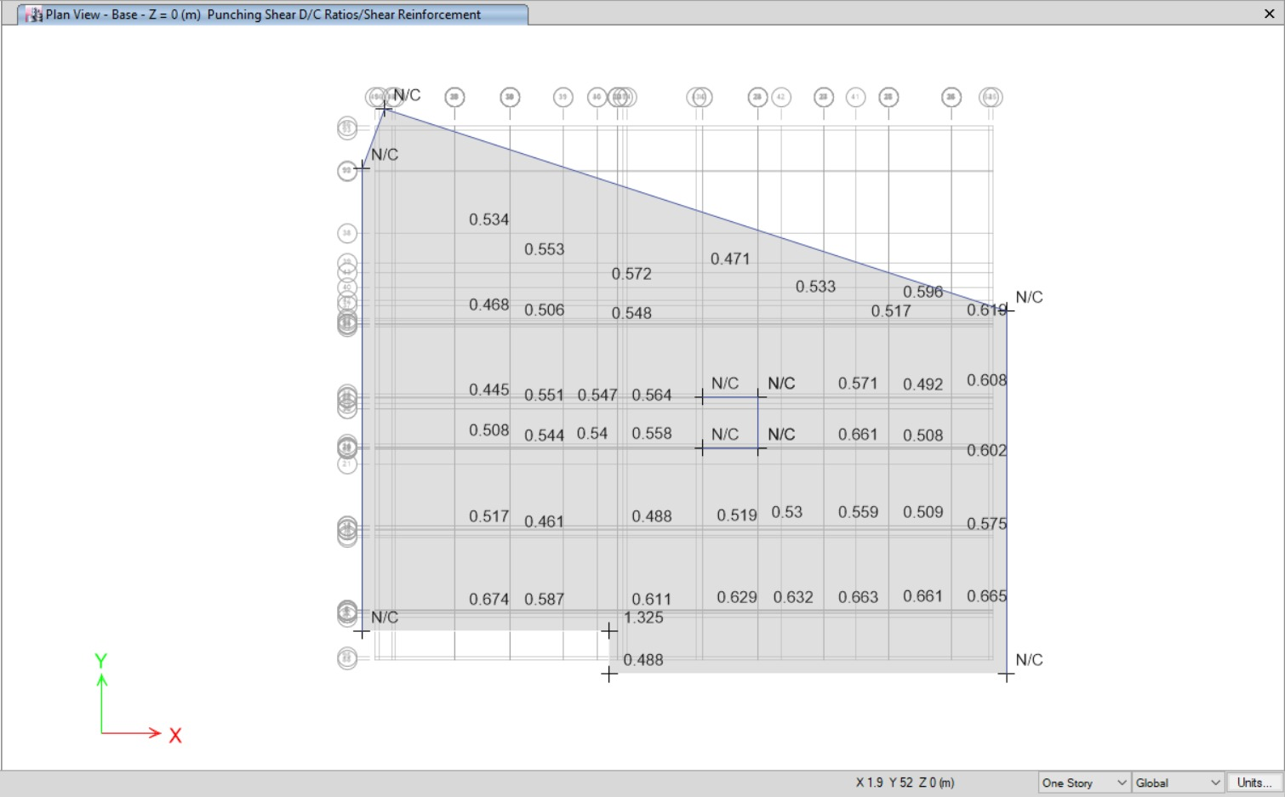
Design of Mat Foundations Under Gravity Loads Effect and Lateral Loads.
punching shear check : all the punching shear values are less than 1 so Punching designed safely

Slide 13
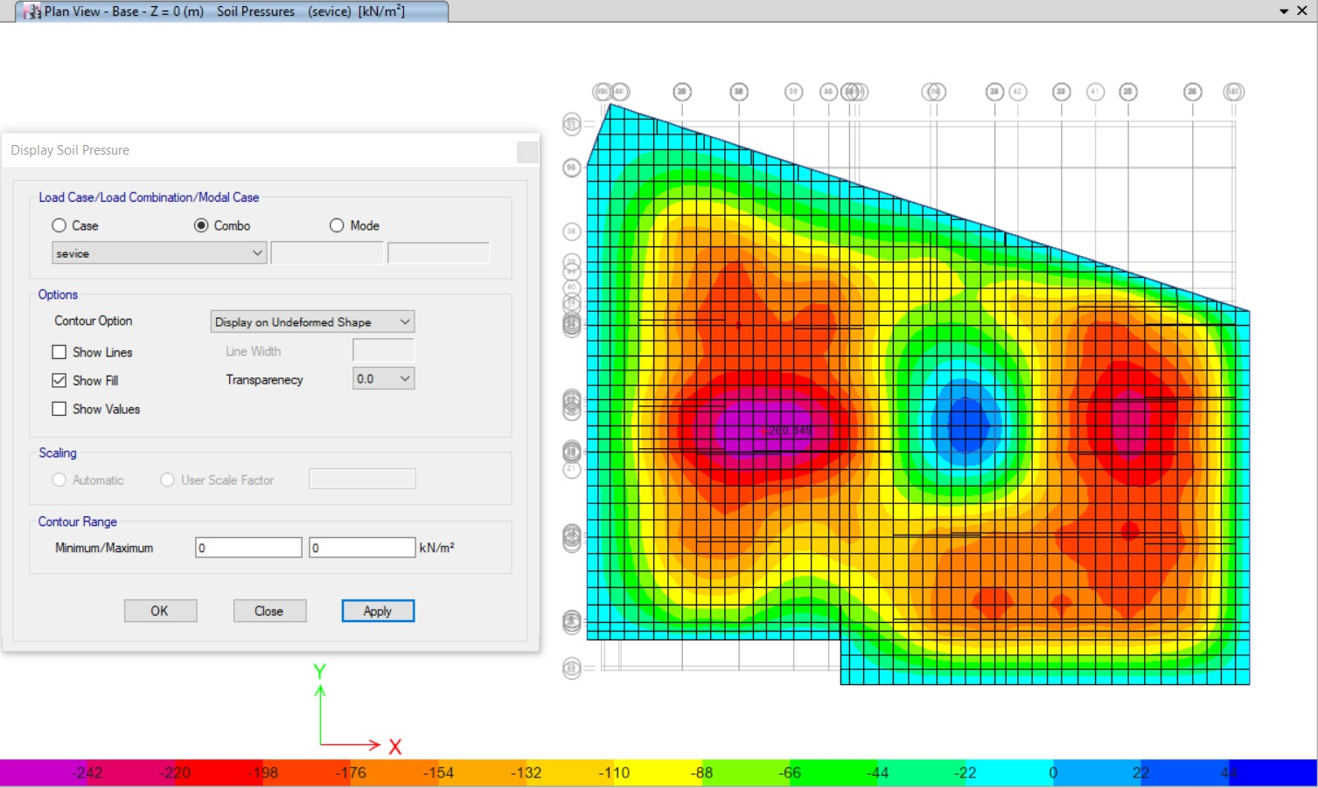
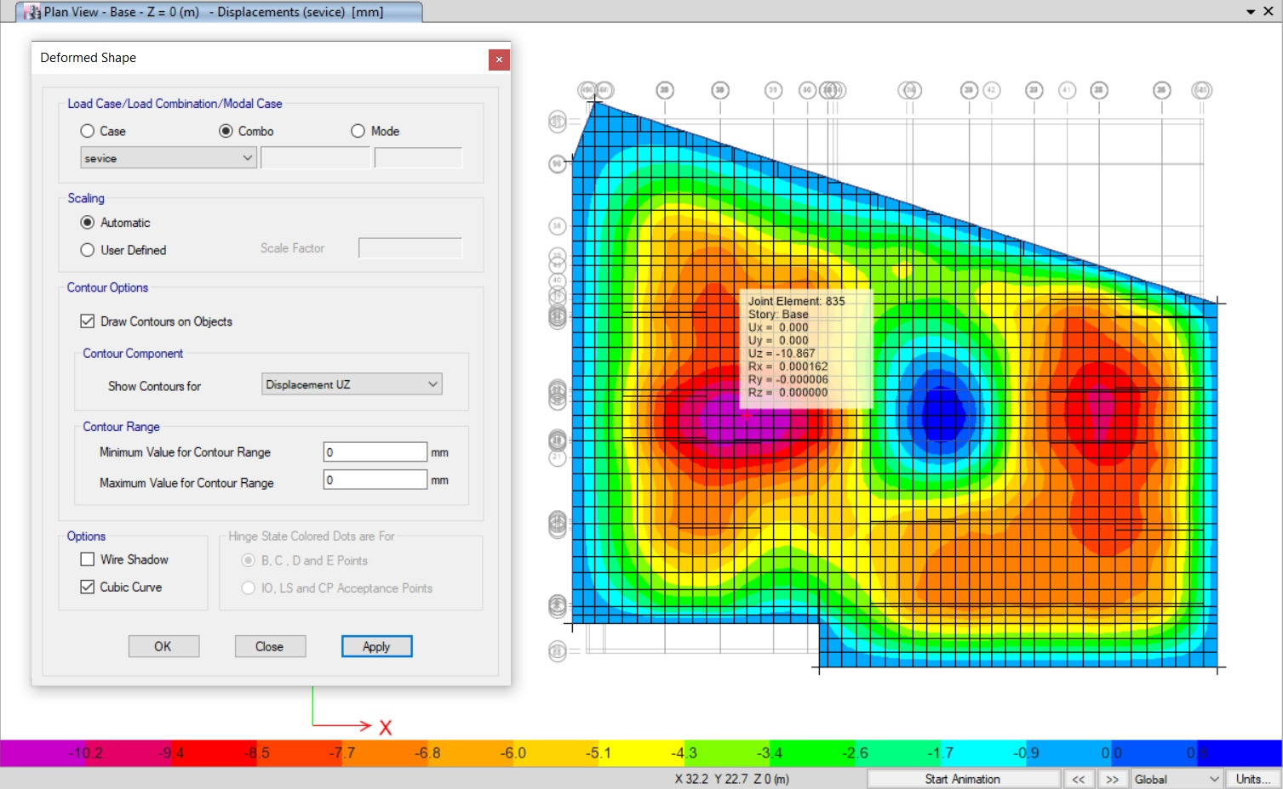
Bearing Capacity Check (Soil pressure) : all the values should be less than the allowable bearing capacity of the soil which is 266
The maximum value of pressure is 242 kN/m2 < 266 , so the check is ok
Settlement Check (Deflection) : The deflection of the footing should less than 10 mm from service loads
The maximum value of deflection is 10.2 near to 10 mm, So the check is ok.

Slide 14

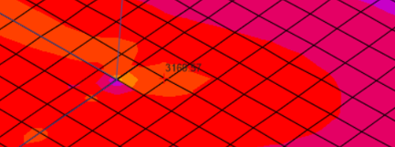
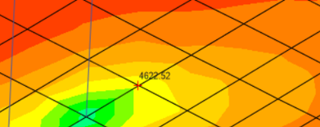
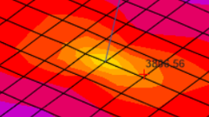
Steel Reinforcement of the Mat Foundation
Flexural Design
Minimum area of steel of the footing As min per in code ACI-2014 is As min = 0.0018 b h As min = 0.0018 * 1000 * 1000 = 1880 mm2 / m
Top Reinforcement of mat foundation in y → AS = 2822.74
1 Φ 20 / 10 cm or 10 Φ 20 / m for top bars in y direction
Top Reinforcement of mat foundation in x → AS = 3168.75
1 Φ 22 / 12cm or 8 Φ 22 / m for top bars in x direction
Bottom Reinforcement of mat foundation in y → AS = 4622.52
1 Φ 25 / 10 cm or 10 Φ 25 / m for bottom bars in y direction
bottom Reinforcement of mat foundation in x → AS=3896.56
1 Φ 25 / 12 cm or 8 Φ 25 / m for bottom bars in x direction

Slide 15
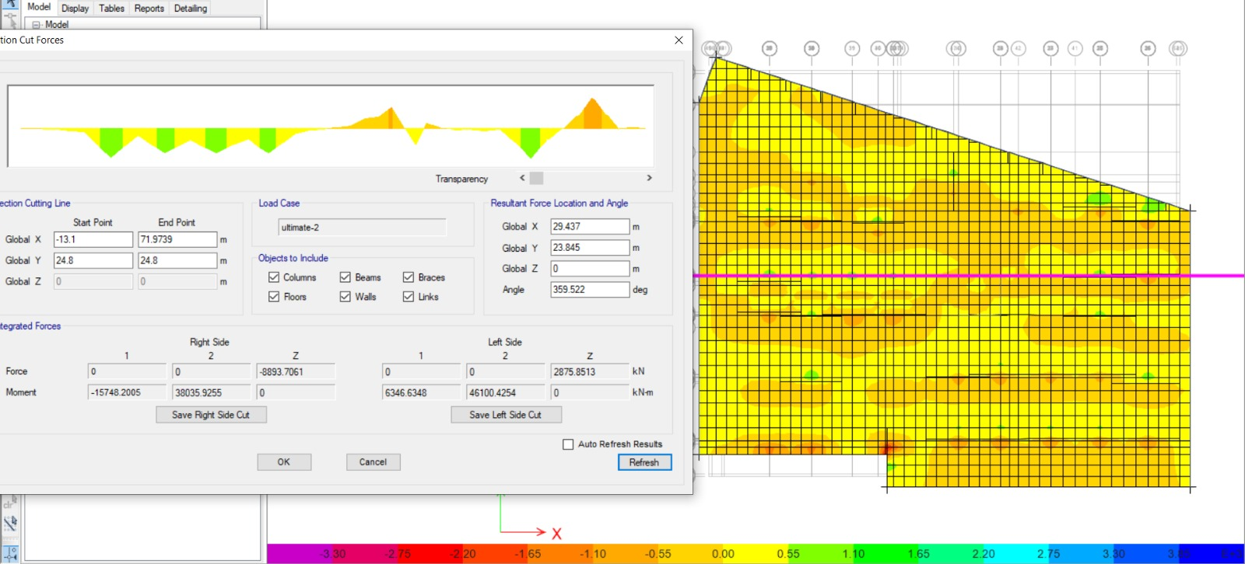
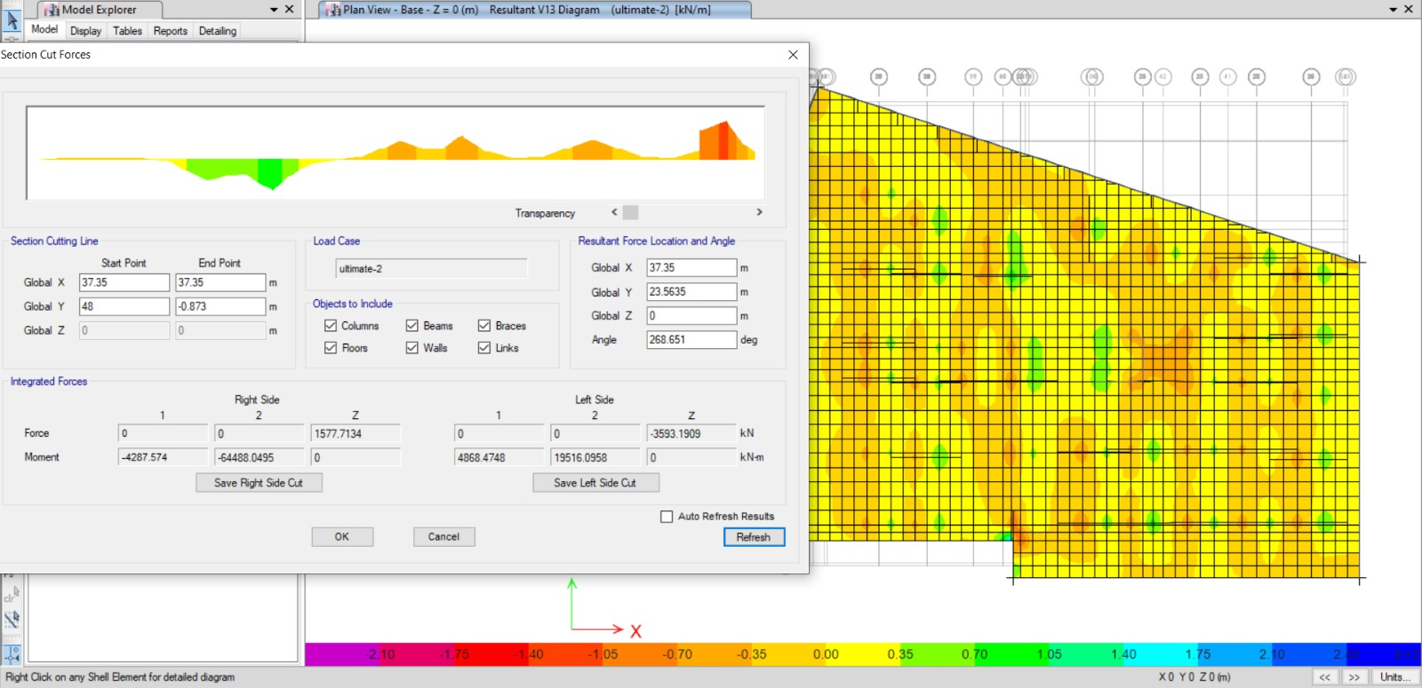
Shear Design
Vu should be less than ΦVc
ΦVc = 0.66 * 0.75 * √𝑓𝑐 * ρw^1/3 *b * d* ,, where d = h – 50 mm
ΦVc = 0.66 * 0.75 * √28 * 950*(0.002)^1/3*1000/1000= 313.5 kN / m
- The shear values for mat foundation in x direction
Vu from ETABS = 8893.7/47.47 = 187.35
187.35 < 313.5
Vu from ETABS = 8893.7/47.47 = 187.35
187.35 < 313.5 So no need for shear reinforcement
The shear values for mat foundation in y direction
Vu from ETABS = 3593.19/36 = 99.81
99.81 < 313.5 So no need for shear reinforcement
* This means that we do not need steel stirrups

Slide 16
Quantity Survey

Slide 17
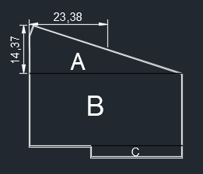
Steel Reinforcement
# of Bars for strip (A)
14.37 - 0.05 = 14.32
14.32 / .12 = 119.33 = 120 bars
The space between steel bars
Asume Φ = 25 >>> (3896.56)/25*25*(3.14/4) = 12 cm
Bar Length (m) for strip (A)
23.28 + .65 + .65 + 1.5 + 1.5 + 1.5 = 29.1
(3*8) + 5.1 = 29.1 m
Weight (Tons) (m) for strip (A)
(25*25/162)*120*29.1 = 13.472 Tons

Slide 18
Steel Reinforcement
X- Direction Bottom Rebar
Weight (Tons) | Diameter (mm) | Bar Length (m) | # of Bars | strip
56.0 | Φ25 | 29.1 | 120 | Strip (A)
 | Φ25 | 55.7 | 180 | Strip (B)
 | Φ25 | 34.5 | 30 | Strip (C)
X- Direction Top Rebar
Weight (Tons) | Diameter (mm) | Bar Length (m) | # of Bars | strip
44.0 | Φ22 | 29.1 | 120 | Strip (A)
 | Φ22 | 55.7 | 180 | Strip (B)
 | Φ22 | 34.5 | 30 | Strip (C)

Slide 19
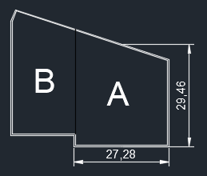
Steel Reinforcement
Bar Length (m) for strip (A)
29.36 + .65 + .65 + 1.5 + 1.5 + 1.5 + 1.5 = 36.65
(4*8) + 4.65 = 36.65 m
# of Bars for strip (A)
27.28 - 0.05 - 0.05 = 27.18
27.18 / .10 = = 272 bars
# of Bars for strip (A)
27.28 - 0.05 - 0.05 = 27.18
27.18 / .10 = = 272 bars
For (chair bars)
We need ( 1Φ14 / 2000mm)
After Calculate ===> The Number of (chair bars) are 354 ===> and Length of One = 2.9m
354*2.9*1.209=1621==1.241 Tons

Slide 20
Steel Reinforcement
Y- Direction Bottom Rebar
Weight (Tons) | Diameter (mm) | Bar Length (m) | # of Bars | strip
68.0 | Φ25 | 36.65 | 272 | Strip (A)
 | Φ25 | 42.2 | 182 | Strip (B)
Y- Direction Top Rebar
Weight (Tons) | Diameter (mm) | Bar Length (m) | # of Bars | strip
43.0 | Φ20 | 36.65 | 272 | Strip (A)
 | Φ20 | 42.2 | 182 | Strip (B)
The Total Weight = 212.45 Tons

Slide 21
Conclusion
From this project, the aim of the design is to have a economical solution. Thus, for buildings with multi-story and has a large weight, the best solution is to design foundation as mat foundation. And In this project We designed it seismically.

Slide 22
THANK YOU
FOR BEING HERE

