Slide 1

AN-NAJAH NATIONAL UNIVERSITY
COLLEGE OF ENGINEERING AND INFORMATION TECHNOLOGY MANAGEMENT INFORMATION SYSTEMS
INFORMATION SYSTEMS FOR THE HEALTH CLINIC IN NABLUS
PROJECT TEAM:
ASEEL BASSEM
Sara shakhshir Manar kanaan
SUPERVISED BY :
DR. AHMAD SHRAIDEH
ACADEMIC YEAR: 2022-2023

Slide 2

An Introduction.
The new status of the ministry.
Contents:
Our idea.
Solution.
Workflow.
Tool used in the project.
Current status of the ministry
Recomendations
Problems

Slide 3

About the health clinic:
The health clinic is a clinic responsible for the general health of citizens in the city of Nablus. It provides treatment and some medicines to citizens, vaccinations are provided to children, and citizens can undergo some medical examinations.

Slide 4


Our Idea :
The idea is to create a website and information system for the health clinic of the Ministry of Health in Nablus to solve the problems it has

Slide 5



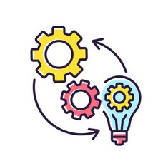
Workflow:
found a suitable solution
Analyzed the system
Figured the existed problems
Implementation of the plan

Slide 6











start
The current status of the health clinic (Nablus)
End

Slide 7


Slide 8

Problems:
The suffocating crisis.
waiting for a long time.
Inability to know the availability of the drug. Poor organization of the Inventory process.

Slide 9

Weaknesses in the services provided by the system:
Not knowing when to vaccinate children.
Some problems recording the attendance of the employees.

Slide 10
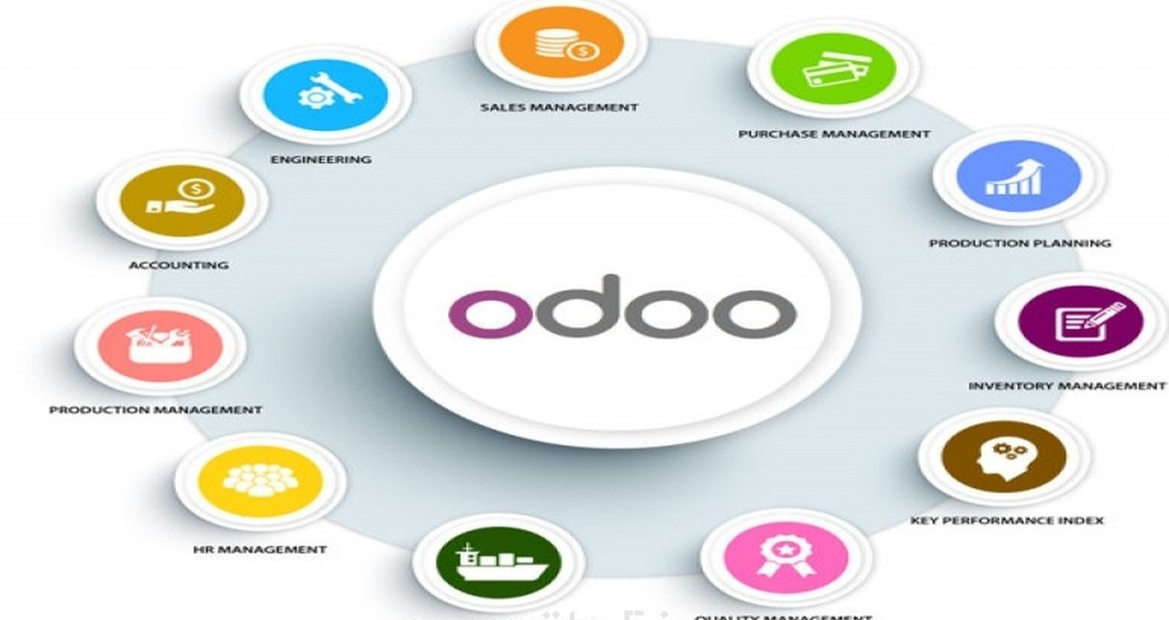
The tool we are using is odoo :

Slide 11










Modules:
Point Of Sales(POS).
Inventory.
Calender.
Time Off.
Employee.
Attendance.
Website.
Dashboard. 9-Vaccination .
10-Patient records.

Slide 12
SOLUTION:
reservation system. Inquiry about medicines.
Receipt of notice of the reservation date.
The arrival of an e-mail message to the mother to vaccinate her child.
Improve inventory management.
Improvement in the management of attendance and absence of employees.

Slide 13

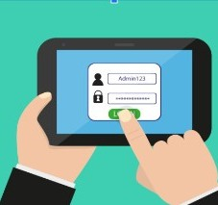





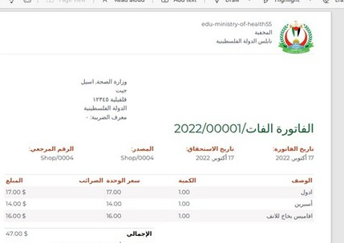



How the new status is going to be for citizens:
start
End

Slide 14


Slide 15

Recommendations:
Developing the system for reservations to save more time through a special time for diagnosis and a special time for dispensing medicine.
Keep up with new additions that have been added to Odoo.
Developing health services and managing chronic diseases on a larger scale.
Increasing the satisfaction of citizens and employees of the services on the system

Slide 16
THANK YOU

