Slide 1
A stand alone PV system design in
remote area in Hebron
Prepared by :Ruqayya Imran
Supervisor :Tamer khatib

Slide 2
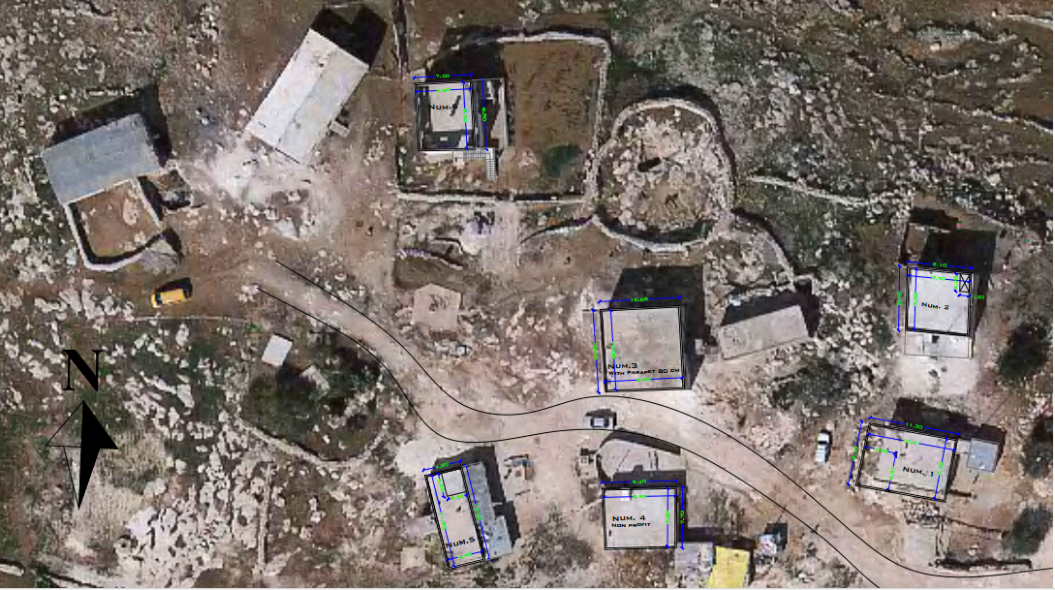

Slide 3
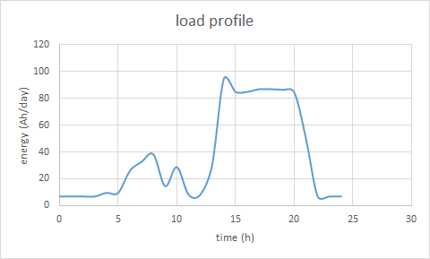
Previous results
Load estimation
Total Ah for all houses = 908.3576 Ah/day
Load profile

Slide 4
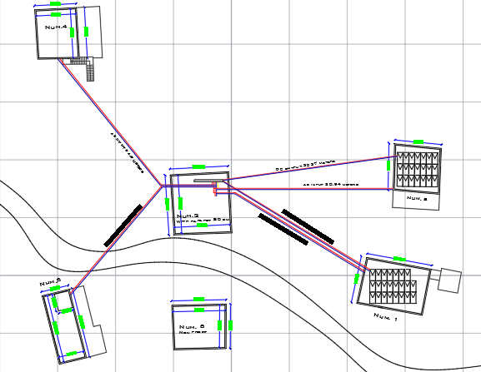
System layout

Slide 5
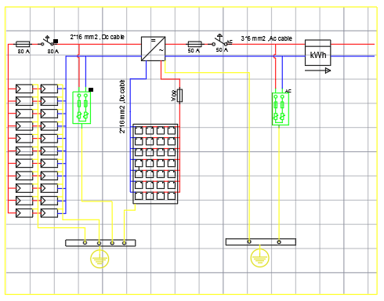
Circuit diagram

Slide 6
Cost analysis
Item | Description | Specification | Unit price (USD) | Quantity | Total price (USD)
1 | PV modules | 320 Wp | 170 | 44 | 7480
2 | Battery | 12V , 100Ah | 195 | 56 | 10920
3 | Inverter | 8 KW , 48V | 3690 | 2 | 7380
4 | DC cables solar type 16 mm² cross section |  | 2.25 | 60 m | 135
5 | AC cables solar type 10 mm² cross section |  | 2 | 132 | 264
6 | DC CB | 80A | 132 | 2 | 264
7 | AC CB | 63 A | 94 | 2 | 188
8 | DC fuse | 80A | 54 | 4 | 216
9 | AC fuse | 63A | 30 | 2 | 60
10 | DC surge protection |  | 63 | 2 | 126
11 | AC surge protection |  | 45 | 2 | 90
12 | PV module KWh meter panel |  | 56 | 1 | 56
13 | Generation KWh meter panel |  | 26 | 5 | 130
14 | Mounting structure |  | 2728 |  | 2728
15 | Complete system installation and operation |  | 1100 | 1 | 1100
16 | DC Electrical Panel |  | 45 | 1 | 45
17 | AC Electrical Panel |  | 45 | 1 | 45
18 | System grounding |  | 400 | 1 | 400
 |  |  |  |  | 31647

Slide 7
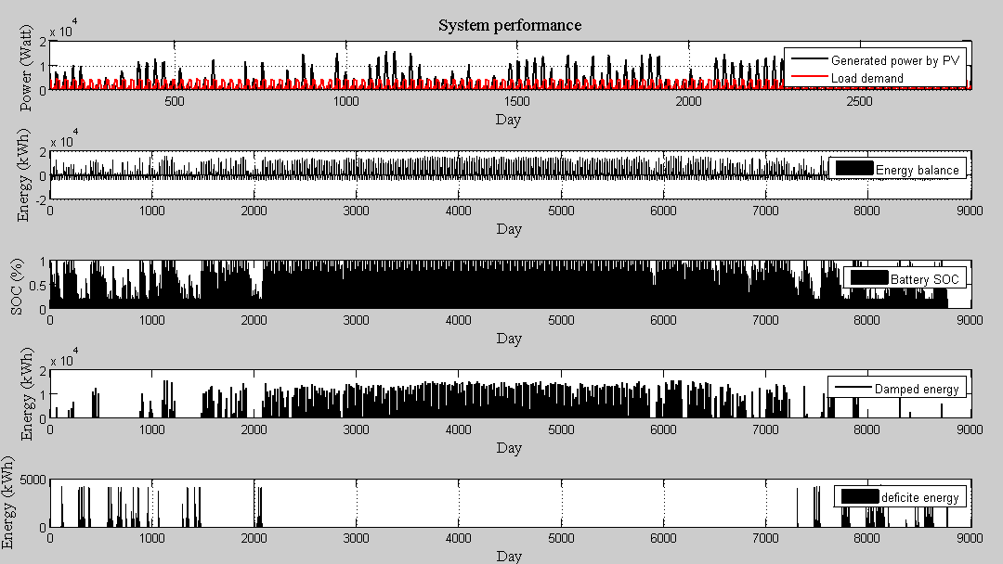
simulation

Slide 8
Decentralized system

Slide 9
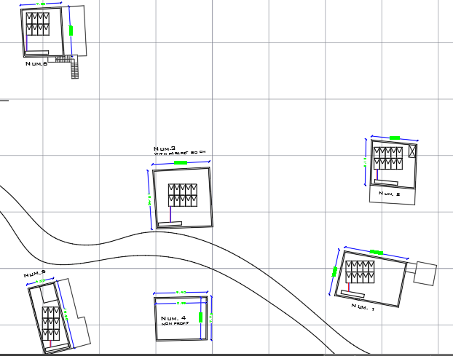
System layout

Slide 10
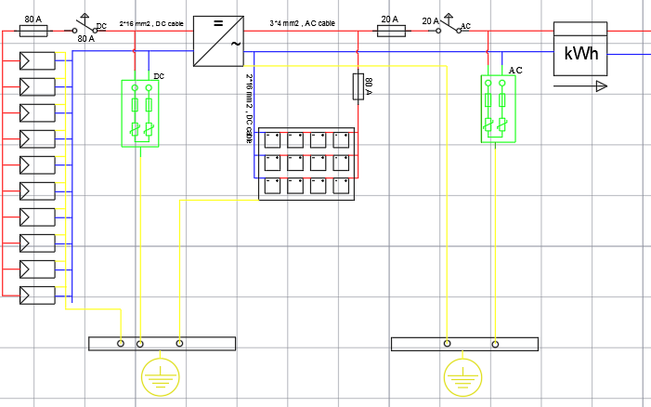
Circuit diagram
House 1, 2 and 3

Slide 11
Discussion
Item | Decentralized | >< | centralized
PV module | 340 | >
Battery | 90 | >
Inverter | 4210 | >
DC cable |  | < | 71.75
AC cable |  | < | 220.5
DC .CB | 320 | >
AC .CB |  | < | 88
DC fuses | 126 | >
AC fuses |  | < | 45
DC surge arrester | 189 | >
AC surge arrester | 510 | >
PV module KWh meter | 224 | >
Generation Kwh meter |  | < | 130
Steel structure | 124 | >
DC electrical panel | 180 | >
AC electrical panel | 180 | >

