Slide 1
AqarKey
Real Estate Company
Supervisor: Dr. Najwan Deleq
Hala Shakaa Sana Herzallah Rama Kharraz

Slide 2


Aqarkey

Slide 3

Aqarkey

Slide 4
Aqarkey
why ?

Slide 5





Aqarkey

Slide 6


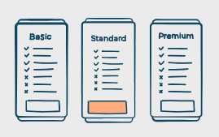

Aqarkey
Revenue methods

Slide 7


Slide 8



Aqarkey
Our Team
Rama Kharraz
Sana Herzallah
Hala Shakaa

Slide 9







Tools used:

Slide 10





Aqarkey

Slide 11









Aqarkey
odoo

Slide 12
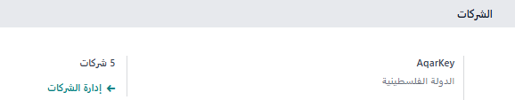
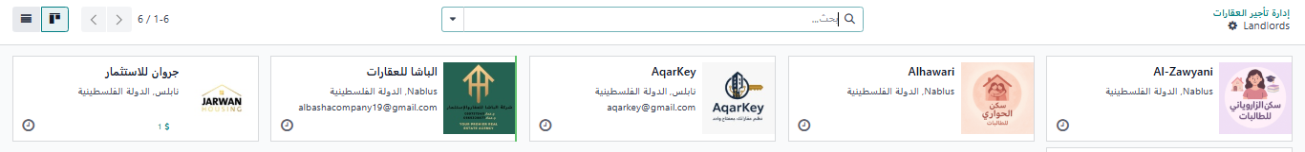
Aqarkey
Landlords

Slide 13
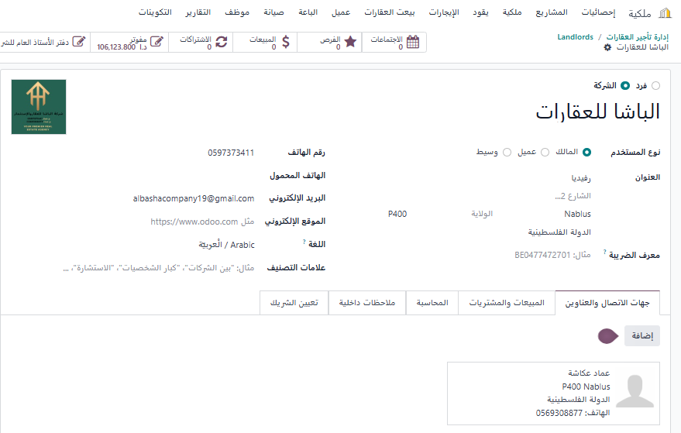

landlord details
Aqarkey

Slide 14
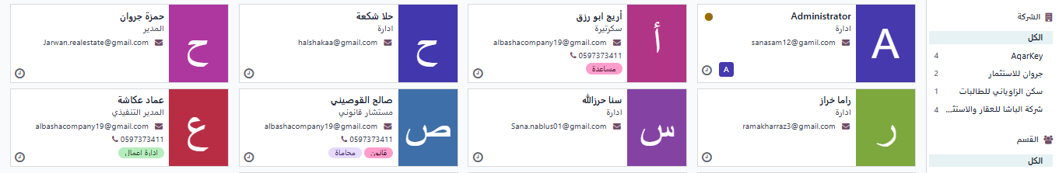
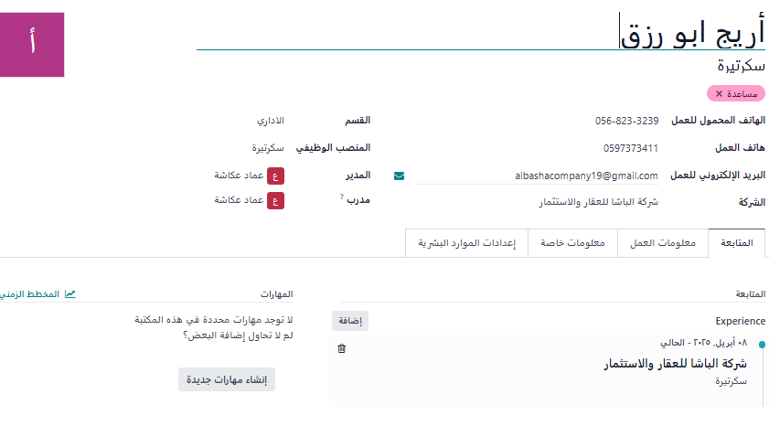
Aqarkey

Slide 15
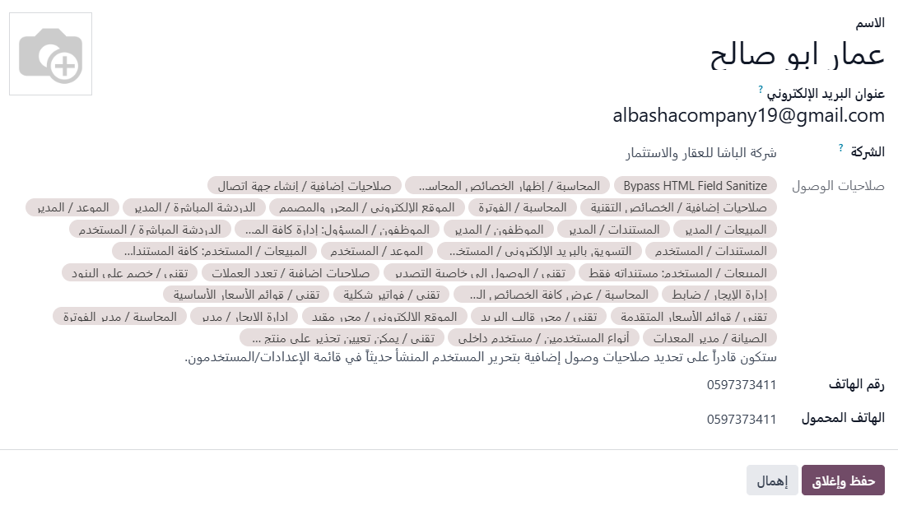

Aqarkey
أريج ابو رزق

Slide 16
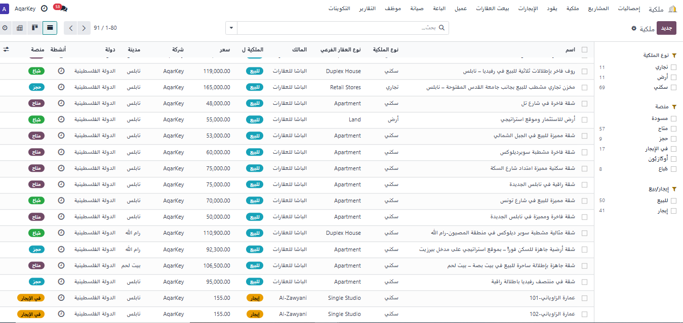
Property Module :
Aqarkey

Slide 17
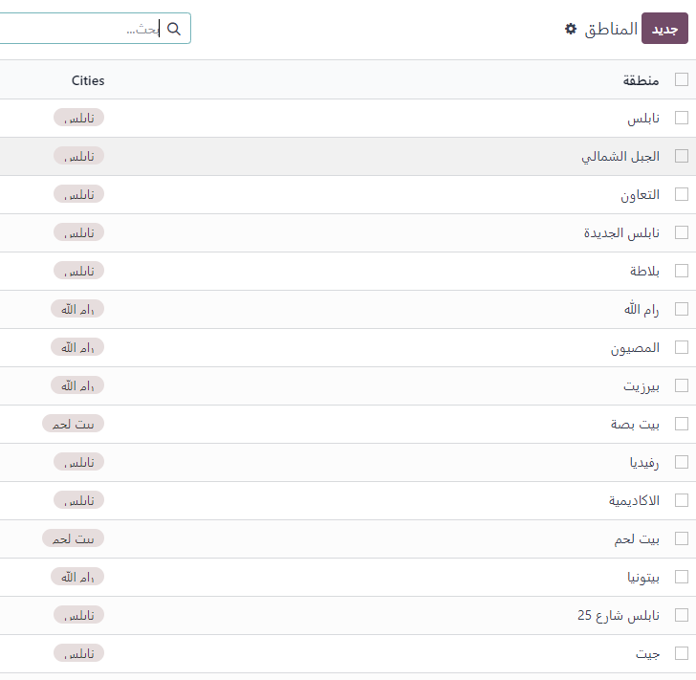
Aqarkey

Slide 18
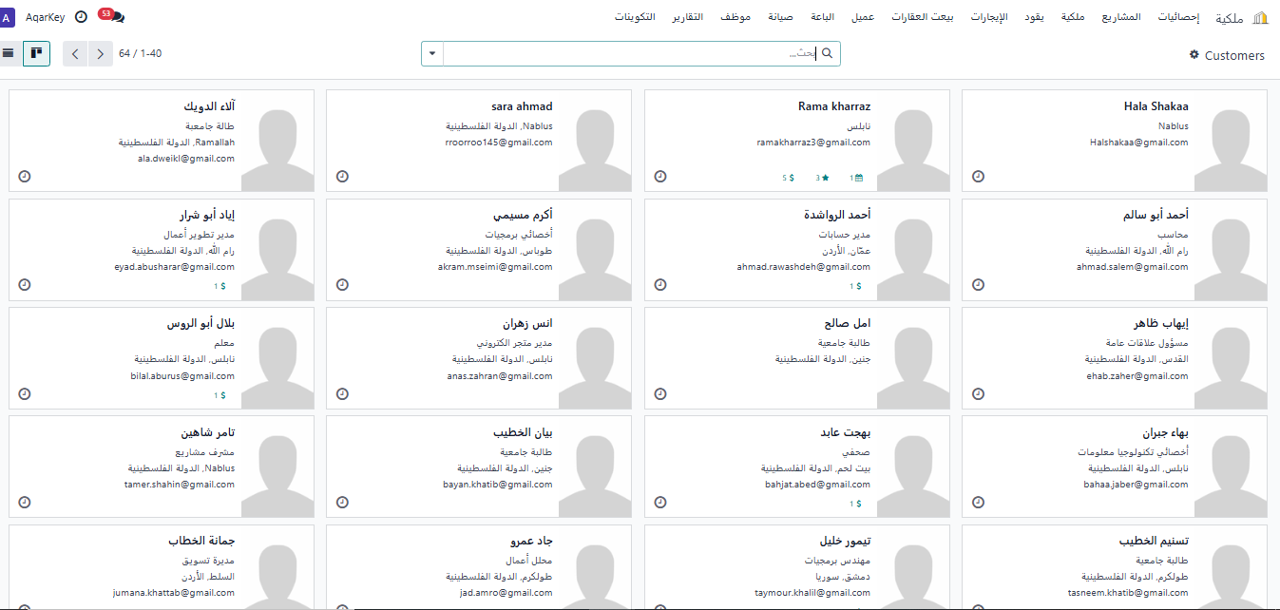
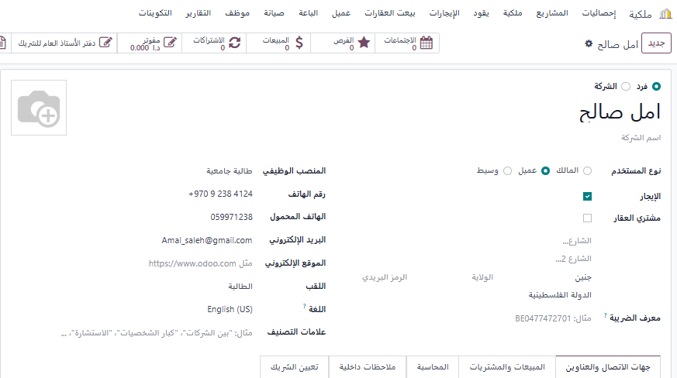

Aqarkey
Customer’s details
أمل صالح

Slide 19

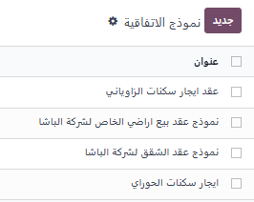
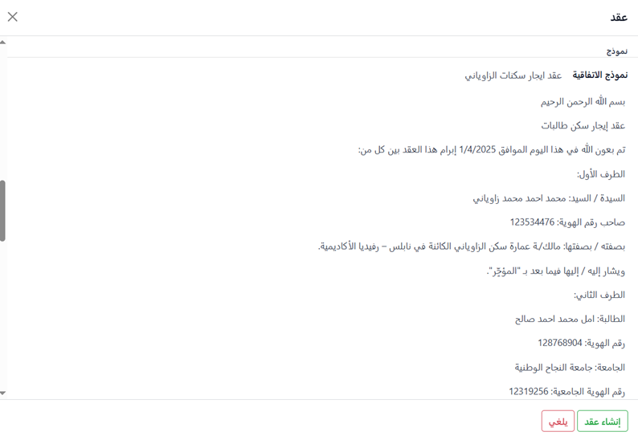
Aqarkey

Slide 20
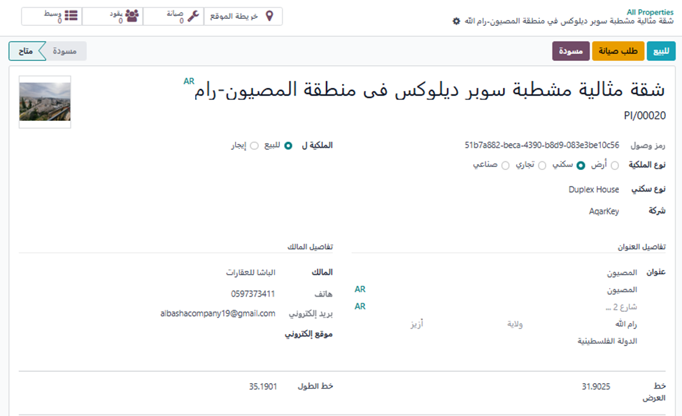
Aqarkey
Property details

Slide 21
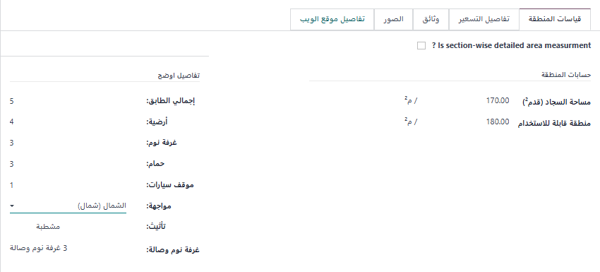
Aqarkey

Slide 22
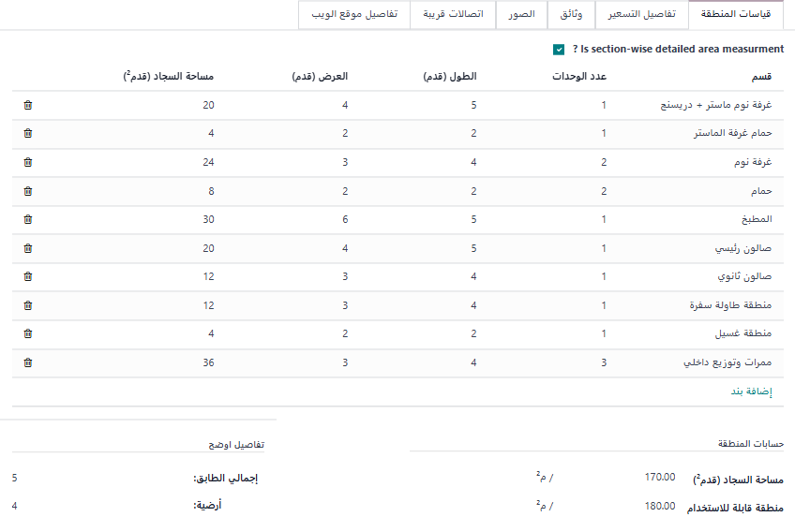
Aqarkey

Slide 23
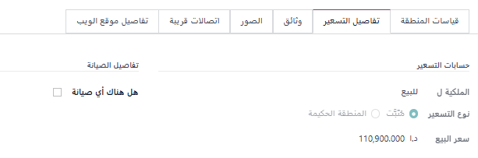
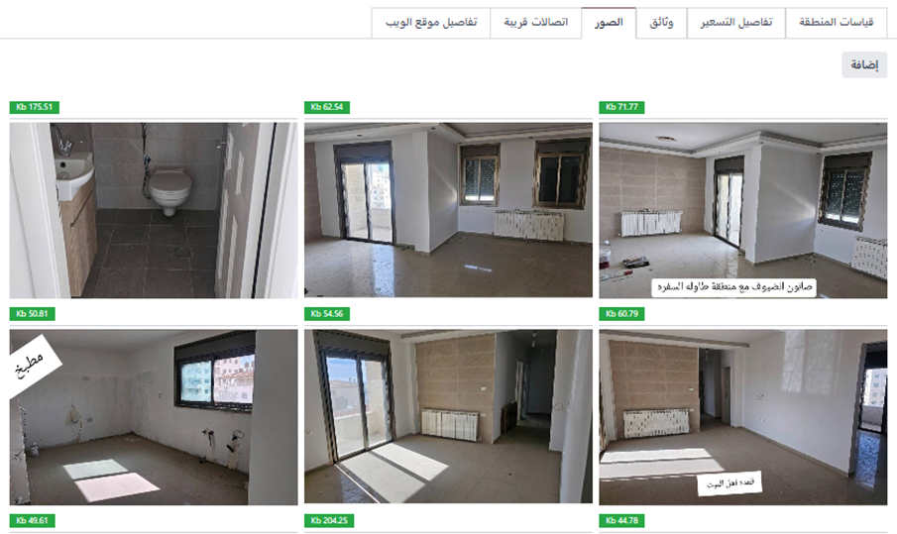
Aqarkey

Slide 24
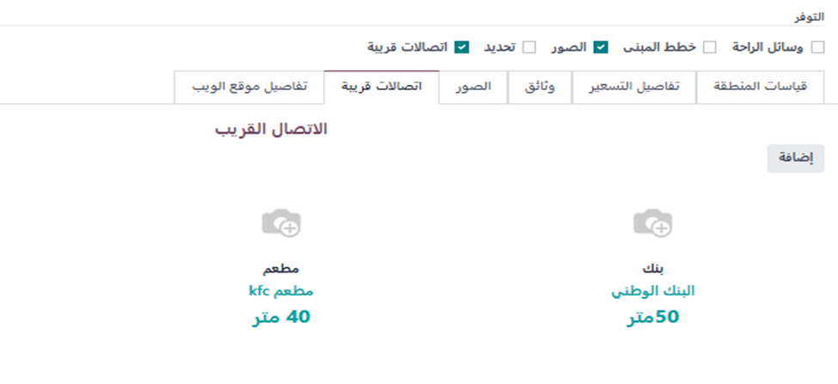
Aqarkey

Slide 25
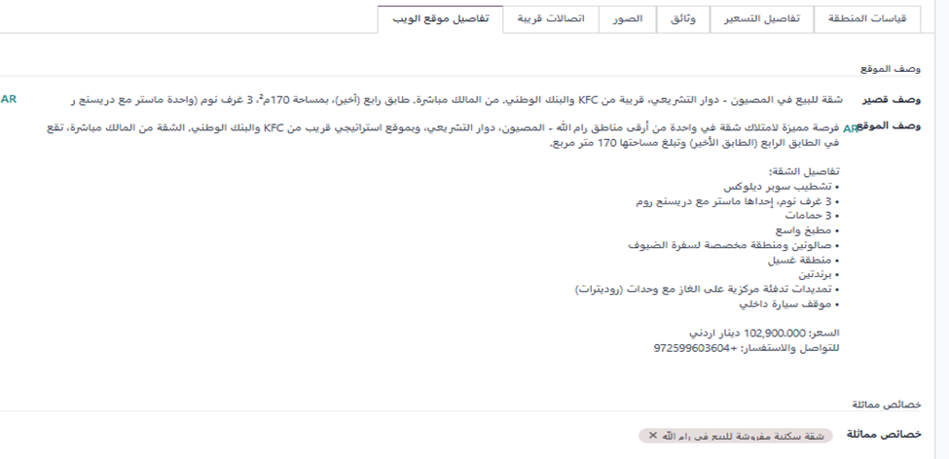
Aqarkey

Slide 26
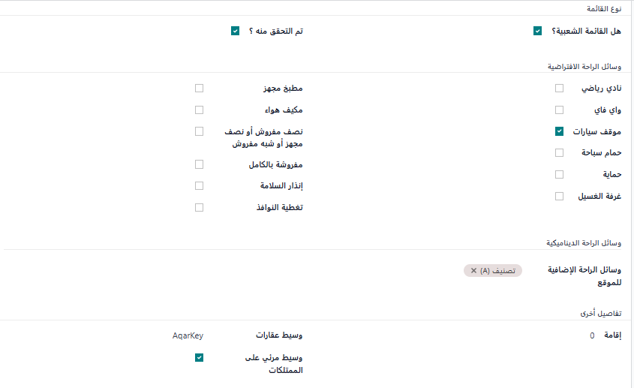
Aqarkey

Slide 27
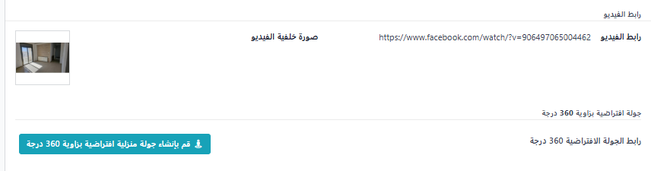
Aqarkey

Slide 28
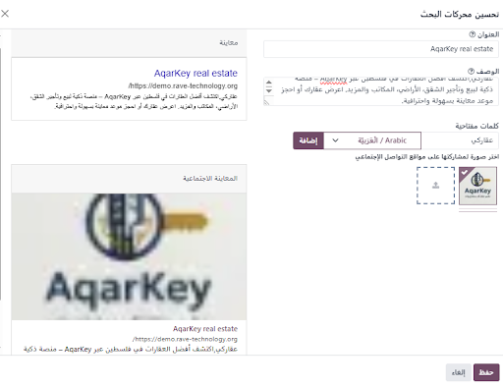
SEO
Aqarkey

Slide 29
Aqarkey
Home page :

Slide 30
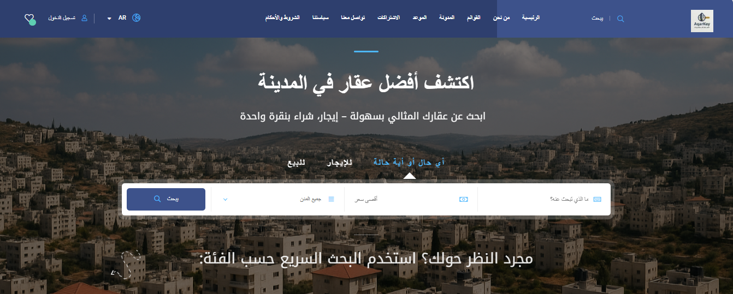
Aqarkey

Slide 31
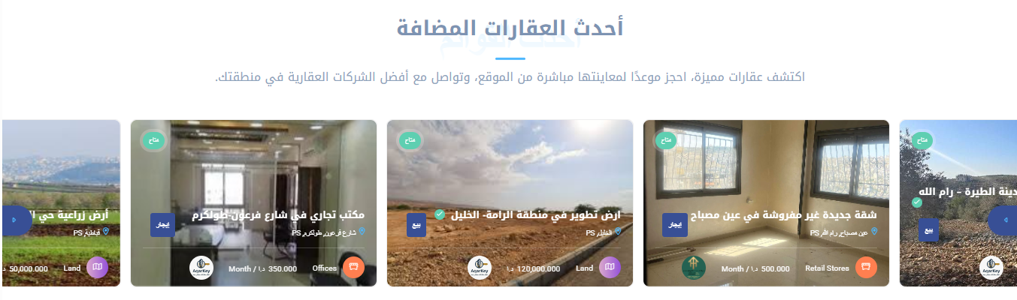
Aqarkey

Slide 32
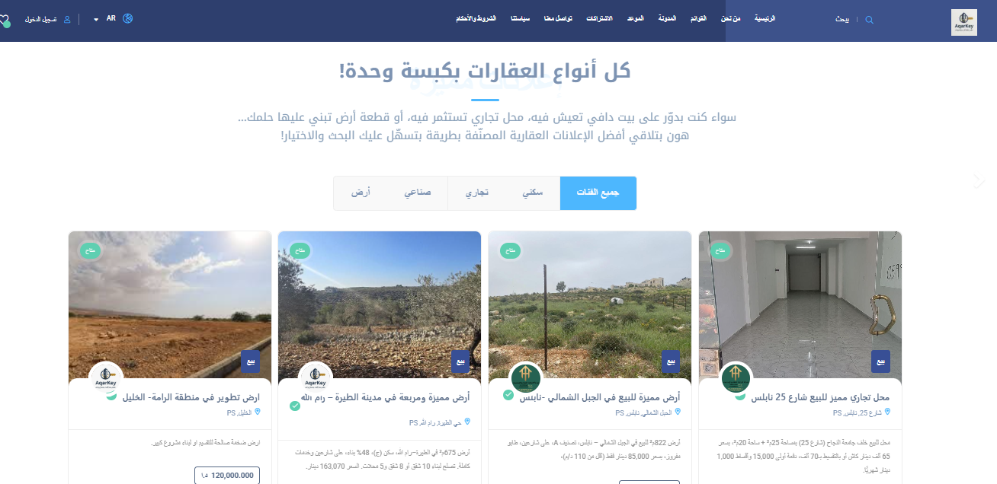
Aqarkey

Slide 33
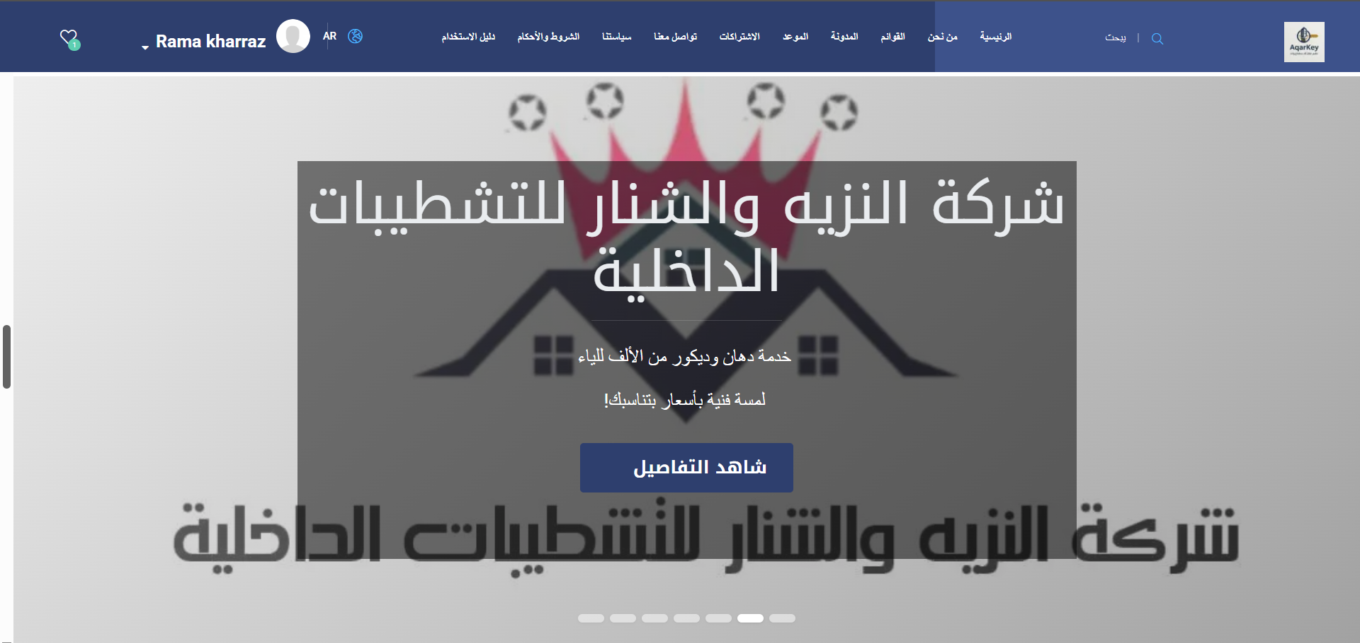
Aqarkey

Slide 34
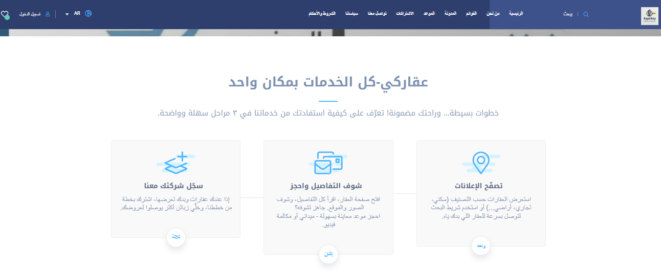
Aqarkey

Slide 35
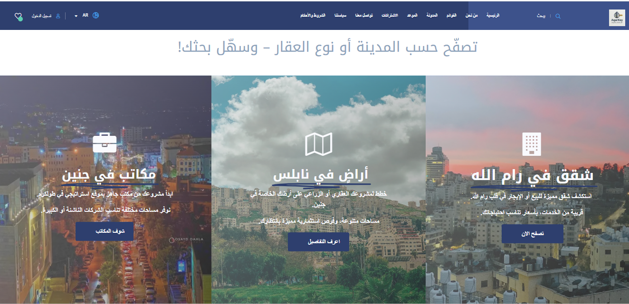
Aqarkey

Slide 36
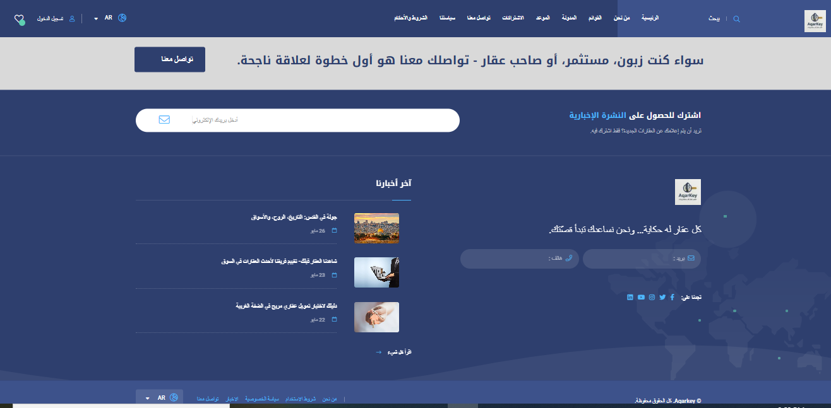
Aqarkey

Slide 37
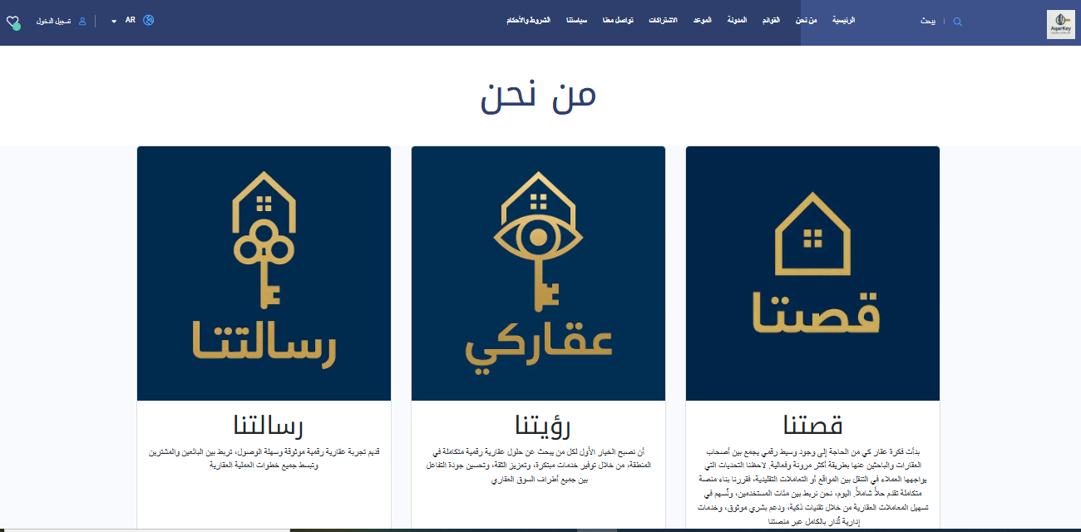
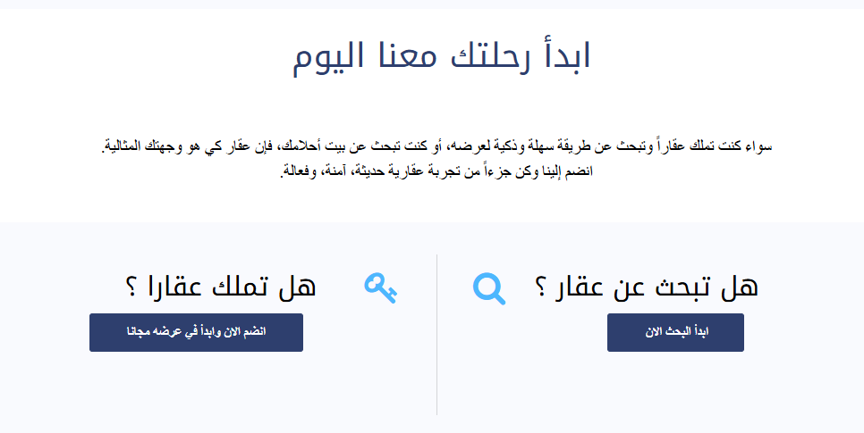
Aqarkey
About us

Slide 38

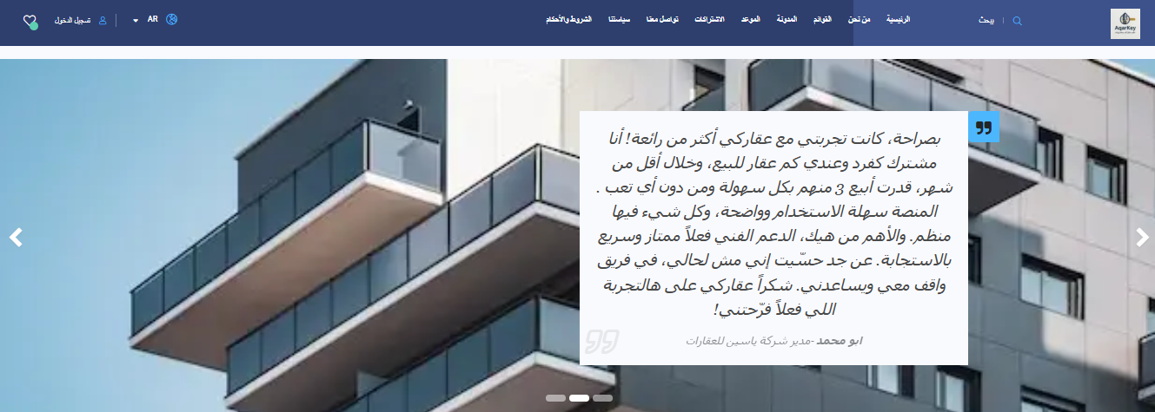
Aqarkey
About us

Slide 39
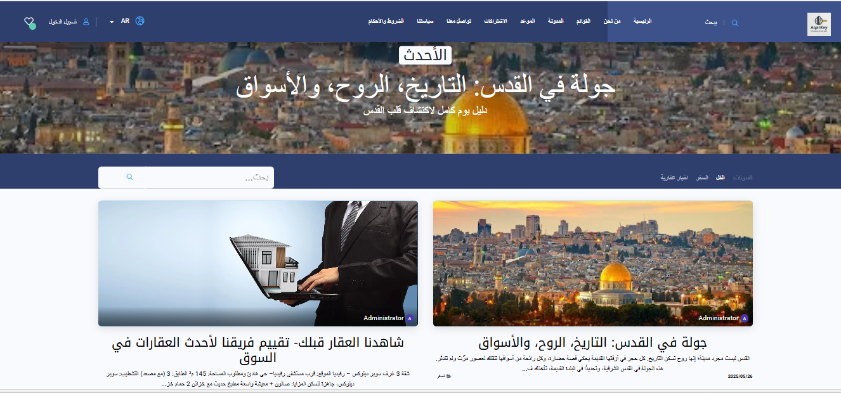
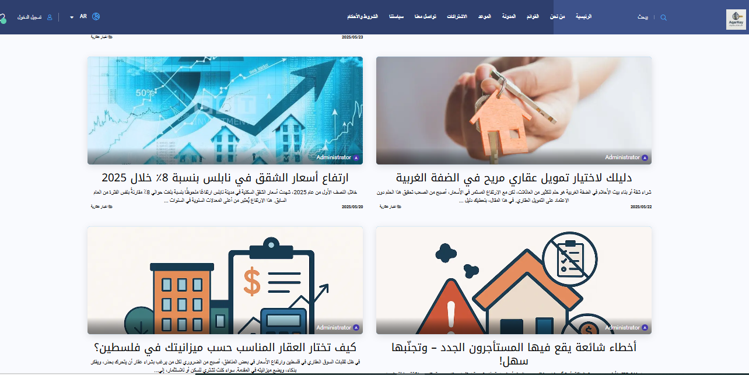
Aqarkey
Blog

Slide 40
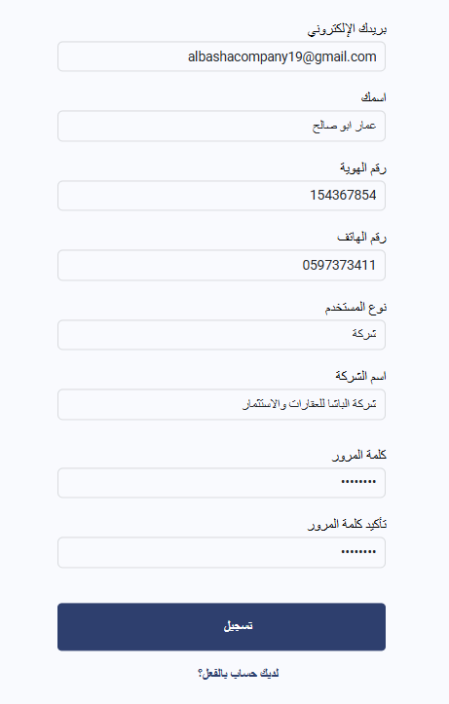
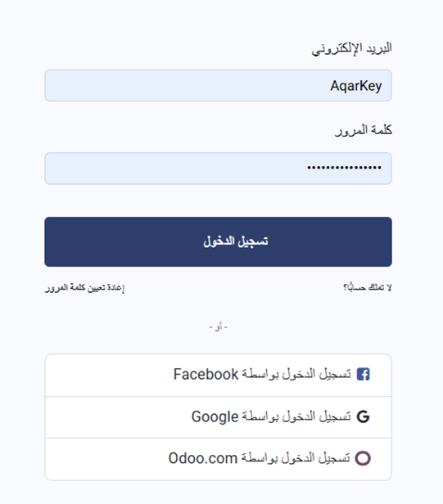
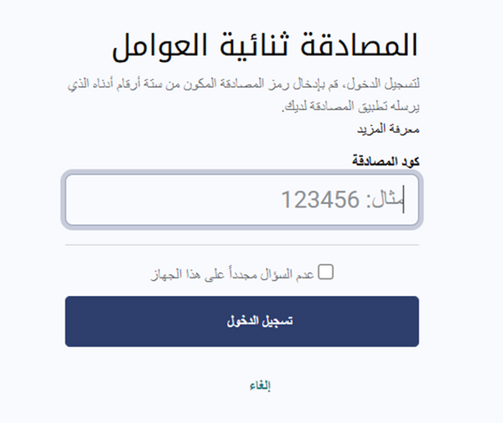
Sign up / Log In
Aqarkey

Slide 41
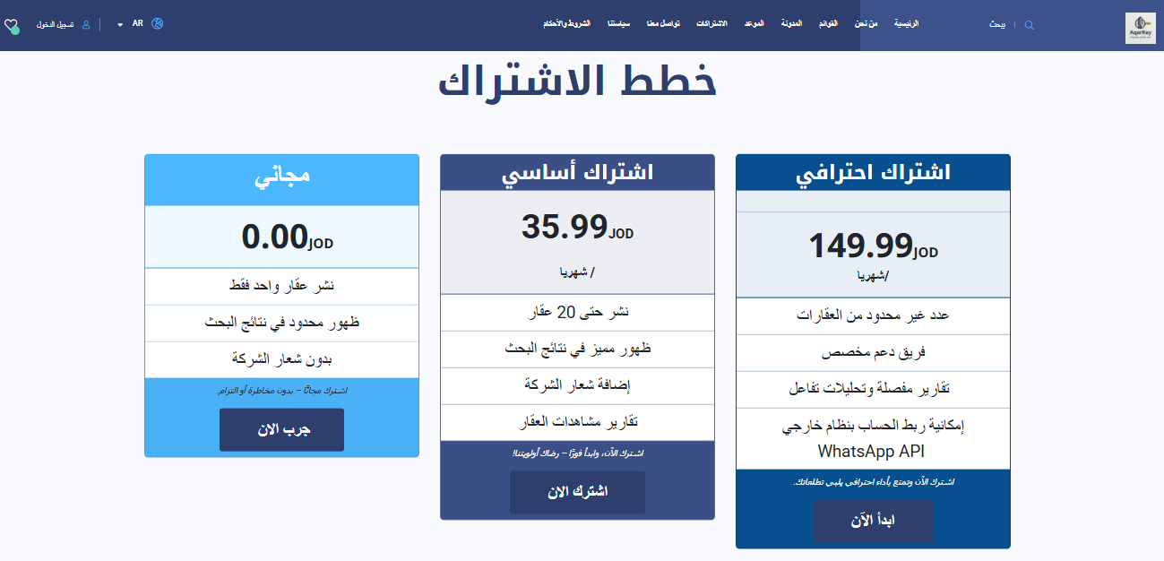
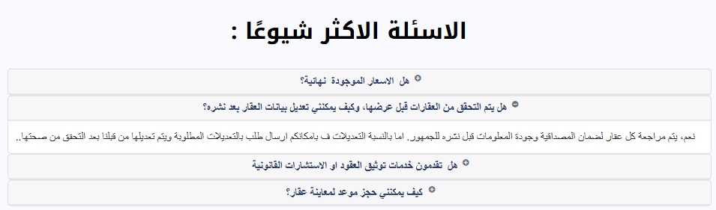
Aqarkey
Subscription plans

Slide 42
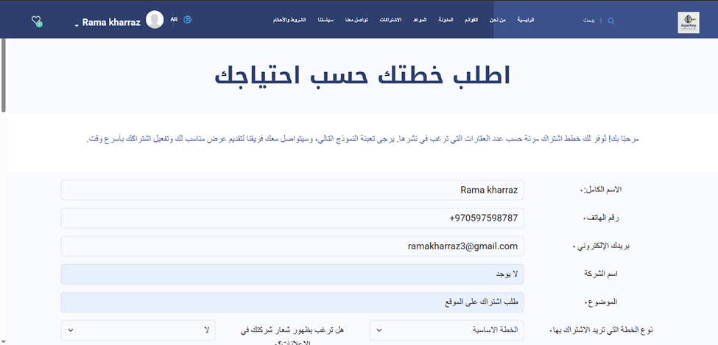
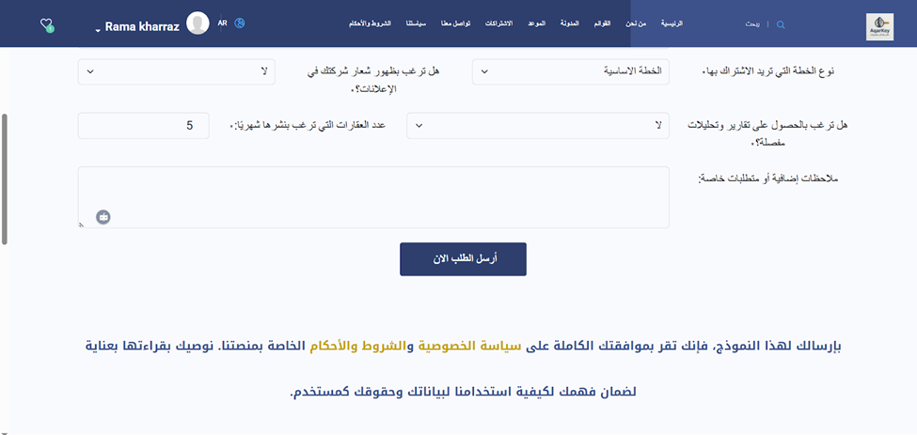
Aqarkey
Subscription form

Slide 43
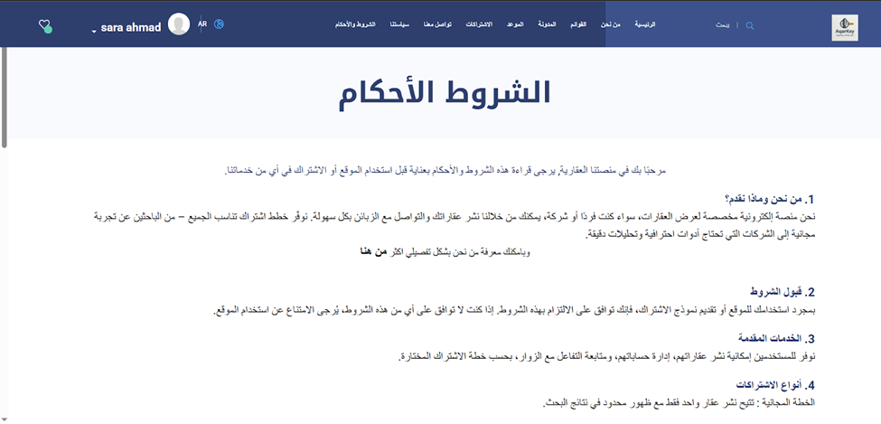
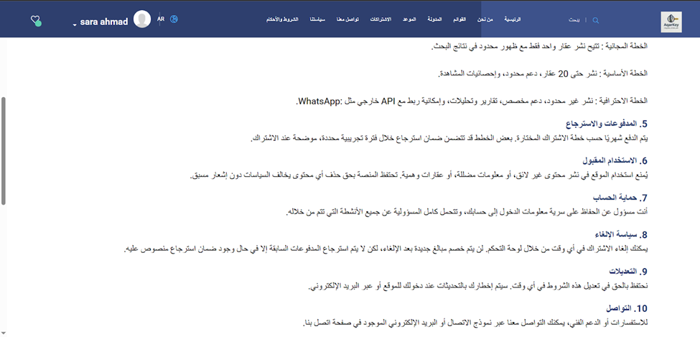
Aqarkey
Terms and Conditions

Slide 44
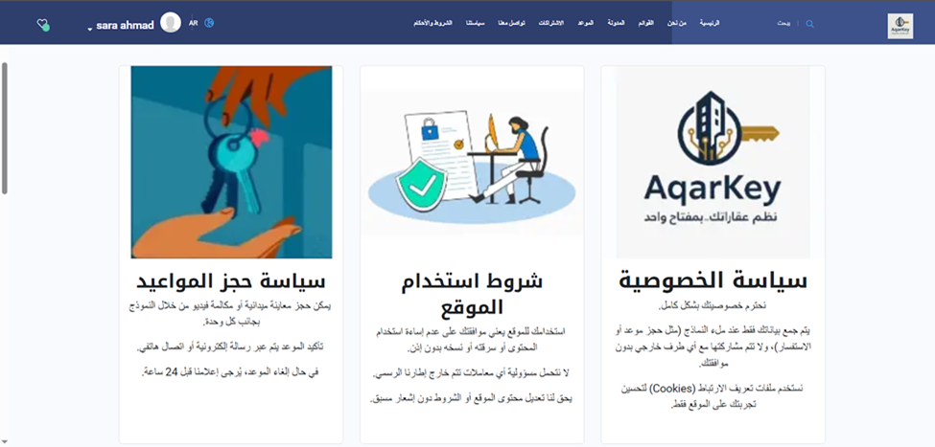
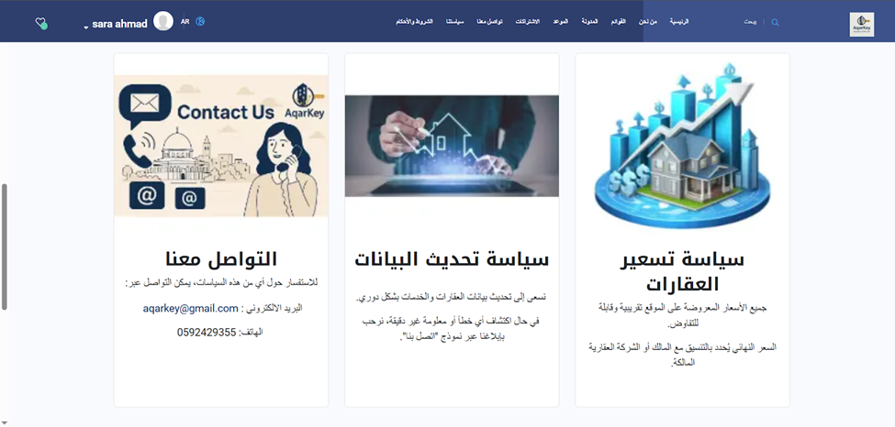
Aqarkey
Our policy

Slide 45
Where does the subscription form go and where does it reach us ?

Slide 46
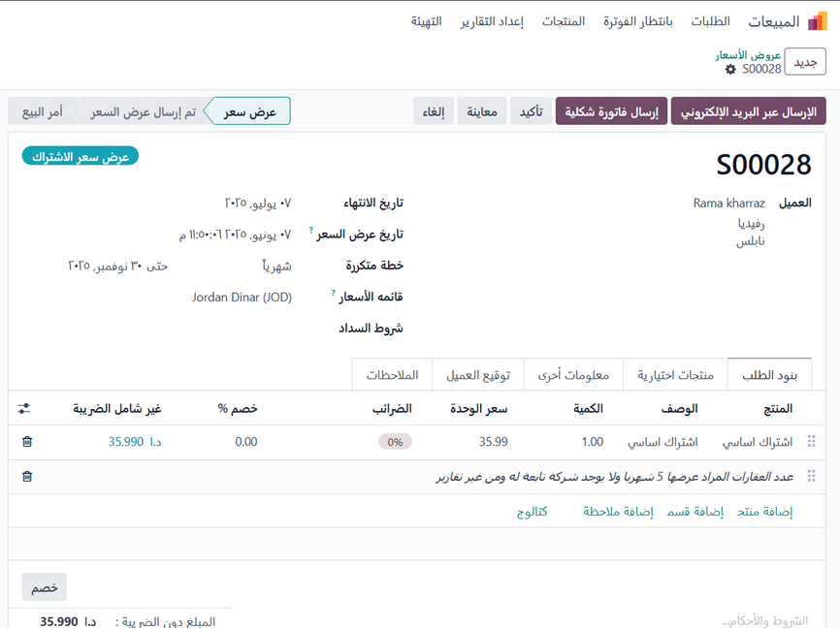
Sales
Aqarkey

Slide 47
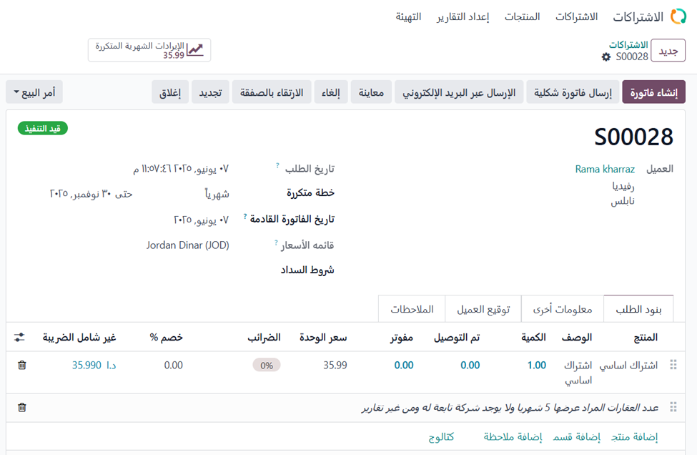
Subscriptions
Aqarkey

Slide 48
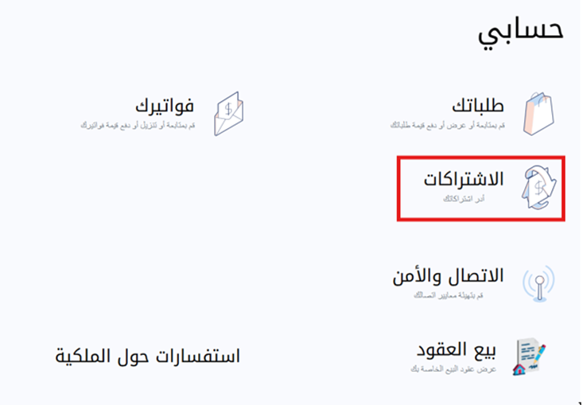
Aqarkey
User Account

Slide 49
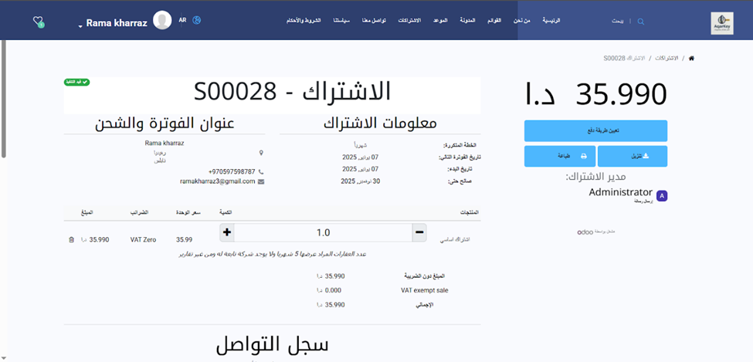
User Account
Aqarkey

Slide 50



Aqarkey
Subscription payment

Slide 51

Aqarkey
Invoice

Slide 52

Aqarkey
Customer invoice

Slide 53

Aqarkey
Real Estate Companies Profile

Slide 54

Aqarkey
Al Basha Company Dashboard

Slide 55


Aqarkey
Appointments
Interested clients

Slide 56

Aqarkey

Slide 57




Aqarkey
Contact us form

Slide 58
Aqarkey
Where do we receive a property offer request?

Slide 59



CRM
Aqarkey

Slide 60




Aqarkey
1

Slide 61

Aqarkey
2

Slide 62


Aqarkey

Slide 63


Aqarkey

Slide 64


Aqarkey

Slide 65


Aqarkey

Slide 66

Aqarkey

Slide 67

Aqarkey

Slide 68

Aqarkey
Book an appointment

Slide 69

Aqarkey
Book an appointment

Slide 70


Aqarkey

Slide 71

Aqarkey

Slide 72

Aqarkey

Slide 73


Aqarkey

Slide 74

Aqarkey

Slide 75

Aqarkey

Slide 76


Aqarkey
Property reservation

Slide 77

Aqarkey

Slide 78

Aqarkey

Slide 79

Aqarkey

Slide 80


Aqarkey

Slide 81

Aqarkey

Slide 82

Aqarkey

Slide 83


Aqarkey

Slide 84

Aqarkey
Contact us form Property search

Slide 85

Aqarkey
Contact us form

Slide 86

Aqarkey
CRM

Slide 87


Aqarkey
live chat

Slide 88

Aqarkey
live chat

Slide 89

Aqarkey
live chat

Slide 90

Aqarkey
Chatbot

Slide 91

Aqarkey
Chatbot

Slide 92


Chatbot
Aqarkey

Slide 93

Aqarkey
User Guide

Slide 94

Aqarkey

Slide 95

Aqarkey
BLACK LIST :

Slide 96


Aqarkey
AqarKey Administrator Dashboard

Slide 97

Aqarkey
AqarKey Administrator Dashboard

Slide 98

Aqarkey
AqarKey Administrator Dashboard

Slide 99

Aqarkey
AqarKey Administrator Dashboard

Slide 100

Aqarkey
AqarKey Administrator Dashboard

Slide 101


Aqarkey
AqarKey Administrator Dashboard

Slide 102

Aqarkey
AqarKey Administrator Dashboard

Slide 103



Aqarkey
Recommendations:
Launching a Mobile Application (Android and iOS)
Integrating with AI Technologies, Especially Text Mining
Geographical Expansion in the Middle East

Slide 104
Thank You

