Slide 1

HOT DRINK VENDING MACHINE
Malik Ali & Shaheen Abbas
Dr. Moien Omar & Dr. Samer mayaleh
JANUARY 2026

Slide 2
TABLE OF CONTENTS
01 Idea & Overview
05 Future Work
02 Features
06 Questions
03 Methodology
04 Constrains

Slide 3
IDEA
& OVERVIEW

Slide 4
Ouer Idea
  A Hot Beverage machine that automates the full process

Slide 5
Ouer Idea
  A Hot Beverage machine that automates the full process
  water heating

Slide 6
Ouer Idea
  A Hot Beverage machine that automates the full process
  water heating
2. cup dispensing

Slide 7
Ouer Idea
  A Hot Beverage machine that automates the full process
  water heating
2. cup dispensing
3. dropping the powder

Slide 8
Ouer Idea
  A Hot Beverage machine that automates the full process
  water heating
2. cup dispensing
3. dropping the powder
4. mixing

Slide 9
Objectives
  fully-automated machine

Slide 10
Objectives
  fully-automated machine
  ensure beverage consistency through precies

Slide 11
Objectives
  fully-automated machine
  ensure beverage consistency through precies
  real-time ingredient monitoring and automated alerts

Slide 12

FEATURES
multi drinks in on machine
Heating
Automatic cup dispensing

Slide 13
FEATURES
auto heater refill
consistent mixing
dual user control

Slide 14
MTHODOLOGY

Slide 15
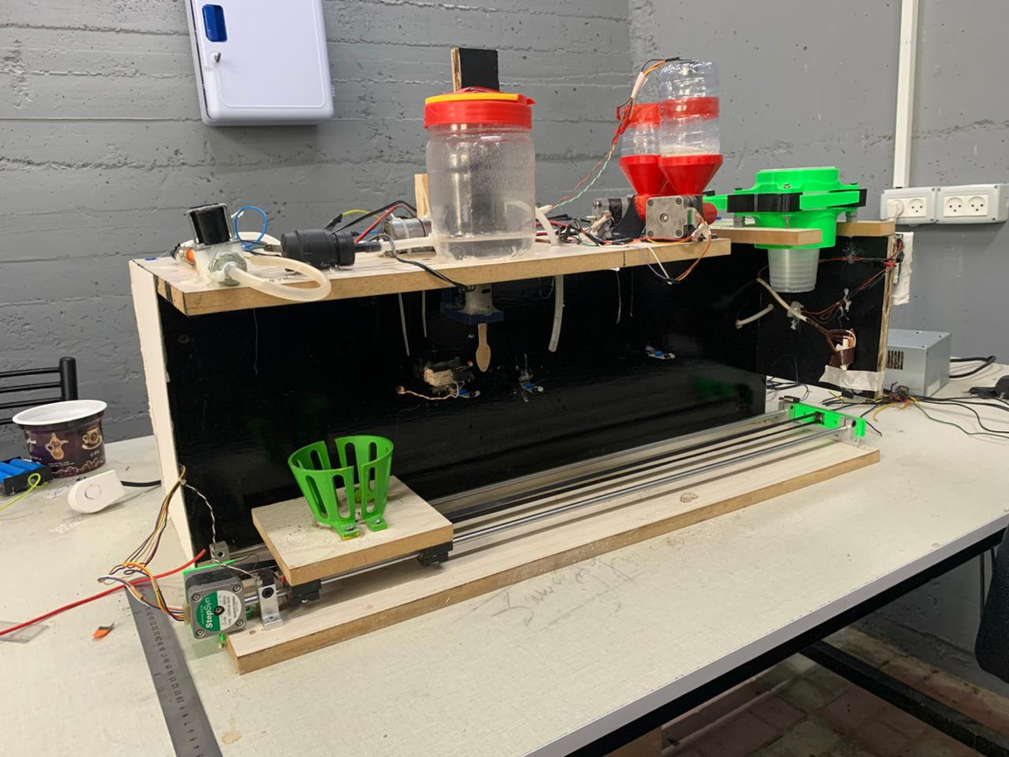

cup dispensing
water tank
powder holders
System Architecture
mixing
Tools
System stages
User Action
cup holder & slider

Slide 16
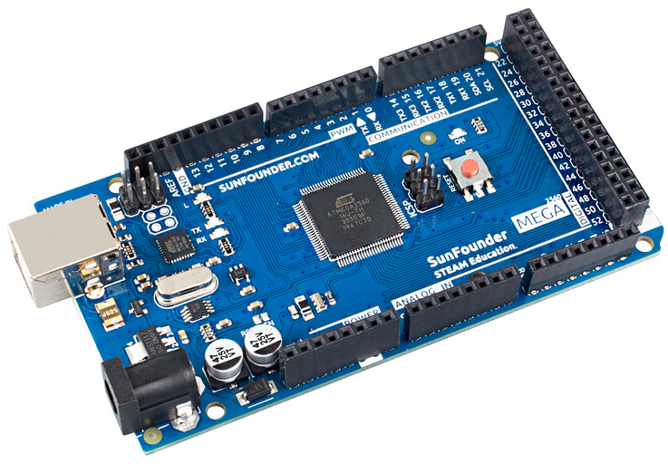
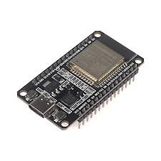
System Architecture
microcontrollers
sensors
Tools
Motors
System Stages
Drivers
pumps
User Actions
I/O devices

Slide 17
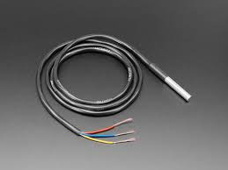
System Architecture
microcontrollers
DS18B20
sensors
Tools
Motors
System Stages
Drivers
pumps
User Actions
I/O devices

Slide 18
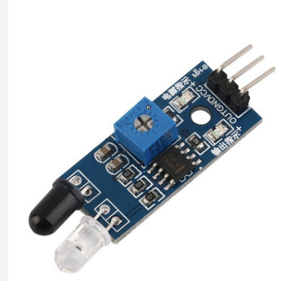
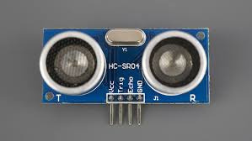
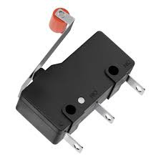
System Architecture
microcontrollers
sensors
Tools
Motors
System Stages
Drivers
pumps
User Actions
I/O devices

Slide 19
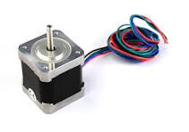
stepper motor nema17 (x5)
System Architecture
microcontrollers
sensors
Tools
Motors
System Stages
Drivers
pumps
User Actions
I/O devices

Slide 20
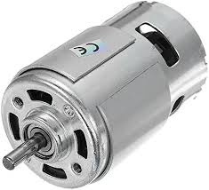
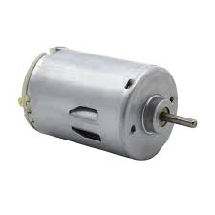
DC motor X2
System Architecture
microcontrollers
sensors
Tools
Motors
System Stages
Drivers
pumps
User Actions
I/O devices

Slide 21
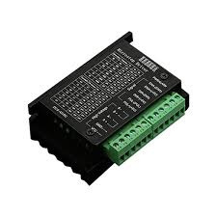
System Architecture
microcontrollers
TB6600 3.5A (x5)
sensors
Tools
Motors
System Stages
Drivers
pumps
User Actions
I/O devices

Slide 22
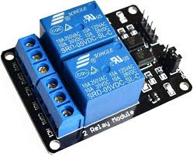
System Architecture
microcontrollers
2 channel relay(x2)
sensors
Tools
Motors
System Stages
Drivers
pumps
User Actions
I/O devices

Slide 23
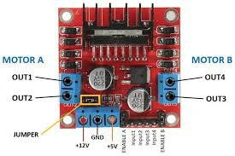
System Architecture
microcontrollers
H-bridge
sensors
Tools
Motors
System Stages
Drivers
pumps
User Actions
I/O devices

Slide 24
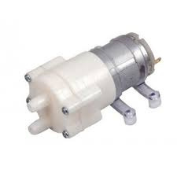
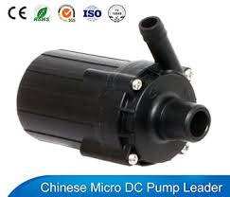
System Architecture
microcontrollers
12v DC pump (x2)
sensors
Tools
Motors
System Stages
Drivers
pumps
User Actions
I/O devices

Slide 25
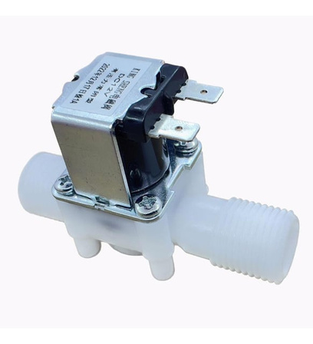
System Architecture
microcontrollers
sensors
12v solenoid valve
Tools
Motors
System Stages
Drivers
pumps
User Actions
I/O devices

Slide 26
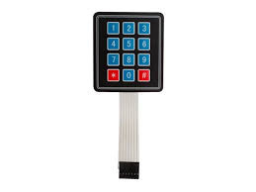
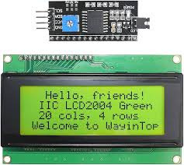
System Architecture
microcontrollers
4*3 keybad
sensors
Tools
Motors
System Stages
Drivers
20*4 lcd with I2C
pumps
User Actions
I/O devices

Slide 27
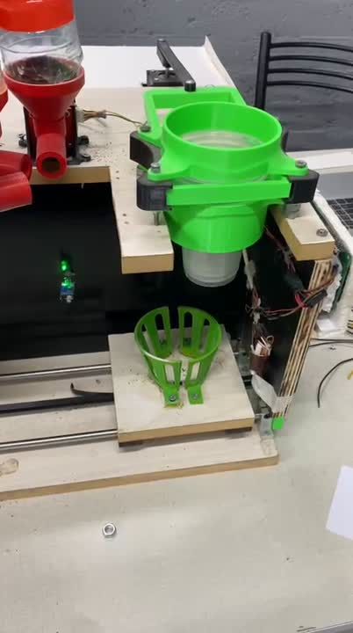
System Architecture
Homing Slider
cup dispensing
Tools
Powder dispensing
System Stages
Hot water fill
mixing
User Actions
move to end and refill heater

Slide 28
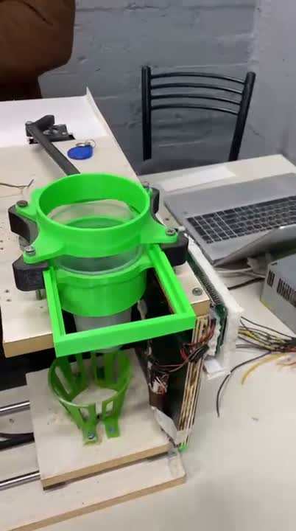
System Architecture
Homing Slider
cup dispensing
Tools
Powder dispensing
System Stages
Hot water fill
mixing
User Actions
move to end and refill heater

Slide 29
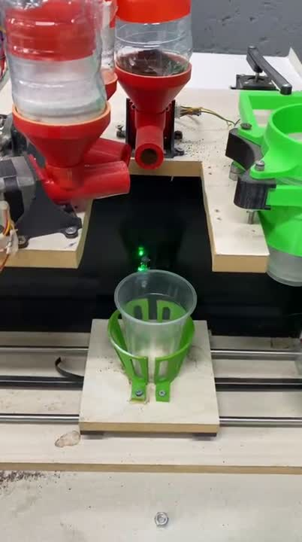
System Architecture
Homing Slider
cup dispensing
Tools
Powder dispensing
System Stages
Hot water fill
mixing
User Actions
move to end and refill heater

Slide 30
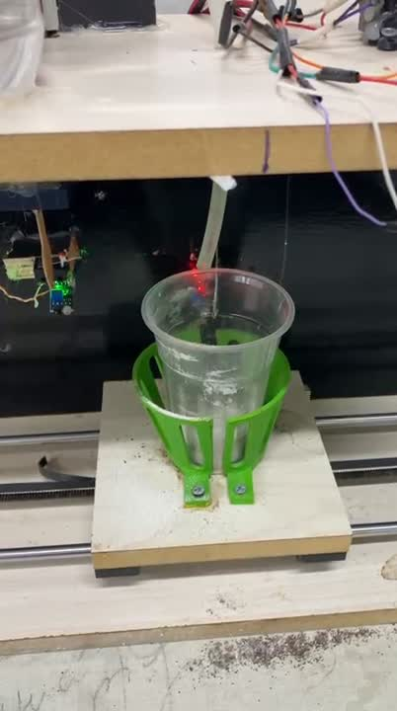
System Architecture
Homing Slider
cup dispensing
Tools
Powder dispensing
System Stages
Hot water fill
mixing
User Actions
move to end and refill heater

Slide 31
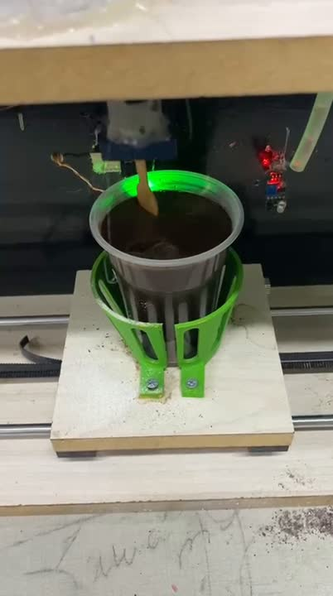
System Architecture
Homing Slider
cup dispensing
Tools
Powder dispensing
System Stages
Hot water fill
mixing
User Actions
move to end and refill heater

Slide 32
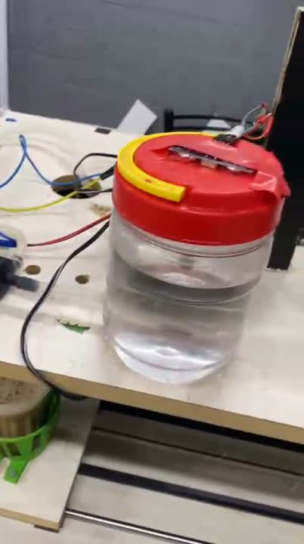
System Architecture
Homing Slider
cup dispensing
Tools
Powder dispensing
System Stages
Hot water fill
mixing
User Actions
move to end and refill heater

Slide 33
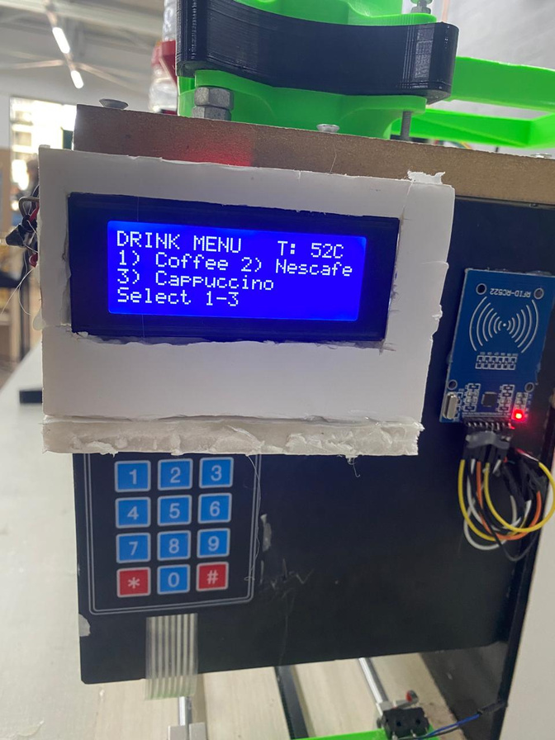
System Architecture
user
Tools
System Stages
User Actions

Slide 34
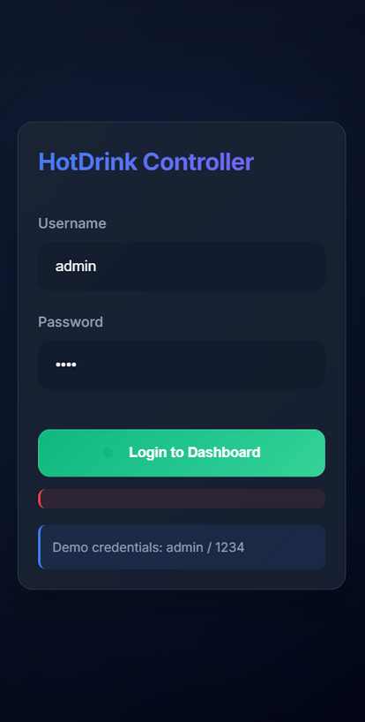
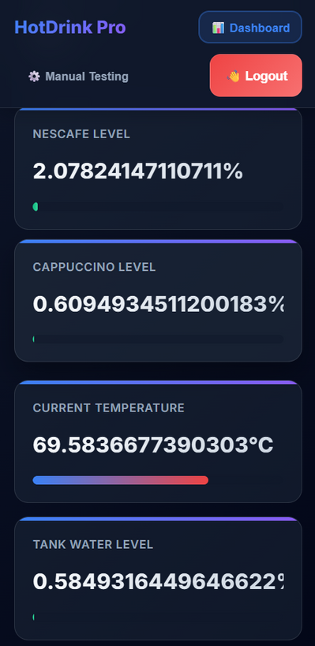
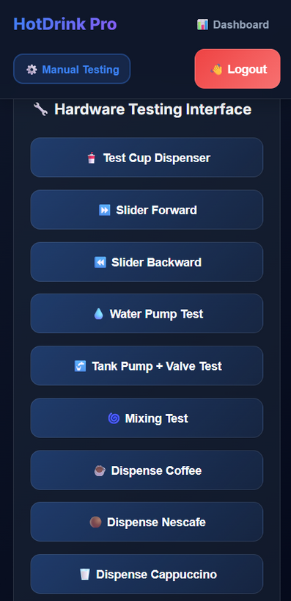
System Architecture
Admin
Tools
System Stages
User Actions

Slide 35
CONSTRAINS
  Cost
  Lack of mechanical experience

Slide 36
FUTURE WORK
  multiple cup sizes
  integrate real payment

Slide 37

THANK YOU 🙏🏻

