Slide 1
Design of Future Transportation System For Palestine Technical University
Praperd By:
Firas B.M. Jammal
Bashar B.A. Saadeh
Mahmoud F.A. Shayeb
supervision of: Prof. Sameer Abu-Eisheh

Slide 2
Outline
1- Introduction
2-methodology
3- Data collection
4- Data analysis
5- Design Stage.
6- Bill of Quantity.
7- Conclusion and Recommendations

Slide 3
Introduction

Slide 4
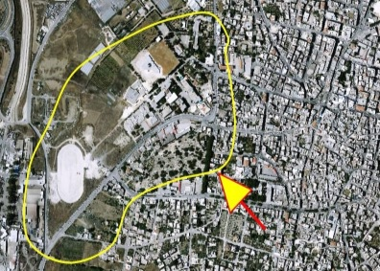
Introduction
The university attracts a students from different locations to study in.
Traffic is growing at the campus and to/from it due to continuous increase in number of students.
Need to study the current status of transportation system and analyze future transportation for the university and around it.
Eventually, the project will assist to propose measures to better satisfy demand for vehicles and pedestrians, public transport, parking and to manage and improve the performance of intersections/ roads around the campus.

Slide 5
Methodology

Slide 6
Methodology
Literature Review
Data Collection
Data Analysis
Design Development

Slide 7
Traffic/Transportation Studies
Inventory study
Traffic volume/ Pedestrian study
Traffic volume/ Pedestrian analysis
Public transportation study
Public transportation analysis
Parking
Study
Parking analysis
Questionnaire
Questionnaire analysis

Slide 8
Design Stages
Horizontal and Vertical Alignment
Cross Section
Design of parking facilities
Design of Public Transportation Terminal
Roundabout Design
Intersections Design

Slide 9
Data Collection

Slide 10
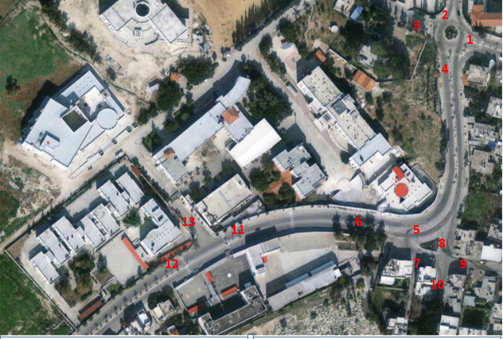
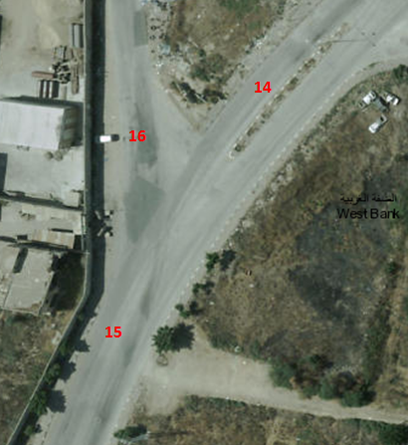
Inventory study
- Inventory study done for 16 links – access and surrounding streets.

Slide 11
Inventory study
 | East to West (m) |  |  |  | West to East(m)
No.of Link | Side walk width | No.of lane | Width of lane | Width of parking | Side walk width | No.of lane | Width of lane | Width of parking | Median | Width right of way
1 | 2.8 | 1 | 4.5 | 2 | 2.5 | 1 | 4.5 | 2 | 1.2 | 19.5
2 | 2 | 1 | 4.6 | No parking | 2 | 1 | 4.6 | No parking | 1.2 | 14.4
3 | 2 | 2 | 2.8 | No parking | 2 | 2 | 2.8 | No parking | 2 | 17.2
4 | 3.20 | 1 | 4.5 | 2 | 2.30 | 1 | 4.5 | 2 | 1.2 | 19.7
5 | 1.2 | 2 | 4.5 | No parking | 2 | 3 | 3 | 2 | .65 | 23.2
6 | 1.9 | 2 | 2.85 | 2 | 2.9 | 2 | 2.3 | 2 | 1.5 | 18.6
7 | 1.4 | 1 | 5.15 | No parking | 1.2 | 1 | 5.15 | No parking | No median | 12.9
8 | 3.15 | 2 | 3.1 | No parking | 1.2 |  |  | No parking | No median | 10.55
9 | 3.1 | 1 | 3 | 2 | 3.3 | 1 | 3 | 2 | No median | 16.4
10 | 2.8 | 1 | 5.3 | No parking | 3.1 | 1 | 5.3 | No parking | No median | 16.5
11 | 2.4 | 2 | 2.65 | 2 | 2.6 | 2 | 2.7 | 2 | 1.8 | 21.5
12 | 1.5 | 2 | 2.6 | 2 | 2.5 | 2 | 2.5 | 2 | No median
13 | 2.1 | 1 | 4.7 | No parking | 1.8 | 1 | 4.7 | No parking | No median | 13.3
14 | 2 | 2 | 3.6 | No parking | 2.5 | 2 | 3.6 | No parking | 1.8 | 20.7
15 | 2 | 2 | 3.5 | No parking | 2 | 2 | 3.5 | No parking | No median | 18
16 | No | 1 | 3.2 | No parking | No | 1 | 3.2 | No parking | No median | 6.4

Slide 12
Traffic volume counts
The traffic volume was collected manually at the main critical intersections around the campus and providing access to the university.
The count was conducted from 7:30am-4:15pm on 15 March 2017 for Kadoorie Main Entrance intersection.
Based on the results, the peak hour at the intersection was from (2:30pm-3:30pm), where this hour was considered to collect data for traffic volume for the other intersections around the university.
Counts were conducted on 4 intersections:
Kadoorie Main Entrance intersection (roundabout).
Ihsan samara intersection .
Industrial school intersection.
Rtah intersection.

Slide 13
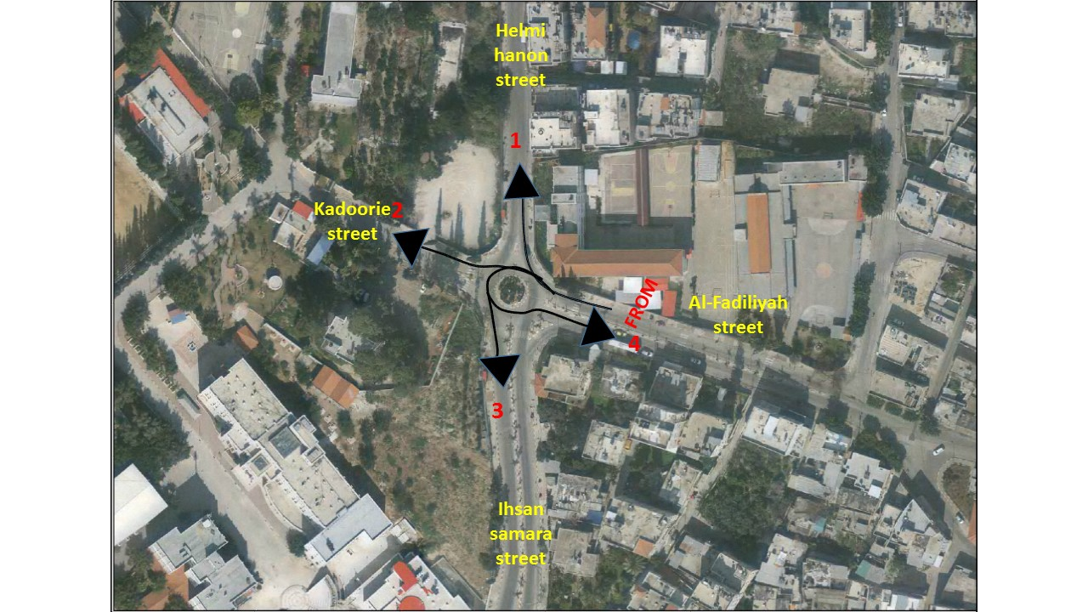
Traffic volume counts
Khadoorie Main Entrance intersection
1. Al-Fadiliyah Approach
 | Helmi hanon street (1) |  |  | Kadoorie street (2) |  |  | Ihsan samara street (3) |  |  | Al-Fadiliyah street(U-turn)(4) |  |  | Sum
time/vehicle class | Cars | Bus | Truck | Cars | Bus | truck | cars | Bus | truck | cars | Bus | truck
1.30-1.45 | 47 | 1 | 0 | 3 | 0 | 0 | 53 | 1 | 2 | 5 | 0 | 0 | 112
1.45-2.00 | 28 | 1 | 0 | 5 | 1 | 0 | 50 | 0 | 2 | 7 | 0 | 0 | 94
2.00-2.15 | 37 | 0 | 0 | 4 | 0 | 0 | 55 | 0 | 2 | 5 | 0 | 0 | 103
2.15-2.30 | 40 | 0 | 0 | 6 | 0 | 0 | 46 | 1 | 1 | 5 | 0 | 0 | 99
Peak hour | 1:30pm-2:30pm
Peak hour volume | 408
Peak hour factor | 0.91
Design Heavy vehicles %(Bus+ truck) | 5.15%

Slide 14
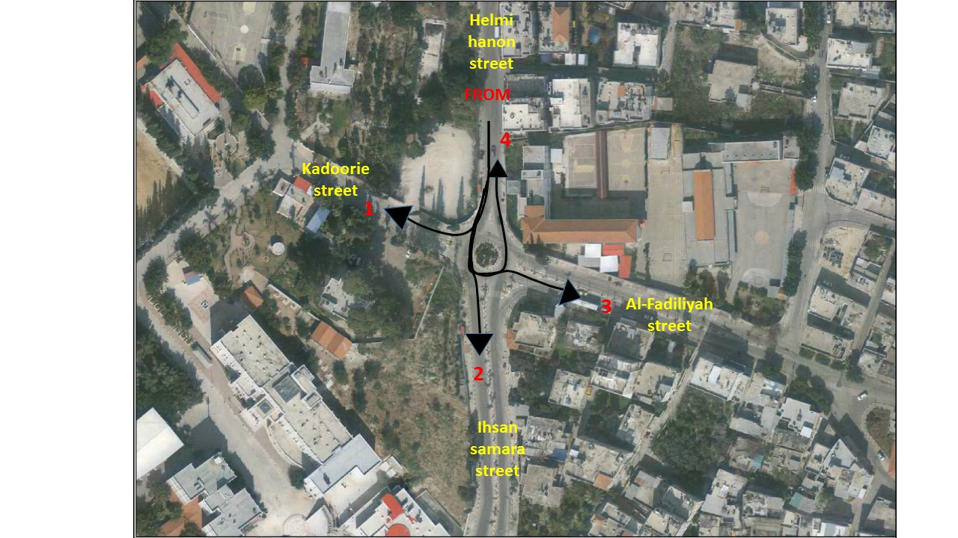
Traffic volume counts
2. Helmi Hanoon Street
 | Khadoorie Street(1) |  |  | Ihasan Samara Street (2) |  |  | AL-Fadiliya Street (3) |  |  | Helmi hanoon street (U turn ) (4) |  |  | sum
time/vehicle class | car | Bus | truck | private car | Bus | Truck | Car | Bus | truck | car | Bus | Truck
1.15-1.30 | 6 | 0 | 0 | 70 | 4 | 1 | 9 | 0 | 0 | 3 | 1 | 1 | 95
1.30-1.45 | 3 | 1 | 0 | 59 | 2 | 3 | 12 | 0 | 0 | 1 | 0 | 0 | 81
1.45-2.00 | 1 | 0 | 0 | 62 | 2 | 0 | 14 | 1 | 1 | 2 | 0 | 1 | 84
2.00-2.15 | 1 | 0 | 0 | 58 | 1 | 2 | 18 | 0 | 0 | 3 | 0 | 0 | 83
Peak hour | 1:15pm-2:15pm
Peak hour volume | 343
Peak hour factor | 0.9
Design Heavy vehicles %(Bus+ truck) | 6.10%

Slide 15
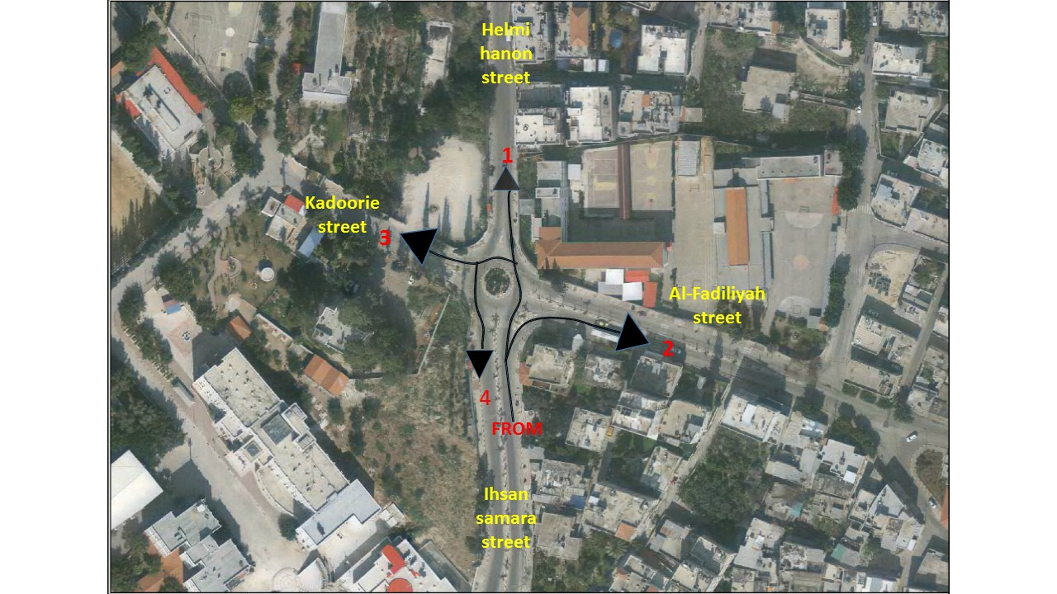
Traffic volume counts
3. Ihsan samara street
 | Helmi hanon street (1) |  |  | Al-Fadiliyah street (2) |  |  | Kadoorie street (3) |  |  | Ihsan samara street(U-turn) (4) |  |  | sum
time/vehicle class | Car | Bus | truck | Car | Bus | Truck | car | Bus | truck | car | Bus | truck
1.00-1.15 | 73 | 4 | 1 | 45 | 1 | 0 | 3 | 0 | 0 | 7 | 0 | 0 | 134
1.15-1.30 | 47 | 4 | 3 | 24 | 0 | 0 | 4 | 0 | 0 | 3 | 0 | 0 | 85
1.30-1.45 | 63 | 1 | 1 | 61 | 0 | 0 | 1 | 0 | 0 | 29 | 1 | 0 | 157
1.45-2.00 | 62 | 1 | 3 | 37 | 2 | 2 | 2 | 0 | 0 | 15 | 0 | 0 | 124
Peak hour | 1:00pm-2:00pm
Peak hour volume | 500
Peak hour factor | 0.8
Design Heavy vehicles %(Bus+ truck) | 4.80%

Slide 16
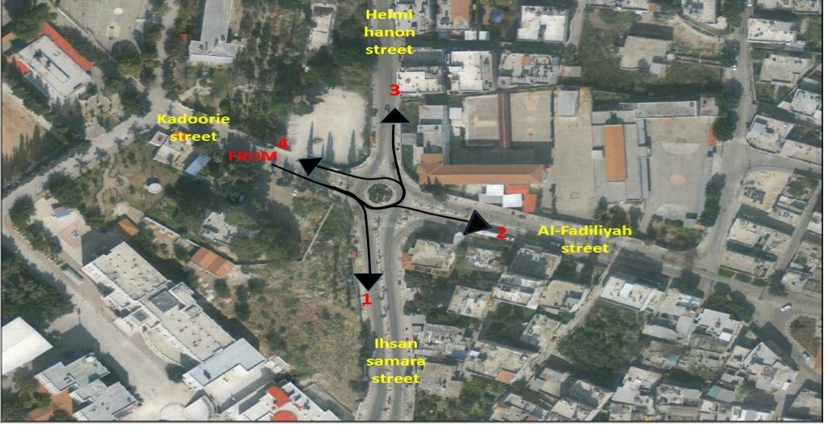
Traffic volume counts
4. Khadoorie Street
 | Ihsan samara street (1) |  |  | Al-Fadiliya street (2) |  |  | Helmi Hanoon street (3) |  |  | Khadoorie Street ( U-turn) (4)
 |  |  |  |  |  |  |  |  |  |  |  |  | Sum
time/vehicle class | Car | Bus | Truck | car | Bus | Truck | Car | Bus | truck | Car | Bus | Truck
2.30-2.45 | 4 | 0 | 0 | 0 | 0 | 0 | 2 | 0 | 0 | 1 | 0 | 0 | 7
2.45-3.00 | 18 | 0 | 0 | 15 | 0 | 0 | 13 | 0 | 0 | 0 | 0 | 0 | 46
3.00-3.15 | 29 | 0 | 0 | 16 | 0 | 0 | 18 | 0 | 0 | 0 | 0 | 0 | 63
3.15-3.30 | 9 | 0 | 0 | 6 | 0 | 0 | 8 | 0 | 0 | 0 | 0 | 0 | 23
Peak hour | 2:30pm-3:30pm
Peak hour volume | 139
Peak hour factor | 0.55
Design Heavy vehicles %(Bus+ truck) | 0%

Slide 17
Traffic volume counts
Calculate traffic volume the inside of kashuri intersection for peak hour morning:
time/vehicle class | Sum
2:30-2:45 | 257
2:45-3:00 | 270
3:00-3:15 | 297
3:15-3:30 | 369
Peak hour | 2:30pm-3:30pm
Peak hour volume | 1163
Peak hour factor | 0.79
Design Heavy vehicles %(Bus+ truck) | 1.8%

Slide 18
Pedestrian counts
Pedestrian volume studies were conducted from 7:15am-4:am
In two days to calculation peak hour volume .
The volume studies were conducted for sidewalk counts for 9 links and others 3 for crosswalk
Links:
Al-Fadiliyah Street
Helmi Hanoun Street
The main entrance to Palestine technical university
Ihsan Samara Street
Agriculture College street (within the university)
Sport collage street (within the university)
Road-leading-to-colleges-Khadouri street (within the university)
Entrance continuing education
The entrance to the industrial school

Slide 19
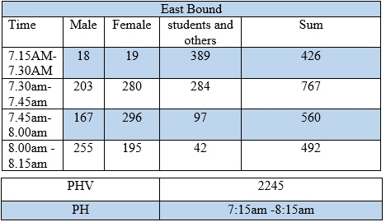
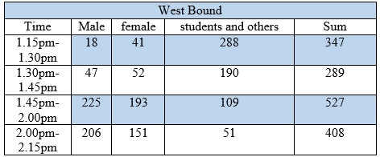
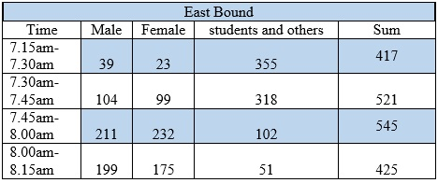
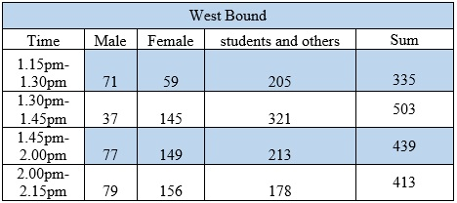

Pedestrian counts:
Al-Fadiliyah Street
The morning peak hour was on the east side and afternoon peak hour on west side. Study conducted on Wednesday 8/2/2017
Study conducted on Thursday 9/2/2017

Slide 20
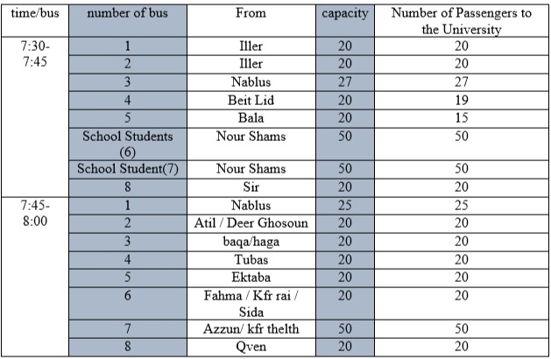
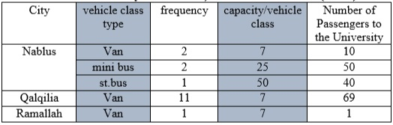
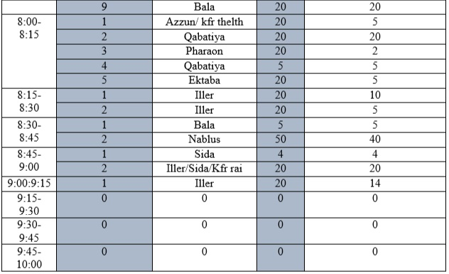
Public transportation studies
Transportation of public transport was considering the number of public transportation vehicles )buses, vans, private taxis) to the entrance of the university from different cities and villages.
Study was conducted in front of the main entrance to the university on 12/3/2017 from 7:30am to 10 am.
Summary for the vans, minibus and Standard BUS (Cities)
Public transportation (Villages Buses)

Slide 21
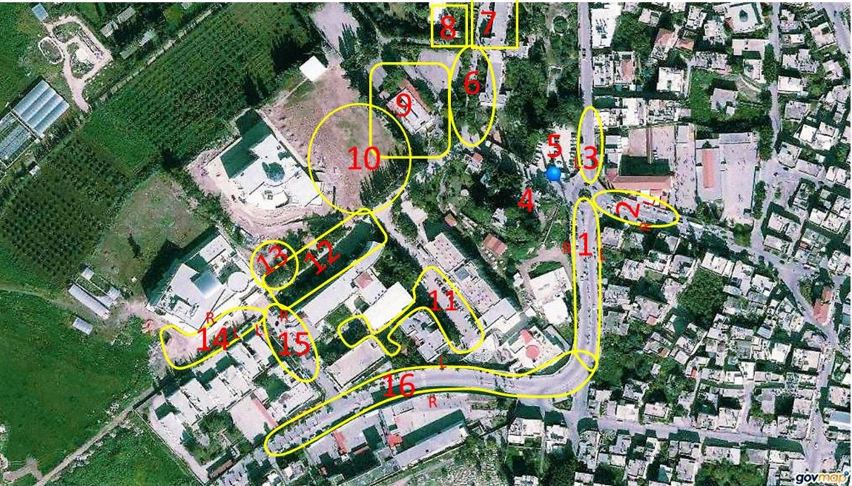
Parking studies
The parking study was counted in several zones inside and outside the university parking on 20/2/2017 from 7am to 3:30pm.

Slide 22
Parking studies
show a sample parking collection for zone (1) and show summarized for important basic calculation for zone.

Slide 23
Questionnaire
The purpose of the questionnaire was to involve in the users determining the future aspects of the traffic system at the university in addition to identifying the extent of user’s acceptance of new services.
An electronic copy was shared on Facebook for Palestine Technical University-Kadoorie (PTUK) students.
The size of sample was calculated by using scientific procedures.
Sample size for analysis was 361 sample.

Slide 24
Data analysis

Slide 25
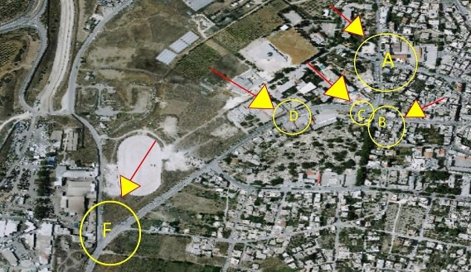
Traffic volume analysis
Peak Hour Traffic volumes and PHF were calculated for intersections.
Results were used to find the level of service using Highway Capacity Software for intersection (HCS2000), and Highway Capacity Manual. For the roundabout(Kadoorie Main Entrance intersection).
These intersections are in the figure.

Slide 26
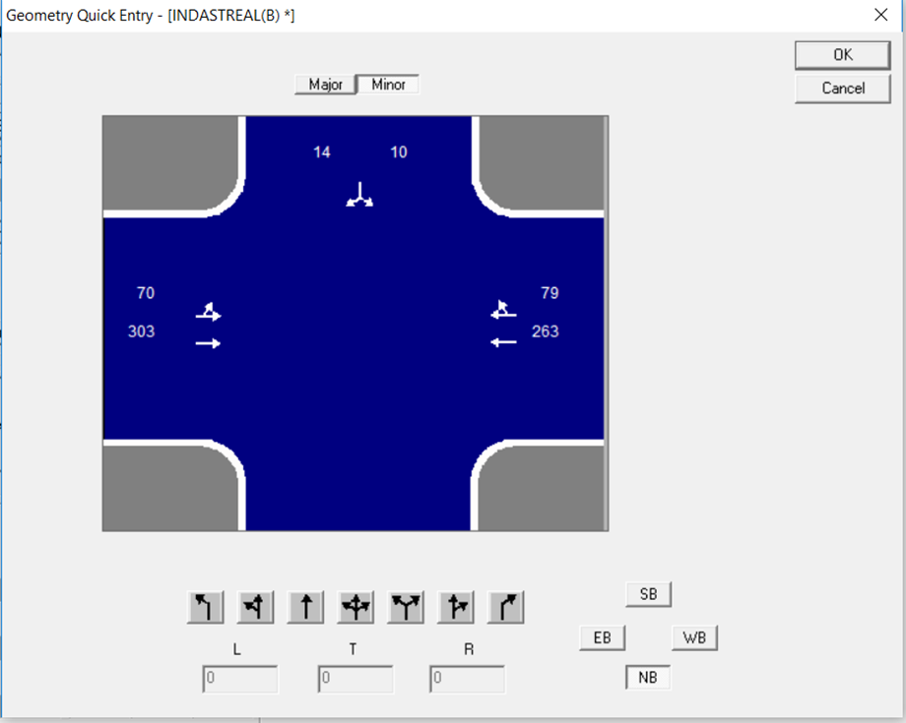
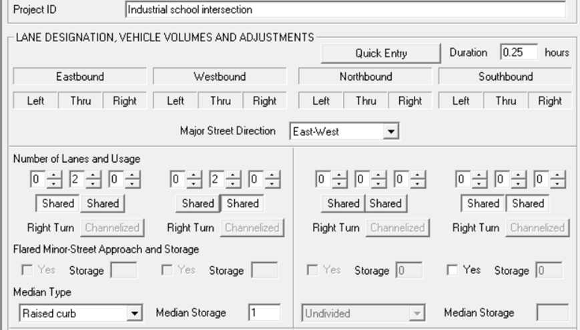
Traffic volume analysis
Sample calculation:
Level of service analysis for Industrial School Intersection (intersection D) using (HCS2000) based on entering traffic volumes.

Slide 27
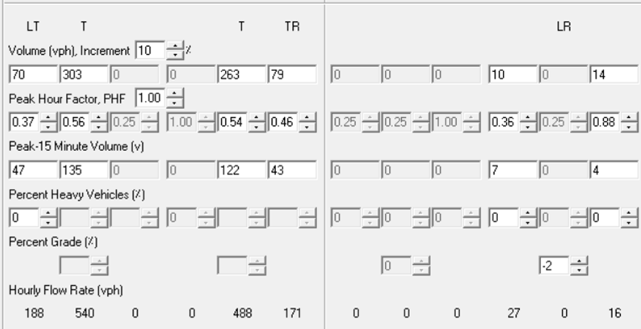
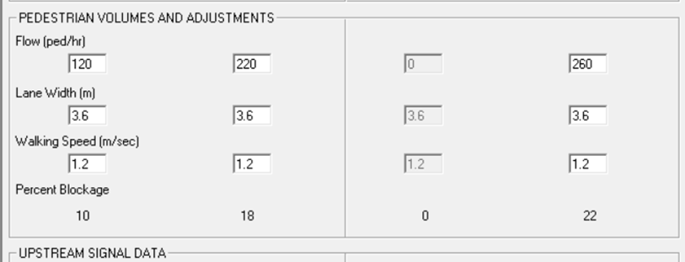
Traffic volume analysis

Slide 28
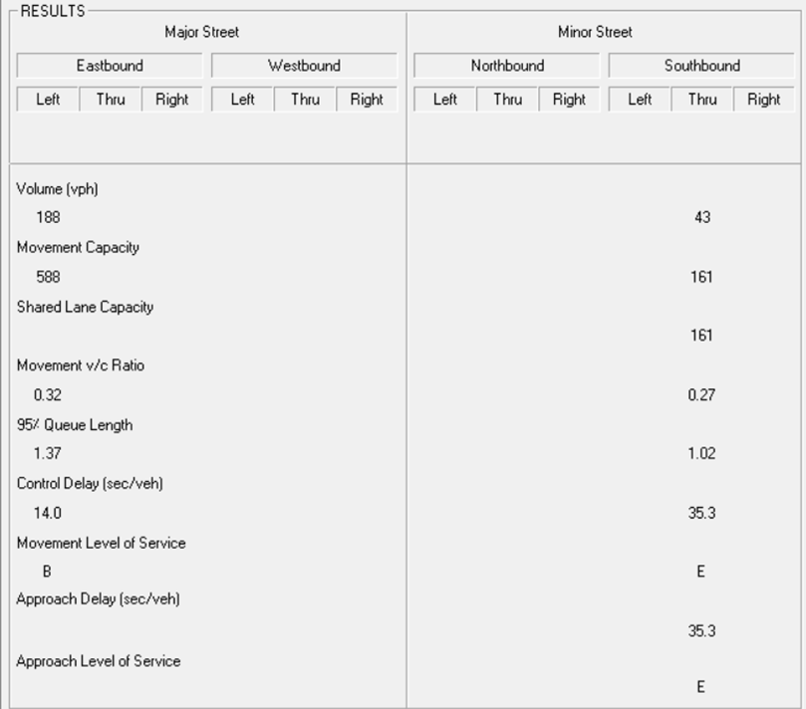
Traffic volume analysis
Delay (s/veh) =$\frac{Σcontrol delay x volume}{Σvolume}$=$\frac{14×188+35.3×43}{188+43}$=17.96
Level of service is C
Intersection Number | intersection | Peak hour | LOS in this period | LOS after 15 years
1 | Al Mqbra | 2:30pm-3:30pm | C | F
2 | Ihsan samara | 2:30pm-3:30pm | B | F
3 | Industrial | 7:30am-8:30am | C | F
4 | Kashori | 7:30am-8:30am | B | F

Slide 29
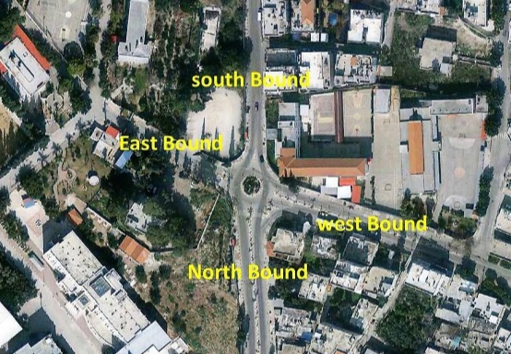
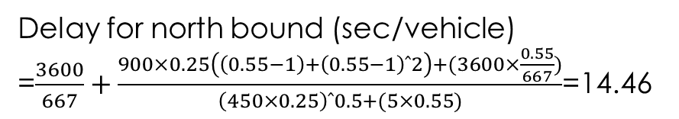
Traffic volume analysis
Level of service for Kadoorie Main Entrance roundabout using Highway Capacity Manual .
Delay was found for the approaches and for the roundabout now and for the future.
Assume T=0.25 |  |  | 0.25
Delay/Lane
 | NORHTBOUND | SOUTHBOUND | EASTBOUND | WESTBOUND
lane | 14.46 | 11.95 | 80.01 | 82.06
bypass |  |  |  | 6.80
Approach | LOS
northbound | B
southbound | B
Eastbound | F
westbound | F
northbound bypass | A
Total Delay for roundabout 2017 | 38.94 | LOS | E
Total Delay for roundabout after 15 years | 1596.39 | LOS | F

Slide 30
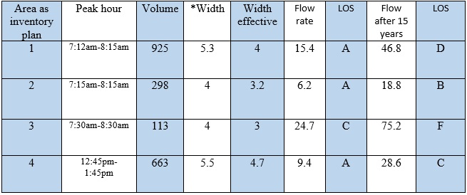
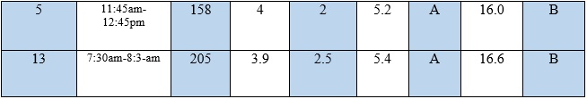
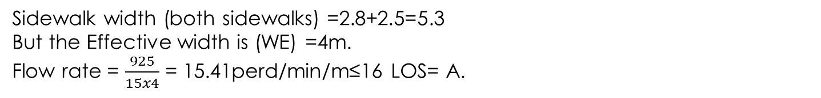
Pedestrian analysis
Sample calculation:
Al-Fadiliyah Street (Wednesday 8/2/2017 )
Peak hour =7:15AM -8:15AM
Consider the heaviest quarter in the peak hour
Volume = 767+158 = 925 perd/15min.
Sidewalk width (both sidewalks) =2.8+2.5=5.3
But the Effective width is (WE) =4m.
Flow rate = $\frac{925}{15x4}$ = 15.41perd/min/m≤16 LOS= A.

Slide 31
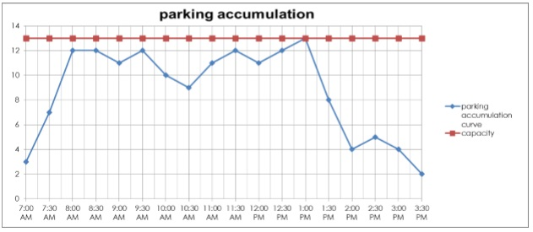
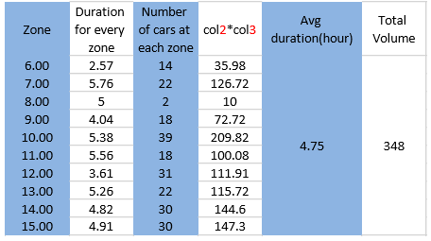
Parking analysis
After collecting the parking data and making some basic calculations, data are analyzed as shown in the Table.
Sample:
Parking accumulation for zone 1 in figure.
Calculation of parking for whole the campus:

Slide 32
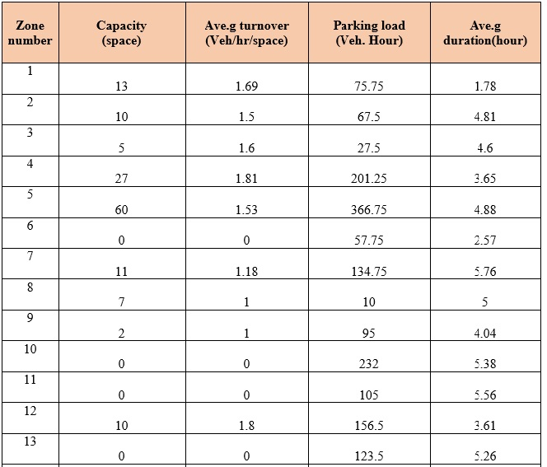
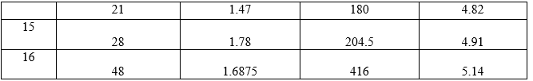
Parking analysis
Key parking variables for different zones.

Slide 33
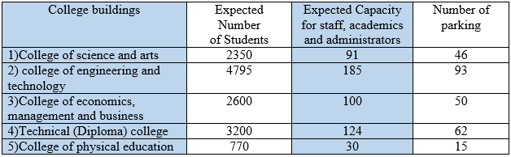
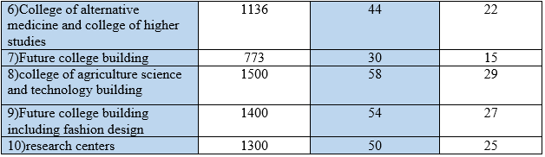
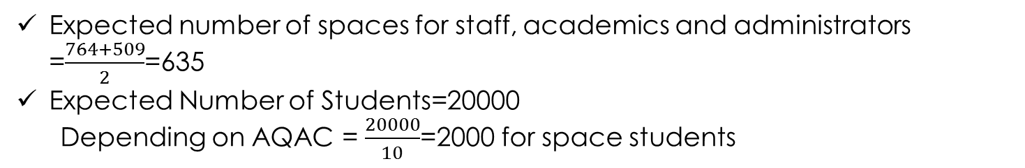
Parking analysis
Expected parking need after 15 years for each college and for campus university.
Expected number of spaces for staff, academics and administrators =$\frac{764+509}{2}$=635
Expected Number of Students=20000
Depending on AQAC = $\frac{20000}{10}$=2000 for space students

Slide 34
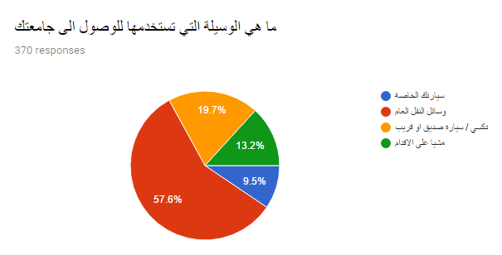
Questionnaire analysis:
After looking at the results of the questionnaire, these percentages were calculated to find the extent to which students expected to use public transportation by students.
Students using private cars to arrive to the university is = 9.5%×6500=620 student.
Students using taxi or ride with their friends to arrive to the university=19.7%*6500=1281 student.
Students using public transportation (coming from outside Tulkarm to the main terminal or dropped in front of the university) = 57.6%*6500=3744 student.
Students coming on foot=13.2%*6500=858 student.(Note: This may mean from the city itself, as this is an unrealistic value because 57.6% come to city by public transportation then come to university by feet)

Slide 35
Design of Facilities

Slide 36
Design Criteria
Design Standards for roadway.
Design Vehicle .
Design speed.
Cross section Elements .
Travel Lane Width b. Medians
c. Sidewalks d. Bicycle Lanes
parking lots.
Marking and signing.

Slide 37
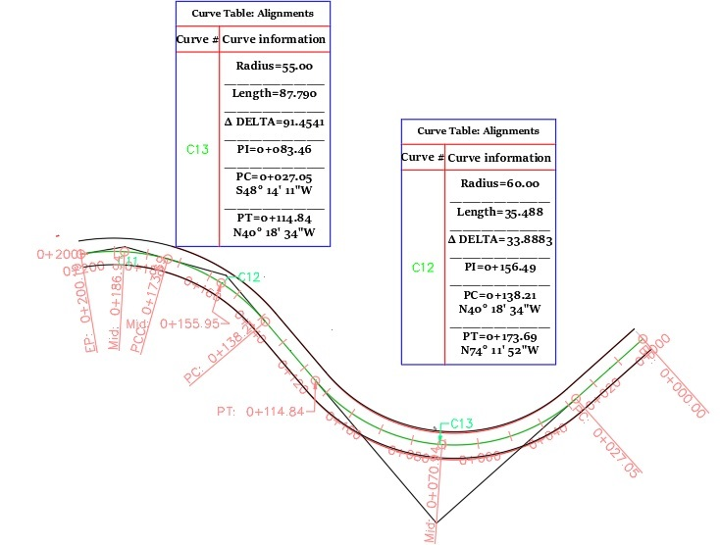
Horizontal Alignment
This project contains three kinds of horizontal curves: simple curves, reverse curves, compound curves.
Sample design
Horizontal Alignment for road 4 in master plan using civil3d AutoCAD with taking design standards for roadway.

Slide 38
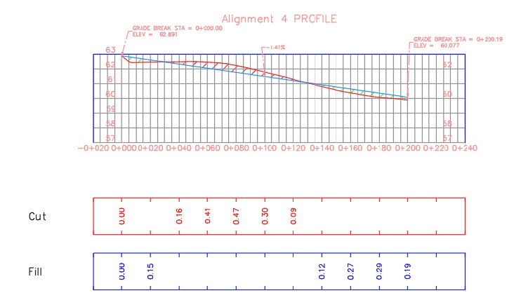
Vertical alignment
Long vertical curves provide larger and more pleasing viewing distances appearance of the driver with regard to the following criteria: stopping sight distance, passing sight distance, drainage water taking into account the minimum slope for the line is 0.5.
Sample design
Vertical alignment for road 4 in master plan using civil 3d AutoCAD with taking design standards for roadway.

Slide 39
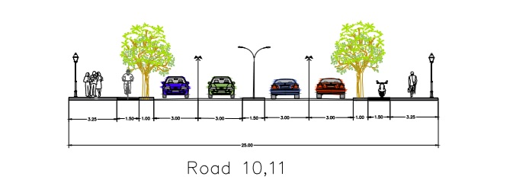
  Cross Section
Elements of the cross section of the streets include various parts of the existing road include Travel Lanes, Shoulders, Sidewalks, Medians, and Bicycles Lanes.
Sample Design
Cross section for road 10,11

Slide 40
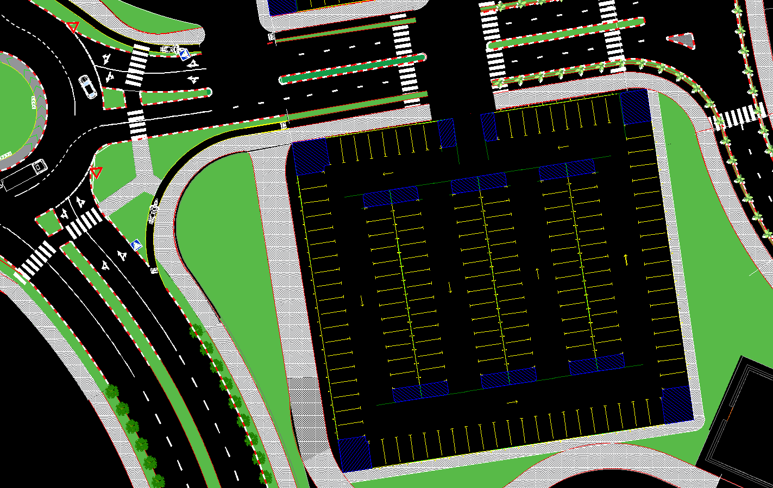
Design of Parking Facilities
The parking demand for academics and administration staff on-campus has been estimated for the design period of 15 years, so it found that the demand is 635 space. Therefore; five off-street parking lots have been proposed to satisfy the increasing demand for parking on the campus.
In this project, parking stall width is 2.5 m and the length equal 5.5 m for passenger cars and 4 m width with 14 m length for buses
Sample design for parking .

Slide 41
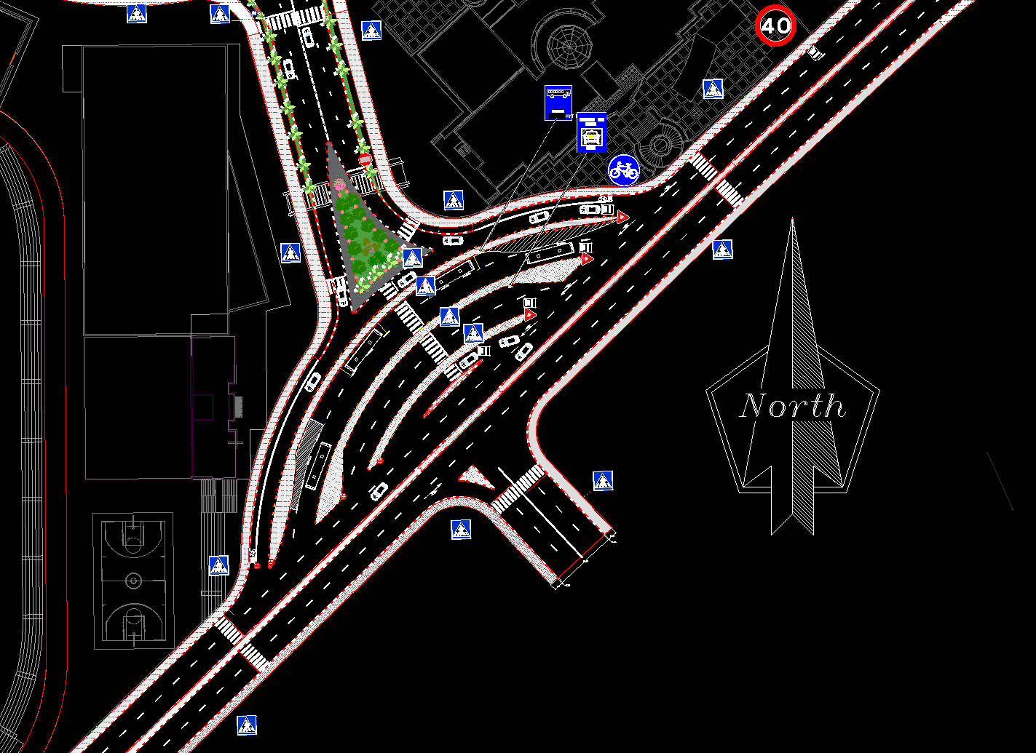
  Design of Public Transportation Terminal
studies at the entrance of PTUK, where 2363 pedestrians enter the university, in addition to public transport passengers of 922 students. About 40% of students use public transport.
It has been divided for buses and taxis separately taking into account the appropriate dimensions according to the design criteria
City transit bus is considered as the design vehicle inside the campus and for the special lane of buses in public transportation area around the campus.

Slide 42
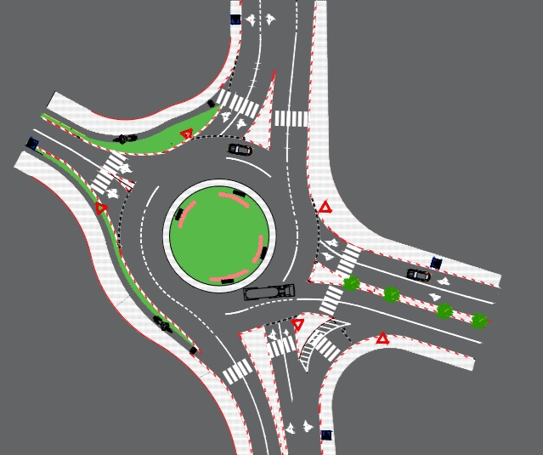
Roundabout Design
From previous traffic studies and analysis around the campus have been considered for design four roundabout to maintain the effectiveness of the traffic flow, and to maximize safety on the street.
Double-trailer and semi-trailer considered as the design vehicle at the roundabouts and intersections around the campus
Sample design
for Kadoorie roundabout.

Slide 43
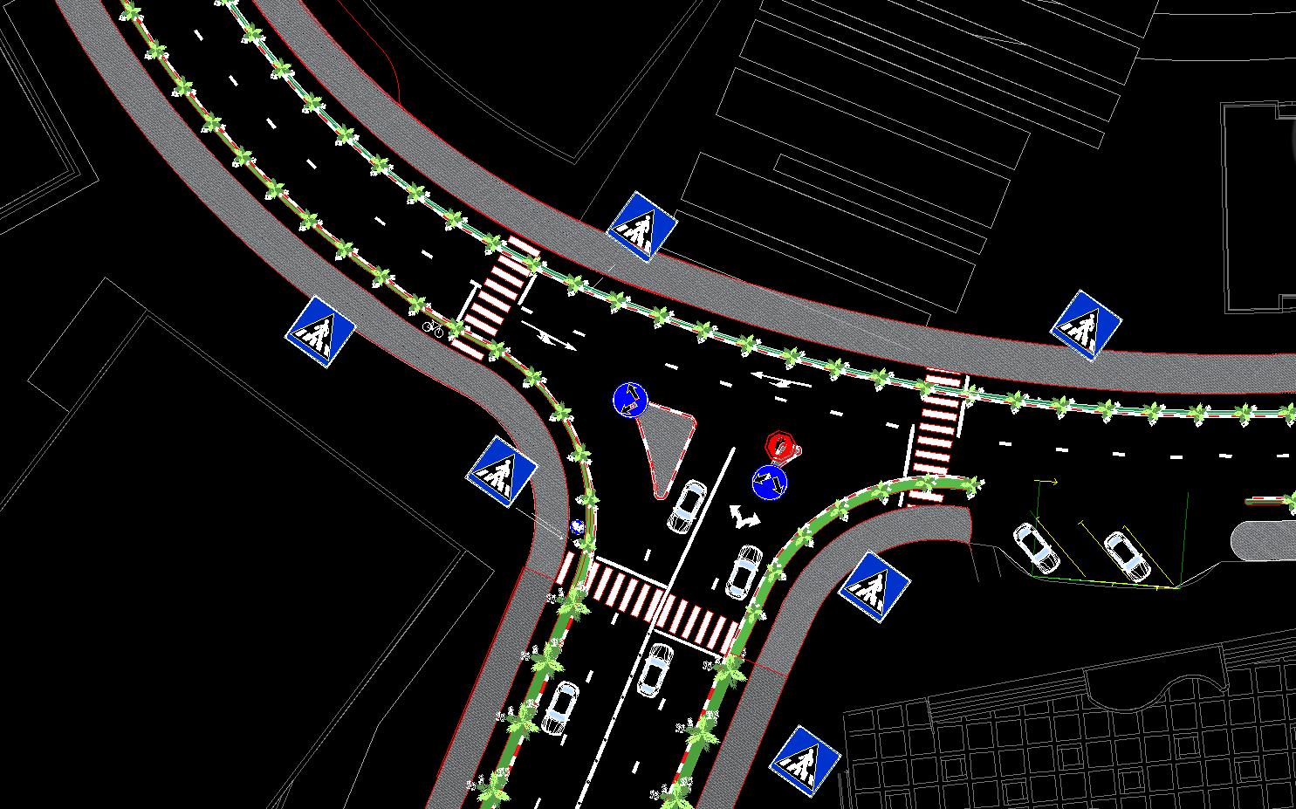
Intersections Design
Intersections are an important part of a highway facility because, to a great extent, the efficiency, safety, speed, cost of operation, and capacity of the facility depend on their design .
There are five different widths for right of way in the campus (6-8-12-18-25) meters, designed to serve the categories within the campus (car - bicycle - pedestrian - green area) except 6 meter street which was designed as Service roads.
bus is used as a design
vehicle on the interior streets
of the University.

Slide 44
Bill of Quantity

Slide 45
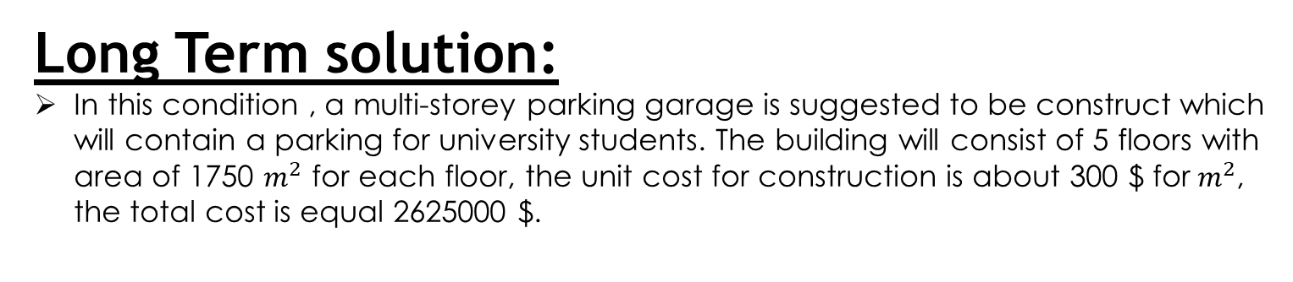
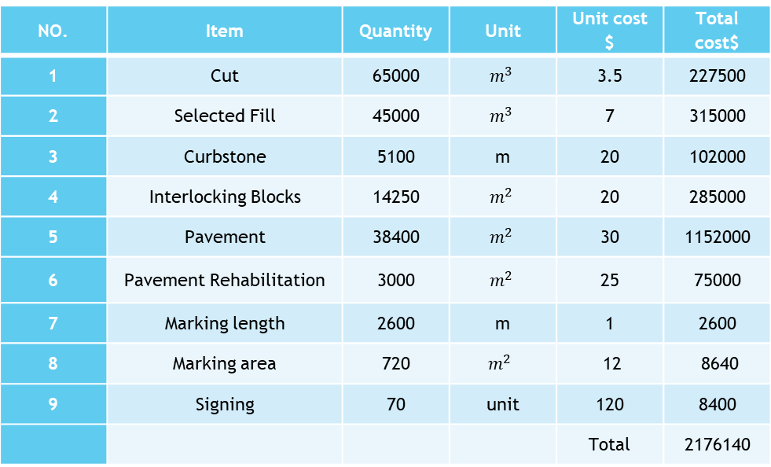
    Short Term solution
As shown in the below table the initial cost for the roads structure inside the campus plus parking spaces and public transportation area equals 2180000 $.
NO. | Item | Quantity | Unit | Unit cost $ | Total cost$
1 | Cut | 65000 |  | 3.5 | 227500
2 | Selected Fill | 45000 |  | 7 | 315000
3 | Curbstone | 5100 | m | 20 | 102000
4 | Interlocking Blocks | 14250 |  | 20 | 285000
5 | Pavement | 38400 |  | 30 | 1152000
6 | Pavement Rehabilitation | 3000 |  | 25 | 75000
7 | Marking length | 2600 | m | 1 | 2600
8 | Marking area | 720 |  | 12 | 8640
9 | Signing | 70 | unit | 120 | 8400
 |  |  |  | Total | 2176140
    Long Term solution:
In this condition , a multi-storey parking garage is suggested to be construct which will contain a parking for university students. The building will consist of 5 floors with area of 1750 $m^{2}$ for each floor, the unit cost for construction is about 300 $ for${ m}^{2}$, the total cost is equal 2625000 $.

Slide 46
Conclusions and Recommendations

Slide 47
Conclusion
The streets around the university campus have been redesigned by designing roundabouts to regulate traffic
Planning a complete area away from the congestion area to serve the public transport and the process of loading and unloading.
Designing the parking spaces to serve the students and employees, whether academic or administrative,
Planning the internal roads of the university, construction new roads, planning, marking and design intersections, which facilitate entry and exit, and make traffic smooth inside the university.

Slide 48
Recommendations
The municipality is recommended to implement the designs to regulate traffic and re-construct the intersections and roundabouts around the campus in order to solve solutions the limited capacity of the streets problem, on light of the increase in the volumes of traffic.
The PTUK is recommended to adopt the design of internal roads and intersections, parking facilities, and public transport terminal.
To prevent heavy vehicles that obstruct traffic from using the main rotor nearby roads at specified hours (peak hours).
Cooperation between the official bodies such as the police and the municipality through the implementation of legal procedures to control all violations that occur.

Slide 49
Thanks for Your Attention

