Slide 1

An-Najah National University
Faculty Of Engineering chemical Engineering Department
Graduation Project II
Physical and Chemical Improvements of Interfacial Adhesion of Polymer/Glass Fiber Sheet Composites
Prepared by:
Hiba Hmdan
Obadah Khaliliah
Malak Ra'ft
Yara Sawafta
Supervision of Eng. Shadi Sawalha
Dr. Raed Ma’ali

Slide 2
OUTLINE
Problem that encountered in composite material
Objective
Literature view
Methodology
Composite testing
Results
Recommendation

Slide 3
The main problem that encountered in composite material:
The composite has been used due to the availability of some properties such as high strength and low weight. And lack of availability in many materials, which are less strength to weight ratio and high .
The main problem that encountered in composite material is the uncompatabilty between fiber and matrix.

Slide 4
The aim of this project:
The aim of project is to improve the interfacial adhesion between glass fiber mat and thermoplastic polymers by different means; either physical or chemical which may include surface treatment of the fiber or incorporation of a third material which could act as a coupling agent.

Slide 5
LITERATURE VIEW
Thomason, J. L. (2017). Kinetics of dissolution of glass fibre in hot alkaline solution. Journal of Materials Science.
Huff, N. T. (1997). Effects of silane coupling agents on the interphase and performance of glass-fiber-reinforced polymer .
Van den Oever, M., &Peijs, T. (1998). Continuous-glass-fiber-reinforced polypropylene composites II. Influence of maleic-anhydride modified polypropylene on fatigue behavior.
Etcheverry, M., & Barbosa, S. E. (2012). Glass fiber reinforced polypropylene mechanical properties enhancement by adhesion improvement. Materials

Slide 6
Methodology
Materials:
1. Polypropylene.
2. glass fiber .
3.Coupling agent(amino propyltriethoxysilane), polypropylene grafted maleic anhydride modified (PPgMA). Sodium hydroxide, Ethanol.

Slide 7
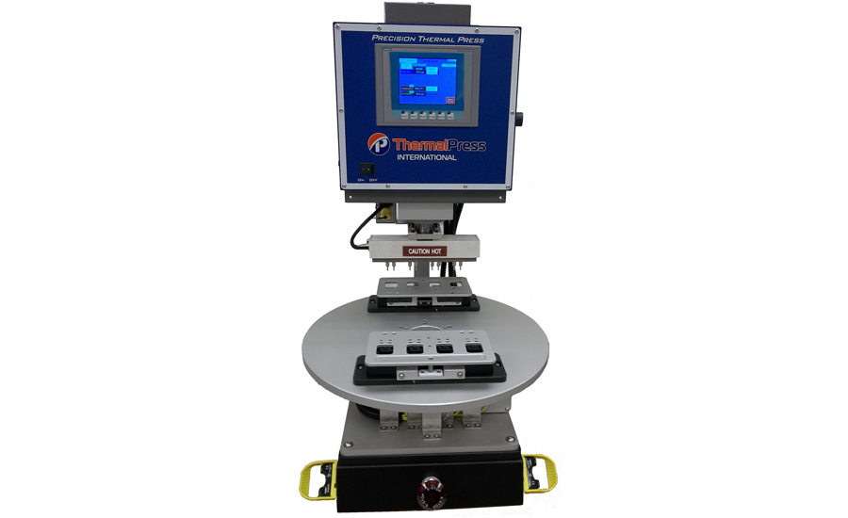
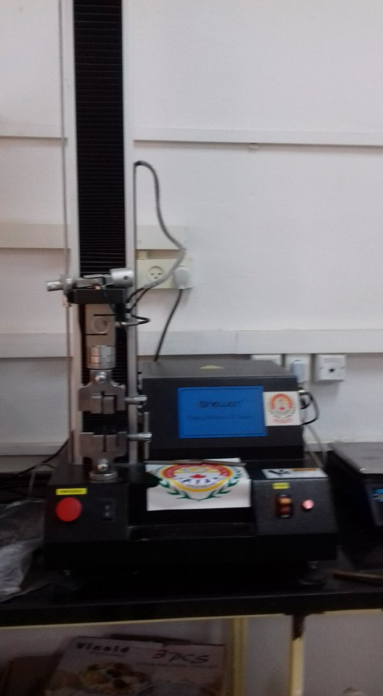
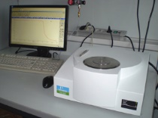
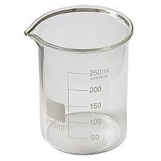

Methodology
Equipments:
Thermal press apparatus
Tensile Testing Machine
Differential scanning calorimeter (DSC) apparatus
Beakers &scales

Slide 8



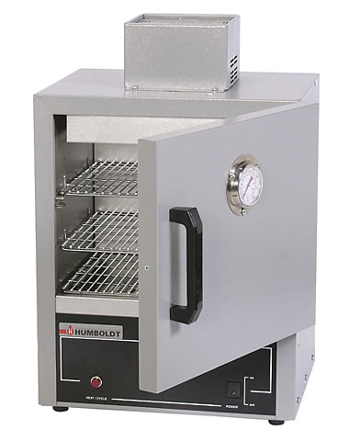
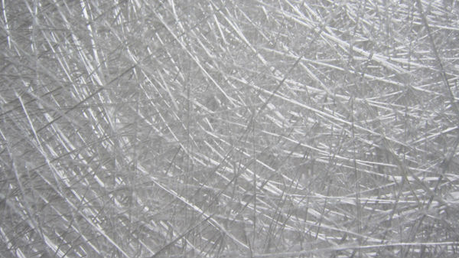
Sample preparation:-
Alkaline Treatment of Glass Fibers:
10% (wt/v) solution of NaOH
oven at 100˚C
Glass fiber

Slide 9


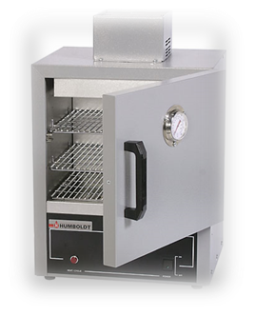
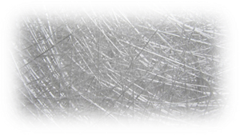


Sample preparation:-
Silanization of Glass Fiber
110˚C for 5 min, followed by 24 h at room
ethanol/water = 80/20 wt%.
amino propyl triethoxysilane= 1 wt%

Slide 10
Production of composite material:
polypropylene sheets (1ml thickness) were prepared by thermal pressing of pp granule for 5 min at 180˚c.
Glass fibers was distributed between two of prepared sheets and pressed by thermal pressing apparatus for 5 min at 180˚c, after that it was cooled.

Slide 11
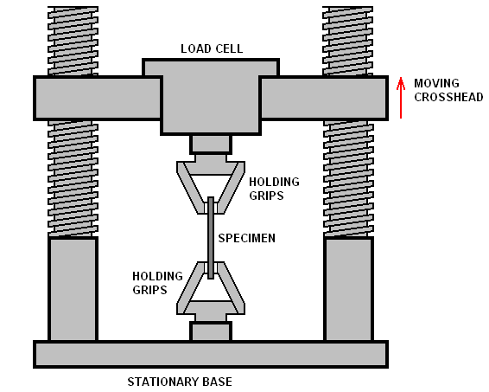
Testing of samples:
Tensile test: The sample was gripped at both ends by an apparatus (1.5 cm from each end of the sample), which slowly pulls lengthwise on the piece until it fractures.
Thermal test: A small piece (5 mg weight) was taken from each sample to be tested by the DSC apparatus.

Slide 12
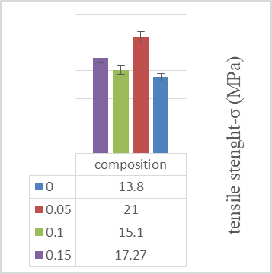
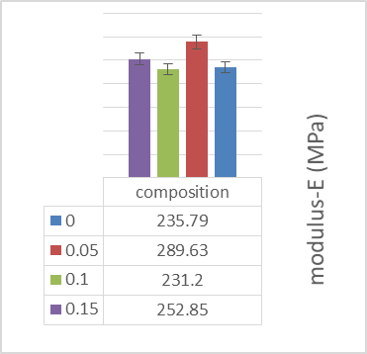
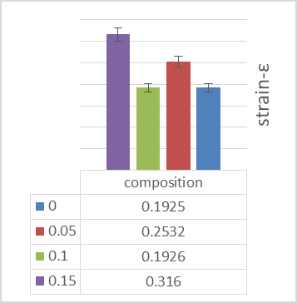
Results and discussion:
1.Untreated PP-glass fiber composites.

Slide 13
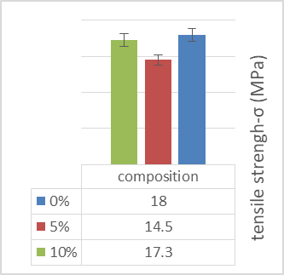
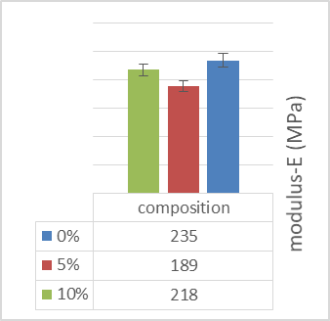
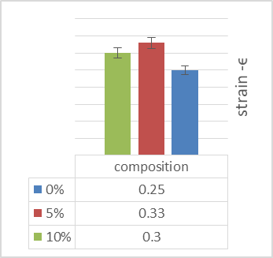
Results and discussion:
2.NaOH treated PP-glass fiber composite.

Slide 14
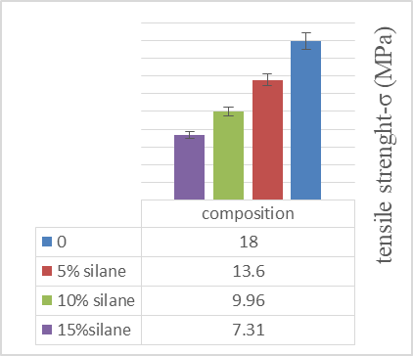
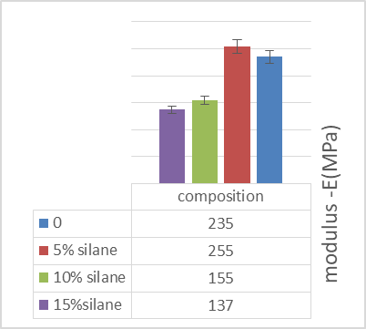
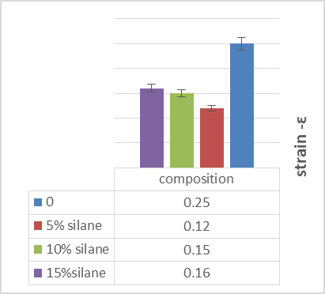
3.Silane treated PP-glass fiber composite

Slide 15
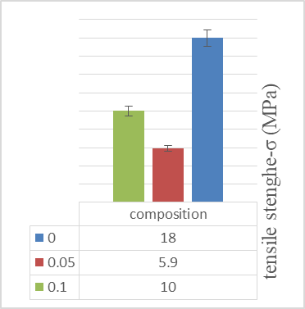
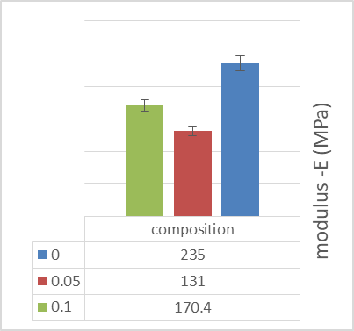
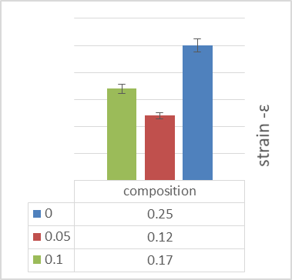
Results and discussion
4.silane + NaOH treated PP-glass fiber composite.

Slide 16
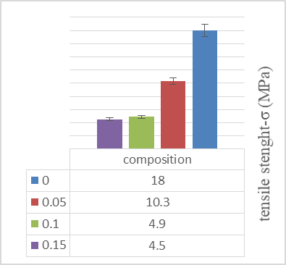
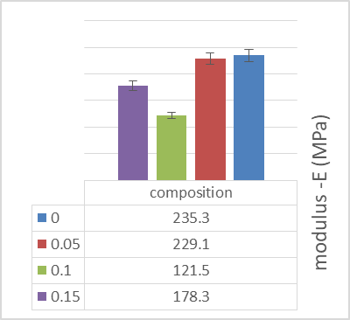
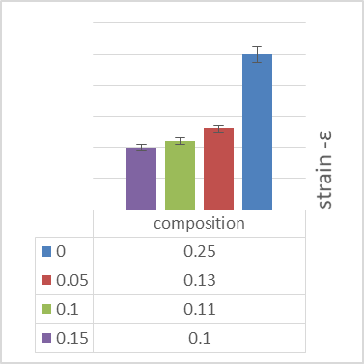
5. PPgMA treated glass-fiber composite.

Slide 17
DSC test

Slide 18
RECOMMENDATION
1. Use other mixing method such as extraction and internal mixer to improve mixing.
2. Use other type of saline.
3. The PPgMA should be mixing with glass fibers before addition to the poly propylene matrix to prevent voids.

Slide 19
Thank you

