Slide 1

A Mitigation for Black Hole Attack in AODV Routing Protocol
with Enhancement in Performance
By: Abeer Elian
Senin Bazian
Rawan Hamad
Supervised by:
Dr: Ahmad Awad

Slide 2

Home
Problem
Related work
Contributions
Experimental Result
Future work
Introduction
Proposed Approach
Conclusion
TABLE OF CONTENTS
01
Introduction
05
Proposed Approach
02
Problems
Experimental Results
06
03
Related work
07
Conclusion
04
Contributions
08
Future Works

Slide 3

Home
Problem
Related work
Contributions
Experimental
Result
Introduction
Proposed Approach
Conclusion
Future work
01
INTRODUCTION

Slide 4
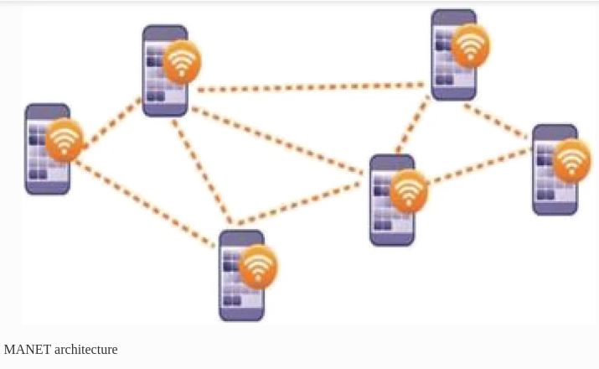
Home
Problem
Related work
Contributions
Experimental Result
Future work
Introduction
Proposed Approach
Conclusion
Introduction
MANET
01
A Mobile ad hoc network is a self-configuring network that is generated spontaneously by a group of mobile nodes without the use of centralized administration.

Slide 5
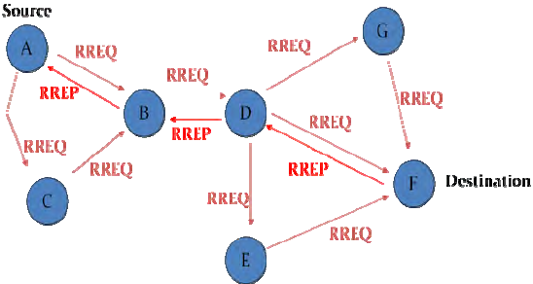
Home
Problem
Related work
Contributions
Experimental Result
Future work
Introduction
Proposed Approach
Conclusion
Introduction
02
AODV Protocol
Ad Hoc On-Demand Distance Vector.It is routing protocol which is designed for wireless and mobile ad hoc network.

Slide 6
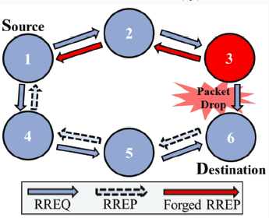
Home
Problem
Related work
Contributions
Experimental Result
Future work
Introduction
Proposed Approach
Conclusion
Introduction
Black Hole Attack
03
is an example of a denial-of-service attack that targets a reactive routing protocol and disrupts routing services, resulting in low packet delivery rates.

Slide 7

Home
Problem
Related work
Contributions
Experimental Result
Future work
Introduction
Proposed Approach
Conclusion
02
PROBLEMS

Slide 8

Home
Problem
Related work
Contributions
Experimental Result
Future work
Introduction
Proposed Approach
Conclusion
The Problem & Motivation
1
2
3
4
5
Limited physical security
Black hole attacks still exist until today
MANET has no centralized authentication
Scalability Issue
Cooperativeness

Slide 9



Home
Problem
Related work
Contributions
Experimental Result
Future work
Introduction
Proposed Approach
Conclusion
03
Related Work

Slide 10
Home
Problem
Related work
Contributions
Experimental Result
Future work
Introduction
Proposed Approach
Conclusion
Related Work
Removing the unnecessary RREQ packet by comparing the hop count field with a random value.
1
Adding an extension called Watchdog that identifies the compromised node by monitoring the node if it forwards a RREQ packet to neighbors, if not it’s compromised.
2
Source Node sends a fake RREQ and checks if any node responds back it will be labeled as a malicious node.
3

Slide 11


Home
Problem
Related work
Contributions
Experimental Result
Future work
Introduction
Proposed Approach
Conclusion
04
Contributions

Slide 12
Home
Problem
Related work
Contributions
Experimental Result
Future work
Introduction
Proposed Approach
Conclusion
Contributions
1
Proposal to framework working to prevent the black hole attack.
2
Preserving the performance of AODV.
3
The Randomized Energy-Based method.
-The prevention was done by sequence number.
- The maintenance of performance was done by Drop factor.

Slide 13

Home
Problem
Related work
Contributions
Experimental Result
Future work
Introduction
Proposed Approach
Conclusion
05
PROPOSED APPROACH

Slide 14
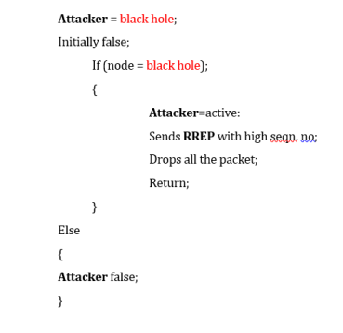
Home
Problem
Related work
Contributions
Experimental Result
Future work
Introduction
Proposed Approach
Conclusion
The Logic of Black Hole Attack

Slide 15
Home
Problem
Related work
Contributions
Experimental Result
Future work
Introduction
Proposed Approach
Conclusion
Start
RREP-Table is not
empty
False
If (Dest_Seq_No
- Src_Seq_No)
Is Not huge
Don’t Update
Routing
Table
*NOTE: Applied to Each Node.
True
Update Routing Table
Prevention Mechanism
End

Slide 16
Home
Problem
Related work
Contributions
Experimental Result
Future work
Introduction
Proposed Approach
Conclusion
Start
//Define Variables
Drop_Factor=Remaining_Energy/Total_Energy;Random_Value=Random.No;
False
Drop
RREQ_packet
Random_Value > Drop Factor
True
Forward RREQ
packet
Randomized Energy-Based Mechanism to preserve the performance
End

Slide 17

Home
Problem
Related work
Contributions
Experimental Result
Future work
Introduction
Proposed Approach
Conclusion
06
Experimental Results

Slide 18
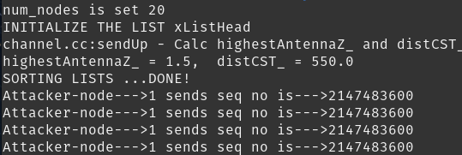
Home
Problem
Related work
Contributions
Experimental Result
Future work
Introduction
Proposed Approach
Conclusion
Huge Seq.No !!
The Attacker Sent out high Sequence Number

Slide 19
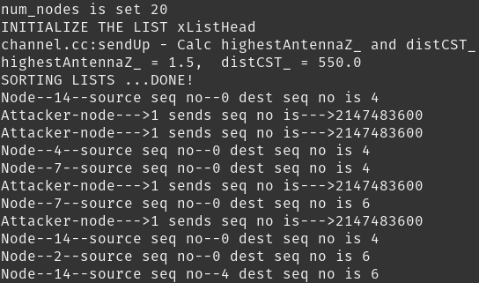
Home
Problem
Related work
Contributions
Experimental Result
Future work
Introduction
Proposed Approach
Conclusion
Mitigation of Black Hole Attack
Normal vs Fake

Slide 20

Home
Problem
Related work
Contributions
Experimental Result
Future work
Introduction
Proposed Approach
Conclusion
Random Value
Drop RREQ
Forward RREQ
Randomized Energy-Based Mechanism

Slide 21
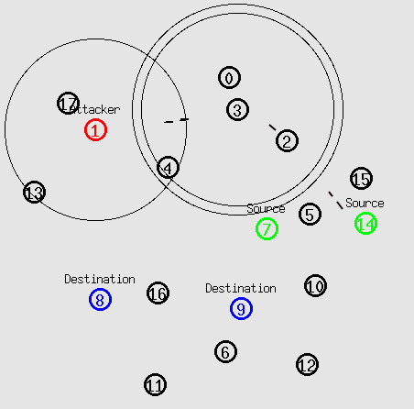
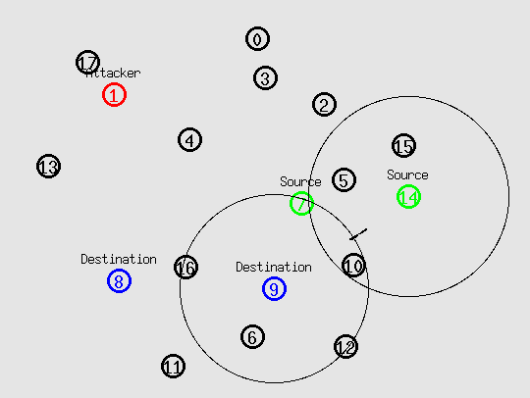
Home
Problem
Related work
Contributions
Experimental Result
Future work
Introduction
Proposed Approach
Conclusion
The Attack
The Prevention

Slide 22
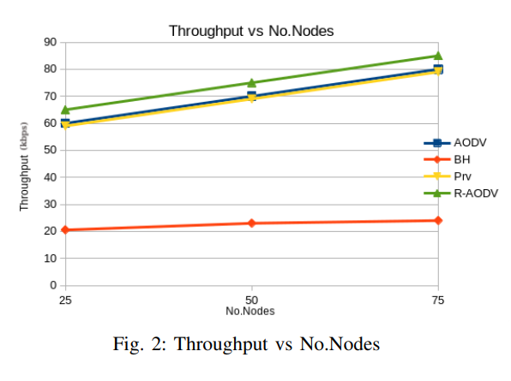

Home
Problem
Related work
Contributions
Experimental Result
Future work
Introduction
Proposed Approach
Conclusion
PERFORMANCE METRICS
1-Throughput
Original AODV routing
BlackholeAODV (BH).
Prevented Blackhole AODV (Prv).
Prevented Blackhole on Randomized Energy-Based AODV (R-AODV).

Slide 23
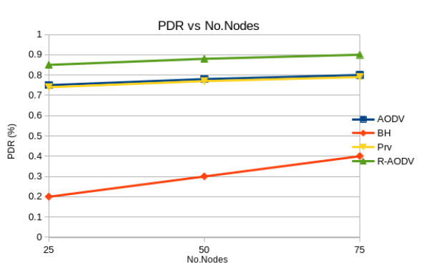

Home
Problem
Related work
Contributions
Experimental Result
Future work
Introduction
Proposed Approach
Conclusion
2-Packet Delivery Ratio (PDR)
Original AODV routing
BlackholeAODV (BH).
Prevented Blackhole AODV (Prv).
Prevented Blackhole on Randomized Energy-Based AODV (R-AODV).

Slide 24
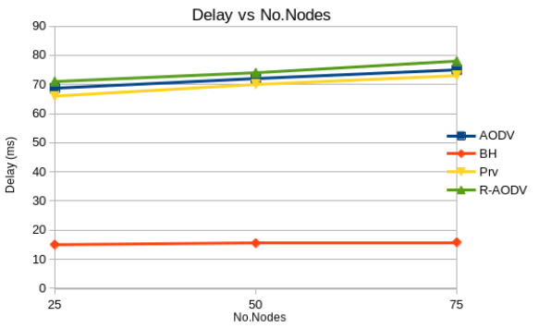

Home
Problem
Related work
Contributions
Experimental Result
Future work
Introduction
Proposed Approach
Conclusion
3-Delay
Original AODV routing
BlackholeAODV (BH).
Prevented Blackhole AODV (Prv).
Prevented Blackhole on Randomized Energy-Based AODV (R-AODV).

Slide 25

Home
Problem
Related work
Contributions
Experimental Result
Future work
Introduction
Proposed Approach
Conclusion
07
CONCLUSION

Slide 26

Home
Problem
Related work
Contributions
Experimental Result
Future work
Introduction
Proposed Approach
Conclusion
We reviewed the methods and its implementations.
We have presented the congestion control mechanisms for black hole attack prevented in AODV ad hoc.
In addition, we presented a set of simulation studies to compare their performance to the original AODV.

Slide 27

Home
Problem
Related work
Contributions
Experimental Result
Future work
Introduction
Proposed Approach
Conclusion
08
FUTURE WORKS

Slide 28
Home
Problem
Related work
Contributions
Experimental Result
Future work
Introduction
Proposed Approach
Conclusion
We will major evaluate and investigate the performance of the suggested schema for larger networks and greater mobility rates using a collaborative black hole assault in order to test the efficiency and the realism of our implementation.
FUTURE WORKS

Slide 29

THE END

Slide 30

ANY QUESTION ?
THANKS

