Slide 1
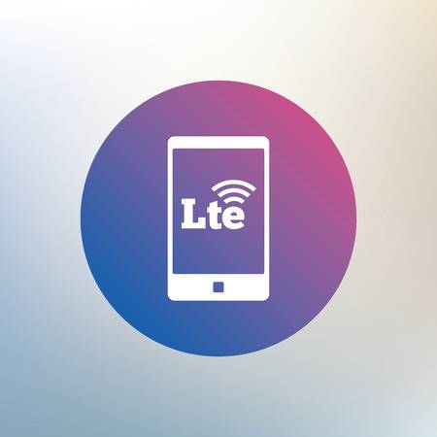
The Future of LTE : Femtocell Perspective
Prepared by :
Hiba Shihab
Ola Alhaj

Slide 2

Outline
Key Features of LTE Technology.
LTE Network Architecture.
LTE Multiple Access Schemes.
The concept of femtocells and small cells.
Benefits of Femtocells.
Femtocell Architecture with 4G Network.

Slide 3
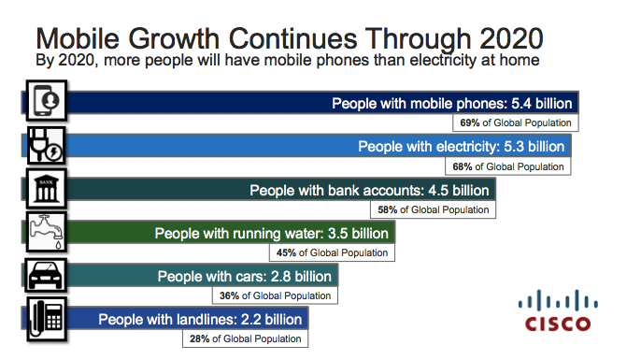
Motivation for LTE
Mobile phone user population is increasing annually.

Slide 4
Motivation for LTE
Data traffic is growing at an exponential speed.

Slide 5
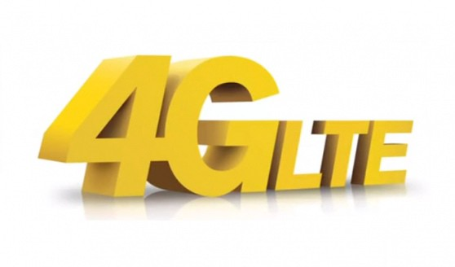
Motivation for LTE
Need for high data rate and spectral efficiency.
Need for packet switched optimized system .
Need for high quality of service.
Need for cheaper infrastructure.

Slide 6

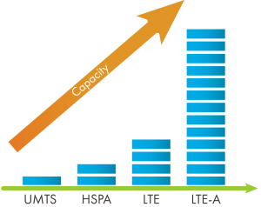
Key Features of LTE Technology
IP optimized technology.
Improved coverage and capacity.

Slide 7
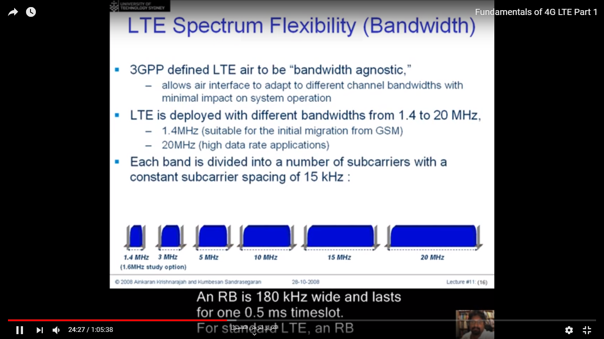
Key Features of LTE Technology
Reduced delay for both connection establishment and transmission latency.
High peak data rate up to 100Mbps.
Improved spectral efficiency : 2-4 times greater than 3G since it uses scalable Bandwidth :1.4,3,5,10,15,20MHz.

Slide 8
Key Features of LTE Technology
Co-existence and interworking with previous cellular technologies.
Reducing cost per Megabyte.
Improvement of the cell edge throughput and capacity by using femtocell technology.

Slide 9
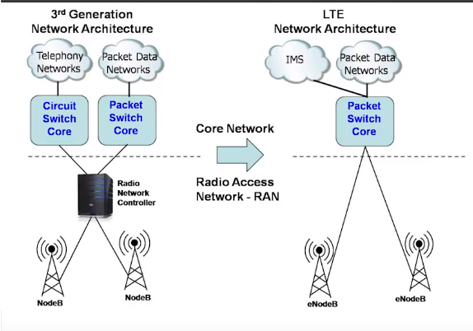
Network Architecture Evolution
No radio network controller AND Flat network architecture.
Pure IP system.

Slide 10
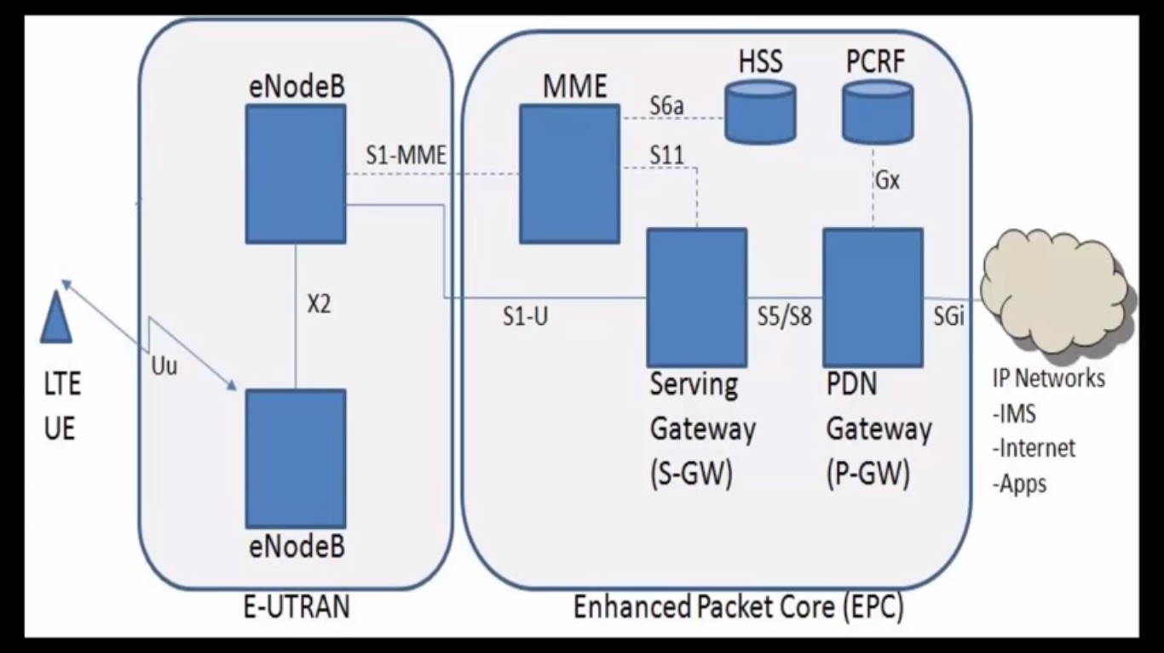
LTE Network Architecture

Slide 11
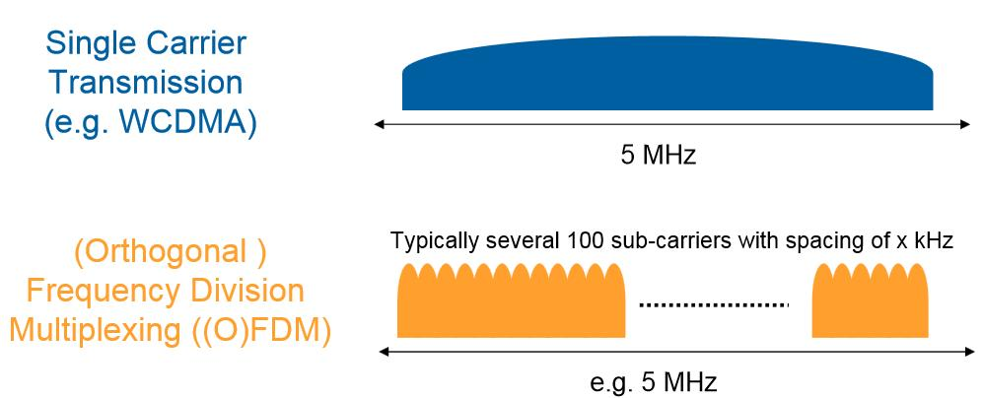
LTE Key Enabling Technology-OFDM
Main Idea : Split data stream into N parallel streams of lower data rate and transmit each on a separate subcarrier.

Slide 12
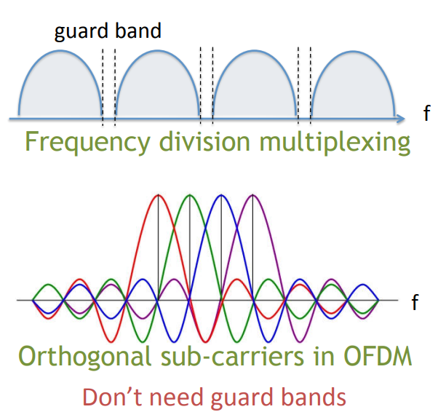
OFDM- Orthogonality Concept
Multiple closely spaced orthogonal subcarriers are used to carry data

Slide 13
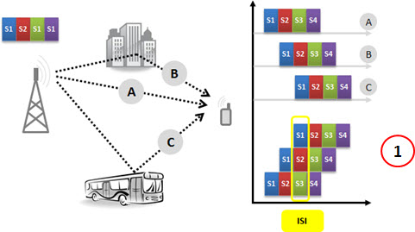
OFDM- CP Concept
ISI interference problem caused by multipath.

Slide 14
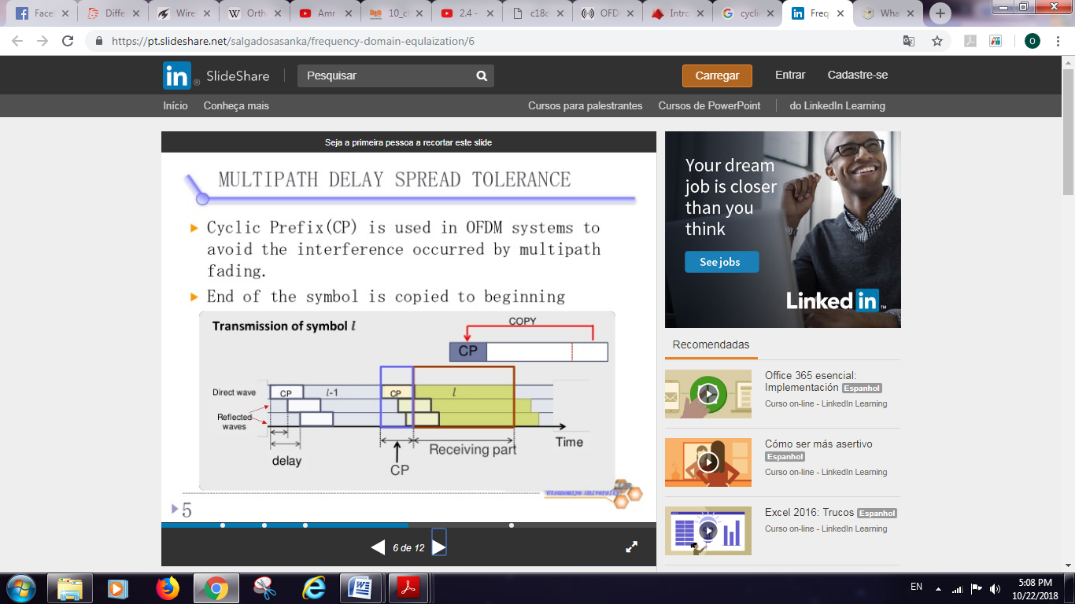
OFDM- CP Concept
Elegant solution to ISI problem by copying the last samples of the OFDM symbol into its front.

Slide 15
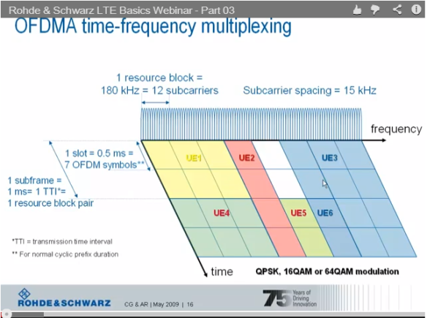
OFDMA and LTE Resource Block
OFDMA- time frequency multiplexing
In OFDMA users are allocated a specific number of subcarriers for a predetermined amount of time.

Slide 16
LTE multiple access scheme in Uplink : SC-FDMA
The main disadvantage of the OFDM is the high peak to average power ratio.
To reduce the peak to average power ratio, increase the efficiency of power amplifier and save the battery life a different access technique is used for the uplink → SC-FDMA.

Slide 17
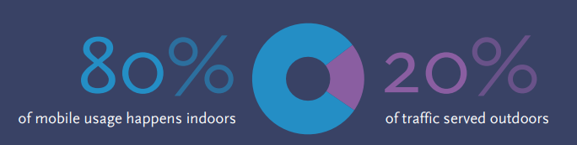
Motivation For Femtocells
The need for expanding 4G network capacity and coverage without much investments on infrastructure.
Half of voice calls and a majority of data traffic originate indoor → Femtocell as an Indoor Coverage Solution

Slide 18

The Concept of Femtocell
Mobile phone base station for home/office.
Connects via broadband interenet.
Provides excellent indoor coverage.
Small number of subscribers → high density.

Slide 19
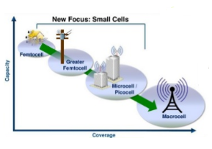
Small Cell Concept
Small cells are low powered cellular radio access nodes.
Mobile operators used them to extend their service coverage.
The new focus is on femtocells to meet high users’ demands at hotspots or cell edges.

Slide 20
Benefits of Femtocells
Subscriber’s benefits
Benefits of Femtocell
Reduced distance between sender and receiver leads to higher signal strength, lower transmit power, and prolong handset life.
Operators’ benefits
- Reduced backhaul cost.
- Increases both coverage and capacity.
- Reduce coverage holes and create new converged services.
- Reduce macrocell backhaul capacity requirements.
- Works with all existing handsets; no need for expensive subsidizes on dual-mode (4G+Wi-Fi).
- Reduced "in home" call charges.
- Improved indoor coverage.
- Increased user throughput.
- Reduced mobile battery drain.

Slide 21
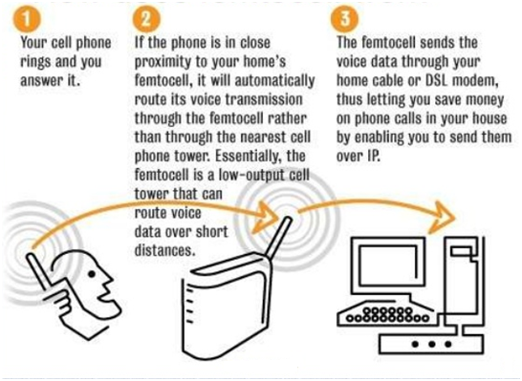
How Dose Femtocell Work ?

Slide 22
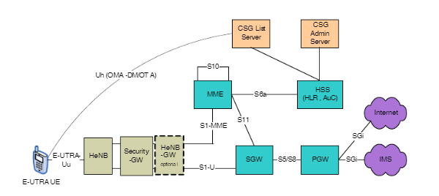
Femtocell Architecture with 4G Network

Slide 23
Conclusion & Future Work
Femtocell is the latest emerging technology that can provide high quality network access to indoor users at low cost.
Potential to speed up the existing 4G cellular system.
Various applications can make use of femtocells such as smart cities, public transportation and health services.

Slide 24


