Slide 1

An- Najah National University
Faculty of Engineering
Electrical Engineering Department
Graduating project 2
Rehabilitation of jenin Electrical Network
Supervisor:
Dr. falah mohammad
Prepared By:
Afrah hamad
Mohammad khaseb
Naser atatrah

Slide 2
Outlines
Introduction.
Data about jenin network.
Load flow analysis and result.
Maximum case improvement.
Minimum case improvement.
Post-fault case improvement.
Discussion.
Economical study.
Pv system .

Slide 3
Introduction
Our project is to make a load flow study and analysis for jenin Electrical Network using ETAP software to improve the power factor and to reduce the electrical losses in the network and so reducing the penalties in the total tariff for the municipality, increasing the reliability of the network.

Slide 4
Data about Jenin network
Jenin electrical network is provided by Israeli Electrical Company (IEC) at 33 KV.
one Connection points with maximum demand 22MW.
Overhead cable used ACSR (95mm2 &50 mm2)
Underground cable used XLPE (50 mm2)
The network has:
- 205 BUS
- 86 Distribution transformer
- 85 loads (residential, industrial, commercial).

Slide 5
Load flow analysis and Results
Original network
In these part of project we will make a load flow analysis for the network in the reality, We consider the one electrical supplies as swing generators.

Slide 6
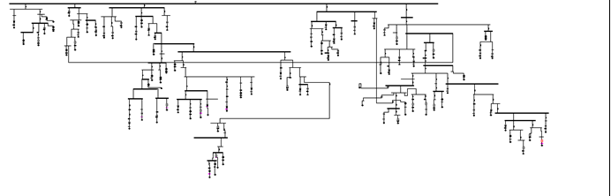
Load flow analysis and Results
Original network

Slide 7
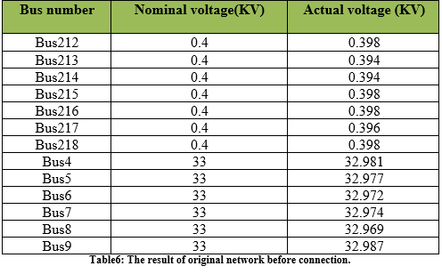
Load flow analysis and Results
Buses Voltage

Slide 8
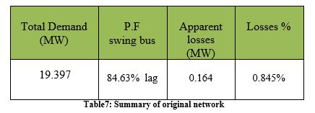
Load flow analysis and Results
Summary

Slide 9
Maximum case improvement
Increase the electrical supply voltages
Increase the voltage on the electrical supply busses up to (3%) from the original voltage (33 KV), the new value of the electrical supply busses voltage is (33.99 KV).
Tap changing
In these method change the tap ratio of the transformer to (5%).
Power factor improvement
we use used capacitor bank to improve the power factor in the network, So in Max .case we used (31) capacitor bank at primary and secondary side of transformer.

Slide 10
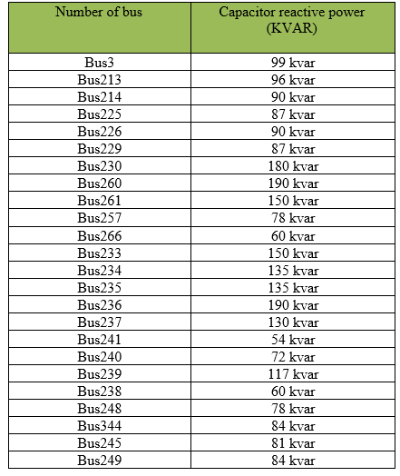
Maximum case improvement
The capacitors used in Max.case improvement ,as shown below:

Slide 11
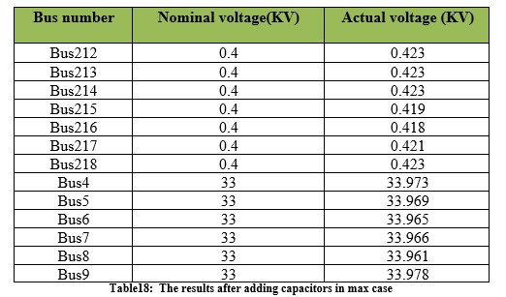
Maximum case improvement
Buses Voltage

Slide 12
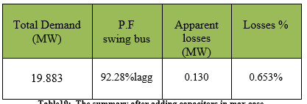
Maximum case improvement
Summary

Slide 13
Minimum case improvement
Increase the electrical supply voltages
Increase the voltage on the electrical supply busses up to (2%) from the original voltage (33 KV), the new value of the electrical supply busses voltage is (33.66 KV), and we multiply the apparent power of the loads and by 30%.
Tap changing
In this case we no need to change the tap.
.

Slide 14
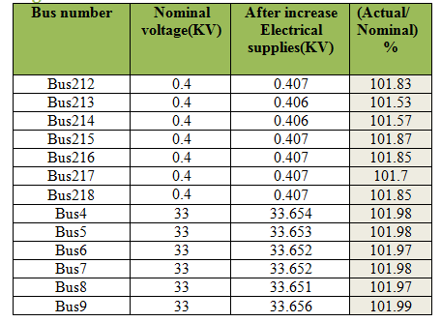
Minimum case improvement
Buses Voltage

Slide 15
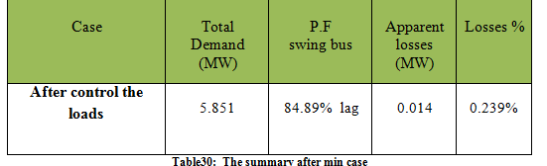
Minimum case improvement
Summary

Slide 16
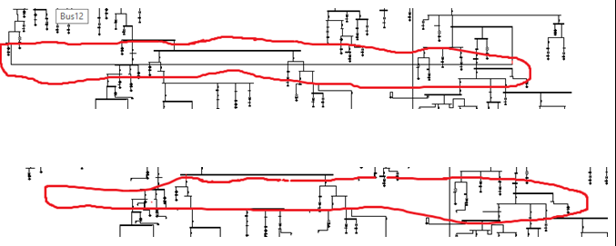
Post-fault case improvement
In this case, the maximum case is used after improvement check for the bus with the highest apparent power and Delete the higher T.L between two We delete the T.L between the buses 16 and 77 .
buses

Slide 17
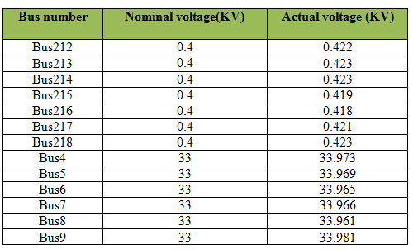
Post-fault case improvement
Buses Voltage

Slide 18
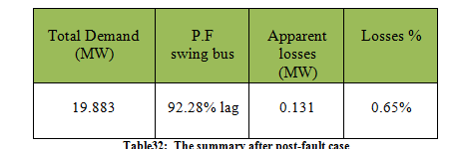
Post-fault case improvement
Summary

Slide 19
Discussion
In these chapter we want to compare between cases:_
1. Original case connection.
2. Maximum case improvement.
3. Minimum case improvement.
4. Post-fault case improvement.
According to busses voltage and total summary.

Slide 20
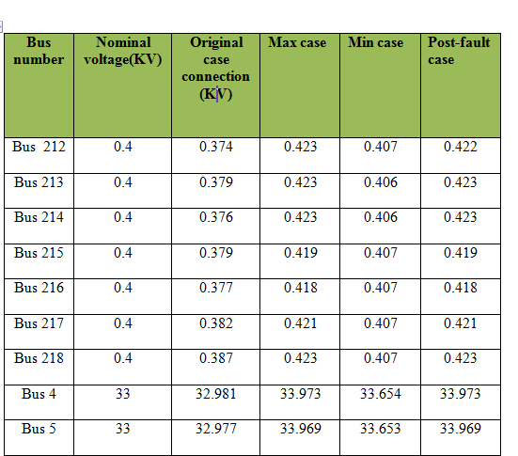
Discussion
Buses Voltage in (KV)

Slide 21
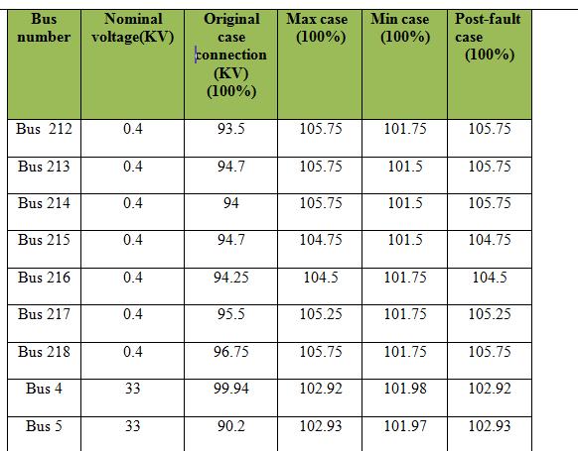
Discussion
Buses Voltage in (Actual/Nominal))

Slide 22
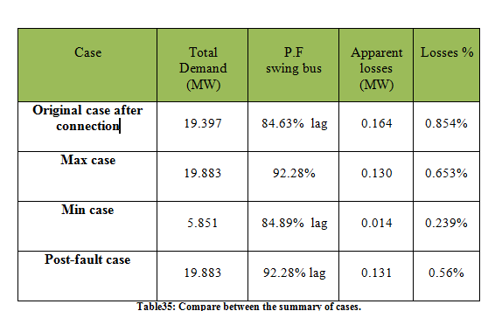
Discussion
Summary

Slide 23
Economical study
In this chapter we will study another face of the project which is a very important in any project, it's the economical study to the system.
In these chapter we will study three parts:_
1. Saving in penalties.
2. Saving in losses
3. Simple payback period

Slide 24
Economical study
Saving in penalties
- P max=26.528 (MW).
- P min=10.217 (MW)
- P.F before improvement = 0.8588
- P.F after improvement = 0.9197
- Pav = ( Pmin+ Pmax) / 2 =18.3725 (MW)
- L.F = Pavg/Pmax= 0.7
- Total energy per year = (Pav * 8760) = 160943.1 (MWH)
- Total cost per year = ( Total energy * cost (NIS/KWH))
= 160943.1 *0.47= 75643257 (NIS/year)
- Saving in penalties of P.F = 0.01*(0.9197-0.8588)*Total cost of energy
= 46066.75(NIS/year)

Slide 25
Economical study
Saving in losses
- Losses before improvement=0.164 (MW)
- Losses after improvement = 0.130(MW).
- Average losses before improvement = (0.7 * 164) = 114.8(KW).
- Energy of the losses before improvement = (114.8 * 8760) = 1005648(KWH).
- Cost of losses before improvement = (1005648 * 0.47) = 472654.56(NIS/year).
- Average losses after improvement = (0.7 * 130) = 91 (KW).
- Energy of the losses after improvement= (91 * 8760) = 797160(KWH).
- Cost of losses after improvement = (797160 * 0.47) = 374665.2(NIS/year).
Saving in losses = cost of losses before – cost of losses after = 1005648 -374665.2= 630982.8NIS/year)

Slide 26
Economical study
Simple payback period
- Total fixed capacitor banks used=1140 KVAR
- Cost per KVAR= 3JD=15NIS
- Total regulated capacitor banks using in maximum case=1983 KVAR
- Cost per KVAR= 15JD=75NIS
- Total cost of capacitor banks= (75*1983) + (1140*15) =165825 NIS
- Total saving=saving in losses +saving in penalties
=46066.75+325670.46=371737.21 NIS
- S.P.B.P=Investment /Saving
=165825/371737.21
S.P.B.P= 5.4 months

Slide 27
Pv system
Growing concerns for the depletion of the world's natural resources and our future energy supply has increased the need and development of solar power. The most critical advancement in the development of solar technology has been Photovoltaics, a solar energy system that uses semi-conductors to directly convert solar radiation into electricity.
Photovoltaic (PV) systems are composed of a large number of cells (typically made of crystalline silicon) arranged in formation on a metal frame, the entirety of which is known as a module.

Slide 28
Pv system
The amount of electricity generated is dependent on several factors:-
the size and arrangement of the PV system
the PV module array
the efficiency of the electrical components used to covert solar energy into electricity usable by your home or building (called inverters).

Slide 29
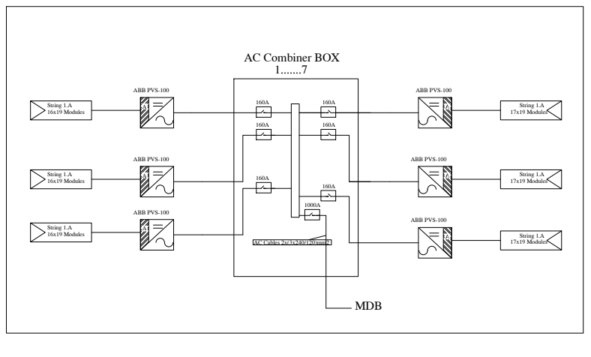
Pv system

Slide 30
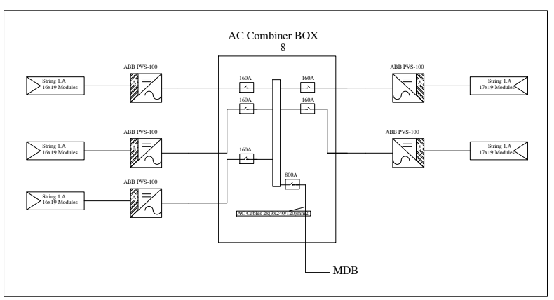
Pv syatem

Slide 31
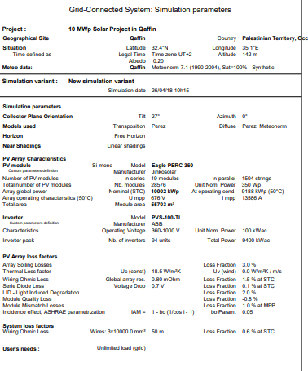
pv system

Slide 32
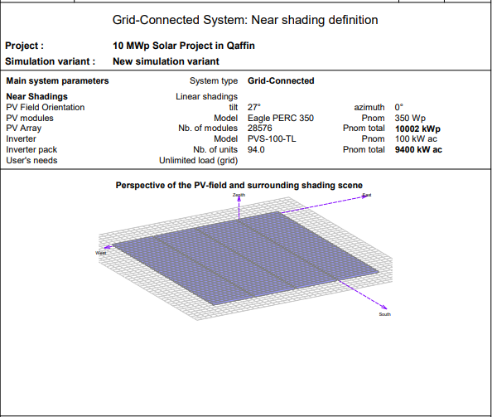
Pv system

Slide 33
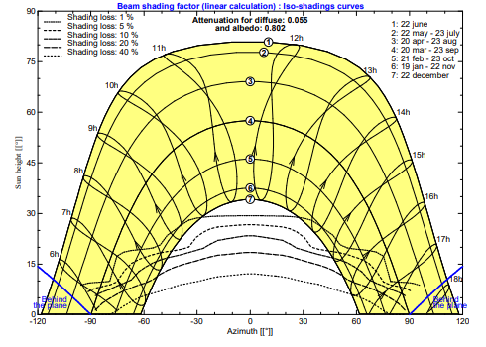
Pv system

Slide 34
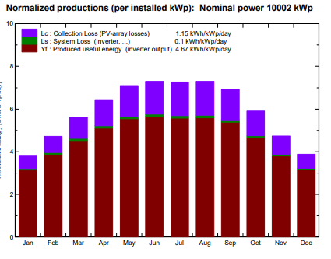
Pv system

Slide 35
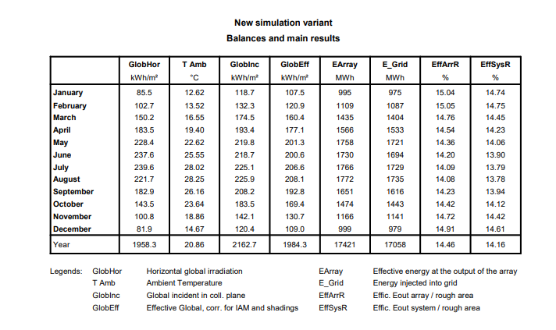
pv system

Slide 36
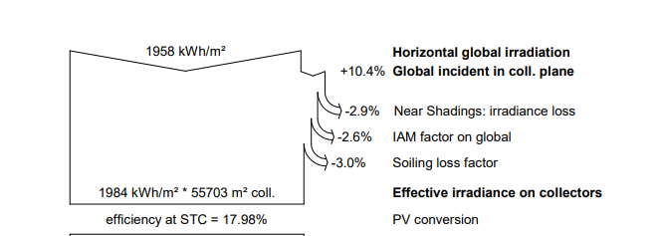
Pv system

Slide 37
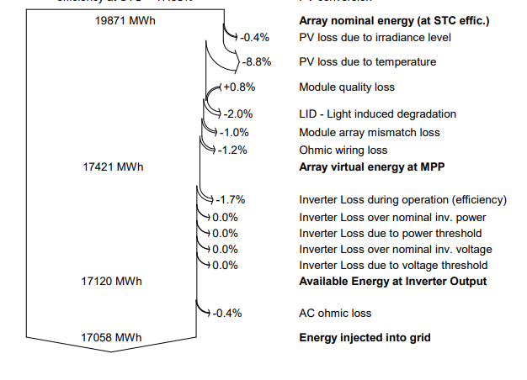
Pv system

Slide 38
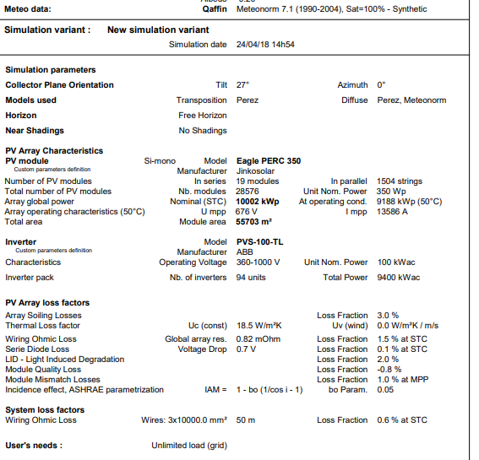
Pv system without shading

Slide 39
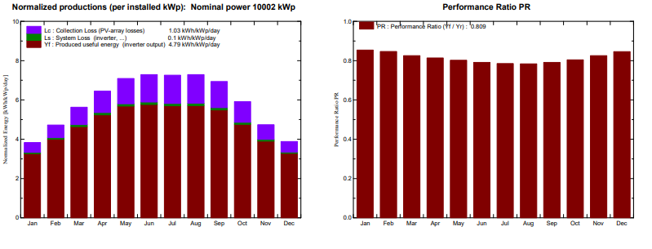
Pv system without shading

Slide 40
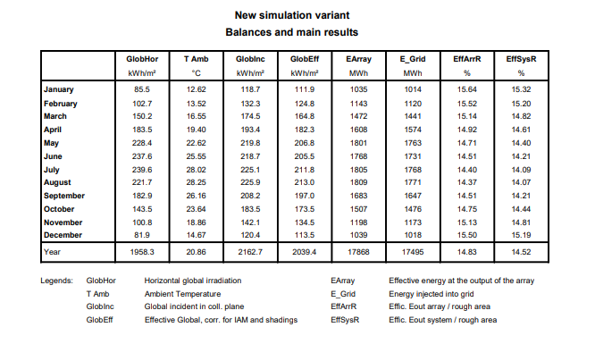
Pv system without shading

Slide 41
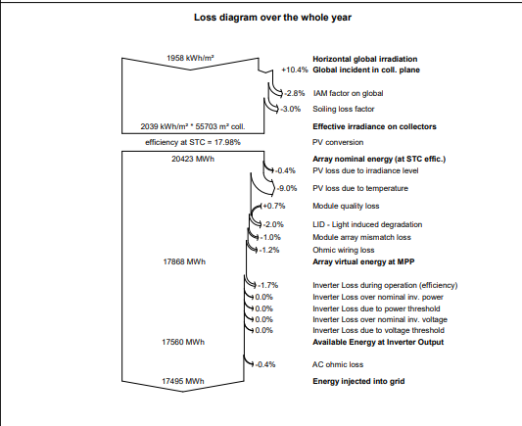
Pv system without shading

