Slide 1



P
L
P
O
R
Hardware Graduation Project

Slide 2



P
L
P
R
O
Done By:
Supervisors:
Dr.Eamd Natsheh
Dr. Abdullah Rashed
Raghad Mustafa
&
Woroud Fouleh

Slide 3




Why PoolPro?
Safety
Accuracy
Remote control

Slide 4



PoolPro
PoolPro is a smart pool system designed to enhance the efficiency, safety, and cleanliness of pools, by employing modern technology.
This innovation allows for seamless, dynamic control via a mobile application, ensuring an optimal and hassle-free pool experience for users.

Slide 5


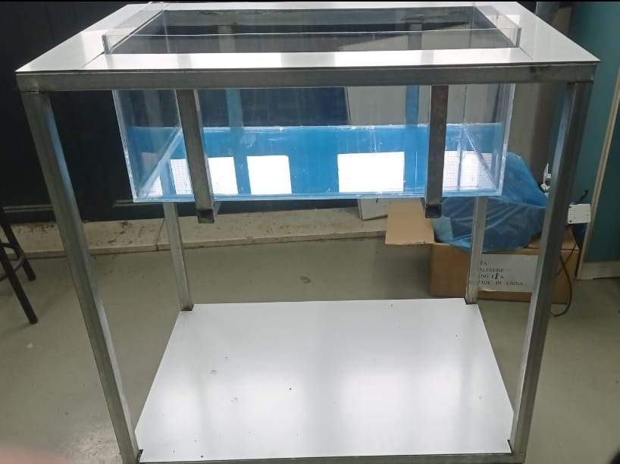
Pool Structure

Slide 6
  Features
  1
  2
  3
  4
  5
Sterilization &
Filtration
Cover closing and opening
Filling the pool
Light system
Heating

Slide 7


Building Process
&
Hardware components

Slide 8
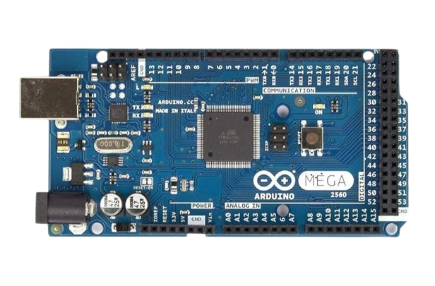
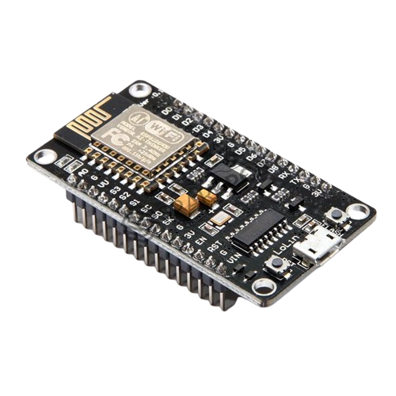
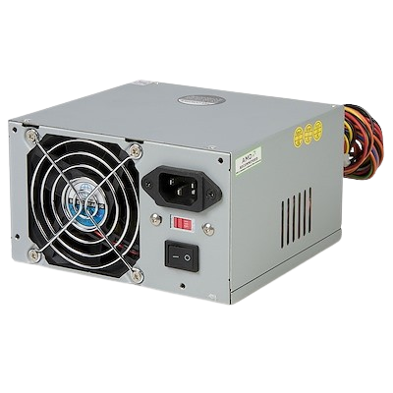
Microprocessors & Main components
Arduino Mega2560
ESP NodeMCU 8266
PC power supply

Slide 9
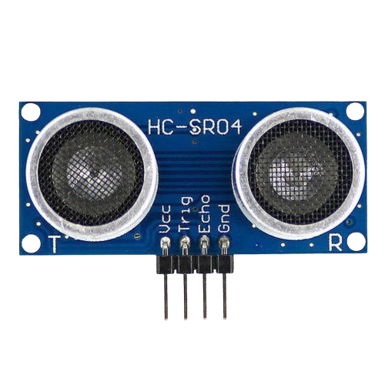
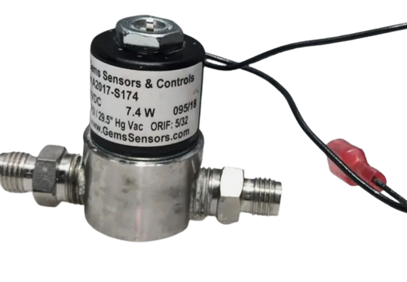
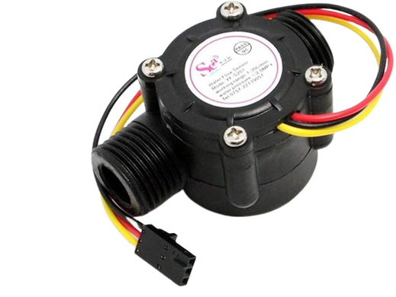
Filling the pool
Water valve
Ultrasonic sensor
Flow
sensor

Slide 10
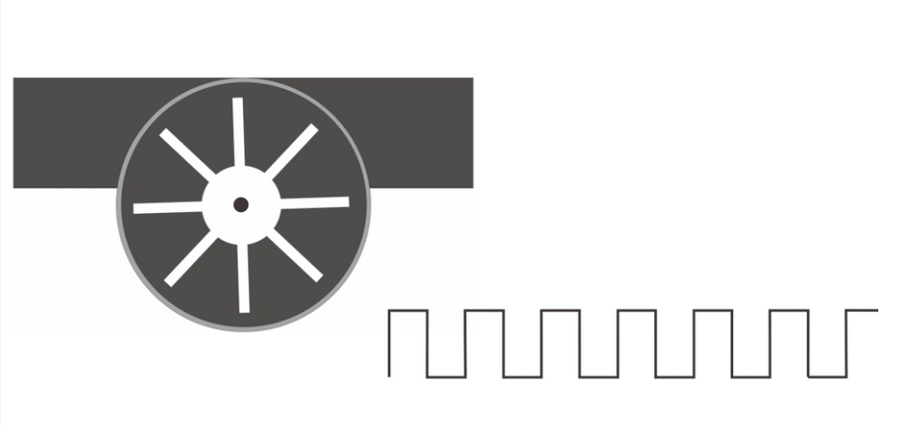
Flow sensor
volume = 2.663 * pulse
Why 2.663?
Pulses

Slide 11
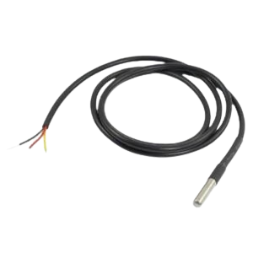
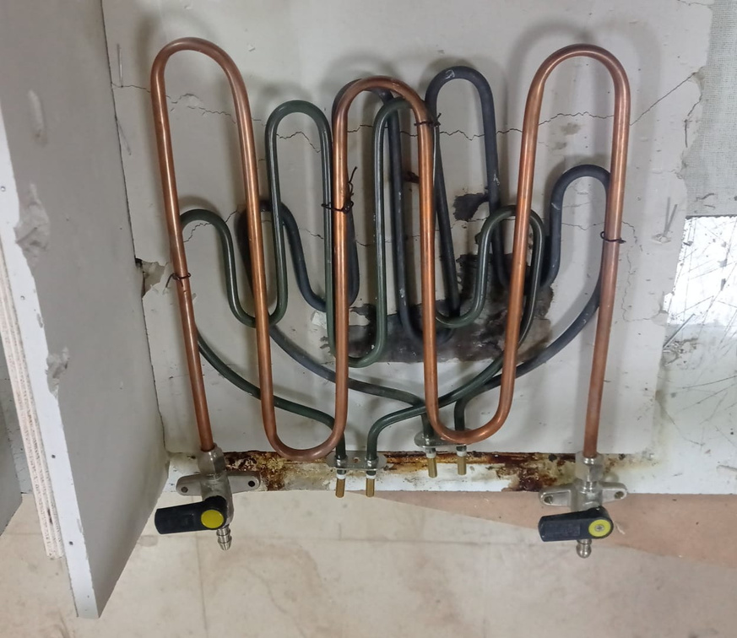
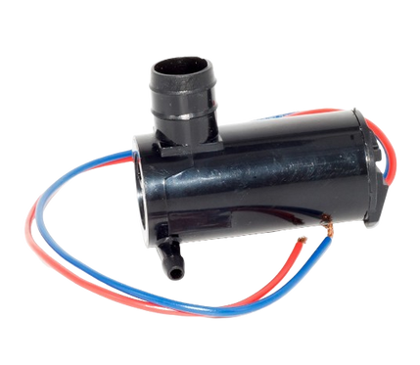
Heating
Temperature sensor
water pump

Slide 12
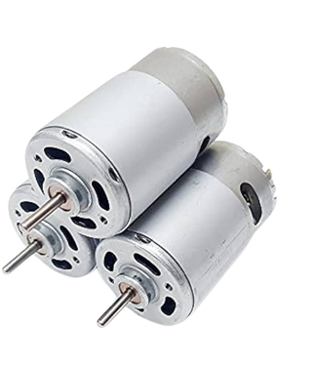
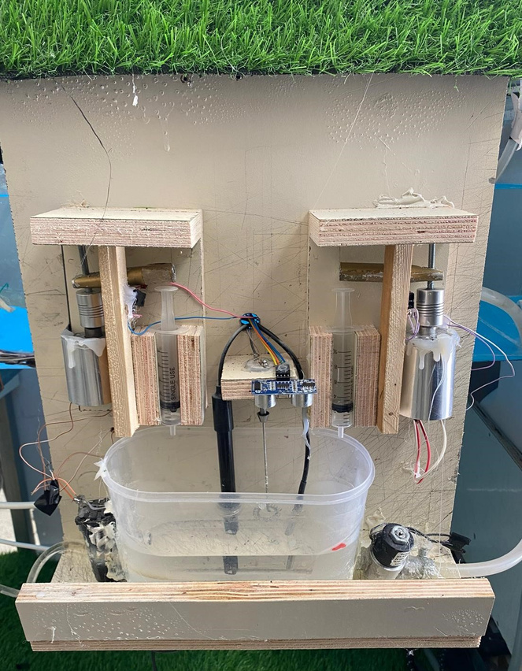
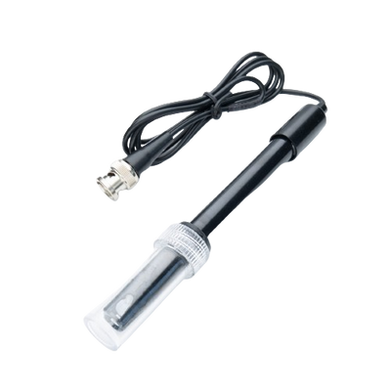
Sterilization
Ultrasonic sensor
DC motors
PH sensor
water pump
water valve

Slide 13
HCL Volume calculations
PH1 = PH standard =7.6.
PH2 = PH read from PH sensor.
Delta PH = PH2 – PH1
[HCL]= antilog (PH) mol\L
By applying the following function
M1 * V1 = M2 * V2
Volume of HCL = ([HCL] *H* W*L)/15

Slide 14
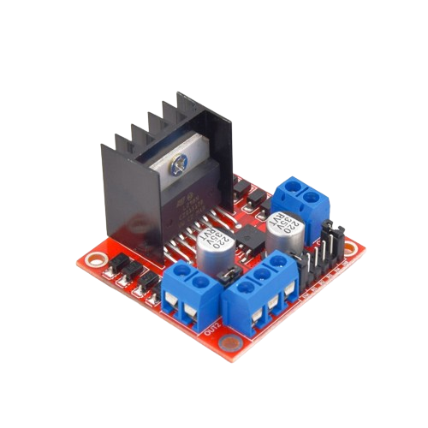
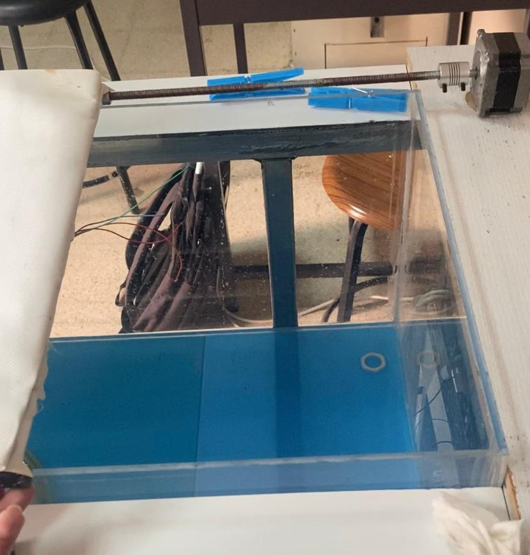
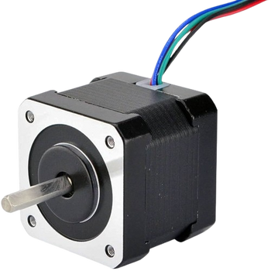
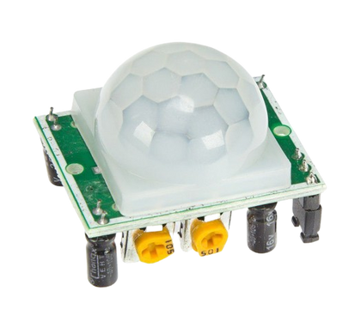
Closing and opening cover
Stepper Motor
H-Bridge motor driver
PIR motion sensor

Slide 15
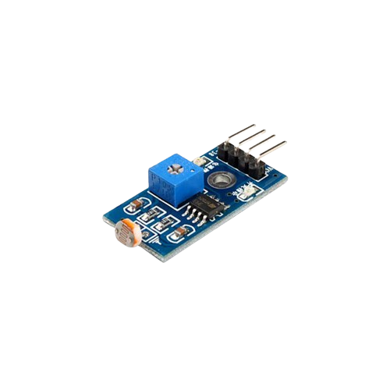
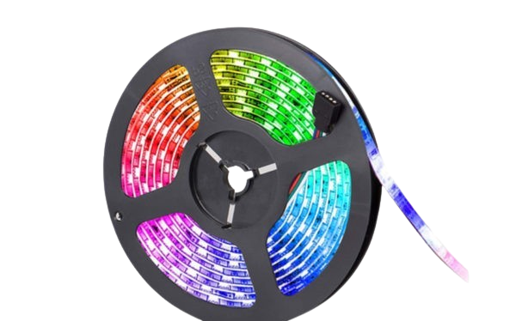
Light system
RGB led strip
LDR
sensor

Slide 16
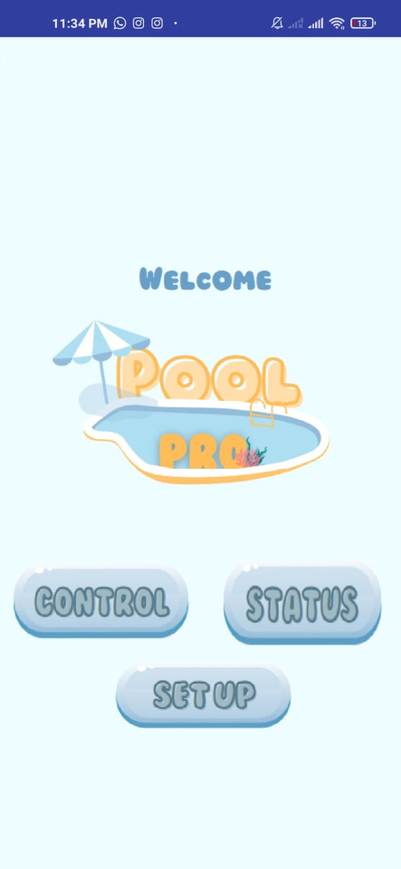
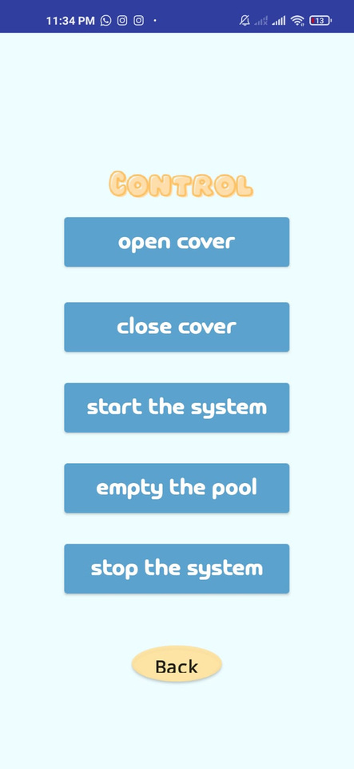
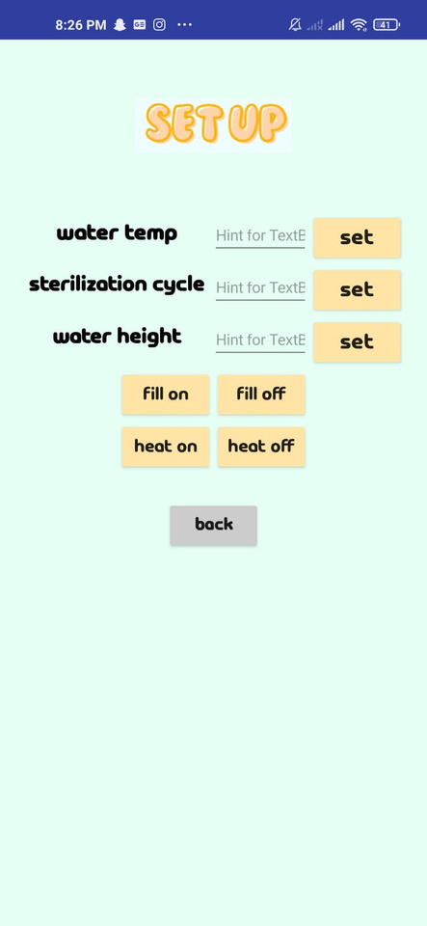
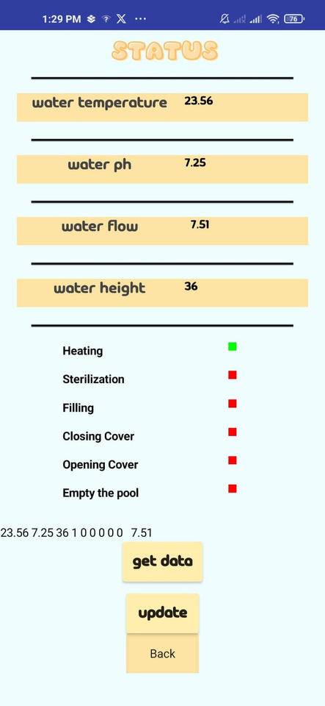
Application

Slide 17

Water and heating isolation
Pool body
Cost of some
components
Unaccurate sensors problem
Constraints and limitations

Slide 18
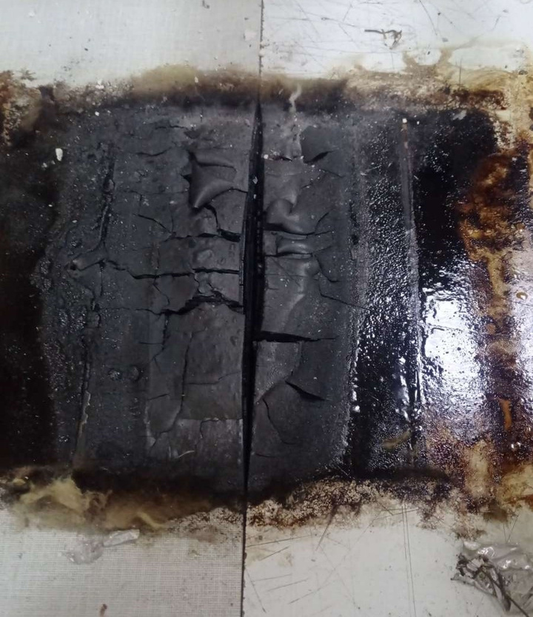
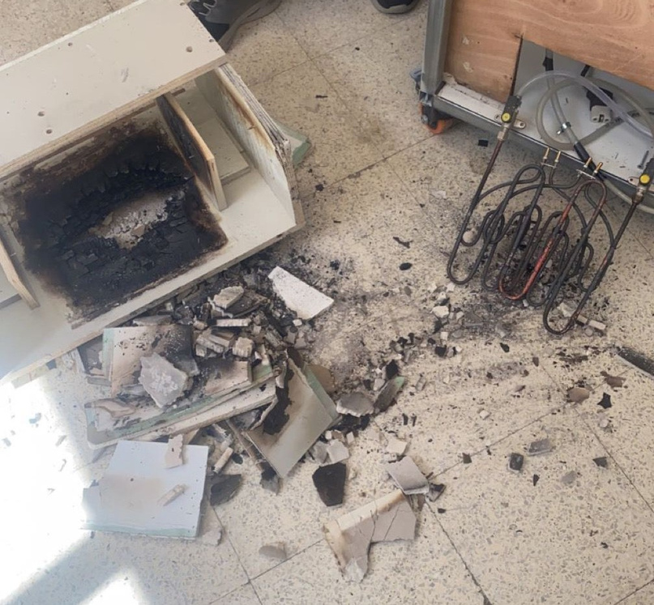
Constraints and limitations

Slide 19


FUTURE WORK
Add a drowning rescue system.
Install advanced sensors for water quality and
chlorine levels.
Use cameras and digital image processing to
detect objects/movement with the cover closed.
Implement energy-efficient components and
optimizesystem algorithms for sustainability.

Slide 20
Thank
You!

Slide 21
LIVE
DEMO!

