Slide 1


Slide 2


Slide 3
1. Objectives.
Outline
2. Tools.
3. Project life cycle.
4. Constraints.
5. Future Work.
6. Demo.

Slide 4


1. Objectives:
Providing assistance :
Through a wheelchair with advanced features than the ordinary wheelchair.

Slide 5
2. Tools:
1. Arduino.
2. Bluetooth Controller.

Slide 6

1. Arduino:
Writing the Arduino functionalities.

Slide 7

2. Bluetooth Controller:
Android Application to control the chair.

Slide 8
3. Project Life-Cycle:
Chair development.

Slide 9
Chair development:
1. Designing.
2. Connect the components.
3. Programming.
4. Testing.
5. Final design.

Slide 10
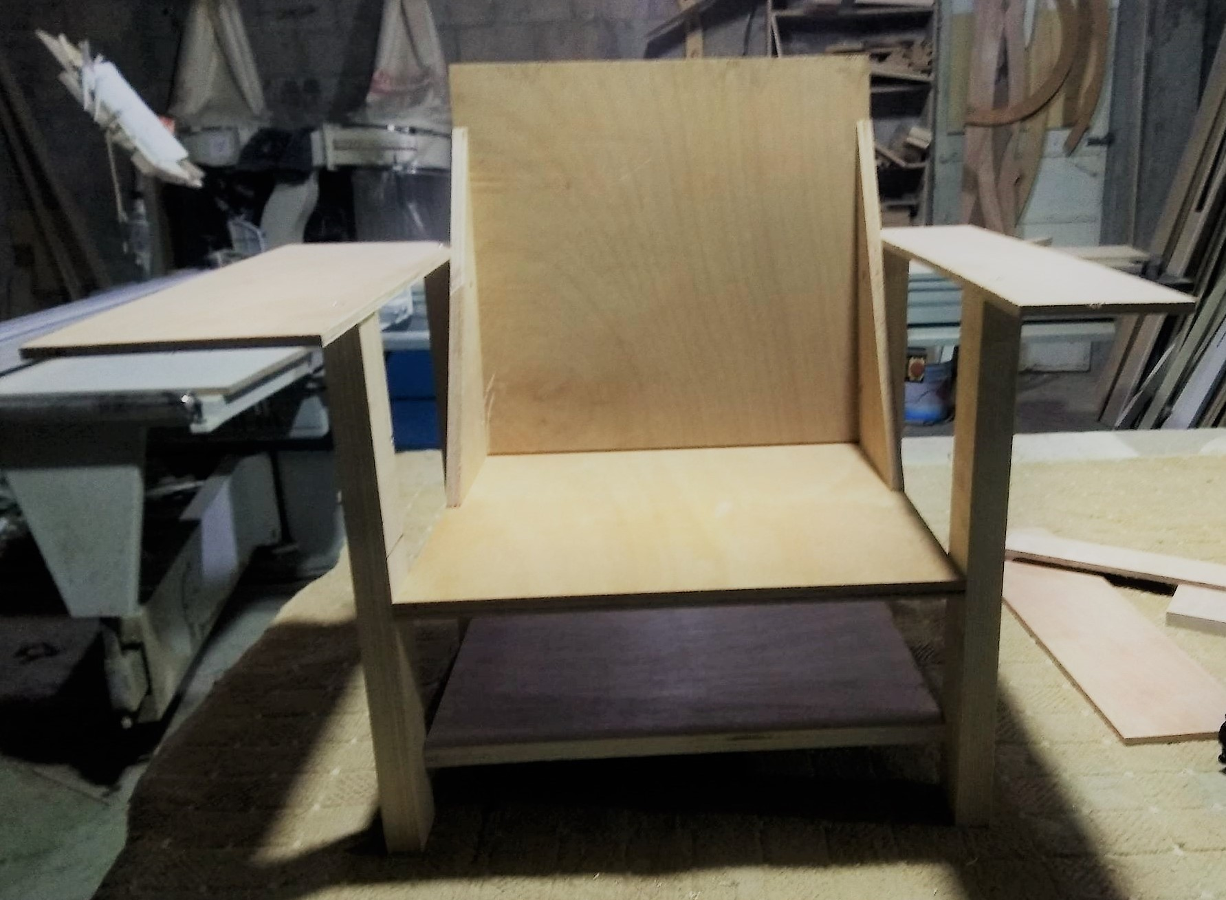
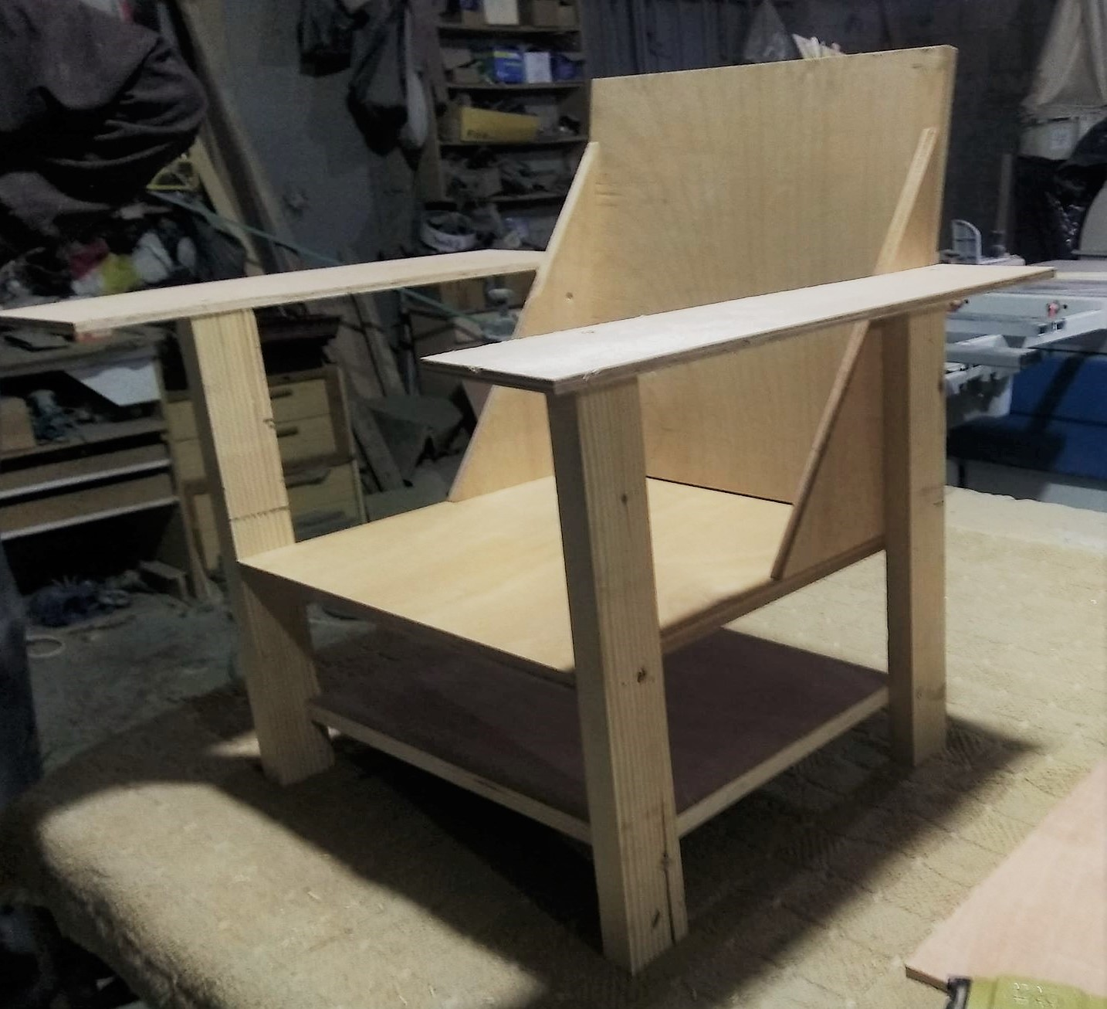
1. Designing:
The First Design.

Slide 11
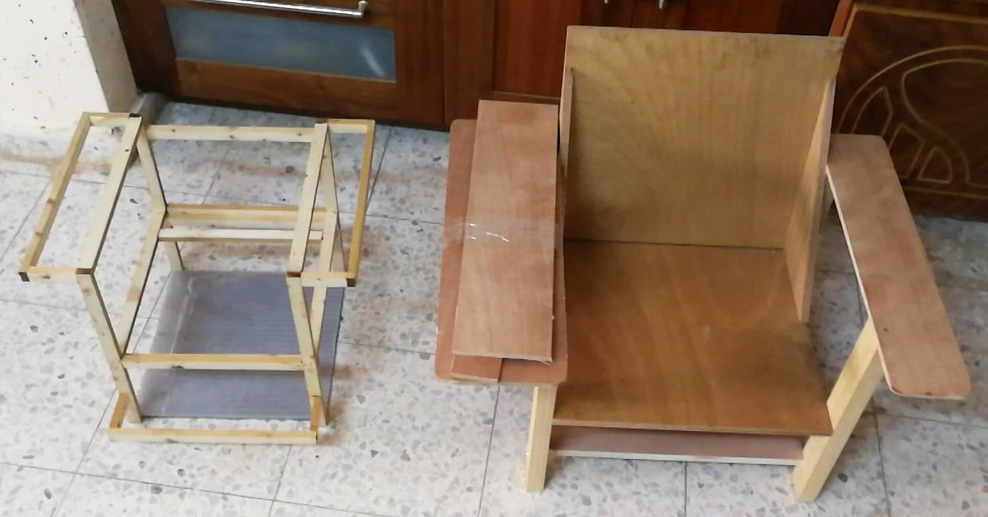
The Second Design.

Slide 12
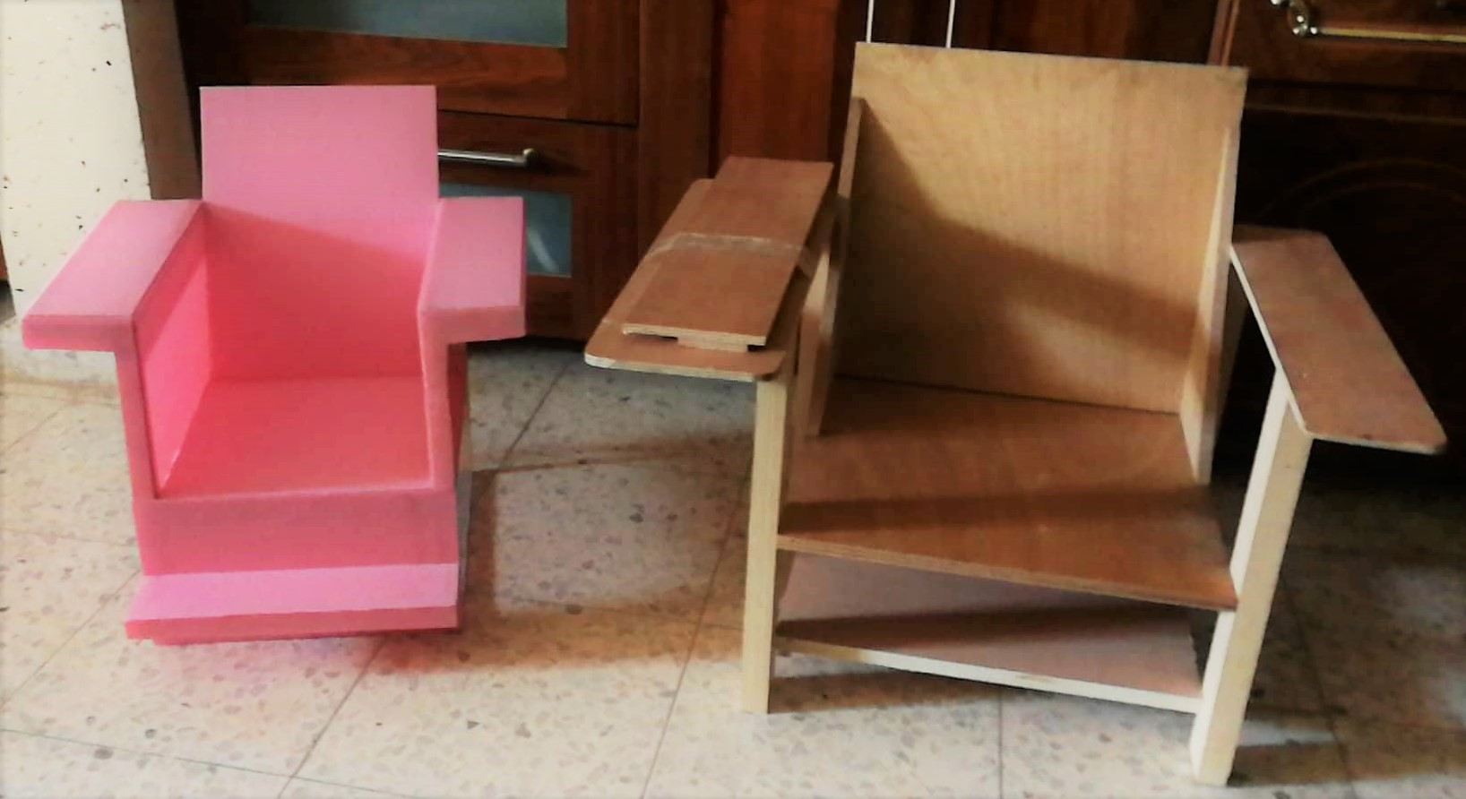
The Second Design.

Slide 13
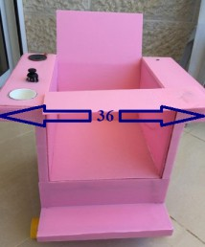
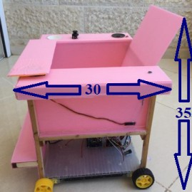
The Final Design.

Slide 14
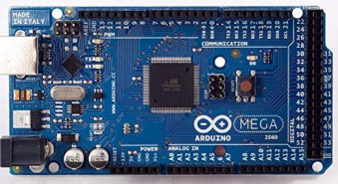
2. Connect the components:
1. Arduino Mega:
3 Serial, 9 PWM, analog and digital output.

Slide 15
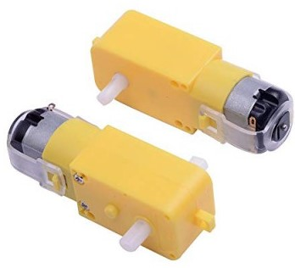
2. 4-DC motors:
Connected with 4 wheels.

Slide 16
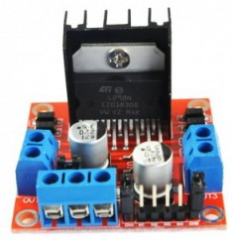
3. H-bridge:
2 H-bridge, each one is connected with 4-pins (PWM).

Slide 17
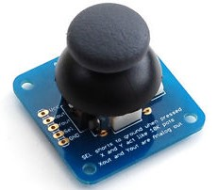
4. Joystick Controller:
Forward, backward, left and right. And push button.

Slide 18
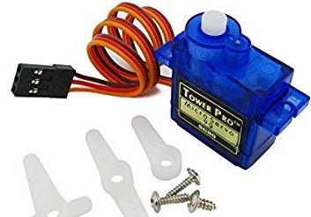
5. Servo Motor:
Connected with PWM. Moves from 0-180 degree.

Slide 19
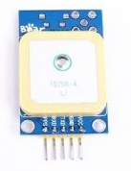
6. GPS:
Connected with Serial 3, in pins 14 and 15. For emergency.

Slide 20
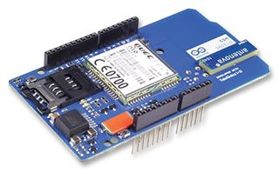
7. GSM:
Connected to serial 2 in pins 16 and 17. Requires 3.7v

Slide 21
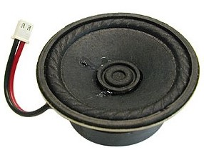
8. Speaker:
Connected to the GSM.

Slide 22
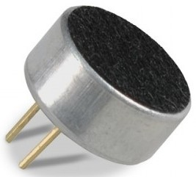
9. Microphone:
Connected to the GSM.

Slide 23
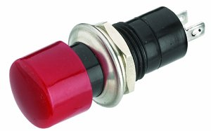
10. Push Button:
To make the call.

Slide 24
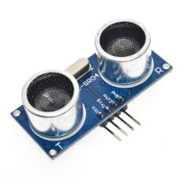
11. Ultrasonic Sensor:
Front and back ultrasonic sensors. It detects an object in a distance of (50cm).

Slide 25
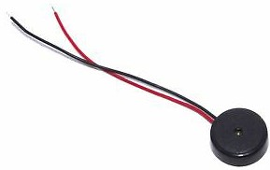
12. Buzzer:
Output a sound to warn the person.

Slide 26
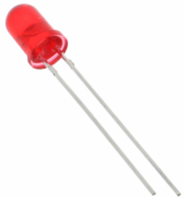
13. Leds:
It lights in the emergency cases.

Slide 27
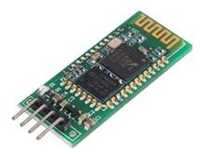
14. Bluetooth HC-06:
Connected to serial1 in Arduino 18 and 19 pins. For the Android application.

Slide 28
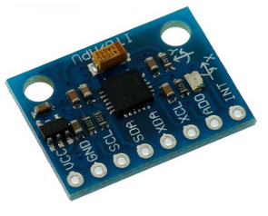
15. Gyroscope Sensor:
Uses the SPI communication protocol. For emergency.

Slide 29
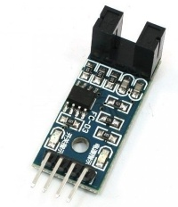
16. IR Encoder:
Connected to Arduino PWM.

Slide 30
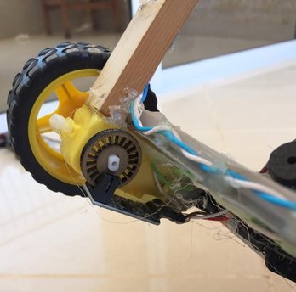
16. IR Encoder:

Slide 31
4. Constraints:
1. Time.
2. Operational Constraints.
3. Other Projects.

Slide 32
5. Future Work:
1. Developing the chair to be smart, through the Artificial Intelligence science.
2. Developing a chair that works on the internet of things.
3. Add more features to it.
4. Developing the project by adding different controlled format like voice command..

Slide 33
Demo:

Slide 35
Questions:

