Slide 1
Farmable
Project Proposal
Here is where your presentation begins
Hala Barqawi & Asala Tibi
Supervisor: Dr.Raed Qadi

Slide 2
TABLE OF CONTENTS
Introduction
Features
01
Problem & Solution.
02
For Both Mobile and Website
Architecture
Technologies & Tools
03
General explanation
04
How we build our Project.
Mobile application
Future Works
05
View Mobile & website
06
Possible Future Works

Slide 3

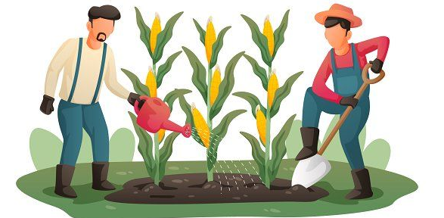
Problem
Farmers must be on-site for the majority of the day. They must keep track of things like planting, seeding, harvesting, and weeding to ensure that their crops grow well.
Farmers who lack management skills or knowledge.Also farmers who have more fields to keep track and control on them .

Slide 4
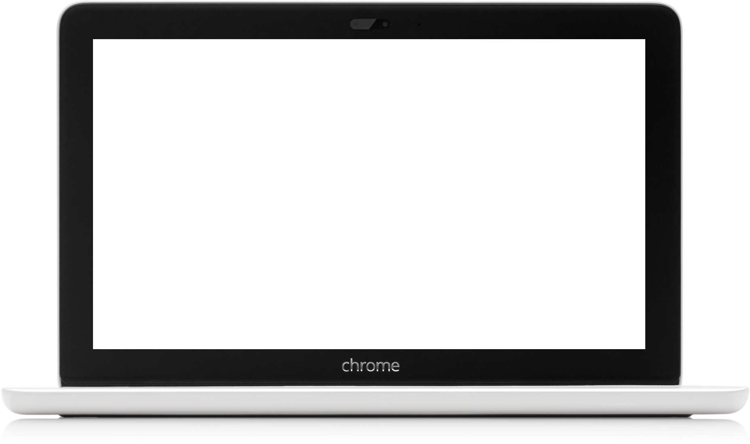
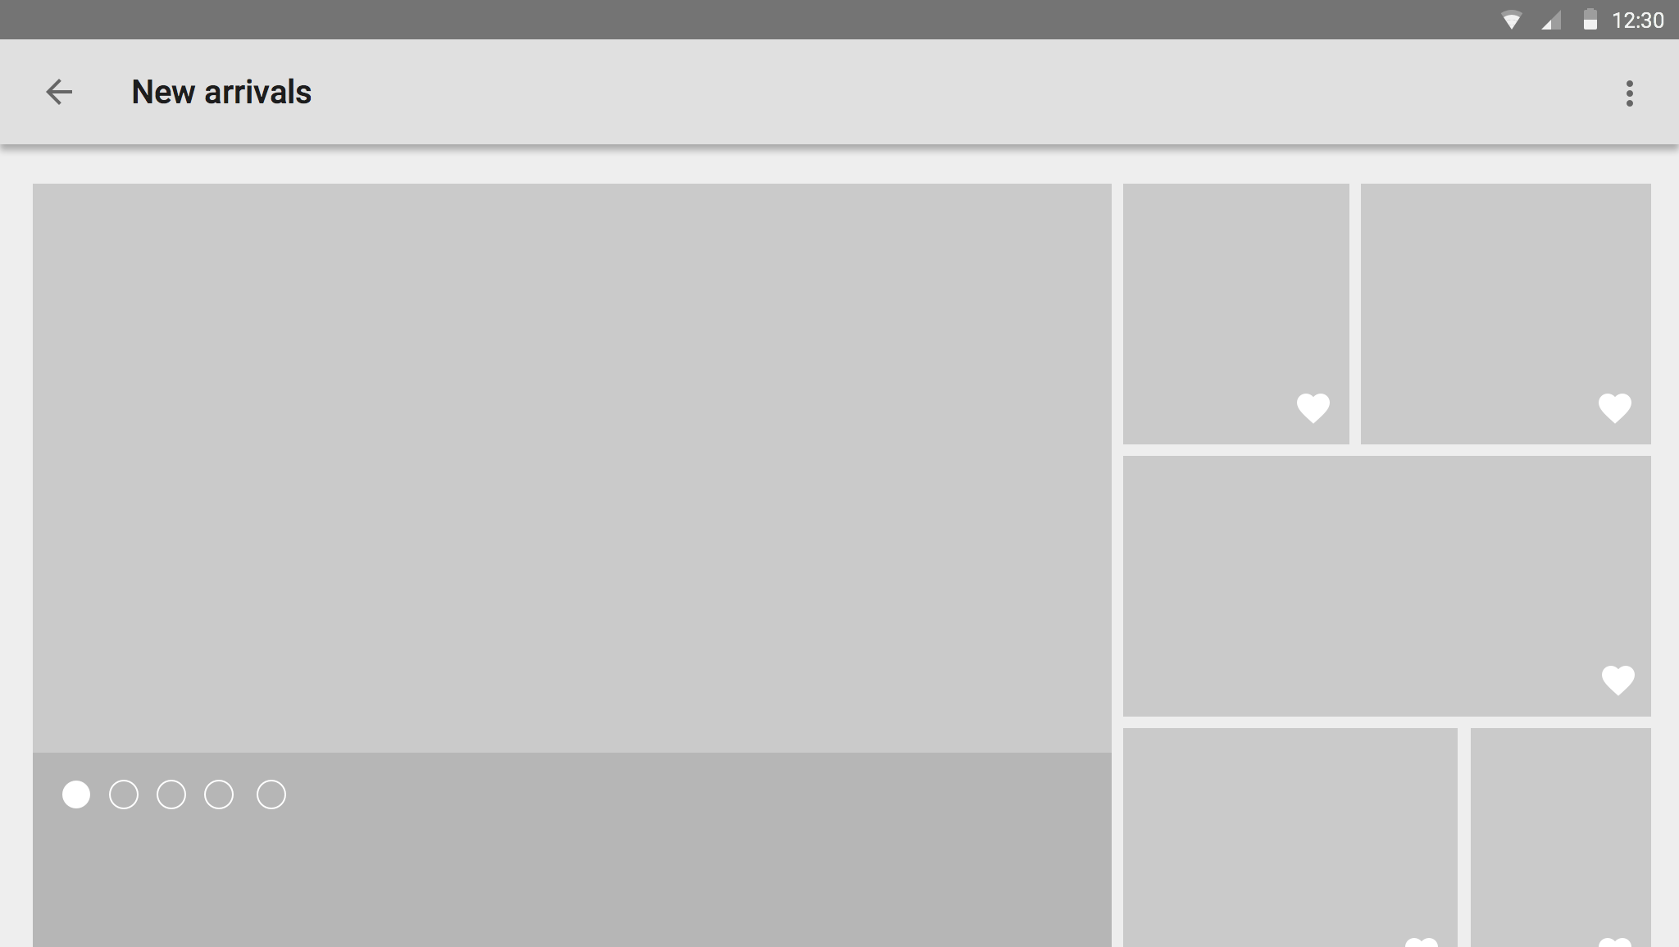

Solution
Farmable
Farmable
A helper application and website are required to log and organize all tasks for each worker on the farm, allowing the manager-farmer- to have a complete overview of what happened in his fields. Furthermore, all sales and expenses for all seasons are archived in one location.

Slide 5

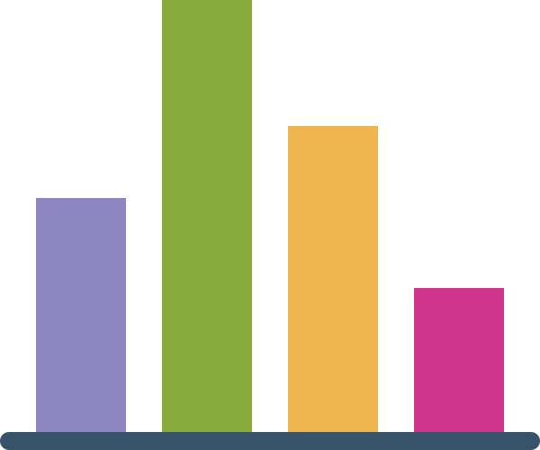


Mobile Application Features
01
02
03
04
05
Visualization
Google Map
Authorization &
Authentication
Chat
Notification

Slide 6
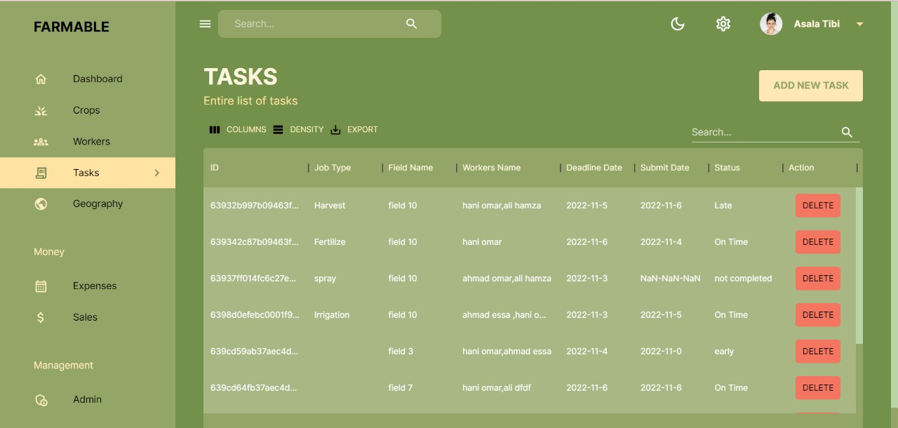
Web Application Features
Farmable -Admin Panel-
01
Complete OverView of Crops , Plan and delegate record Task.
02
View Fields Location using Google map.
03
Data Visualization - Dashboard-.

Slide 7
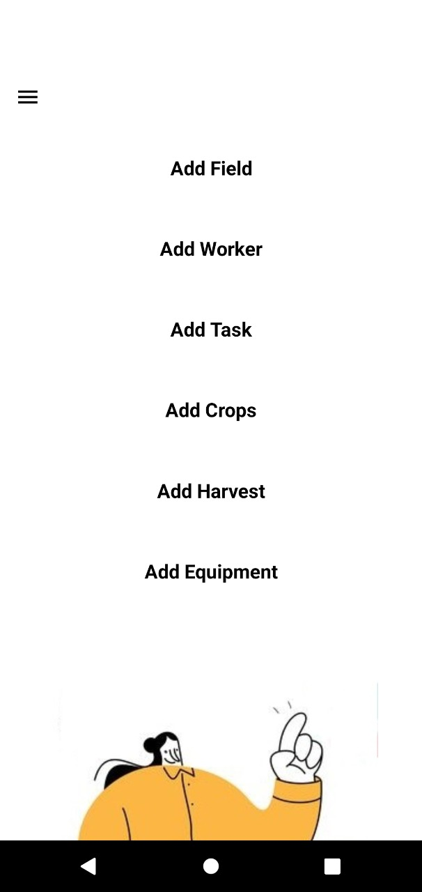
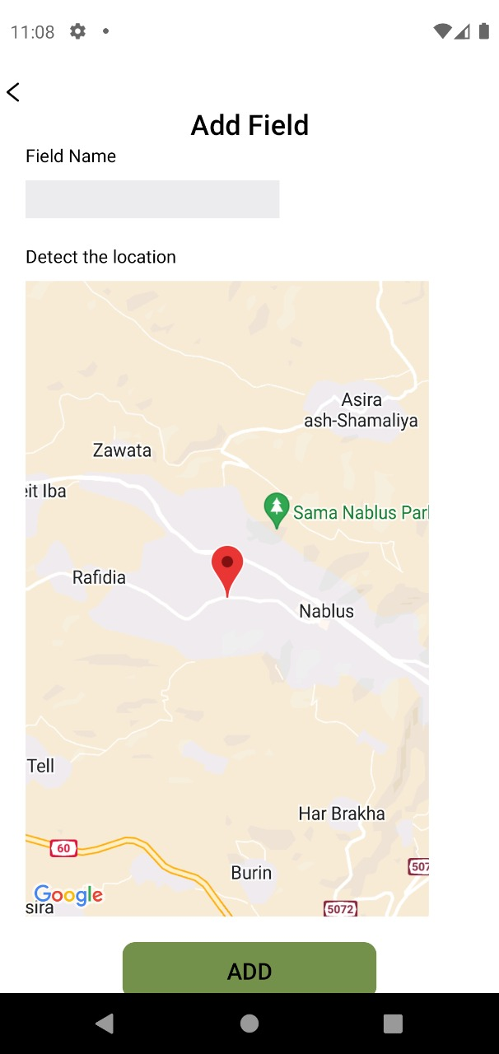
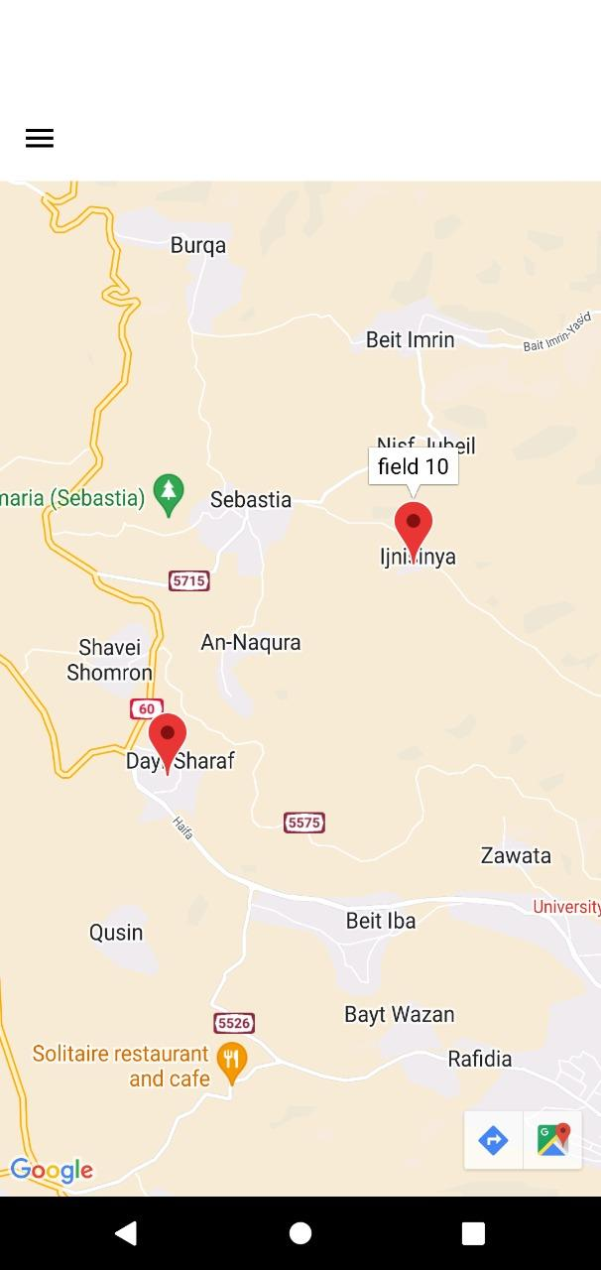
Fields

Slide 8
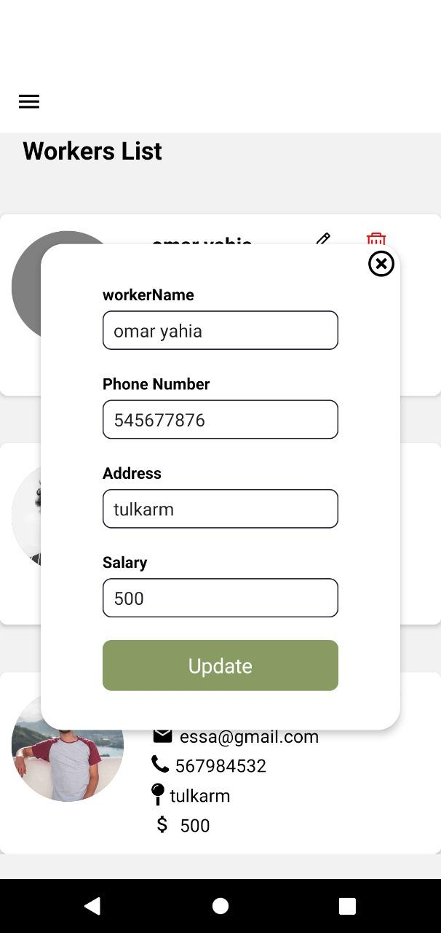
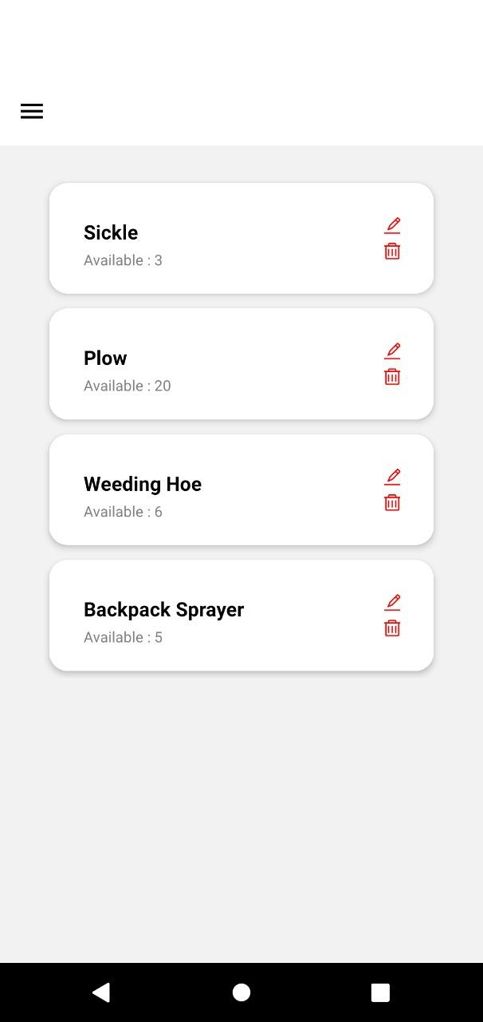
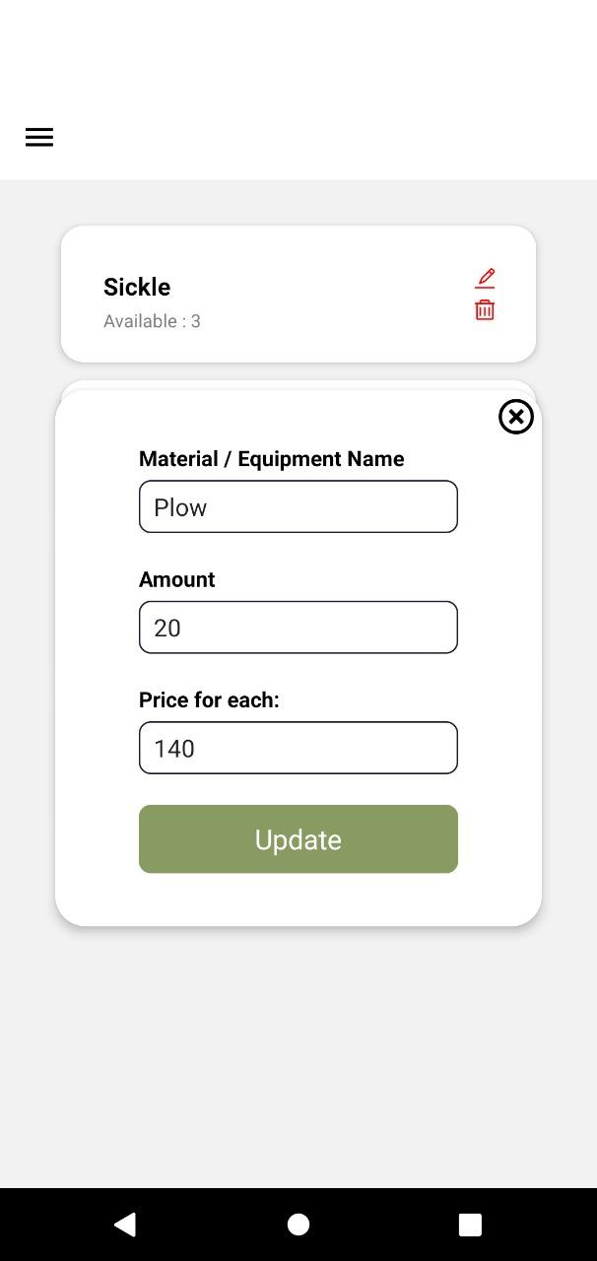
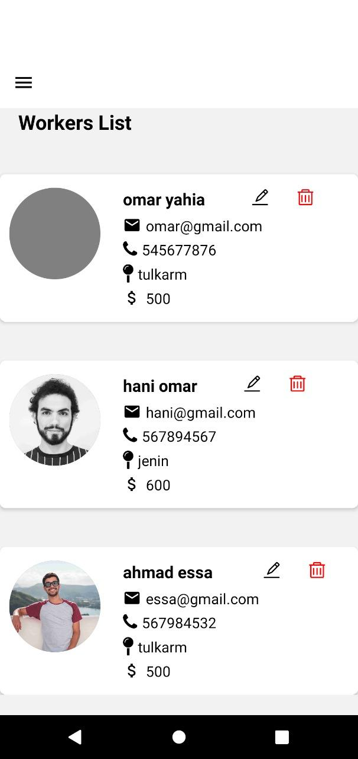
Equipment
Workers

Slide 9
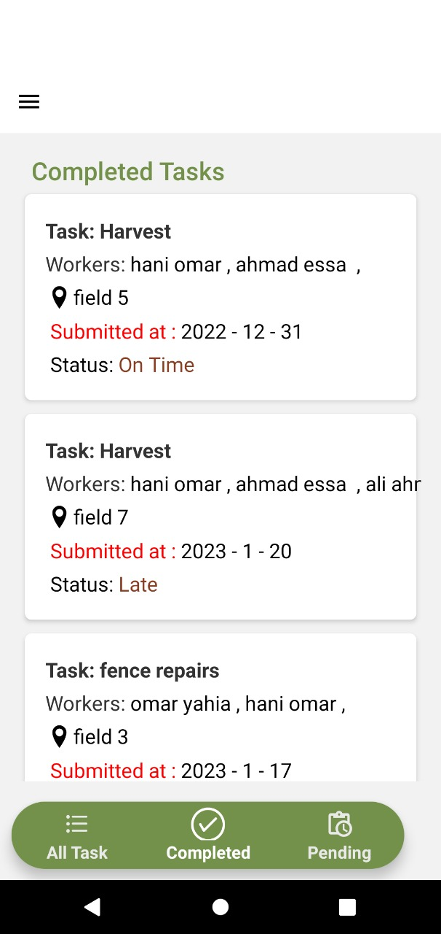
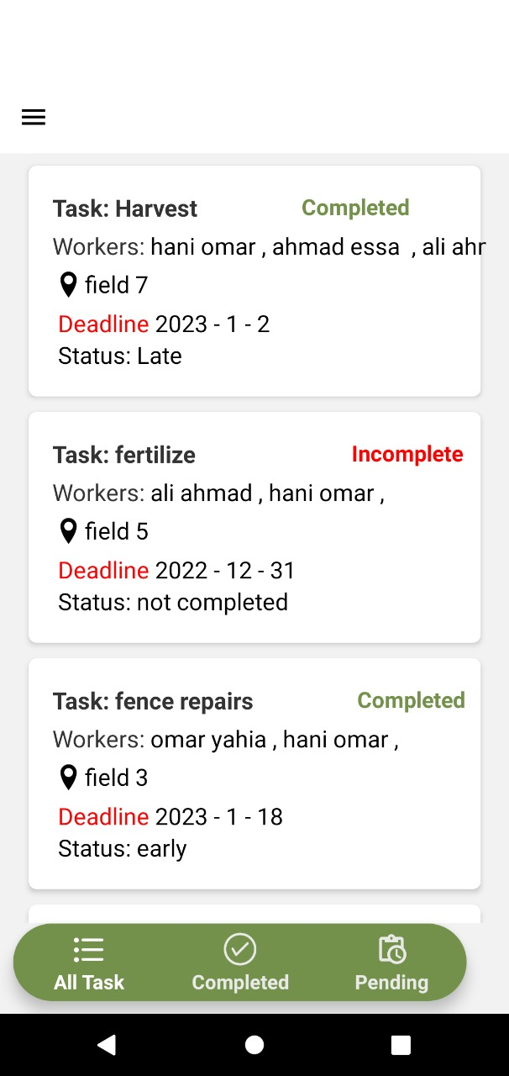
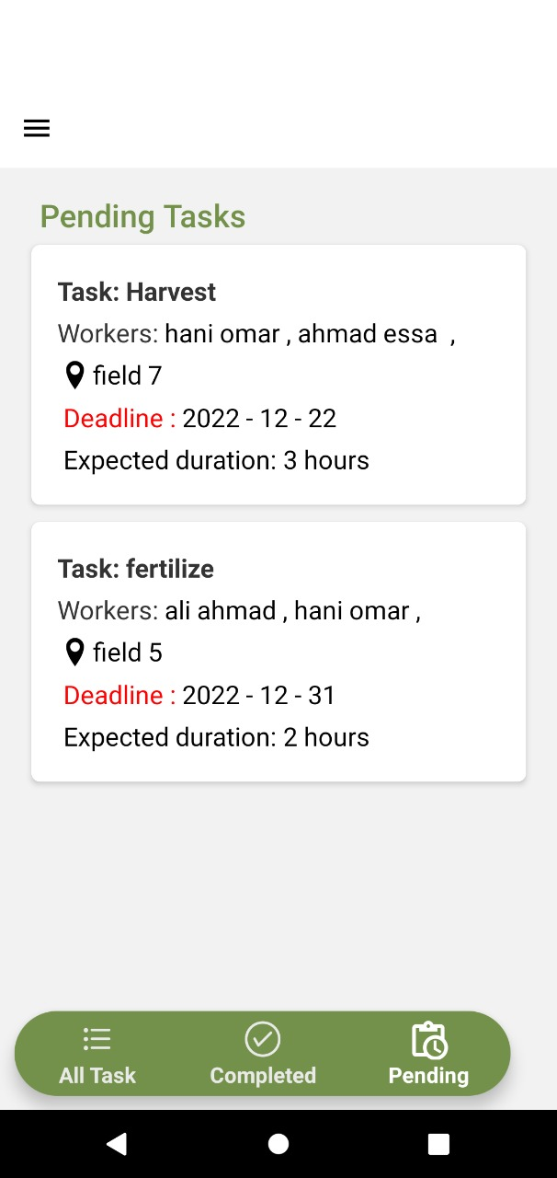
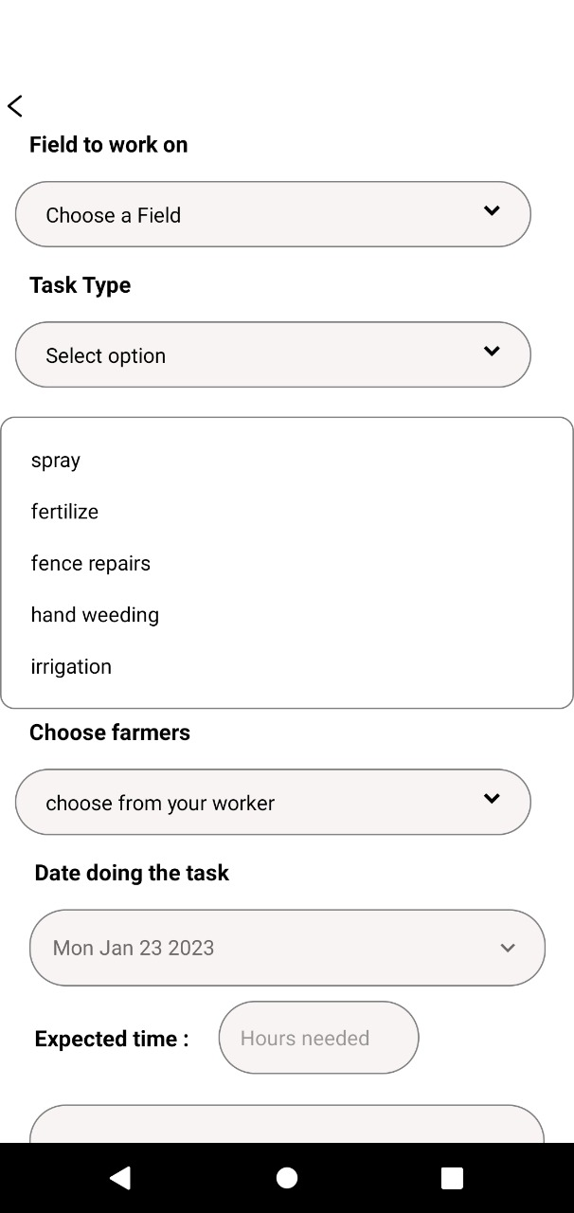
Tasks

Slide 10
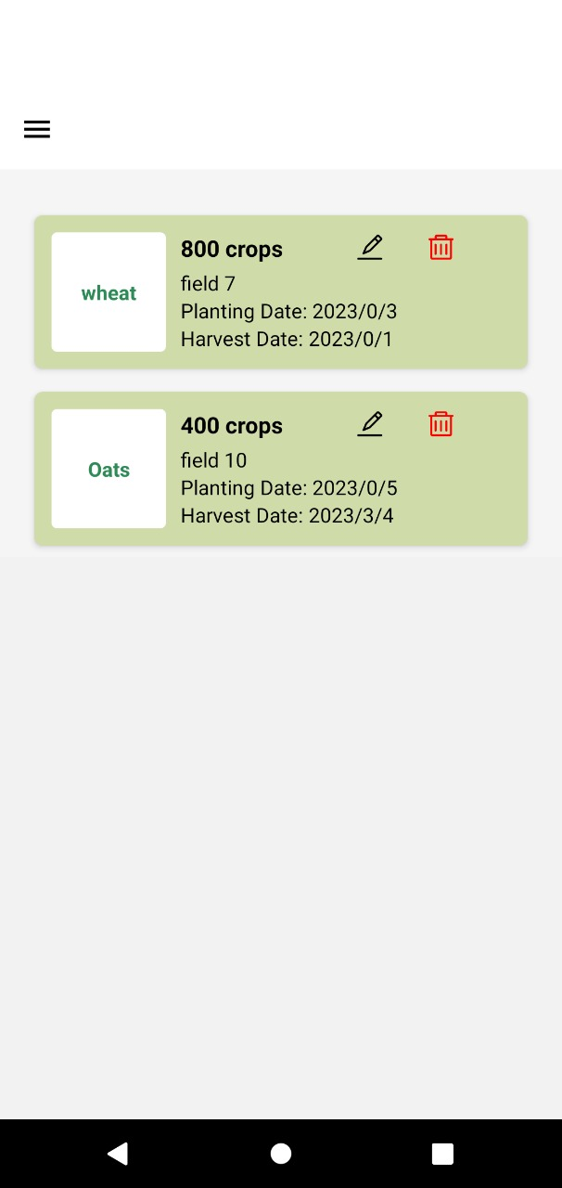
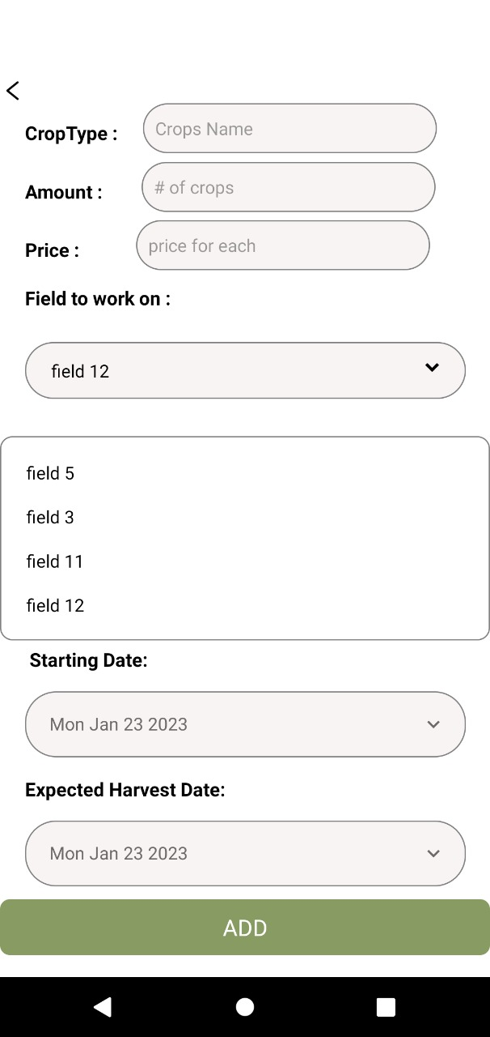
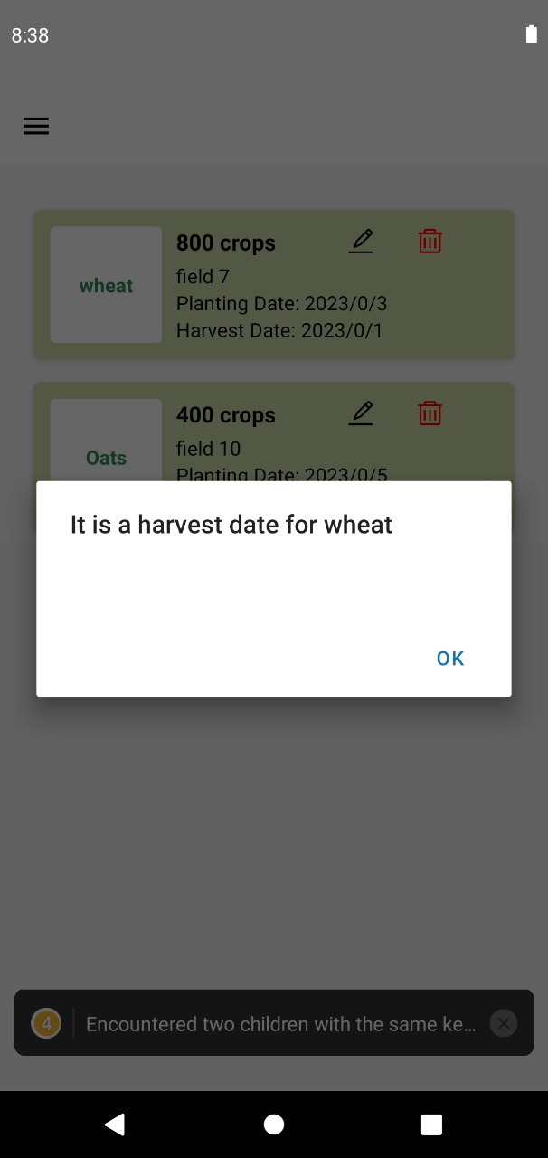
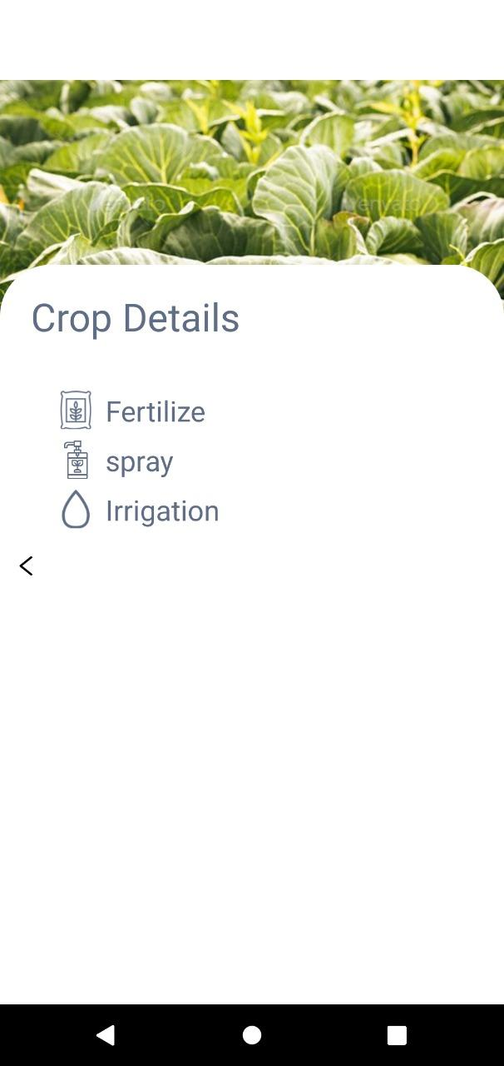
Crops

Slide 11
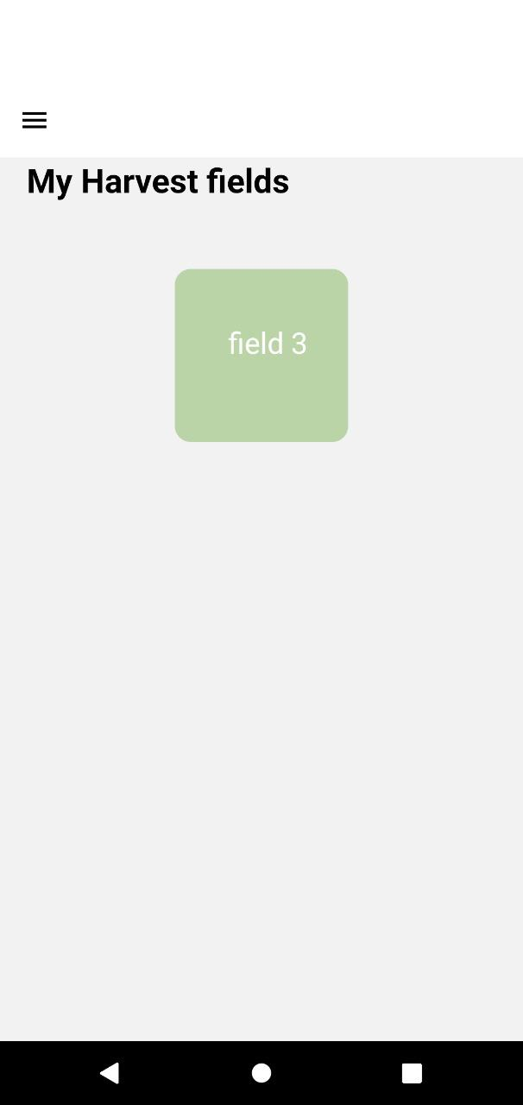
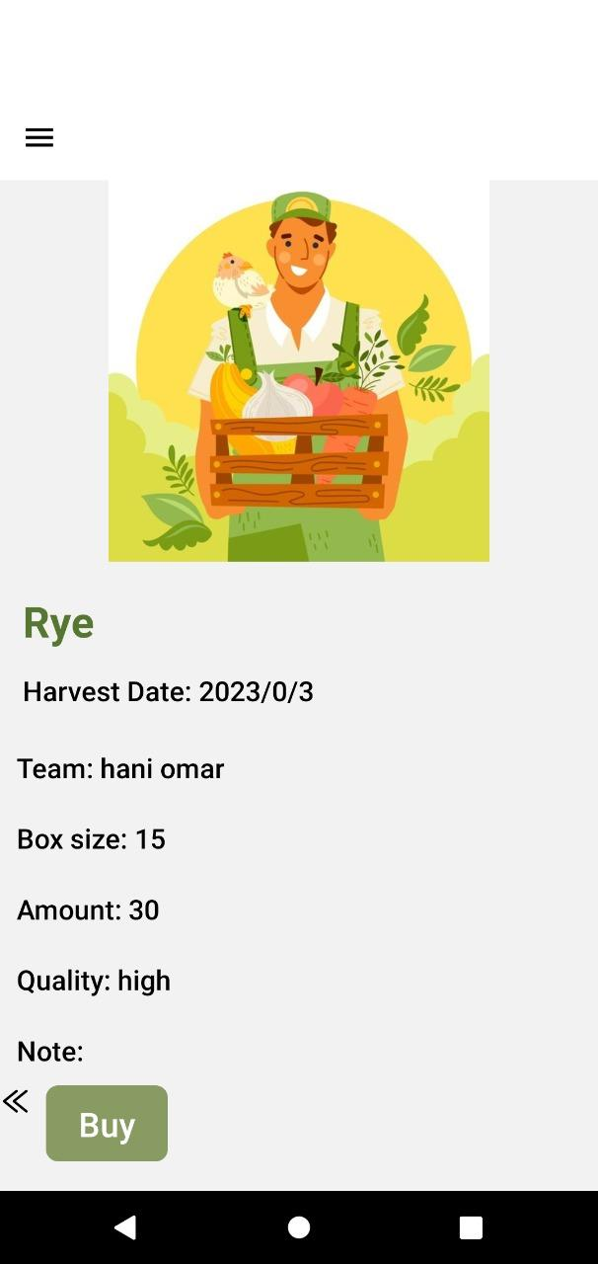
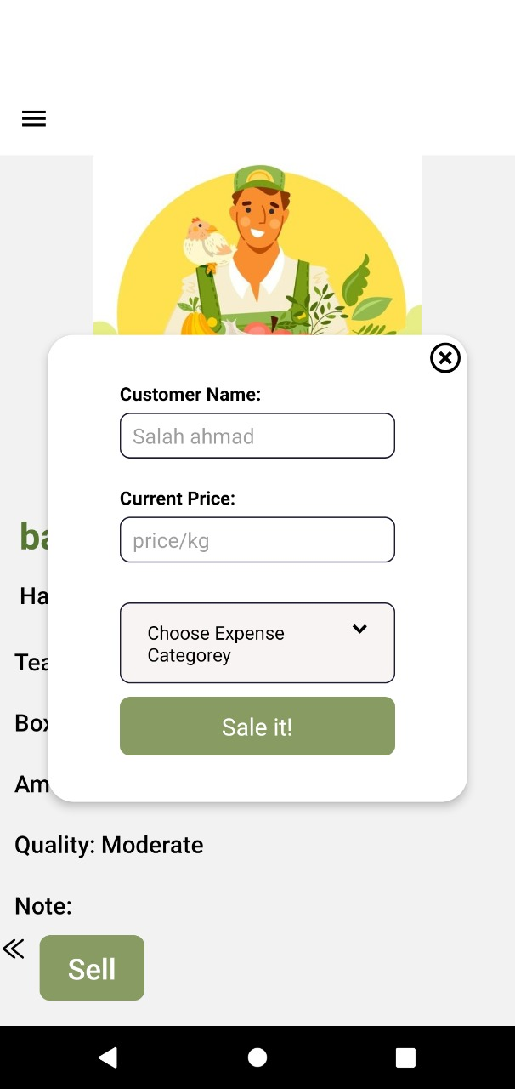
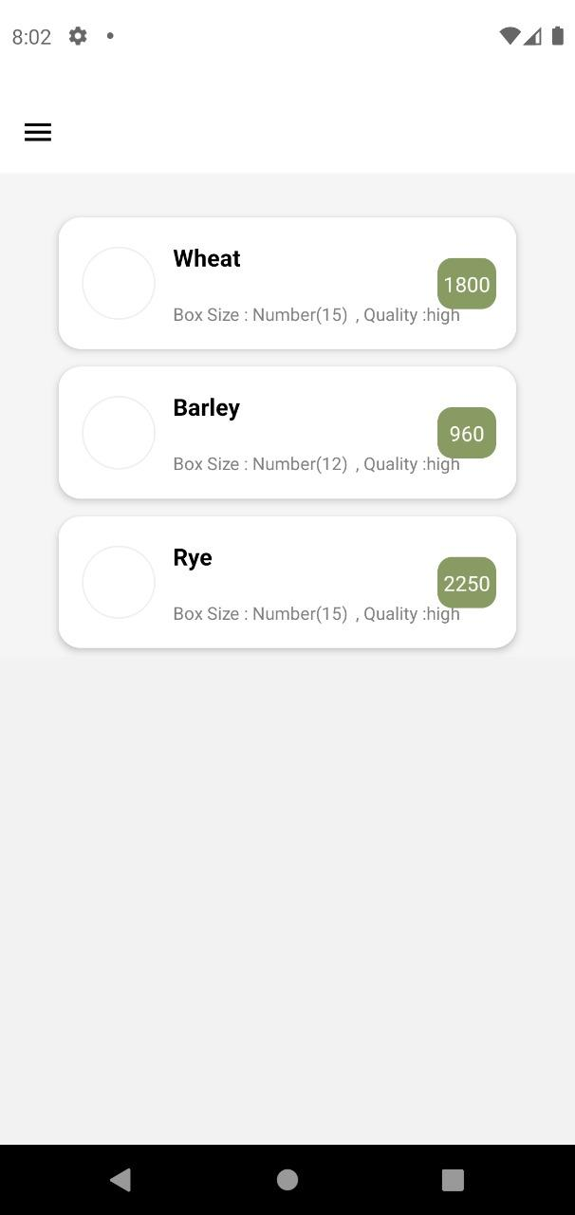
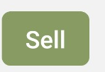
Harvests
Sales

Slide 12
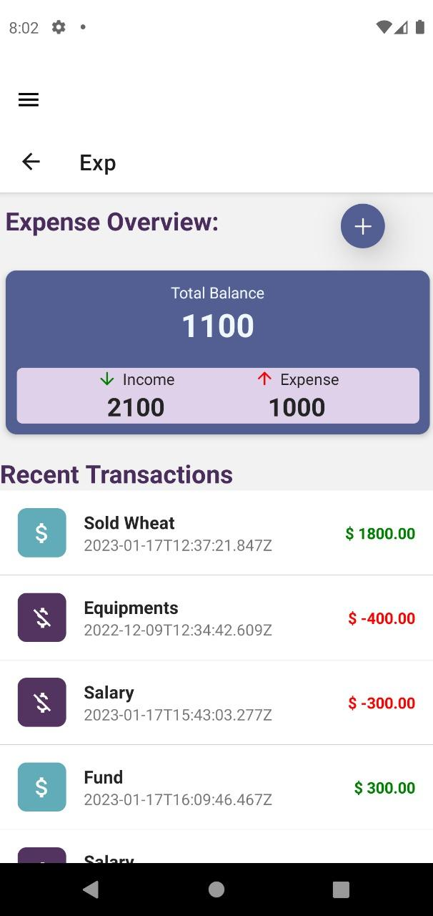
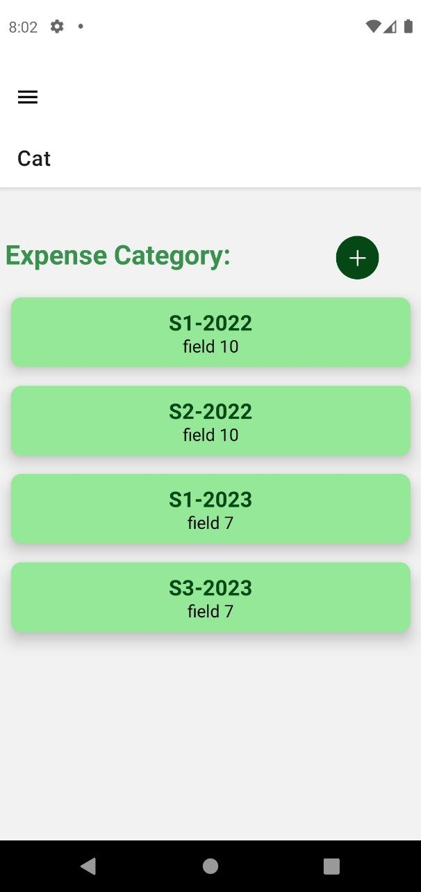
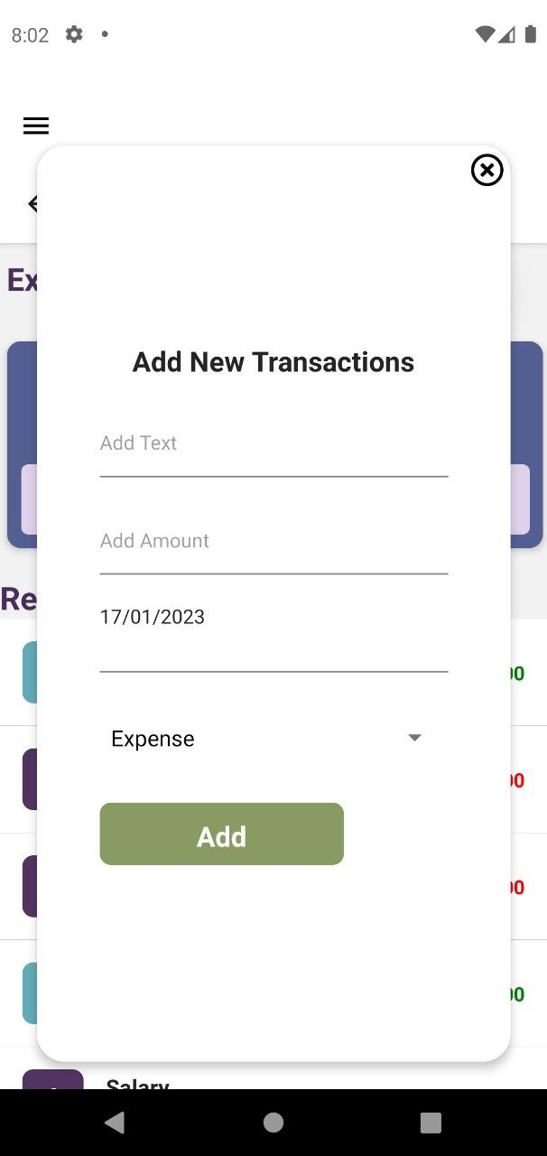
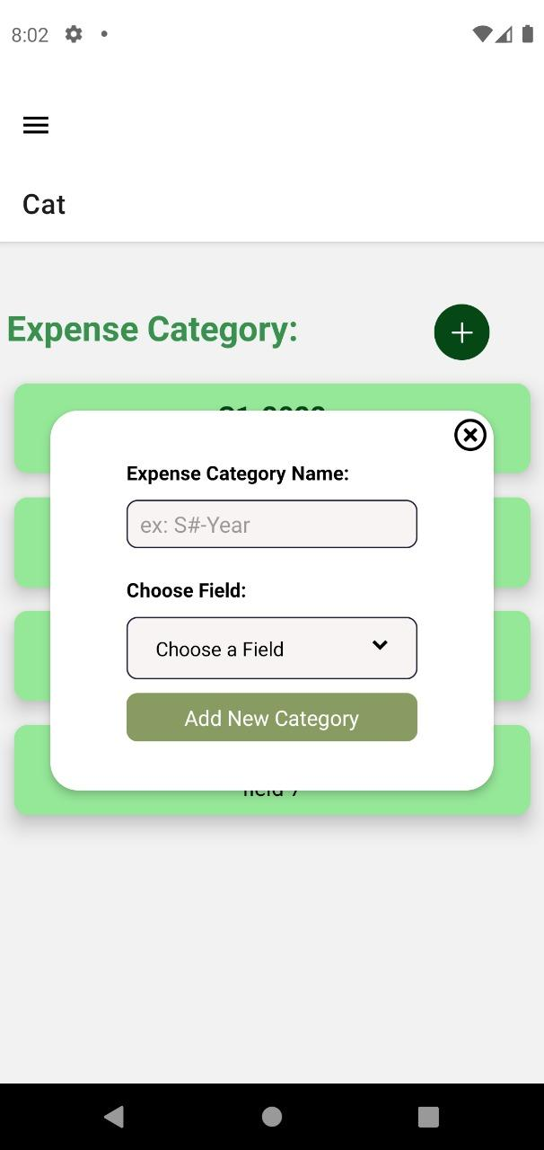
Expense Track

Slide 13
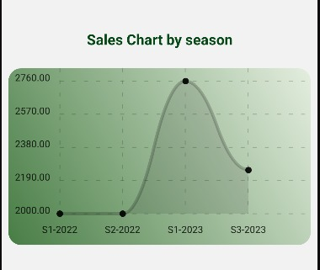
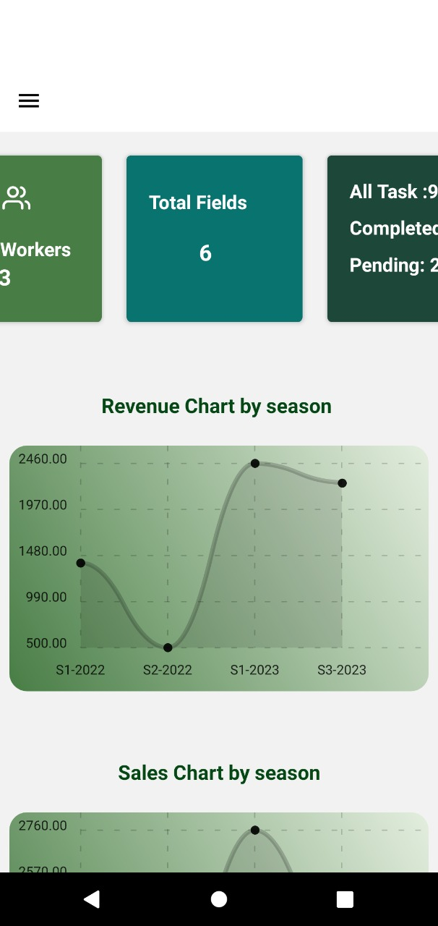
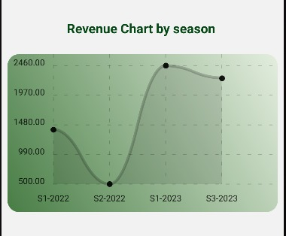
Dashboard

Slide 14
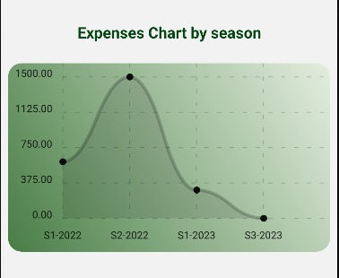
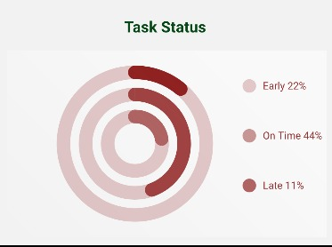
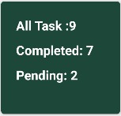
Dashboard

Slide 15
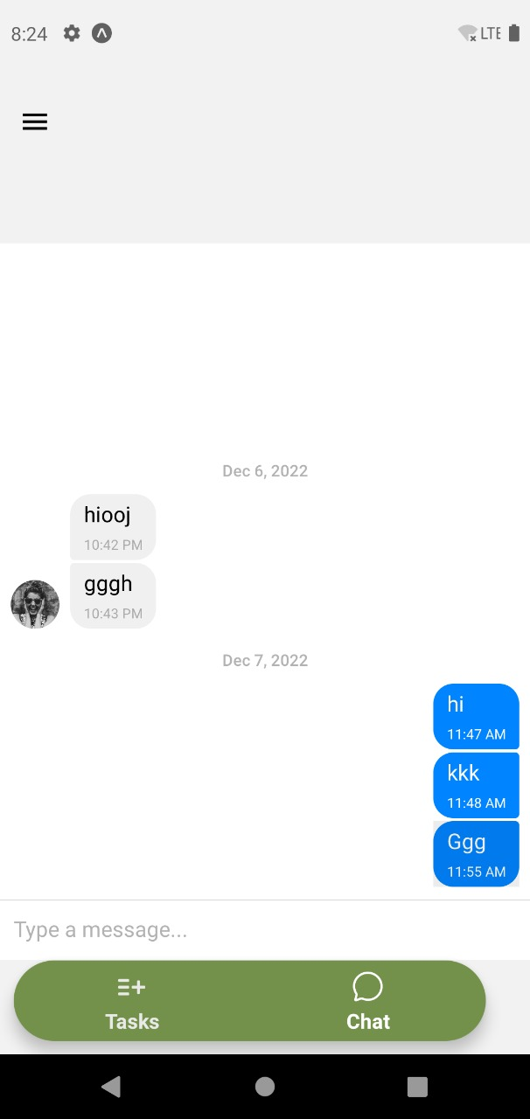
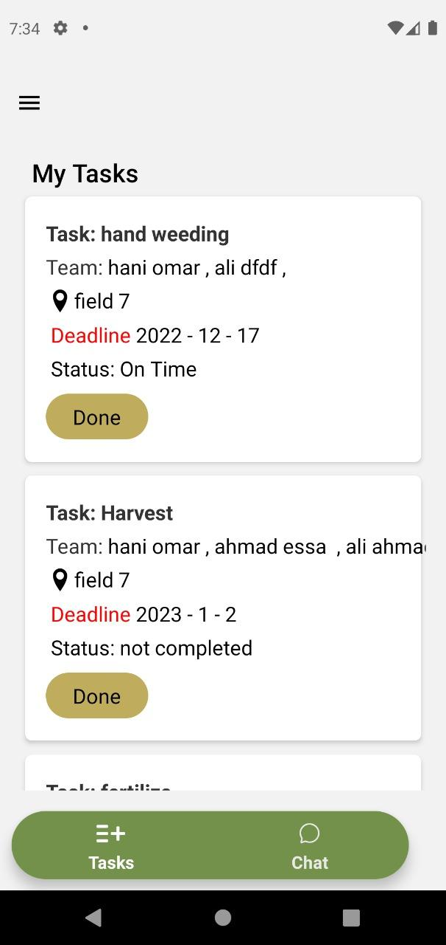
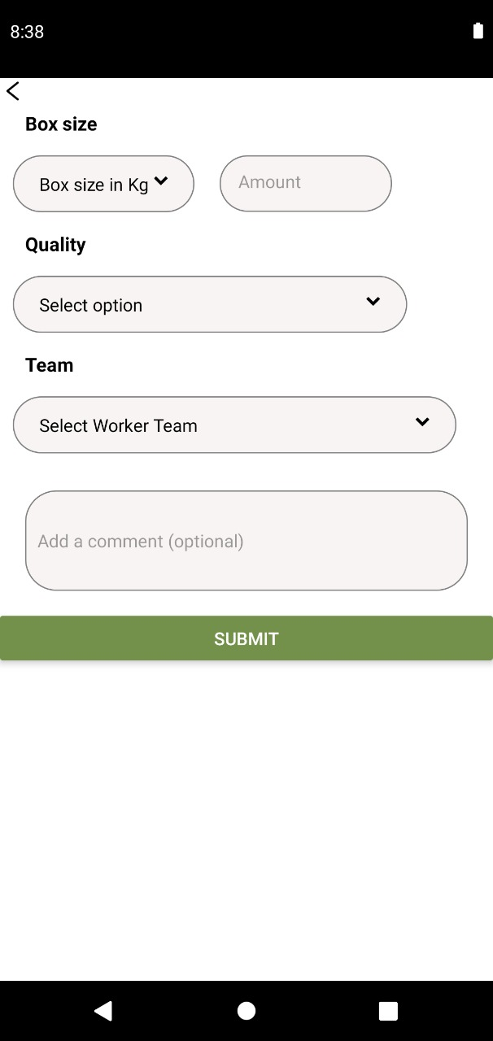
Worker Side:

Slide 16
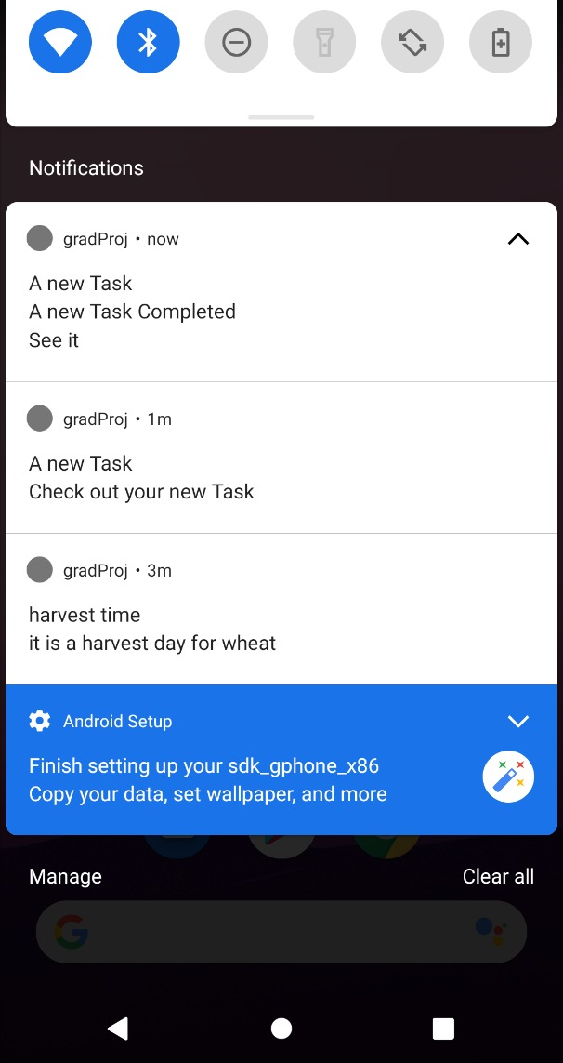
Notifications:
For Admin
For Worker

Slide 17
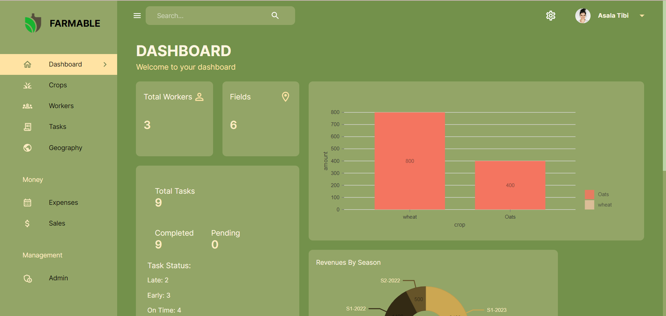
Web Admin-Panel

Slide 18
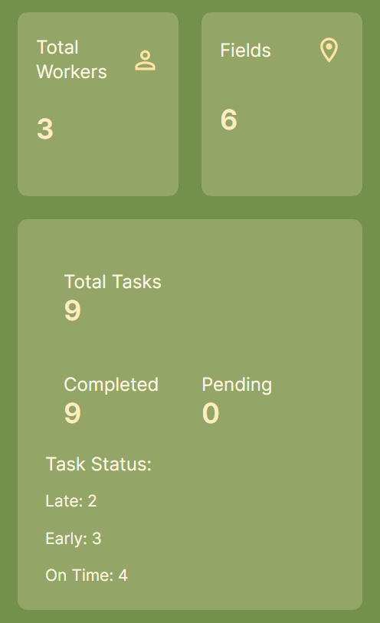
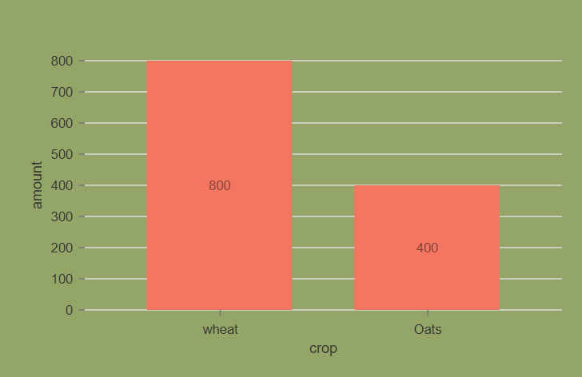
Dashboard

Slide 19
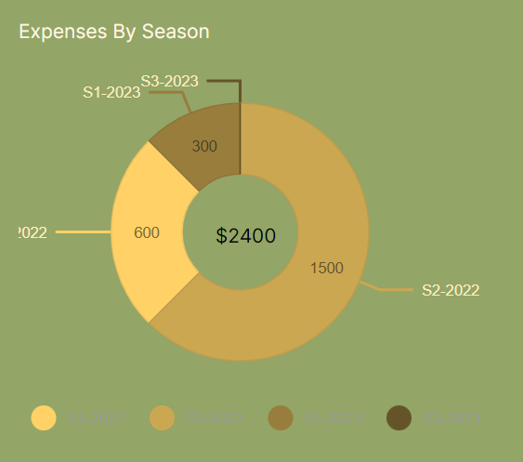
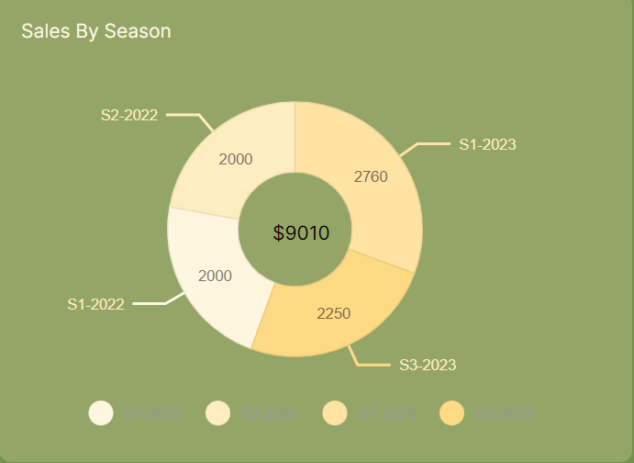
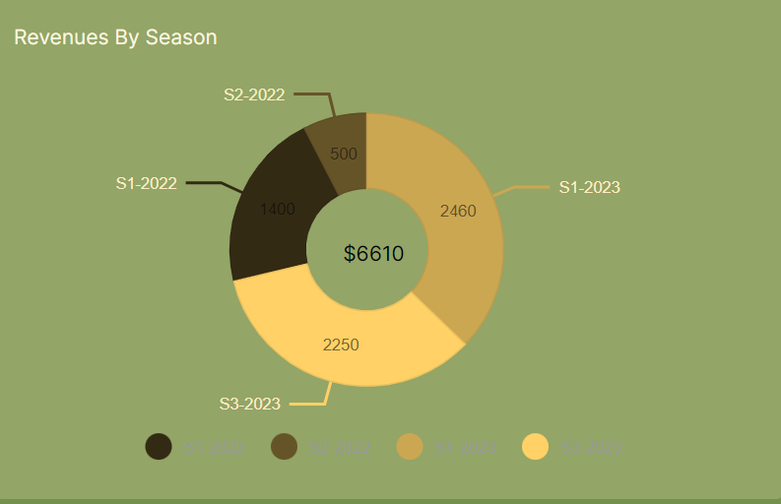

Slide 20
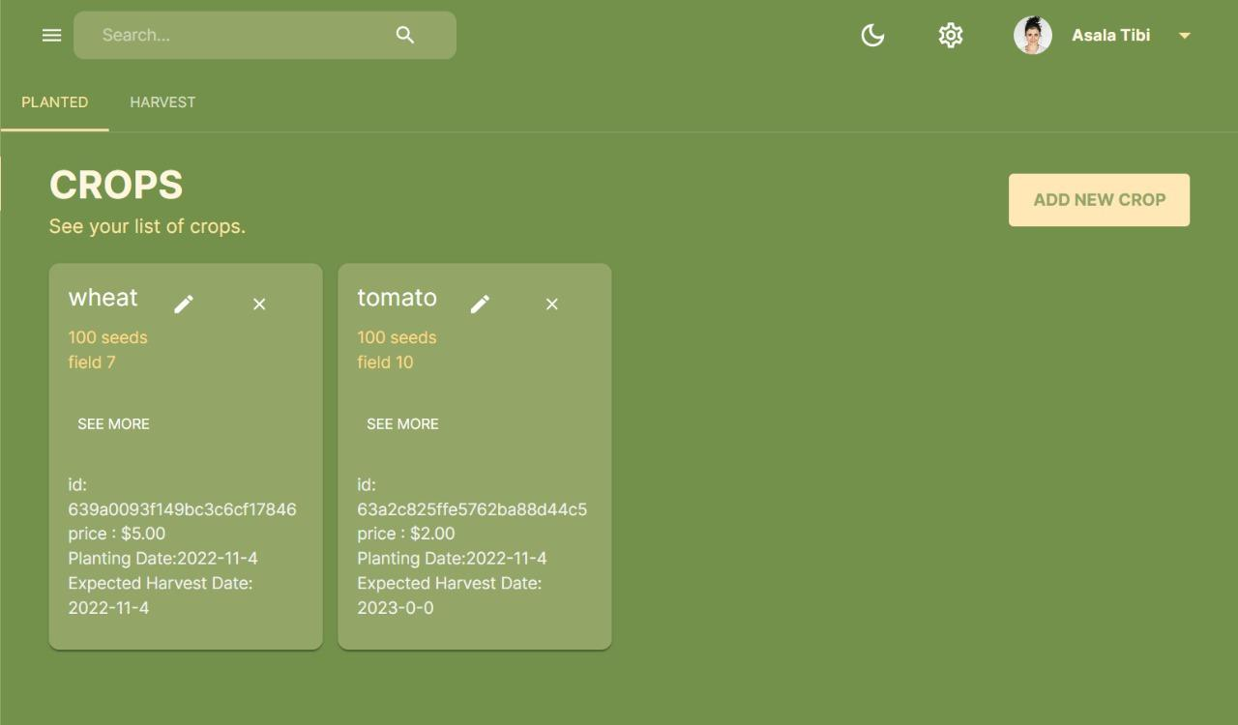
Web Admin-Panel

Slide 21
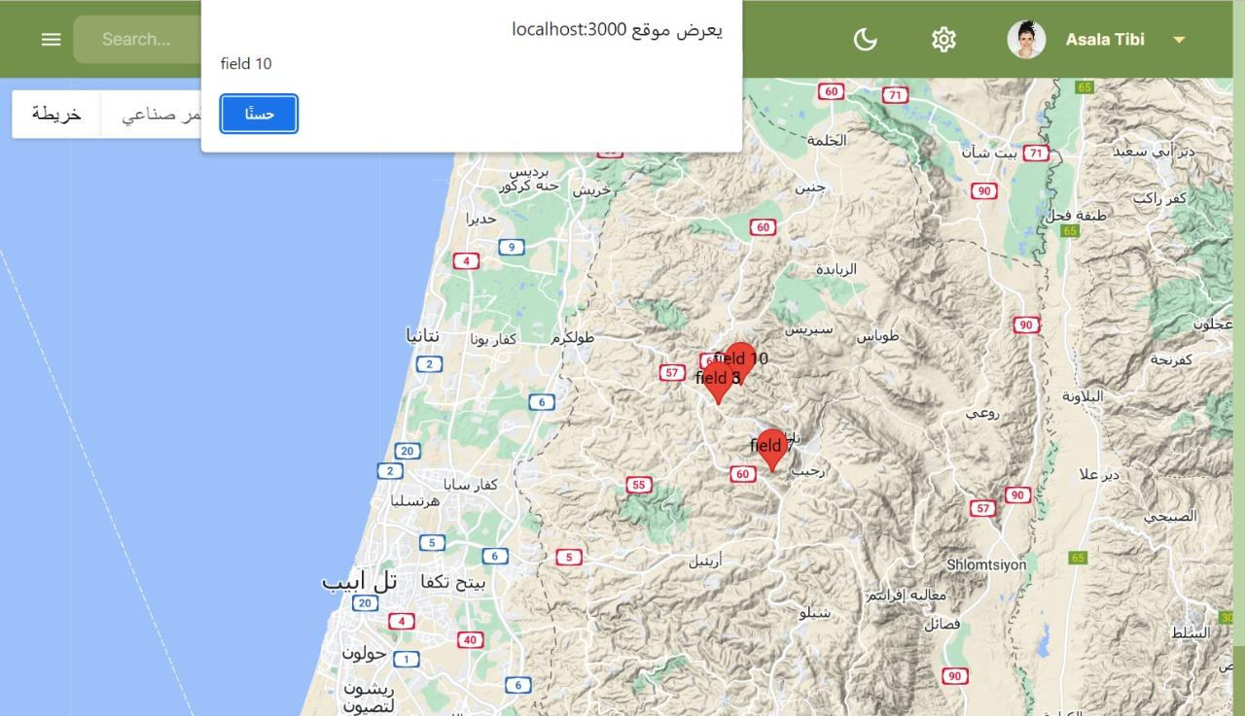
Web Admin-Panel

Slide 22
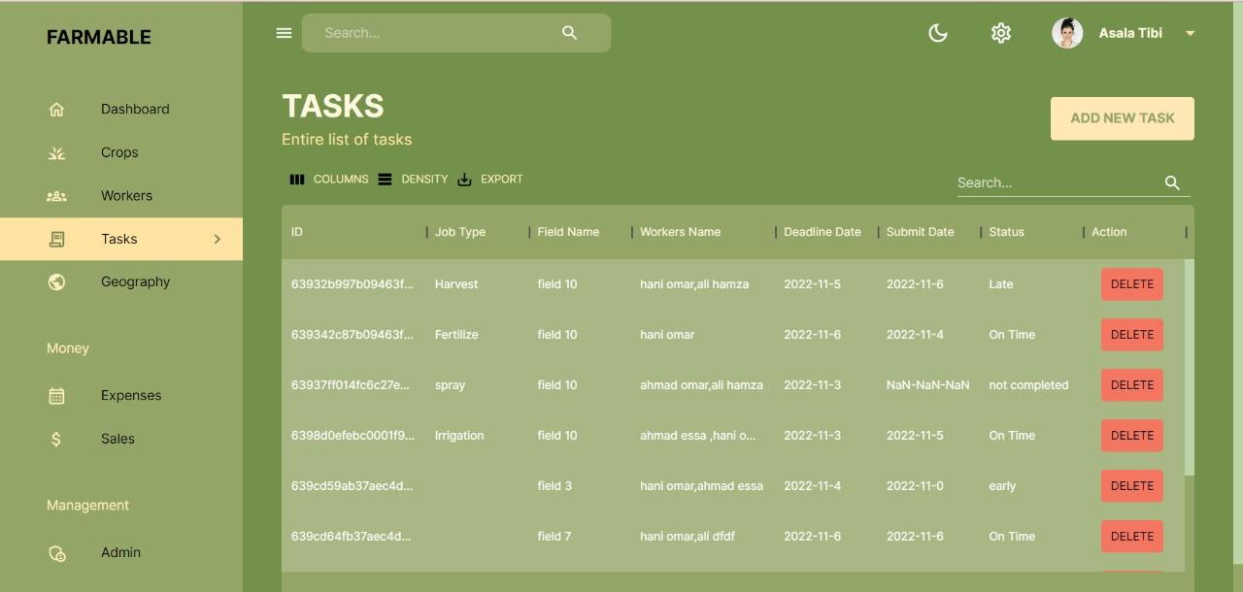
Web Admin-Panel

Slide 23
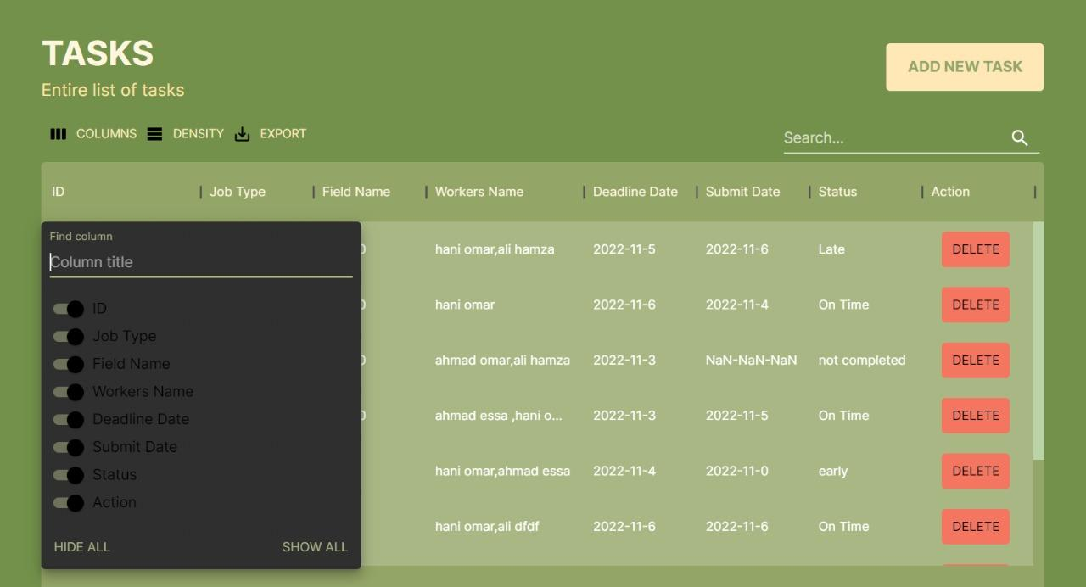
Web Admin-Panel

Slide 24
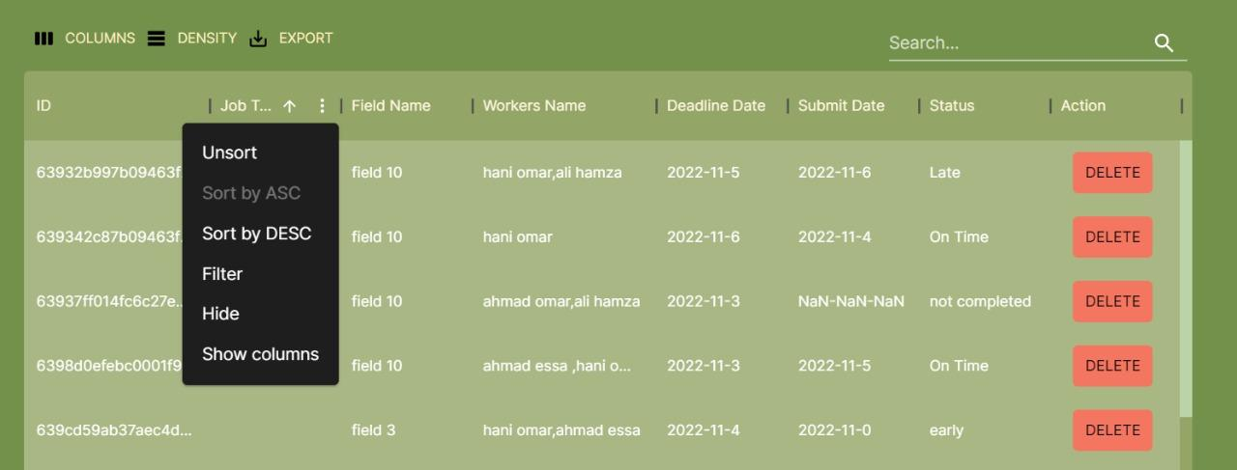

Web Admin-Panel

Slide 25





Technologies & Tools
Front-end
Back-end
DataBase
Node js
Atlas MongoDB
React for website.
React-Native for mobile .
Third party software Tools

Slide 26

Architecture
Mobile Application
Data and API server
Website.(Admin Panel)
Database server
Third-party software

Slide 27


Future Work
Custom Maps for fields
Using IOT & merge with hardware technologies
Track worker movement on the fields.
for more precisely tracking the crops in each field

Slide 28

THANK YOU

