Slide 1
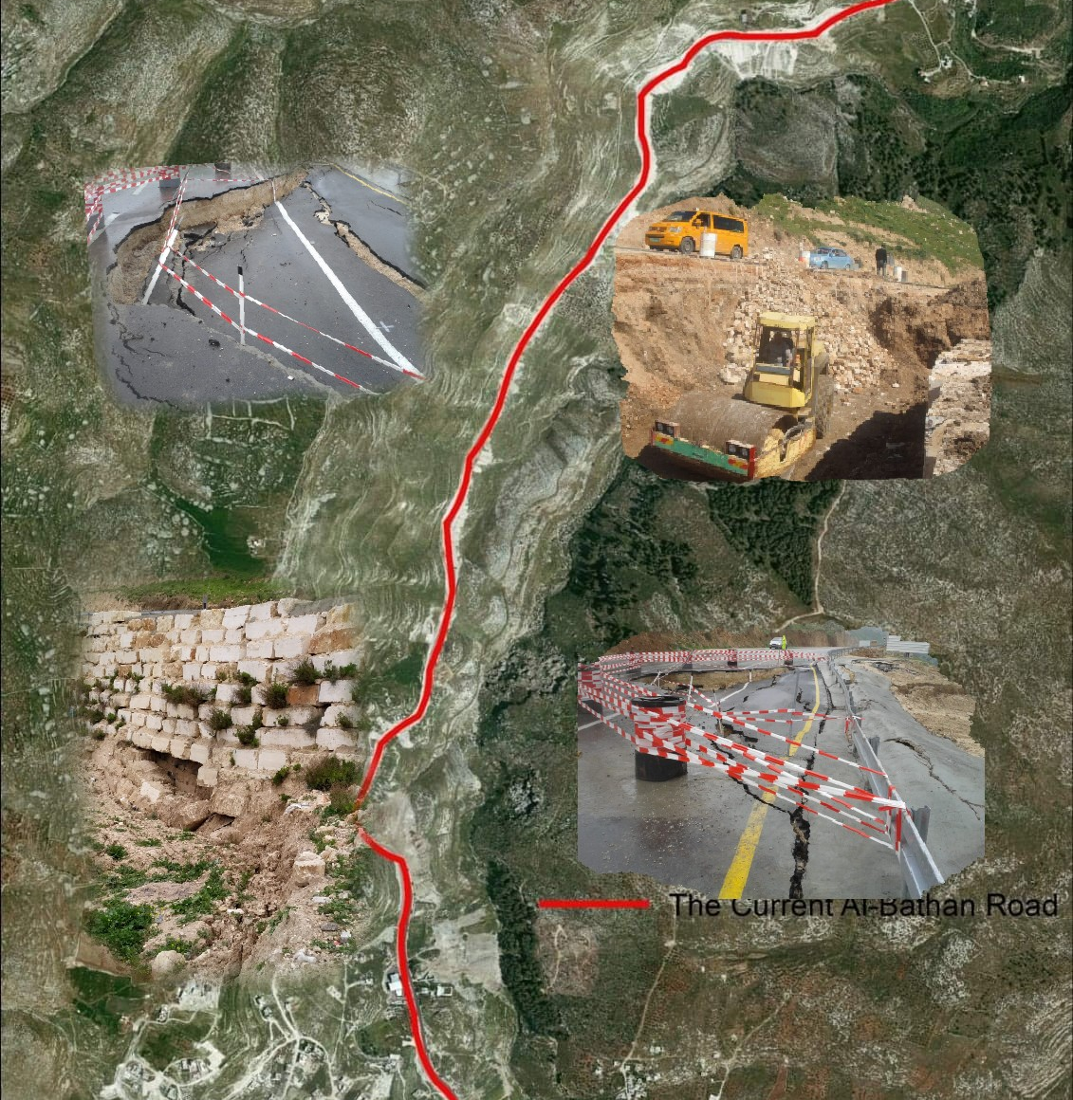

Graduation Project II
Assessment and Proposed Alternative Solution of Nablus Al-Bathan Road Subsidence
By
Israa Qanaze
Lubna Imad
Under the Supervision of:
Dr. Amjad Isaa

Slide 2








Contents
Background
Objectives
Methodology
Design Criteria
Geometric Design
Conclusion and Recommendations

Slide 3
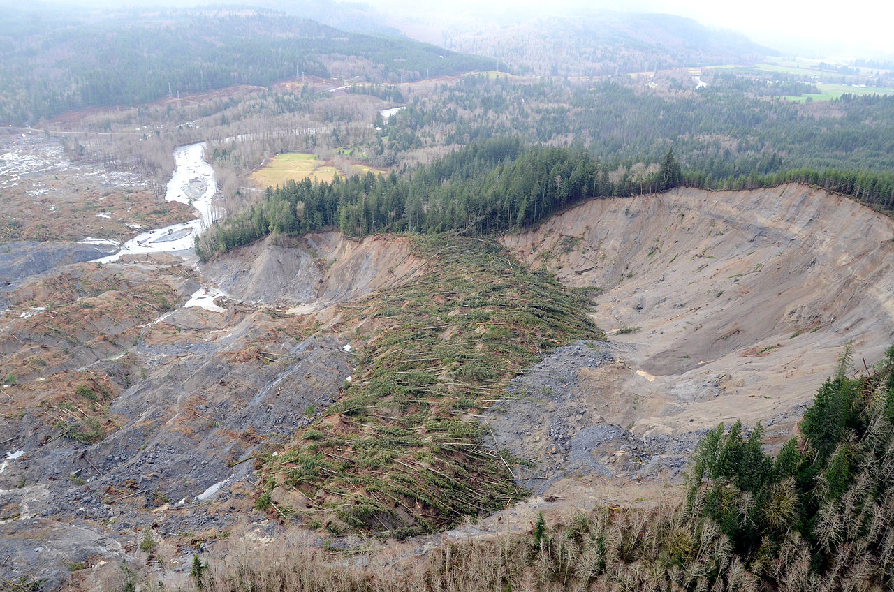
Landslides occur in many places around the world, especially in the mountainous areas.
Background
They occur when the component of gravity is large enough so that the driving force overcomes the resistance force from the shear strength of the soil along the rupture surface.
3

Slide 4

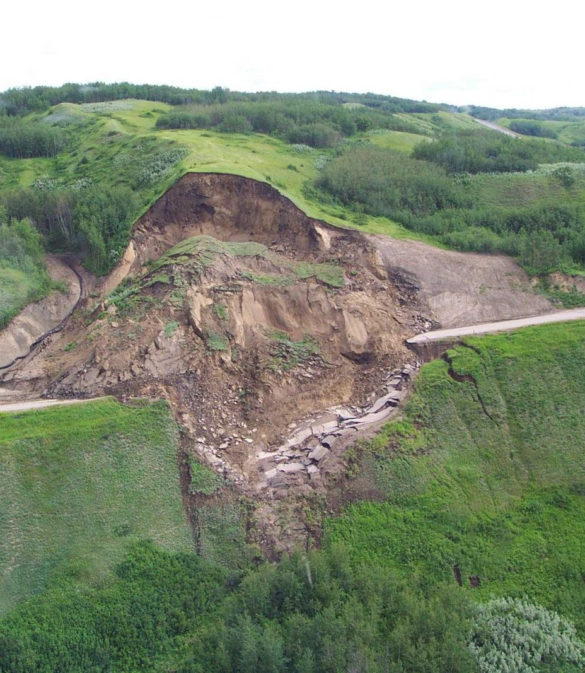
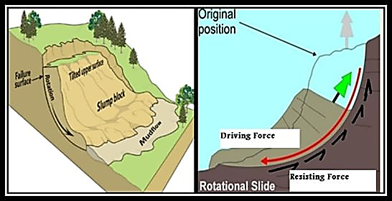
4

Slide 5




Objectives
Propose a new road design while avoiding all the problems in the current road
Design all the details related to the proposed highway
Evaluate the current situation of the road
Develop different alternative solutions to the current problem

Slide 6
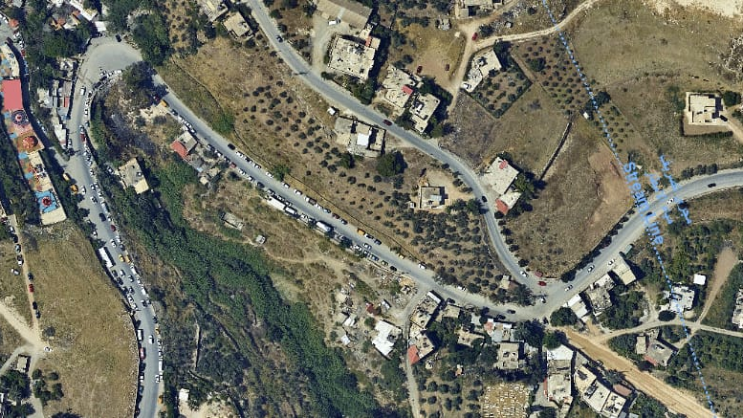
Current Road Evaluation

Slide 7
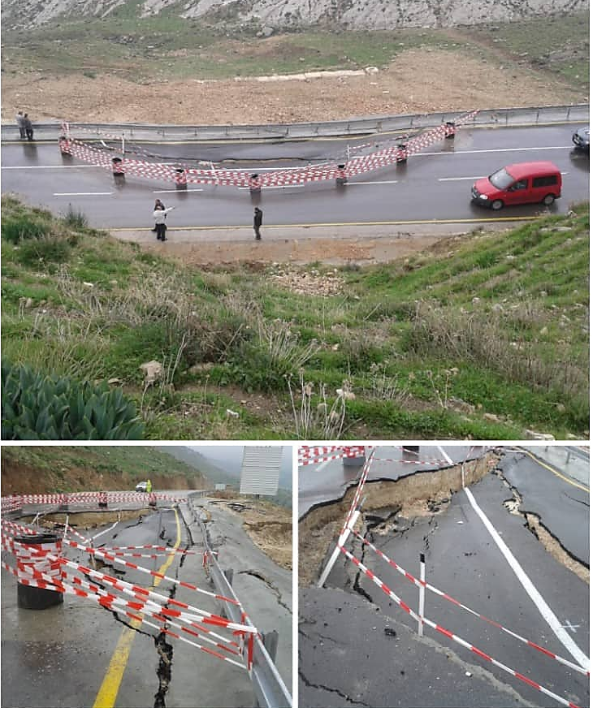
Figure: Typical cracks that occur yearly along the Nablus - Al-Bathan Road. (2010
7

Slide 8
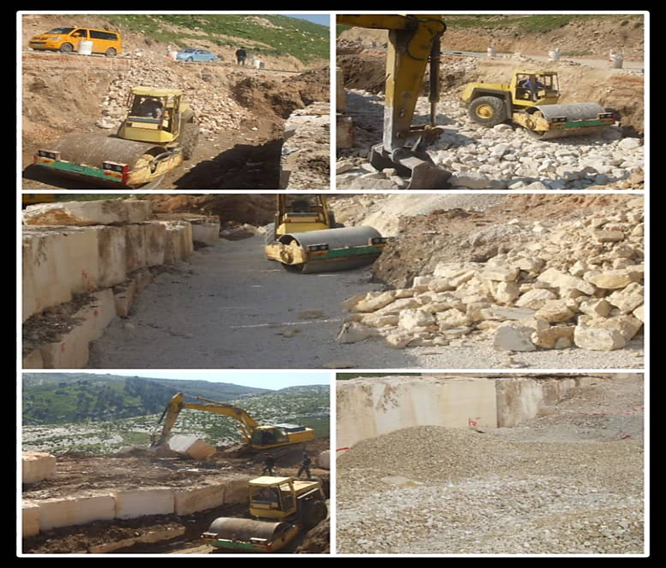
Figure: Remedial measures to fix the problem at station (2+100) in 2012
8

Slide 9
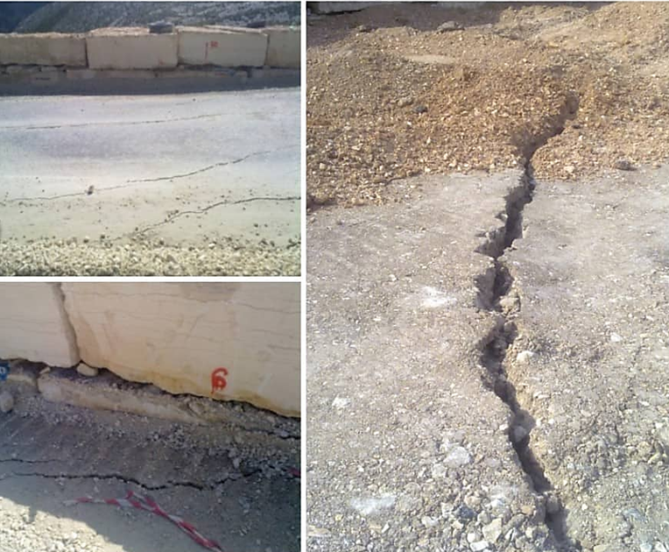
Figure: Large settlements in the eastern side next to the big boulders in 2012
9

Slide 10
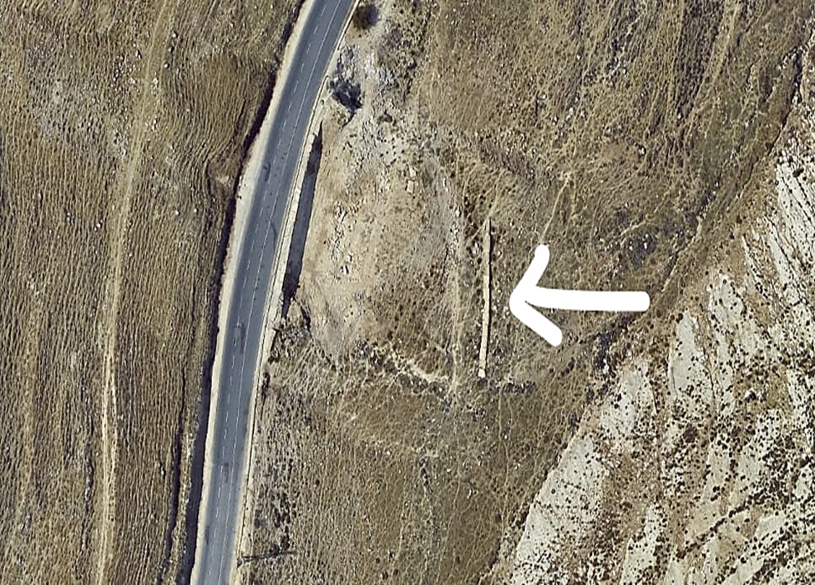
Figure: boulders at the bottom of the valley
10

Slide 11
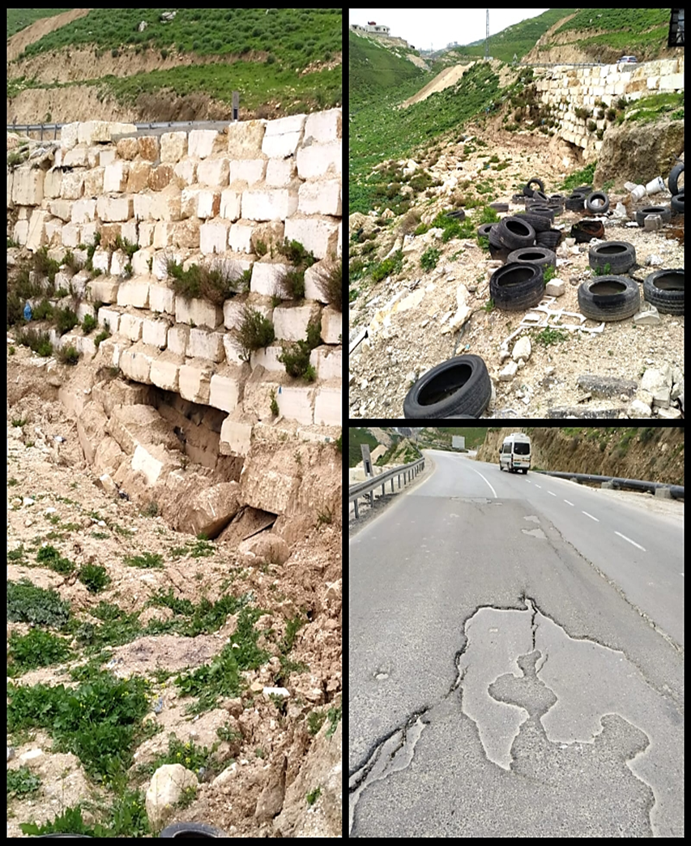
Figure: Significant boulders dropped and cracks in the middle of the road
11

Slide 12
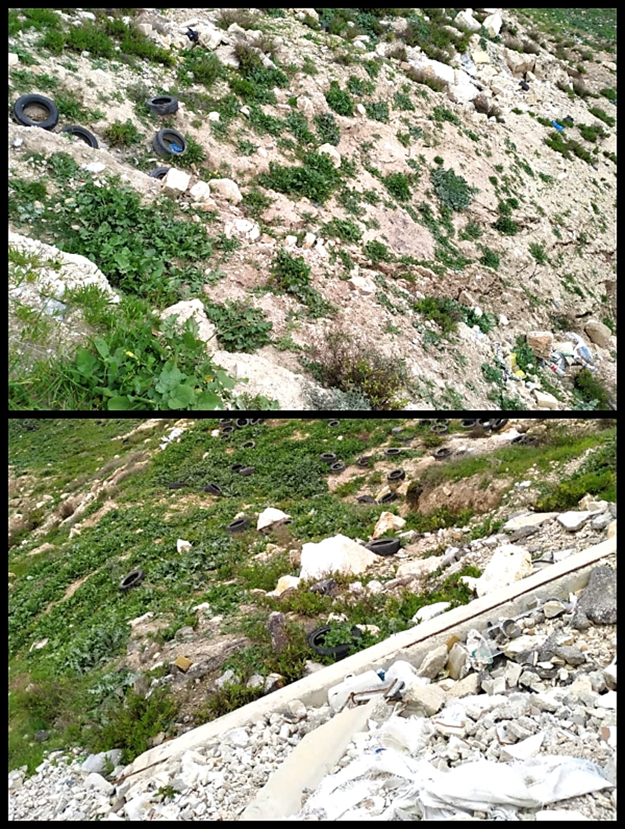
Figure: Several Swellings of the soil
12

Slide 13
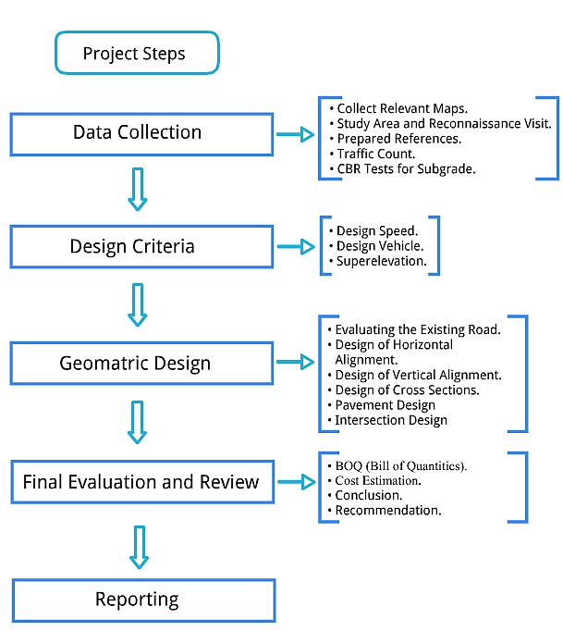
Methodology
13

Slide 14
Design criteria
→ Functional classification
Based on AASHTO 2011, the new proposed highway can be classified as a rural principal arterial highway.
14

Slide 15
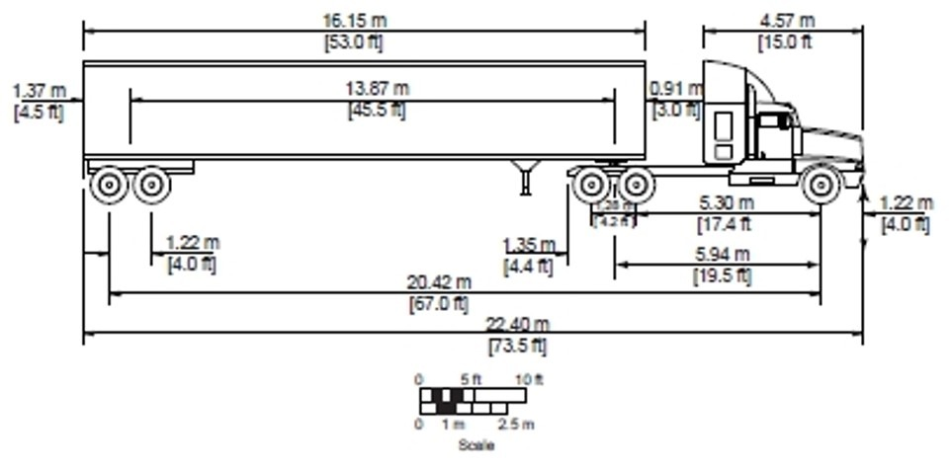
Design vehicle
Semi-trailer WB-20 | Overall (m) |  |  | Overhang (m)
 | Height | Width | Length | Front | Rear
 | 4.1 | 2.6 | 22.4 | 1.2 | 1.4-0.8

Slide 16

Design speed
Based on the topography of the study area, which is a mountainous terrain, the design speed range is the lowest
In this project and according to the AASHTO 2011, the design speed will be 70km/hr. [45 mph].

Slide 17
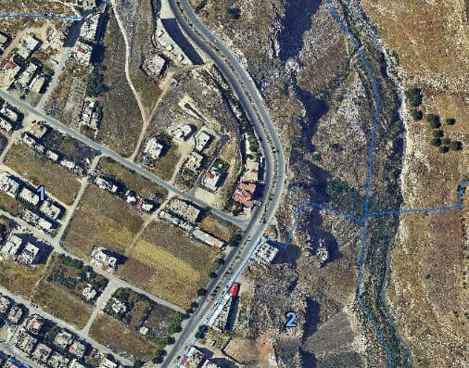
Traffic Analysis
17

Slide 18
Level of service
By analyzing the level of service for the four lanes, the level of service is found to be B, which is suitable for such a highway.
18

Slide 19

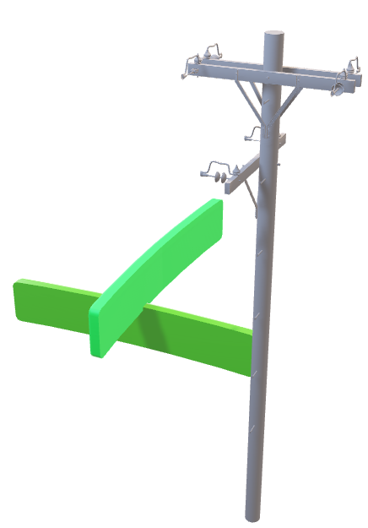
cross-section
Design
We have 4 typical cross-section scenarios
19

Slide 20
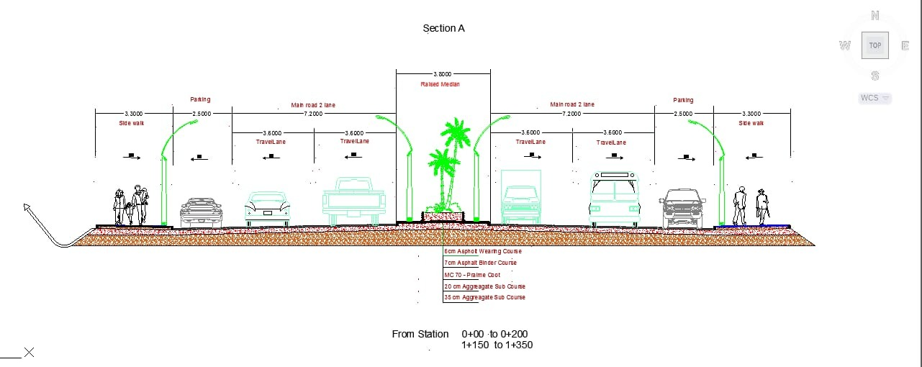
Typical cross-section A that includes a side walk and a ditch
20

Slide 21
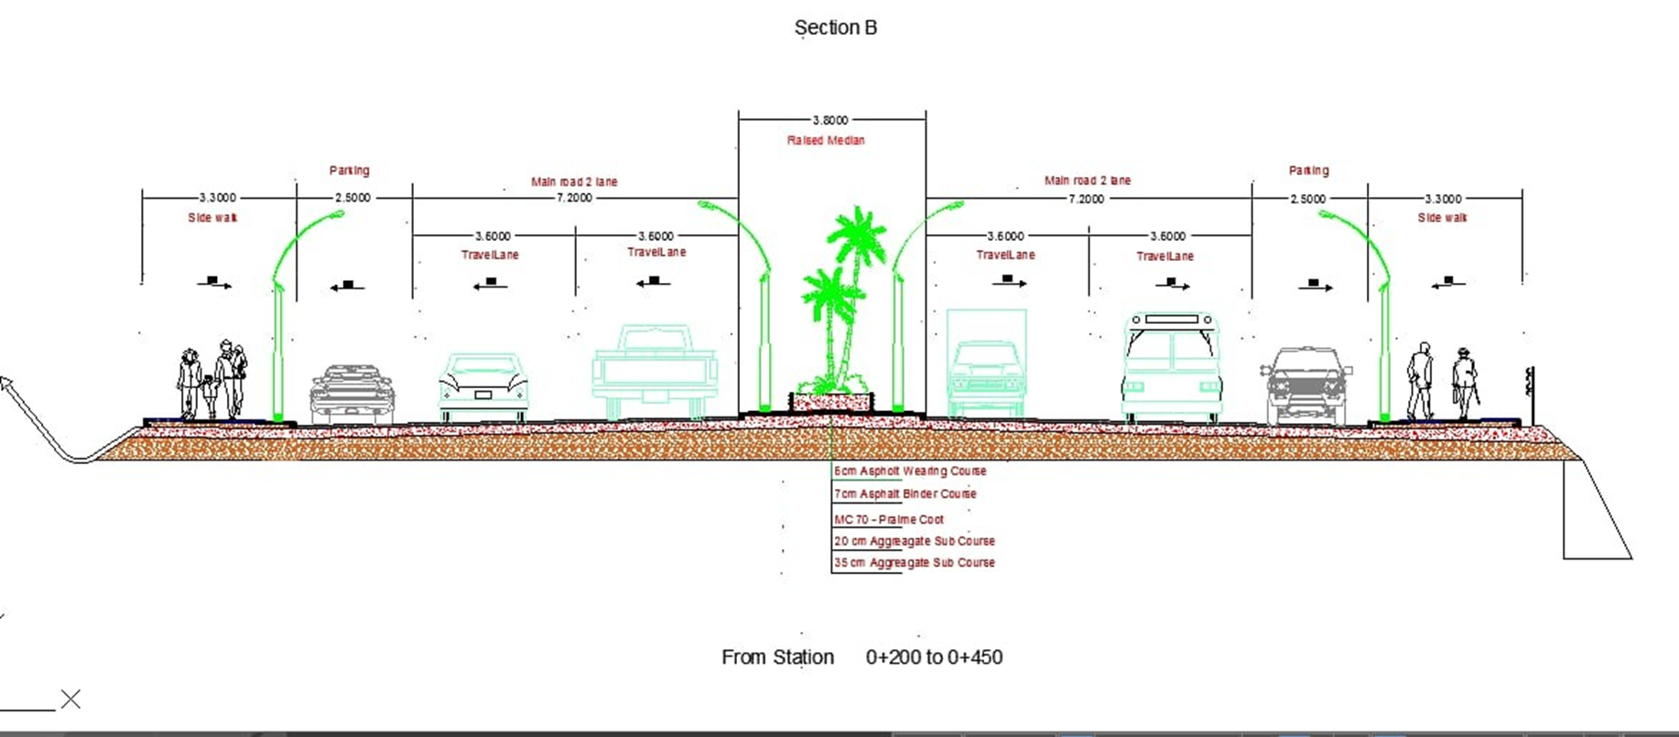
Typical cross-section B that includes a side walk, a retaining wall and a ditch
21

Slide 22
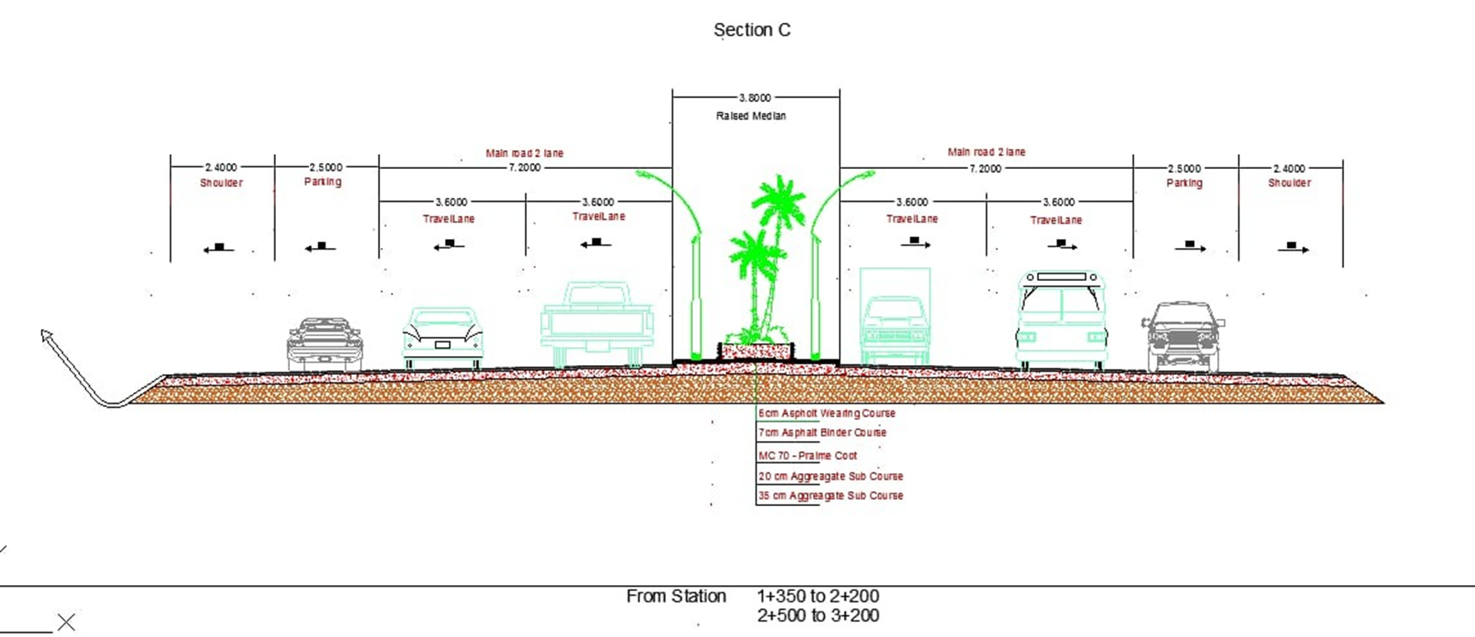
Typical cross-section C that includes a shoulder and a ditch
22

Slide 23
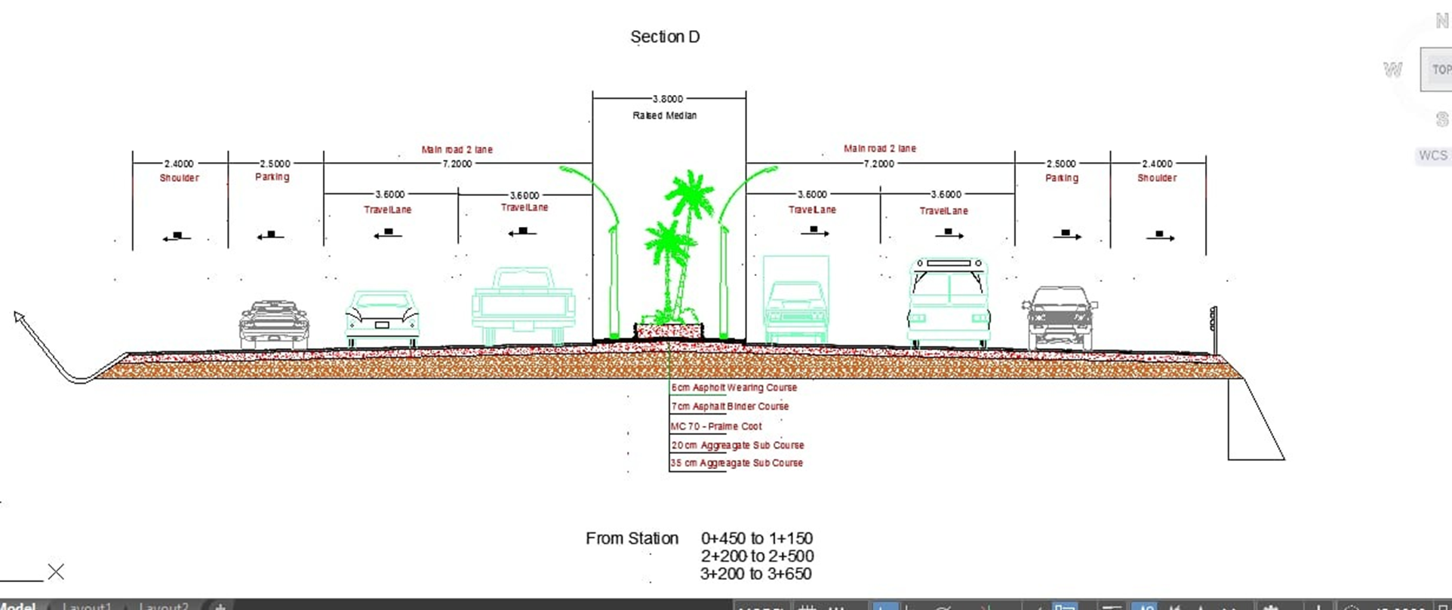
Typical cross-section D that includes a shoulder, a retaining wall and a ditch
23

Slide 24

Design of horizontal alignment
Type of Curve | Number
Simple curve | 20
24

Slide 25
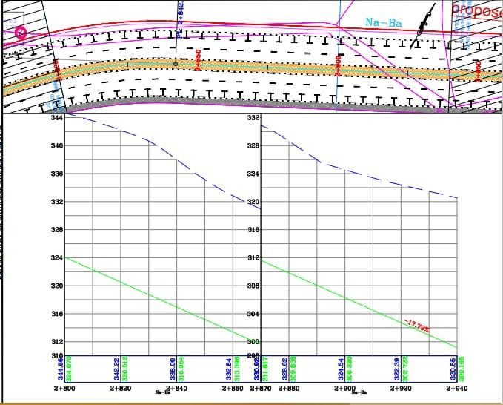
Design of vertical alignment
25

Slide 26
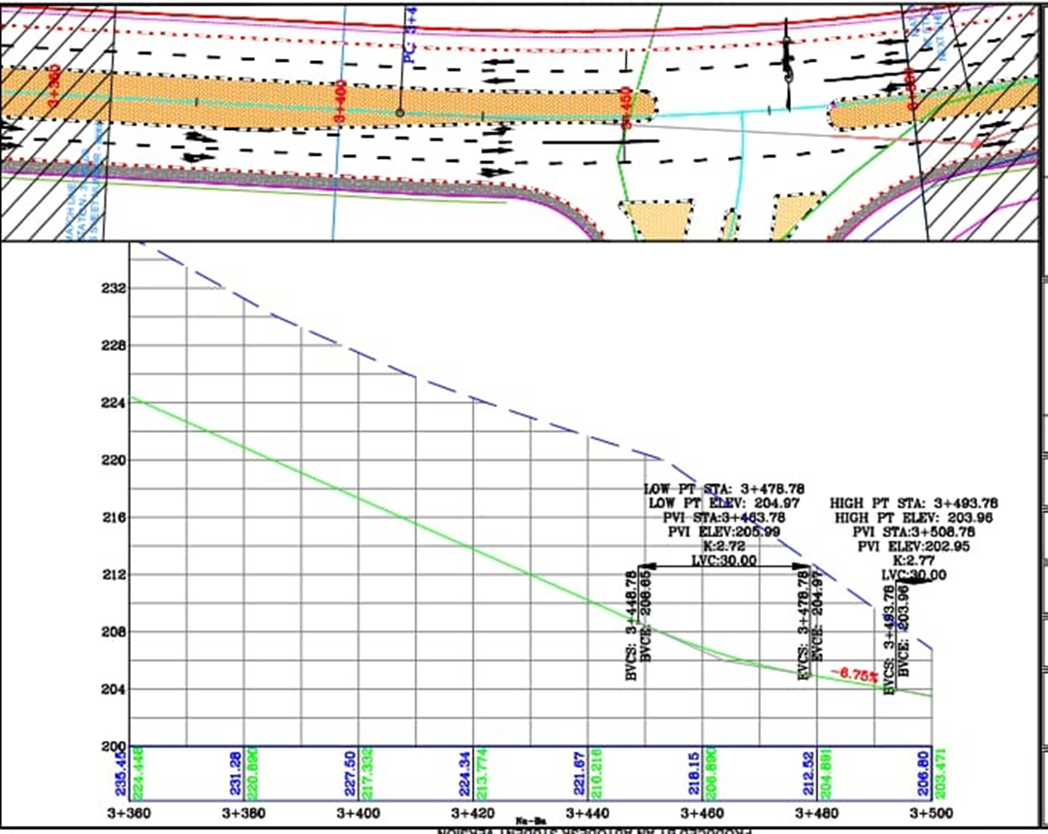
Design of vertical alignment
26

Slide 27
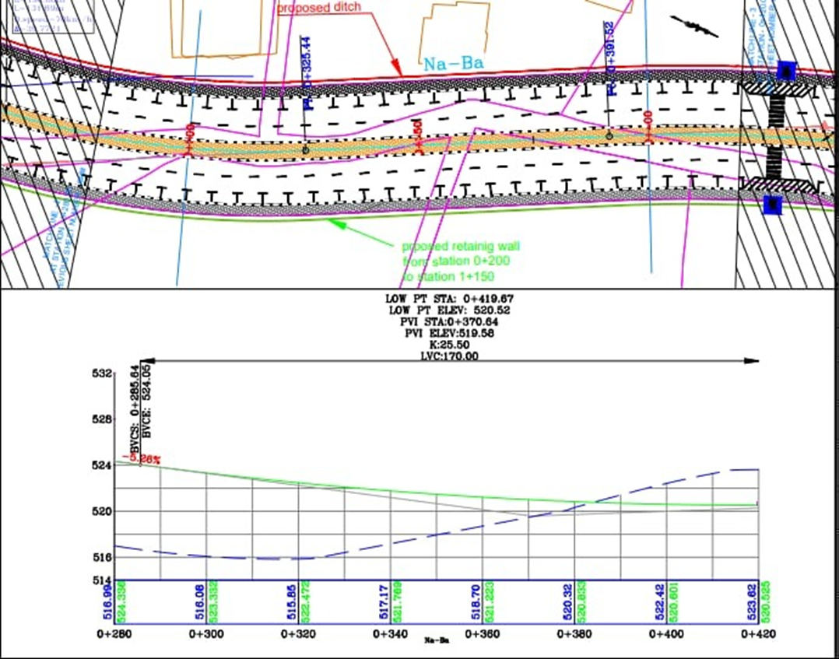
Design of vertical alignment
27

Slide 28
Design of vertical alignment
Station | Grade
2 +028 – 2 +040 | 12.5%
2+060 – 2+100 | 14%
2+120 | 15.58%
2+140 | 16.37%
2+160-2+380 | 17.38%
2+400-3+448 | 17.79%
Max. Grade ➔ 11 %
All segments match the max grade except the following
28

Slide 29
Design of vertical allignment
Type of Curve | Minimum K | Number
Crest Curve | SSD For V=70→K=17 | 6
Sag Curve | HSD For V=70→K=23 | 6
29

Slide 30
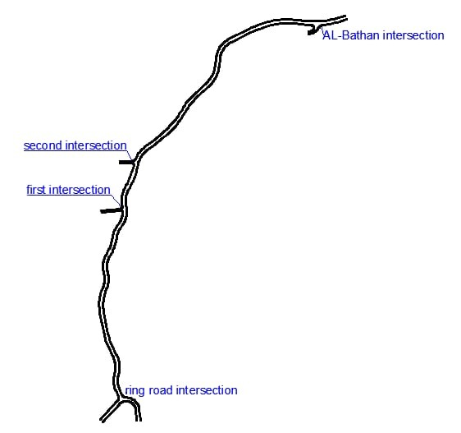
Intersections
30

Slide 31
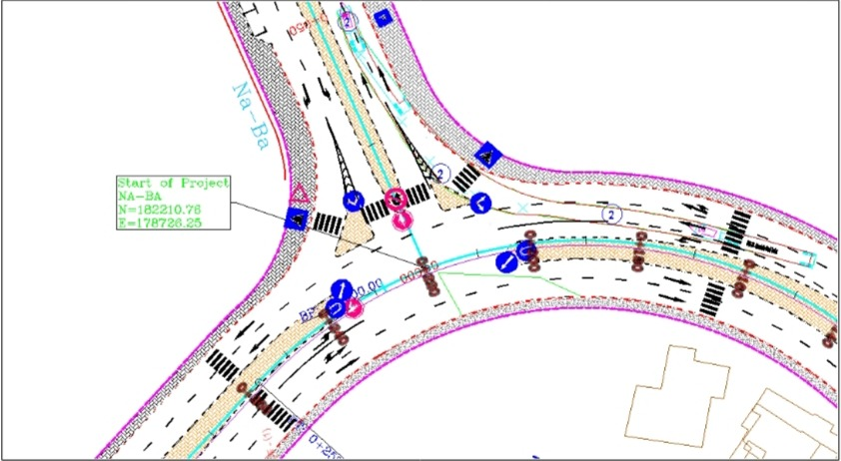
Intersections
Ring-road intersection
31

Slide 32
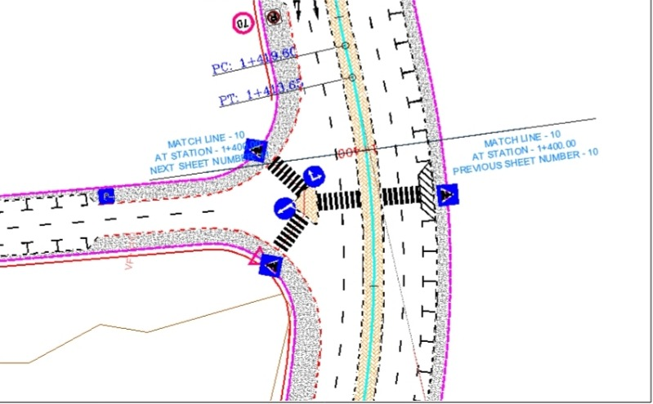
Intersections
first intersection
32

Slide 33
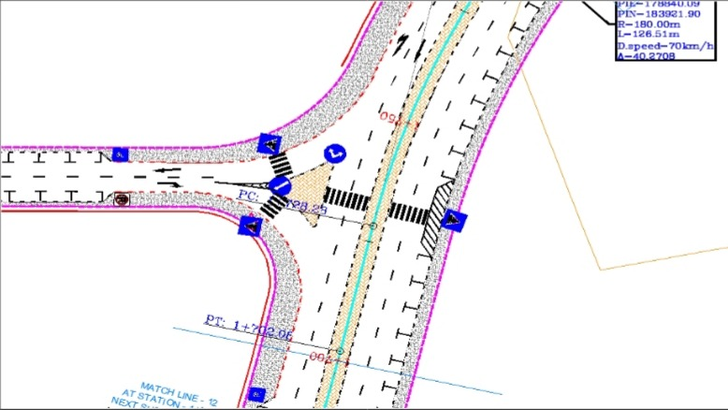
Intersections
second intersection
33

Slide 34
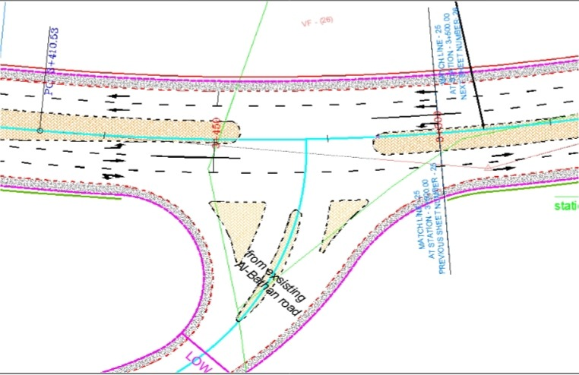
Intersections
Al-BAthan intersection
34

Slide 35
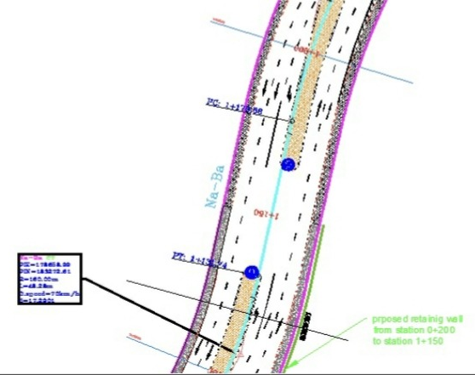
Intersections
U-Turn
35

Slide 36
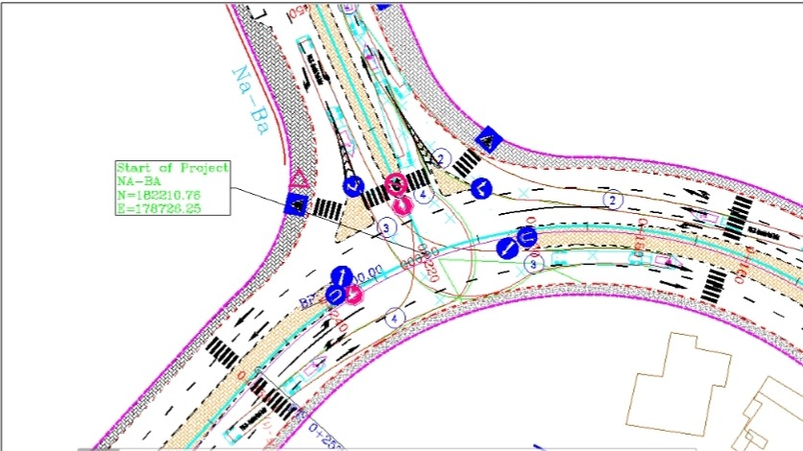
Intersections
Vehicle tracking check
36

Slide 37
Graduation Project II
Assessment and Proposed Alternative Solution of Nablus Al-Bathan Road Subsidence
By
Israa Qanaze
Lubna Imad
Under the Supervision of:
Dr. Amjad Isaa

Slide 38
38

Slide 39
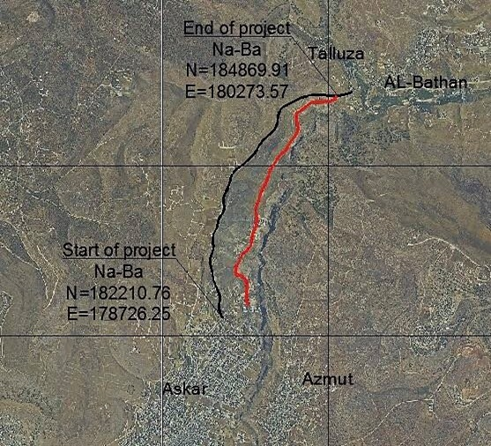
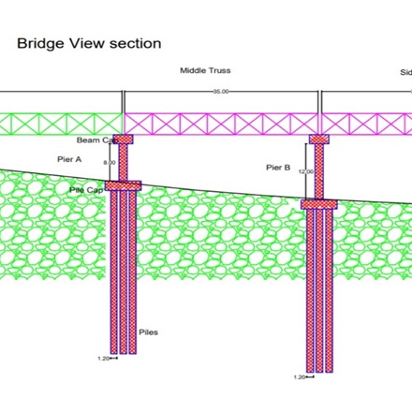
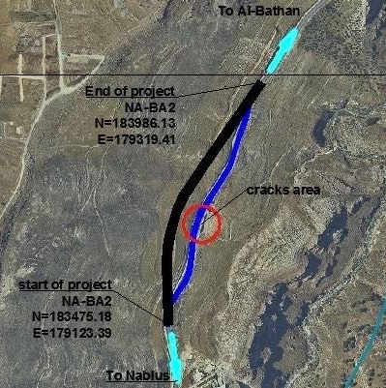
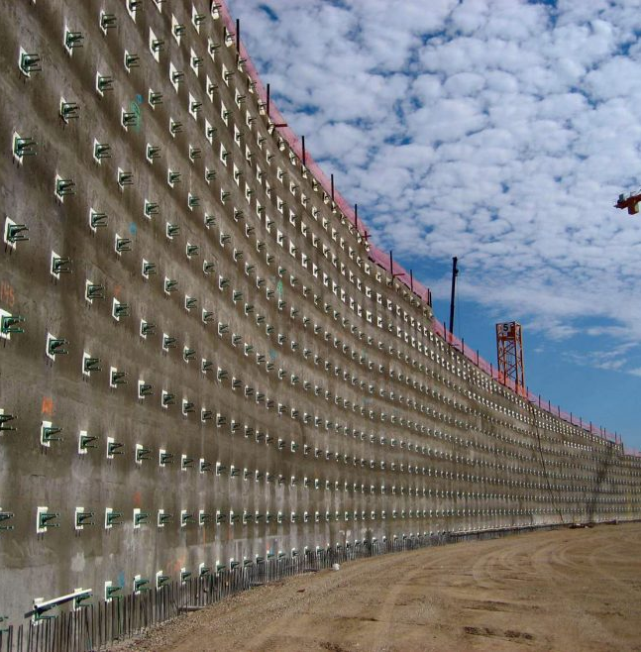
Proposed Solutions
Alternative Road
The Proposed Bridge
Realignment
Soil Nailing

Slide 40
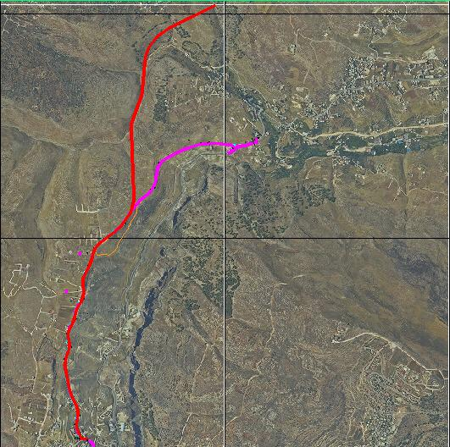
Pink : Road proposed in project 1.
Red : New proposed road in this project
40

Slide 41
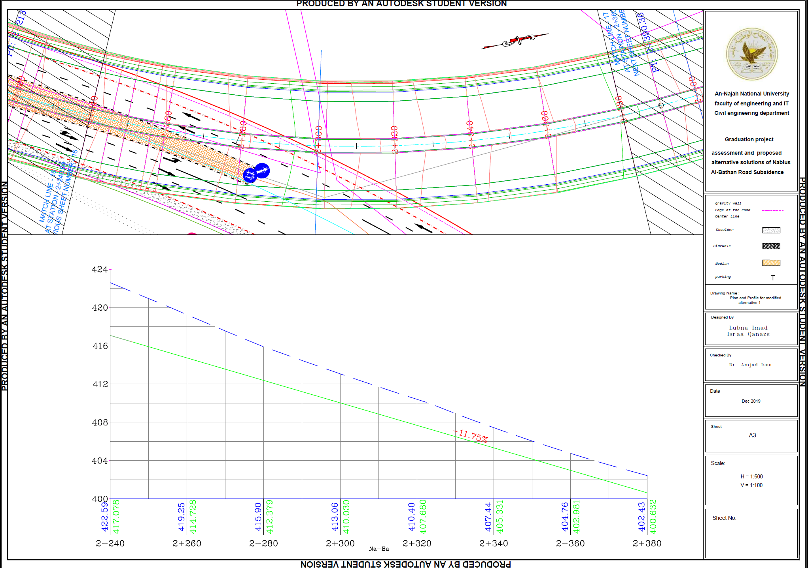
41

Slide 42
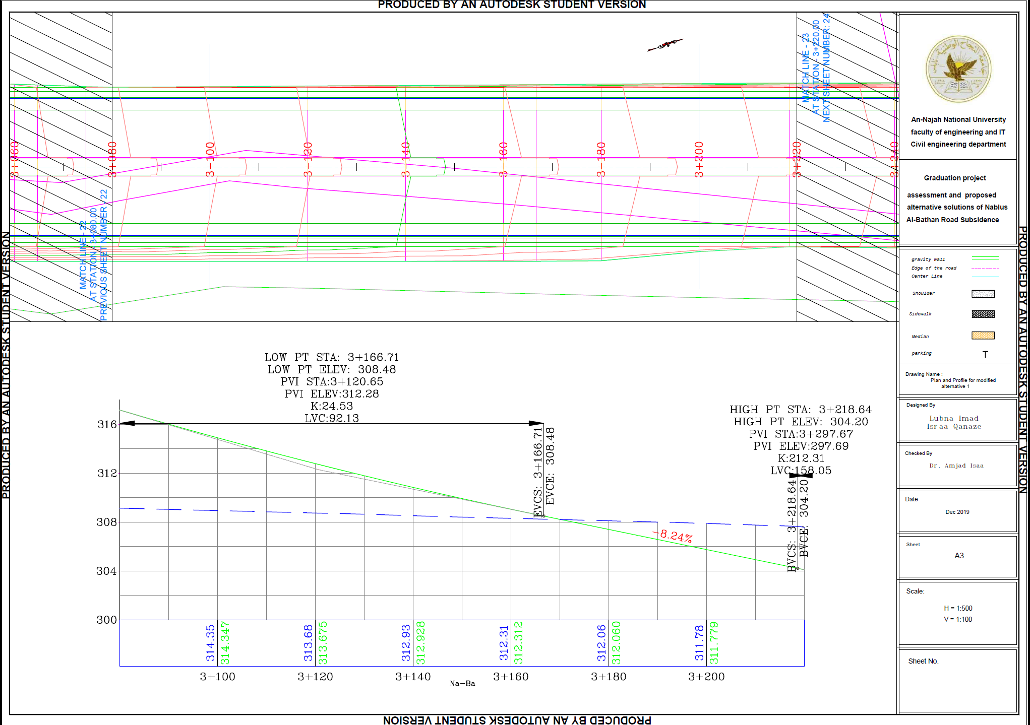
42

Slide 43
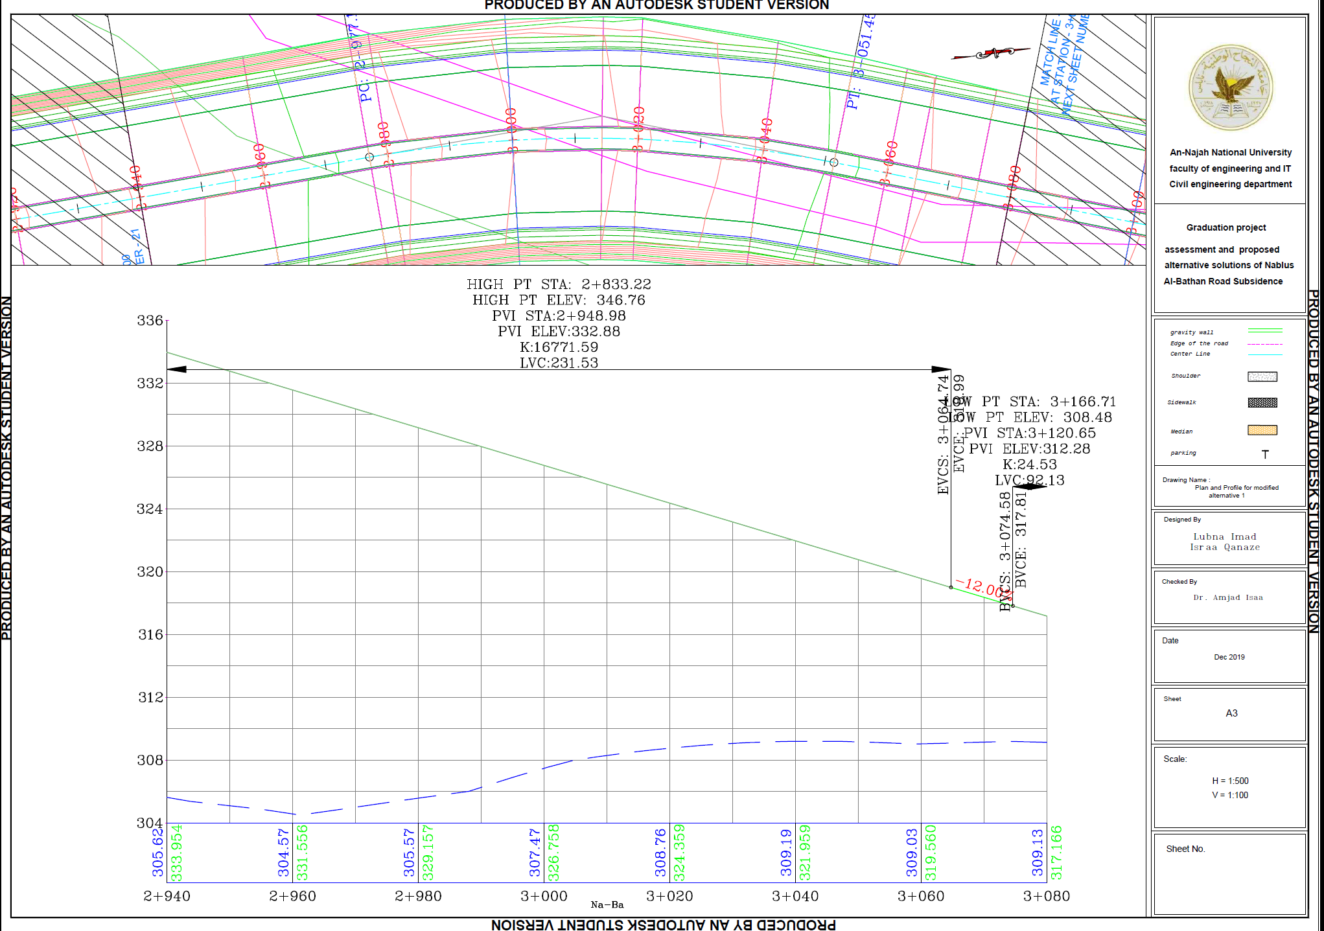
43

Slide 44
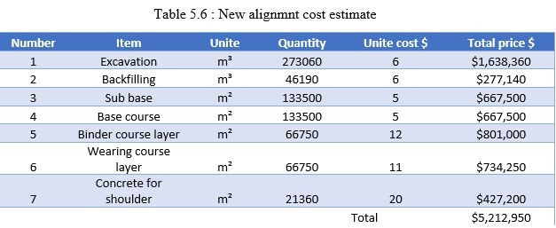
Estimated Cost
44

Slide 45
Alternative No. 2
Alternative Road
The Proposed Bridge
Realignment
Soil Nailing

Slide 46
GEOMETRIC DESIGN OF THE PROPOSED BRIDGE
46

Slide 47

Location description
Al-Bathan is a Palestinian village that lies north east to the city of Nablus
The proposed bridge extends over the center line of the existing road
Will cover 50m that includes the cracked area along with 50m on each side
A Truss bridge with steel material
47

Slide 48
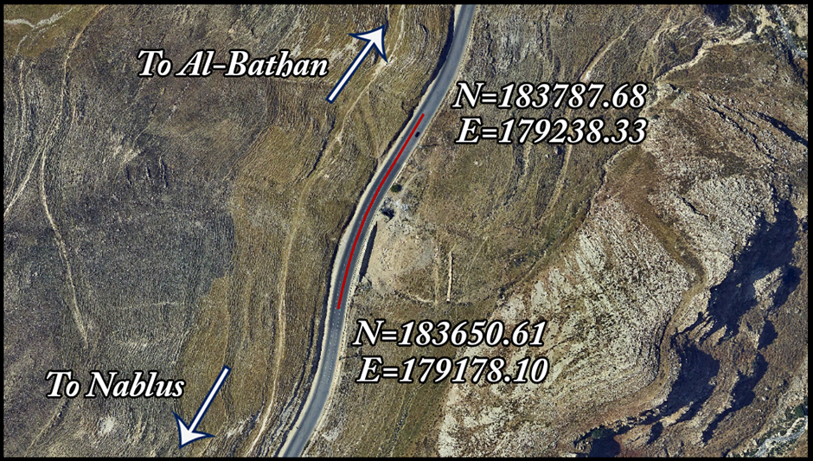
General view of the bridge location

Slide 49
The proposed bridge extends over the center line of the existing road
49

Slide 50
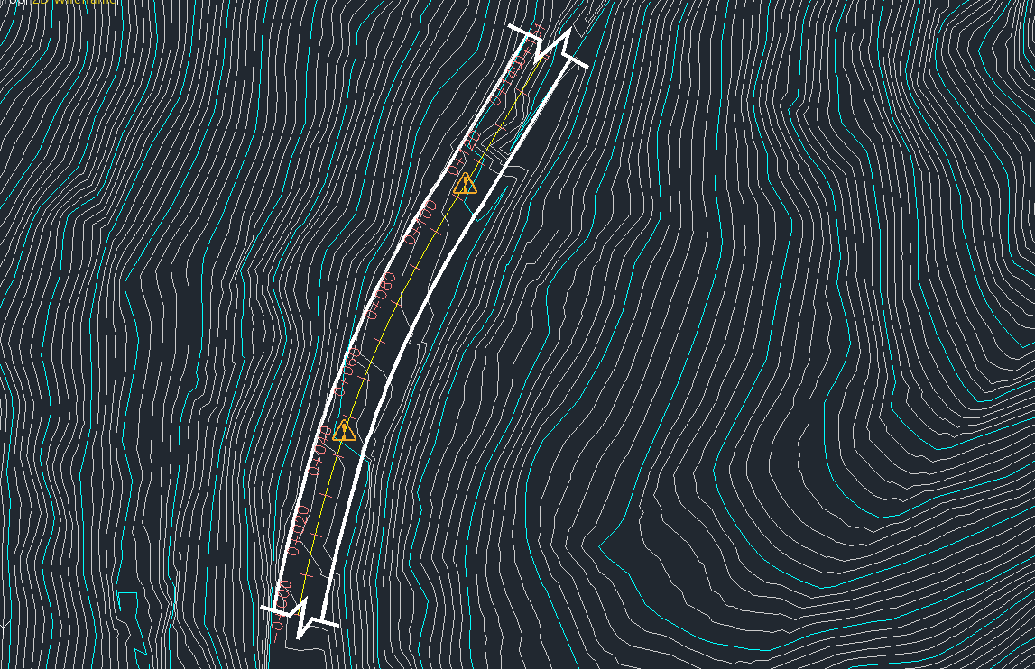
Horizontal alignment of the proposed bridge
50

Slide 51
The profile of the existing road was established based on contour lines
The profile shows ground elevation on the vertical axis with station on the horizontal axis
51

Slide 52
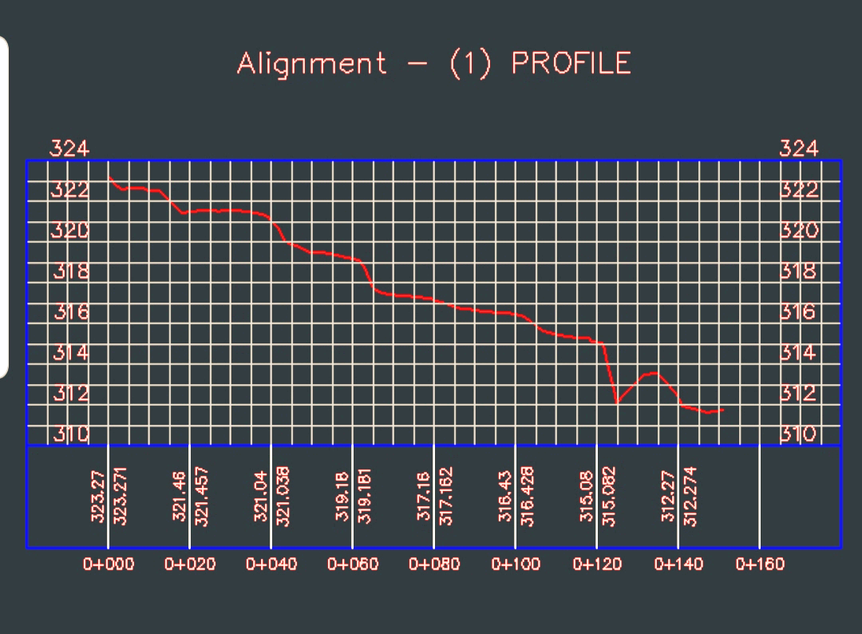
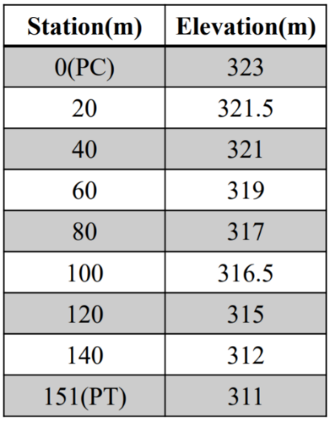
The Profile of the Existing Road
Elevation of Stations
52

Slide 53
The proposed Al-Bathan bridge is designed with three traffic lanes in addition to shoulders on one side similar to the existing road
53

Slide 54
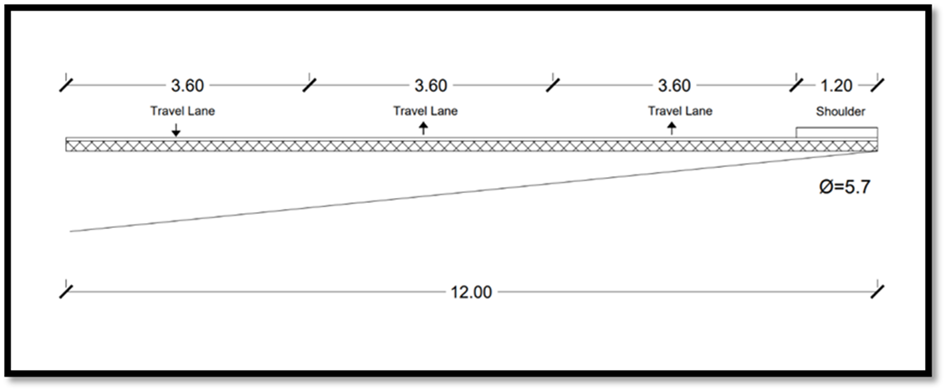
Typical Cross Section of the Bridge
54

Slide 55
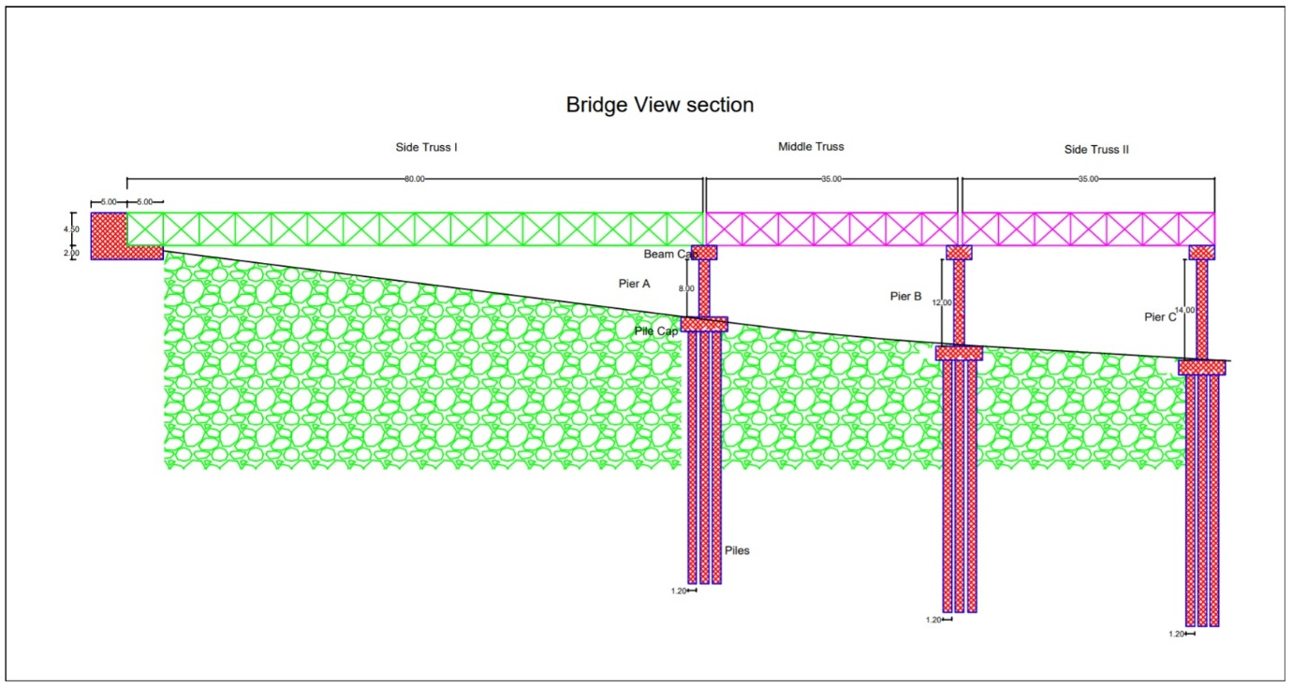
Truss
Foundations
Slab
Columns
Piers
Abutment
Structural Design Option For Al-Bathan Bridge
55

Slide 56
The Profile of the Existing Road
Elevation of Stations
56

Slide 57
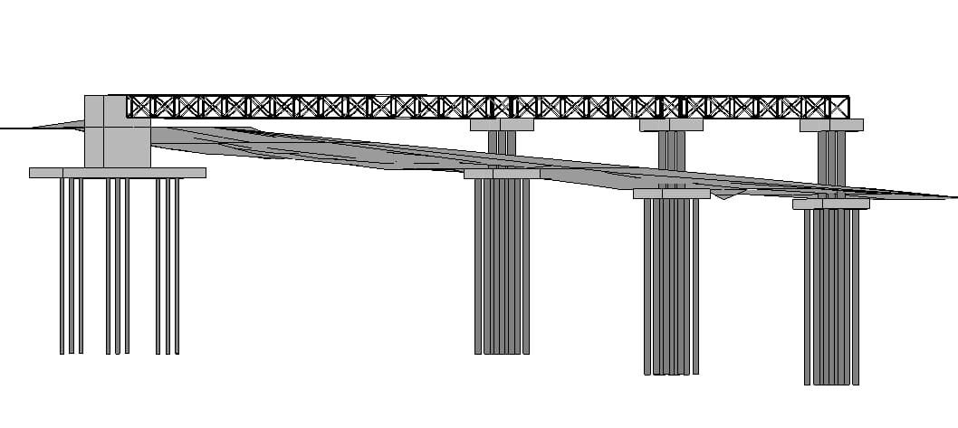
57

Slide 58
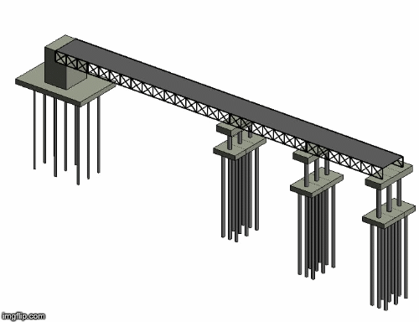
58

Slide 59
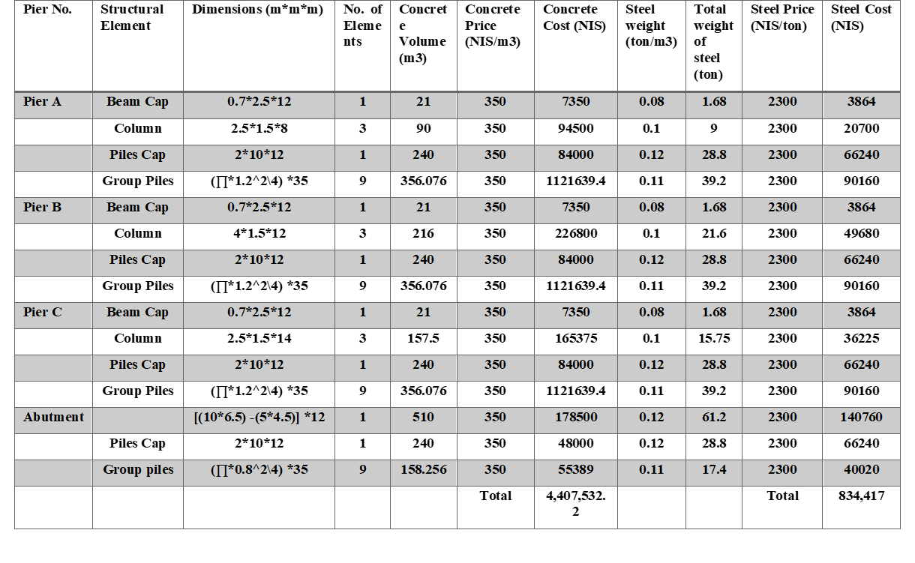
Estimated Cost
59

Slide 60

Preliminary total steel weight used = 615 tons
Cost = 615*2300 = 1414500 NIS
Price of the precast unit slab = 120 NIS/m2
Cost = width * length * price
= 12*150*120 = 216000 NIS
Cost for the material = 1414500+216000+4407532.2+834417 = 6872449.2 NIS
Price of the excavation for foundations = 23 NIS\m²
Cost = volumes of group piles * price
= (356.076 + 356.076 + 356.076 + 158.256) * 23 = 28,830 NIS
The total cost of the bridge = 6,901,279.2 NIS = $1,974,090.21

Slide 61
Alternative No. 3
Alternative Road
The Proposed Bridge
Realignment
Soil Nailing

Slide 62
Realignment for
Al-Bathan road
62

Slide 63

The realignment alternative for Al-Bathan road
63

Slide 64
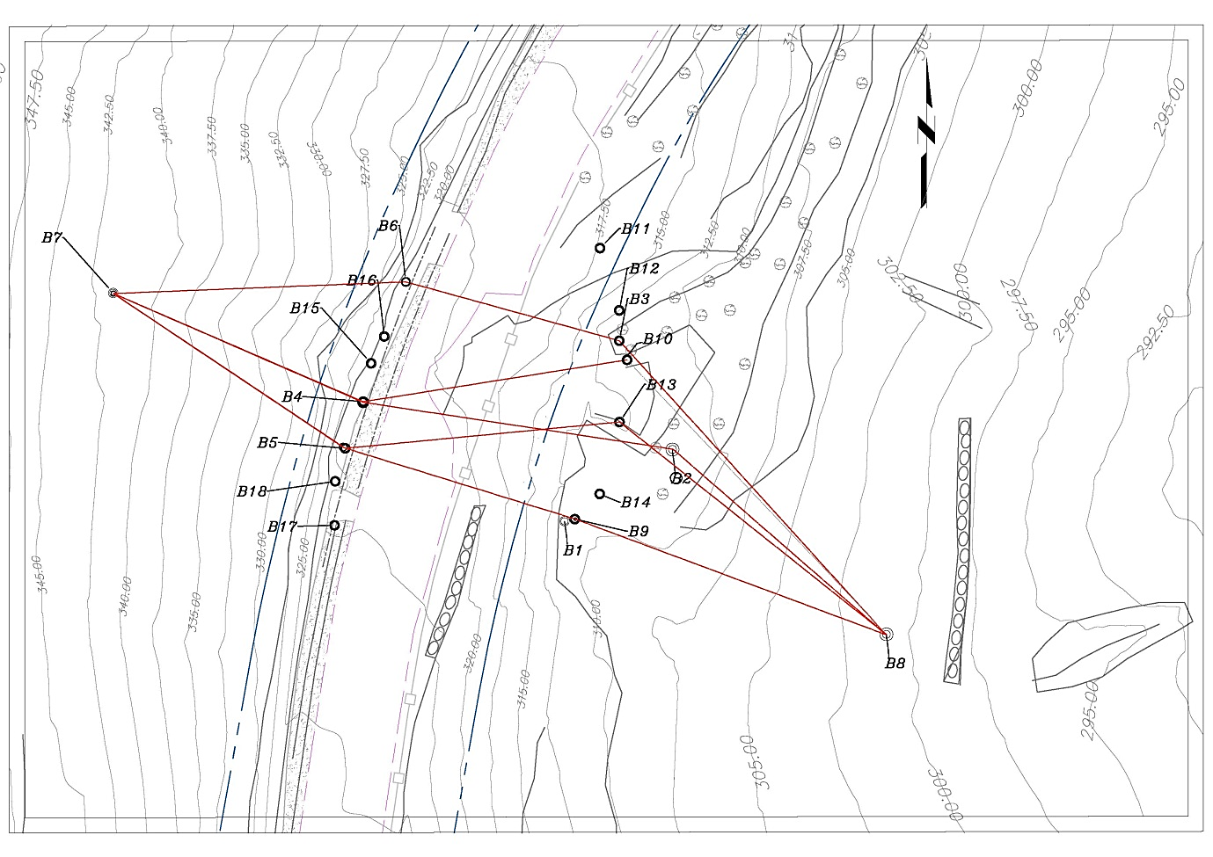

Slide 65
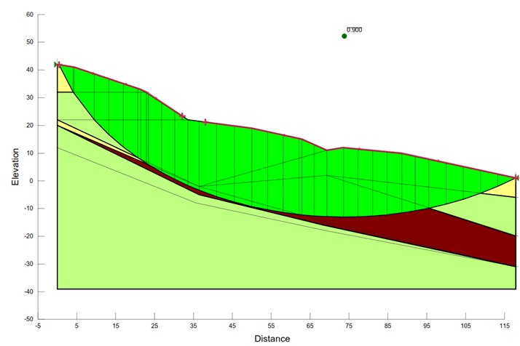
Slope Stability Analysis
65

Slide 66
Design criteria
ACCORDING TO THE DESIGN CRITERIA OF THE EXISTING ROAD
→ Functional classification
Based on AASHTO 2011, it is classified as a rural principal arterial highway.
→ Right of way
20m
66

Slide 67
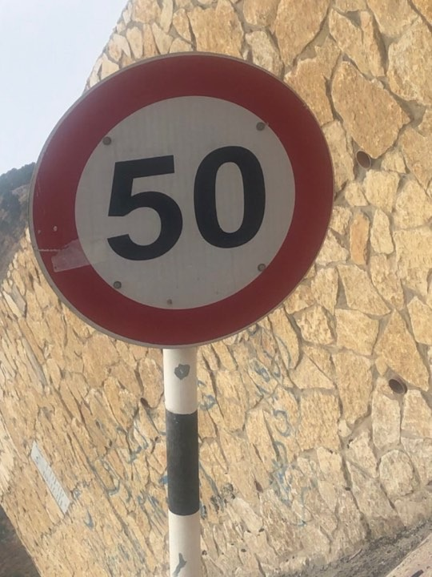
Design speed
Currently, the design limit of the existing road is 50km/hr
Thus, the design speed is 60km/hr

Slide 68
The number of lanes is three according to the existing road with width of 3.6m (based on AASHTO 2011)
68

Slide 69

Design of horizontal alignment
Type of Curve | Number | Minimum Radius
Simple curve | 3 | 105
69

Slide 70
Parameter | Length | Radius | Minimum Radius | Design Speed
Two points | 138.558m |  |  | 60 km/hr
Radius | 61.200m | 200.000m | 105.000m | 60 km/hr
Two points | 37.810m |  |  | 60 km/hr
Radius | 49.568m | 172.302m | 105.000m | 60 km/hr
Two points | 3.024m |  |  | 60 km/hr
Radius | 59.639m | 2190.185m | 105.000m | 60 km/hr
Two points | 217.419m |  |  | 60 km/hr
70

Slide 71
Design of vertical allignment
Type of Curve | Minimum K | Number
Crest Curve | SSD For V=60→K=11 | 1
Sag Curve | HSD For V=60→K=18 | 1
71

Slide 72
Design of vertical alignment
Max. Grade ➔ 12 %
All segments match the max grade
72

Slide 73

73

Slide 74


Slide 75

75

Slide 76


Slide 77
cross-section
Design
We have A typical cross-section
77

Slide 78

Typical cross-section that includes a retaining wall and a ditch
78

Slide 79

The Realignment Alternative Cost Estimate
The total cost of realignment =
$1,503,205.
This is considered the cheapest option
79

Slide 80
Alternative No. 4
Alternative Road
The Proposed Bridge
Realignment
Soil Nailing

Slide 81

Soil Nailing
81

Slide 82
Al-Bathan road area is located at the western shoulder of the Dead Sea rift that has highly affected by structural processes over the geologic time.
The road is part of a sharp slope made by carbonate rock layers (mainly chalk, marlstone, and marly limestone) that are exhausted and may have already reached a level close to rupture.
The area is vulnerable, and the situation is very delicate.

Slide 83


Subsurface Geological cross- section beneath seismic line 5-5
Subsurface Geological cross- section beneath seismic line 6-6
83

Slide 84

Conclusion
The current Nablus-Al Bathan road doesn’t satisfy the safety requirements. No more repairs should be invested in it.
Four alternative solutions are proposed in this project:
1. To design a composite steel bridge crossing the defected area.
2. To use the soil nailing technique (anchors) in order to reinforce and strengthen the existing ground.
3. To widen the road from the western side (the mountain side).
4. To search for a new route that should be located on good soil strata
84

Slide 85
Recommendations
The MOPWH is recommended to adopt the alternative route proposed in this project as the definitive solution
The proper approach to this issue should not only be linked to the cost, but also to the risk management.
Utilizing the help of various resources to address the various facets the problem is also recommended,
85

Slide 86


Thank You
Questions?

