Slide 1
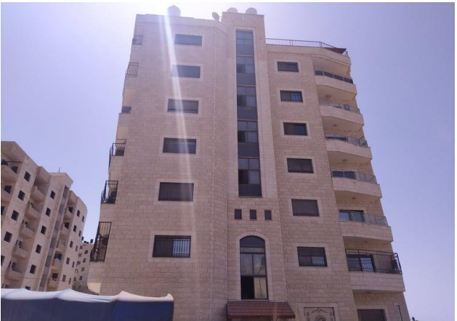
An- Najah National university
Faculty of Engineering
Department of civil engineering
Graduation project II
“Design of Foundation System For Residential Building Under Effect of Different Loads”
Supervised by:Dr. Isam Jaradanh
Prepared by :Loai Sunono
Hamdi Awartani
Firas Nofal
Haya Jomaa
Ro’a Abu Asbeh

Slide 2
summery of project
The main aim of the graduation project is to select and design the most suitable foundation system or systems for a Residential Building. The building has 7 floor and the average area of each floor is 380 m2.
After make analysis in project1 for the building by using ETABS depending on loads the most suitable foundation system is mat foundation . In graduation projectII we use safe2020.
The aim of this project is design the mat foundation in case the building under effect of gravity loads .On the other hand, design of the same mat in case under effect of gravity and seismic loads for soil (bearing capacity=150KN/m^2)
Find the dimensions and steel reinforcement of mat for each case and make comparison between them .

Slide 3
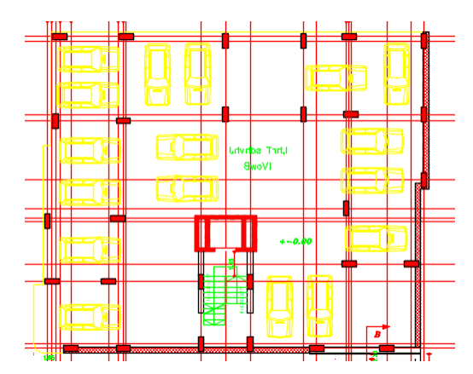
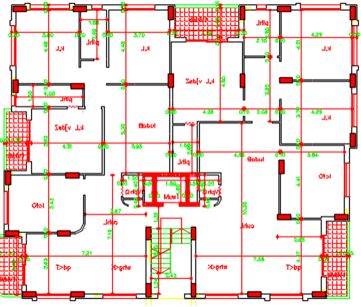
Architectural and structural description
The project is residential building contain 7- stories. Have one -way ribbed Slab system thickness 25 cm and two types of hidden beams (B1 [80×25], B2 [70 ×25]), stairwell, elevator and shear walls.

Slide 4
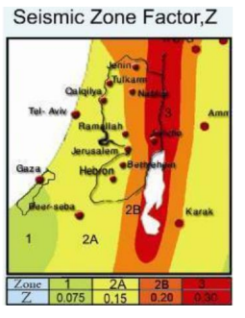
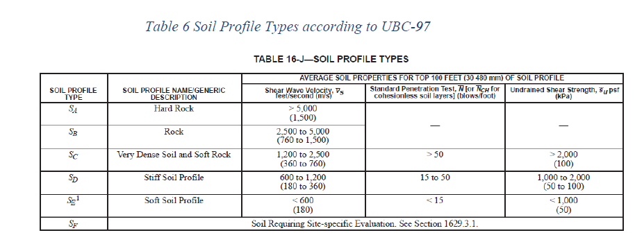
Loads
Gravity loads
In design of structure the gravity loads will be consider, the seismic loads not be considered. The gravity loads are vertical loads effects of the structure such as, Live load, dead load.
seismic loads
The analysis was done on ETABS model according to UBC-97
Seismic factors From ASCE 7-10 found the following :
Importance factor= 1
Site classification= 2B,depending on the value of Z=0.2
the soil type according to UBC-97 is SD.

Slide 5
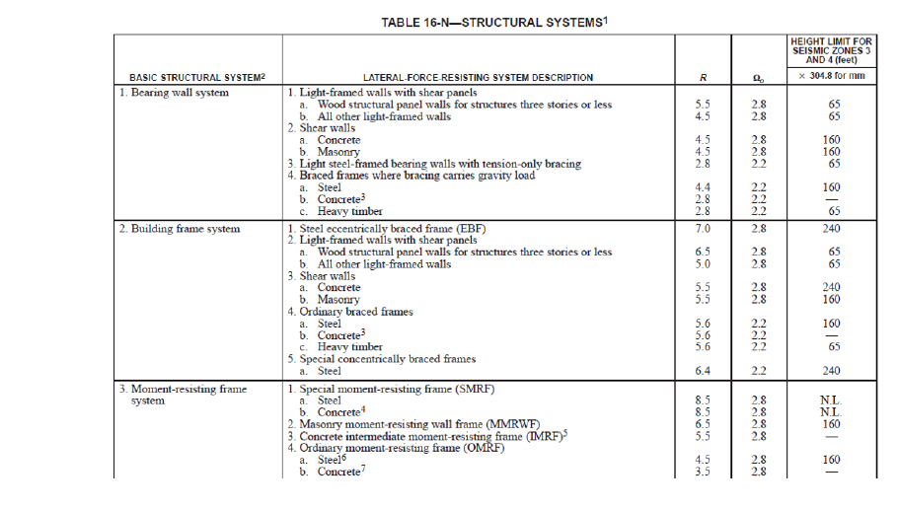

Base Shear Design
R=8.5 from Table

Slide 6
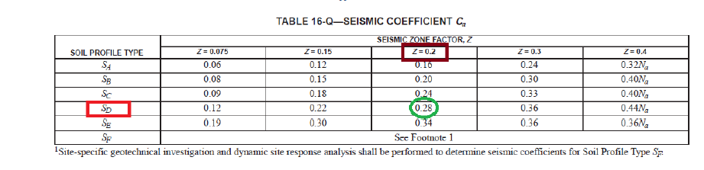
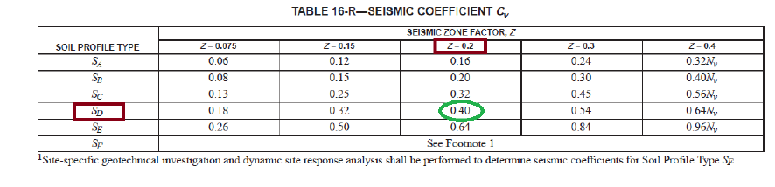
Acceleration Dependent seismic coefficient Ca = 0.28
Velocity Dependent seismic coefficient Cv = 0.4

Slide 7
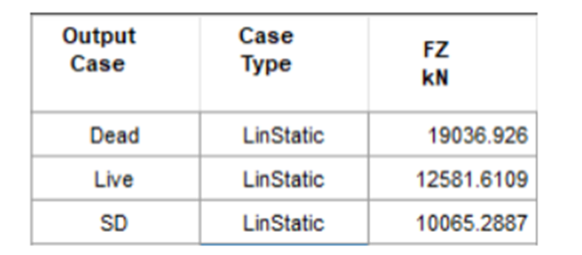
From UBC-97 code using method A. T = Ct × hn^0.75 , where Ct = 0.0488 for other buildings and hn is the height of the building T = 0.0488 * 24.50^.75 = 0.54 sec. So for both directions X and Y, the natural period considered as 0.54 sec
W = Dead Load + 0.25 Live, the table 9 shows the reactions from ETABS program.
W = ( 19036 + 10065 ) + 0.25 * 12581 = 32246 kN.

Slide 8
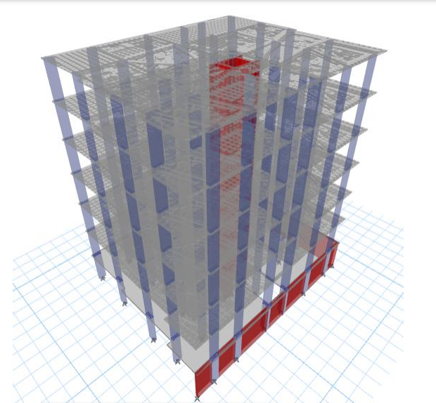
3D Model

Slide 9
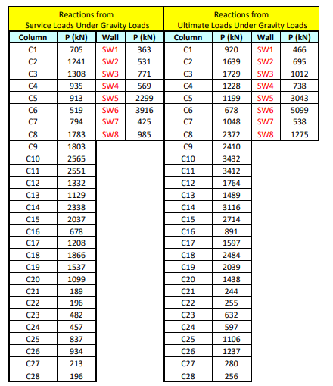
Loads from analysis
Ultimate and service Loads from effect gravity loads

Slide 10
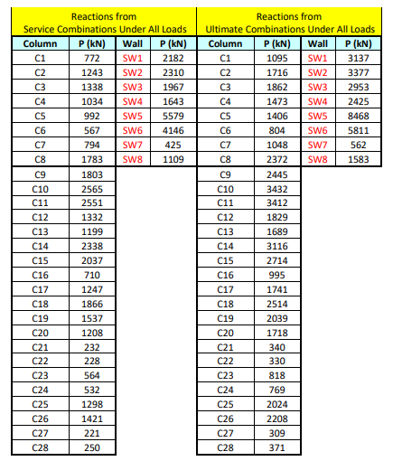
Ultimate and service Loads from effect gravity and seismic

Slide 11
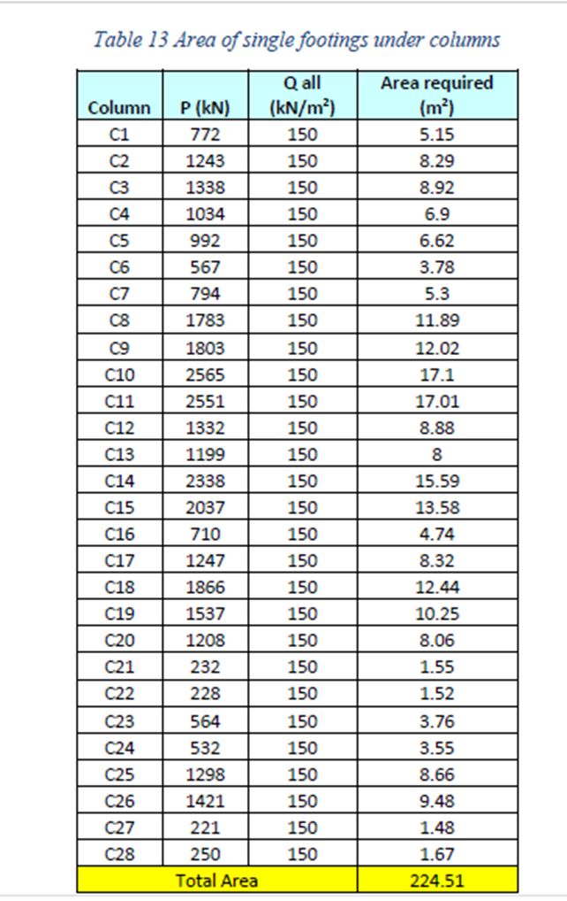
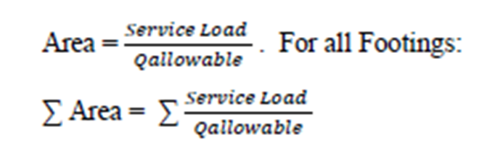
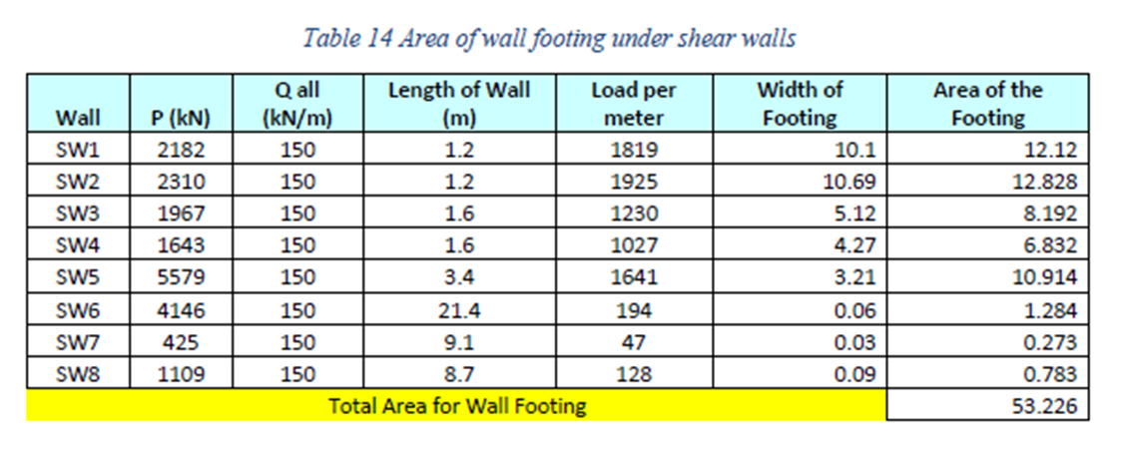
Why was the Mat foundation used?

Slide 12
Floor Area = 374 m2.
Total Area of single footings = 224.51 + 53.226 = 277 m2.
Area of single footing = 74 % of Floor Area > 50 % of floor area >>> Mat Foundation will be the best choice.

Slide 13
Chapter 5: SAFE design of mat foundation(Preliminary dimensions )
foundation will be done for a 7 story building. The raft will be used for economical consideration.
In this project, the raft will be designed as flat plate.
Preliminary mat thickness will be determined according to this conceptual design equation:
𝑃𝑟𝑒𝑙𝑖𝑚𝑖𝑛𝑎𝑟𝑦 𝑚𝑎𝑡 𝑡ℎ𝑖𝑐𝑘𝑛𝑒𝑠𝑠=𝑛𝑢𝑚𝑏𝑒𝑟 𝑜𝑓 𝑓𝑙𝑜𝑜𝑟𝑠∗10 𝑐𝑚 = 7 * 10= 70 cm .
𝑃𝑟𝑒𝑙𝑖𝑚𝑖𝑛𝑎𝑟𝑦 offset=ℎ−𝑐𝑜𝑣𝑒𝑟/2 = (700−50)/2 = 300 mm.
Subgrade modulus = 100* Bearing capacity = 100*150 = 15000 kN/m3.

Slide 14
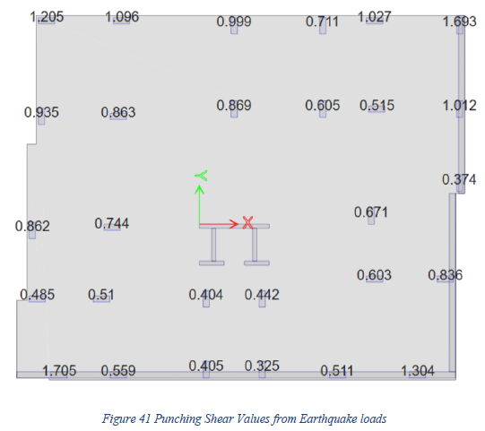
Evaluation of preliminary dimensions
Initially, an initial thickness of 700mm and an offset of 300mm was used.

Slide 15
As shown in figure above, the punching shear check is larger than 1,then one of the following must be done:
• Increase the footing’s depth.
• Introduce drop footing at locations where punching shear ratio is high.
• Increase footing offset.
Mat final Dimensions:
Make the Thickness = 800 mm.
Increase the dimensions of the foundation by 70 cm from all sides.

Slide 16
Chapter( 6+7): SAFE Design for two models of mat foundation (dimension &steel reinforcement)
Design Model 1(Chapter 6):
mat foundation under effect of gravity load
Design Model 2(Chapter 7):
mat foundation under effect of gravity in addition seismic loads

Slide 17
After Design the Cheeks from SAFE :
Check | Mat under effect of gravity load | Mat under effect of gravity load+Seismic load
Punching shear check | All the value less than 1 | All the value less than 1
Soil pressure check(Bearing capacity) | All the value are less than 150KN/m^2 | All the value are less than 150KN/m^2
settlement check | Max value from safe less than 10mm | Max value from safe less than10mm

Slide 18
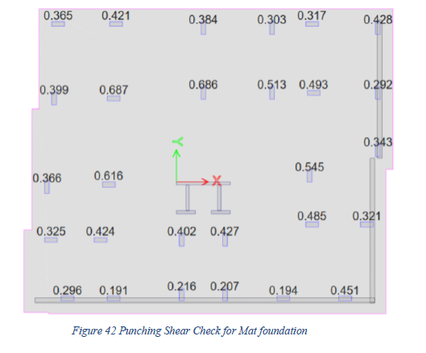
All value for punching shear less than 1 for two cases(under gravity loads or gravity+seismic loads) so the punching shear check is ok.

Slide 19
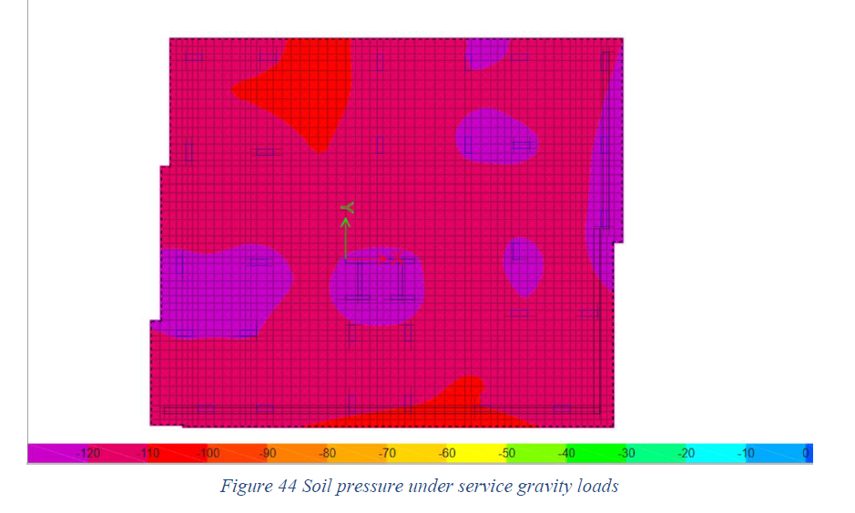
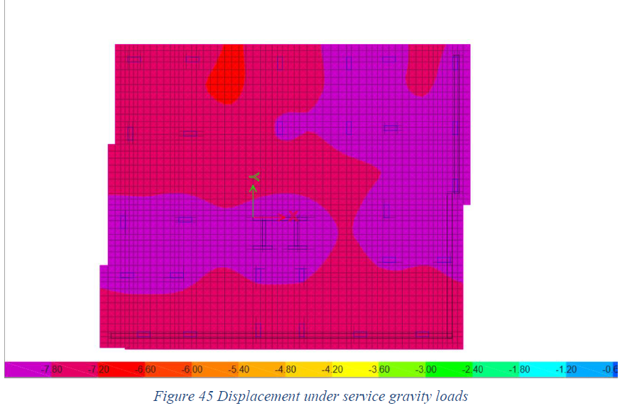
The maximum value of pressure is 120 kN/m2 < 150 kN/m2, So the check is ok.
The maximum value of pressure is 7.8 mm < 10 mm, So the check is ok.

Slide 20
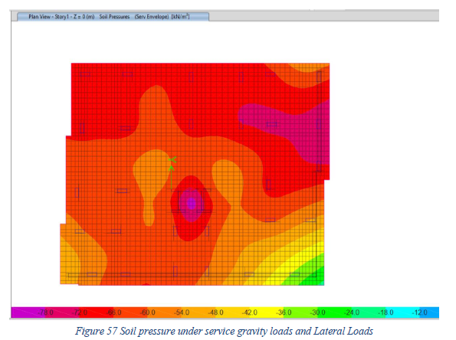
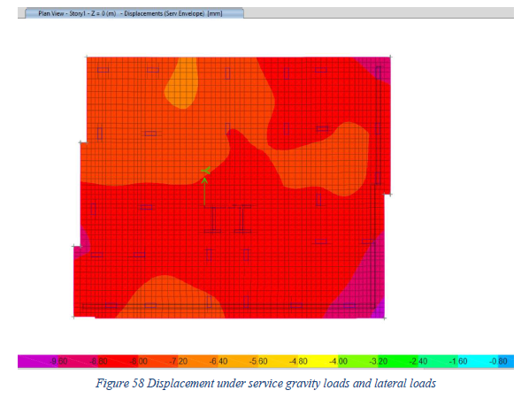
The maximum value of pressure is 88 kN/m2 < 150 kN/m2, So the check is ok.
The maximum value of pressure is 9.6 mm < 10 mm, So the check is ok.

Slide 21
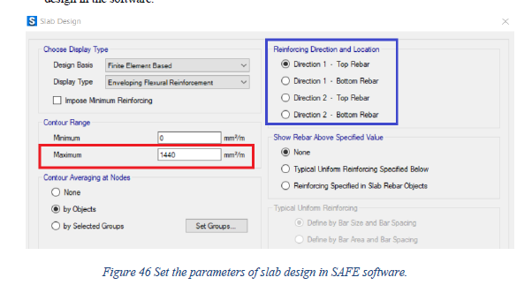
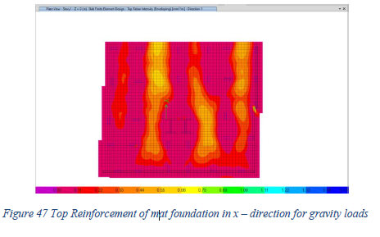
Steel reinforcement(gravity loads)
1. Flexural reinforcement
As_{,min} = 0.0018xbxh = 0.0018*1000*800 = 1440 mm2/m → the foundation will be reinforced with 8 Φ 16 / m or 1 Φ 16 / 125 mm for top and bottom bars.

Slide 22
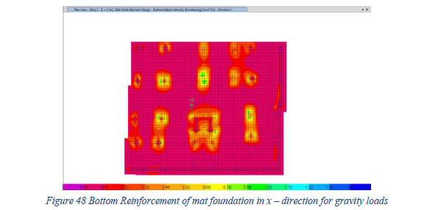
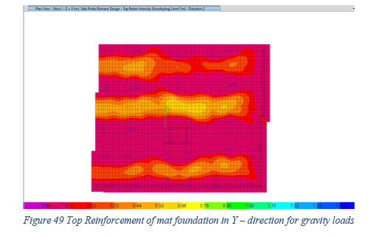
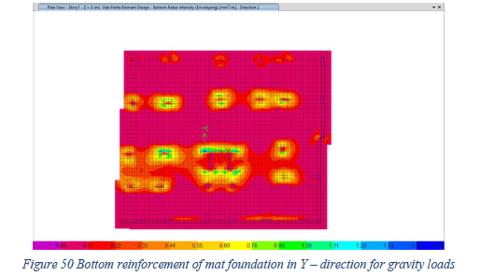
So, from the figures above, No need for additional flexural reinforcement in the foundation. So all the foundation will be reinforced with 8 Φ 16 / m or 1 Φ 16 / 125 mm for top and bottom bars.

Slide 23
2. Shear reinforcement
Shear values will be taken from ultimate combination for gravity loads ( 1.2 D + 1.6 L) at distance d from the face of the columns by using SAFE software, these values should be less than the shear strength of concrete.
Where the shear strength of concrete ΦVc = 16 * 0.75 * √𝑓𝑐 * b * d ,, where d = h – 50 mm
ΦVc for mat with thickness of 80 cm = 16 * 0.75 * √28 * 1000 * (800-50) *10-3 = 500 kN / m
Where Vn is Nominal shear strength
Vc = Nominal shear strength provided by concrete.
Vs = Nominal shear strength provided by shear reinforcement

Slide 24
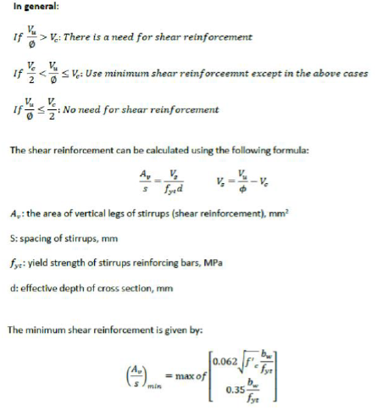
To calculate Vs , the following equations should be satisfied

Slide 25
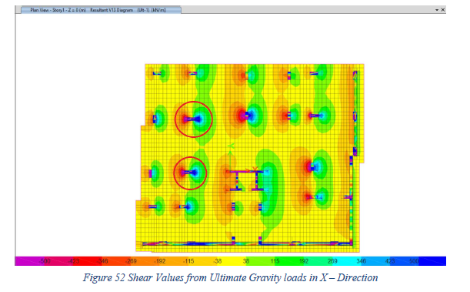
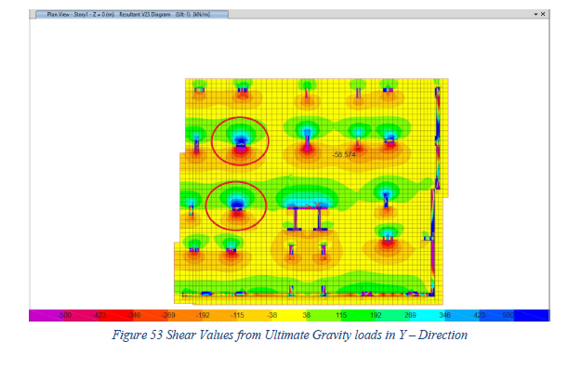
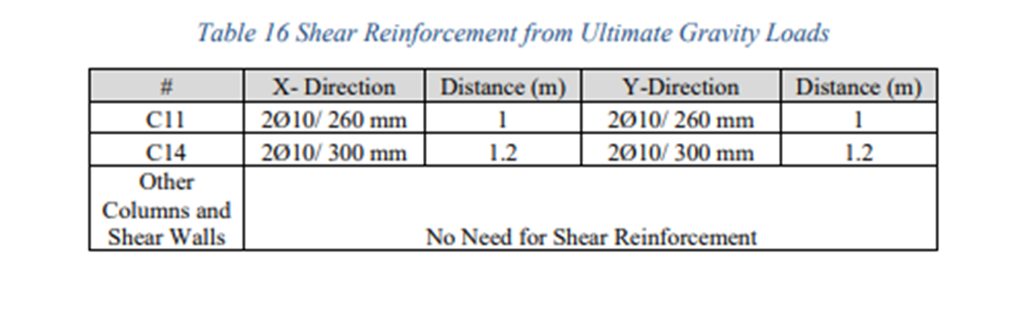
shear values for mat foundation in both x and y directions from safe

Slide 26
Quantity Survey(gravity loads)
Concrete Quantities
Volume of Concrete for Mat Foundation = Area * Depth.
Area of Mat foundation = 431 m2 , and Area of the Blinding with thickness of 10 cm and offset 10 cm from each side equal to 440 m2.
Volume of concrete for mat foundation= 388.8 m3
2. Steel Reinforcement Quantities
As shown in the figure below, the longitudinal reinforcement be drawn with the steel bar length.
Knowing that its reinforced with 8 Φ 16 / m in both directions and in top and bottom layers.

Slide 27
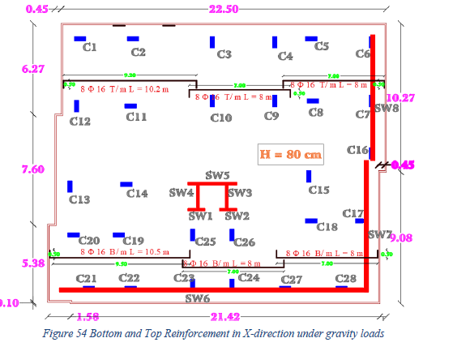
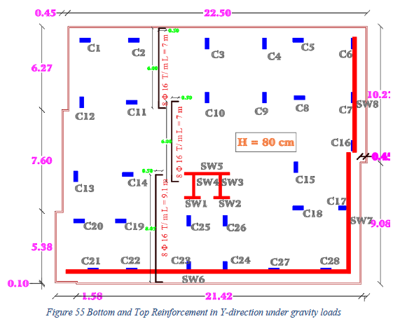

Slide 28
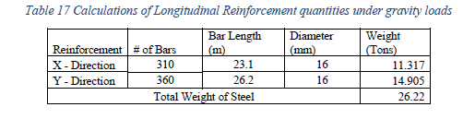
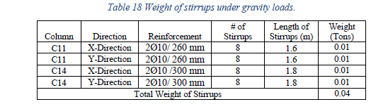
Total steel quantities for the gravity model = 26.26 Tons

Slide 29
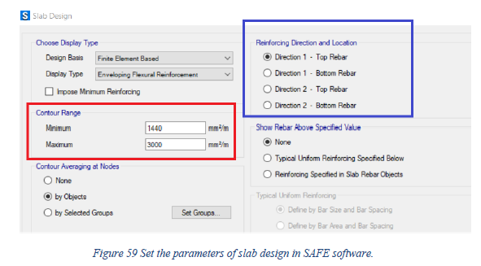
Steel reinforcement(gravity +earthquake loads)
1. Flexural reinforcement
Minimum area steel of the footing Asmin per in code ACI-2014 is Asmin = 0.0018 b h
Asmin = 0.0018 * 1000 * 800 = 1440 mm2/ m >> 8 Φ 16 / m or 1 Φ 16 / 125 mm for top and bottom bars.

Slide 30
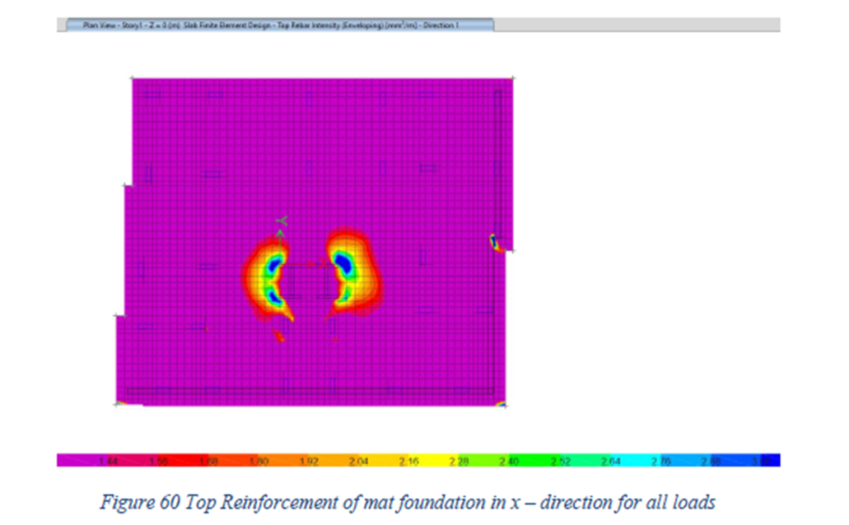
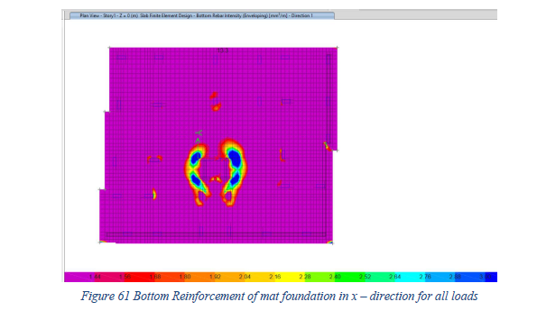
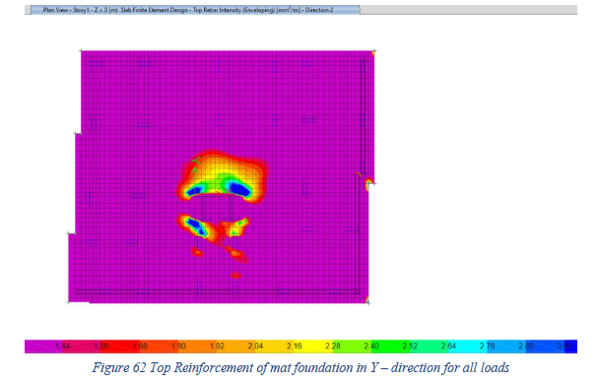
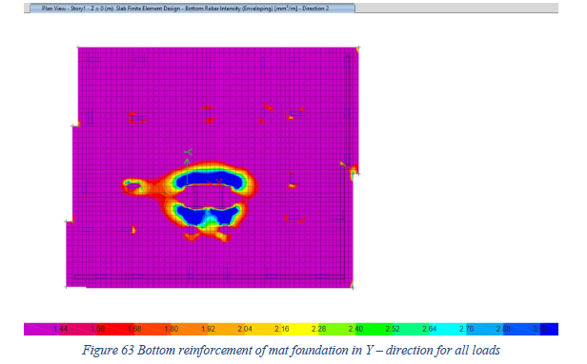
Figures below show the reinforcement in the top and bottom rebar for x and y direction in the footing. Where the Blue Color is the area steel value above the minimum value.

Slide 31
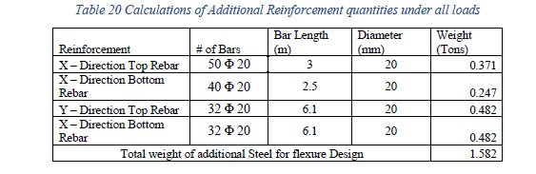
from the figures above, additional flexural reinforcement in the foundation is need.

Slide 32
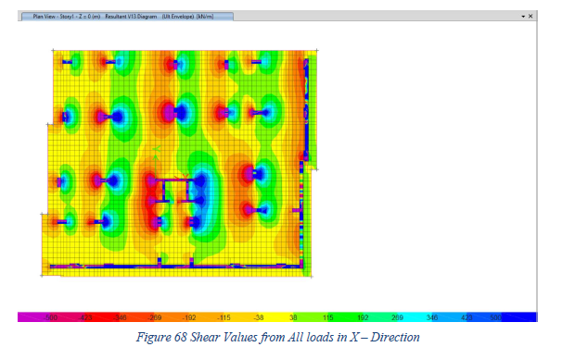
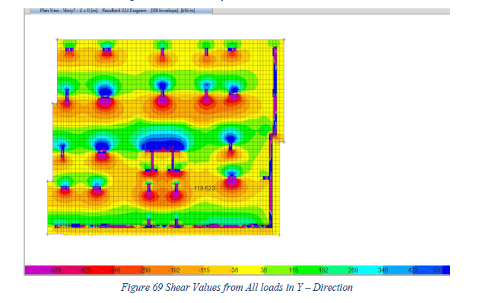
2. Shear reinforcement

Slide 33
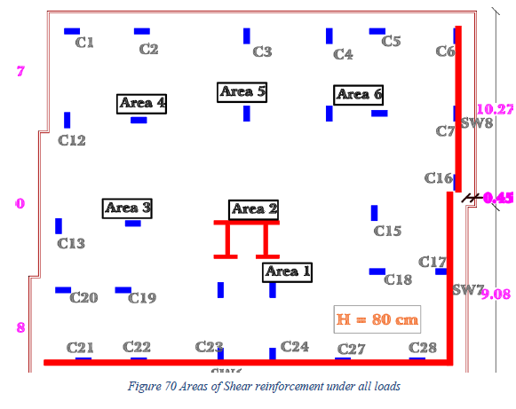
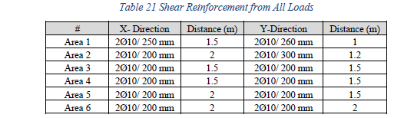
From the figures above, 11 areas should be reinforced with shear reinforcement. Shown in figure

Slide 34
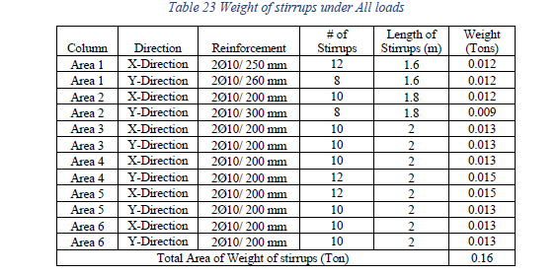
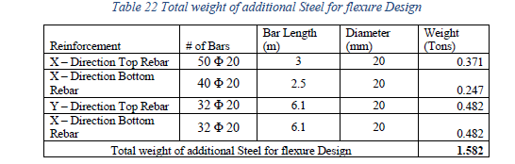
Quantity Survey(gravity+earthquake loads)
Concrete Quantities
the Quantity of concrete under gravity loads same as the Quantity under all loads=388.8 m^3
2. Steel Reinforcement Quantities
Total steel quantities for the gravity and Lateral model = 26.22+0.16+1.582 = 27.4 Tons

Slide 35
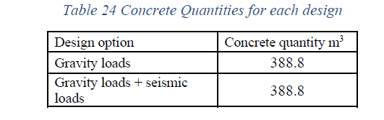
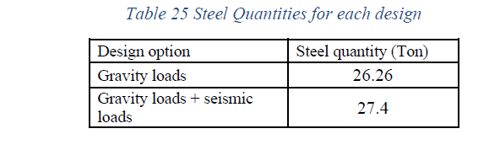
Discussion and Conclusion
The concrete quantity the same two models, the quantity of steel are different.
The difference in steel = 27.4 – 26.26 = 1.14 ton.
Difference on quantity on steel =1.14 / 26.26* 100% = 4.38 % .
From this project, the aim of the design is to have a economical solution. Thus, for buildings with multi-story and has a large weight, the best solution is to design foundation as mat foundation.
In this project, we note that the seismic design requires excess amount of steel reinforcement as additional steel top and bottom bars and stirrups, which was 1.14 tons.
The excess quantity is small because the loads resulting from the seismic effect differ slightly from loads from effect of live and dead loads.

Slide 36
The End
Thanks for listening
☺

