Slide 1
An- Najah National University
Industrial Engineering Department
Implementing Lean Manufacturing System
In Siniora Food Company
Prepared By
Sawsan Abass
Sageda Dadu
Rawan Zhran
Neveen Jamal
Ola Sabra
SUPERVISOR: Dr. Yahya Saleh

Slide 2
Agenda
Introduction
Methodology
Current State Analysis
Problem Statement & Objective
Future State And Improvement
Seven Wastes Analysis
Outcomes
Solutions And Recommendations

Slide 3
Introduction
Definition of Lean system
Literature Review
Siniora Food Factory (SFF)
Seven Wastes
Projects Tools
Ola Sabra

Slide 4
Definition
Lean Manufacturing is a strategy for achieving significant, continuous improvement in performance through the elimination of all waste of time and resources in the total business process
Elimination of waste means eliminating all activities that do not add value
The main purpose of lean is to remove all forms of waste from the value stream (Buker Company, 2011)
Ola Sabra

Slide 5
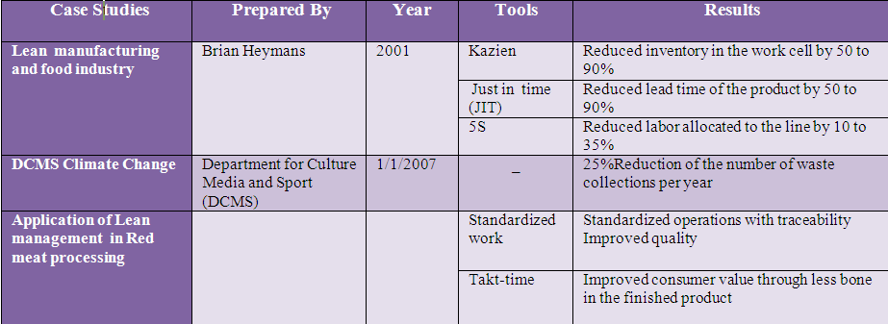
Literature Review
Ola Sabra

Slide 6
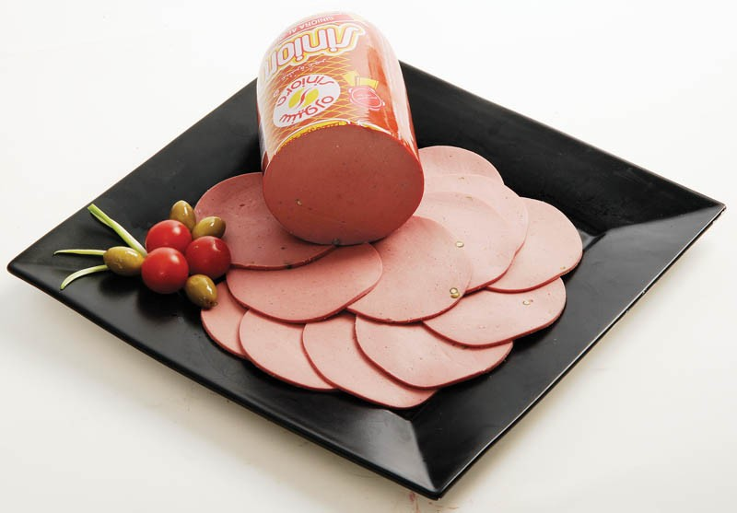
Siniora Food Factory (SFF)
The first meat-processing factory which called siniora, this pioneer company was established in 1920, in Palestine
Siniora has 60 types of product, some of these are :
Mortadella (Salami)
Roast
Luncheon
Ola Sabra

Slide 7
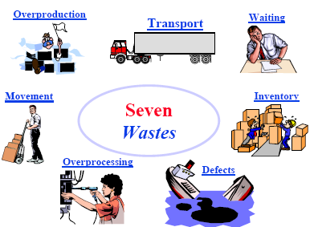
Seven Wastes
Ola Sabra

Slide 8
Project Tools
Value Stream Mapping (VSM)
Value stream mapping is a lean process – mapping method for understanding the sequence of activities used to produce a product ,also amp that outlines the current and future state of a production system
5S(Sort, Sustain, Set in order ,Standardized ,Shine )
A methodology for organizing, cleaning, developing, and sustaining a productive work environment. Improved safety, ownership of workspace, improved productivity and improved maintenance are some of the benefits of 5S program
Ola Sabra

Slide 9
Project Tools cond…
Fishbone Diagram:
A troubleshooting tool that can be used to visually diagram the causes and effects of a problem. Fishbone diagrams are often organized with 5 M(Men Method , Material ,Machine and Measurement .
Flow process chart:
a process flow chart is an instrument that visualizes and analyses the various systems, it is also a simple half-text, half-picture method of showing the steps in a process, using symbols to indicate the type of action being taken and text to give details of the action.
Ola Sabra

Slide 10
Problem Statement
Siniora Food Factory (SFF) has been suffering from different kinds of wastes appearing significantly in its various departments
As its products are perishable ones, Siniora aims at reducing the various kinds and quantities of waste produced in its departments via implementing a lean manufacturing system in its plant
The implementation of such a system, as a result of eliminating/reducing wastes, helps the company improve its productivity, increase efficiency and cut excess inventories
Sawsan Abbas

Slide 11
Objective
The main objective of our project is studying the current state of the factory to determine and estimate the waste and their quantities. Then, the steps of a lean manufacturing system are to be implemented sequentially to eliminate and reduce the estimated wastes
Sawsan Abass

Slide 12
Methodology
Studying And Analyzing the current state of SFF
Dividing the factory into 3 main areas production ,warehouses and maintenance
By using lean and other supportive tools we studied the main areas in details .
Specifying and Quantifying the various types of wastes at SFF
Improving the current system of SFF
Recommending the proposed solution for implementation for the SFF’s top management
Sawsan Abass

Slide 13
Production Area
Siniora process
Sawsan Abass

Slide 14
Production Analysis
Based on fish bone diagram methodology, we analyzed the current state during brainstorming sessions then, we drew fish bone diagram for each machine then, we reached the root causes of the problems in production area which related to Men ,Method , Machine, Measurement and Material
Sawsan Abass

Slide 15
Analytical Tools
Sawsan Abass

Slide 16
Flow Process Chart
It is a supporting analytical tool has been used in order to specify detailed production processes in terms of time and material flow.
Through the use of this chart we were able to determine the added value and non added value events.
The output resulted from flow process chart used as input data to current value stream mapping in order to create rooms for improvement in future value stream mapping .
Sawsan Abass

Slide 17
Current Value Stream Mapping
Sawsan Abass

Slide 18
Future Value Stream Mapping
Sawsan Abass

Slide 19
Sort
Sustain
Set In Order
5S
Standardized
Shine
Sawsan Abass

Slide 20
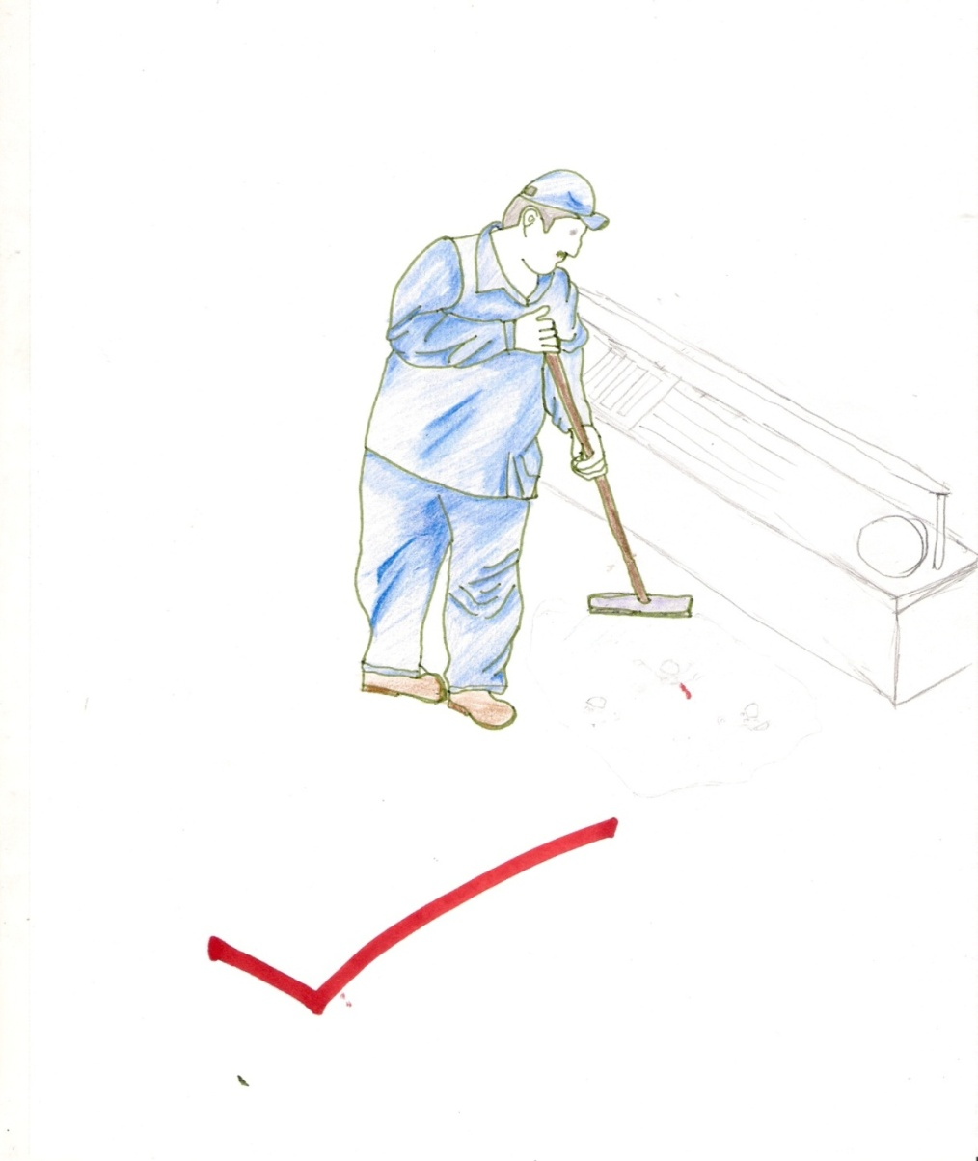
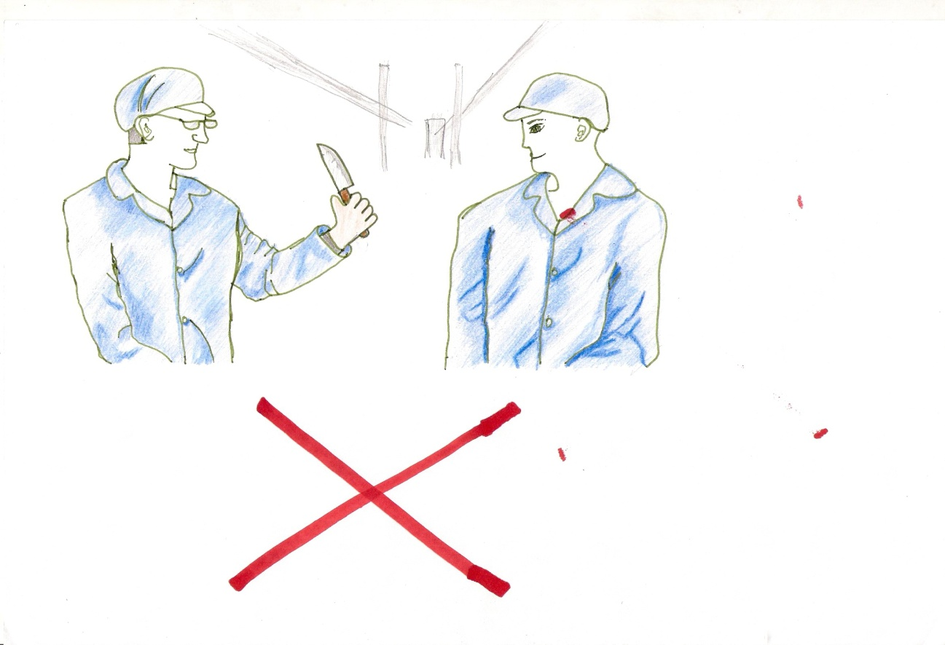
Visual Management
Sawsan Abass

Slide 21
Summary of waste time data Averages
.
Average | Feb-12 | Jan-12 | Dec-11 | Nov-11 | Sep-11 | Aug-11 | Jun-11 | May-11
15:02 | 14:49 | 09:32 | 20:36 | 20:52 | 17:32 | 16:33 | 11:52 | 08:37 | Sum of Loss time
65:00:37 | 66:11:00 | 114:48:00 | 47:32:00 | 102:20:00 | 50:54:00 | 30:17:00 | 43:55:00 | 64:08:00 | Sum of Breakdowns time
10:15 | 07:39 | 11:28 | 12:02 | 20:01 | 18:59 | 23:15 | 13:49 | 166:47:00 | Sum of Planned Breakdowns time
Sawsan Abass

Slide 22
Sawsan Abass

Slide 23
:% Scrap Comparison between DEC2011-FEB 2012
Sawsan Abass

Slide 24
Warehouses
Warehouses in Siniora Company divided to three warehouses these sections are:
Warehouses
Main Warehouse
Southern Warehouse
Cold cuts Warehouse
Sageda Dadu

Slide 25
Warehouses Analysis
Based on fish bone diagram methodology, we analyzed the current state during brainstorming sessions then, we drew fishbone diagram for each warehouse then we reached the root causes of the problems in each
warehouse. And also We aimed to implement 5S terms on warehouses through restudying current layouts for each warehouse separately
Main Warehouse:
Effect: Inappropriate utilization for main warehouse space.
Material , Method and Floor Weakness . Causes:
Sageda Dadu

Slide 26
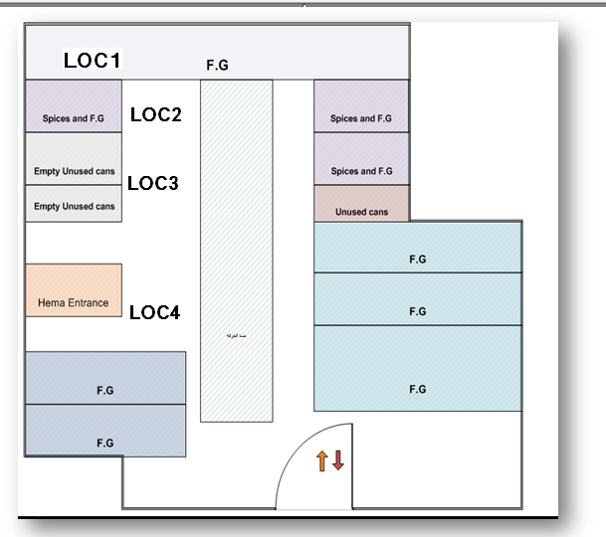
Current Layout Of Main warehouse
Sageda Dadu

Slide 27
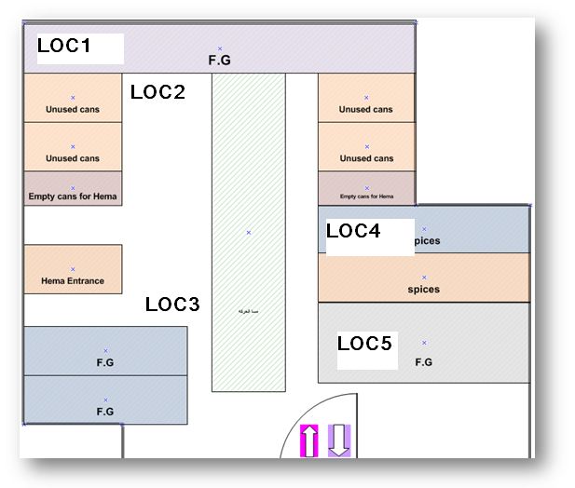
Alternative Layout for main warehouse
Sageda Dadu

Slide 28
Southern Warehouse:
Effect: Inappropriate utilization for Southern warehouse space.
Material , Method, Machine, Men , Environment and Layout . Causes:
Sageda Dadu

Slide 29
Current layout for southern warehouse.
Sageda Dadu

Slide 30
Alternative of the southern warehouse
Sageda Dadu

Slide 31
Cold cuts warehouse:
Effect:
No enough space to contain huge quantity
produced.
Causes :Material, Machine, Method and Men
Sageda Dadu

Slide 32
Current layout for cold cut warehouse
Sageda Dadu

Slide 33
Sample Data For Inventory Scrap
Avg(Kg) | Product Name
36.3 | Siniora Slices Trk 200g
21.77 | Siniora Slices Pasta 200g
84.68 | Siniora Slices Salami 200g
123037 | Siniora Slices 200g
112.53 | Siniora Lunch Beef 800g
45.76 | Siniora Trk Saus 400g
138.73 | Siniora Chicken Saus 400g
293.17 | Siniora Bef Saus 1Kg
13.173 | Siniora Bef Saus 380g
129.47 | Siniora Bef Saus 400g
7.35 | Siniora Salami Smoked 900g
14.383 | Siniora Salami Smoked 2Kg
7.275 | Siniora Salami Smoked 450g
6.15 | Siniora Trk Smoked 900g
Sageda Dadu

Slide 34
Maintenance department (spare parts warehouse & workshop )
Maintenance department and spare parts warehouses are one of the main departments in S. F. F; it includes all spare parts and equipment needed .
Effect:
Difficulties in reaching tools .
Causes:
Men ,Machine and Method
Rwan Zahran

Slide 35
The current layout maintenance work shop
Rawan Zahran

Slide 36
Sort
Sustain
Set In Order
5S
Standardized
Shine
Rawan Zahran

Slide 37
Seven Wastes Analysis :
In order to analyze seven wastes, which represent backbone of lean system ,practical visits have been done (warehouses , production area and maintenance) during these visits major of these waste have been noticed and relevant data has been collected based on its priority in term of high impact .
Rawan Zahran

Slide 38
Defect in previously soaked cases
Defect in the final products
Nonconforming final product
Defects
Defects during cook phase
Defects in R.M
according to its
transfer ways.
Back order from the customers.
Defects during production process
Rawan Zahran

Slide 39
Worker’s motion inside Warehouses in order to store material
Motion
Worker’s motion in order to move pans
Workers Motion during production processes
Worker’s motion in order to bring machine spare parts
Worker’s motion in order to bring production needs
39
Rawan Zahran

Slide 40
Produce huge quantities to avoid long setup time
Over production
The manufacturing process for minced meat delayed
Produce huge quantities for Amman and Gaza exporting
Produce huge quantities as a result of miss planning
40
40
Rawan Zahran

Slide 41
Waiting time on the cutter machine because the mincer is slower than cutter
Loss time taking for changing the types of the products
Waiting
Waiting time of the packaging line because lack in pallets and cartoons
Waiting time on the polyclip line because of lacks of trolleys
Raw material are waiting because there is no means to handle it (forklift)
Waiting in Furnaces area because of low efficiency of the steam engine
41
Neven Jamal

Slide 42
Over production causes excess inventory
Inventory
Unused material such as cans and cartoons
Minced meat in pans are waiting in a temporary store represented in refrigerator
Large quantities of semi- finished products are put in a buffering zone
Tactical planning for seasonal raw materials causes inventory
42
42
Neven Jamal

Slide 43
Transportation
Haven’t been studied
Over Processing:
Not being noticed
Neven Jamal

Slide 44
Solutions And Recommendation
In order to achieve goals of our project that have been mentioned previously , which aimed to implement lean manufacturing system by using plenty of lean tools and other supportive tools, after analysis that have been done we reached to realistic solutions and recommendations that covered all targeted departments (warehouse, production and maintenance) that aims to promote system effectively and its represented effectively in
Neven Jamal

Slide 45
Production Proposal
Designing visual management boards for each production lines to clarify the followed instructions in production area
Increase number of pans if needed.
Document procedures which ensure continuous preventive maintenance includes all production lines
Rescheduling for production plans to keep up with demand.
Set instructions to ensure workers commitment.
Neven Jamal

Slide 46
Production Proposal
Feasibility study for ability of adding new Mincer.
Purchasing number of trolleys and sticks.
Feasibility study for ability of adding new boiler
Purchasing special device for measuring the required length of case speedily
Ability to extent showering area in the direction of packaging room.
Purchasing more suitable balance with edges.
Neven Jamal

Slide 47
Warehouses Proposal
Studying all suggested alternatives of layout and choosing the optimal solution from company's point view.
Establishing a crane in the southern warehouse in order to facilitate arranging, entering and getting out materials in addition to facilitate workers motion.
Get rid of empty cans through pressing them , send them back to the supplier or buying labeling machine in order to relabeling these cans.
Specialize containers for Amman and Gaza products in order to have better utilization for cold cut warehouse and facilitate sorting all cold cut products
Position pierced shelves in the last room in cold cut warehouse.
Neven Jamal

Slide 48
Maintenance Proposal
Clarify the responsibilities and job description for both maintenance and financial department.
Replace the freezer shutter with closed door to ensure high quality cooling process.
Computerize the maintenance department and spare part warehouse by using barcode system to monitor the input/ output piece.
Hanging boards for manual tool which facilitates reaching for these tool easily and efficiently
Neven Jamal

Slide 49
Outcomes
According to Value Stream Mapping Tool :
Current Non Added Value Time = 40Hrs
Future Non Added Value Time = 30 Hrs
According To Actions Taken
% Of Loss Time At Dec 2011= 10.4%
%% Of Loss Time At April 2012= 6.2%
According To Suggested Actions
Current Storage Area in Southern warehouses take in 192 pallet
Storage Area will increased by 50 pallet
Future storage Area 192+50=242 pallet
Neven Jamal

Slide 50


