Slide 1

APPLYING OF GEOSYNTHETICS IN ROADS PROJECTS
Raghad Qashou’ Jana Kafri

Slide 2

Introduction and Methodology
Pavement Design
OUR PATH
Erosion Control
Retaining walls
Conc. & Recom.

Slide 3

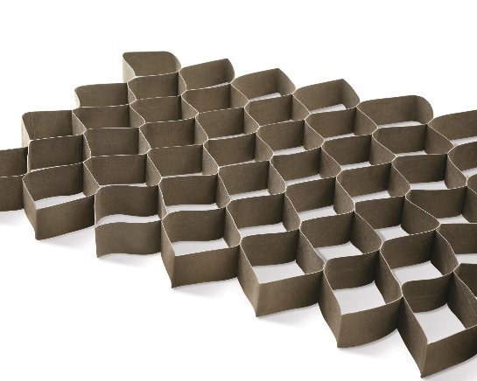
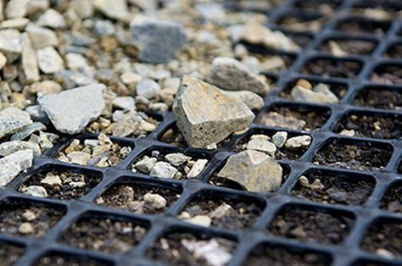
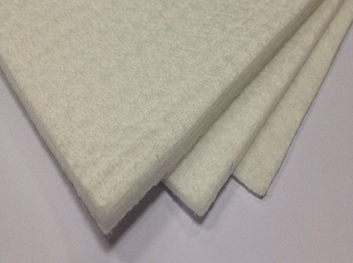
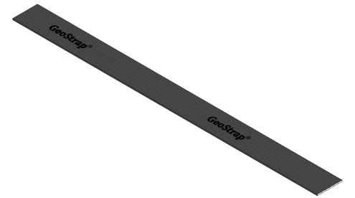
INTRODUCTION
What are the Geosynthetic products used in this part of project?
Geocells
Bi-Axial Geogrid
Non-Woven Geotextile
Geostrips

Slide 4
INTRODUCTION
1.3 - 9% saving
Cost
REMINDER!
Pavement Design
GS
Carbon ftprt
4.5-12% less
Soakaway Tanks
GS
Cost
65% saving
Soil stabilization
Landscaping
Slope protection
Asphalt Pavement
Water Drainage
What are the uses of Geosynthetic materials ?

Slide 5
INTRODUCTION
Project Objectives
The main objective of this project is to study both the cost and environmental impact of some elements to be constructed in the conventional way and compare it to the same elements constructed using the Geosynthetics
Cost Saving
Time Saving
Environmental impact
Quality
Project Significance

Slide 6
METHODOLOGY

Slide 7

CONCLUSIONS AND RECOMMENDATIONS
5
RETAINING WALLS REVIEW AND COMPARISON
EROSION CONTROL REVIEW AND COMPARISON
4
3
2
1
DATA COLLECTION AND LITERATURE REVIEW
STANDARDS AND SPECIFICATIONS

Slide 8
SOIL STABILIZATION

Slide 9
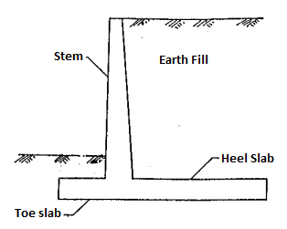
Soil Stabilization
Reinforced Concrete Retaining walls
Designed to support and resist lateral soil pressure when the required change in the elevation of the ground exceeds the repose's angle of the soil.
Components
Disadvantages:
The steps of concrete mixing, casting, curing will affect the final strength of the structure.
Relatively high cost
Shrinkage > cracks > loosing strength

Slide 10
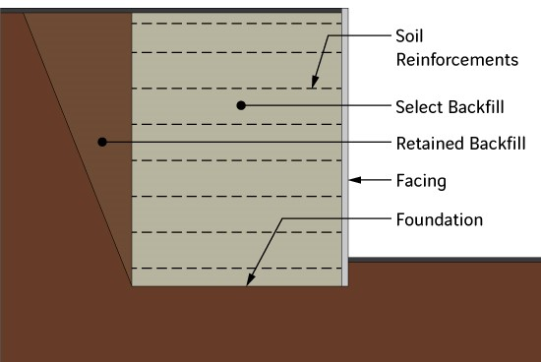
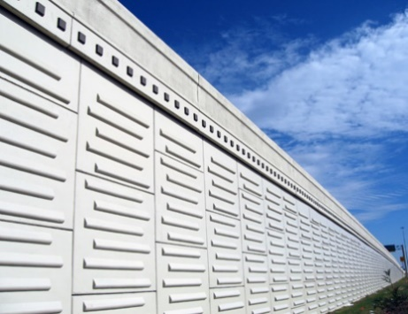
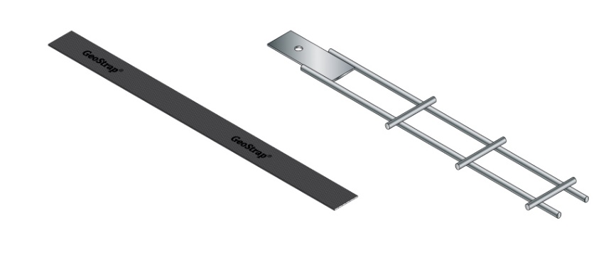
MSE WALL
Mechanically Stabilized Earth
The stability of the wall system is derived from the interaction between the backfill and soil reinforcements
Main Components:
Facing Panels
Geostrips

Slide 11
MSE Methodology
Establish project parameters
Estimate wall embedment
Evaluate external stability
Evaluate internal stability
Design of facing element
Check Global stability including compound stability

Slide 12
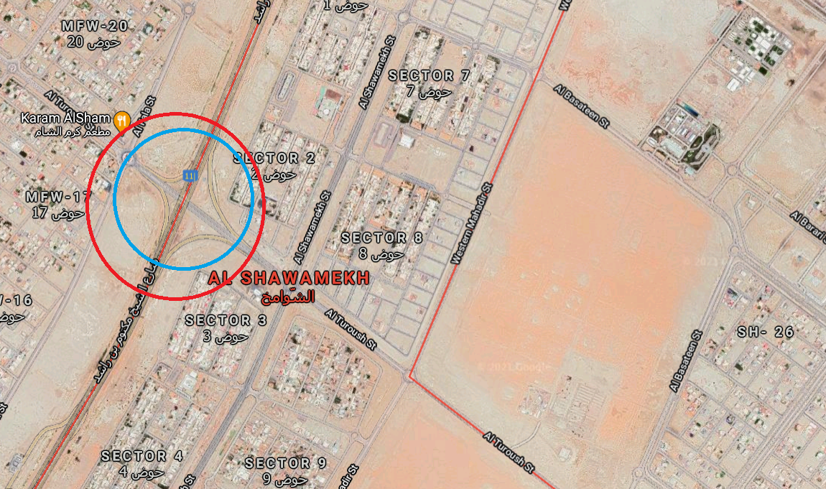
LOCATION
The location where the retaining wall need to be applied with an area of 15,600 sqm

Slide 13
Benefits of MSE Walls
Flexibility to accommodate high differential settlement and several feet of total settlement.
Extreme wall heights can be achieved.
High resistance to seismic and other dynamic forces.
Free-draining, due to granular backfill and open panel joints
Rapid, predictable, and repetitive construction
Excavation works for the foundation are reduced.
Extreme loads can be carried.

Slide 14
Cost Comparison
Area | Conventional RC Retaining Walls |  | MSE Walls
 | Cost (AED/m2) | Total (AED) | Cost (AED/m2) | Total (AED)
15,600 m² | 1450* | 22,620,000 | 750* | 11,700,000
*The prices include labor and backfilling
A total saving of 10,920,000 AED which is represented by 48.3% of the cost.

Slide 15
EROSION CONTROL

Slide 16
LOCATION
The location where the Erosion control techniques need to be applied with an area of 90,000 sqm

Slide 17
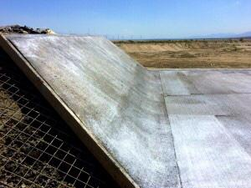
EROSION CONTROL
CONVENTIONAL METHOD
COMBINATION
Reinforcing Steel Grid
Concrete mix – form a slab of 15 cm thickness
Expansion Joints/4m
The cost of applying reinforced concrete mat for slope protection according to the ADM is 65/sqm on avg. including labor, equipment and all the elements mentioned.

Slide 18
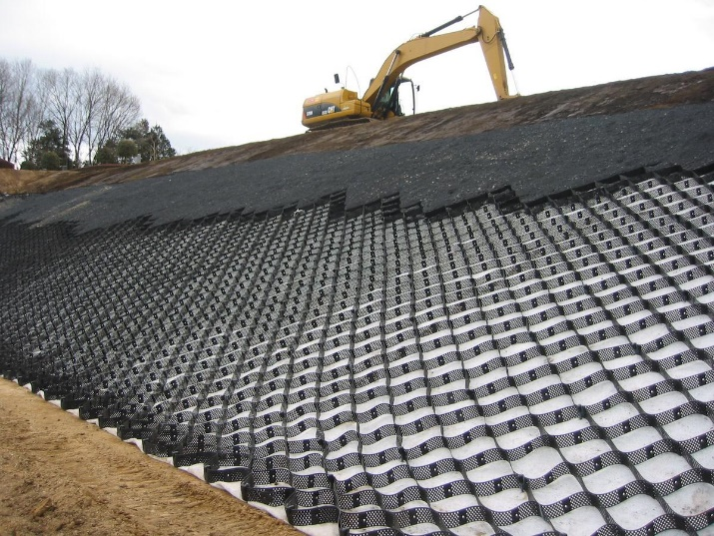
EROSION CONTROL
GEOCELLS
COMBINATION
Geocells
Clip+ Ropes + Anchors
Backfilling soil/gravel
MAIN FUNCTIONS ASPECTS
Effectively increases stiffness and reduces vertical settlement and lateral spreading

Slide 19
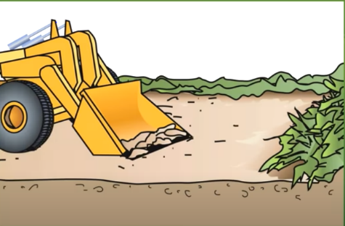
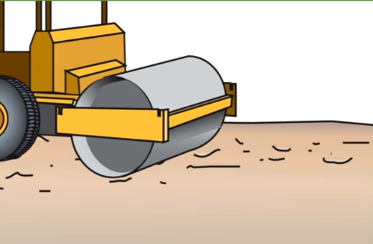
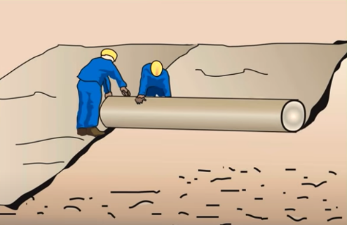
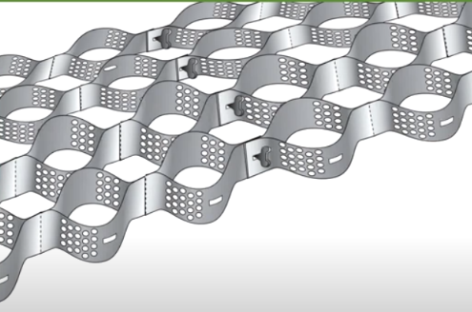
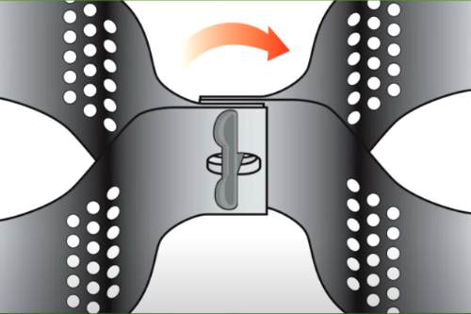
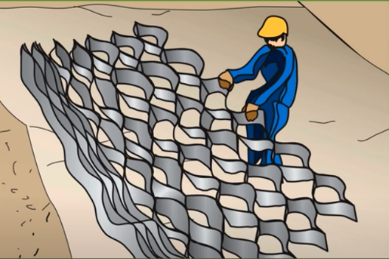
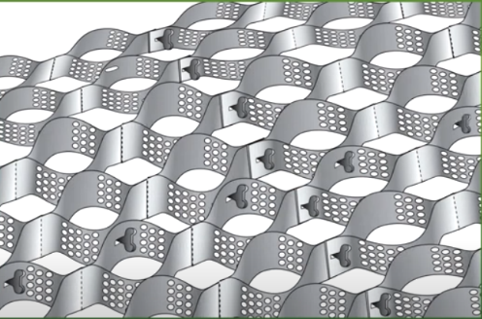
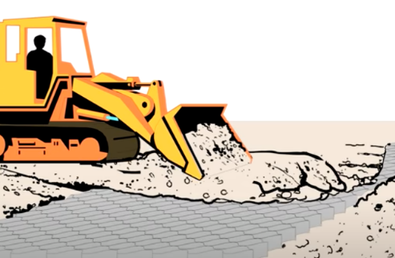
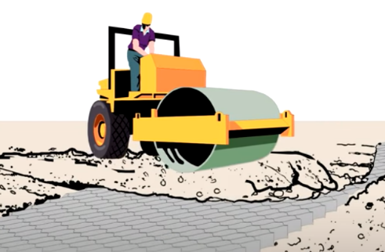
1
2
3
6
5
4
7
8
9

Slide 20
COST COMPARISON
As provided from Best-Grid Co., The price of installing the Geocells including labor work and backfilling material is 39 AED/sqm on average.
Area (m2) | Conventional |  | Geocells
 | Cost (AED/m2) | Total (AED) | Cost (AED/m2) | Total (AED)
90,000 | 65 | 5,850,000 | 39* | 3,510,000
The savings in this project will be 2,340,000 AED, which will be saving 40% of the cost

Slide 21
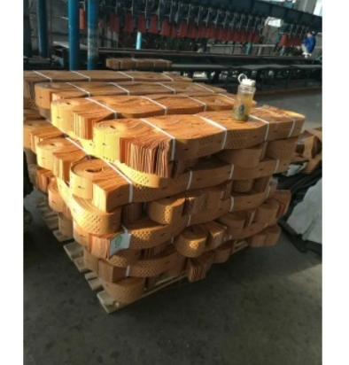
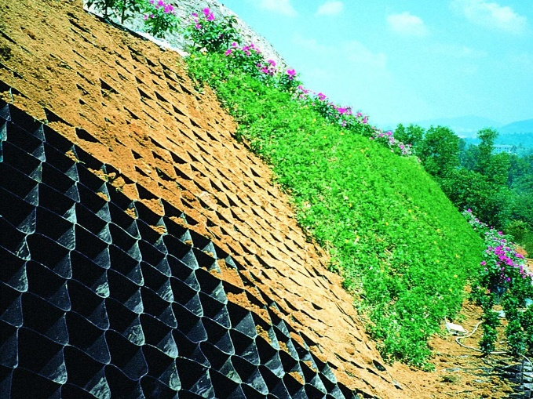
Advantages of Geocells
Easily transported {Logistics is Large QTY is not a problem}
Easy to install {No skilled labors needed}
Can be installed in any weather condition.
Faster to install {1100 sqm/day}
Cost effective
Reduce carbon foot‐print
More aesthetic

Slide 22
PAVEMENT DESIGN
Local Road

Slide 23
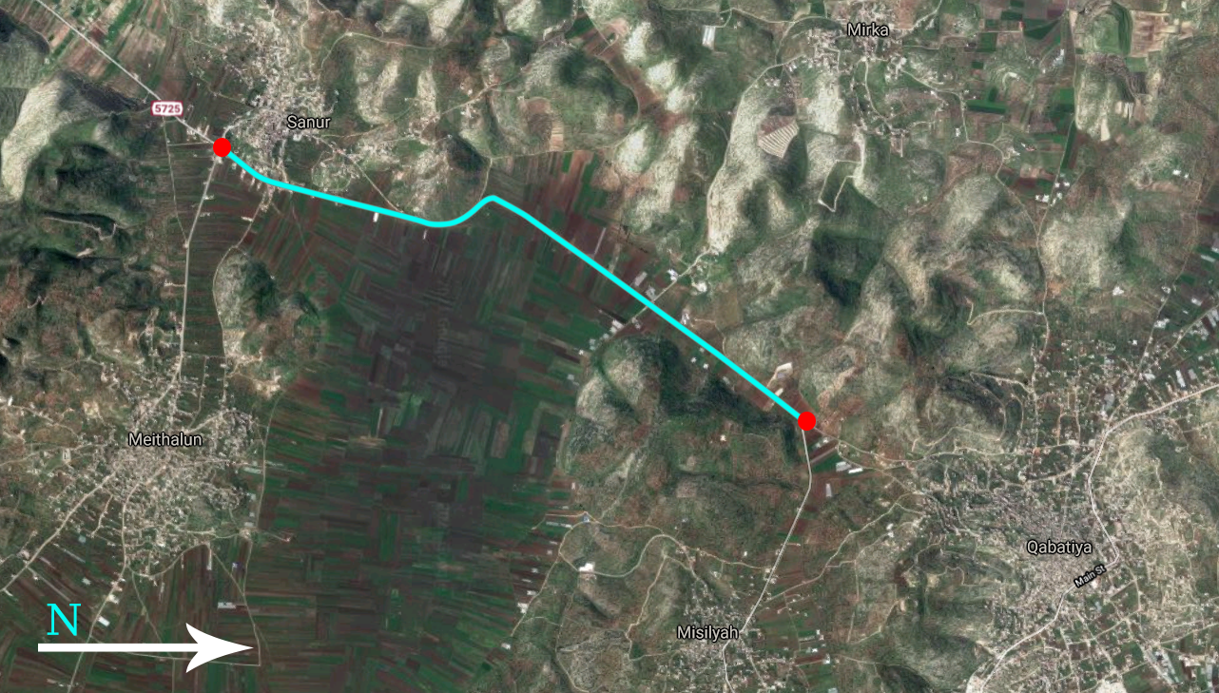
LOCATION

Slide 24
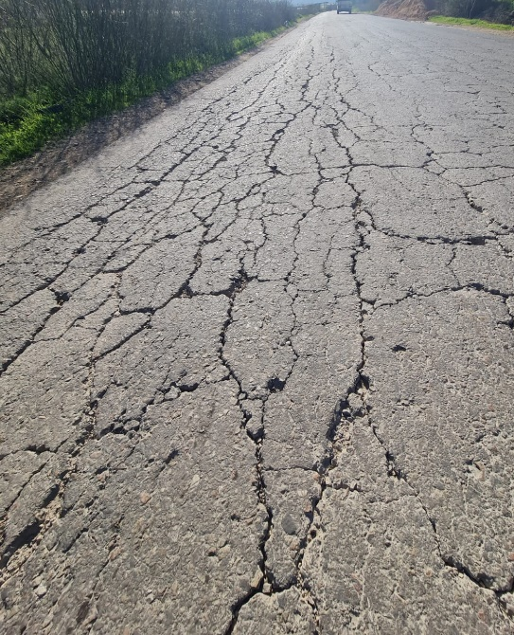
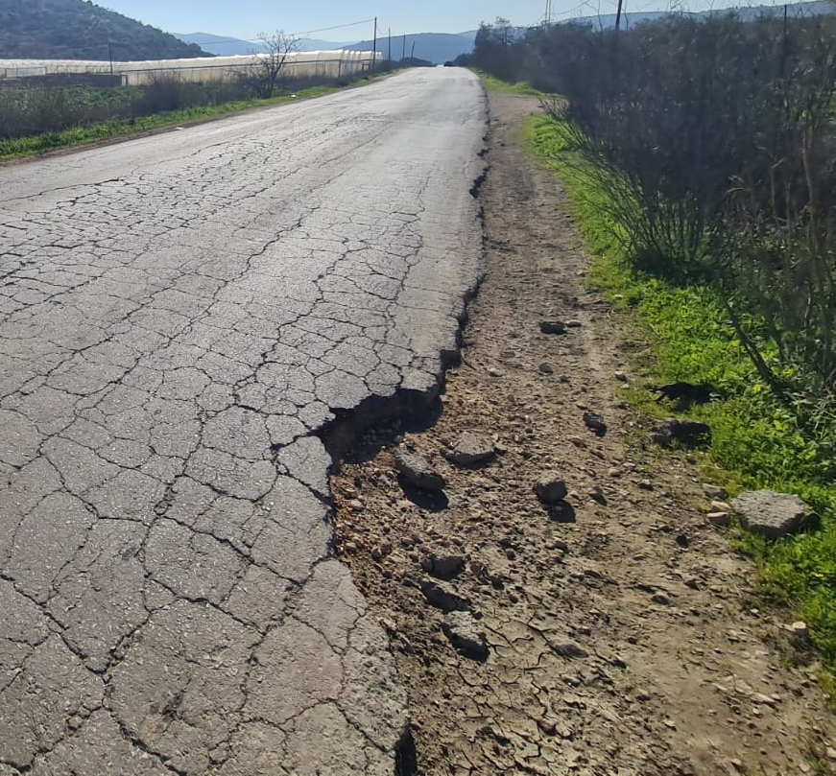
Qabatyia-Sanur Street problems
Severe cracks along the street.
Potholes.
Deformation in asphalt were noticed in some areas.
No shoulders on any side of the street.
Limited/tight width of the street.

Slide 25
PAVEMENT DESIGN
 | Trailer | Single unit 3 axle | Single unit 2 axle 6 tires | Bus | Single unit 2 axle 4 tires | Taxi van | Passenger car
ESAL factor ⁽¹⁾ | 0.98 | 0.73 | 0.21 | 0.21 | 0.02 | 0.02 | 0.0004
Number of axles | 5 | 3 | 2 | 2 | 2 | 2 | 2
Number of vehicles ⁽²⁾ | 18 | 1 | 11 | 5 | 4 | 28 | 363
Design lane factor | .45 | .45 | .45 | .45 | .45 | .45 | .45
Growth rate ⁽³⁾ | 29.78 | 29.78 | 29.78 | 29.78 | 29.78 | 29.78 | 29.78
AADT | 2870 | 2870 | 2870 | 2870 | 2870 | 2870 | 2870
Percent of vehicles | 0.0418 | 0.002325 | 0.02558 | 0.0116 | 0.0093 | 0.0651 | 0.8441
ESAL | 2.87 x 10⁶ | 7.15 x10⁴ | 1.51 x10⁵ | 6.84 x10⁴ | 6.5 x10³ | 3.6 x10⁴ | 9479
Total ESAL | 3.21 x10⁶
(1) Source: Ministry of Public Works and Housing, Ramallah, Palestine
(2) From the peak hour count
(3) Based on an annual growth factor of 4% for a design period of 20 years.

Slide 26
PAVEMENT DESIGN
DATA ANALYSIS
INPUT
Log₁₀ W₁₈ =(Z_{R}) x (S₀) +9.36 x log₁₀(S_{N}+1) -0.20 +2.32 x log₁₀Xm_{R} – 8.07 +$\frac{\log{10 (\frac{ΔPSI}{4.2−1.5})}}{.4+(\frac{1094}{{\left(SN+1\right)}^{5.19}})}$
PARAMETERS
PARAMETERS | QABATIYA-SANUR ST.
ESALs | 3.21 x 10⁶
Reliability (%) R | 95%
Standard Normal Deviation | -1.645
Overall Standard Deviation, S_{o} | 0.45
Initial Serviceability, Pi | 4.5
Terminal Serviceability, Pt | 2
Design Serviceability Loss ΔPSI | 2.5
Drainage Coefficient, m | 0.8

Slide 27
PAVEMENT DESIGN
Using the previous parameters as an input for W18 equation the following summary is resulted:
Pavement | Required ESAL | Calculated SN | Conventional Pavement |  | Geosynthetic Pavement 1 |  | Geosynthetic Pavement 2
 |  |  | SN | ESAL | SN | ESAL | SN | ESAL
LOCAL | 3,210,000 | 4.136 | 4.189 | 3,529,013.5 | 4.139 | 3,226, 669.1 | 4.154 | 3,311,234.7
As summary of the calculated thickness for both conventional and geosynthetic designs, in addition to saving results is shown as follows:

Slide 28
PAVEMENT DESIGN
Layer Description | Conventional Section | Reinforced Section Option1 | Reinforced Section Option2
 | Thickness (mm) | Thickness (mm) | Thickness (mm)
Asphalt Wearing course | 50 | 50 | 50
Asphalt Binder course | 90 | 70 | 60
Granular base course | 150 | 150 | 150
Granular Sub-base course | 200 | 150 | 180
Geogrid Reinforcement | - | EGRID 30-30 | EGRID 30-30
TOTAL THICKNESS | 490 | 420 | 440
Structural Number (SN) | 4.189 | 4.139 | 4.154
ESAL’s | 3,529,013.5 | 3,226,669.1 | 3,311,234.7
REQUIRED ESAL’s | 3,210,000.0

Slide 29
PAVEMENT DESIGN
COST-OPTION 1
LAYER DESCRIPTION | CONVENTIONAL SECTION |  |  |  |  |  | BG REINFORCED SECTION (Option 1)
Asphalt Wearing Course | 50 | mm | 25.30 | NIS /m² | 25.30 | NIS /m² | 50 | mm | 25.30 | NIS /m² | 25.30 | NIS /m²
Tack Coat | 1 | Layer | 2.5 | NIS /m² | 2.5 | NIS /m² | 1 | layer | 2.5 | NIS /m² | 2.5 | NIS /m²
Asphalt Base Course | 90 | mm | 45.54 | NIS /m² | 45.54 | NIS /m² | 70 | mm | 33.87 | NIS /m² | 33.87 | NIS /m²
Prime Coat | 1 | Layer | 3 | NIS /m² | 3 | NIS /m² | 1 | layer | 3 | NIS /m² | 3 | NIS /m²
Base Course | 150 | mm | 85 | NIS /m³ | 12.75 | NIS /m² | 150 | mm | 85 | NIS /m³ | 12.75 | NIS /m²
Sub-Base Course | 200 | mm | 80 | NIS /m³ | 16 | NIS /m² | 150 | mm | 80 | NIS /m³ | 12 | NIS /m²
E’GRID 30-30 | 0 | Layer | 8 | NIS/m² | 0 | NIS /m² | 1 | layer | 8 | NIS /m² | 8 | NIS /m²
TOTAL | 105.99 |  |  |  |  | NIS /m² | 97.42 |  |  |  |  | NIS /m²

Slide 30
PAVEMENT DESIGN
COST-OPTION 2
LAYER DESCRIPTION | CONVENTIONAL SECTION |  |  |  |  |  | BG REINFORCED SECTION (Option 2)
Asphalt Wearing Course | 50 | mm | 25.30 | NIS /m² | 25.30 | NIS /m² | 50 | mm | 25.30 | NIS /m² | 25.30 | NIS /m²
Tack Coat | 1 | Layer | 2.5 | NIS /m² | 2.5 | NIS /m² | 1 | layer | 2.5 | NIS /m² | 2.5 | NIS /m²
Asphalt Base Course | 90 | mm | 45.54 | NIS /m² | 45.54 | NIS /m² | 60 | mm | 29.17 | NIS /m² | 29.17 | NIS /m²
Prime Coat | 1 | Layer | 3 | NIS /m² | 3 | NIS /m² | 1 | Layer | 3 | NIS /m² | 3 | NIS /m²
Base Course | 150 | mm | 85 | NIS /m³ | 12.75 | NIS /m² | 150 | mm | 85 | NIS /m³ | 12.75 | NIS /m²
Sub-Base Course | 200 | mm | 80 | NIS /m³ | 16 | NIS /m² | 190 | mm | 80 | NIS /m³ | 15.2 | NIS /m²
E’GRID 30-30 | 0 | Layer | 8 | NIS/m² | 0 | NIS /m² | 1 | layer | 8 | NIS /m² | 8 | NIS /m²
TOTAL | 105.09 |  |  |  |  | NIS /m² | 95.92 |  |  |  |  | NIS /m²

Slide 31
PAVEMENT DESIGN
SAVINGS OPTION 1:
In Construction Cost = 7.67 NIS/M2
Carbon footprint = 14.06 kgCO2e/m2
Total area of Local roads in the design area = 61200 m²
TOTAL SAVINGS
Conventional Cost = 6,431,508 NIS
Saving in Construction Cost = 469,404 NIS (7.3 % saving)
SAVINGS OPTION 2:
In Construction Cost = 9.17 NIS/m2
Carbon footprint = 13.78 KgCO2e/m2
Total area of Local roads in the design area = 61200 m²
TOTAL SAVINGS
Conventional Cost = 6,431,508 NIS
Saving in Construction Cost = 561,204 NIS (8.73 % saving)

Slide 32
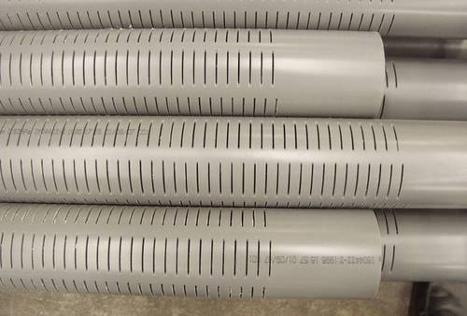
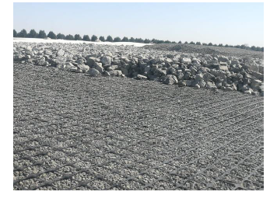
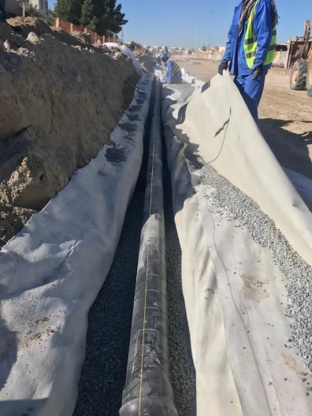
Suggested Solution
For high water table
Perforated Pipes
Capillary Break Layer

Slide 33
CONCLUSIONS
Cost Saving
As noticed, using the geogrid in the pavement design saved 7.3-8.7% of the cost comparing to the conventional method. Using MSE walls saved up to 48.3% of the cost as well as using the Geocells in erosion control saved 40%.
Environmental Effect
The carbon footprint/ (CO2) emissions calculated shows that using the geogrid the pavement design has reduced these emissions by 7.34 as well as designing the pavement in Chapter 8 has saved around 13.3-13.5%. .
Raw Material Reduction
Reducing the Asphalt layer’s thickness in Pavement Design, in addition to reducing the usage of concrete to zero in Tanks Design, all of the designs have reduced the usage of raw materials in addition to water and energy consumption (e.g. Machinery).

Slide 34
RECOMMENDATIONS
The project team advise the relevant Palestinian stakeholders who are responsible on infrastructures design and construction in general in Palestine to implement a feasibility study for using the Geosynthetic materials in Palestine.
The project team recommends to include Geosynthetic material in Palestine Standards as a first step to enhance the usage of Geosynthetics in infrastructure and engineering projects.

Slide 35

THANK YOU !

