Slide 1



Slide 2
1
HOW WE GET THE IDEA
2
Objectives
3
TRADITIONAL METHODS
4
DESIGN MODEL
Content
5
CONSTRAINTS
6
TOOLS AND TECHNOLOGIES
7
DETAILS OF TOOL USAGE
8
CONCLUSION
9
FUTURE ENHANCEMENTS

Slide 3

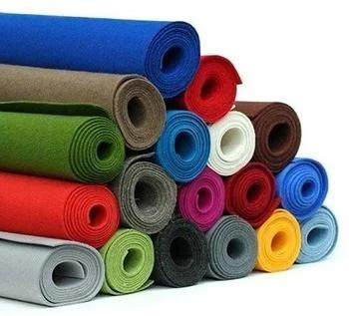
HOW WE GET THE IDEA

Slide 4
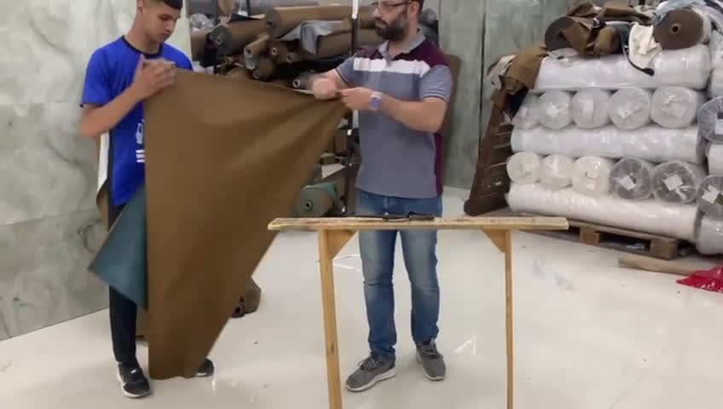

Slide 5

Objectives
accuracy
reduce the time
minimize waste
Saftey
BACK TO CONTENT PAGE

Slide 6

BACK TO CONTENT PAGE

Slide 7
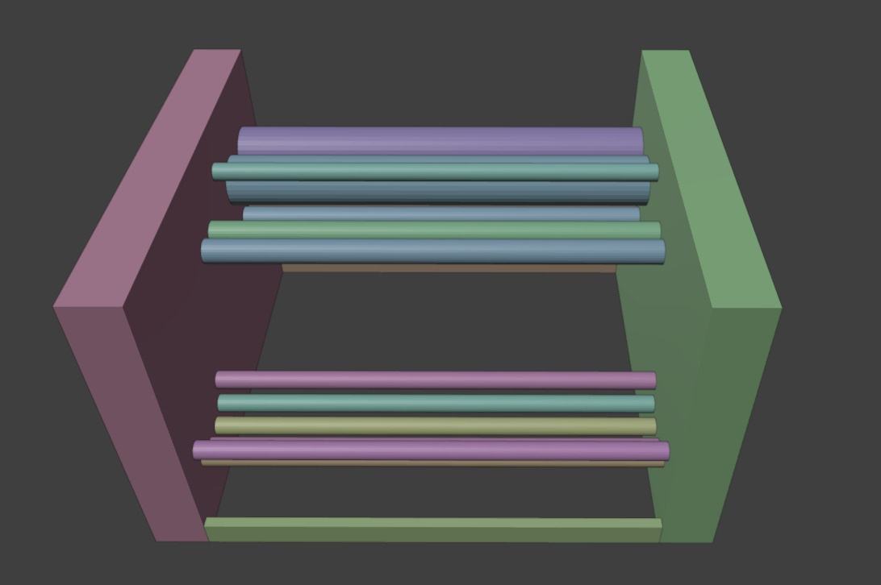
Arrangement of Cylinders
(a) Container

Slide 8
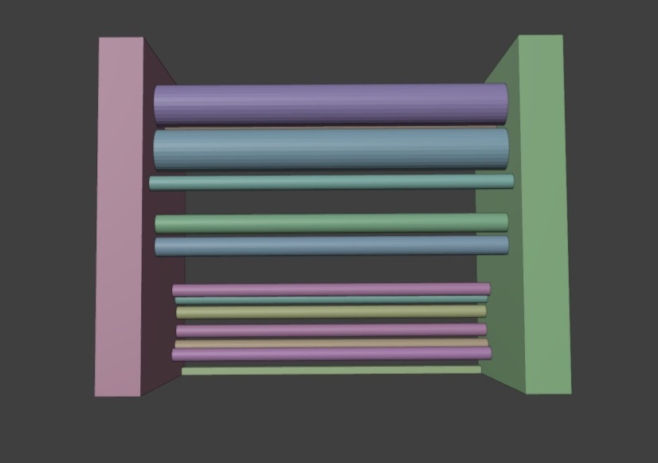
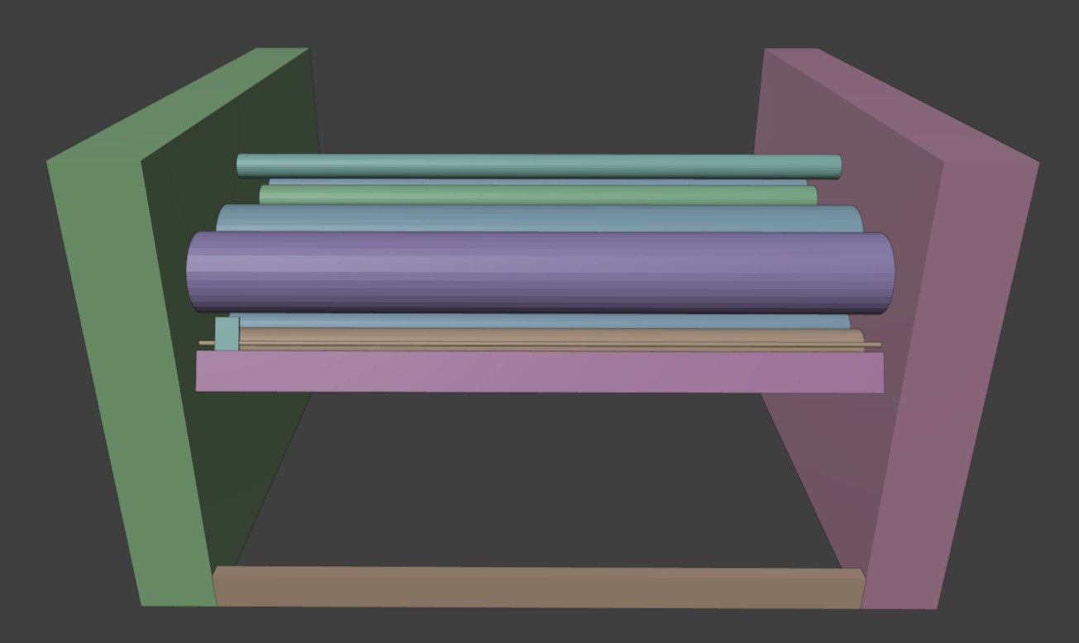
Arrangement of Cylinders
(b)Moving cylinder

Slide 9
Arrangement of Cylinders
(c)Cylinders in the middle

Slide 10
Arrangement of Cylinders
(d)blade part

Slide 11
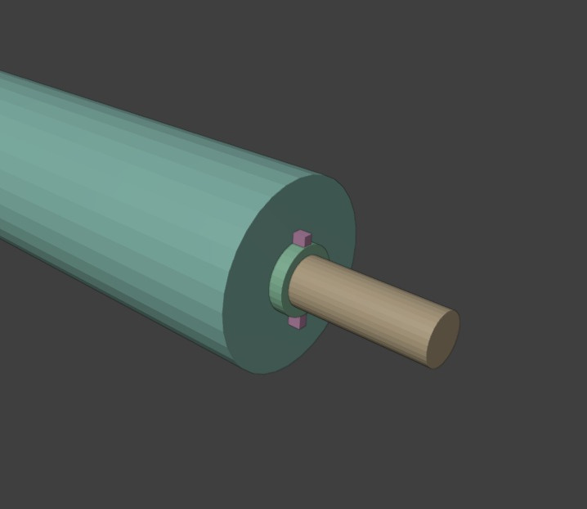
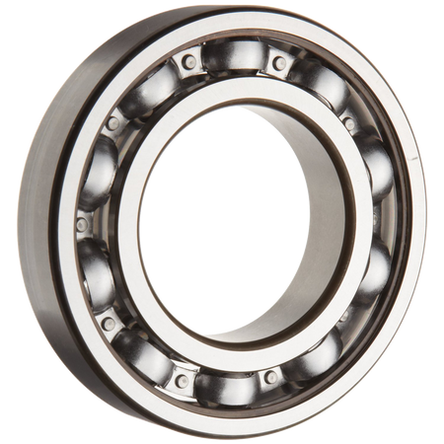
The Cylinder
bearings
iron rod
plastic roll

Slide 12
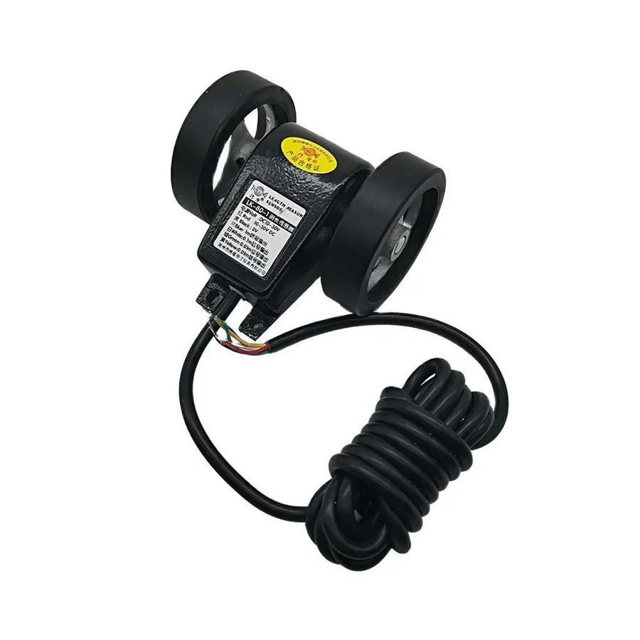
Constrains
REPLACEMENT OF THE LK80 SENSOR
BACK TO CONTENT PAGE

Slide 13
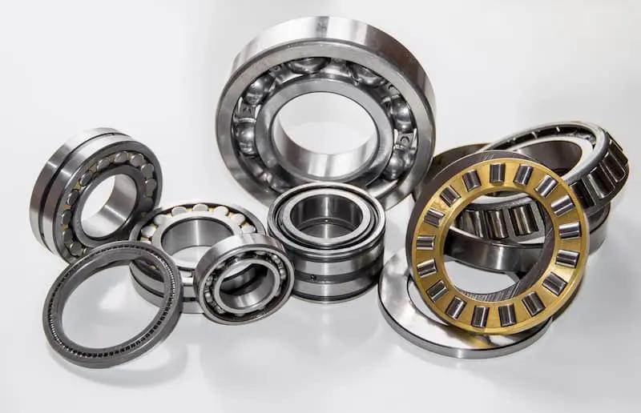
Constrains
MATCHING BALL BEARING AND SOFT IRON ROD SIZES
BACK TO CONTENT PAGE

Slide 14

Constrains
LACK OF EXISTING REFERENCES
BACK TO CONTENT PAGE

Slide 15

Constrains
THE BUDGET
BACK TO CONTENT PAGE

Slide 16
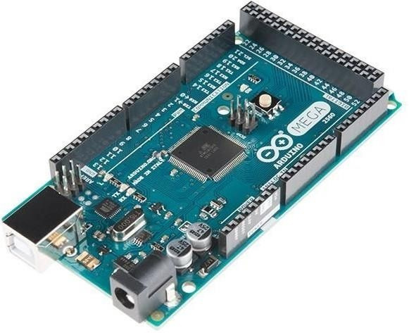
Tools and Technologies
Arduino Mega
BACK TO CONTENT PAGE

Slide 17
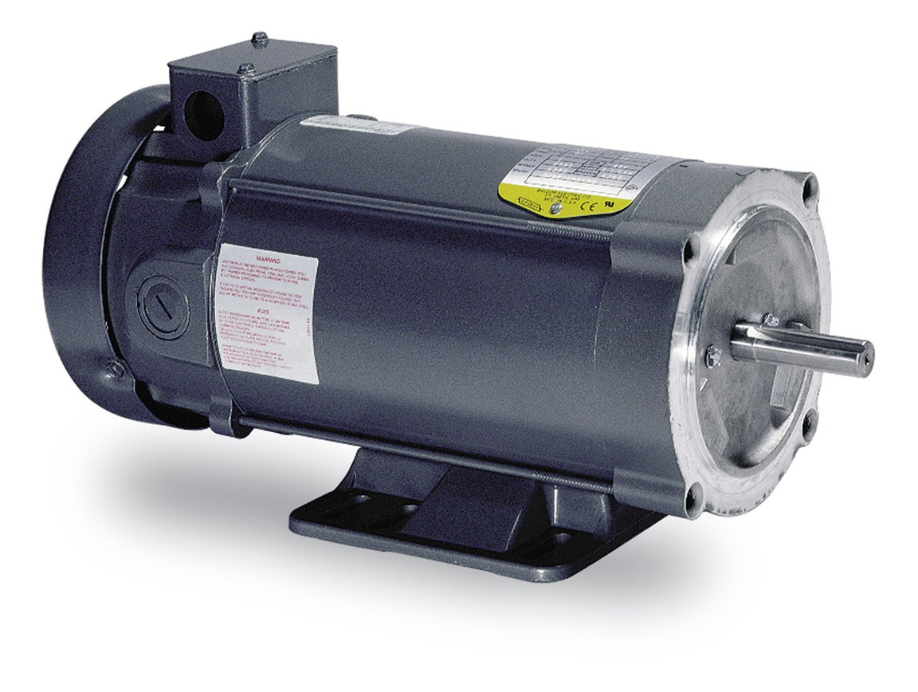
Tools and Technologies
DC Motor
BACK TO CONTENT PAGE

Slide 18
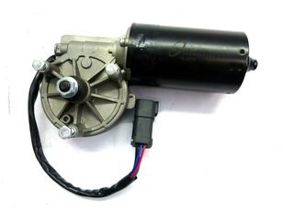
Tools and Technologies
Windshield Wiper Motor
BACK TO CONTENT PAGE

Slide 19
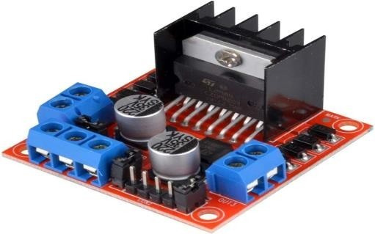
Tools and Technologies
l298n motor driver
BACK TO CONTENT PAGE

Slide 20
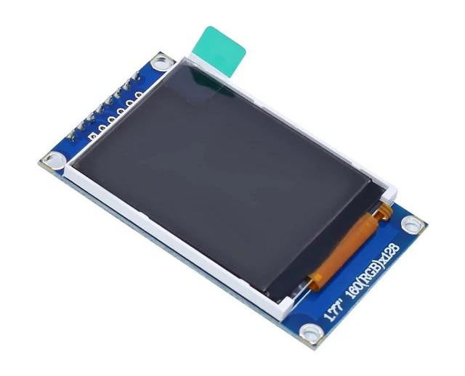
Tools and Technologies
LCD
BACK TO CONTENT PAGE

Slide 21
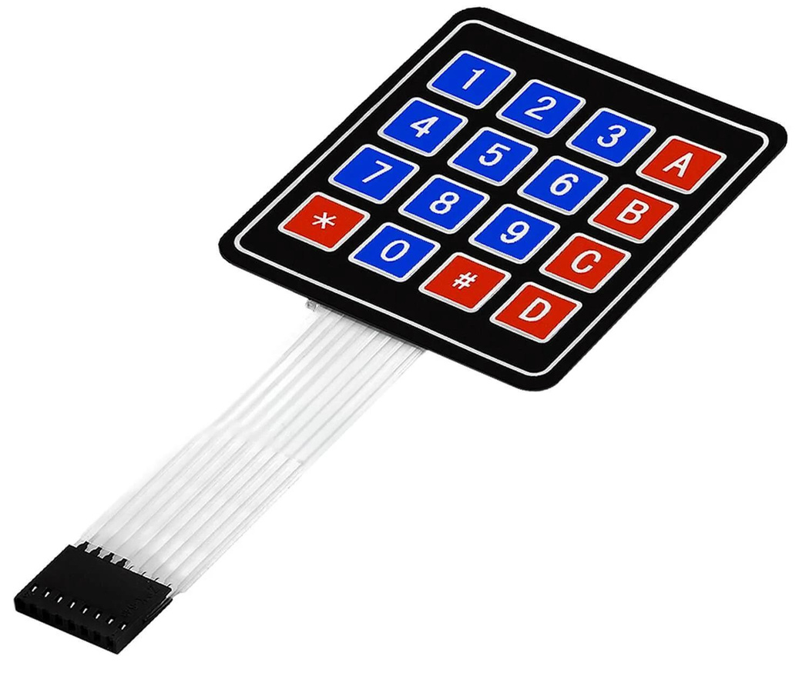
Tools and Technologies
Keybad
BACK TO CONTENT PAGE

Slide 22
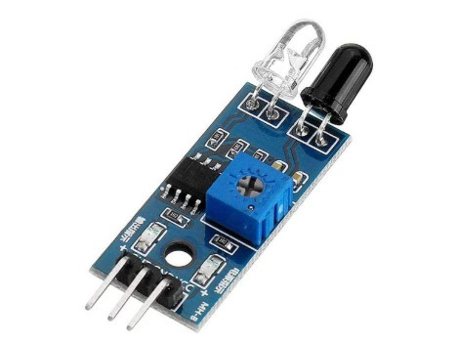
Tools and Technologies
IR Sensor
BACK TO CONTENT PAGE

Slide 23
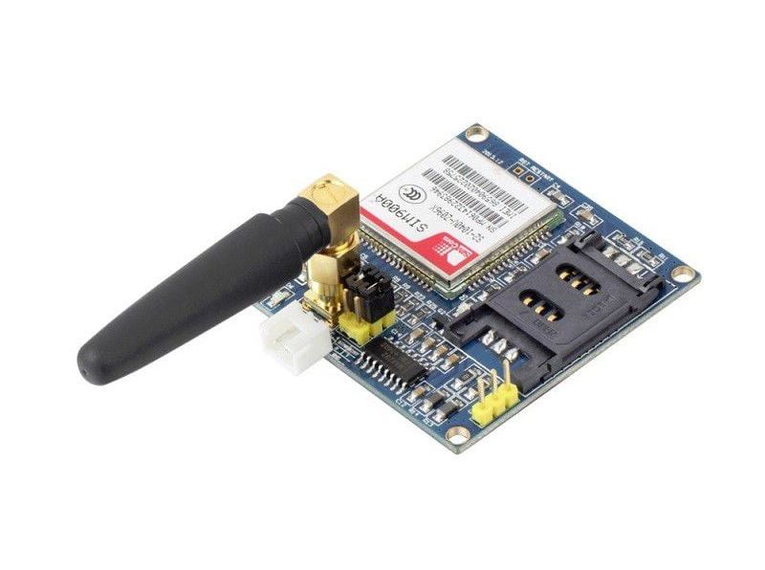
Tools and Technologies
SIM900A
BACK TO CONTENT PAGE

Slide 24
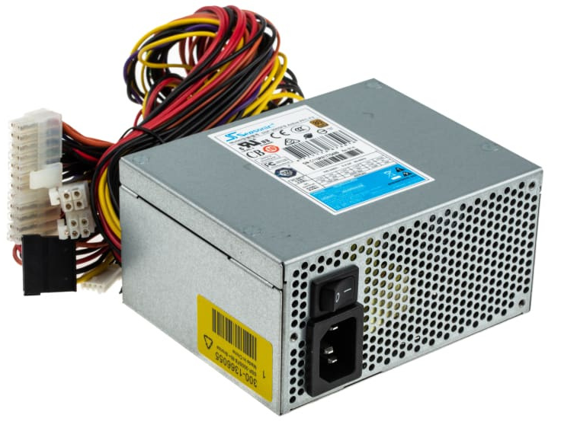
Tools and Technologies
power supply
BACK TO CONTENT PAGE

Slide 25
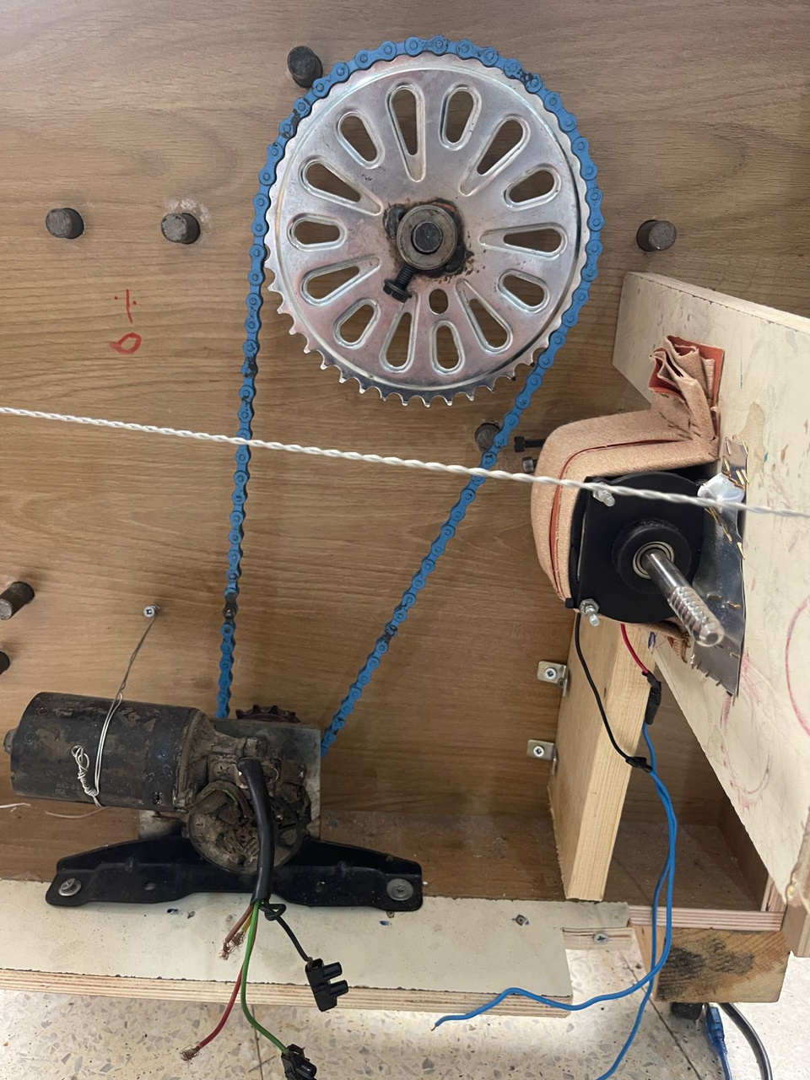
Details of tools uage
Mechanic
BACK TO CONTENT PAGE

Slide 26
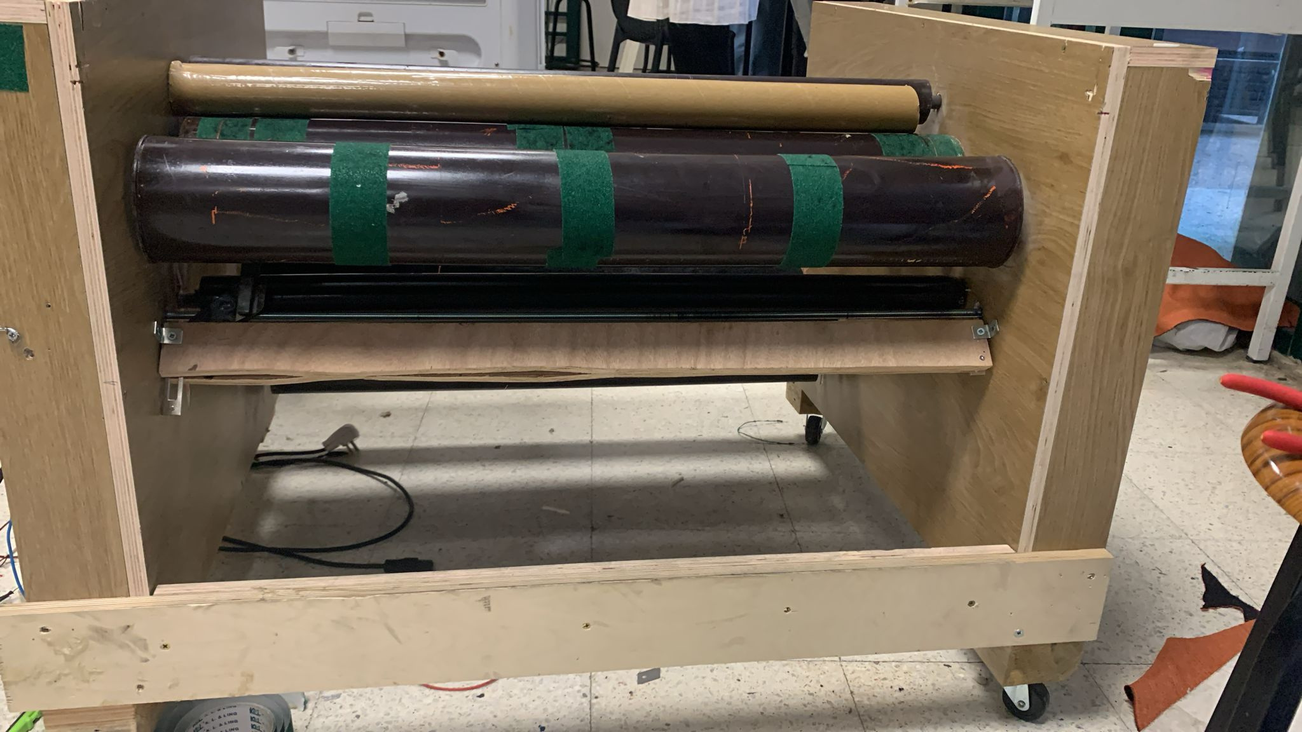
Details of tools uage
DC motor And Cutting part
BACK TO CONTENT PAGE

Slide 27
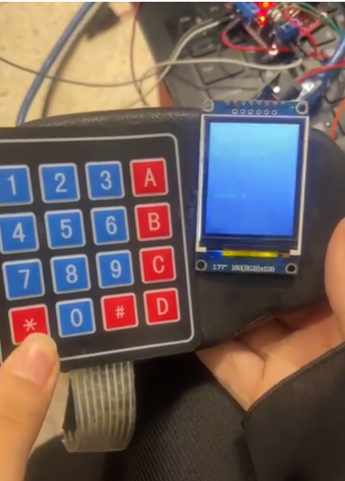
Details of tools uage
user Interface
BACK TO CONTENT PAGE

Slide 28

Conclusion
Impact on Industry and Market Trends
BACK TO CONTENT PAGE

Slide 29

Future Enhancements
Dealing with more one Fabric (more containers)
Fabric CNC (scalable)
Emergency stop
BACK TO CONTENT PAGE

Slide 30

Thank You
Feel Free to Ask Anything

