Slide 1
3ltayer
Presented by: Mohammad Habash
Basssam hillo
Supervisor: Dr. haya sammaneh

Slide 2
Outline
Introduction.
Motivation.
Features.
Technologies.
Methods & Techniques.
Constraints.
Future work & recommendations.

Slide 3
What is 3ltayer
It’s a Android and Web application to manage markets, captains and users and let user order items from markets and track his order in map.

Slide 4
Motivation
Transportation in Palestine suffers from traffic jams.
User face difficulties to track his orders.
User face difficulties to order from markets.
3G Availability.

Slide 5
Features
GPS tracking tool for users.
Manages the distribution of orders to the best captains for it.
Notification system that provides a level of direct notification between the users and captains.
Orders history to display all arrived orders for captains and users..
Traders can add all their markets items.

Slide 6




Technologies

Slide 7
React
JavaScript library used mainly in building front-end interfaces.
React applications are written using JSX.
Facebook developed React to support browsers.
React can be used to develop the whole app or just a single page for mobile or web application.

Slide 8
Firebase
Firebase Real-time Database is a cloud-hosted database.
Data is stored as JSON and synchronized in real-time to every connected client.
It stores and syncs data with our NoSQL cloud database.
Data is synced across all clients in real-time, andremains available when our app goesoffline.

Slide 9
Android( Java, XML )
Java object oriented programming language.
Java cross-platform language that can be run on any platform in other words.
many applications were written in Java, with many libraries and tools available to help developers.
XML, which is a markup language that denes a set of rules for encoding a human-readable and machine-readable document.
XML was chosen mainly because it is familiar and is supported by a number of IDEs.

Slide 10
Methods & Techniques
Registration.
Home page & Navigation.
Notification system.
Database.

Slide 11
Registration

Slide 12
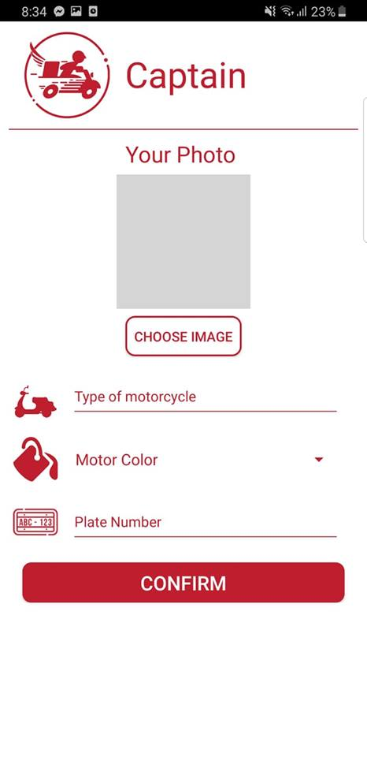

Slide 13
Home & Navigation

Slide 21
Notification System

Slide 22
Database

Slide 23
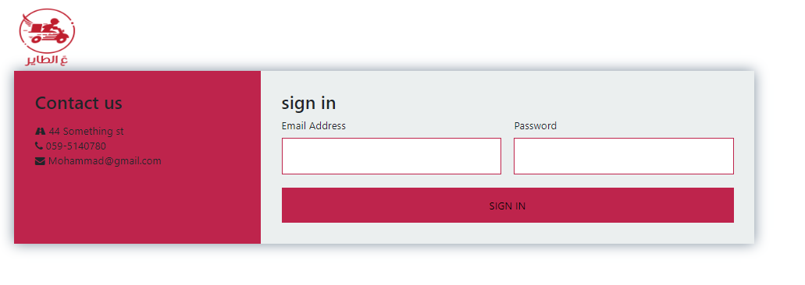

Slide 28
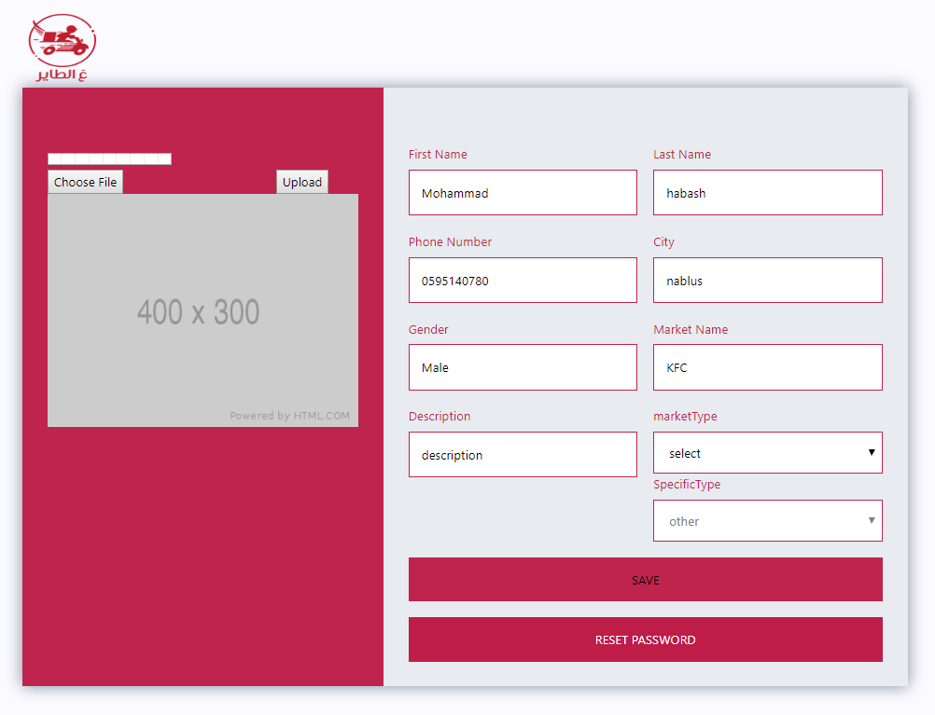

Slide 29
Constraints
Shortage of Time.
React setup is tedious and annoying.
Documentations: most of react documentations were about basic concepts.
A lot of things we needed to learn:
  Android Studio: to test and build our app.
  JSX: To produce react components, render elements, etc.
  ES6: We only have basic familiarity with the JavaScript syntax.

Slide 30
Future work
Make chat between user and captain.
Notify market to prepare the order.
Evaluate users and captains.

Slide 31
Thank You

