Slide 1

An-Najah National University
Faculty of Engineering & Information Technology
Department of Building Engineering
Graduation Project (2)
Assessment and Redesign of Nablus municipality
Students:
Ali Darawsheh , Islam Daraghmeh , Moath Zeedan , Nu’man hamed
Supervisor :Dr. Narmeen Al-Barq

Slide 2
Outline :
Project Description.
Architectural Aspects
Environmental Aspects
Structural Aspects
Electro-Mechanical Aspects
Cost estimation

Slide 3
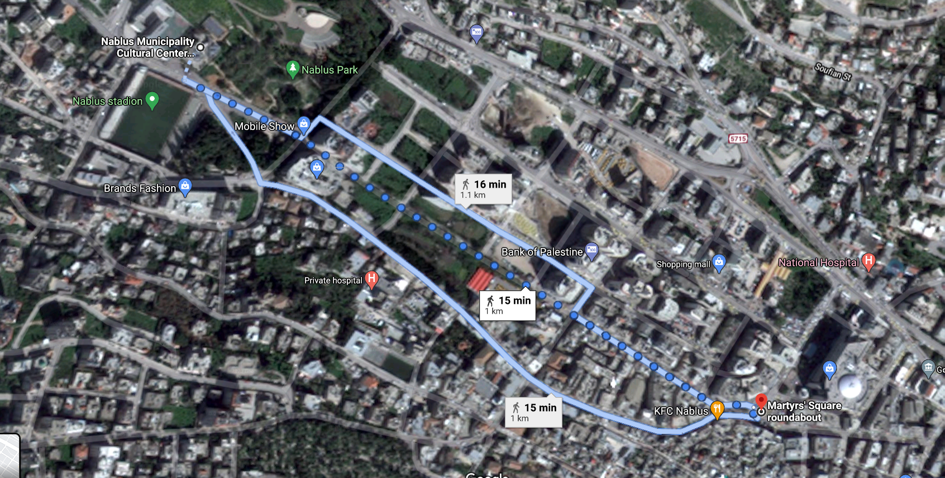
Description of the project :
Location :
The location of the Nablus municipality, one kilometer west of the Martyrs Square roundabout, according to the photo.

Slide 4
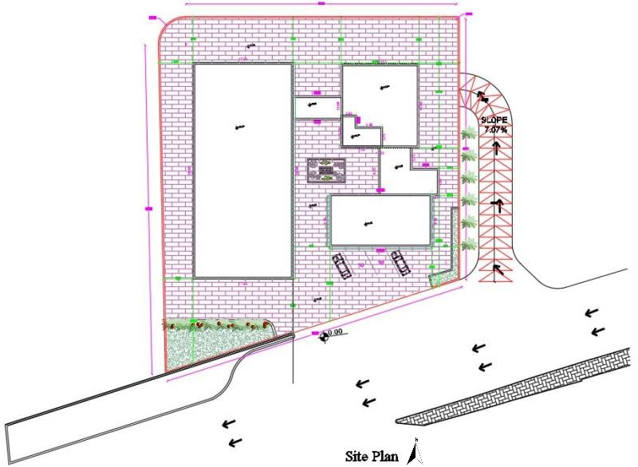
Architectural aspects
Site Plan
Before redesign

Slide 5
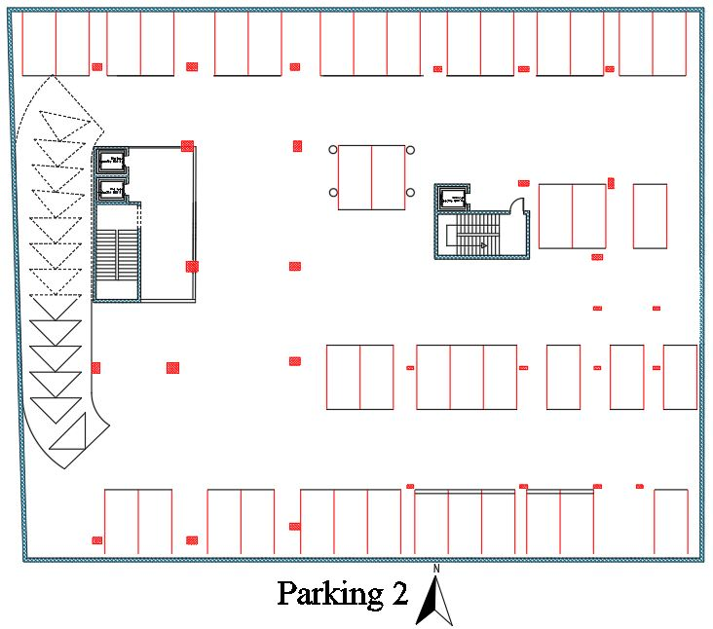
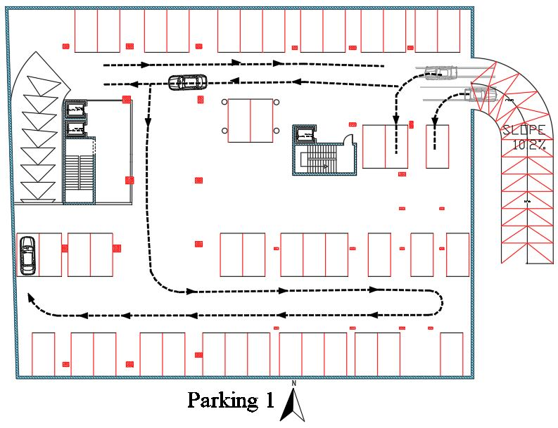
Architectural aspects
Parking floor

Slide 6
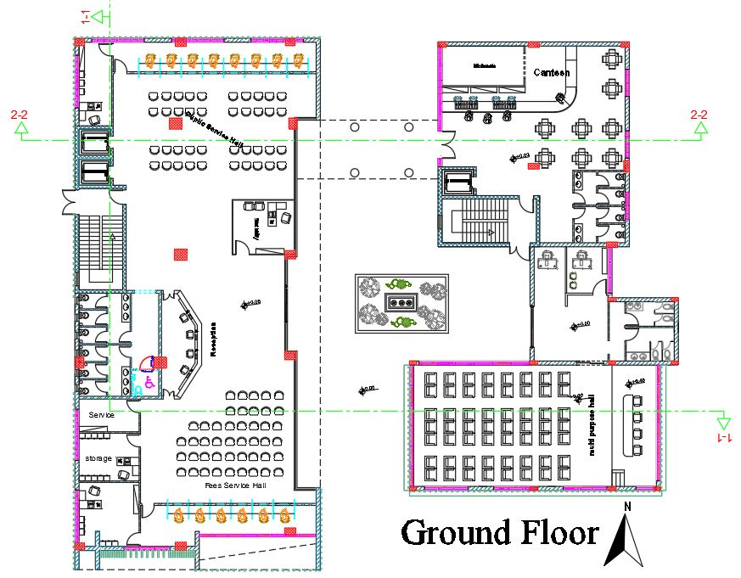
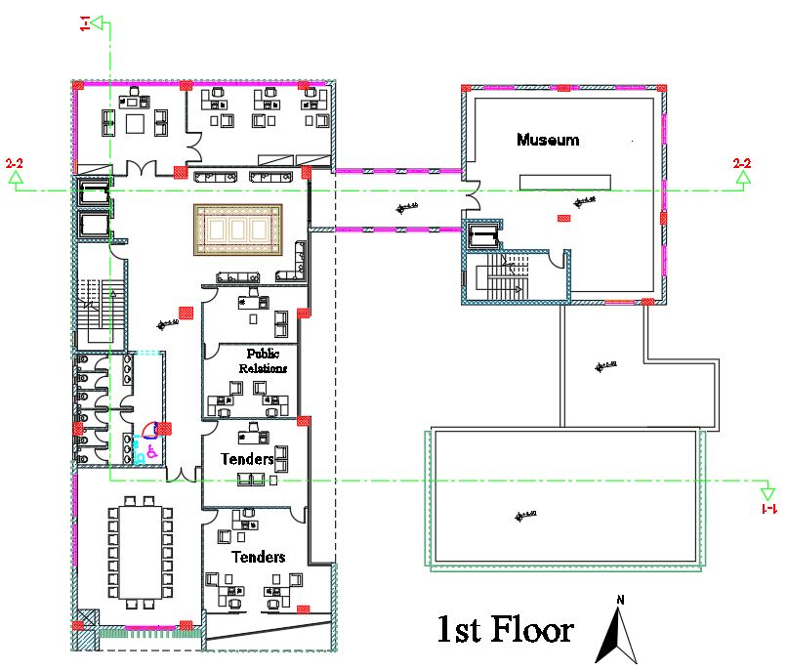
Architectural aspects
Ground floor plan
First floor plan

Slide 7
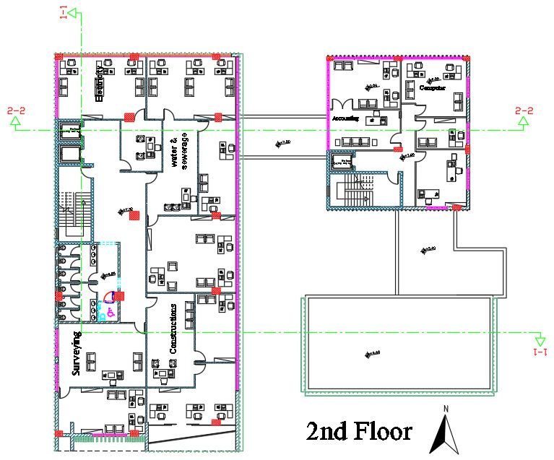
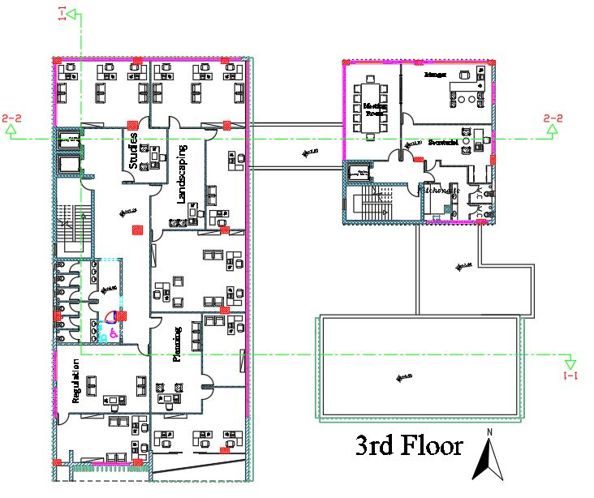
Architectural aspects
Second floor plan
Third floor plan

Slide 8
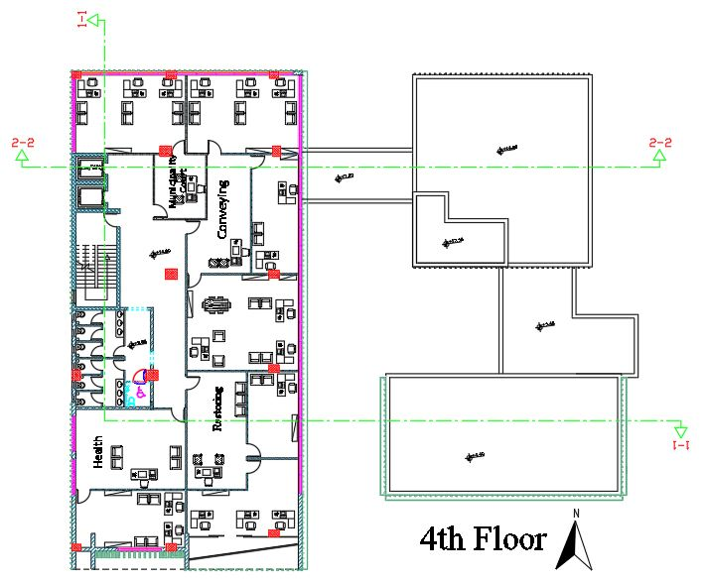
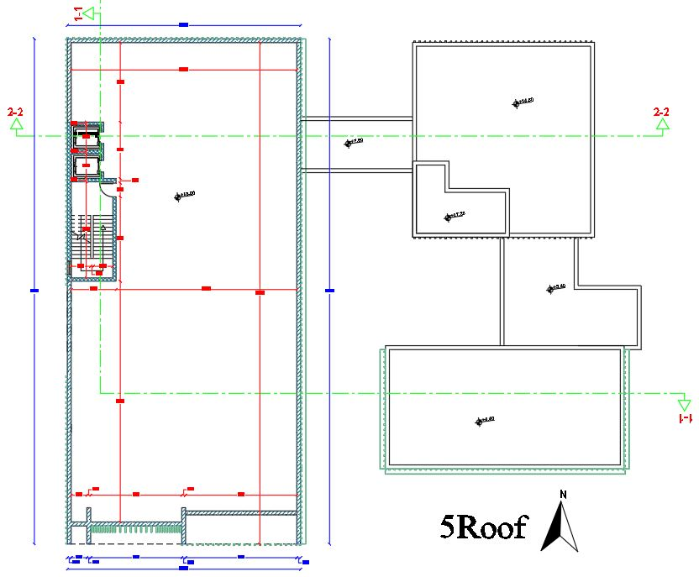
Architectural aspects
Fourth floor plan
Roof floor plan

Slide 9
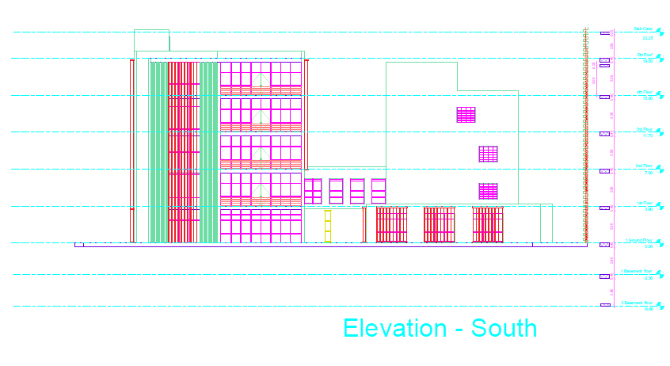
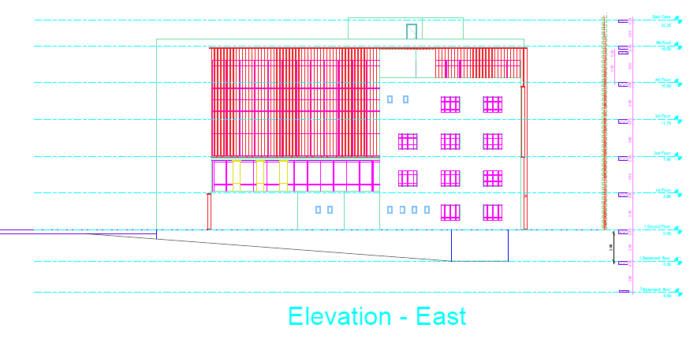
Architectural aspects
South Elevation
East Elevation

Slide 10
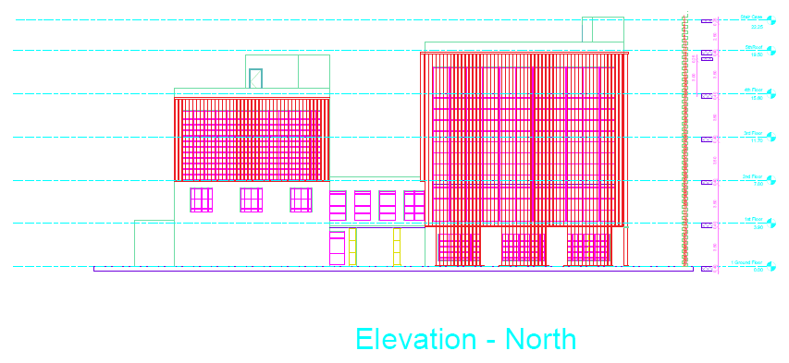
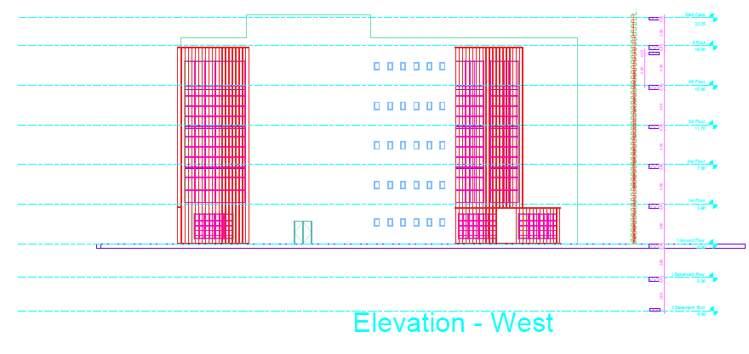
Architectural aspects
North Elevation
West Elevation

Slide 11
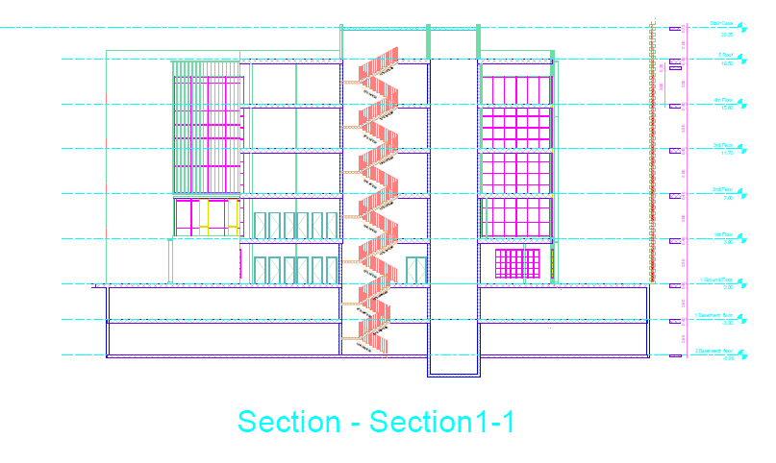
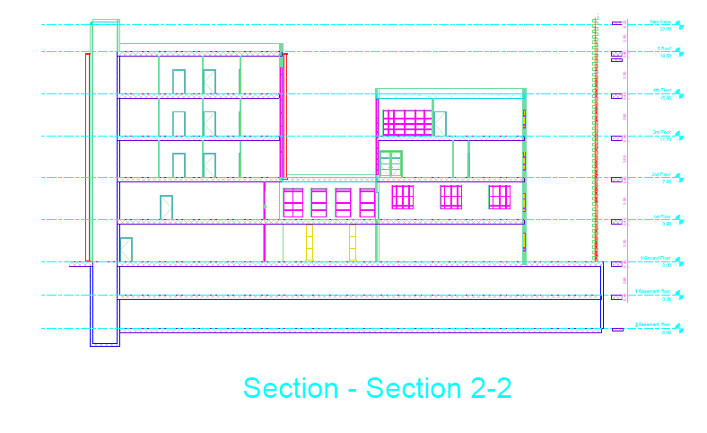
Architectural aspects
Sections : The levels were modified so that the parking was a height of 2.5 m, the height of the ground floor 4m, and the height of the remaining floors 3m
Section 1-1
Section 2-2

Slide 12
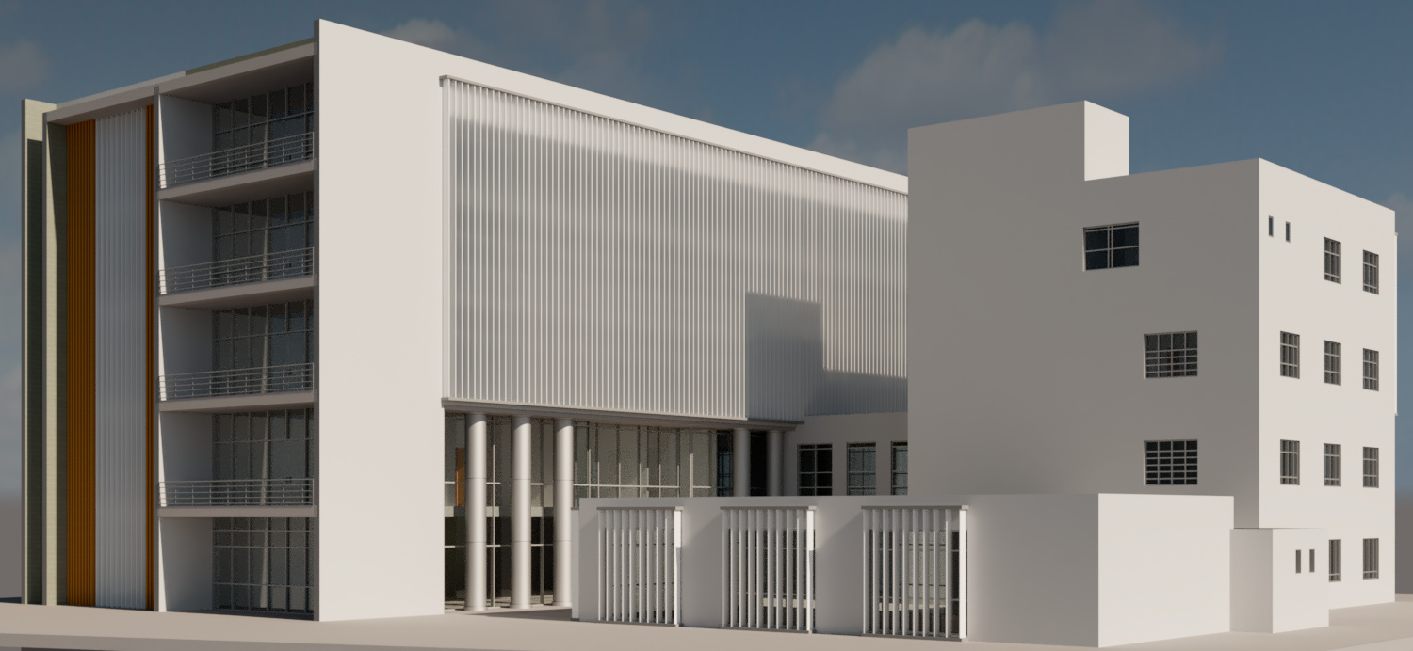
Architectural aspects
3D model

Slide 13
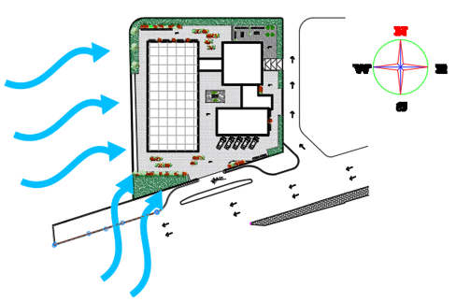
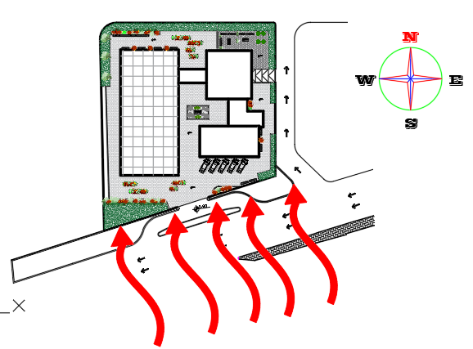
Environmental analysis and evaluation
Site analysis
Wind direction : the general direction in our country is from the south-west direction.
The noise: mainly from the street and from the municipality's stadium.
The orientation of building The municipality's address is south-west at an angle of 205 degrees.

Slide 14
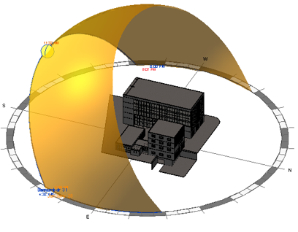
Environmental analysis and evaluation
Site analysis
Sun path the sun moves from east to west passing through the south. Therefor, the south west facade will be the one which exposed the most sun heat.

Slide 15
Environmental analysis and evaluation
Shading system
According to the path of the sun, the whole building is exposed to the sun's rays and the reason for that is because the walls are curtain walls, so that Shutters and Louvers were used as a shading system.

Slide 16
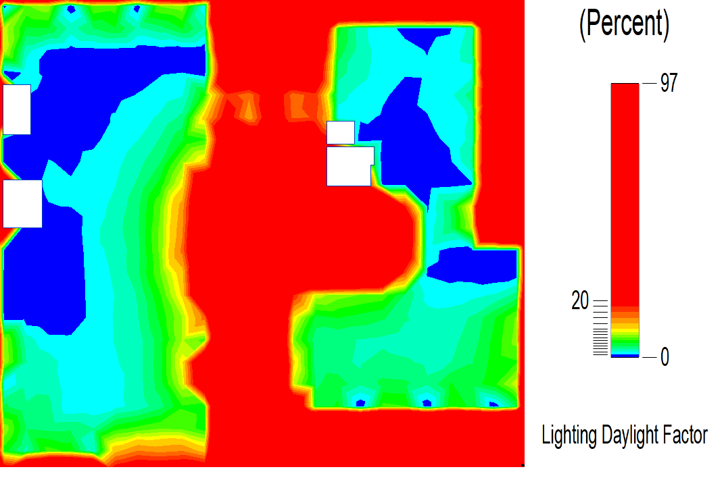
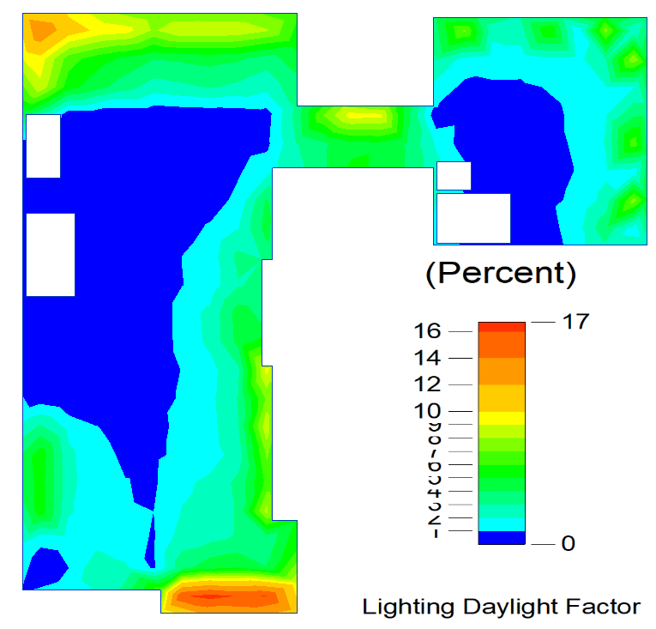
Environmental analysis and evaluation
Day-light Factor
Ground floor
First floor

Slide 17
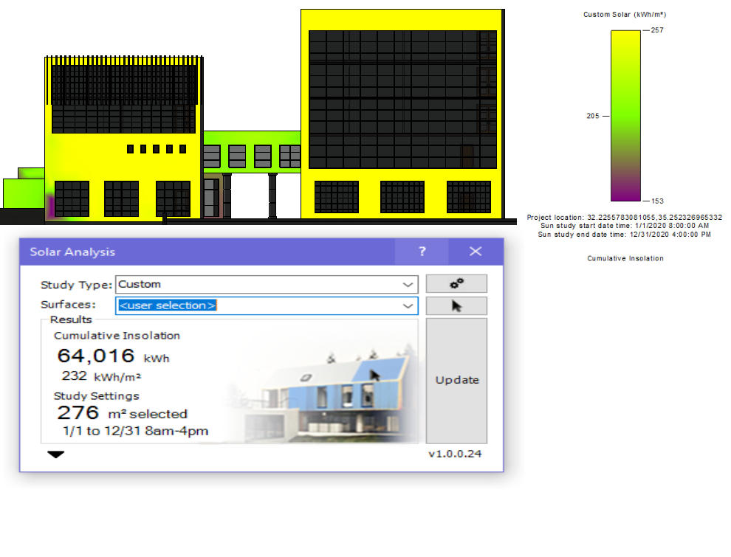
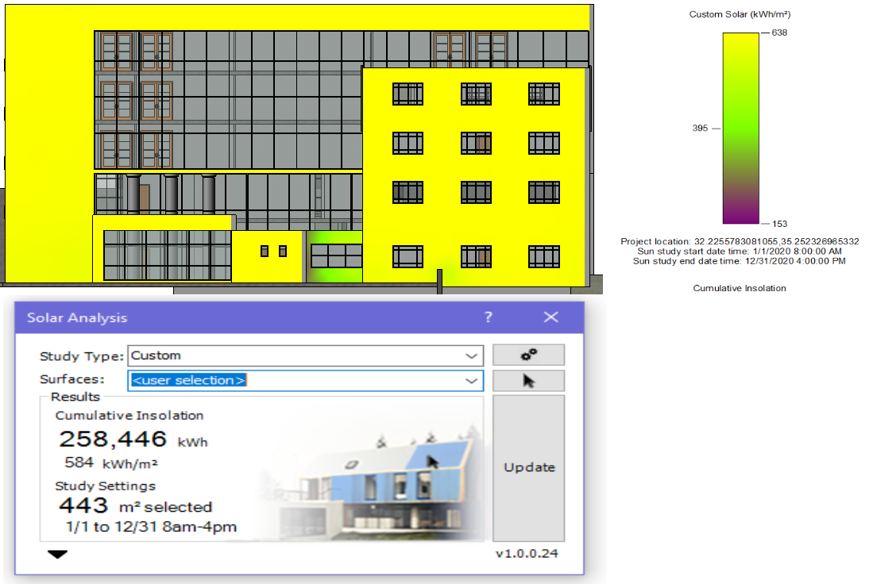
Environmental analysis and evaluated
Solar radiation on the elevation
North elevation
East elevation

Slide 18
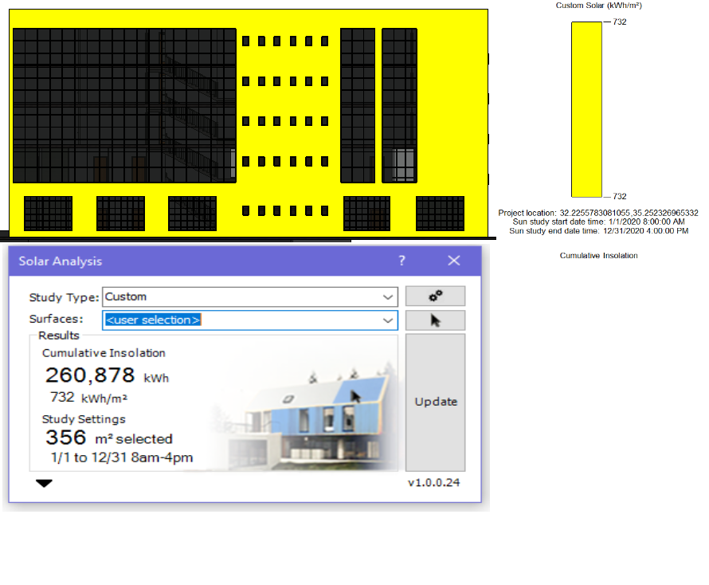
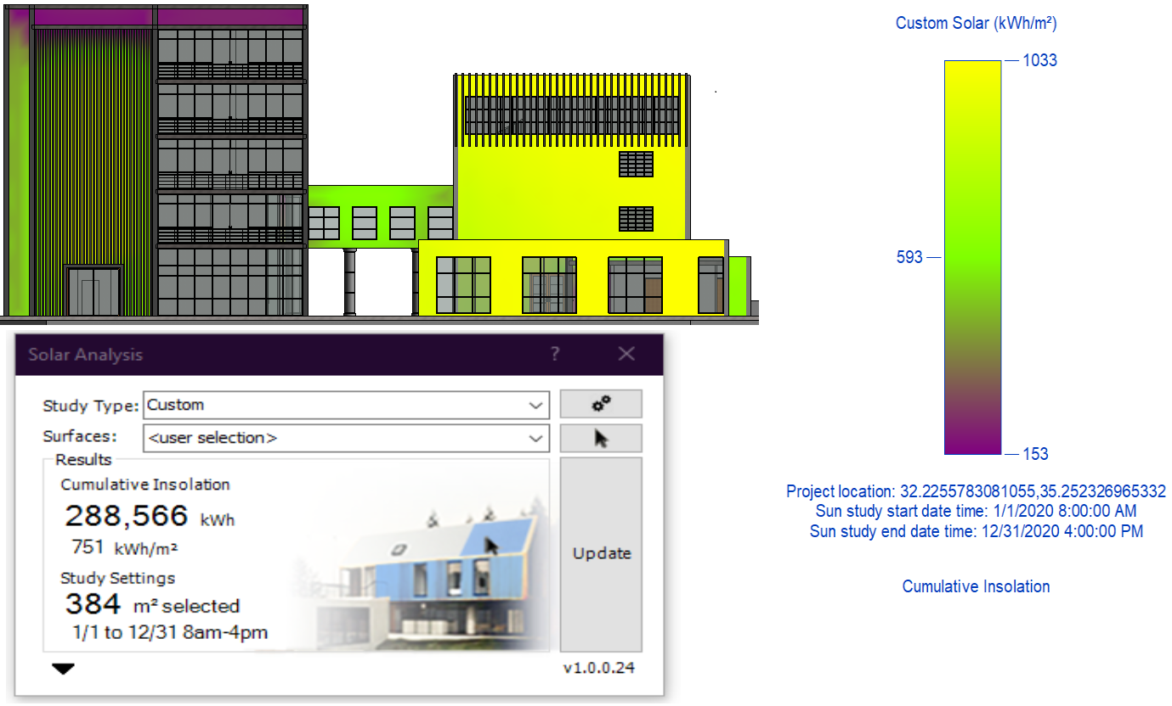
Environmental analysis and evaluated
Solar radiation on the elevation
South elevation
West elevation

Slide 19
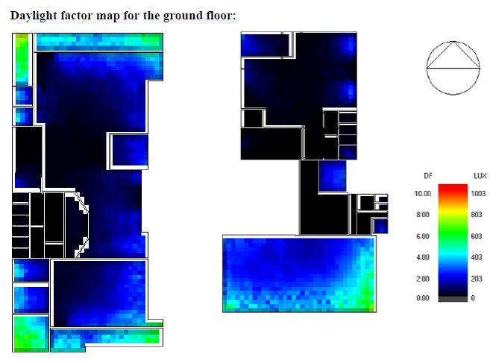
Daylight factor from Design Builder

Slide 20
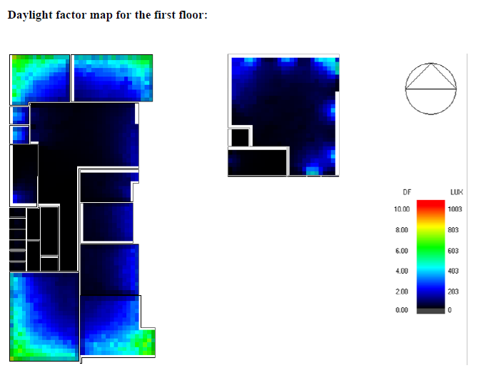

Slide 21
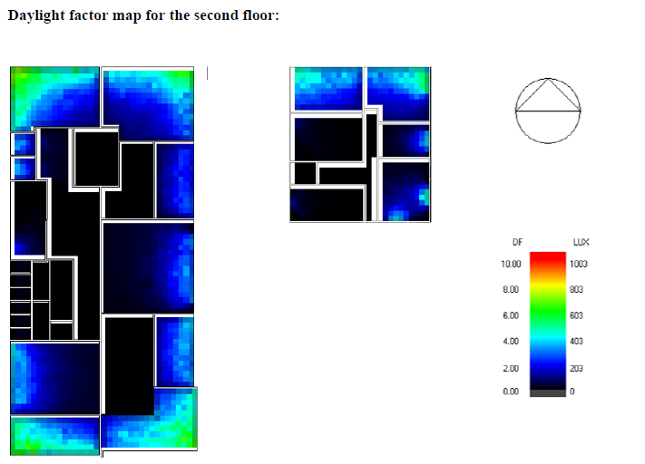

Slide 22
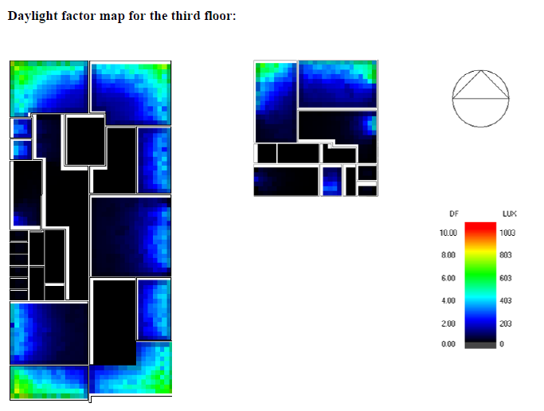

Slide 23
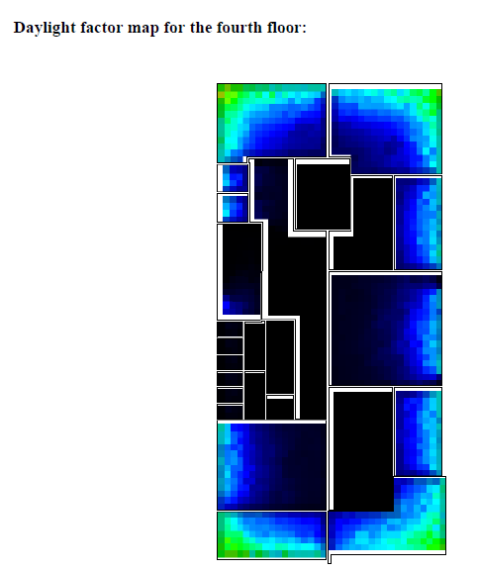

Slide 24
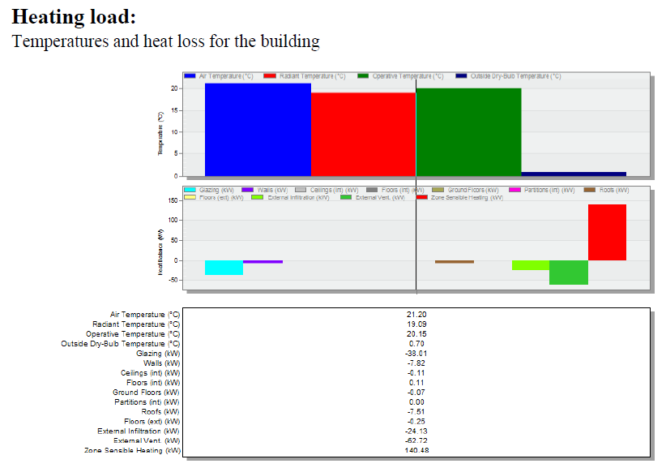
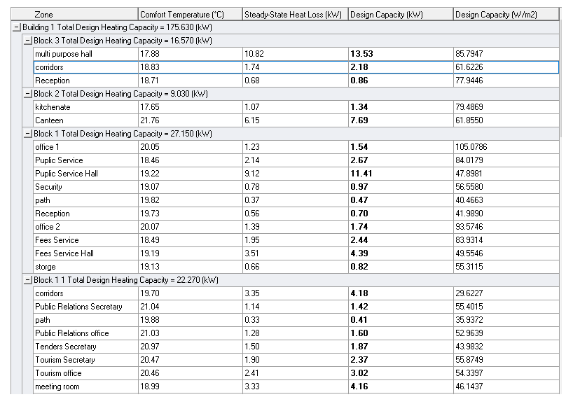
Heating load

Slide 25
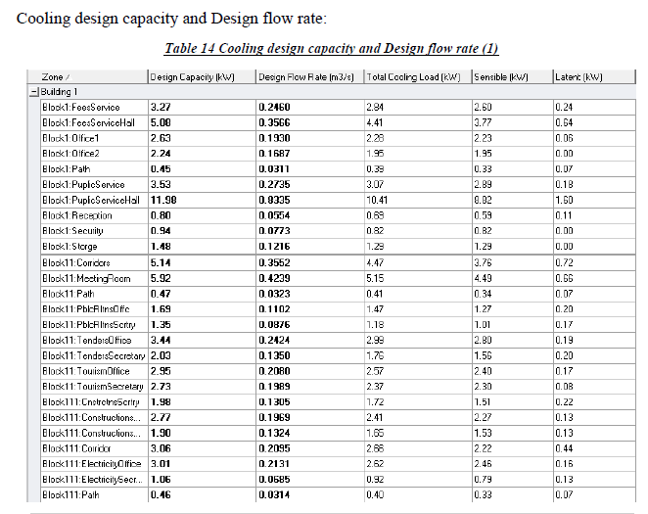
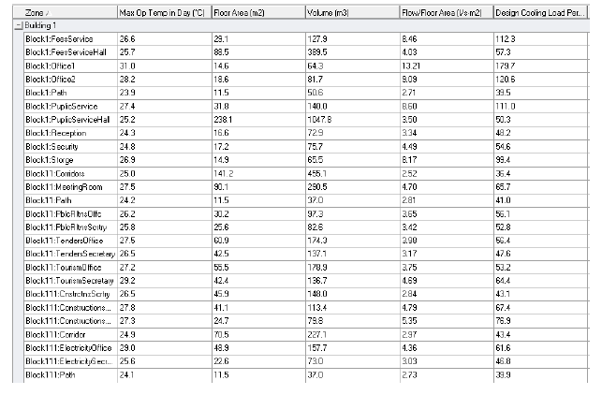
Cooling load

Slide 26
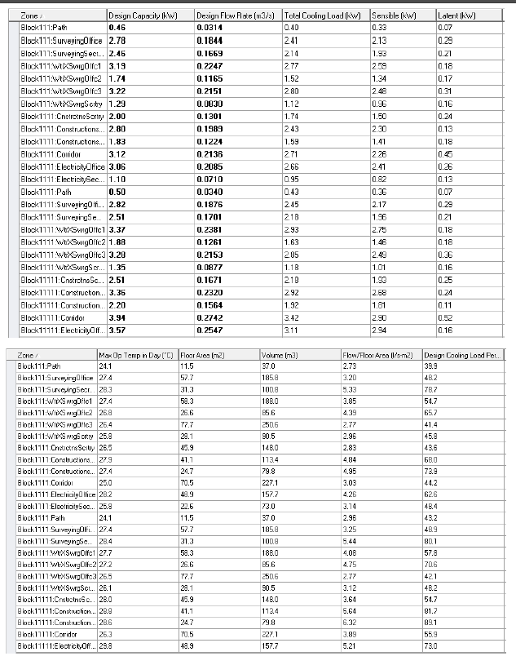
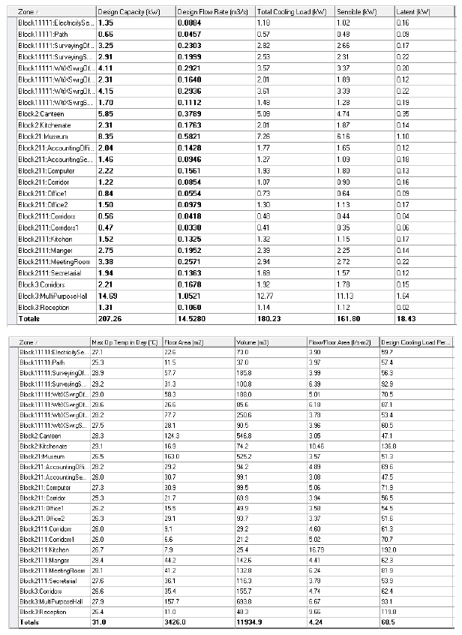

Slide 27
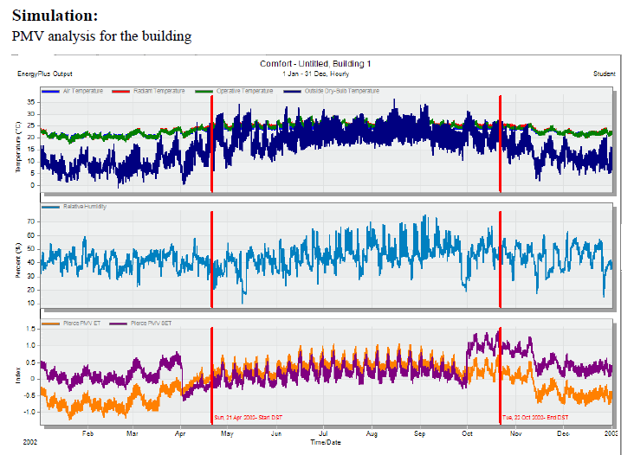
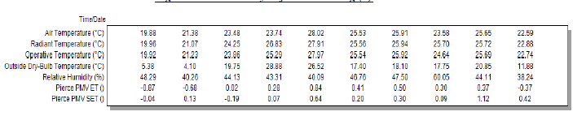

Slide 28
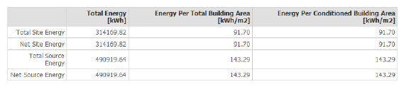
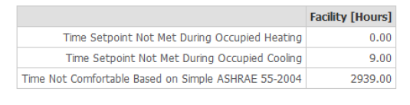
The total energy for the building = 91.79
Time not comfortable for the building = 2939

Slide 29
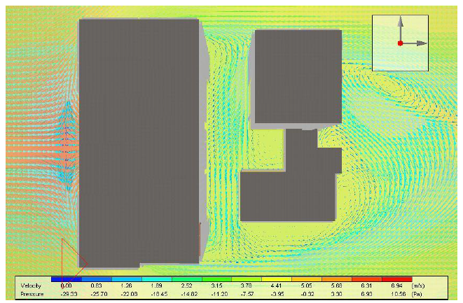
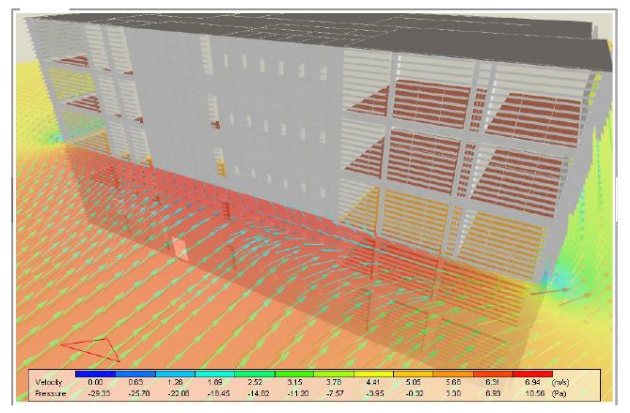
External CFD Top view
External CFD horizontal section

Slide 30
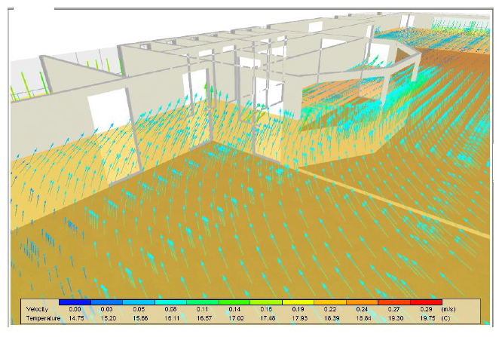
Internal CFD horizontal section

Slide 31
Structural analysis
General information
Design code :
American Concrete Institute ACI 318
International Building Code (IBC-2012).
Uniform Building Code (UBC 97)
Materials :
Concrete.
f´c = 24 Mpa.
specific weight of Reinforced concrete (Ɣ) = 25 KN/m³
specific weight of voided (Ɣ) = 1.18 KN/m³
Steel
Fy = 420 Mpa

Slide 32
Structural analysis
General information
Loads
Live Load= 3 KN/m²
Live Load of parking = 5 KN/m²
Superimposed dead load = 4 KN/m² (assumed)
Weight of Masonry wall = 18 KN/m (assumed)

Slide 33
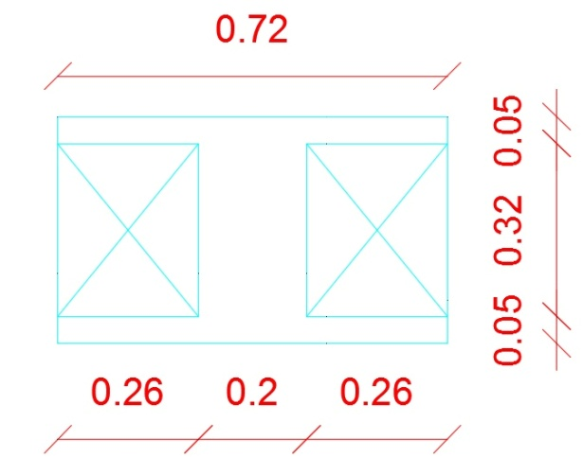
Structural analysis
Structural element used
- Slab:
Voided slab with thickness of 42 cm .
- Columns:
The columns are dimensional for :
Block 1 : Interior: (0.9, 0.8), Edge :( 0.6, 0.8), Corner :( 0.5, 0.7)
Block 2 : Interior: (0.4, 0.8), Edge :( 0.4, 0.8), Corner :( 0.4, 0.6)
Block 3 : Interior: (0.25, 0.5), Edge :( 0.25, 0.6), Corner :( 0.25, 0.5)
- Shear walls:
Thickness 30 cm for walls.

Slide 34
Structural analysis
Structural element used
- Main beams:
The main beams dimensions are assumed to be 0.70m depth and 0.7m width .
- Footing:
Footing used: mat foundation

Slide 35
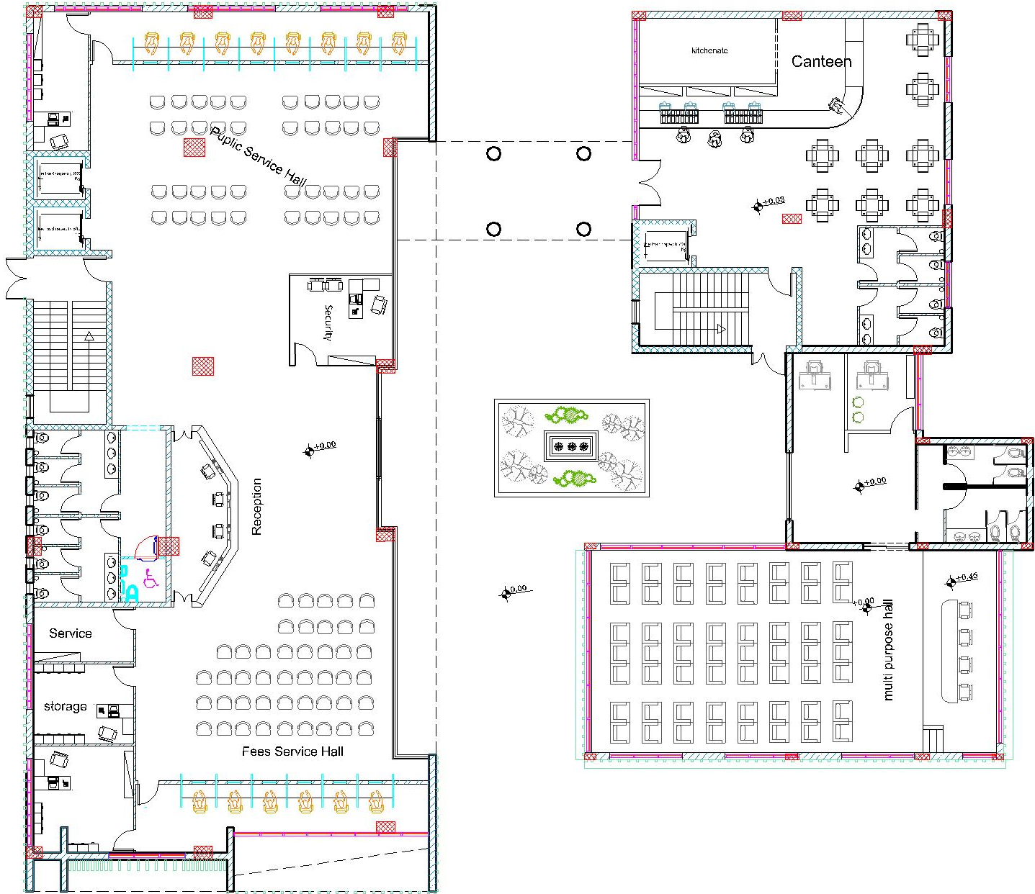
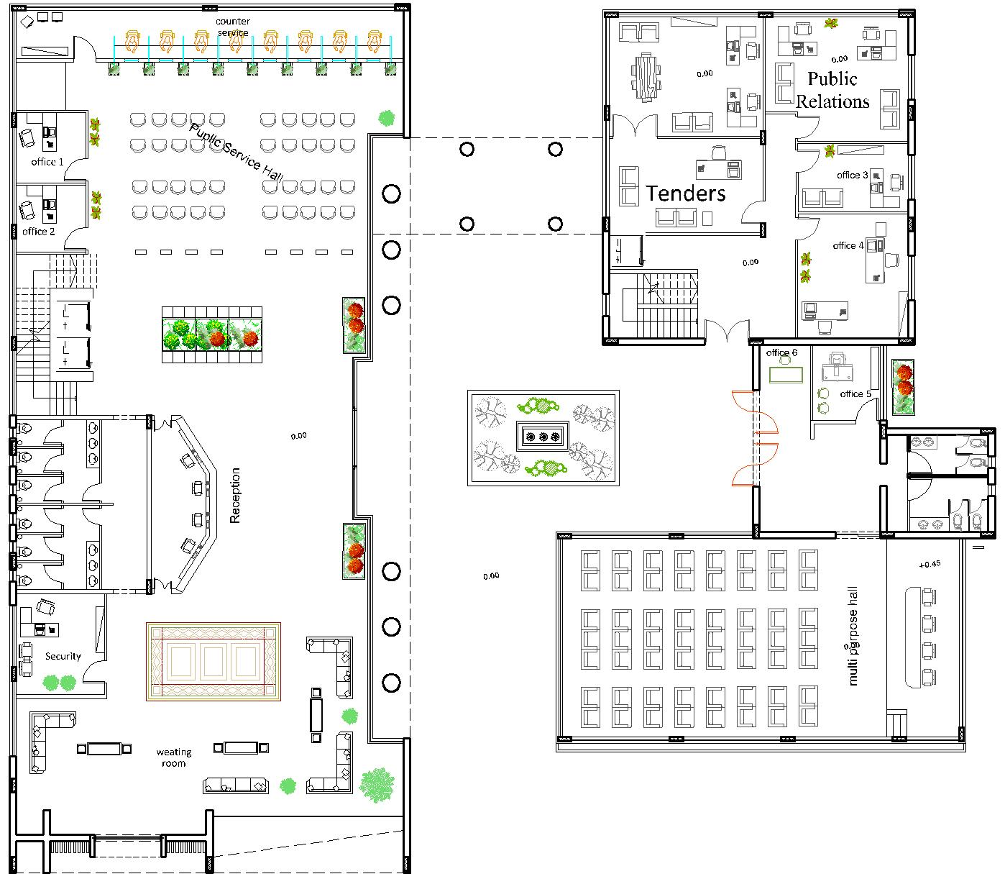
The structural layout after redesign The structural layout before redesign

Slide 36
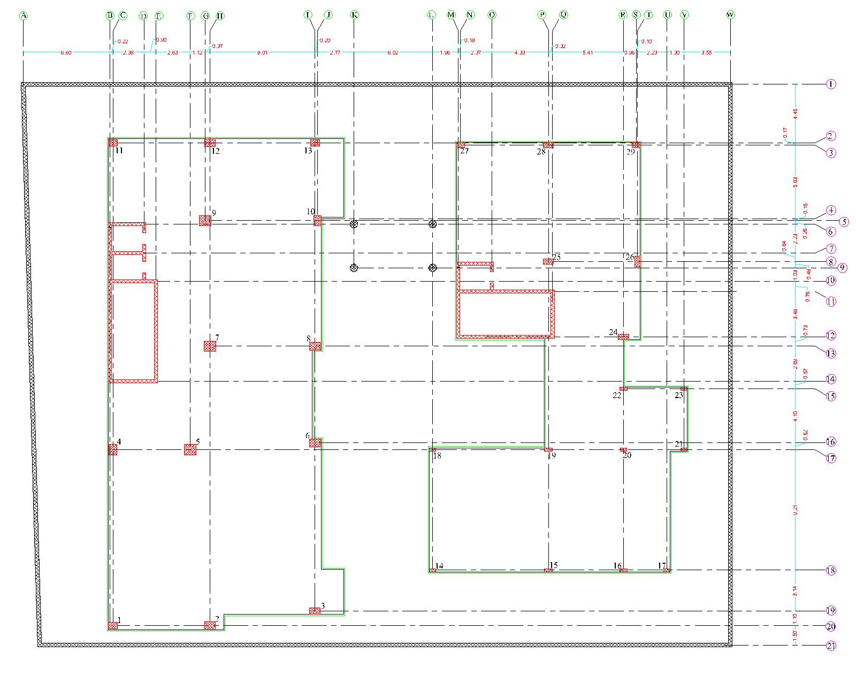
Structural analysis
Structural layout for the building after redesign
Columns center lines after redesign

Slide 37
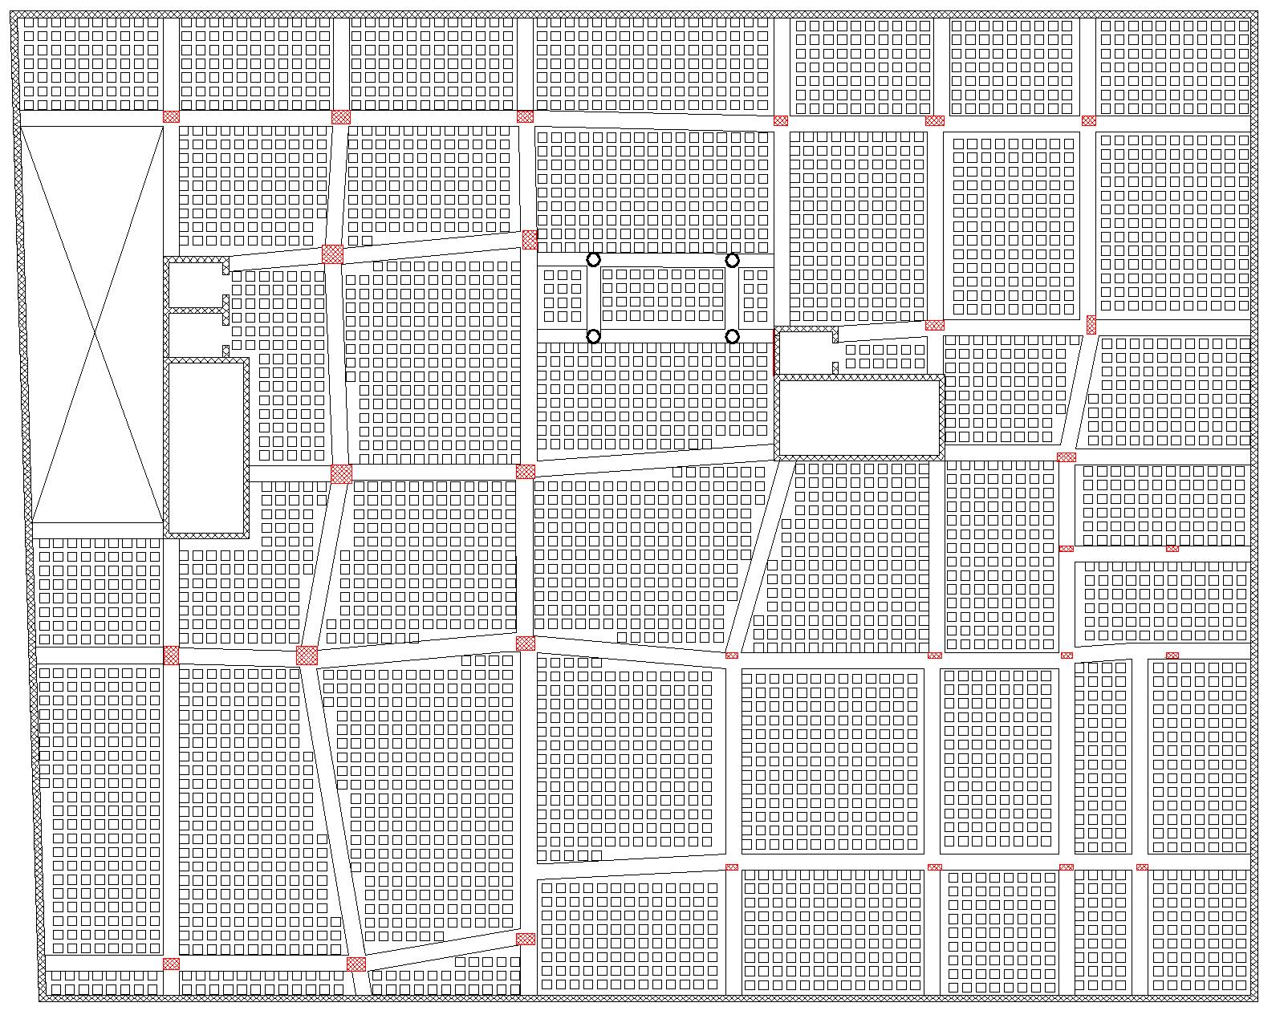
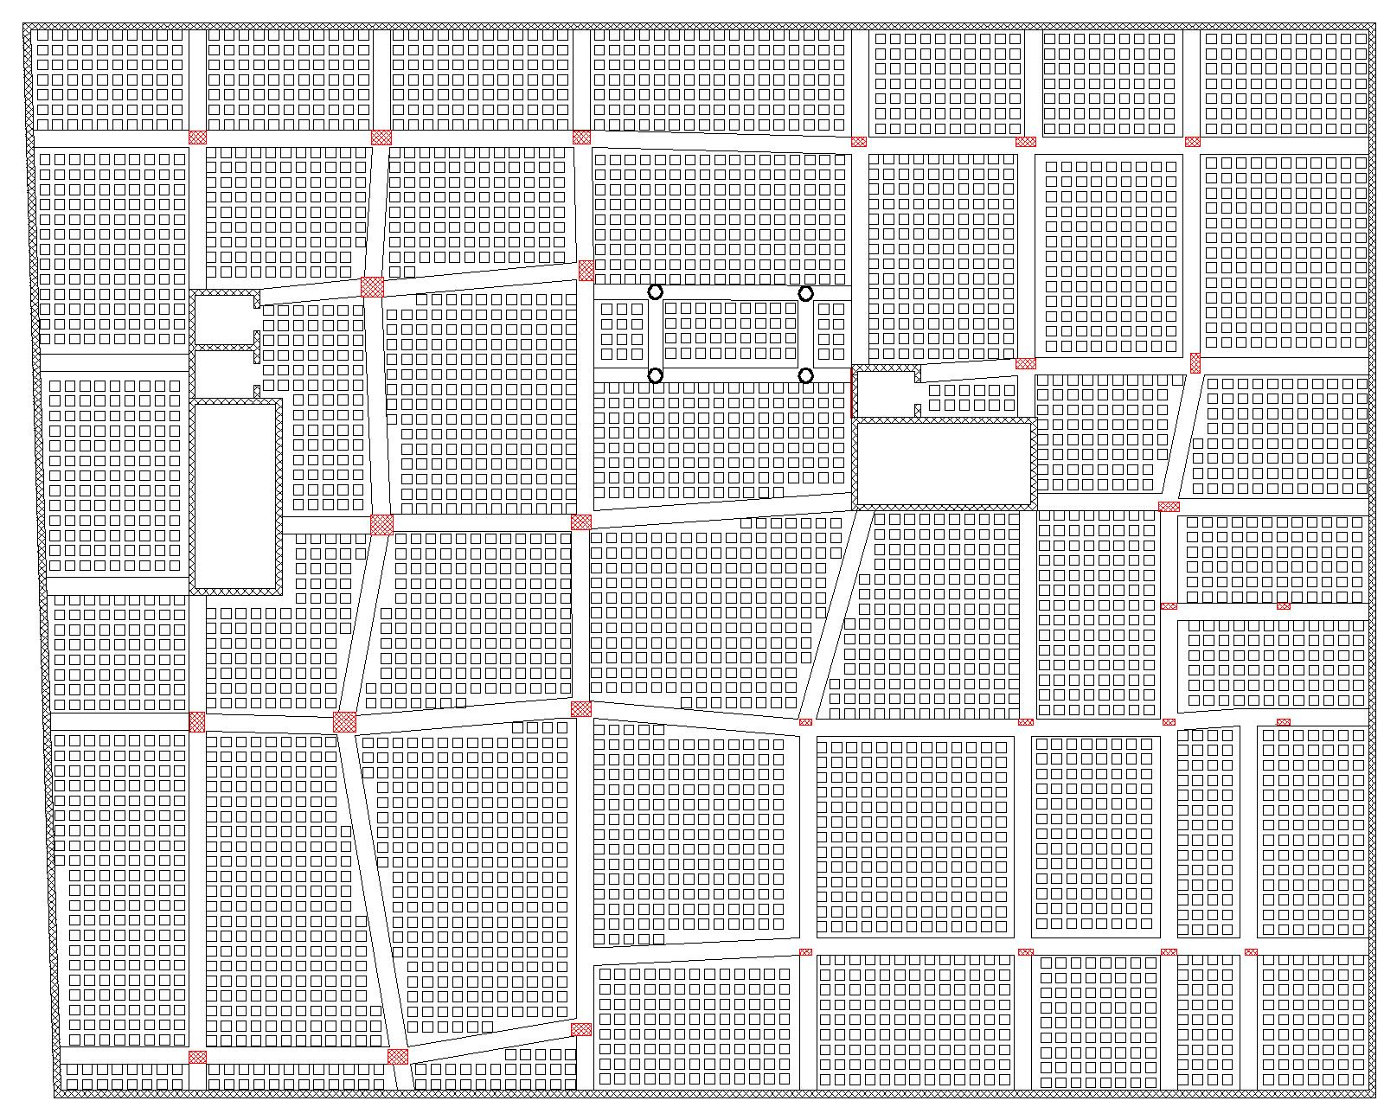
Beam and slab Layout
Parking floor (1)
Parking floor (2)

Slide 38


Beam and slab Layout
Ground floor
First floor

Slide 39


Beam and slab Layout
Second floor
Third floor

Slide 40

Beam and slab Layout
Fourth floor

Slide 41

Structural analysis
Structural ETABS model
Figure :3D model from ETABS

Slide 42
Structural analysis
ETABS checks
All checks will be done to make sure that the work was done properly
according to ACI which is :-
Deflection check.
Compatibility check.
Equilibrium check.
Internal forces check.

Slide 43

Deflection check:
Critical span length =13.05m
Deflection limit (Δ) = $\frac{13.05}{0.24}$ = 54.375 mm
From ETAB Deflection = Uz = 13 mm
The deflection in slab does not exceed the limit.

Slide 44

Compatibility check
Compatibility check was done on ETAB, all element are moving together.

Slide 45

Equilibrium check
Table :Base reactions from ETAB
Table :Equilibrium check
Loads | ETABS (KN) | Parts | Manual | %Error
Live | 31480.51 | Slabs | 32371.65 | 2.83%
SID | 45952.588 | Slabs | 33,264.71
 |  | Wall | 13,611.60
 |  | Total | 46,876.31 | 2.01%
Dead | 94130.2 | Slabs | 50055.47
 |  | Columns | 6035
 |  | Beams | 14334.4
 |  | Shear walls | 20269
 |  | Total | 90693.87 | 3.65%

Slide 46

Internal forces check
Column 5:
From ETAB ultimate axial force = 13418.1067 KN.
Column weight =567 KN.
Slab weight = 10367.28 KN.
Beam weight = 1947.46 KN.
Total manual = 12881.74 KN.
% error = 3.997% < 10% … Ok

Slide 47

Beam:
Moment from ETAB = 404.605 KN.m.
Manual:
Moment (form beam) = 97.98 KN.m
Moment (form external walls) = 116.64 KN.m
Moment (form slab) = 206.99 KN.m
Avg. = 421.6147 KN.m
% error = 4.2% < 10% … Ok

Slide 48

Seismic design
Seismic loads will be calculated depending on IBC-2012 and UBC-97 codes
Project location in (Nablus), Soil bearing capacity = 200 KN/m²
Seismic zone is 2B, the value of zone factor (Z=0.2)
Soil profile type : SC
I = 1
R = 5.5
Cv = 0.32
Ca = 0.24
Period check:
T = 0.59 sec.
T _{limit} = 1.4 * T = 1.4 * 0.59 = 0.831 sec.
period check is ok

Slide 49


Drift check:
According to the UBC code the max drift check ΔM (drift) = 0.7 * R * Δ_{S}
Drift allowable = 0.02 * story height.
Drift check is ok.
Base shear check:
Error = 0.433 % < 1% , check is ok.
49

Slide 50



Slabs Design:
Voided slab with thickness 42 cm
Stair slab for block 1 with thickness 25 cm
Stair slab for block 2 with thickness 25 cm

Slide 51


Reinforcement of Voided slab:
Second Basement Floor slab
first Basement Floor slab

Slide 52


Reinforcement of Voided slab:
Ground Floor slab
First Floor slab

Slide 53

Reinforcement of Voided slab:
Second Floor slab
Third Floor slab

Slide 54
Reinforcement of Voided slab:
Fourth Floor slab

Slide 55

Reinforcement of Stair slab:
Stair slab

Slide 56
Beams Design
Steel Reinforcement of beams for basement frames :-

Slide 57
Beams Design
Steel Reinforcement of beams for basement frames :-

Slide 58
Beams Design
Steel Reinforcement of beams for Ground Floor frames :-

Slide 59


Detailing for cross- section of the Frame

Slide 60


Columns Design
Design of column 1:
Dimensions: 700mm * 500mm
ρ = 0.01
As = ρ * Ag = 0.01 * 700 * 500 =3500mm².
Use 14 Ø 18 .
Use stirrups 2 Ø 10mm/15 cm.

Slide 61



Design of columns 2 - 9:

Slide 62


Design of the stairs
Load on slab = (1.2D+1.6L)
DL = 5 KN/m².
LL = 3 KN/m².
SID = 4 KN/m².
Load on slab = 15.6 KN/m².
Figure : Stairs plan
Figure : Section in the stairs (Section A-A)

Slide 63


Design of retaining wall
Unit weight of concrete (ɣ concrete) = 25 KN/m³.
Unit weight of soil (ɣ soil) = 18 KN/ m³.
Friction angle of soil = 35 ̊.
Bearing capacity of soil = 200 KN/$m^{2}$.
Figure : Results from Prokon program
Figure : Reinforcement of retaining wall

Slide 64


Design of shear walls:
Table : area steal of shear wall from ETABS program
Vertical reinforcement:-
A_{s} = (44659/34.809) = 1282.97 mm2 /m
A_{s} = 7 Ø 16/m
Table : shear design of shear wall from ETABS program
Horizontal reinforcement:-
A_{s} = 1042.80mm2 /m
A_{s} = 7 Ø 14/m

Slide 65


Design of shear walls:
Figure : Reinforcement of shear wall (Horizontal section)
Figure : Reinforcement of shear wall (vertical section)

Slide 66

Design of water tank
Location of water tank
Materials properties for underground water tank design:
Concrete compressive strength = 24 MPa.
Unit weight of soil = 18 KN/m³.
Soil friction angle = 35 ̊.
Bearing capacity of soil = 200 KN/m³.
Assumptions for the water tank:
ACI design code.
Water tank dimensions (6m width, 5m length, 2.9m height).
Not a supporting roof.
The water height in water tank equals 2.4m.
Rectangular water tank.
H = 2.9m and L = 6m.
(L / H) = (6 / 2.9) = 2.06 > 2 Shallow Tank
66

Slide 67


Element | Bars # Ø db | Length of bare (M)
Wall-H (inter) | 8 Ø 12 | 7.33 & 8.33
Wall-H (out) | 7 Ø 12 | 7.40 & 8.40
Wall-V (inter) | 8 Ø 14 | 4.10
Wall-V (out) | 7 Ø 12 | 4.10
Water tank reinforcement:
Horizontal section for water tank
Vertical section for water tank
67

Slide 68

Footing design
In this project mat foundation was used
Such that:
Soil bearing capacity (q all) = 200 KN/m².
Concrete compressive strength = 28 MPA.
Density of concrete = 25 KN/m³.
Density of soil = 18 KN/m³.
Footing layout
68

Slide 69

Mat foundation reinforcement:
69

Slide 70

Mat foundation reinforcement:
70

Slide 71

Solve Punching shear by Droop panel:
The dimensions of droop panel
2*2*1.20 & 2.5*2.5*1.20
Droop panel reinforcement use 11 Ø 14
71

Slide 72

Solve shear force by Studs reinforcement:
use 1 studs Ø 12 @ 300mm
72

Slide 73

Section in Mat foundation reinforcement:
73

Slide 74

Sheet Pile design:
74

Slide 75

Sheet Pile design:
Dimensions the sheet pile:
Length 14.40 m and diameter 80cm
The space between sheet piles 40 cm
reinforcement sheet piles 30 Ø 22
And stirrups 1 Ø 12 / 9.5cm spring
75

Slide 76
Electrical & Lighting system
51

Slide 77


The electrical load of power, lighting and elevator in the building
77

Slide 78

Main distribution board in the building

Slide 79

Sample of Secondary distribution board for ground floor:

Slide 80

Sample of calculation for power Second floor:
80

Slide 81
Sample of calculation for lighting Second floor:

Slide 82

Power & Distribution socket in ground floor
82

Slide 83

Power & Distribution socket in first floor
83

Slide 84

Power & Distribution socket in second floor
84

Slide 85

Power & Distribution socket in third floor
85

Slide 86

Power & Distribution socket in forth floor
86

Slide 87

Sample of design lighting by DIALux evo for second floor:
87

Slide 88

Distribution luminaries in ground floor
88

Slide 89

Distribution luminaries in first floor
89

Slide 90

Distribution luminaries in second floor
90

Slide 91

Distribution luminaries in third floor
91

Slide 92

Distribution luminaries in forth floor
92

Slide 93

Distribution luminaries in first basement floor
93

Slide 94

Distribution luminaries in second basement floor
94

Slide 95




Artificial lighting
The selected Luminaires
95

Slide 96
Acoustical Design
The spaces that were designed acoustically in the Municipality
1) Tenders office
2) Tourism office
3) manger office
4) Studies office
5) Landscaping office
6) Multi-purpose Hall
The absorption coefficient for the used material

Slide 97




Reverberation time (RT60):
1)The reverberation time for the Tenders office according to sabine 2)The reverberation time for the Tourism office according to sabine

Slide 98




Reverberation time (RT60):
3)The reverberation time for the manger office according to sabine 4)The reverberation time for the Studies office according to sabine

Slide 99


Reverberation time (RT60):
5) The reverberation time for the Landscaping office according to sabine

Slide 100


6) Multi-purpose Hall
Loud speaker for Multi-purpose Hall :-
Figure : decibel for E-3000
Figure : model for Multi-purpose Hall

Slide 101
Table : standard values for Multi-purpose Hall
Table : important values from ease program

Slide 102

Sound Transmission Class (STC)
STC for internal partition :-

Slide 103



STC for External wall :-
Figure :STC for external wall without window
Figure :STC for window
Figure : STC for external wall

Slide 104

impact insulation class (IIC)
impact insulation class (IIC) for the floor :-

Slide 105
Mechanical system:
Mechanical systems include water drainage system, water supply system, rainwater drainage system, firefighting system and HVAC system.
Water supply system:
The components use in the water system:
Water tank.
Pipes (galvanized iron, PVC), Red for hot water and blue for cold water.
Valves.
Collector.

Slide 106


water supply system for ground floor
water supply system for first floor
106

Slide 107


water supply system for second floor
water supply system for third floor
107

Slide 108

water supply system for fourth floor
108

Slide 109

The distribution of the water tank on the roof
109

Slide 110

Firefighting system:
List of symbols:
110

Slide 111


Firefighting extinguisher and distribution of the sprinklers
in the Ground Floor.
Firefighting extinguisher and distribution of the sprinklers
in the first Floor.
111

Slide 112


Firefighting extinguisher and distribution of the sprinklers
in the second Floor.
Firefighting extinguisher and distribution of the sprinklers
in the third Floor.
112

Slide 113

Firefighting extinguisher and distribution of the sprinklers in the fourth Floor.
113

Slide 114


Fire Detectors in the ground floor
Fire Detectors in the first floor
114

Slide 115


Fire Detectors in the second floor
Fire Detectors in the third floor
115

Slide 116

Fire Detectors in the fourth floor
116

Slide 117


Drainage system
Drainage system for ground floor:
Drainage system for first floor:
117

Slide 118


Drainage system
Drainage system for second floor:
Drainage system for third floor:
118

Slide 119

Drainage system
Drainage system for fourth floor:
119

Slide 120
Sewer fixture units(dfu)/slope/size-for Ground Floor
dfu in the whole building.
Sewer fixture units(dfu)/slope/size-for first Floor
120

Slide 121
Sewer fixture units(dfu)/slope/size-for second Floor
Sewer fixture units(dfu)/slope/size-for fourth Floor
Sewer fixture units(dfu)/slope/size-for third Floor
121

Slide 122


The path of the Black and Gray water from the building to the municipality’s manholes.
Both gray and black water will be collected in pipes that-
pass through the bottom of the ground floor
(specifically, the roof of the first basement floor-as shown in the figure-)
and then diverted to the municipality's manholes
122

Slide 123

Rainwater (Storm Water):
The Rainwater (Storm water) that will be stored in the underground water tank, then it will be pumped
123

Slide 124


Rainwater (Storm Water):
The location of the underground water tank which will store the rainwater in it.
124

Slide 125




HVAC system
The HVAC system used VAV system
AHU unit
Air terminal unit
Rounded duct
Diffuser

Slide 126


Slide 127

Quantity Surveying and Cost Estimation:
The total cost of the project is 19594868.72 ILS and the total area of the project is 9111.09 m² which means that the total unit cost per m² is 2150.66 LIS/ m², while in graduation project 1 the unit cost was 3021.6 ILS/m².
%error equals 28.8% in the unit cost.
127

Slide 128
Thank You

