Slide 1
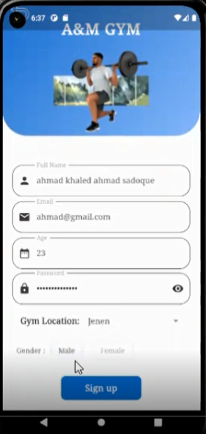
A&M
GYM App
Done by : Mustafa saa’d ALdin , Adel halaweh
Supervised by : Dr.Emad Natsheh

Slide 2
Idea And Motivations !

Slide 3
Table of contents
1. Members Journey
2. Trainers Journey
3. Admin Journey
4. Project Website
5. Chats & Notifications
6. Languages used & tools
7. Future View

Slide 4
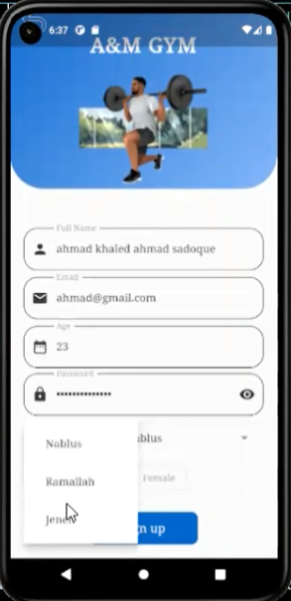
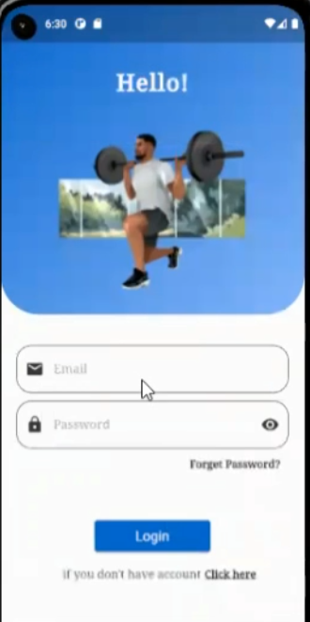
SignUp & SignIn
- Limitation for input fields
- Validation
- Error Massages
- Forget password (Vefication code by email)
-Change password page is available

Slide 5
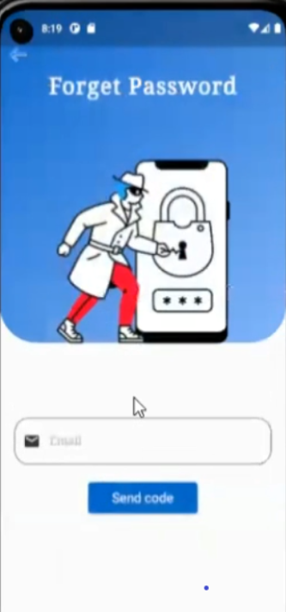
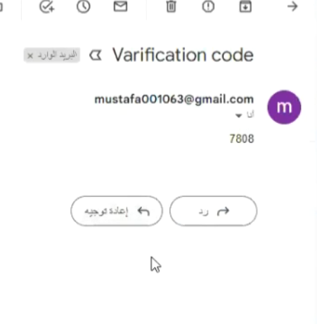
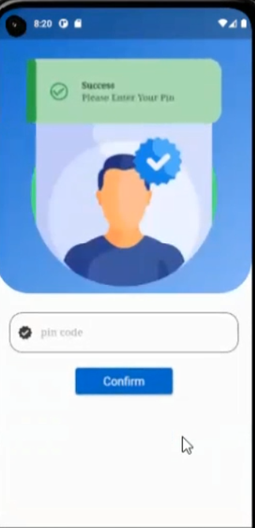
Forget password

Slide 6
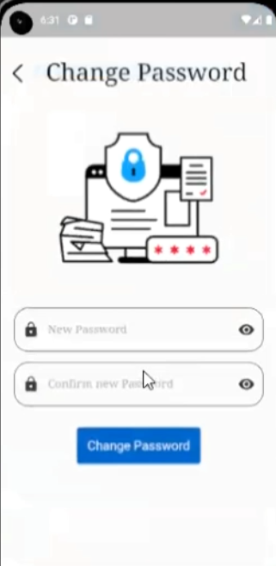
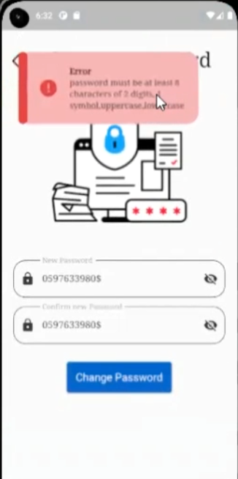
Change password

Slide 7
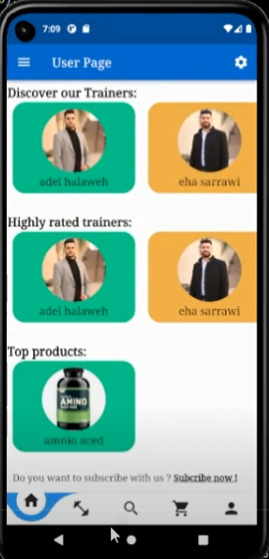
Home page
The home page contains bottom tab bar to navigate between pages like search page , cart and profile .
This page basically divided to three sections:
Trainers list
Highly rated trainers
Top products

Slide 8

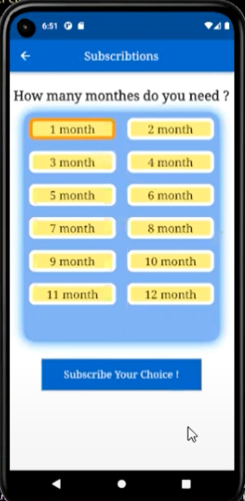
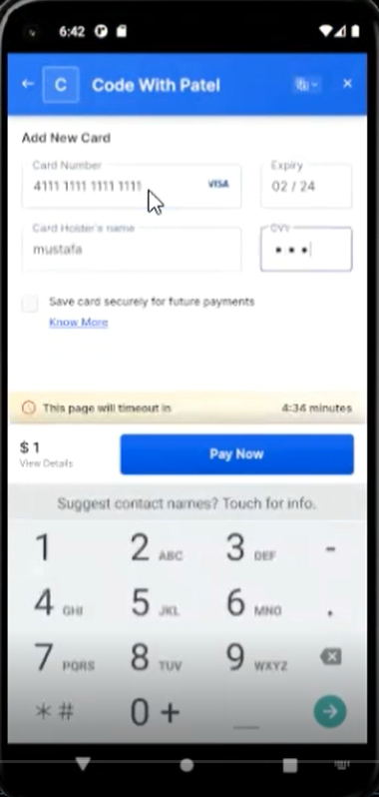
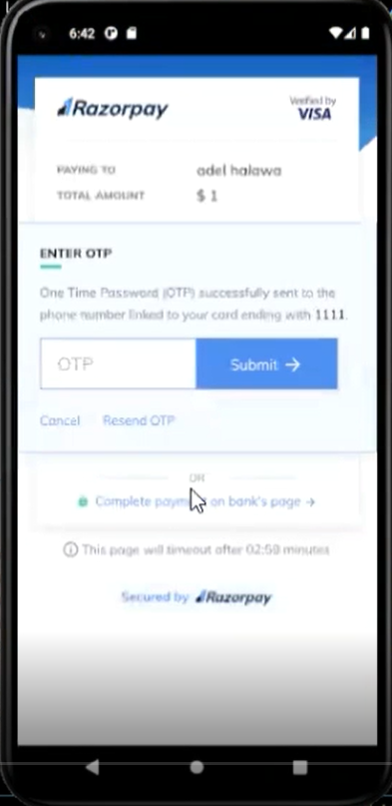
Subscriptions page & Payment process

Slide 9

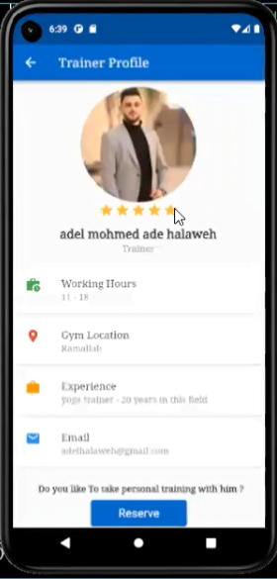
Rating system
the users have the option to rate trainers also the products available at the store

Slide 10

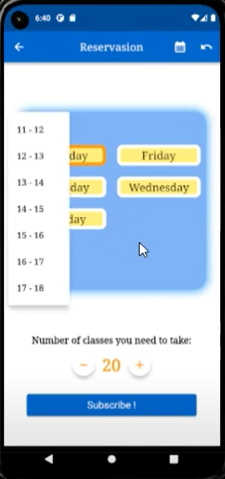
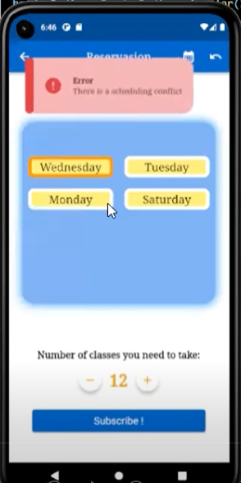
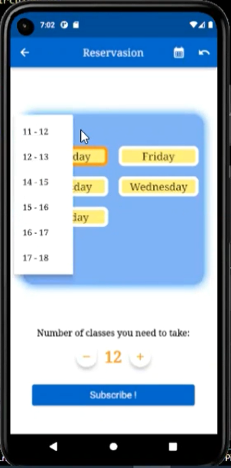
Reservation page
Note that selected time will be removed from the list
conflict detection. An error occurred when there’s conflict .
This process require payment
Select day and time

Slide 11
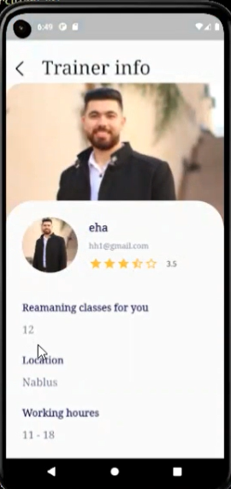
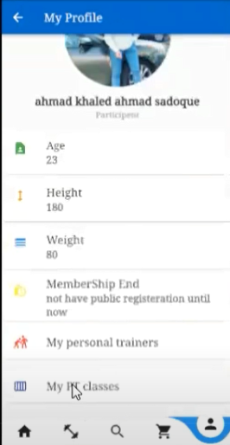
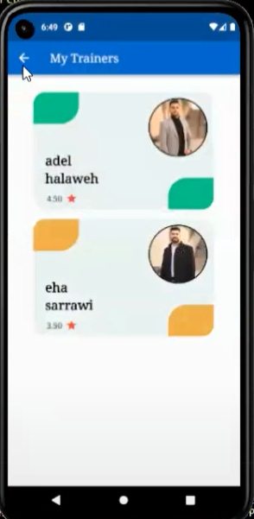
User personal trainers page
Trainer Info Page .
User profile page

Slide 12
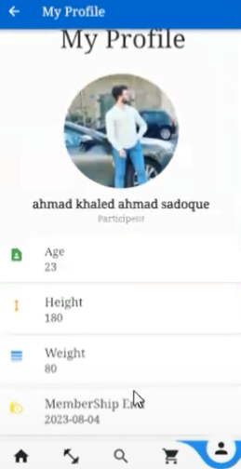

Slide 13
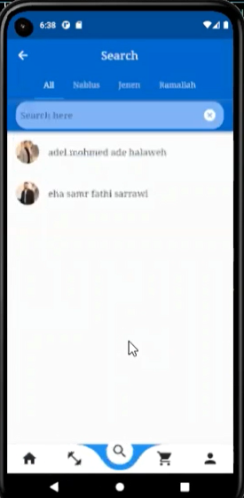
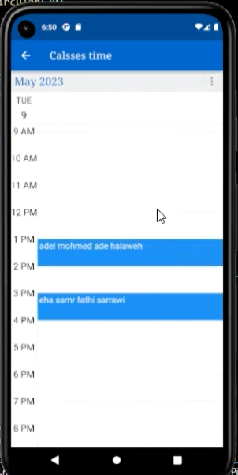
Calendar view & Search page
-The calendar shows user’s classes time either with week view or day view .
-The search page has a filter feature where the user can search for a trainer based on location.

Slide 14
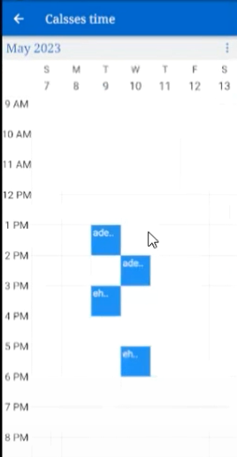
Second view for calendar
-Week view for the calendar

Slide 15
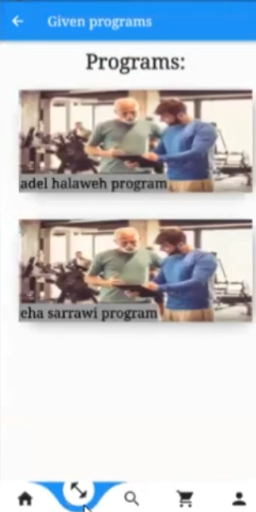
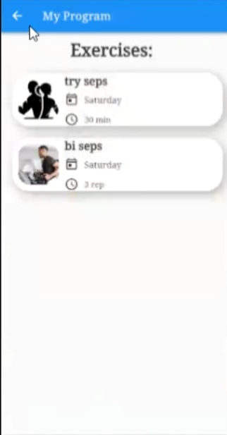
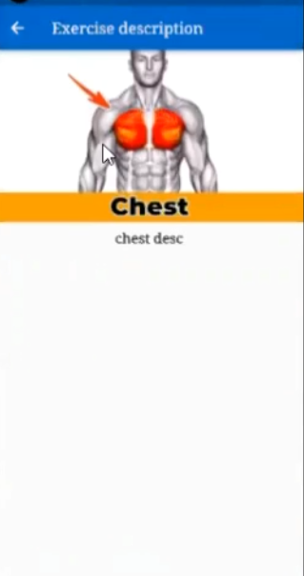
Programs page

Slide 16
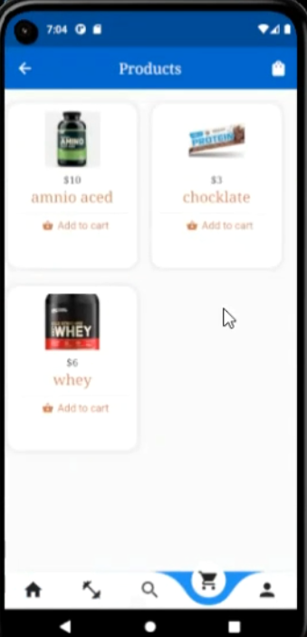
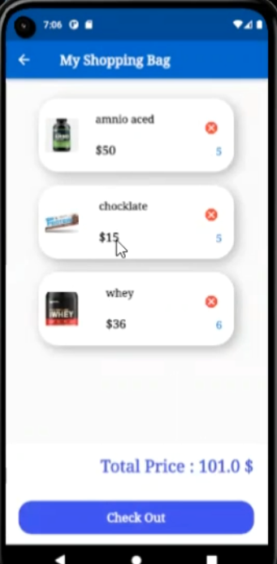
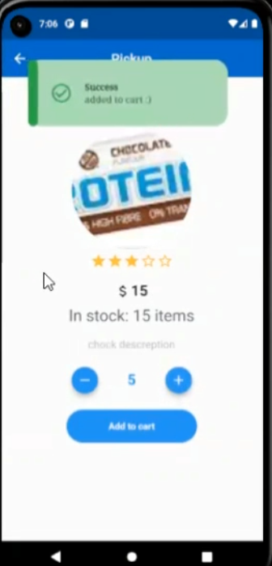
Store pages
Product details page , here the user can add the product to cart with desired amount
Shopping cart page shows products user has selected, here the user can edit the amounts or delete any product from the list .
Show Product Page
This process require payment
Show products page

Slide 17
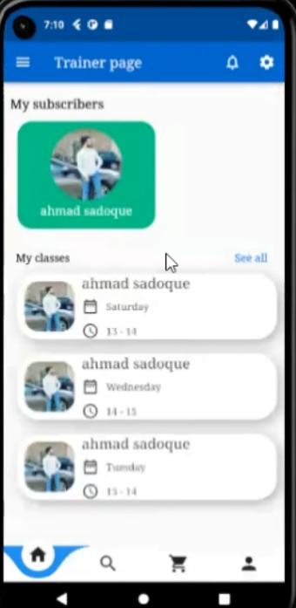
Trainer Home page
Do The home page contains bottom tab bar navigate between pages like search page , cart and profile...
This page basically divided to two sections:
Subscribers list
Classes list

Slide 18
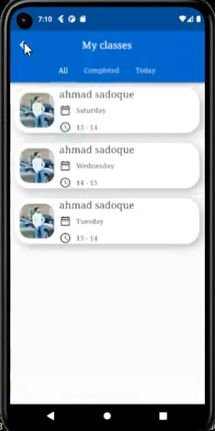

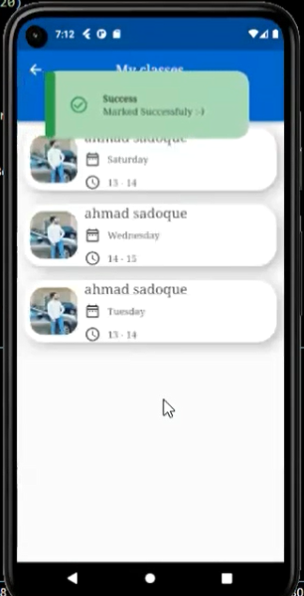
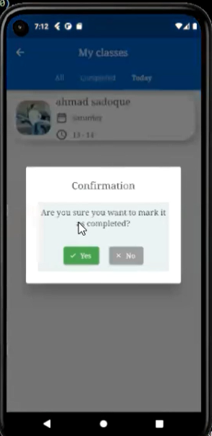
The trainer can mark the class as completed
Trainer classes page (The classes can be filtered by three options

Slide 19
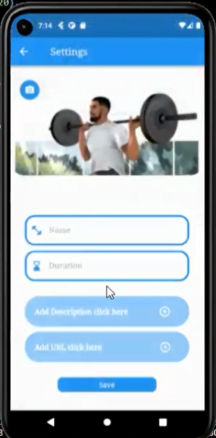
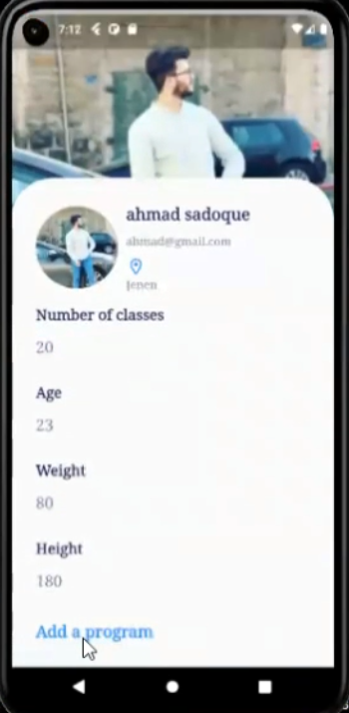
Upload a program page
-From the subscriber profile the trainer can add a program

Slide 20
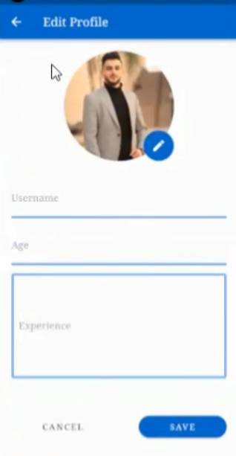
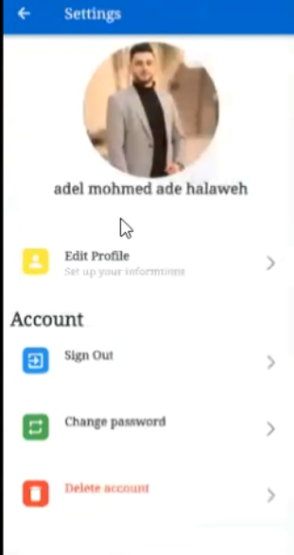
Settings page & edit profile page
-From those pages he can edit his information and more things as in the pictures

Slide 21
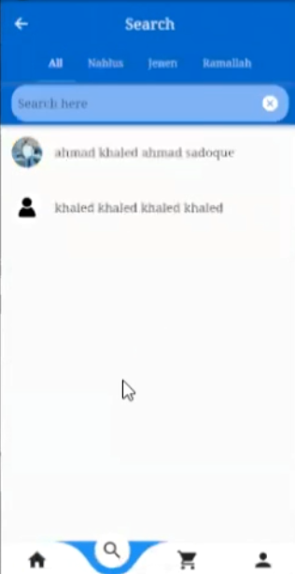
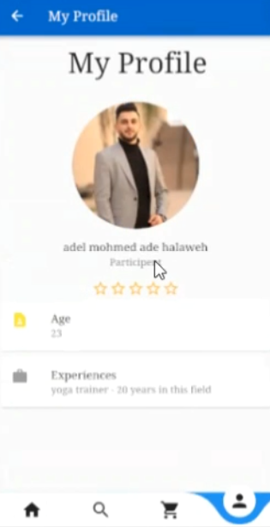
Search page & Profile page
-Search by filter on users & trainer profile page which trainers using it to show their informations such that their current rating.

Slide 22
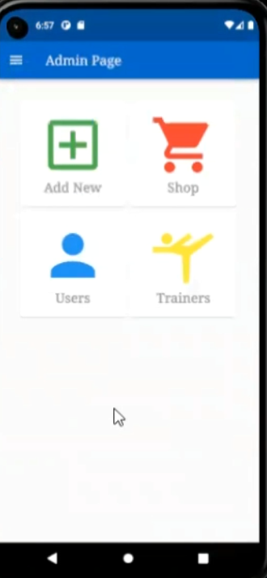
Admin Home page
Its a very basic page with four sections:
Add New
Shop
Users
Trainers

Slide 23
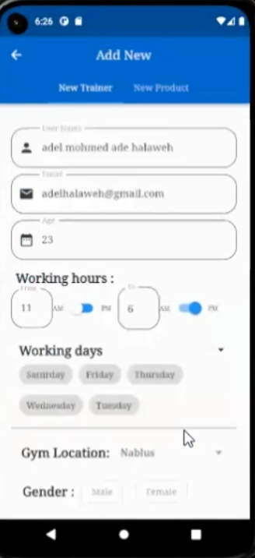
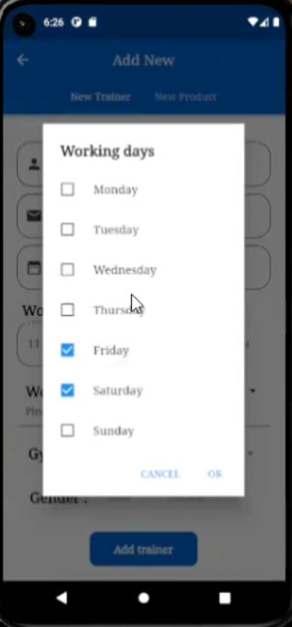
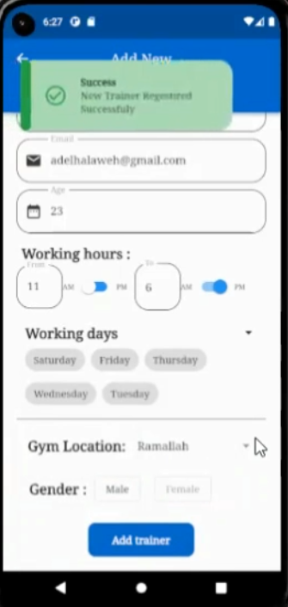
Hiring a trainer (add new trainer)
Password will be genarated randomly and sent to trainer email and he can change it later

Slide 24
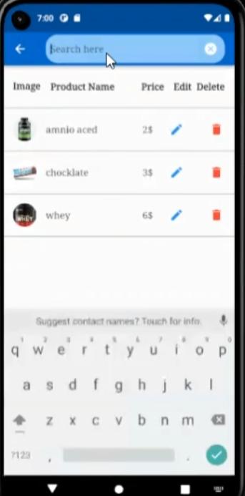
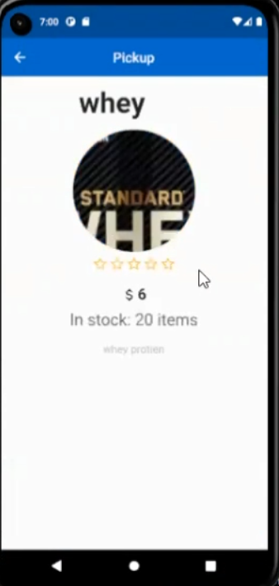
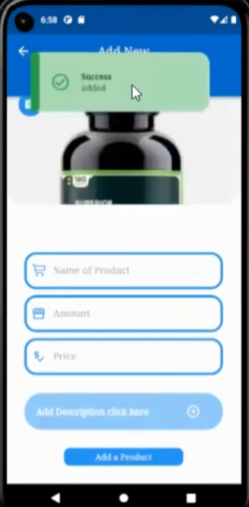
Store pages (Add/Update/Show Products)
Add Product Page
Product Details Page
Shop page

Slide 25
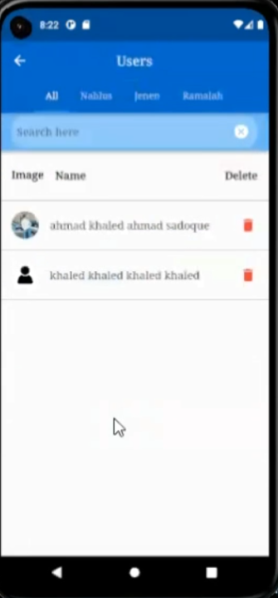
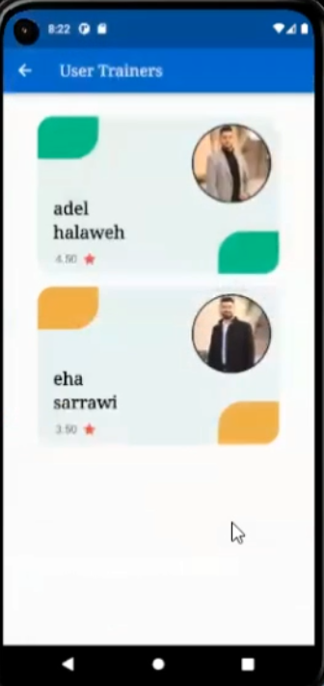
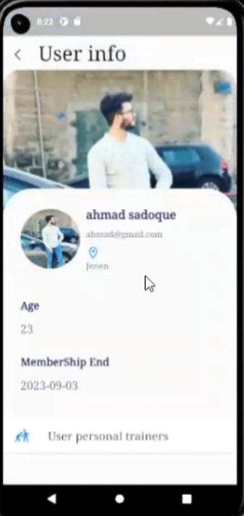
Show/Search for all users & Trainers Info
User Profile page from admon side
User’s
Trainers Page
Product Details Page
Search Method with Filtering options

Slide 26

Notifications
(1)
IMPORTANT MESSAGE!
you have a new member (member name)
When a user (subscriber) registers a personal training with a trainer a notification will be sended to that trainer with the name of the subscriber (user) that registers with him a personal training.
(2)
IMPORTANT MESSAGE!
(Trainer name) marked your class as completed
Notification will be sended to that subscriber with the name of the trainer that has marks the subscriber class as completed

Slide 27
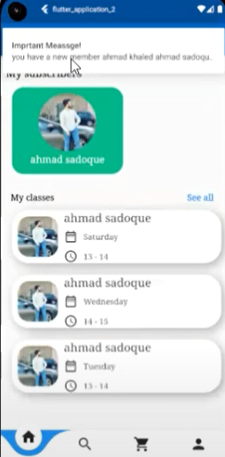

Notification cont.

Slide 28

Chats
All users have a chat system and are allowed to text each others.

Slide 29



Chat cont.

Slide 30

Website
the website surely will do the same functionality For ALL USERS as the mobile app.

Slide 31

Website AdminPage (Add trainer/product)
the website surely will do the same functionality For ALL USERS as the mobile app.

Slide 32

Languages used & tools
Database
Frontend
Firebase
Flutter
Backend
MongoDb
Node js
Postman
used for chat and notifications
Dart
used for testing

Slide 33
Thanks for listening :)

