Slide 1


FOUNDATION DESIGN FOR A SALAHAT BUILDING IN - NABLUS
By:
Ahmad Salahat
Mahdi Gazal
Osama Abu Baker
Under supervision :
Dr Monther Diab

Slide 2
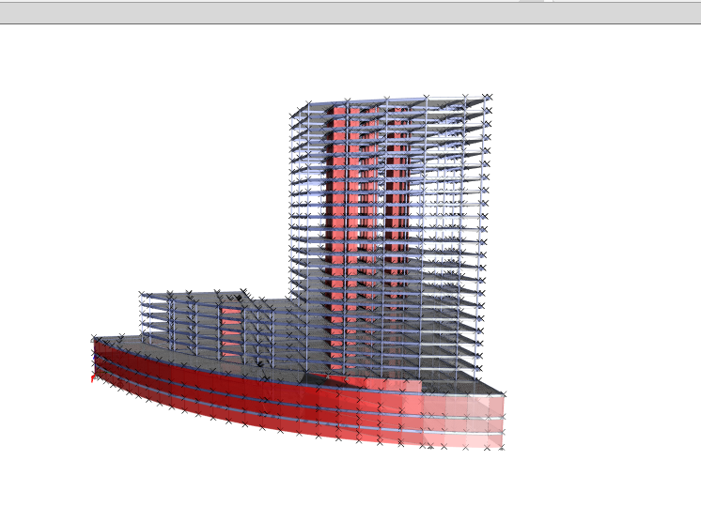
3D ETABS model

Slide 3
Outline:
Introduction
Objectives
Methodology
Analysis
Design
Results and Conclusion

Slide 4
Introduction
foundations is the most important part of a building .it provides a uniform base for the superstructure and transfers the load down to the soil below it uniformly. there ‘s two types of foundations shallow and deep foundations.

Slide 5
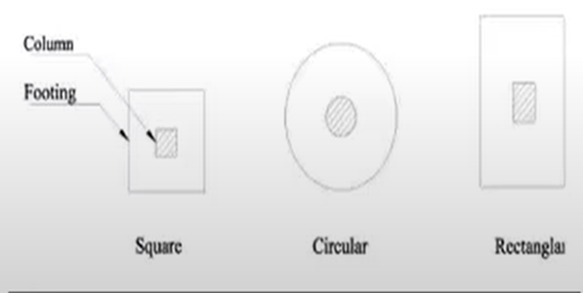
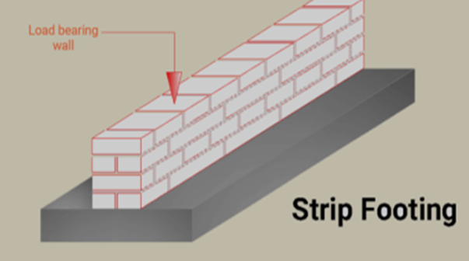
Shallow foundation:
Isolated footing:
Wall or strip footing:

Slide 6
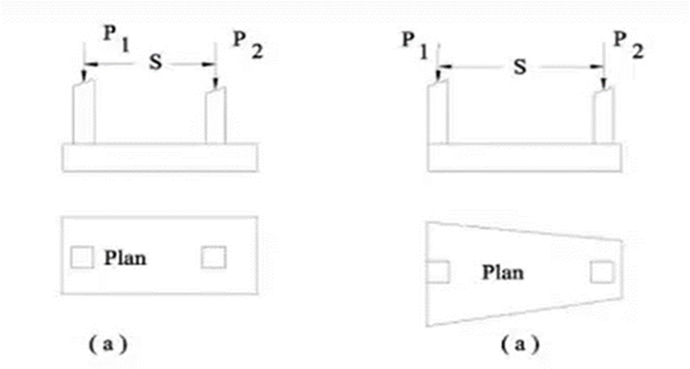
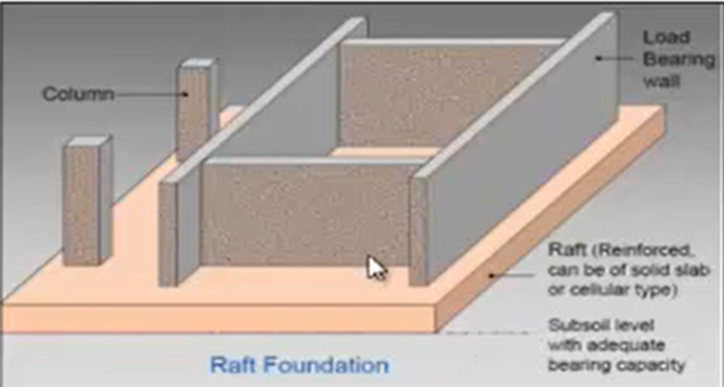
Combined footing
Raft(mat) foundation

Slide 7
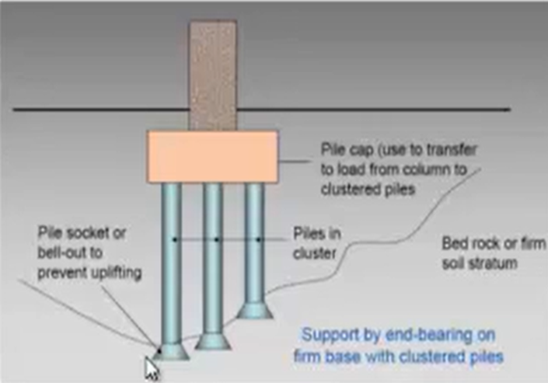
Deep foundation:
Deep foundations are a form of foundations using piles to transfer the loads of a structure down to a firm soil stratum with sufficient load -taking capacity.
Pile foundations

Slide 8
Selection of type of foundations for a building depends on :
Nature of soil
load from the structure.
The allotted cost of foundations.
The available technology.

Slide 9
Therefore, to decide the type of foundation, subsoil exploration must be carried out. Then the soil characteristics within the affected zone below the building should be carefully evaluated. The allowable bearing capacity of the affected soil stress should then be estimated

Slide 10
Objectives
This project aims to analyze and design suitable foundation system for a Salahat Building located at Al-Maagien in Nablus. The building consists of 14 stories with 3118 meter square plan area of each story in basement and the areas on the other floors is different .
The building is divided in two part (Block 1 , Block 2 ).

Slide 11
Methodology
Description of the building.
ETABS was used to analyze and design the structure .
Safe was used to design footing

Slide 12
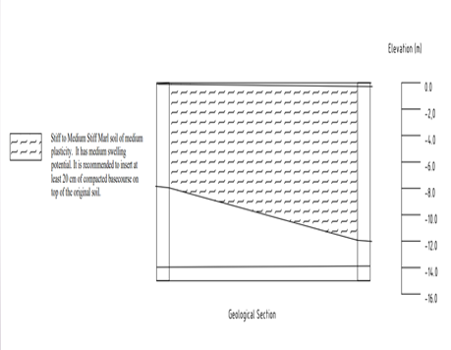
Analysis
Site Description
The soil at the site from geotechnical point of view is wett Stiff Marl soil of medium plasticity . It has medium swelling potential.
Soil Report Recommendation
The top soil layer should be improved by 40 cm base course compacted according to standards , the bearing capacity is 220 KN/m² (2 kg/cm²) .

Slide 13
Description of loads:
The load will be considered as: lateral loads, which come from the soil, that affect on the story of building and gravity loads which are vertical loads that’s effect on structure.

Slide 14
Gravity loads are divided to two types:
Dead load:
Superimposed dead load(SD)
Block 1 :
For basement stories = 6.35 KN/m2
For floor one (F1) = 8 KN/m2
For floor five (F5) = 8.35 KN/m2
Other floor = 8.15
Block 2 :
For all stories and floors = 9 KN/m2

Slide 15
Live loads
Block 1 :
For basement stories = 4 KN/m2
For floor one ( F1 ) = 6.5 KN/m2
For floor five (F5)= 5 KN/m2
Other floor = 2 KN/m2
Block 2 :
For floor three (F3) = 10 KN/m2
For other = 3 KN/m2

Slide 16
Design
The summation of isolated area is more than 50% of the area of the plan site in block 1 & block 2 , so the most appropriate foundation system for this project is mat foundation.
Bearing capacity of soil = 220 KN/m².

Slide 17
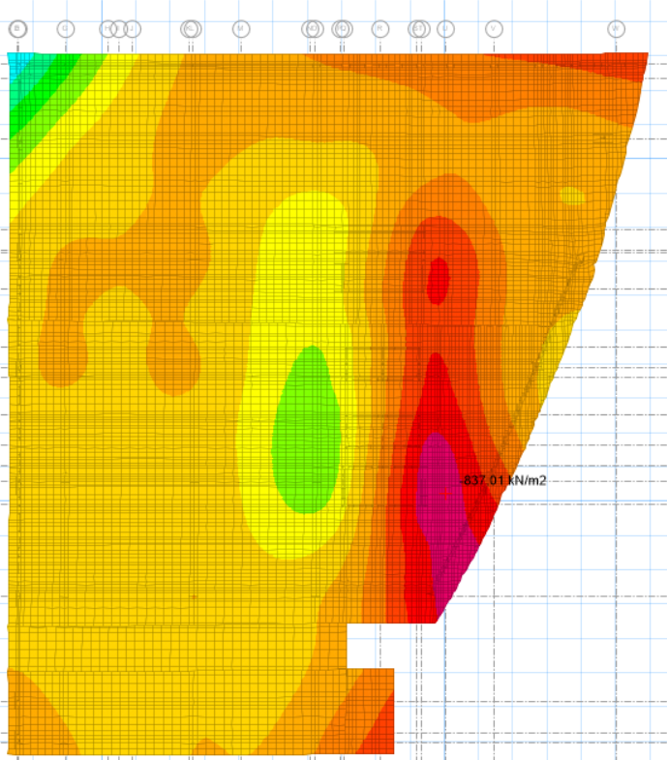
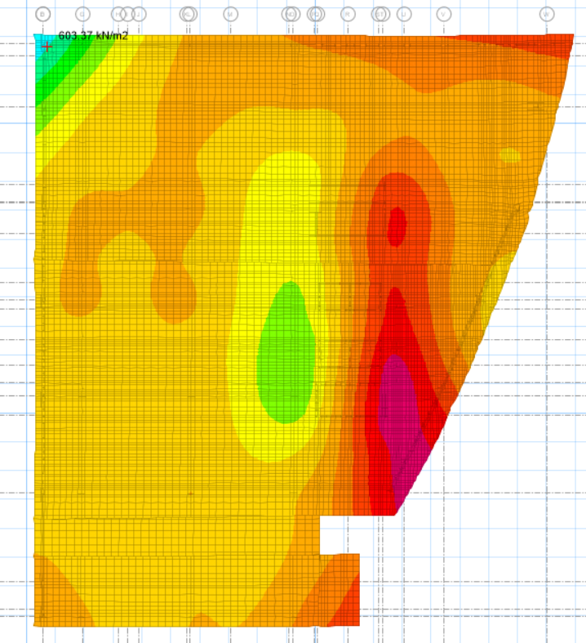
Design
Checks
1.Soil Failure Check
pressures under the mat in block 1 is :
Which have values more than – 220 KN/m2
( compression stresses) up to -800 KN/m2 and has a tension zones due to uplifting stresses with values up to ( 650 kN/m2).
Due to these high values of service stresses in soil, it is recommended to use piles with raft foundation.

Slide 18
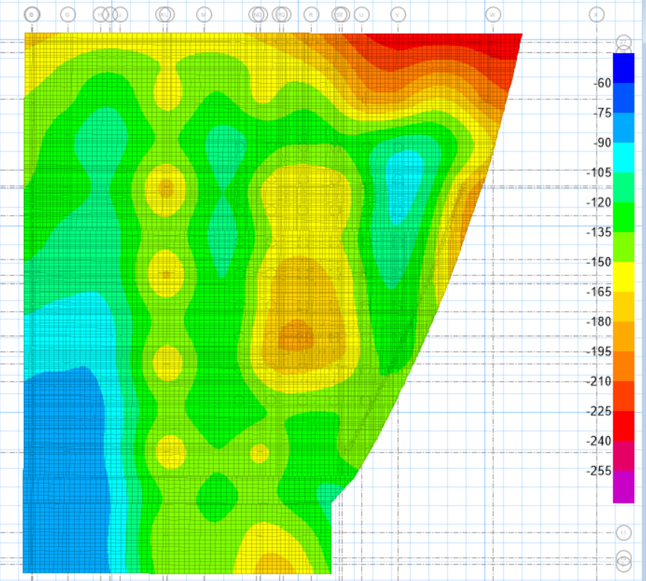
pressures under the mat in block 2 is :
Which have values less than – 220 KN/m2
( compression & tension stresses )
Its OK ………..
After using piles in block 1 :
The highest soil pressure 220 which is equal to the net allowable bearing capacity of soil . ………. OK

Slide 19
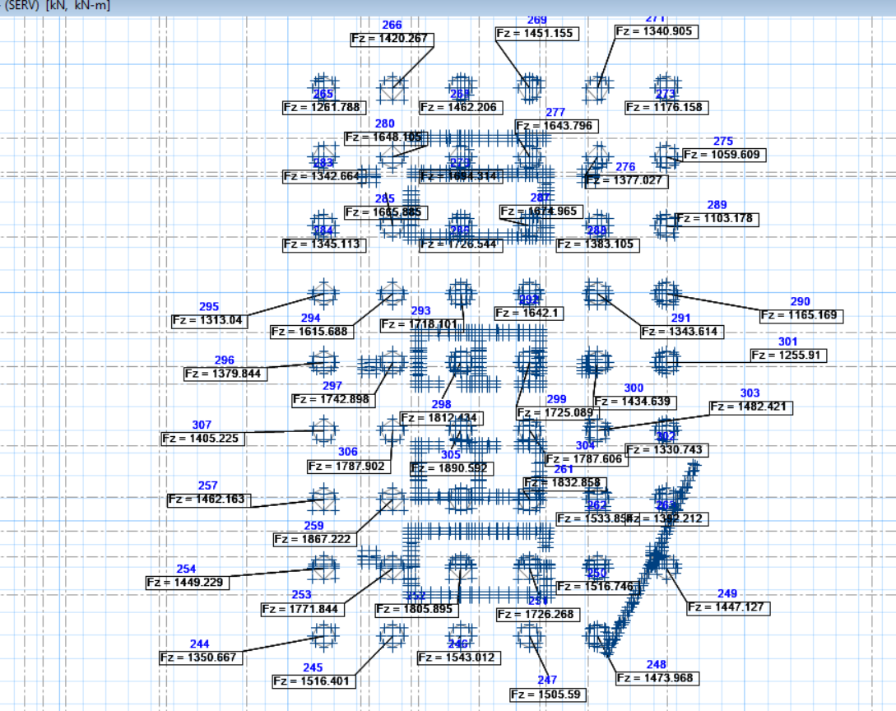
2. Check pile capacity :
P applied <= P capacity
Q total service = Qp + Qs = 1915 + 425 = 2340 KN / pile of 1m diameter .
The highest pile load was 1890 KN which is less than 2340 KN …… OK

Slide 20
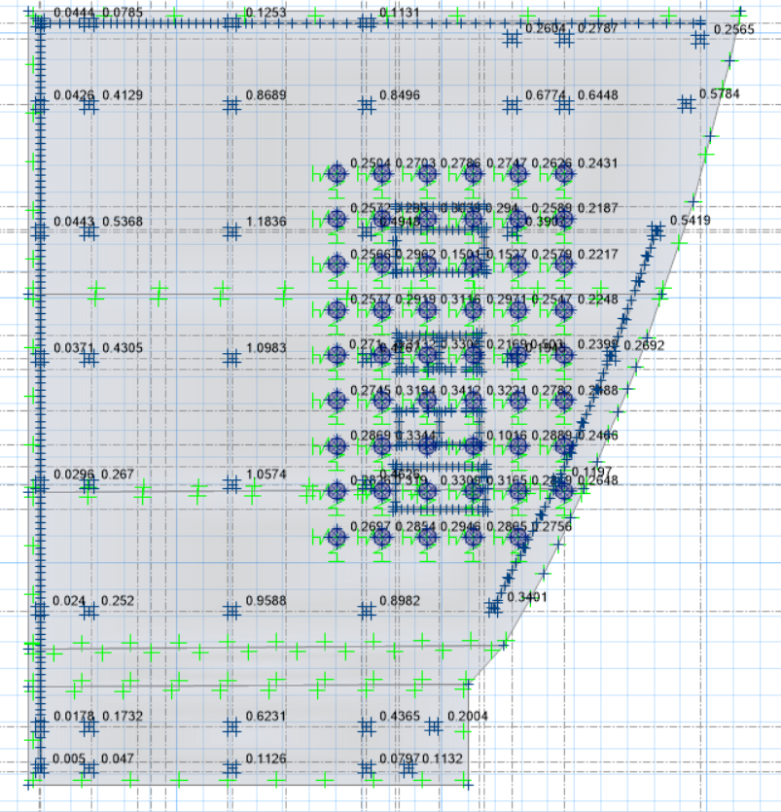
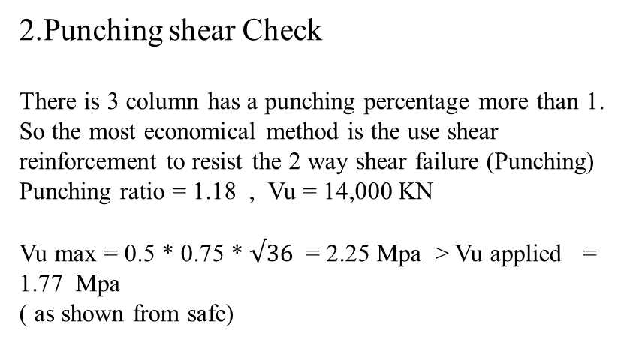
Design
2.Punching shear Check
There is 3 column has a punching percentage more than 1.
So the most economical method is the use shear reinforcement to resist the 2 way shear failure (Punching)
Punching ratio = 1.18 , Vu = 14,000 KN
Vu max = 0.5 * 0.75 * $√36$ = 2.25 Mpa > Vu applied = 1.77 Mpa
( as shown from safe)

Slide 21
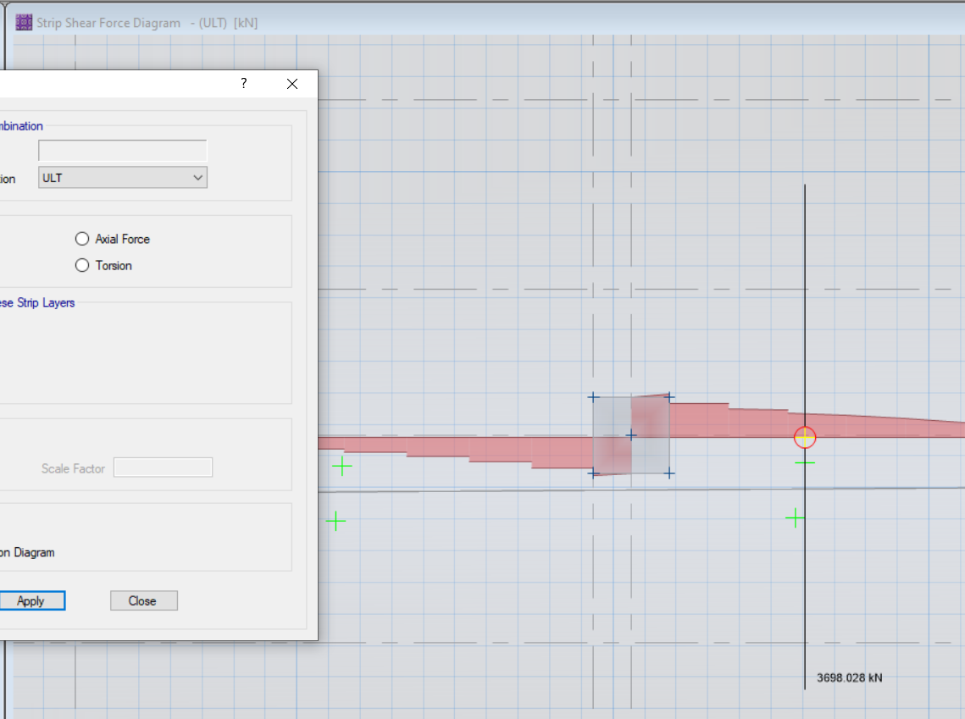
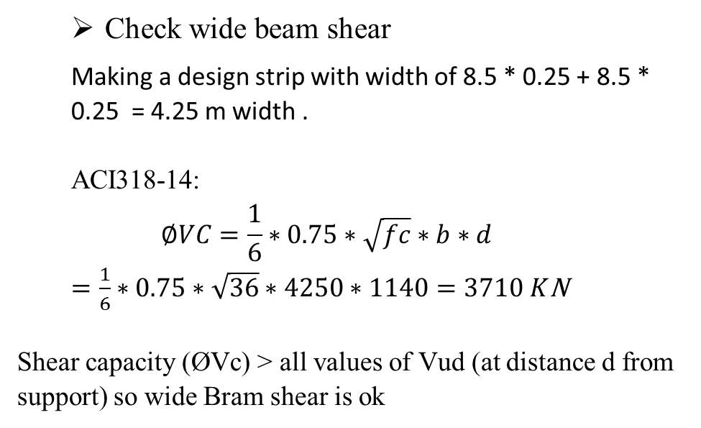
Design
Check wide beam shear
Making a design strip with width of 8.5 * 0.25 + 8.5 * 0.25 = 4.25 m width .
ACI318-14:
$$∅VC=\frac{1}{6}∗0.75∗\sqrt{fc}∗b∗d$$
$=\frac{1}{6}∗0.75∗\sqrt{36}∗4250∗1140=3710 K$N
Shear capacity (ØVc) ˃ all values of Vud (at distance d from support) so wide Bram shear is ok

