Slide 1
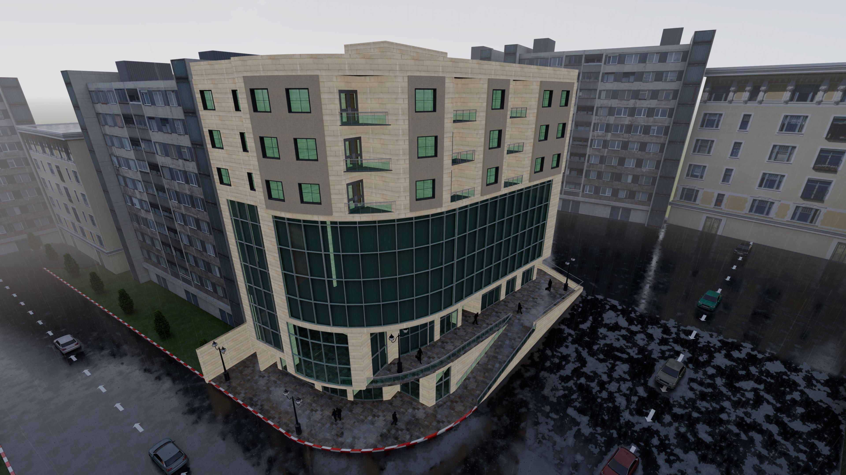

An-Najah National University
Faculty of Engineering & Information Technology
Department of Building Engineering
“Re-Design of Multi-Function Building “
Prepared by:
Bassam Abu Al-Hoos.
Hasan Halbouni.
Saad Ashour.
1
Supervisor: Eng. Fady Fatayer.

Slide 2
Content:
Site location
Acoustic design
Quantity Surveying & Cost Estimation
SAFETY AND FIRE FIGHTING
Architectural aspect
Structural Design
Electro-Mecenichal Design
Environmental Aspects

Slide 3
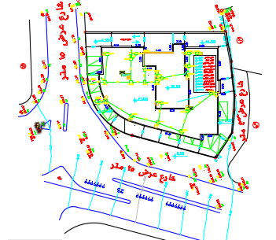
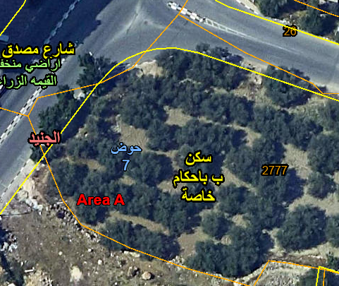
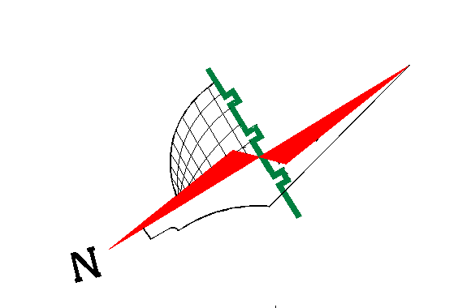
Site location
The location of the building is in Nablus city, Tunis Street, about 542 m above sea level with a total area of 1109 M² with a total floor area of 8362 M²

Slide 4
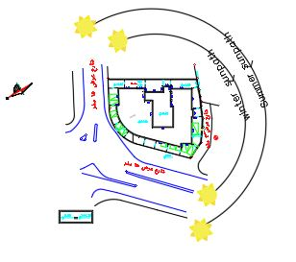
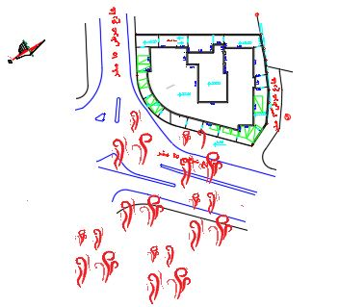
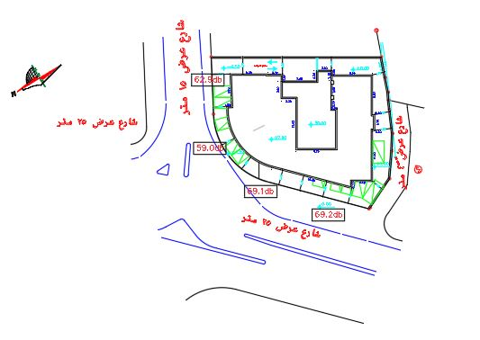
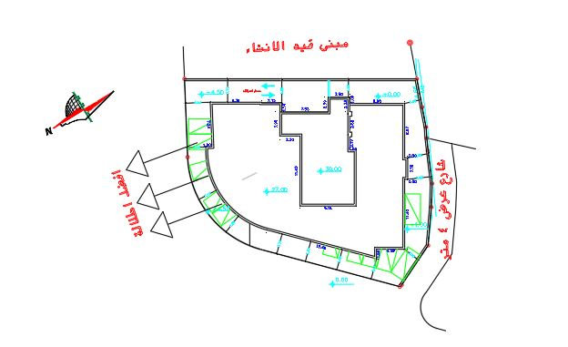
Site Analysis:
Sun Path
Wind Direction
Sound Level
Best view & Surrounding

Slide 5
Architectural Aspects

Slide 6
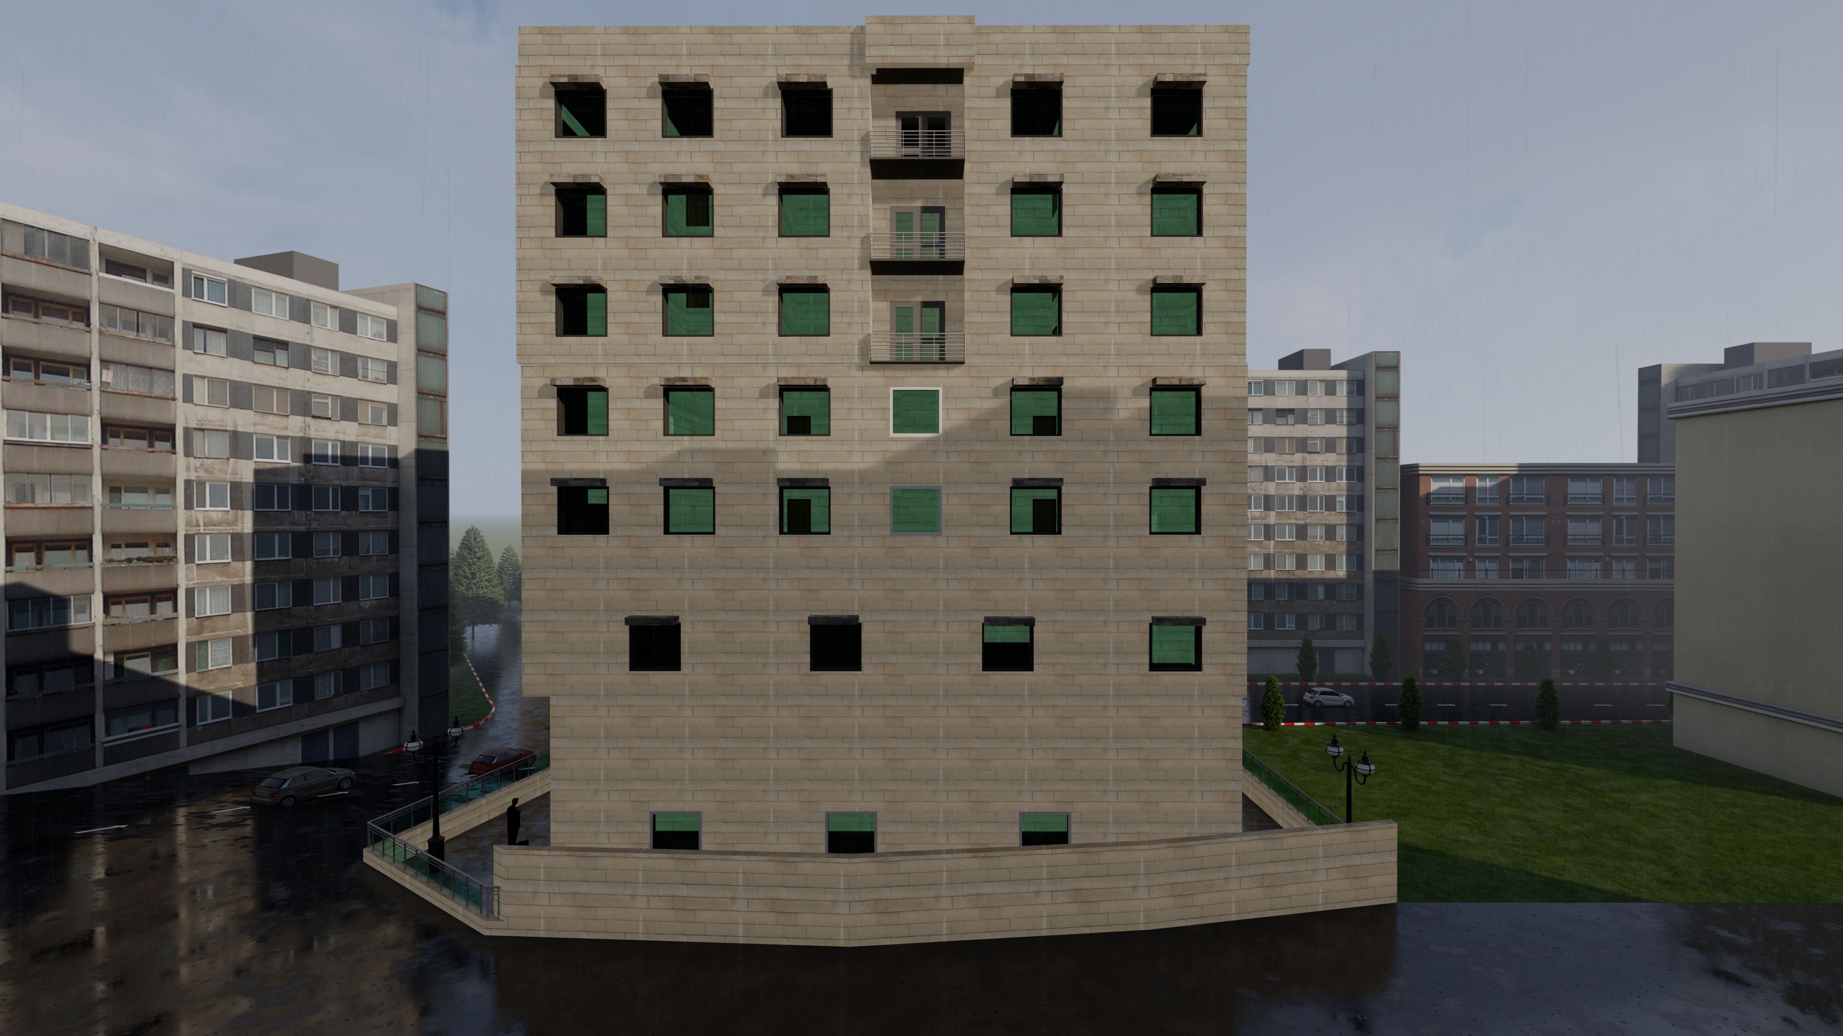
3d Model for the building

Slide 7
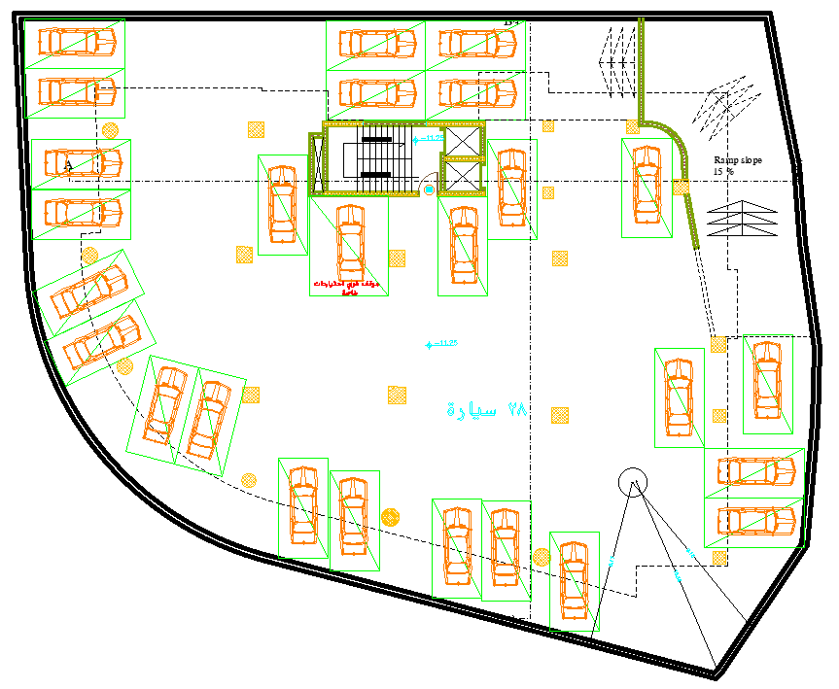
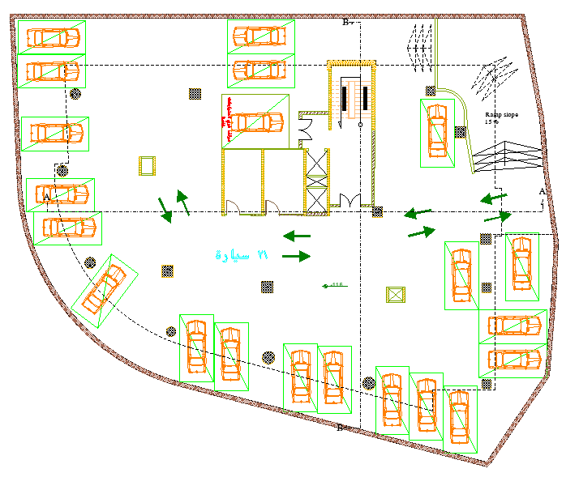
Second parking floor
Before
After

Slide 8
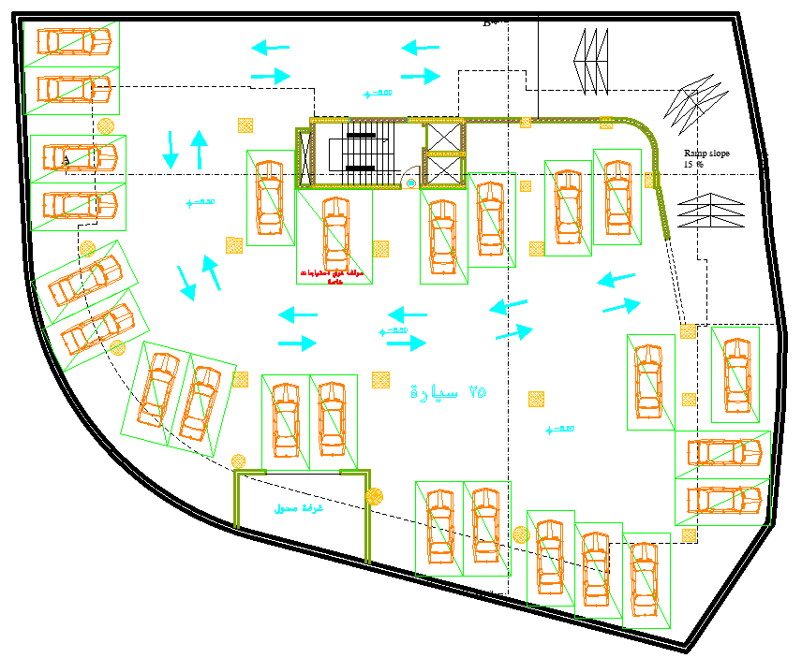
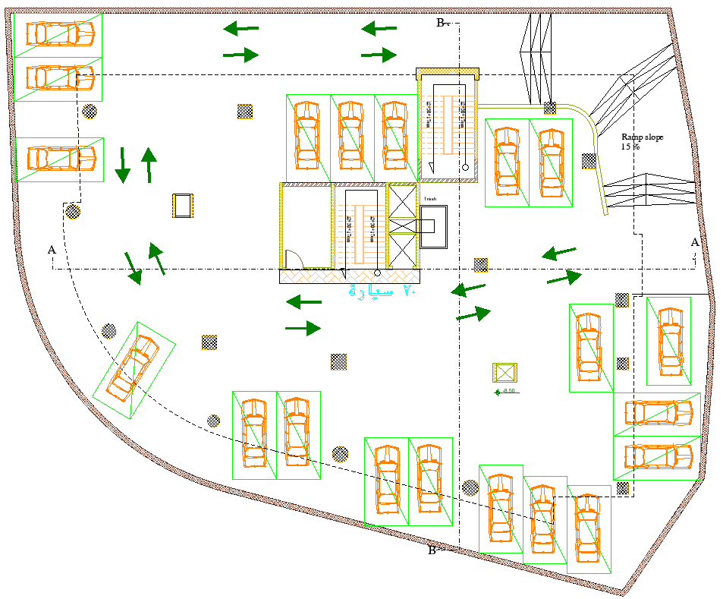
First parking floor
Before
After

Slide 9
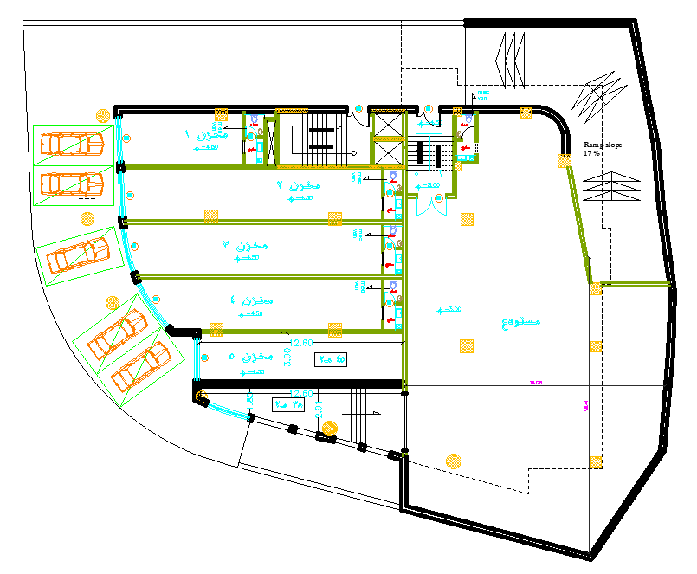
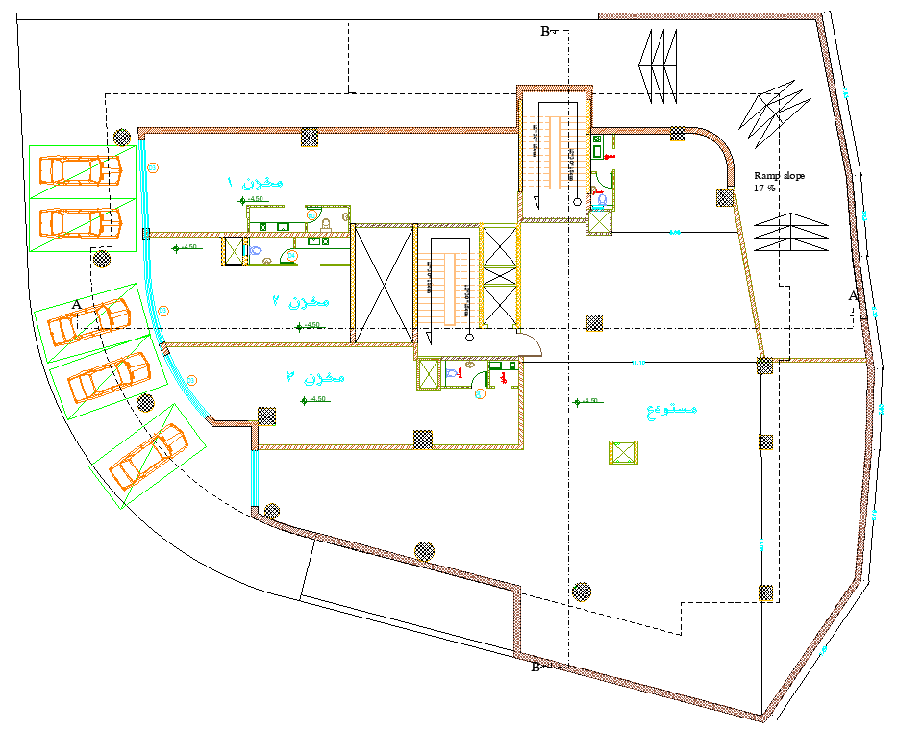
First basement floor
Before
After

Slide 10
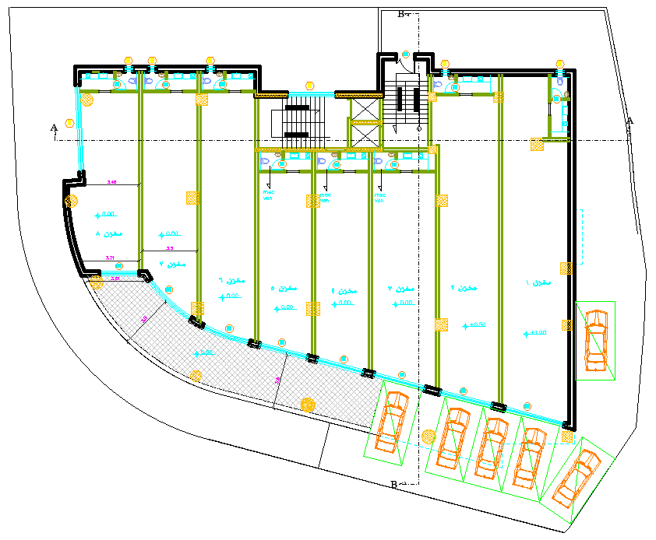
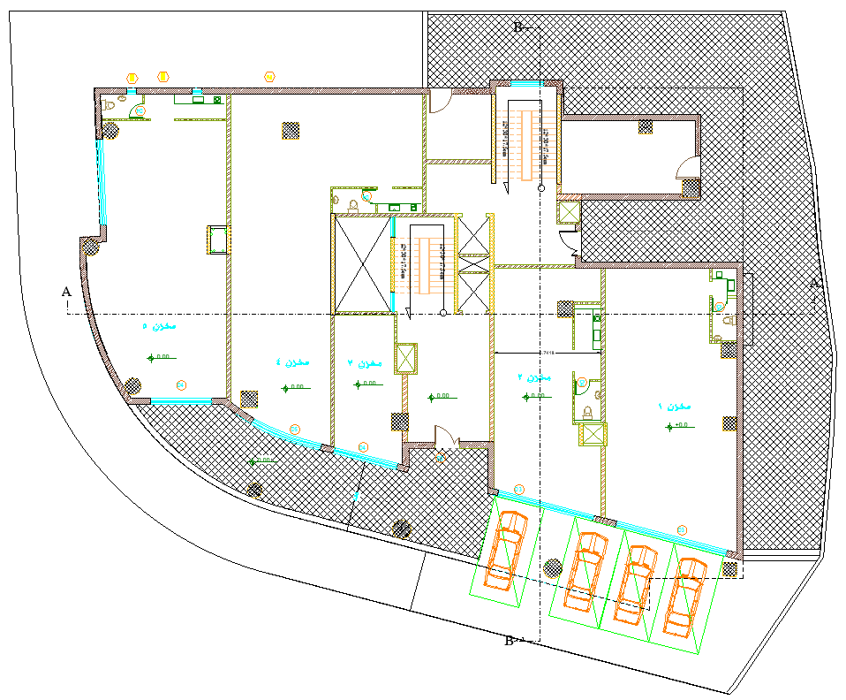
Ground floor
Before
After

Slide 11
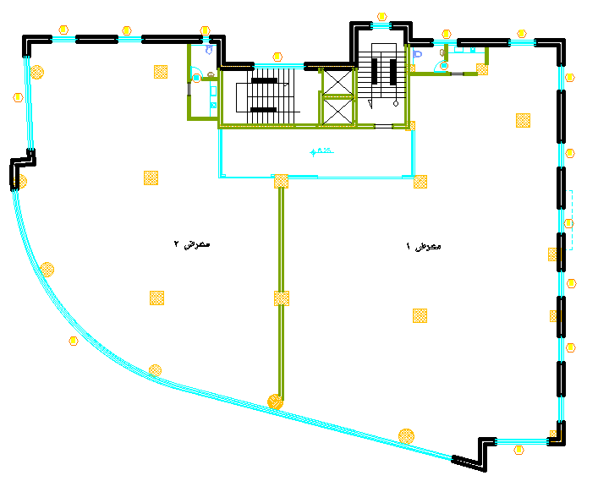
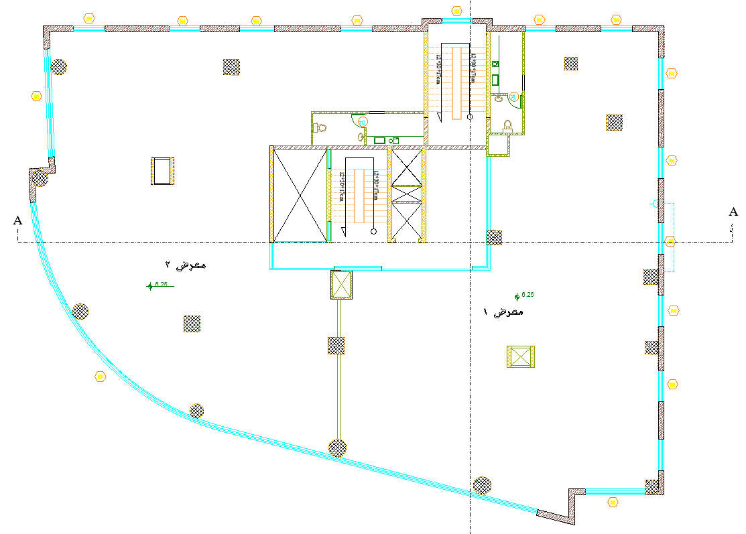
First floor
Before
After

Slide 12
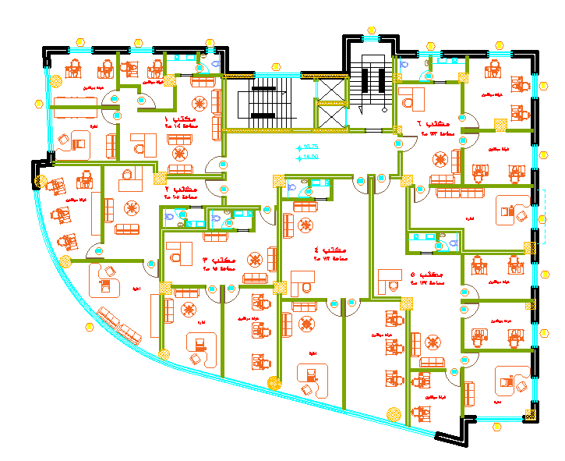
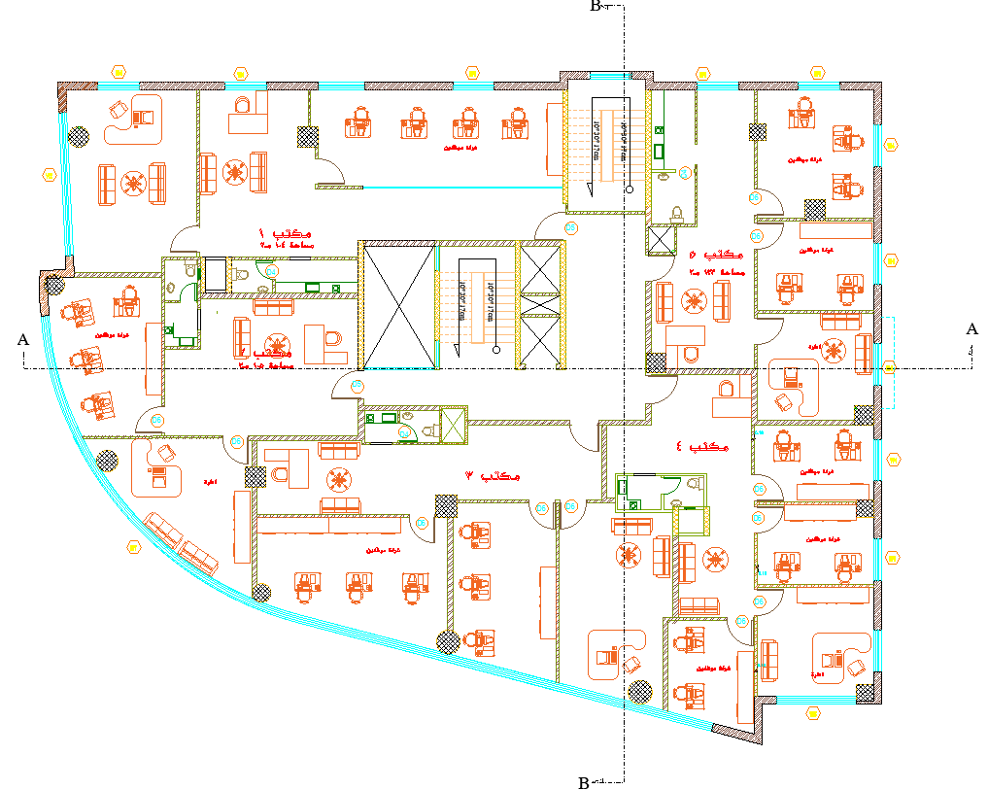
Second & third floor
Before
After

Slide 13
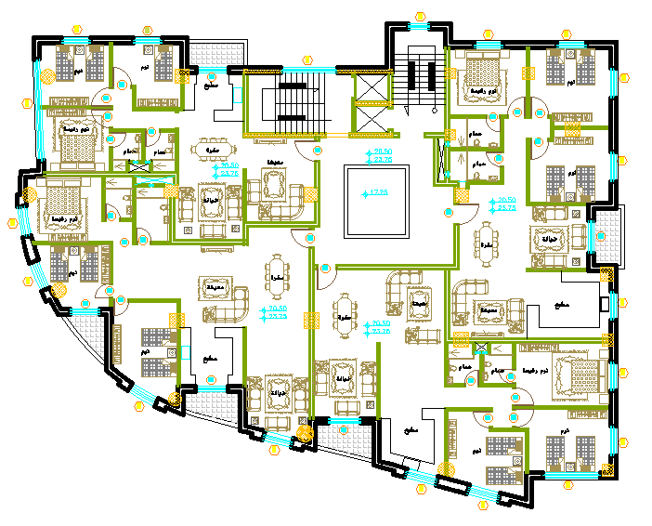
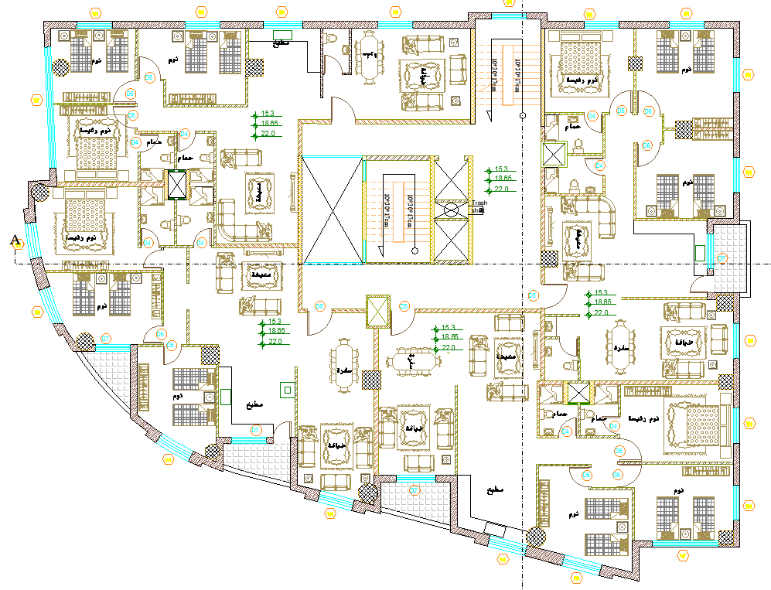
Forth ,Fifth & Sixth floors
Before
After

Slide 14
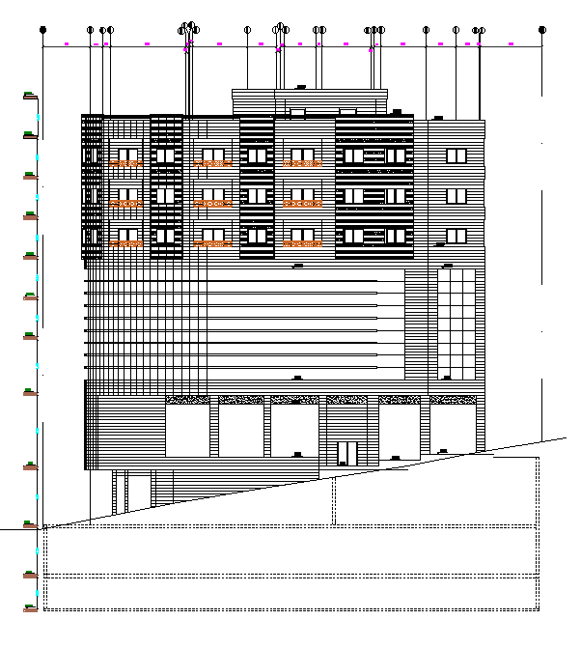
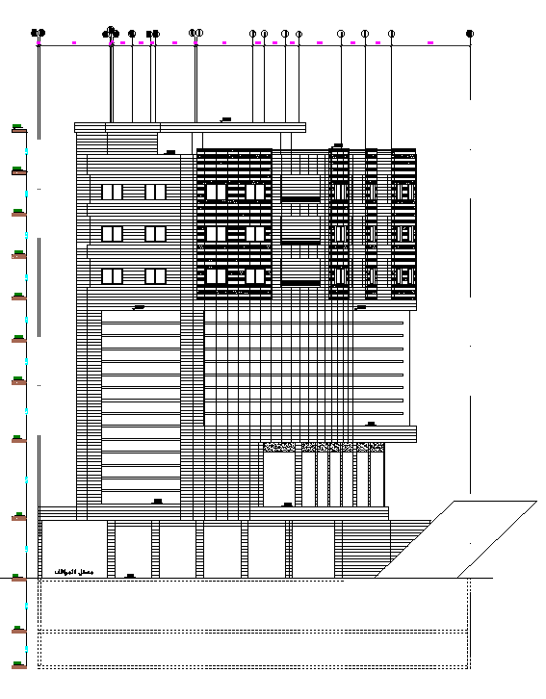
Elevations
Western elevation
Northern elevation

Slide 15
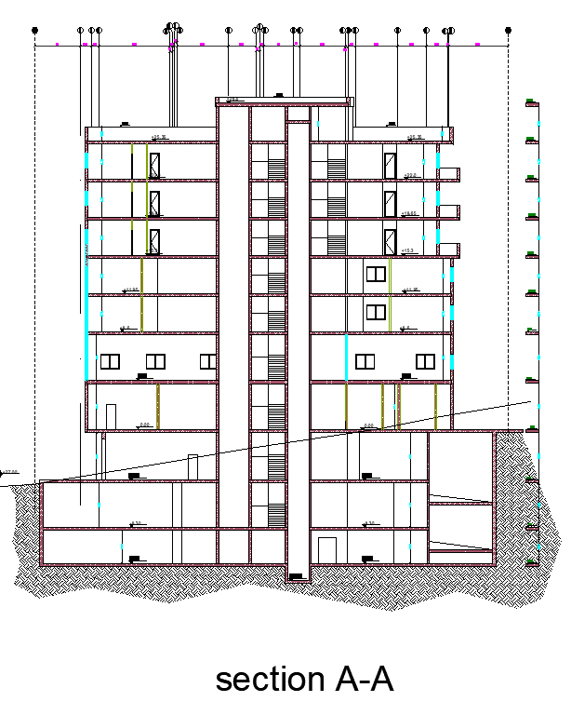
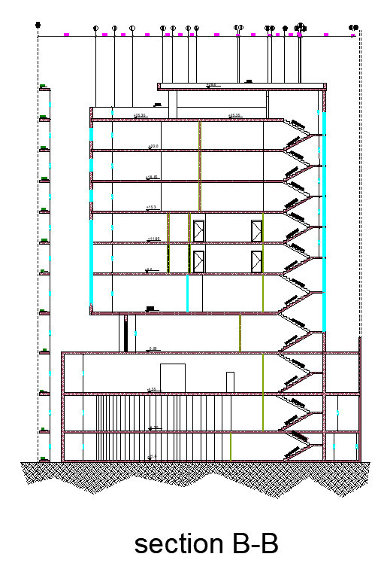
Sections

Slide 16
Environmental Design

Slide 17
Environmental Design
Daylighting
Shading
Thermal design

Slide 18
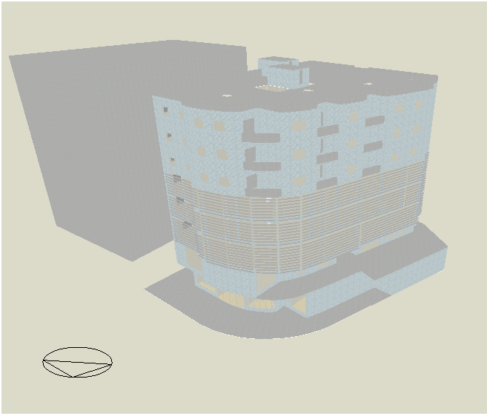
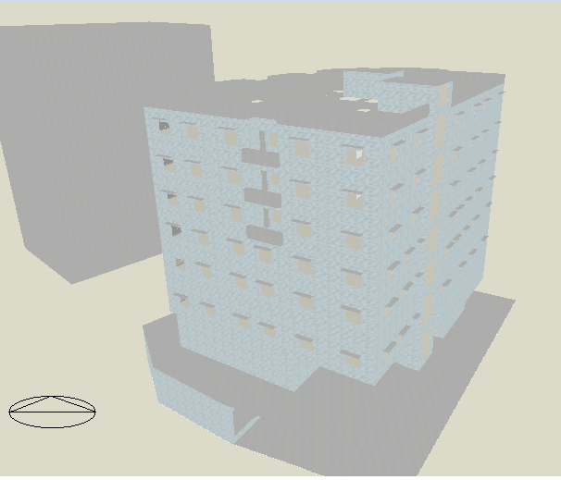
Daylighting
The Energy Conservation Measures (ECM) :
Adding Louvers & Cantilevers
Using low transmission glass.
Using insulation materials
The Model of the building in Design builder
The Model of the building in Design builder

Slide 19
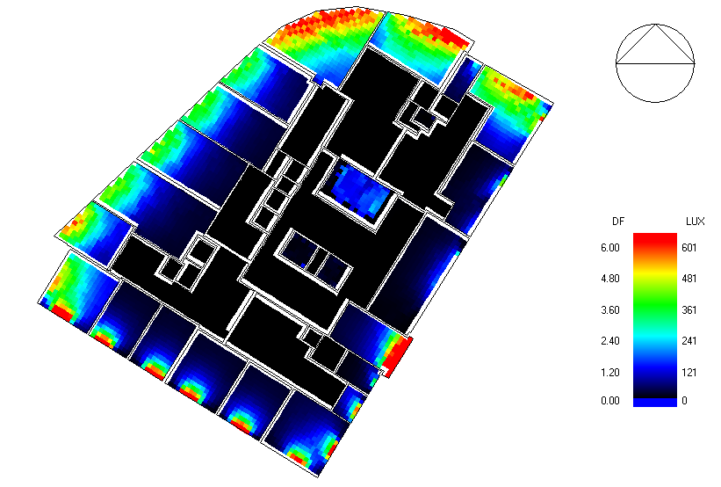
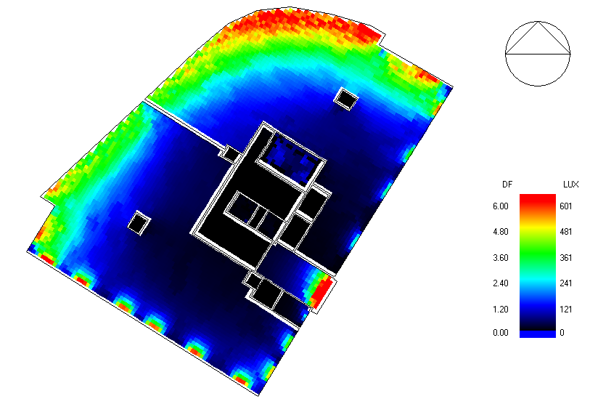
Daylight analysis for the model for the offices & Warehouses
Offices
Warehouses

Slide 20
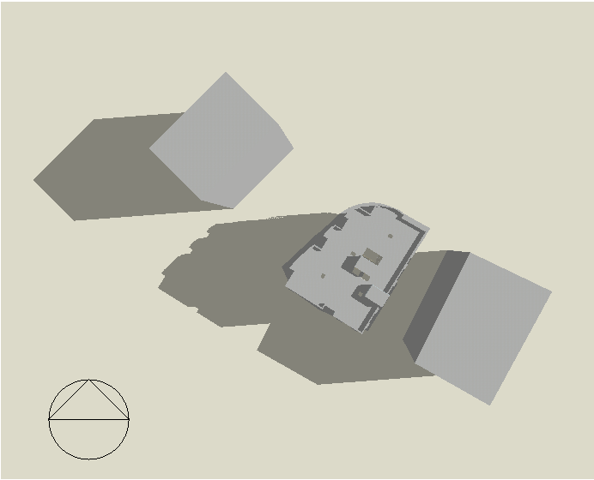
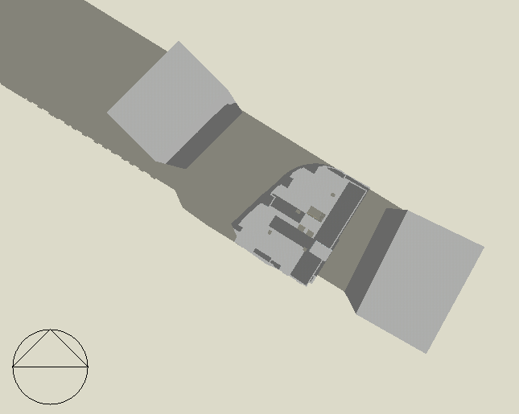
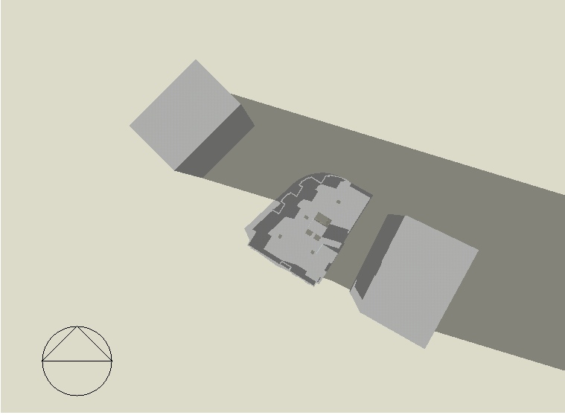
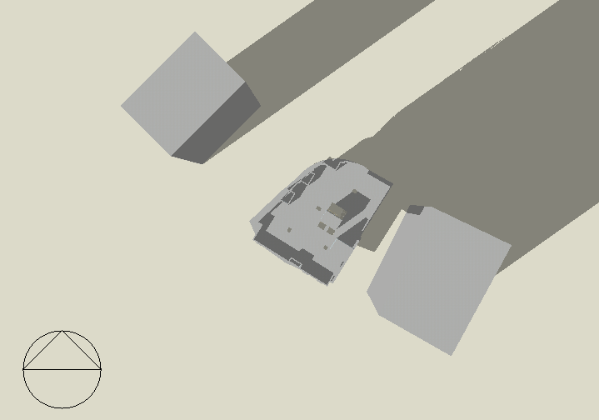
Shading & over Shadowing
21 July /On 8:00 AM
21June /On 8:00 AM
21 July /On 6:00 PM
21 June /On 6:00 PM

Slide 21
Thermal Design

Slide 22
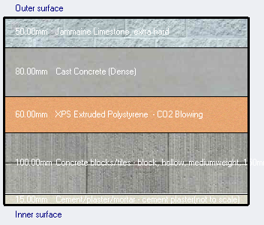
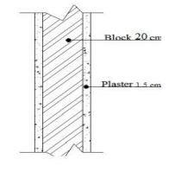
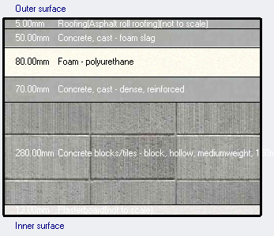
The materials that were used in design builder
Component | Layers | U-value (W/m² .k)
External wall | stone | 0.456
 | concrete
 | extruded polystyrene
 | concrete block
 | plaster
Internal wall | plaster | 2.1
 | concrete block
 | plaster
Roof | asphalt roll roofing | 0.278
 | cast concrete
 | polyurethane
 | cast concrete
 | hollow concrete block
 | Plaster
Glass | Dbl glass | 1.493
External Wall Section
Internal Wall Section
Roof Section

Slide 23
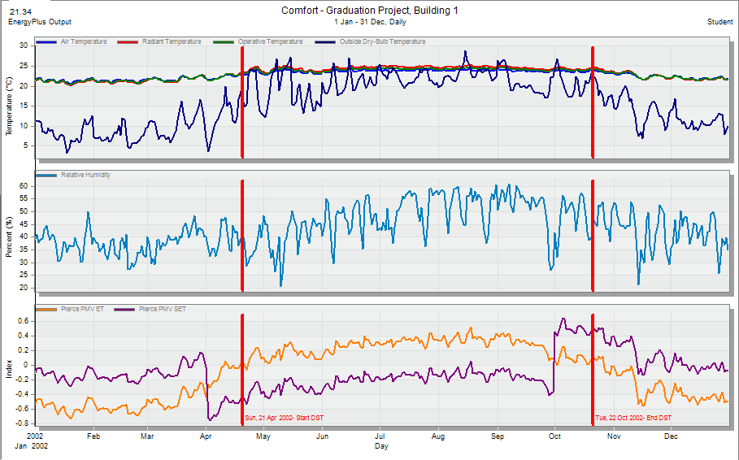
The comfort graph for the building from Design Builder

Slide 24
Comfort hour
The site and source energy for the building from Design Builder

Slide 25
Design Capacities :
Floor No. | Design capacity (KW)
Basement | 34.66
Ground | 19.53
First | 32.02
Second | 25.36
Third | 23.68
Fourth | 15.99
Fifth | 16.16
Sexth | 22.08
Total | 189.48

Slide 26
Structural design

Slide 27
Structural design

Slide 28
Codes, specification & Material:
Codes and specification:
ASCE for loads and combinations.
ACI 318 (American Concrete Institute).
UBC-97 code
Material:
Concrete B400
f'c = 32Mpa, Density = 2500 Kg/ M3.
Steel
Fy = 420 Mpa, Density = 7600.97 Kg/M3.
Hollow Block
(400*200*280) mm.

Slide 29
Loads:
super imposed dead load (SID):
One way
weight of brick (kN/m.rib) =1.34
weight of brick (kN/m2)= 2.44
SID to be added to Etabs = 6.44 KN/m²
Two way
weight of brick (kN/rib^2) =0.54
weight of brick (kN/m^2) =1.78
SID to be added in Etabs =5.78 KN/m²
Live load for retail | 4.79 KN/m²
Live load for residential | 2 KN/m²
Live load for office | 2.4 KN/m²

Slide 30
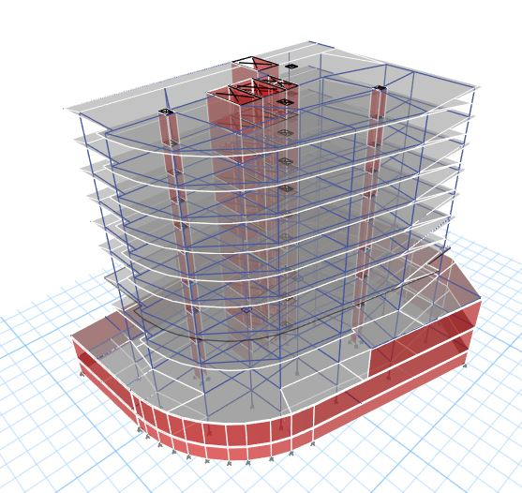
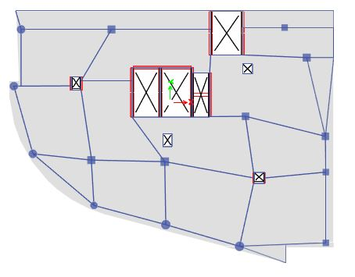
Model layout

Slide 31
Checks:
Equilibrium check
Stress-Strain check
Seismic design check

Slide 32
Equilibrium check:
For Live & SID loads
Load | Etabs | Manual | Error%
Live | 18904.23 KN | 19040.35 KN | 0.71
SID
One way |  | 8502.78 KN
Two way |  | 31359.30 KN
Walls |  | 15992.6 KN
Total | 55804.38 KN | 55854.68 KN | 0.09

Slide 33
Equilibrium check:
For Dead load:
Dead | Etabs | Manual | Error %
Column | - | - | -
circular column (90)cm | - | 1025.55 | -
Column (110*60)cm | - | 589.87 | -
Column (30*80)cm | - | 900 | -
Column (80*80)cm | - | 2288 | -
Column (85*85)cm | - | 645.73 | -
Column (65*65)cm | - | 1132.82 | -
Column (75*75)cm | - | 1005.46 | -
Beams | - | 26464.57 | -
Walls | - | 17213.21 | -
One-way slab | - | 27442.11 | -
Two-way Slab | - | 7070.83 | -
Ramp | - | 1614.12 | -
Total | 85983.49 | 87392.27 | 1.61
ذ

Slide 34
Stress-Strain check:
      Columns:
      beam:
      One way ribbed slab

Slide 35
Stress-Strain check:
Two-way ribbed slab:
For two way slab the checks will be made for column strip, middle strip, frame and beam.
Find the column strip width and frame width.
two way |  |  |  |  |  | Diff%
 |  | frame | CS | MS | Beam | frame | CS | MS | Beam
Etabs | M1 | 201.7 | 144 | 57.7 | 85.3 | 5.32 | 25.69 | -45.49 | 11.48
 | M2 | 193 | 108 | 85 | 80.5 | 3.62 | 21.29 | -18.82 | 8.94
 | M+ | 211 | 115 | 96 | 100.6 | 25.78 | 15.26 | 26.70 | 43.34
safe | M1 | 190.95 | 107 | 83.95 | 75.5
 | M2 | 186 | 85 | 101 | 73.3
 | M+ | 645.2 | 297 | 348.2 | 57

Slide 36
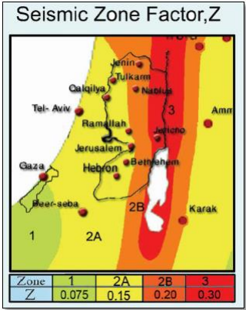
Seismic design check:
The check consist of:
Modal Mass Participation ratio
Period check
base shear checks
Drift check

Slide 37
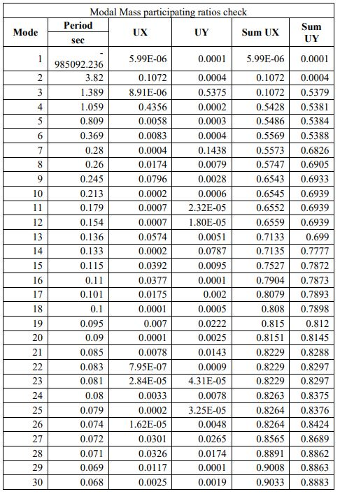
Modal Mass Participation ratio
The check according to UBC code must be greater than 90% in order to use response spectrum analysis.

Slide 38

base shear checks
in this check base shear from response spectrum cases equal or more than base shear from equivalent static method.

Slide 39
Drift check:
This check is made to see the difference between the displacements in the story, in the both direction X and Y.
story | height | dis_x | dis_y | drift_x | drift_y | delta_x | delta_y | delta_limit
0 |  | 0 | 0
1 | 2500 | 0.084 | 0.186 | 0.084 | 0.186 | 0.3234 | 0.7161 | 50
2 | 3750 | 2.78 | 0.734 | 2.696 | 0.548 | 10.3796 | 2.1098 | 75
3 | 4500 | 0.714 | 1.511 | 2.066 | 0.777 | 7.9541 | 2.99145 | 90
4 | 4250 | 2.251 | 2.827 | 1.537 | 1.316 | 5.91745 | 5.0666 | 85
5 | 3000 | 3.997 | 3.845 | 1.746 | 1.018 | 6.7221 | 3.9193 | 60
6 | 3000 | 4.55 | 4.155 | 0.553 | 0.31 | 2.12905 | 1.1935 | 60
7 | 3000 | 4.56 | 3.99 | 0.01 | -0.165 | 0.0385 | -0.63525 | 60
8 | 3000 | 4.155 | 3.49 | 0.405 | -0.5 | 1.55925 | -1.925 | 60
9 | 3000 | 3.573 | 2.68 | 0.582 | -0.81 | 2.2407 | -3.1185 | 60
10 | 3000 | 3.526 | 2.48 | 0.047 | -0.2 | 0.18095 | -0.77 | 60

Slide 40
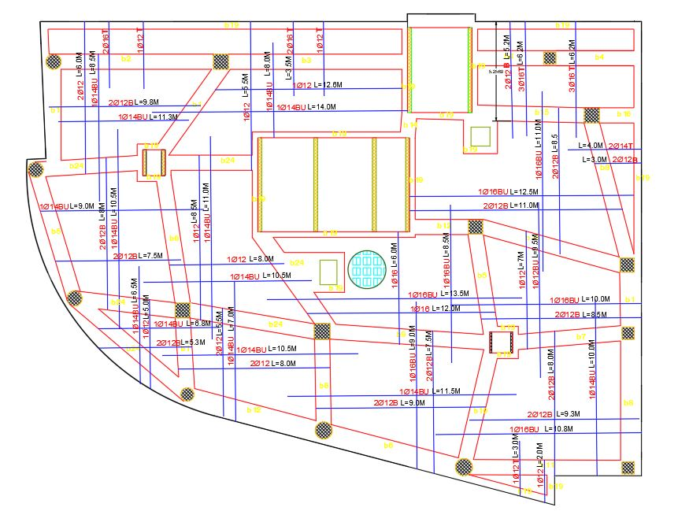
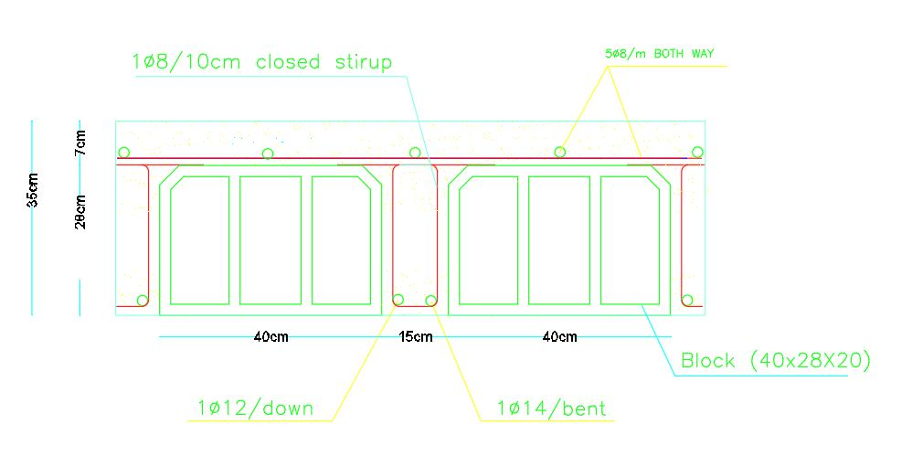
Design of structural elements
Slab:

Slide 41
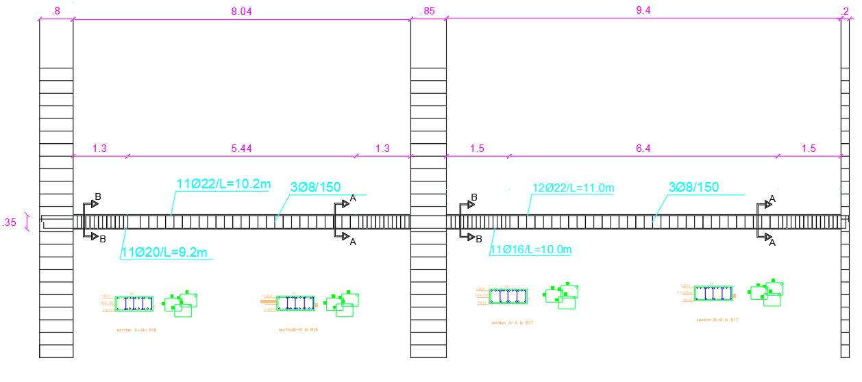
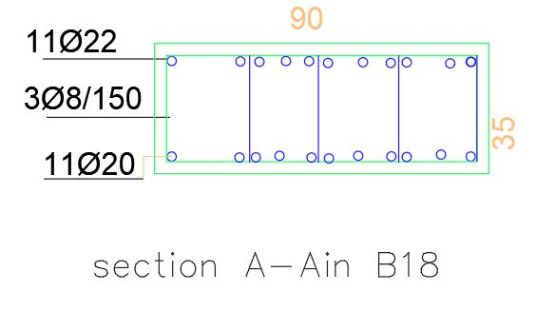
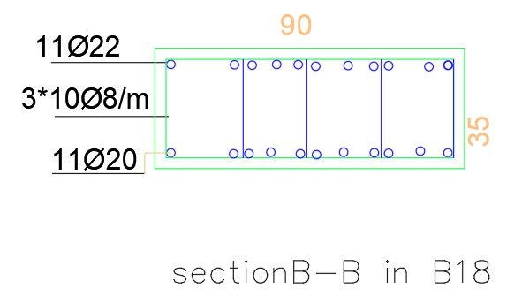
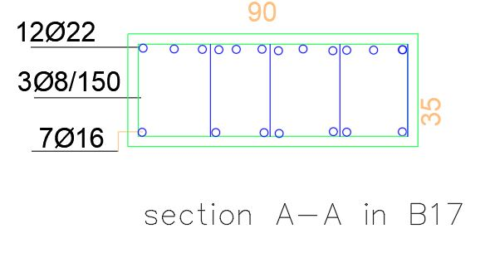
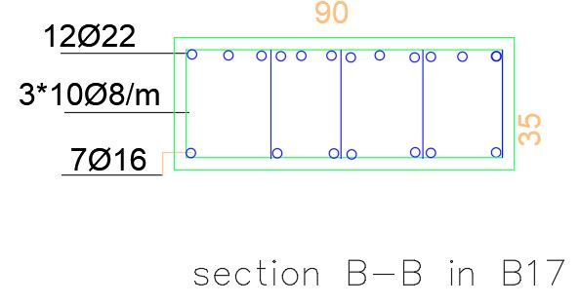
Beams:

Slide 42

Columns:

Slide 43

columns:

Slide 44


Shear wall:

Slide 45


Footing:

Slide 46


Retaining wall:

Slide 47

Stairs:

Slide 48
Electro-Mechanical Design

Slide 49
Electro-Mechanical Design
Hvac
Artificial lighting
Water supply & Drainage

Slide 50
Hvac System

Slide 51
H-vac System
Design Capacities :
Vrf (Variable refrigerant flow) system has been used.
Equipment from Toshiba company has been used.
Square diffusers for retail stores have been used.
Slot linear diffusers for warehouses & Offices have been used.
Split unit in residential apartments has been used.
Floor No. | Design capacity (KW)
Basement | 34.66
Ground | 19.53
First | 32.02
Second | 25.36
Third | 23.68
Fourth | 15.99
Fifth | 16.16
Sexth | 22.08
Total | 189.48

Slide 52
Outdoor unit
Mini outdoor unit for apartments
Outdoor unit for stores ,warehouses &offices

Slide 53




Indoor units:
Fan coil
Indoor fresh air intake
Indoor wall mounted
Square Diffuser
Slot linear Diffuser

Slide 54

The distribution of the ducts and diffusers in the ground floor.

Slide 55

The distribution of the ducts and diffusers in Warehouses.

Slide 56

The distribution of the ducts and diffusers in Offices.

Slide 57

The distribution of the ducts and diffusers in apartments

Slide 58

Out door units in roof

Slide 59
Artificial lighting

Slide 60








Office lighting
Luminaires Selected
Simulation result
Luminaires distribution for office

Slide 61





Office lighting
Staff room
reception
Manager room
Meeting room
corridor

Slide 62






Residential apartment lighting
Luminaires Selected
Simulation result
Luminaires distribution for an apartment

Slide 63






Residential apartment lighting
Living room
Kitchen
Living& Dining room
Master bedroom
Girls bedroom
Boys bedroom

Slide 64








Retail shop lighting
Simulation result
Luminaires Selected
Luminaires distribution for a store

Slide 65






Restaurant lighting
Simulation result
Luminaires Selected
Luminaires distribution for the restaurant

Slide 66


Socket and distribution board
Distribution of circuit breaker in distribution board 15
Distribution of sockets for an office

Slide 67


The electrical loads on M.D.B
The electrical loads of HVAC & elevators
Place of main distribution board
Ascending system for electrical cables

Slide 68
Water supply & Drainage

Slide 69

Water system
For apartments the average day consumption is 159.2L/apt.
For offices the average day consumption is 3.8 L/person.
The pipes used in the building are different from one
function to the other.
Total FU for the building
floor | FU total
b1 | 40
G.F | 40
1ST floor | 20
offices | 100
residentials | 276
total | 476

Slide 70

roof water system layout

Slide 71

Apartments water system

Slide 72



Trash shaft

Slide 73

Drainage
Apartments drainage

Slide 74

Roof drainage

Slide 75

Parking drainage

Slide 76

Pipes in parking ceiling

Slide 77
Acoustical Design

Slide 78

Acoustic design:
The spaces that were designed acoustically in the building:
Manager office
Staff room
Guest room
The absorption coefficient for the finished material

Slide 79




Reverberation time(RT60):
The reverberation time for the guest room according to Sabine
The reverberation time for the staff room according to Sabine

Slide 80



Sound Transmission Loss (STC)
The sound transmission loss (STC) for the internal walls between different spaces
The sound transmission loss (STC) for the external walls

Slide 81

Impact Insulation Class (IIC)
The Impact insulation class for the ceiling = 67 dB and the calculated IIC for the ceiling should be more than 50 dB, so it is ok.

Slide 82
Safety & Fire suppression system

Slide 83




Fire fighting system
Detection and notifications
Suppression systems
Signs and emergency light
Part of fire fighting system for office floor

Slide 84







Signs and emergency light
Heat detector
Smoke detector
Fire hose
Stand pipe

Slide 85



space | Extinguisher type
office | Dry powder Extinguisher
warehouse | Dry powder Extinguisher
Residential apartment | Dry powder Extinguisher
kitchen | Wet chemical Extinguisher
Mechanical & Electrical room | CO2 Extinguisher
Extinguisher
space | Sprinkler type
parking | Water sprinkler
warehouse | Water sprinkler
Restaurant kitchen | Wet chemical sprinkler
sprinkler

Slide 86


Over-lap between all systems
Over –lap for second parking
Over –lap for offices floors

Slide 87
Quantity Surveying & Cost Estimation

Slide 88
Quantity Surveying
The total cost of the building is 13,196,891.66 ILS and the total area of the building is 8362 m² which means that the total unit cost is 1578.2 ILS/ m².
Activity | Cost (ILS)
Earth work | 951,314.06
Foundation Work | 830,287.10
Sub Structure Work | 2,754,492.10
b2&b1 Floor work | 561,160.00
ground Floor work | 306,706.40
First to seventh Floor Work | 1,181,824.00
Stair Work | 49,603.00
Finishes | 4,062,322.00
Fire Alarm | 111,400.00
Lighting & Electrical | 849,100.00
Mechanical work | 1,038,683.00
Elevators | 500,000
Total | 13,196,891.66

Slide 90
The End

