Slide 1
Evaluation and Redesign of Rojeeb Street

Slide 2
Objectives
Evaluation of existing conditions of Rojeeb Street.
Estimation of future conditions of Rojeeb Street.
Redesigning the road taking in consideration :
pavement Design.
Geometric Design.
Traffic Design.

Slide 3
Significance of work
Rojeeb Street connects between two main governorates (Jenin and Nablus).
Due to current conditions of this road a lot of accidents occur on it , this will cost human lives and economic cost . Our design will provide better and more safe conditions to avoid these losses .
Design with consideration of a new eastern public transportation complex.

Slide 4
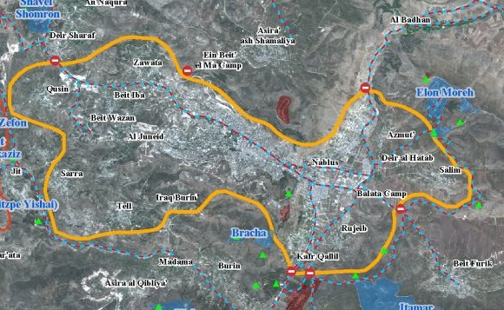
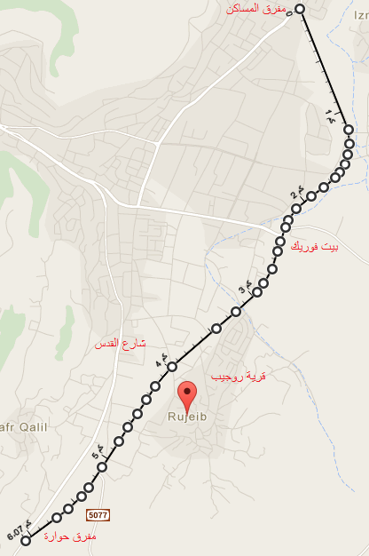
Study area
Site: Rojeeb, Nablus, Palestine
Year: 2014
Nablus
Surroundings:
Howarra from south
Rojeeb from east
Nablus from west
Al-Bathan from North

Slide 5
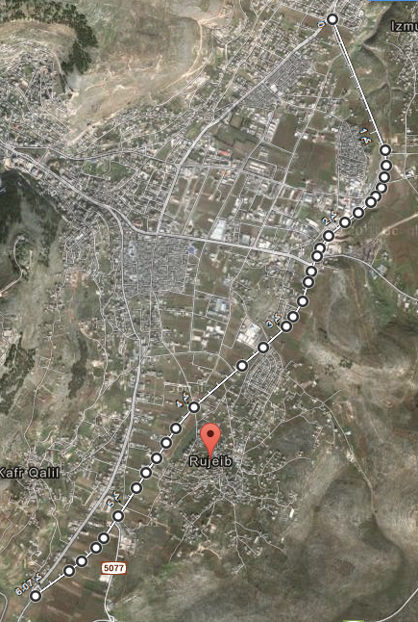
Study area
The street is Located in the eastern region
of Nablus city.
connects between Howarra
(Ramallah) and Al-Bathan (Jenin).
The length is approximately 6 km.

Slide 6
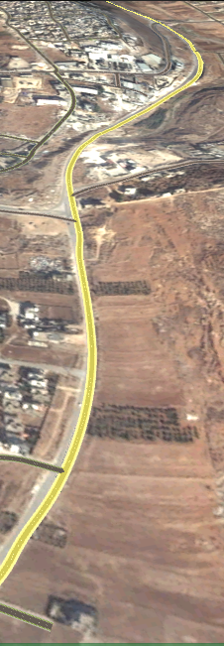
Inventory
The road is mainly divided into two major parts according
to its pavement condition.
First part is from Howwara to Bait-Foreeq .
Second part is from Bait-foreeq to Al-Msaken.
Pavement conditions of street is bad.
Light conditions is bad.
No side walk, no light poles.
Asphalt width is approximately 7m.

Slide 7
Data collection
Contour map.
Road network.
Structural plan (Houses distribution).
Soil samples.
Traffic volume.
Data for estimating the cost of the project.

Slide 8
Traffic volume
Count the traffic volume on the major five intersections in the study area:
Hiwwarah Intersection .
Rojeeb Intersection .
Al Masaken Intersection .
Beit Furik Intersection .
Salem Intersection .

Slide 9
Design speed
Based on AASHTO, the selected design speed of the highway is 100 Km/hr.

Slide 10
Data analysis

Slide 11
Data analysis (Geotechnical analysis)
Taking Samples Of Soil and making Tests on them in the University Lab.
Type of soil is (A-2-4) .
Which is silty and clayey gravel and sand .
CBR values of samples are between 40-50 .
It’s good to use as subgrade.

Slide 12
Data Analysis for Intersections (level of service)

Slide 13
Data Analysis for links (Two Lane Rural Highway)
For the existing conditions
Level of Service is B

Slide 14
Future Analysis

Slide 15
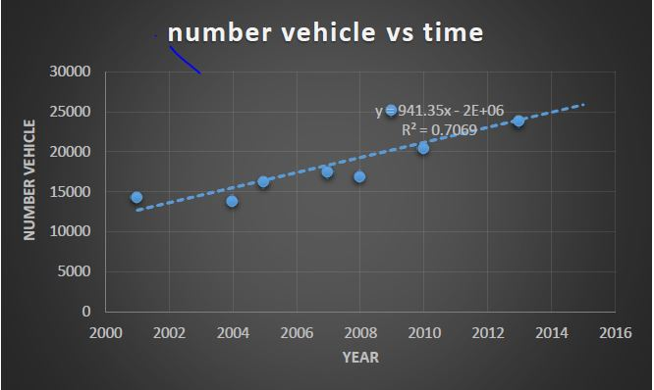
Analysis of Future Conditions
To calculate the future traffic volume, there is a need to determine the traffic growth rate ( i )
Based on the Palestinian Central Bureau of Statistics related to number of vehicles in Nablus form 2001 to 2014.
i=3 % .
Future PHV =1054 vehicles.
LOS is (E)

Slide 16
Geometric Design

Slide 17
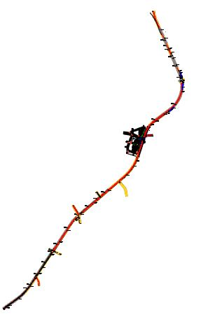
Geometric Design

Slide 18
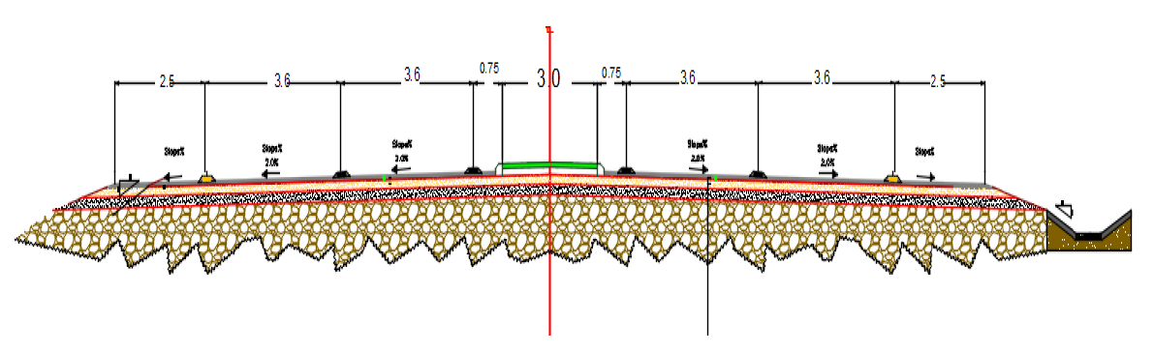
Geometric Design
Typical cross section

Slide 19
Pavement Design
Design the layers of road based on AASHTO .
Road layers contain :
10 cm asphalt pavement.
20 cm base coarse.
20 cm sub base .

Slide 20
Intersection Design

Slide 21
Intersection Design
The design vehicle is WB-19 .
. Simple curve with taper is used.
The width of a Turning Roadway at an Intersection is 6m .
Raised and flushed islands are used .

Slide 22
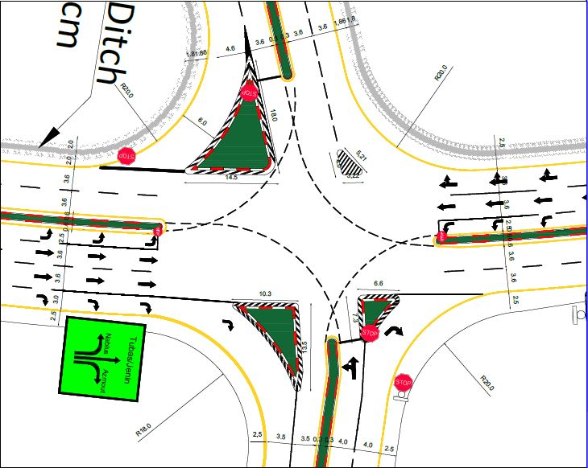
Intersection Design

Slide 23
Control Devices

Slide 24

Control Devices
Signs are used in this design :
Regulatory signs : Stop, Yield, Speed limit, Parking, pedestrian signs
Warning signs
Guiding signs
Some signs used in our design

Slide 25
BILL OF QUANTITY
The estimated total cost of Rojeeb Street is 3928435$, and the details of costs are shown :
$ Total cost | Item
1,768,918 | Earth work
1,080,101 | Sub base and base coare
373,226 | Bituminous construction
459,690 | Miscellaneous works
246,500 | Drainage system cost
???? | Total Estimated Cost

Slide 26
Standards and Specification
Based on the American Association of State Highway and Transportation Officials (AASHTO) for soil classification, geometric design
Manual of Traffic Engineering Studies for traffic studies
Traffic Analysis based on Highway Capacity Manual 2010 (HCM).

Slide 27
Conclusion
This road is important because it connects two main cities and it is expected to construct a new eastern public transportation complex, so this will change the traffic volume of this street.so we need to develop the street to be more efficient.
The existing condition is bad and it need to be changed.

Slide 28
Recommendation
We recommend to adopt this design to solve the current problems and to achieve desired goals , this will help in the economical development of surrounding areas and improve traffic conditions .
When we design the street we must control traffic safety and modernize the private data in order to face the upcoming changes.
During construction of the new terminals, it is important to take all improvement actions into considerations, such as the roundabouts and the redesigned streets, because these actions are very important to support the terminals to function properly.

Slide 29
Thank you

