Slide 1
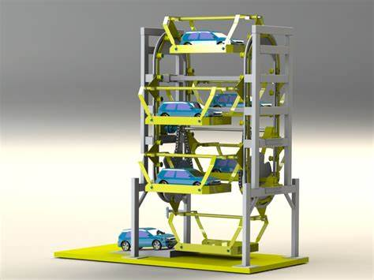
Rotary Parking Application
Graduation Project II
Supervised by :
Dr. Mahmoud Assad
Yasmeen nassar 11820124
Hiba habash :

Slide 2
Outline
Introduction .
Project Motivations .
System Methodology and Flow-Chart .
System Implementations .
System Main Components .
Conclusions and Recommendations .
Problem
Future Work .
Demo

Slide 3
Introduction
why smart parking system?
As the number of people increases, leading to an increase in the number of cars, the need for providing parking spaces that use the least possible space for the largest number of cars has emerged.
The main idea of this project is to utilize space in addition to having a smart payment system where you pay once to enter, and if there are no available parking spaces, the system will not allow you to enter and will display the number of available parking spaces on a LCD screen.
Additionally, a car owner can also request their specific parking spot to take out their car from the parking spot.

Slide 4
System Motivations
Save time and effort for drivers to park their cars in an easy way .
utilize space
User friendly system .
smart payment device
Become more important in the urban crisis .
Make a smart city and climbed for the best .

Slide 5
System Methodology and Flow-Chart
Start
All slot is available are printed the number of them in lcd .
If the driver wont to take out your car
If the driver wont to entrance
Enter the number o your slot in keypad
NO
Did the driver payment?
YES
The entrance gate car will open #of free slots = X-1
The car park in thefirst slot And the rotary parking rotate to second slot after the driver get out
Finish

Slide 6
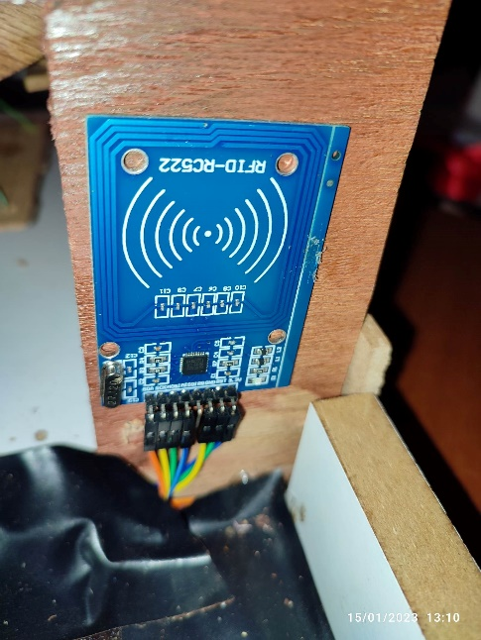
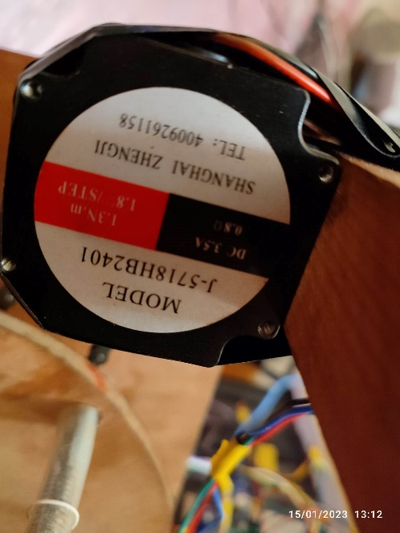
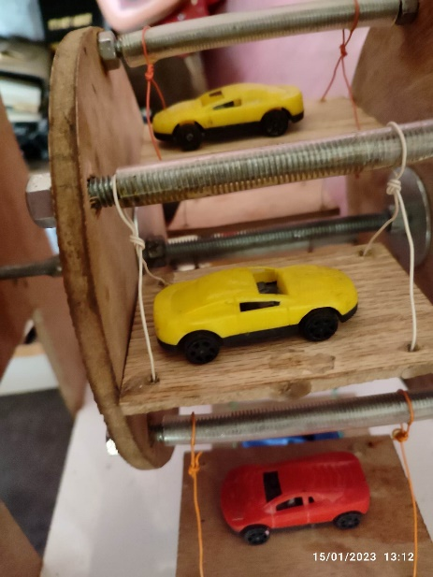
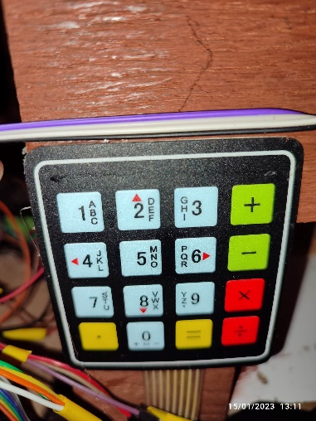
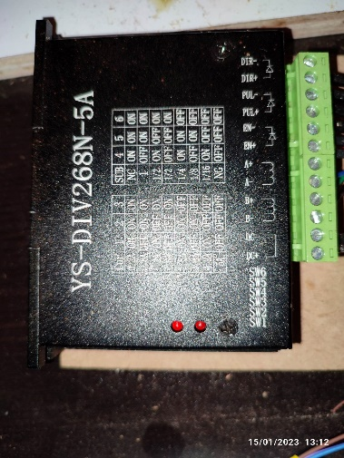
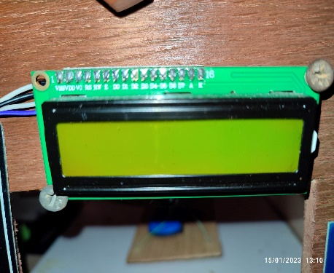
System Implementations

Slide 7
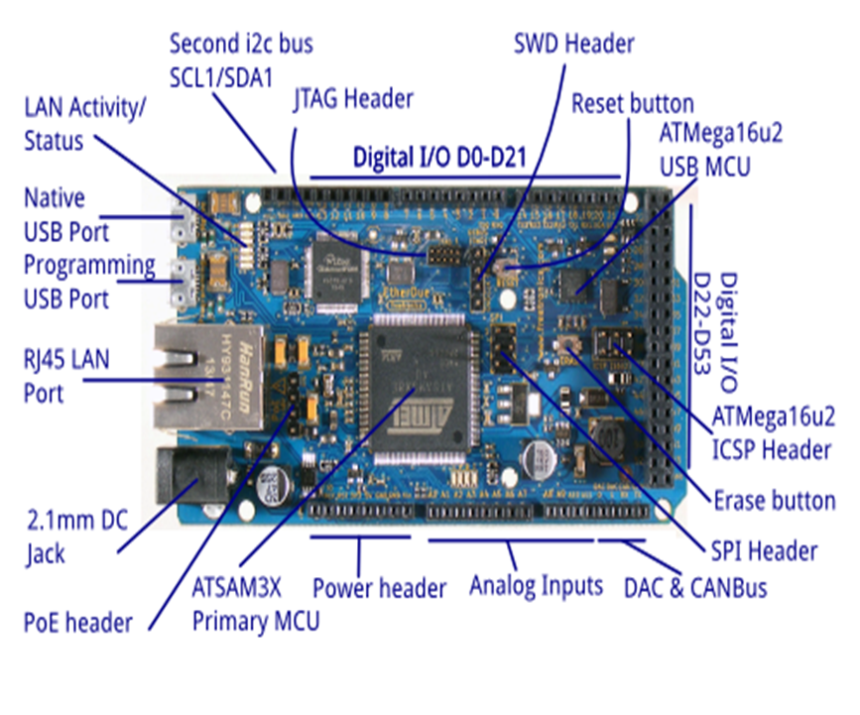
System Main Components
Arduino MEGA
The Arduino Mega is a microcontroller board . It has 54 digital input/output pins , 16 analog inputs, 4 UARTs (hardware serial ports), a 16 MHz crystal oscillator, a USB connection , and a reset button.
In our project we used Arduino UNO but it doesn’t have enough pins , but Arduino MEGA does .

Slide 8
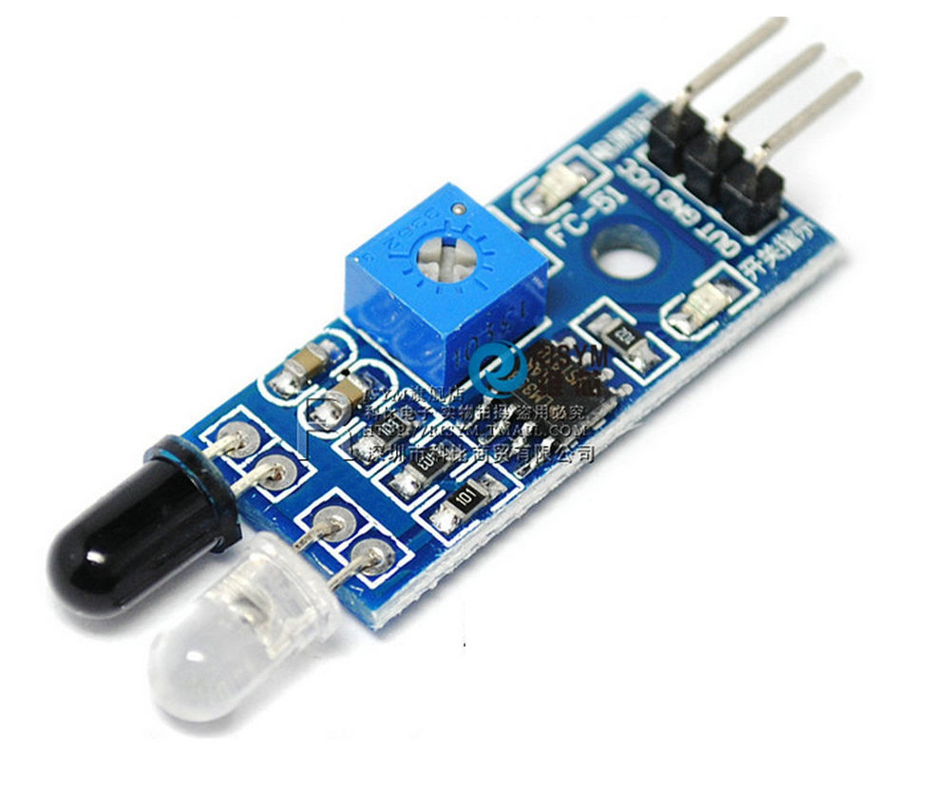
System Main Components
IR_ Sensor (distance sensor)
we chose this type because of its simplicity and it covers the ranges we need. We used three sensor
two to entrance gate car .
And one to detect the driver I gut out .

Slide 9
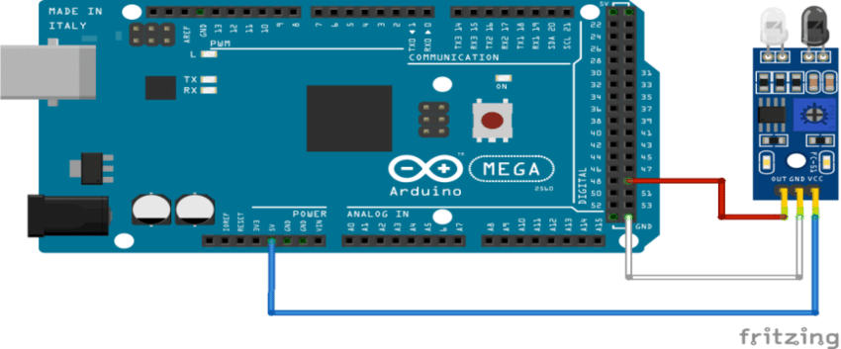
System Main Components
Interfacing ir sensor With Arduino

Slide 10
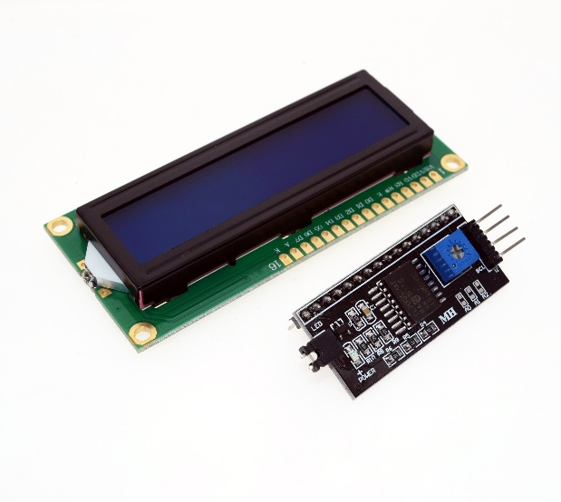
System Main Components
LCD ( with i2c)
in our project we used LCD to show the # of free slot.

Slide 11
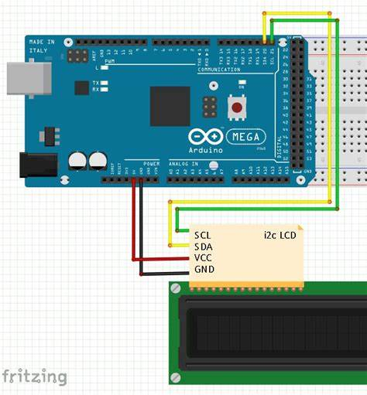
System Main Components
Interfacing LCD With Arduino

Slide 12
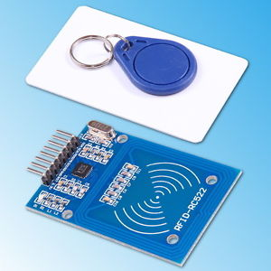
System Main Components
RFID Reader ( Radio Frequency Identification )
RFID systems evolved from barcode labels as a means to automatically identify and track products and people .
In our project we use an RFID reader at the entrance of the parking.
If driver check RFID that’s mean the driver payment to enter the car one time .

Slide 13
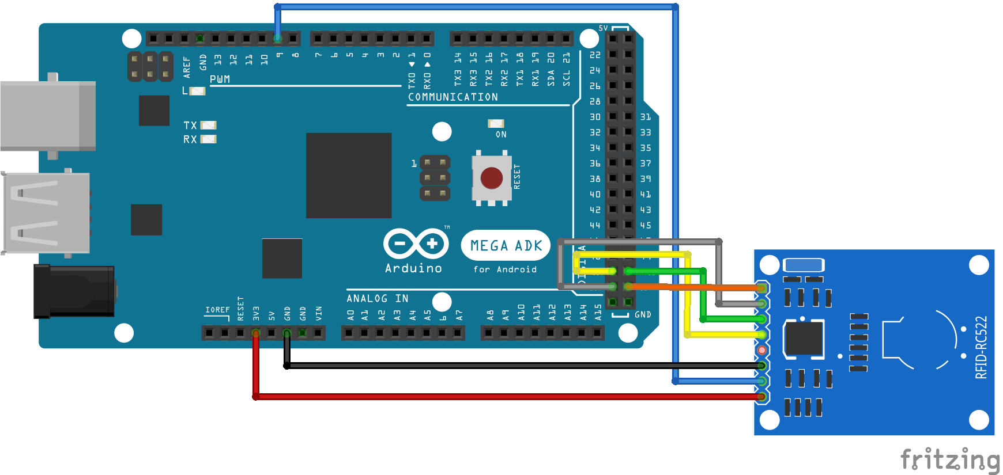
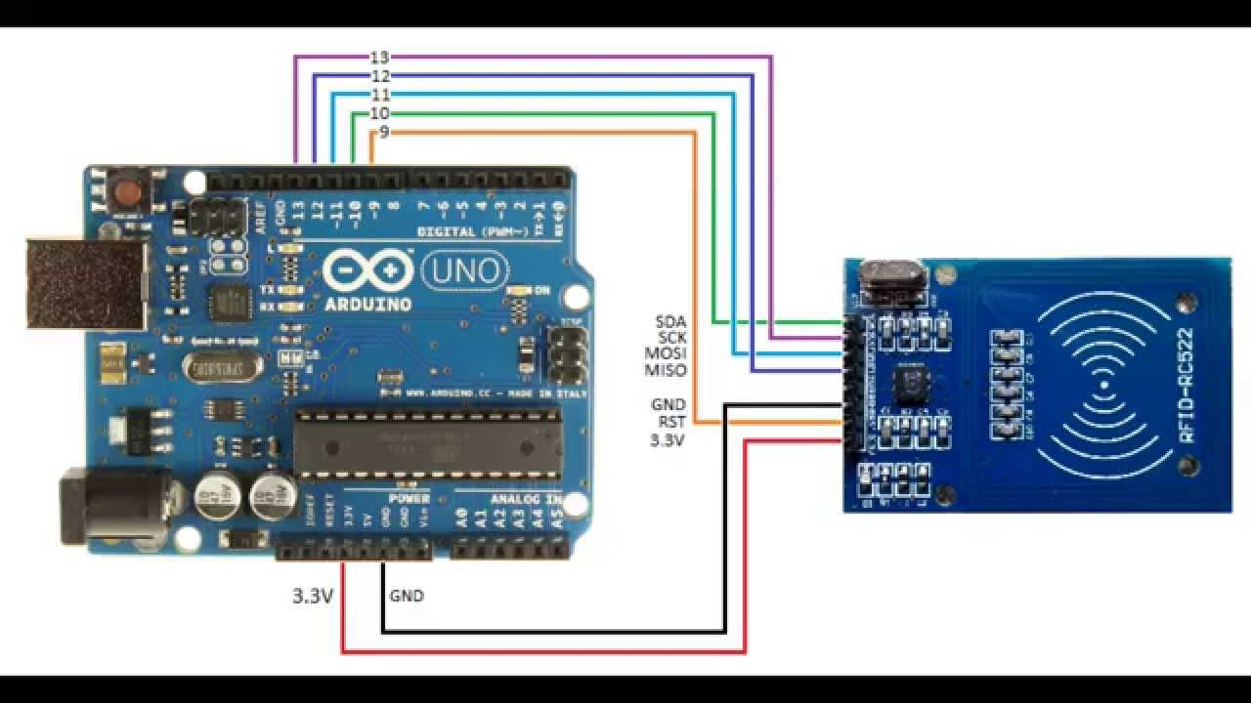
System Main Components
Interfacing RFID With Arduino

Slide 14
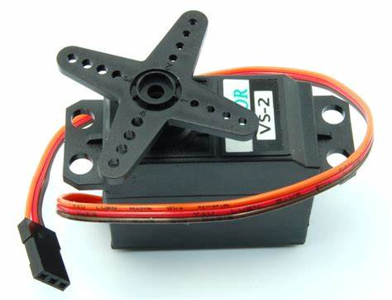
System Main Components
Servo Motor
Servos are controlled by sending an electrical pulse of variable width, or pulse width modulation (PWM), through the control wire.
In our project we used a servo motor to control opening and closing the gate at the entrance of the parking .

Slide 15
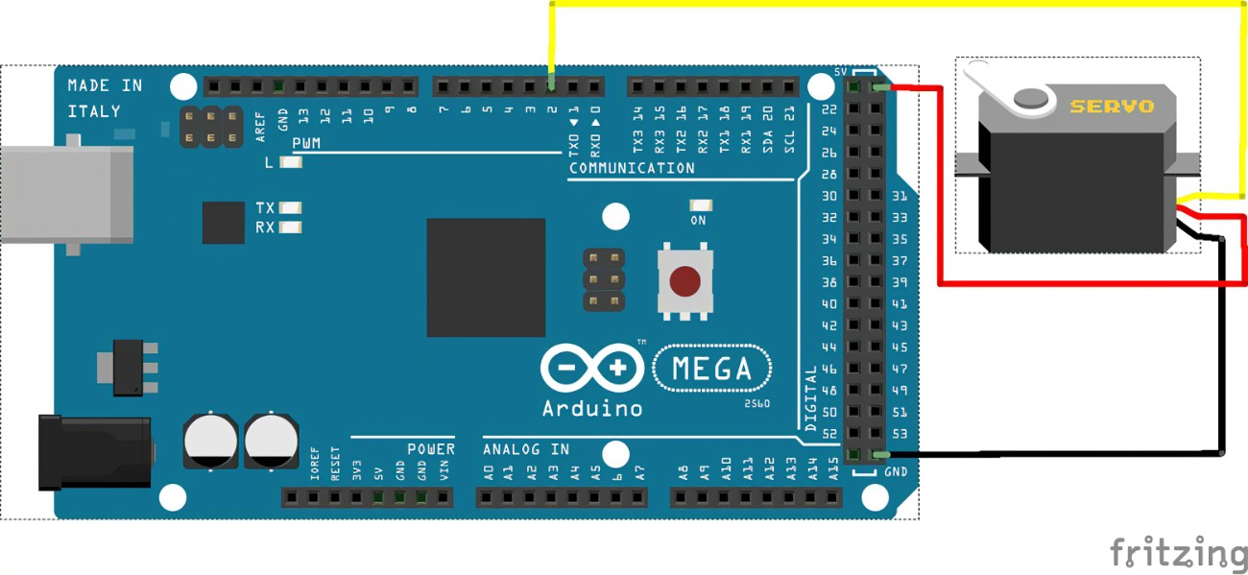
System Main Components
Interfacing Servo Motor With Arduino

Slide 16
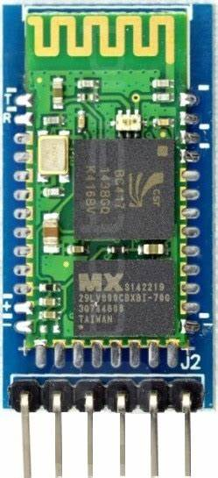
System Main Components
Hc-05 Bluetooth Module

Slide 17
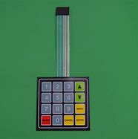
System Main Components
Key-pad :
Driver enter the number of slot in the key pad to take out your car.

Slide 18
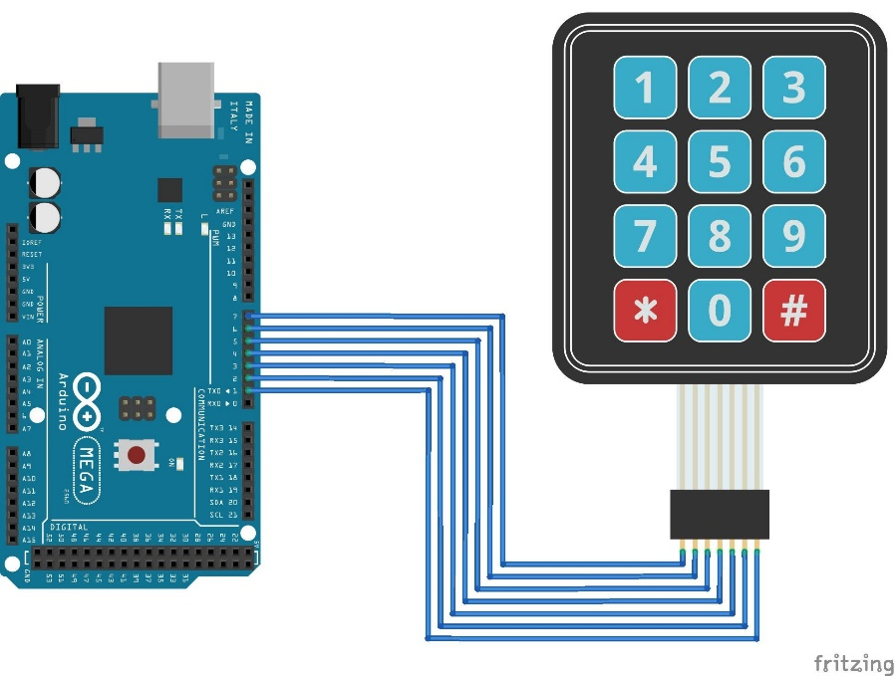
System Main Components
Interfacing RGB LED with Arduino

Slide 19
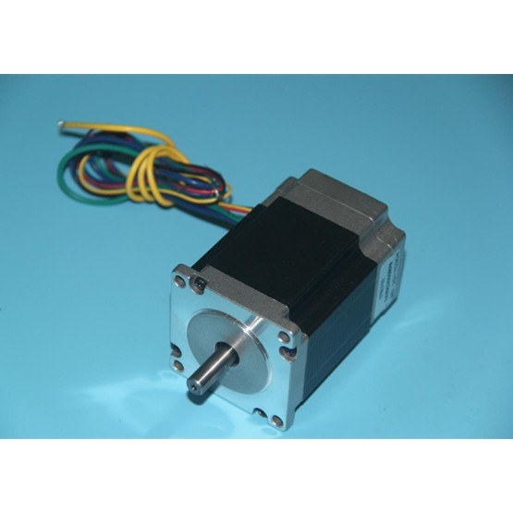
System Main Components
Stepper motor :
We use stepper motor to detect the slot that’s driver enter in key-pad

Slide 20
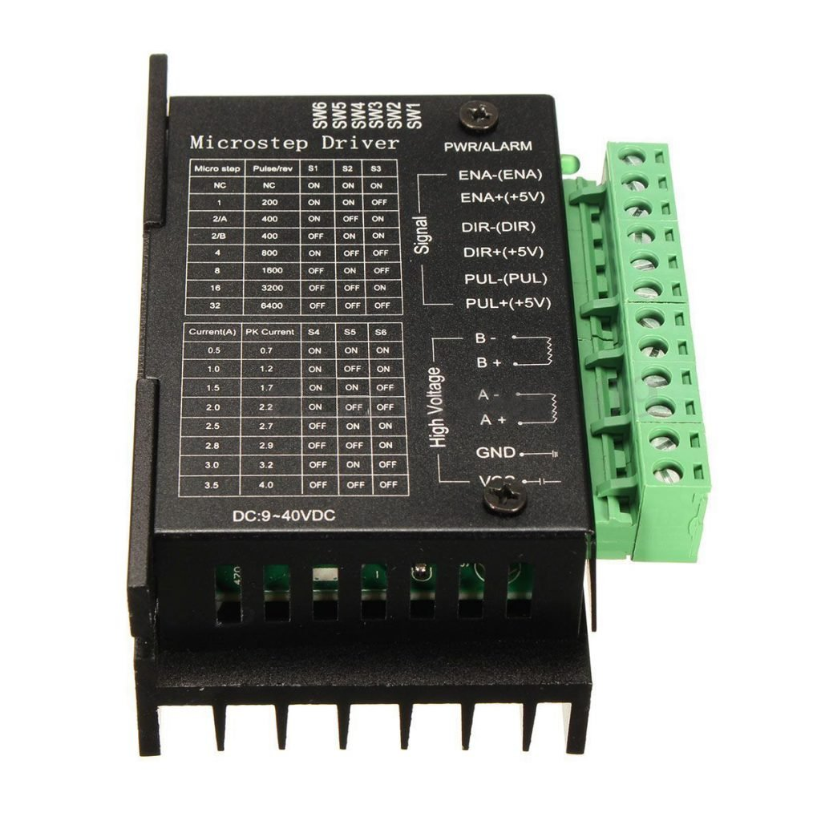
micro step Driver (HY_DIV268N-5A) :
subdivision-type two-phase hybrid stepping motor drive using DC 12 ~ 48V power supply, suitable for drive Two-phase hybrid stepping motor dynamic voltage 12 to 48V, the current is less than 5A outer diameter of 35 to 86 mm
We can control the currant and the degree of step

Slide 21
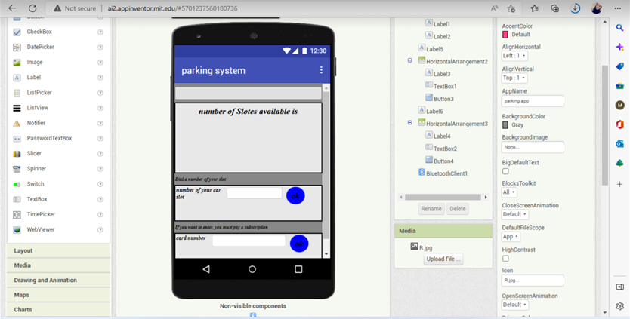
Mobile application :

Slide 22
Problem :
- Running out of pins: our project takes approximately all the pins of the Arduino Mega.
- Design the whole circuit thus connecting the circuit more than once.
- Problems in programming multiple RFIDs and interface them correctly with Arduino.
- Problems in serial communication between the Arduino and PC.

Slide 23
Problem :
  - We could not calculate the torque correctly, so choosing the motor was experimental
  - Connection Arduino mega via hc-05

Slide 24
Conclusions and Recommendations
Reliable, well functioning system model for Rotary parking system.
This system Built to identify the main problem
Propose a solution
Start the implementations of design .

Slide 25
Future Work
Add more features as SMS notifications or remote communication .
Add more features to the app to help the drivers more and more .

Slide 26
Demo :

Slide 27
Demo :

