Slide 1
Design an Alternative Route for Al-Bathan Roadway
Prepared by :
Waheed Hamdallah, Mohammad Zarour, Mohammad Ali
Supervised by :
Eng. Hussin Abu Zant
An-Najah National University
Department of Civil Engineering

Slide 2
Outline
Introduction
  Background.
  Problem statement.
  Objectives.
Methodology
Data collection & Traffic volume studies
Design criteria
LOS analysis
Alternative route selection
Geometric design for the alternative route
Cross section and Pavement design
Traffic Control Devices
Bill of Quantities

Slide 3
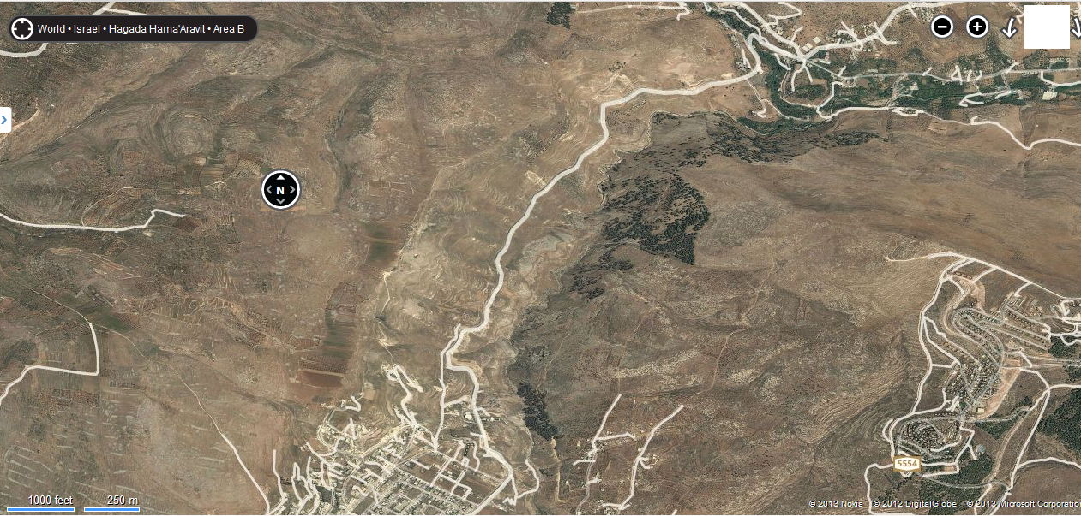
Background
Al-Bathan roadway

Slide 4
Problem statement
The major problem in the current Al-Bathan roadway is the landslides.

Slide 5
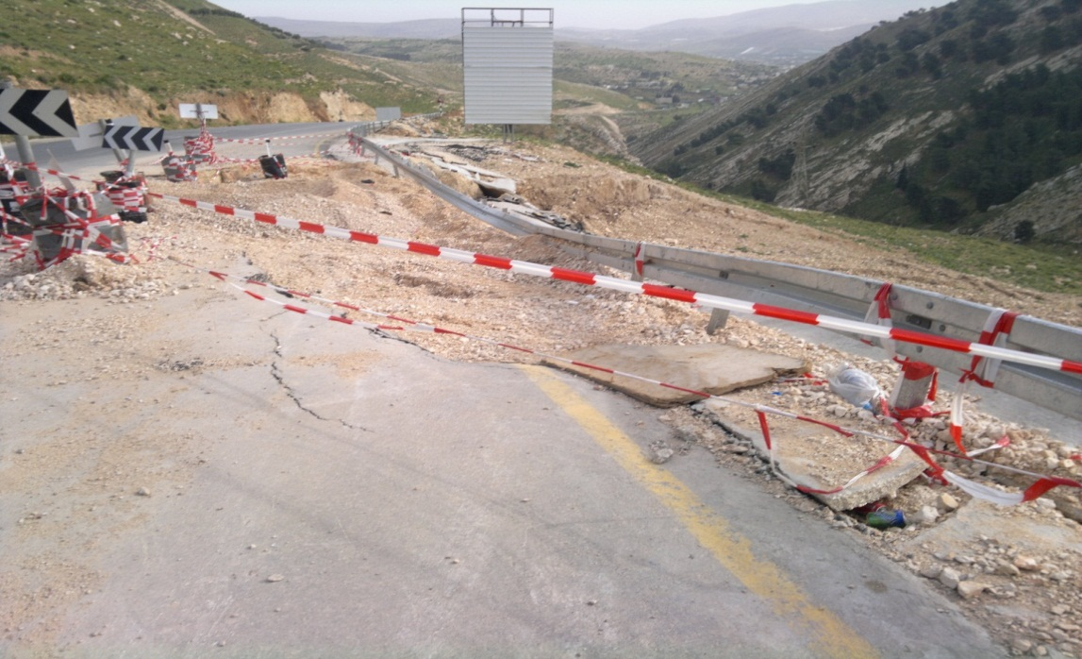
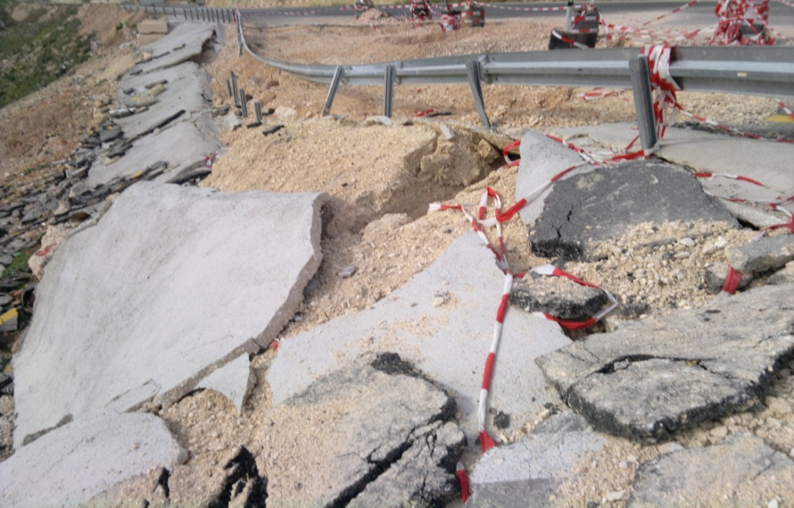
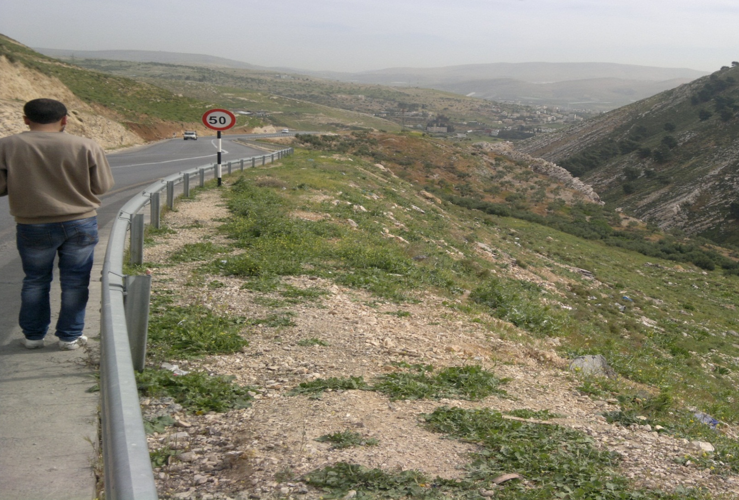

Slide 6
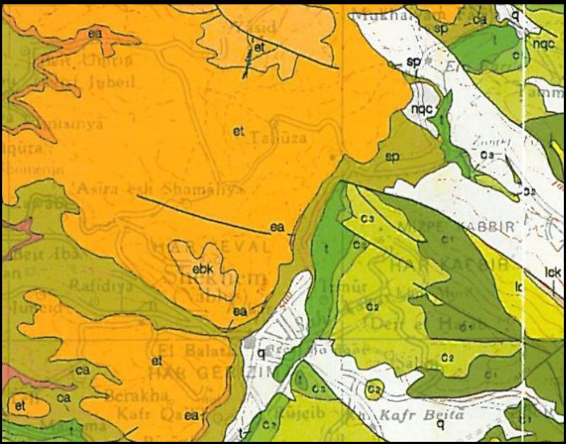
Geological point view of the problem

Slide 7
Objective
Design an alternative route for the current Al-Bathan roadway.

Slide 8
Methodology
Site visit and data collection.
Traffic volume counts and analysis.
Design criteria.
LOS analysis.
Alternative route selection.
Geometric design for the alternative route.
Cross section & pavement design.
Traffic Control devices.
Bill of quantity.

Slide 9
Data collection
Information about the landslides occurred on Al-Bathan road.
Contour map for the general area of 10 m interval.
An up-to-date aerial photo of the whole region.
GIS layers relevant to the study region.
A previous count for Al-Bathan Road.

Slide 10
Traffic Volume Studies
Vehicles classification percentage
Type of vehicle | percent of type
Private car | 55.47 %
Taxi | 28.62 %
Taxi van | 4.87%
Pick-up | 0.43%
Bus | 4.18%
Light Truck | 3.40%
Heavy Truck | 2.18%
Single Truck | 0.39%
Truck/Trailer | 0.26%
Articulated | 0.02%
Tractor | 0.02%
other | 0.16%

Slide 11
Traffic Volume Studies
Total 10-hour traffic volume = 4909 Vehicle.
Peak hour : ( 2:30 pm – 3:30 pm ).
Peak hour volume ( PHV ) = 602 Vehicle .
Peak hour factor ( PHF ) = 0.865

Slide 12
Design hour volume
The calculated growth rate factor is 13.3 %
From practical knowledge the growth rate percentage is approximately equal to 3%.
In this project growth factor of 3.3 % is used.

Slide 13
Design hour volume
Diverted traffic
The assumption is that all the traffic from the original Al-Bathan road will divert to the new alternative road.
Diverted traffic after 20 years is 1153 vehicle.

Slide 14
Design hour volume
Generated traffic
7% of the average daily traffic will be generated due to new possible industries.
5% of the average daily traffic will be generated due to the new agricultural land use.
For each new residential unit the trip rate found to be 0.63 trips, and about 75% of the vehicles will travel are residential unit.
* Total generated traffic after 20 years is 612 vehicle / hr.

Slide 15
Design hour volume
The design hour volume for 20 years is equal 1765 vehicle per hour.

Slide 16
Design criteria
The functional classification of the road is a multilane rural arterial highway.
The design speed is chosen to be 50 mile/ hr. ( 80 km/hr. )
The design vehicle is selected to be ( WB – 15 ) truck.

Slide 17
LOS Analysis
Level of service for the current Al-Bathan roadway (two lane highway) is E .
Level of service for the Alternative Al-Bathan roadway (multi-lane highway) is C .

Slide 18
Difference between activated carbon and magnetic nanoparticles
Design criteria
Route Allocation
GIS program is used to allocate the best alternative route for Al-Bathan roadway.

Slide 19
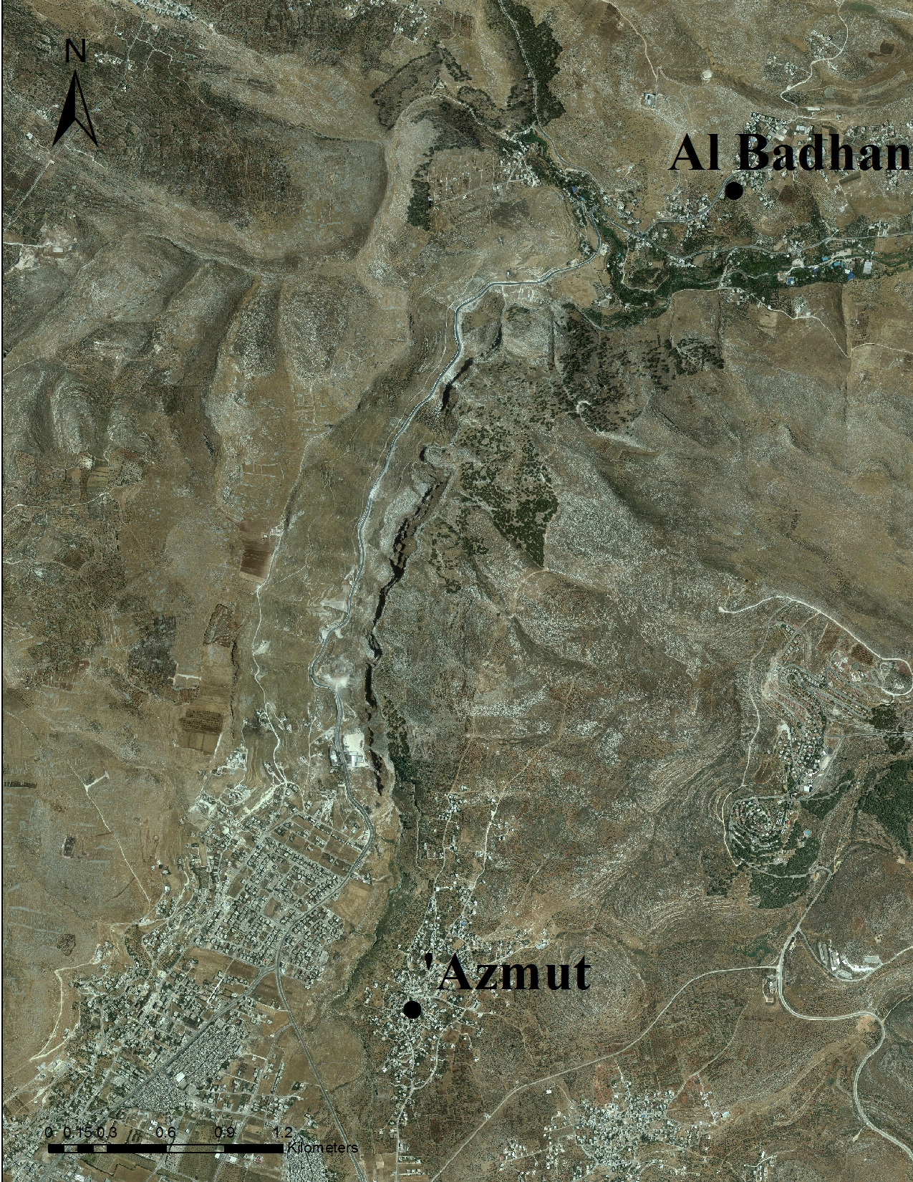
Route allocation – GIS Layers

Slide 20
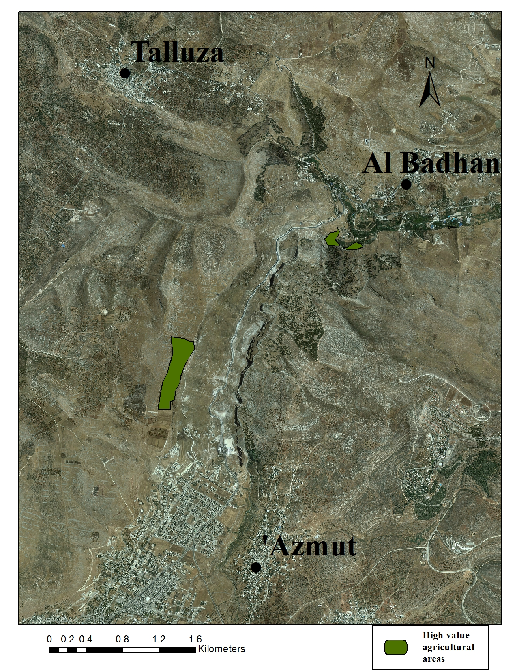
Route allocation – GIS Layers

Slide 21
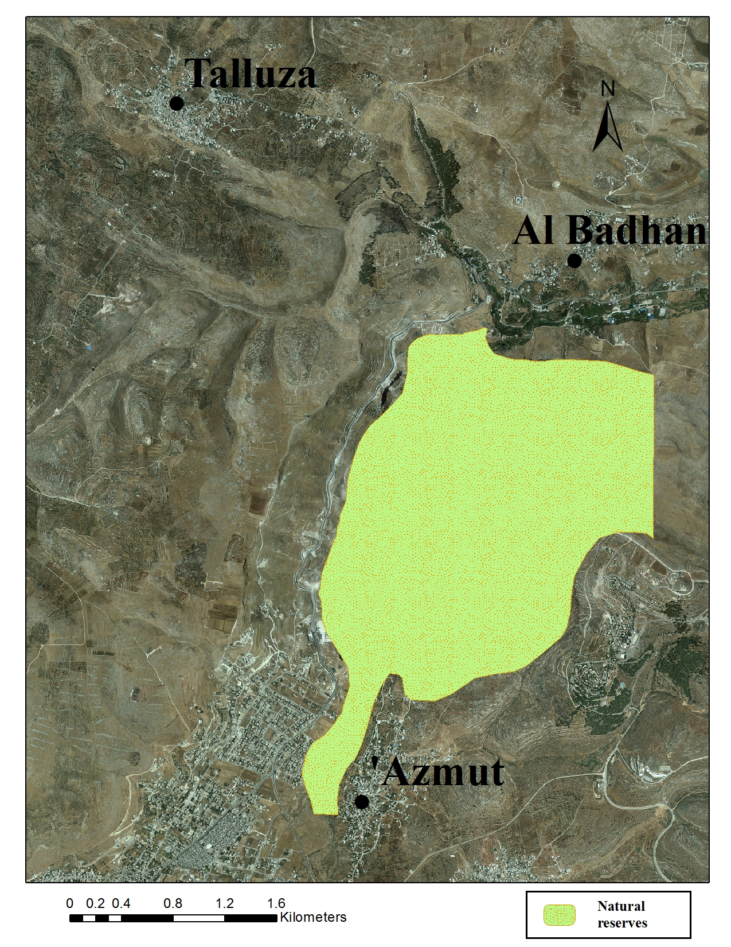
Route allocation – GIS Layers

Slide 22
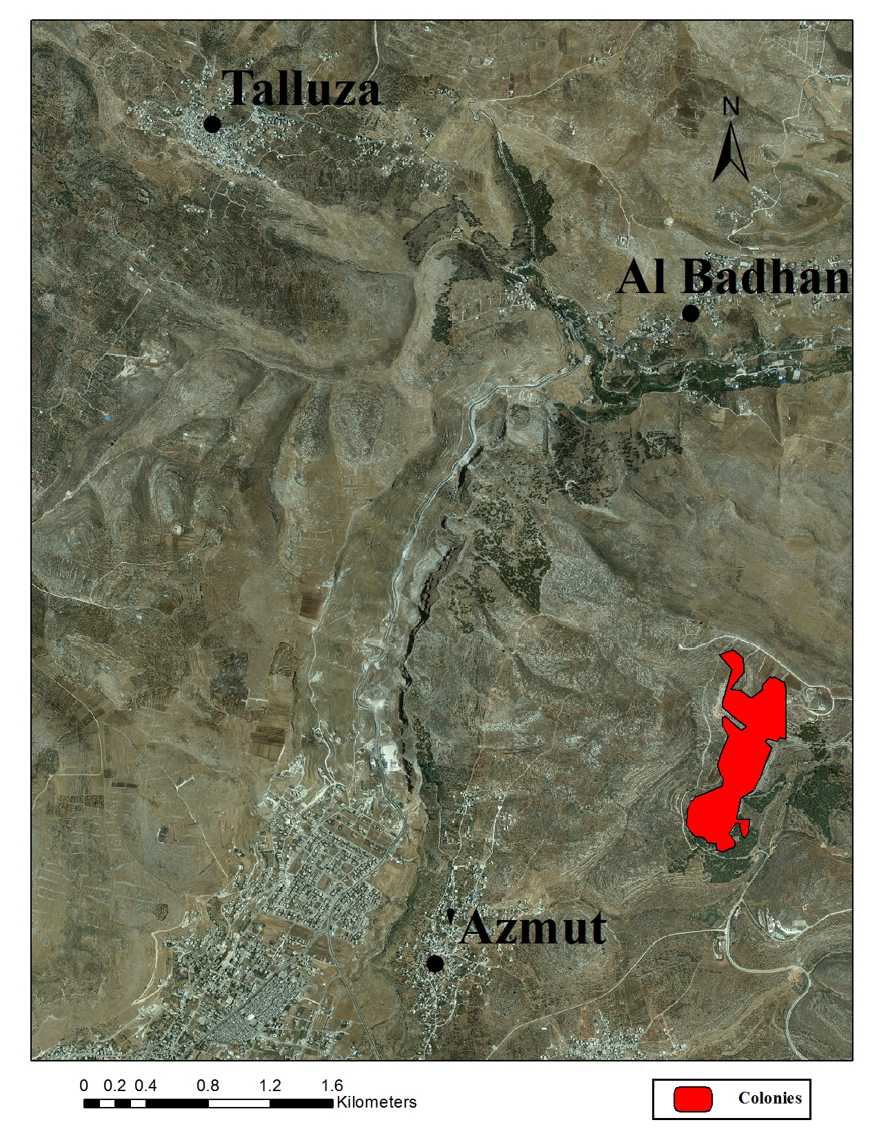
Route allocation – GIS Layers

Slide 23
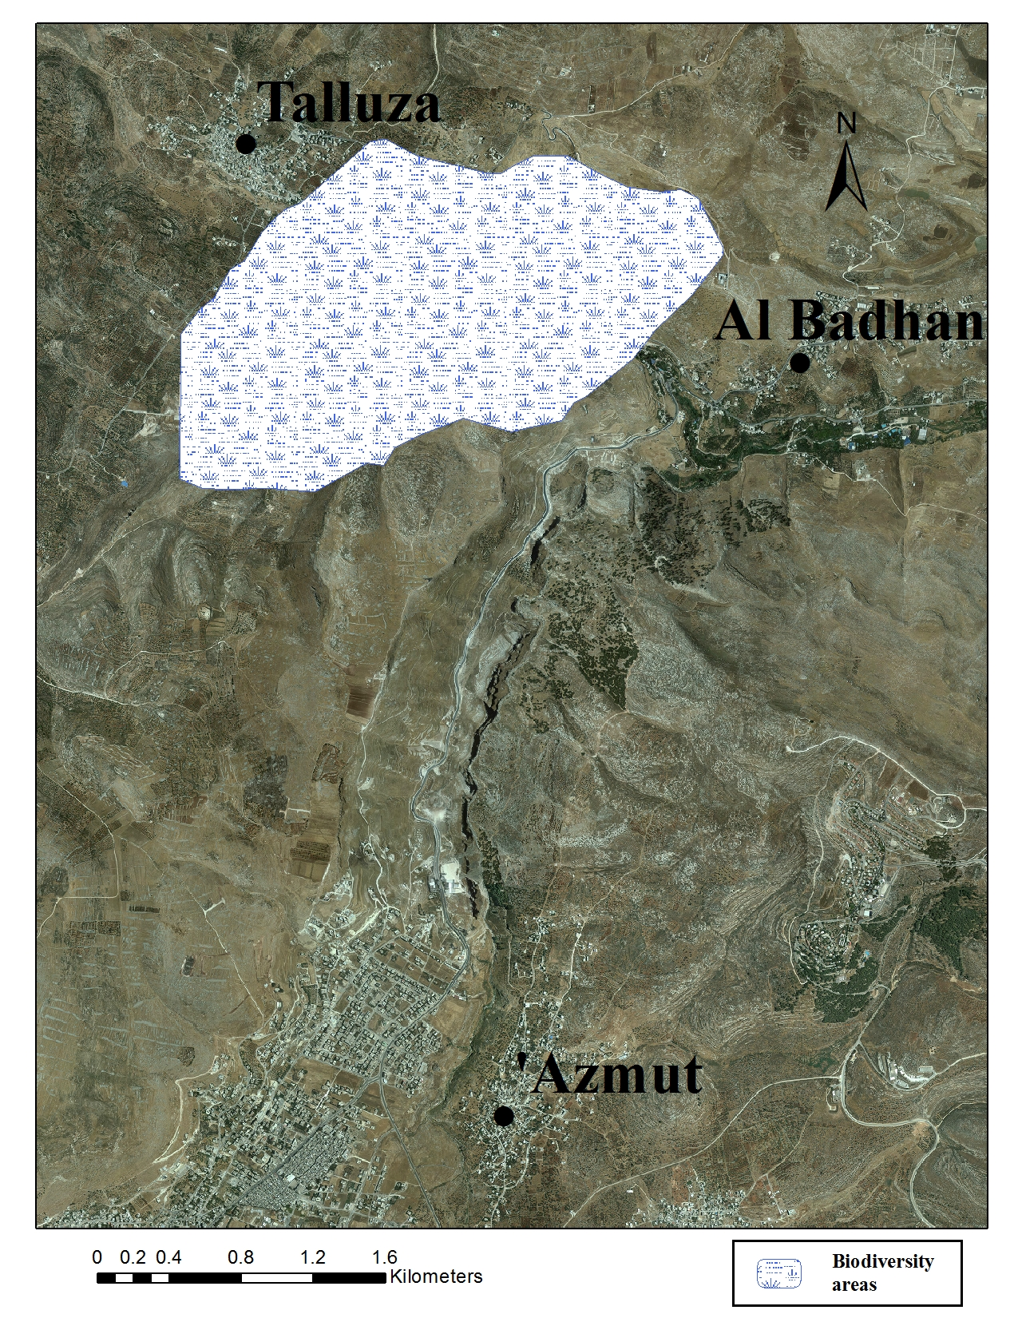
Route allocation – GIS Layers

Slide 24
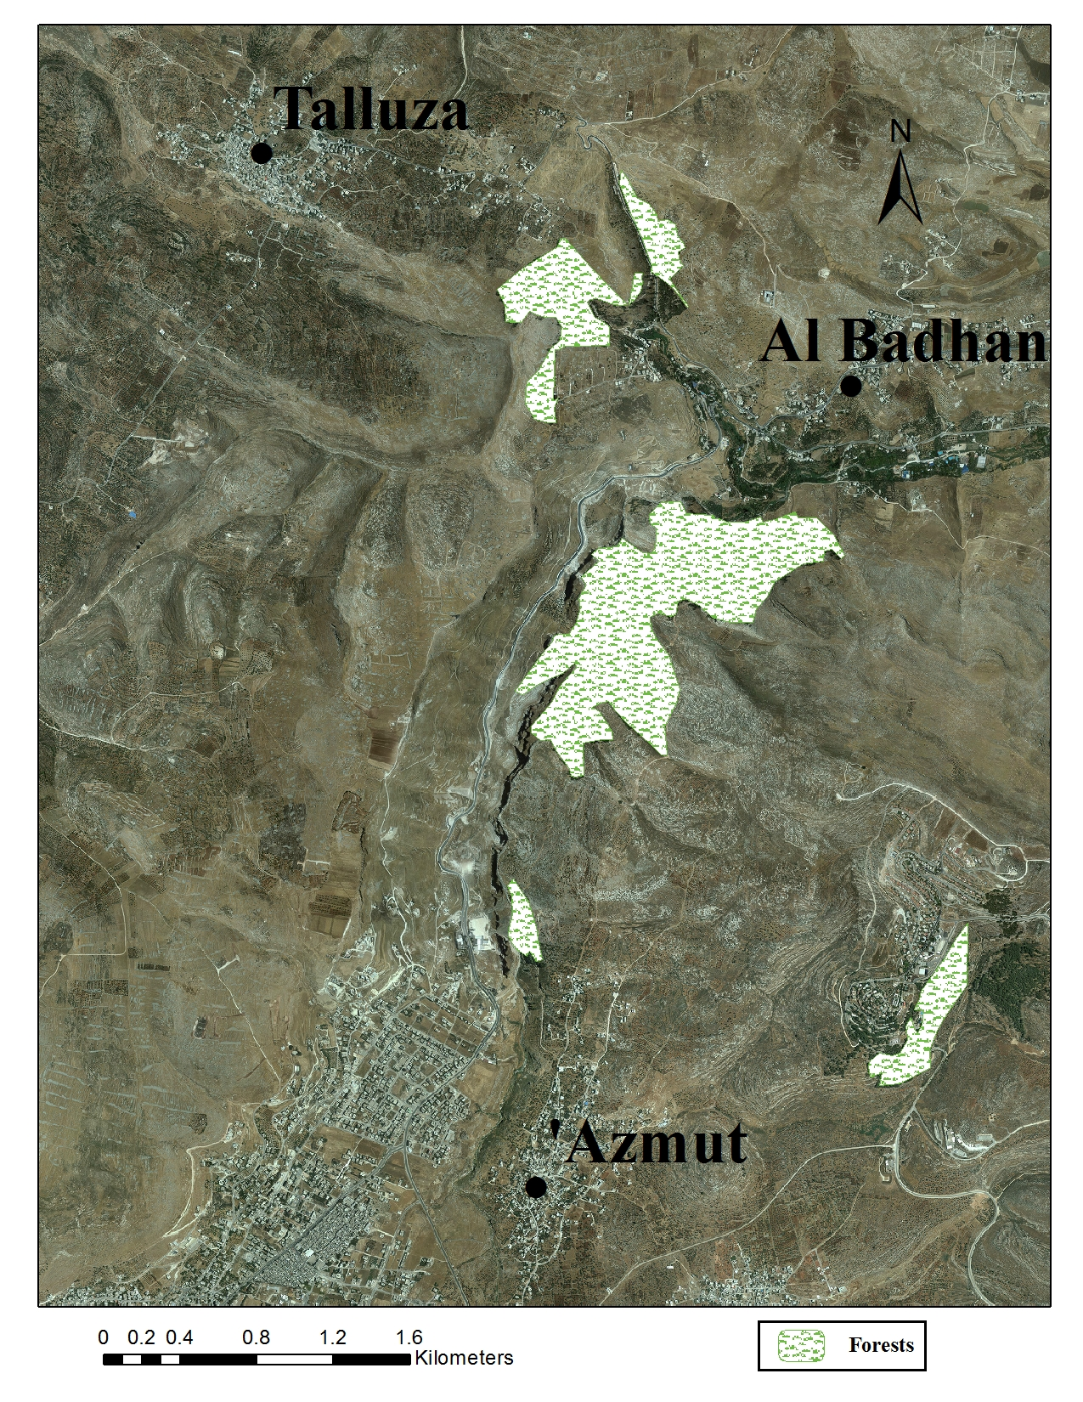
Route allocation – GIS Layers

Slide 25
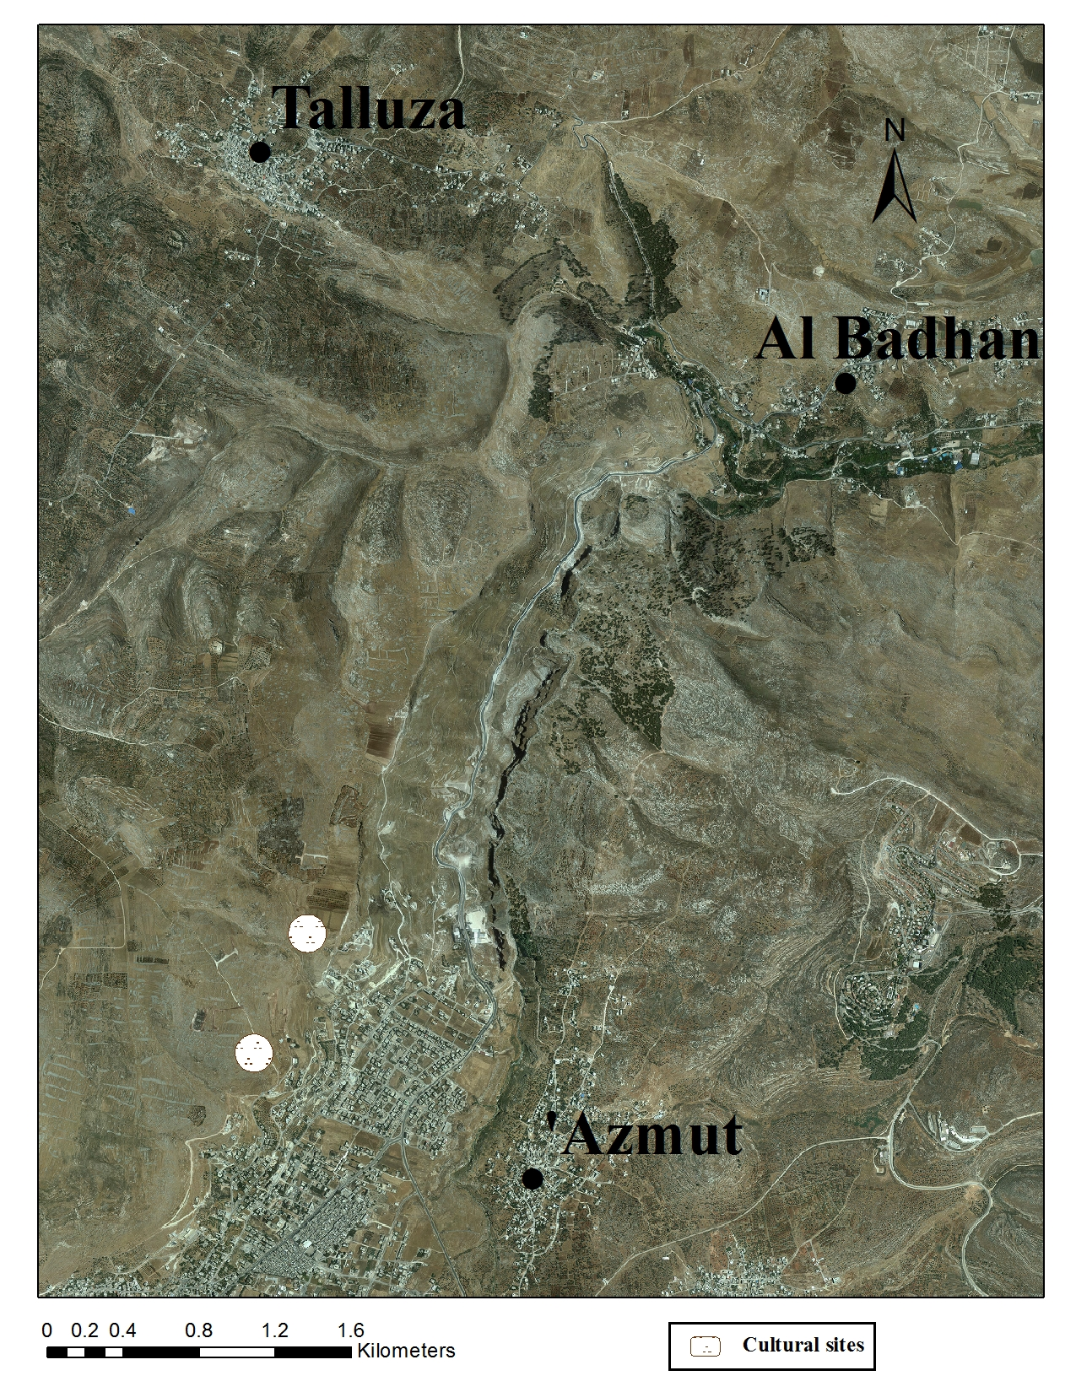
Route allocation – GIS Layers

Slide 26
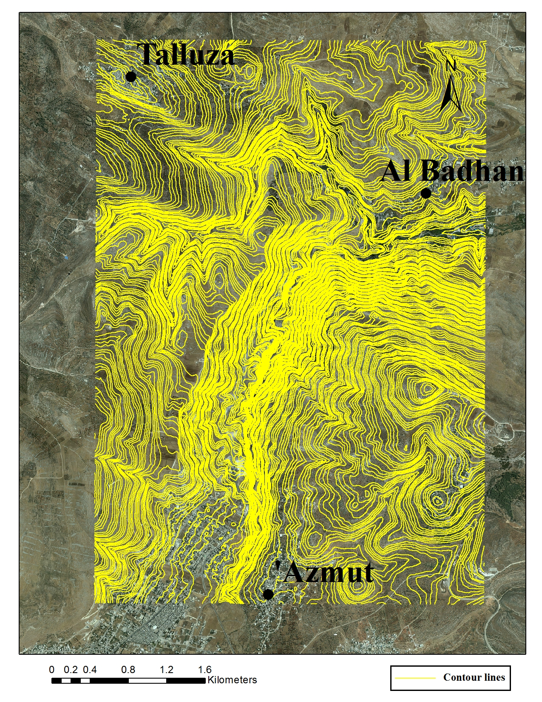
Route allocation – GIS Layers

Slide 27
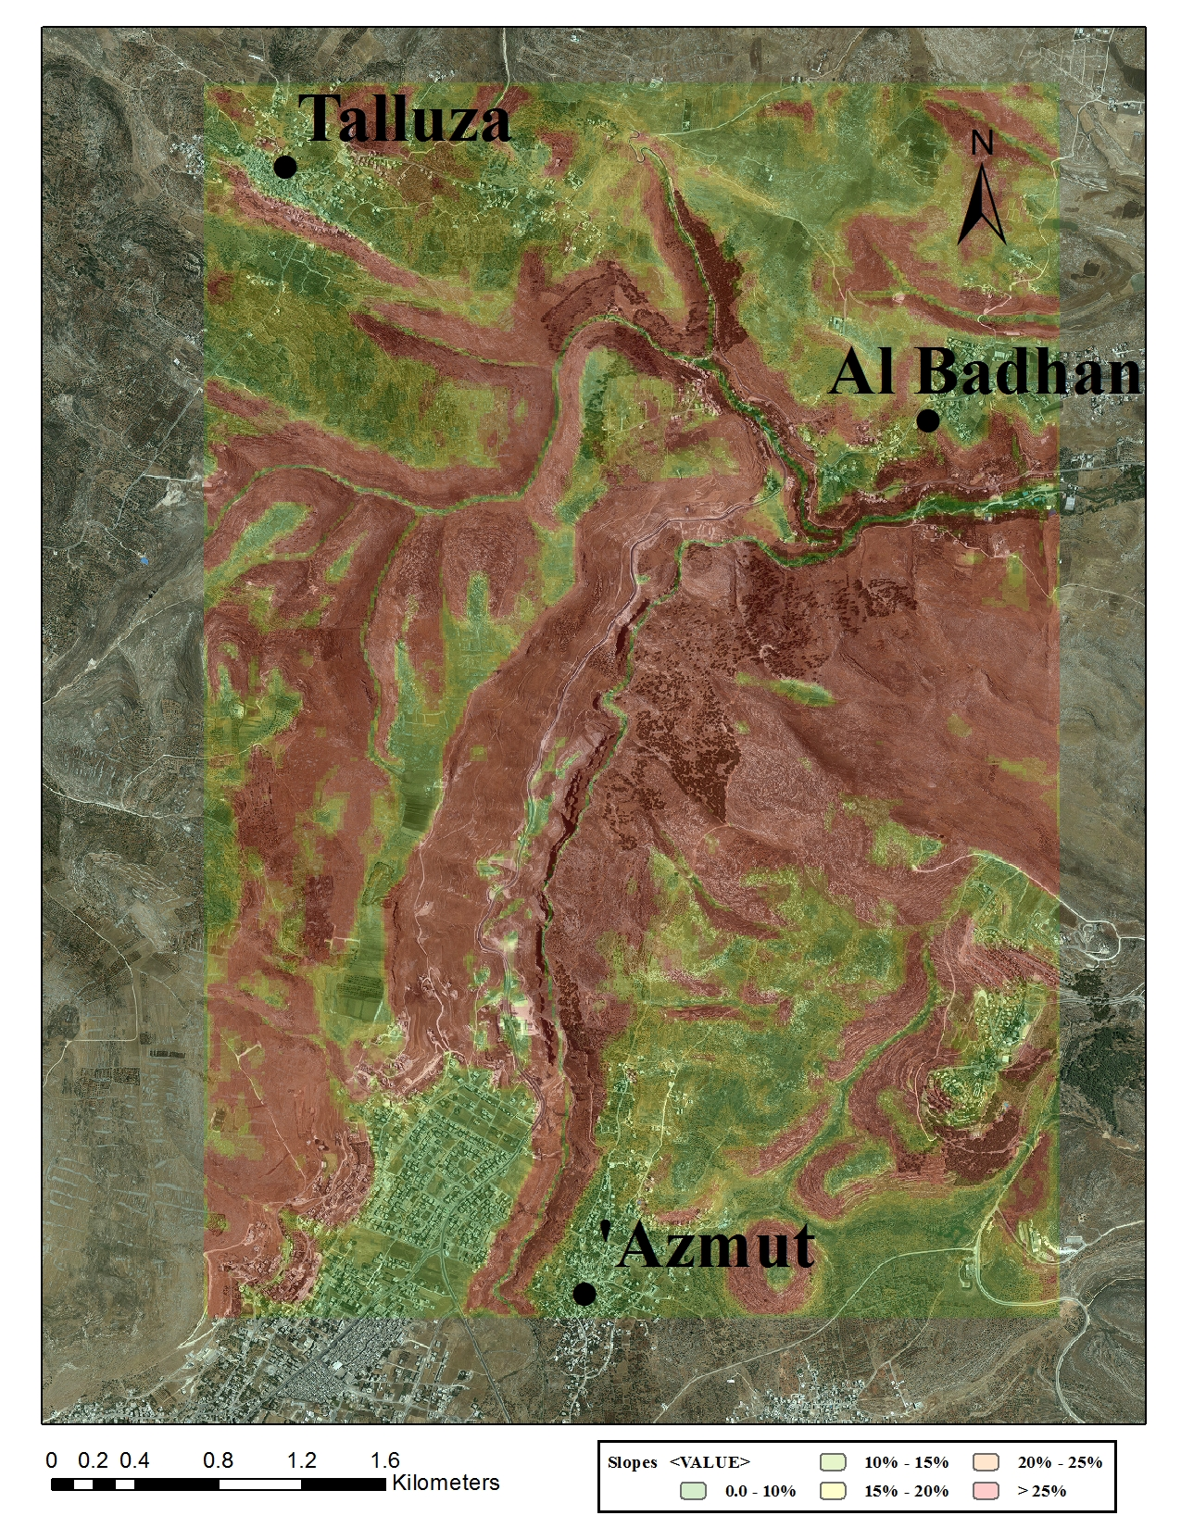
Route allocation – GIS Layers

Slide 28
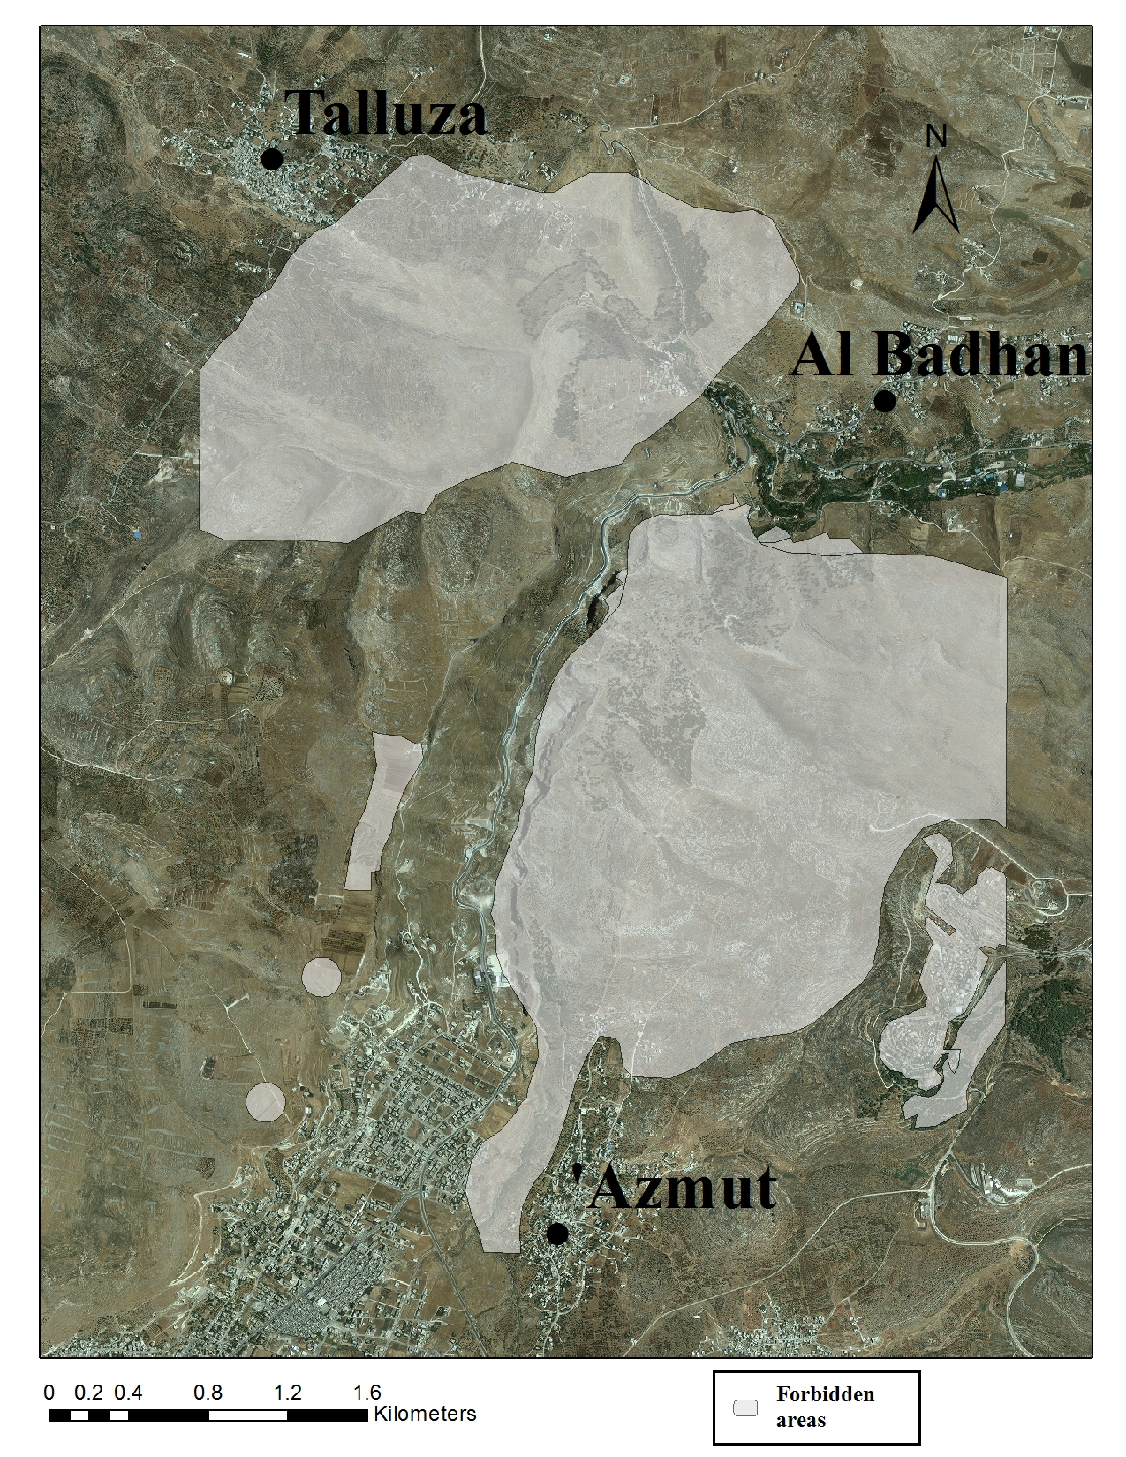
Combined layer

Slide 29
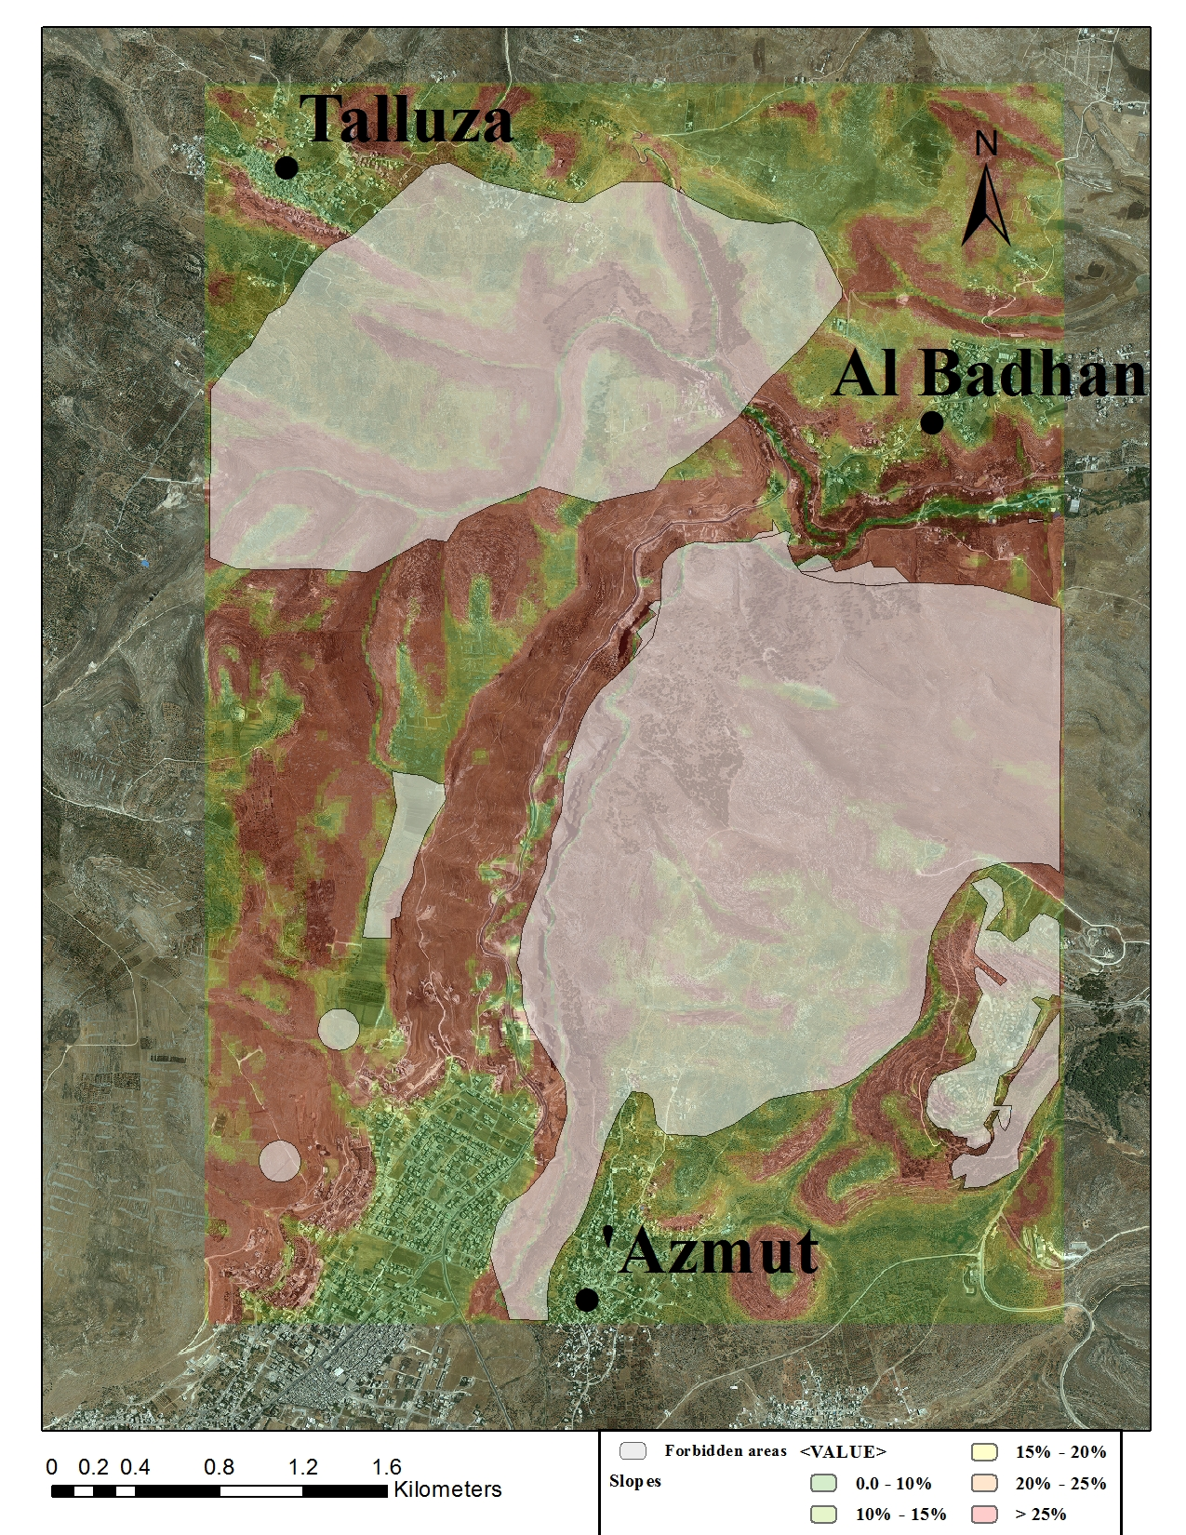
The after erase layer

Slide 30
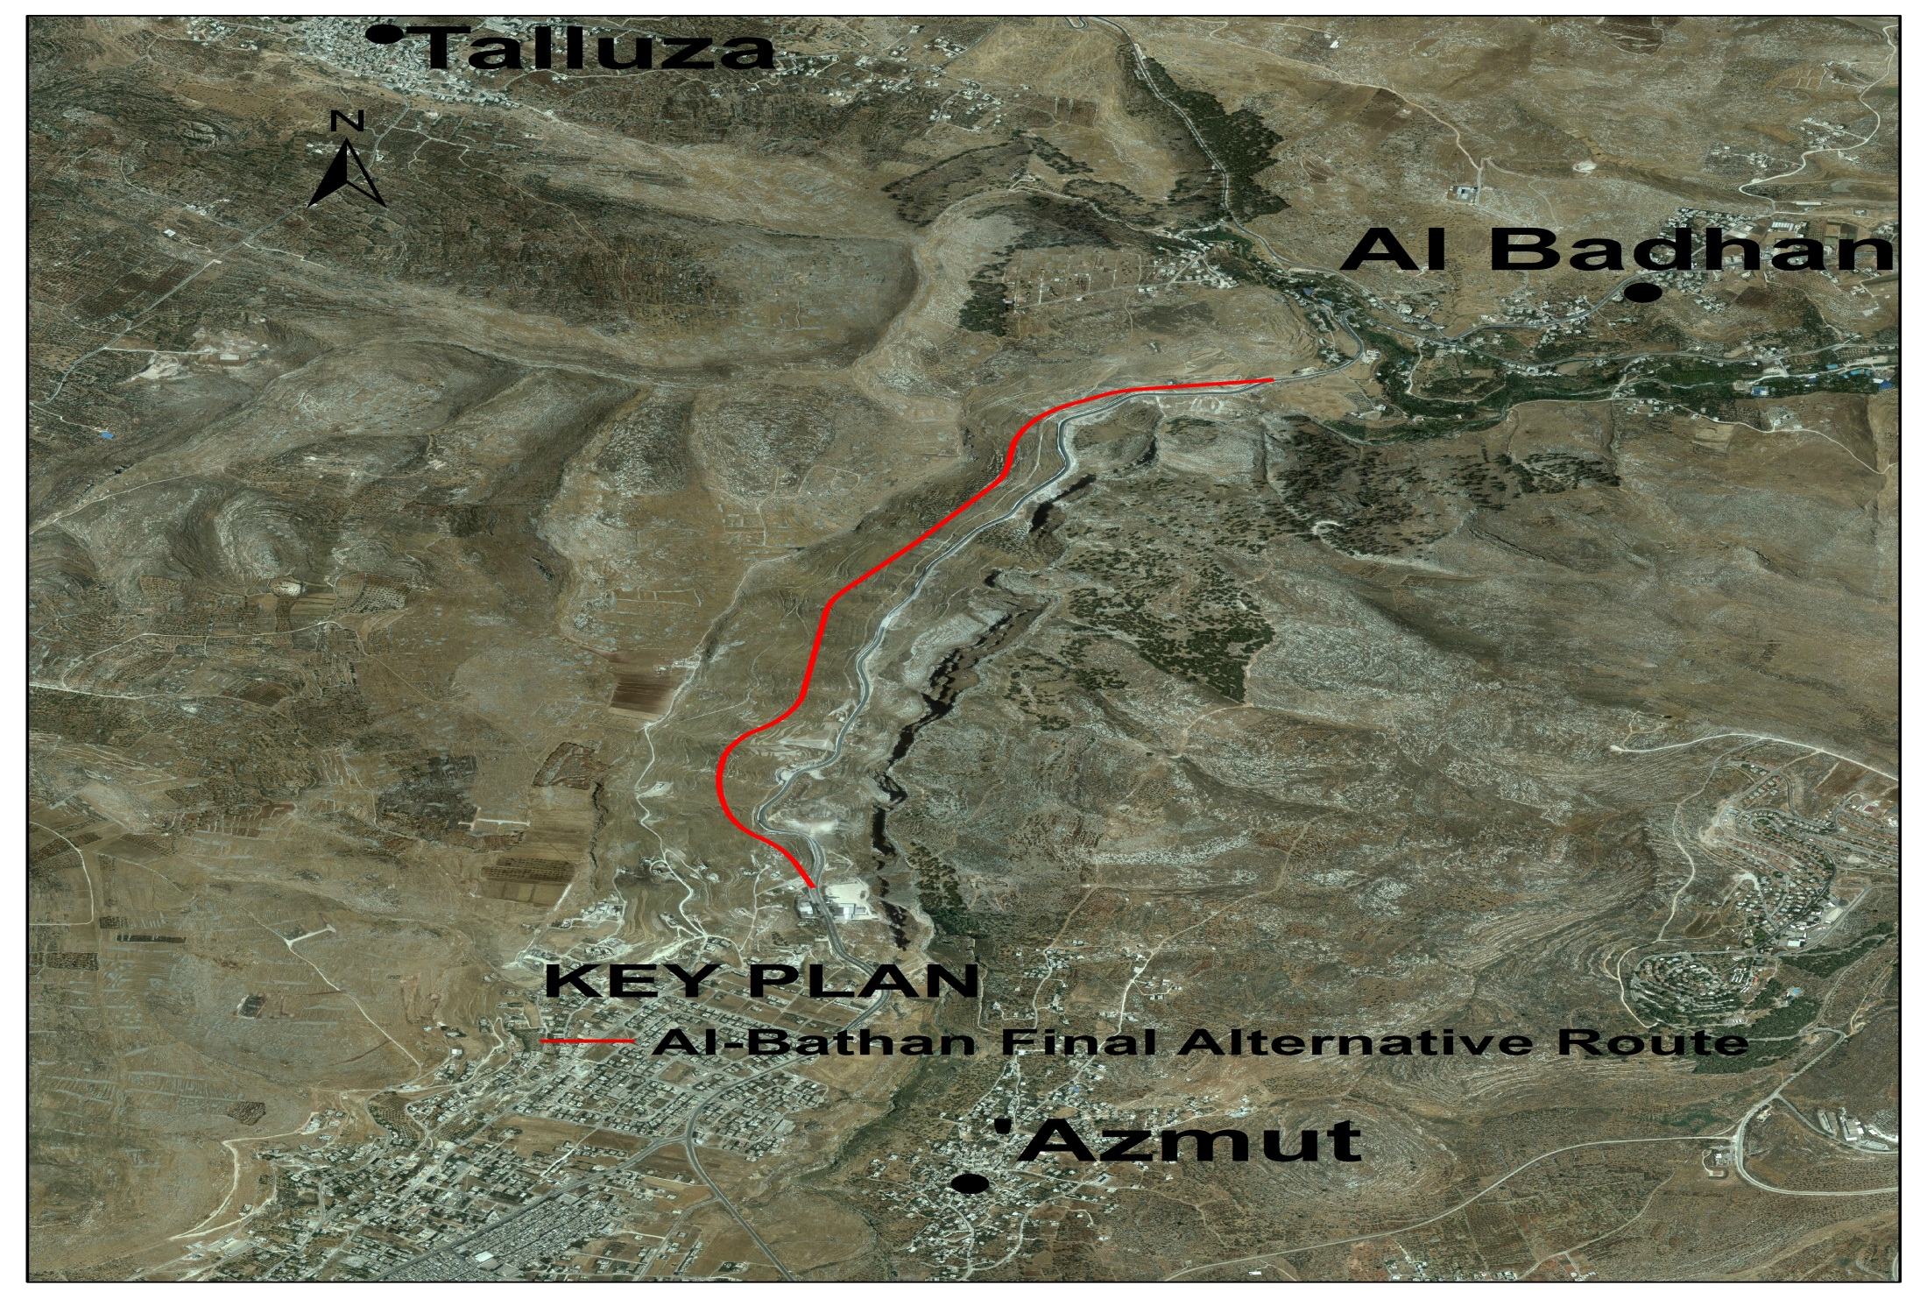
Route allocation – GIS Layers

Slide 31
Geometric Design
Horizontal Alignment
Vertical Alignment
 | Superelevation ( e ) | Side friction ( fs ) | Minimum radius ( m )
Al-Bathan Road | 10% | 0.14 | 210
 | Minimum length ( m ) | Maximum Grades ( % )
Al-Bathan Road | 365 | 7.0

Slide 32
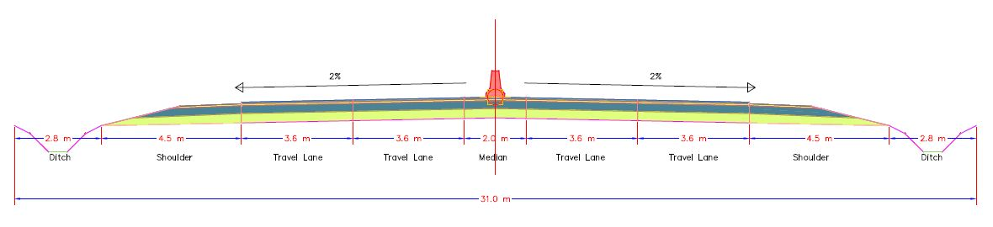
Cross Section Design
Typical Cross Section

Slide 33
Cross Section Design
Pavement Design
Asphalt layer 1 ( cm ) | Asphalt layer 2 ( cm ) | Base layer ( cm ) | Subbase layer ( cm )
5 | 7 | 25 | 30

Slide 34
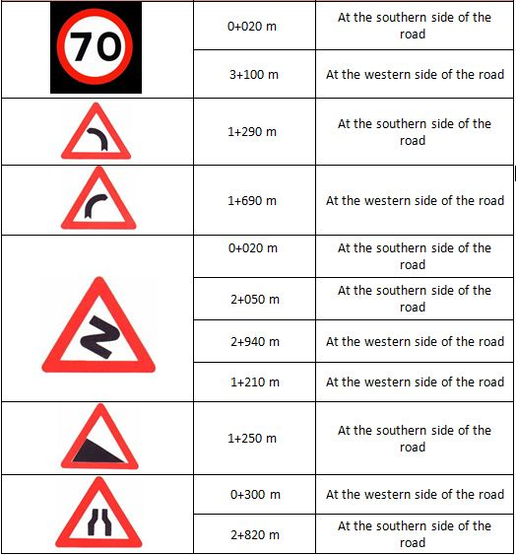
Traffic Control Devices ( TCD )

Slide 35
Bill of Quantities
Bill of Quantities
Category | Item | Unit | Quantity | Unit price ($) | Total price ($)
Earth works | Cut | m3 | 290,800 | 10 | 2908000
 | Fill | m3 | 271,500 | 15 | 4072500
Subbase Layer | Subbase Material | m3 | 79600 | 25 | 1990000
Base Layer | Base Layer Material | m3 | 69200 | 20 | 1384000
Asphalt | Layer 1 (5 cm) | m2 | 51300 | 10 | 513000
 | Layer 2 (7 cm) | m2 | 64750 | 20 | 1295000
Miscellaneous works | Traffic Signs | no. | 11 | 200 | 2200
 | White traffic marking | m | 6400 | 5 | 32000
 | Yellow traffic markings | m | 12800 | 5 | 64000
 | Guard rail | m | 300 | 80 | 24000
 | Ditch construction | m | 6400 | 20 | 128000
Total Cost |  |  |  |  | 12412700

Slide 36
BIG Thanks
Any Questions ?!

