Slide 1
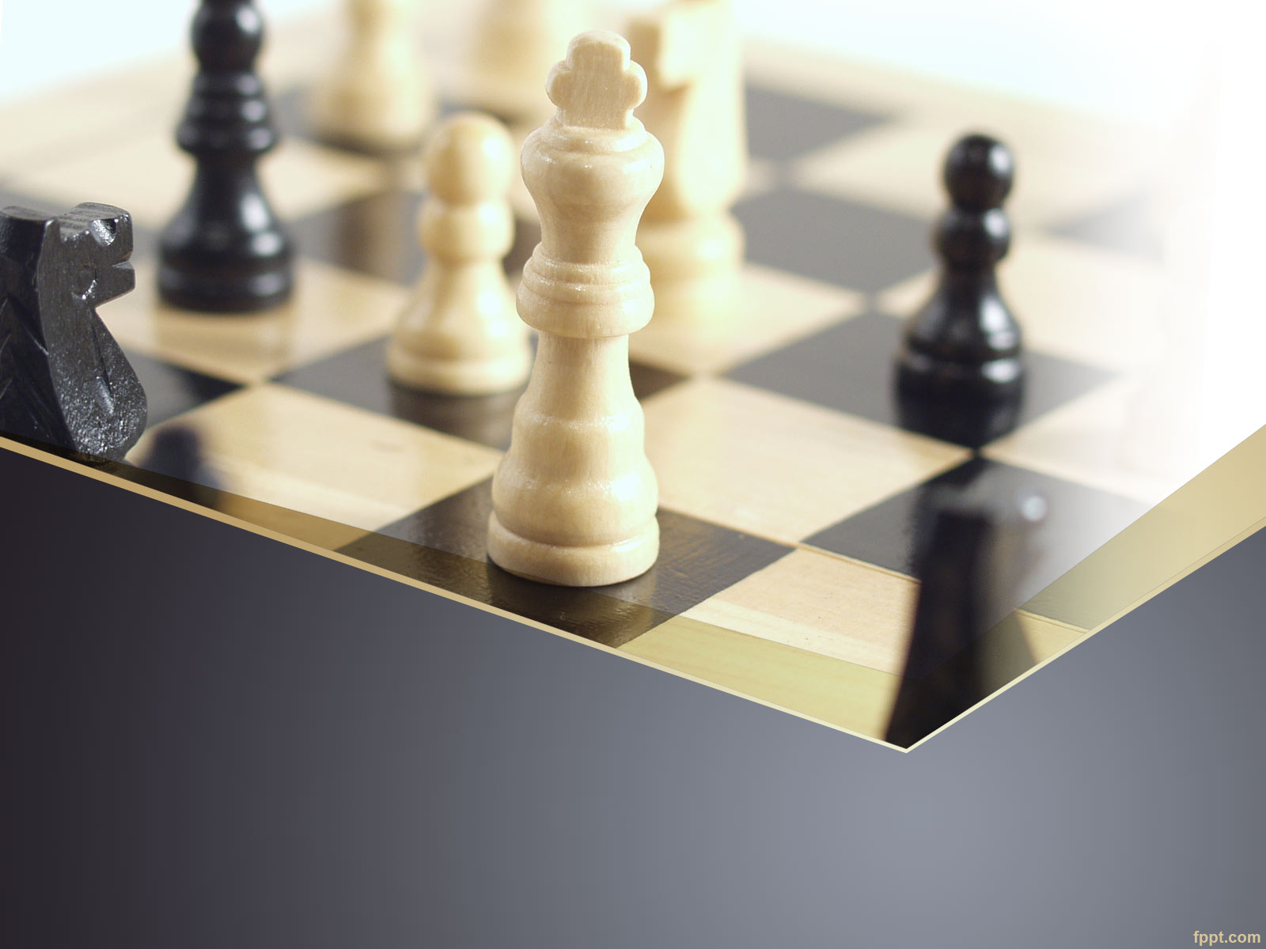
Chess Playing Robot
Raheeq Nassar
Roba Younis

Slide 2
OUTLINE
About Chess.
Motivation and Objectives.
Scope of work.
Hardware components.
Software Techniques
General Architecture.
Demo
Constraints.
Future Work.

Slide 3

CHESS
Is a two-player strategy board game played on a chess bored.
checkered game board with 64 squares arranged in an 8×8 grid.
32 pieces.
6 different types.
Need clever strategies and deep thinking.

Slide 4
Motivation
Merge between Artificial intelligence and human mental abilities.
Create entertainment environment with new style and aspects.

Slide 5
Objectives
Easy to maintain.
Low cost.
Low power consumption.
Improve the world of technology.
Simple design that can be copied and optimized.

Slide 6
Scope Of Work
This project is for every one interested in playing chess, and needs a new way to play it with different type of competitors, a robot.

Slide 7
Hardware Components
Microcontroller
Motors
Sensors
Shift registers

Slide 8
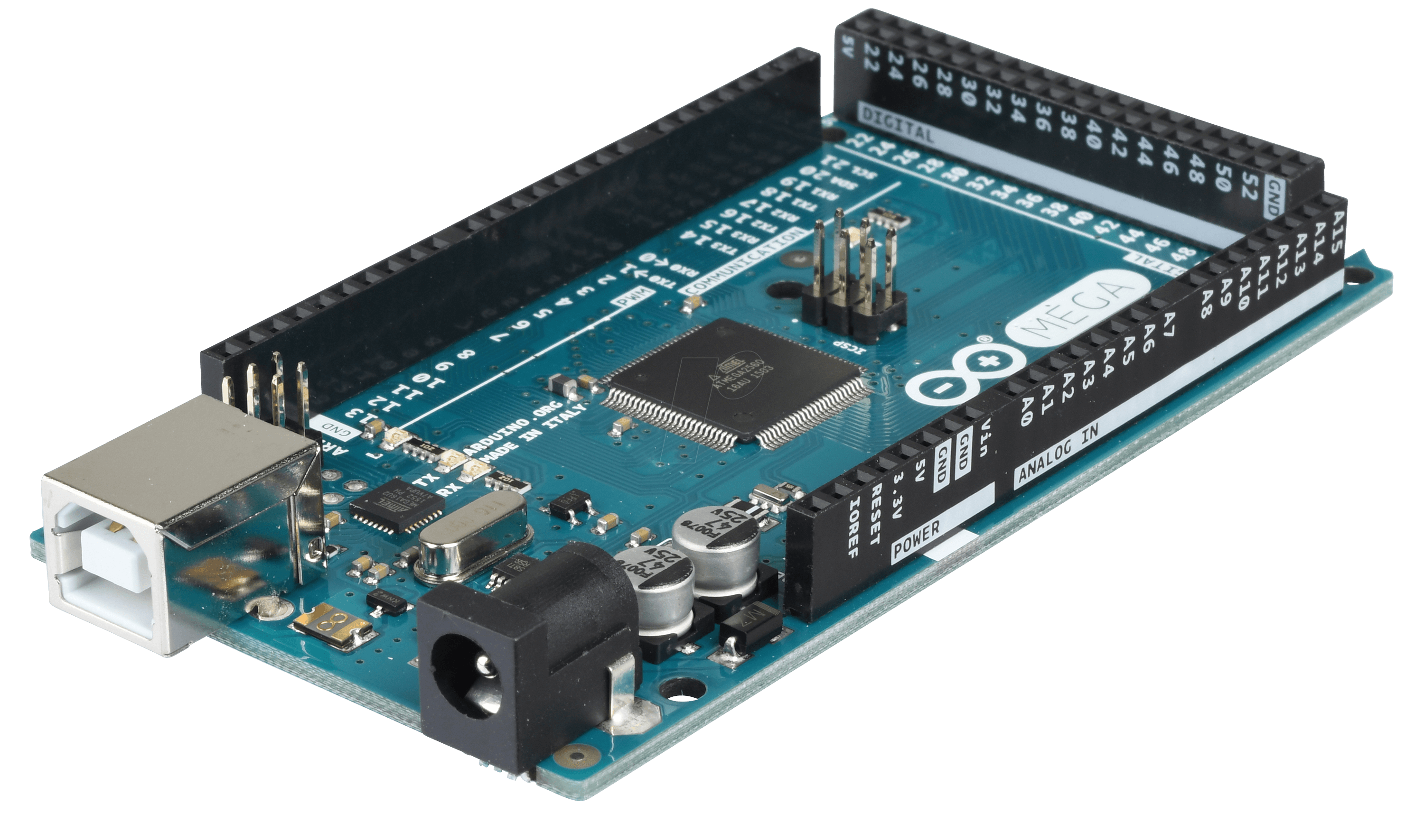
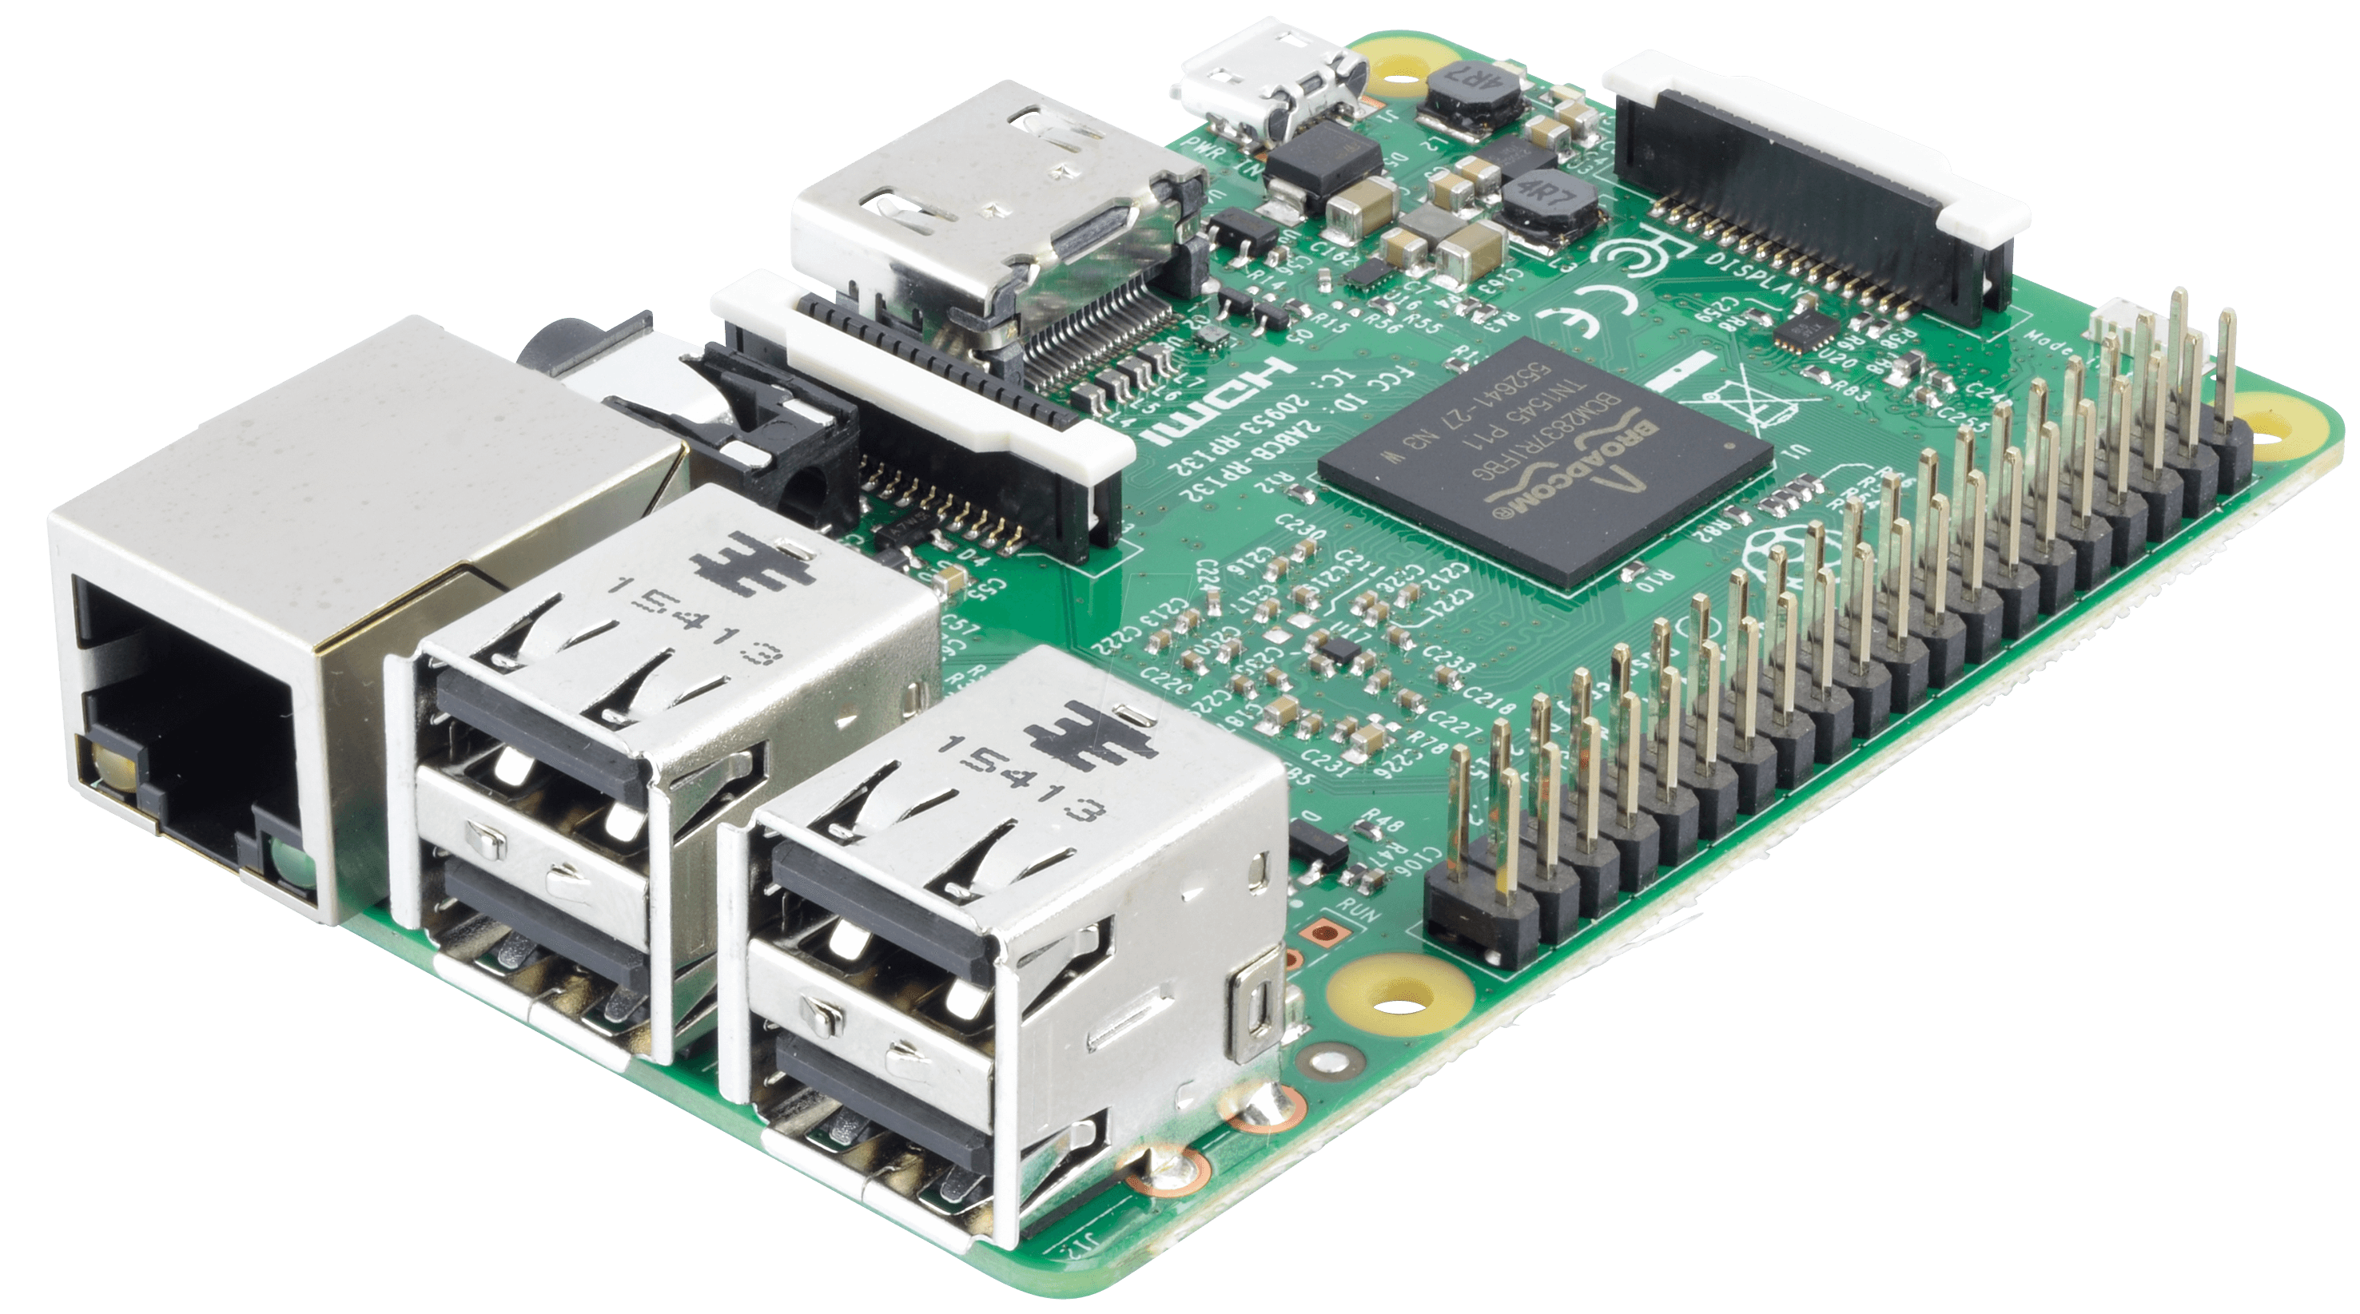
Microcontrollers
We used two types:
Raspberry Pi 3
Arduino Mega ADK

Slide 9
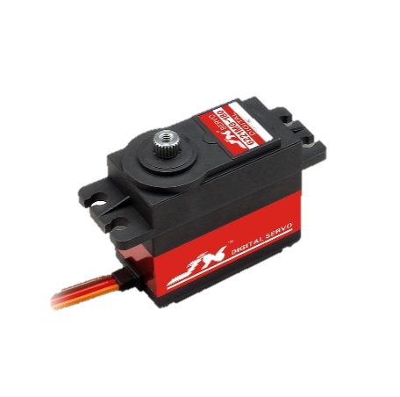
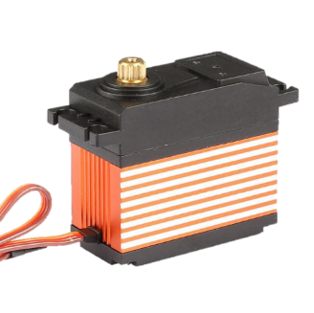
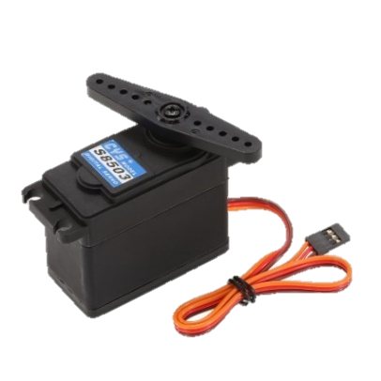
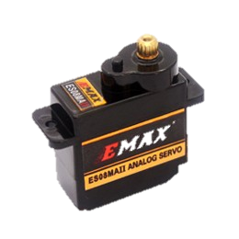
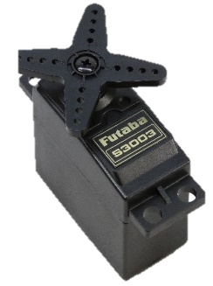
Motors
We used Servo Motors.
Fast
high torque,
accurate rotation angles

Slide 10
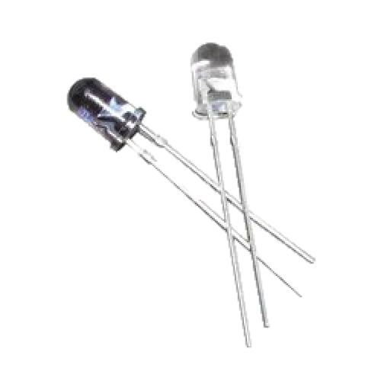
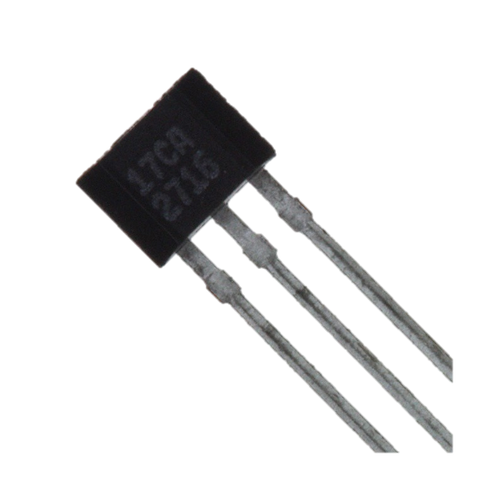
Sensors.
Hall Effect Sensor.
IR sensor.

Slide 11
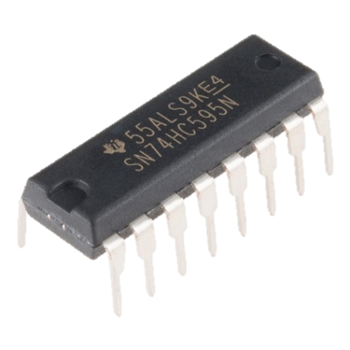
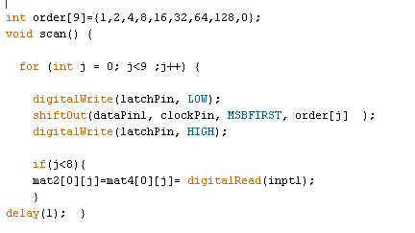
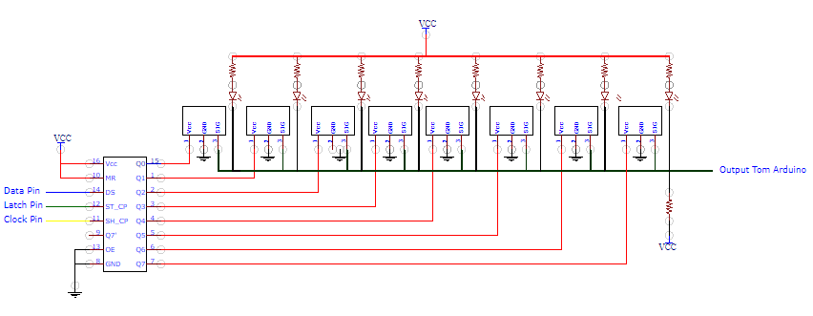
Shift Registers.

Slide 12

Software Techniques
Artificial Intelligence algorithms.
STOCKFISH chess engine.

Slide 13
General Structure
Start
Player’s move
Scan bored
Send move to RPI3
Run STOCKFISH
Wait for Player’s move
Arm’s move
Sends best move to RPI3

Slide 14
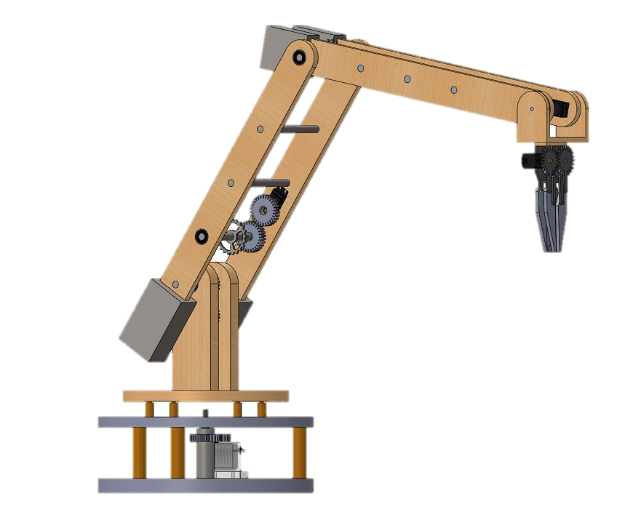
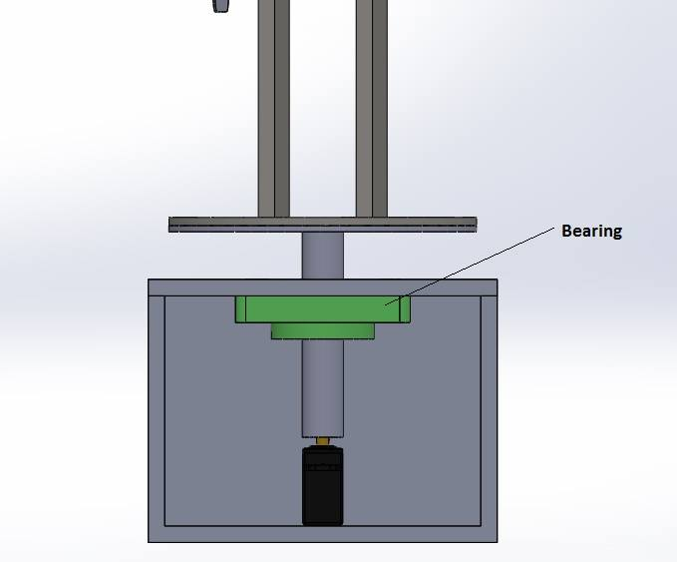
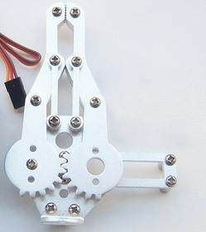
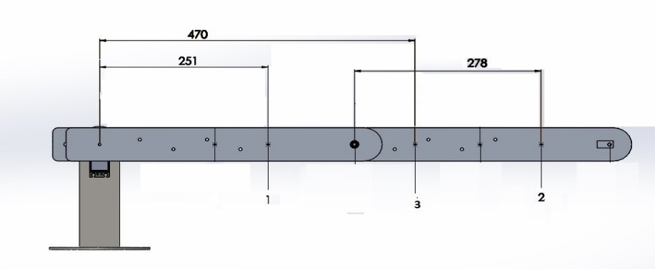
Robotic Arm
Basement.
Arm.
Gripper.

Slide 15
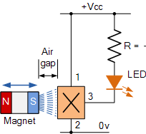
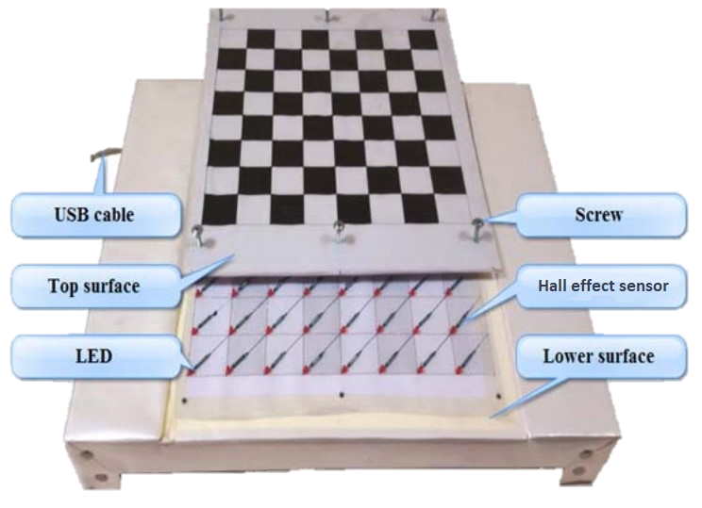
Chess Bored
Consists of:
Hall effect sensors
Indicating LEDs
8-bit shift registers

Slide 16
Demo

Slide 17
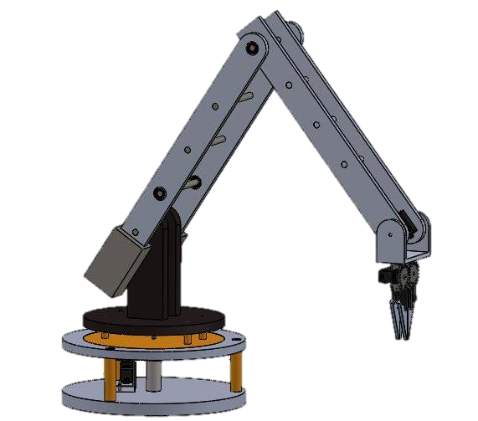
Constraints
Time
Resources.
Academic pressure.
Software problems.
Hardware constraint.

Slide 18
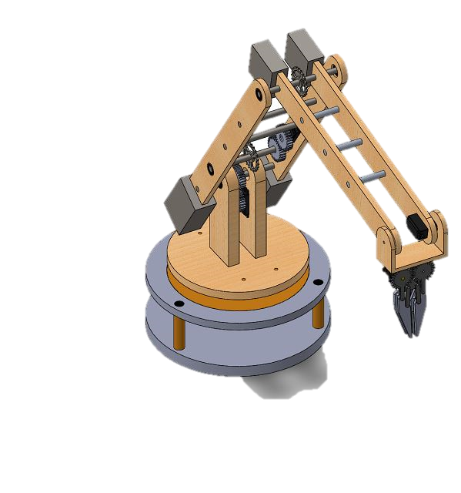
Future Work
Chessboard can be used for more than one game .
improve the interaction between the user and the system by implementing a voice interface.

Slide 19
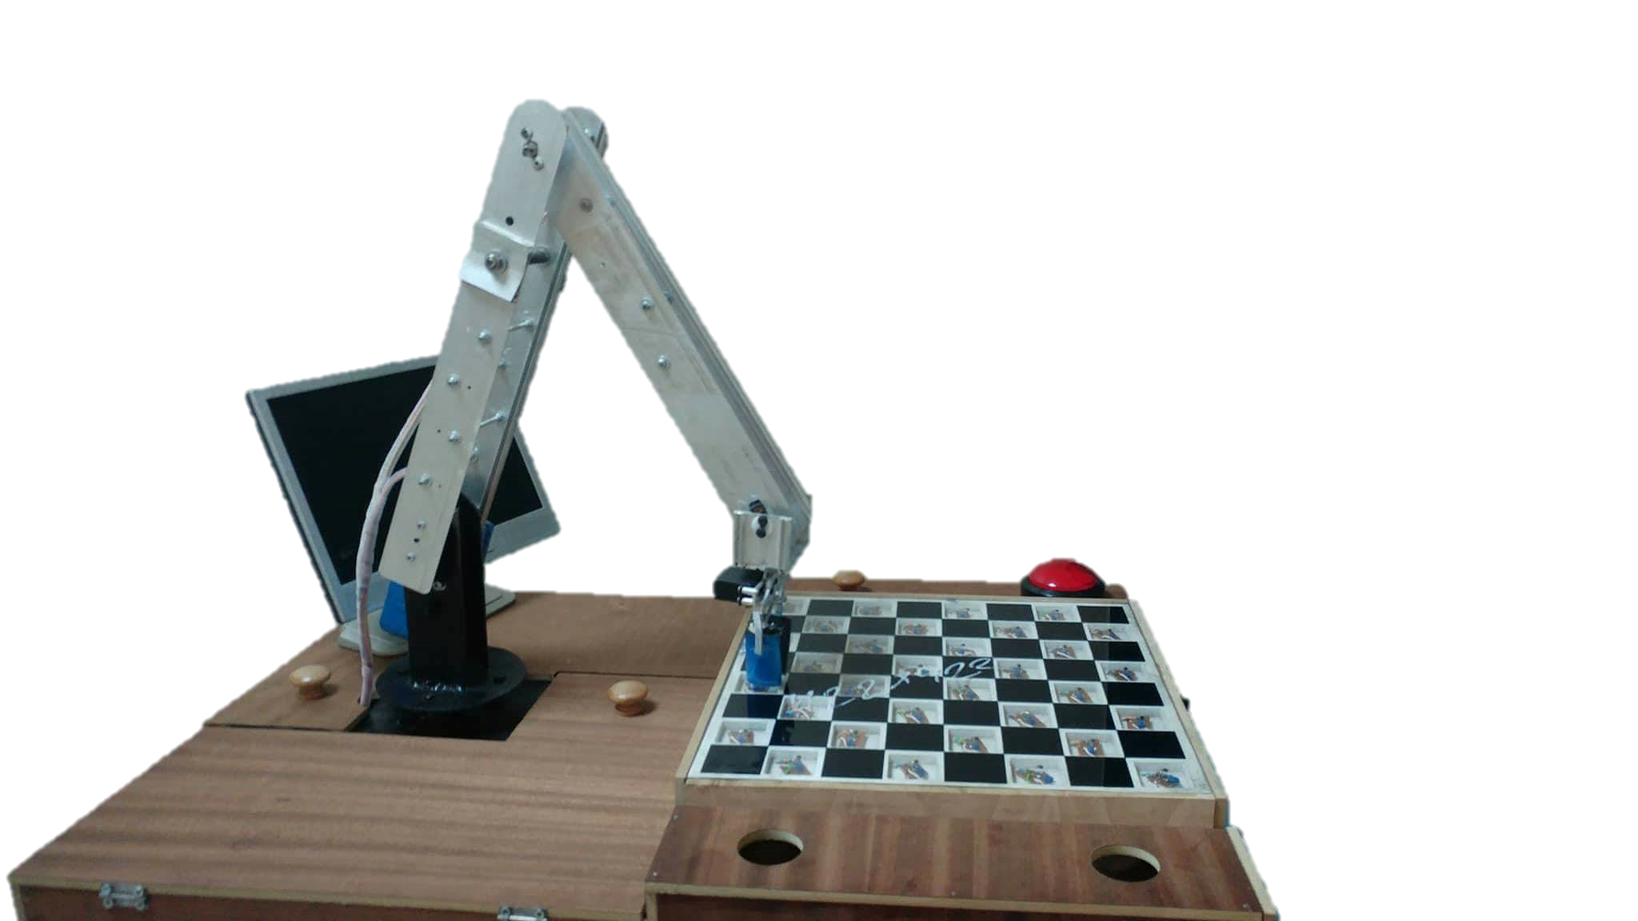
Thank You

