Slide 1
BIM Assessment For AL-Qalb Al Kabeer Project
Prepared by : Faisal Hamad
Ghassan Ikhlaif
Qutaiba Rabyah
Yazan Khalil
Under supervision of: Eng. Reema Nassar

Slide 2
Content
Project outline
What is BIM
Methodology
Quantity survey by Revit and Renders
Time Schedule Using Primavera Software
Naviswork

Slide 3
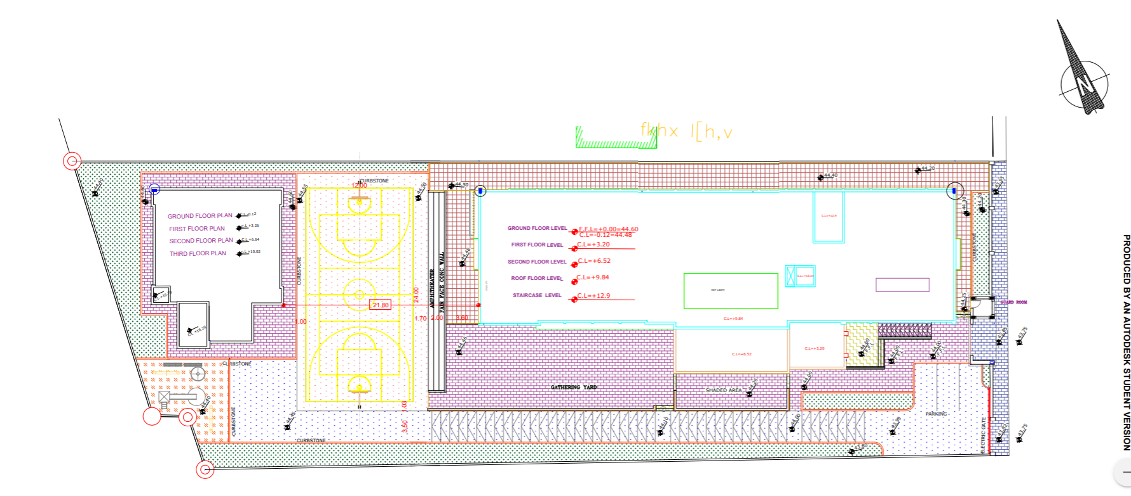
Project Outline

Slide 4
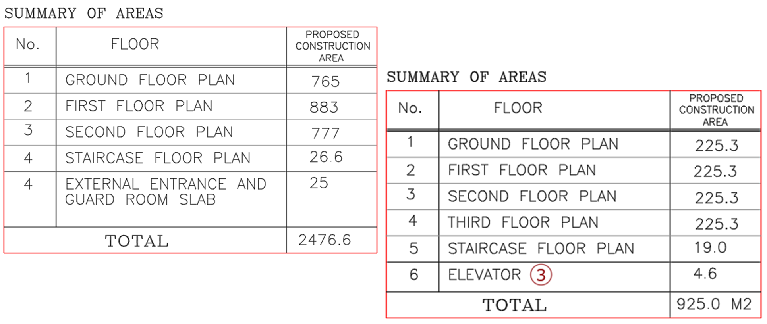
Project outline
Dorm floors area
School floors area

Slide 5
What is BIM ?
"A digital representation of the physical and functional characteristics of a building displayed as a 3D model, with the added capability to integrate a whole array of design and construction data related to cost, schedule, materials, assembly, maintenance, energy use, and more".
Building Information Modeling

Slide 6
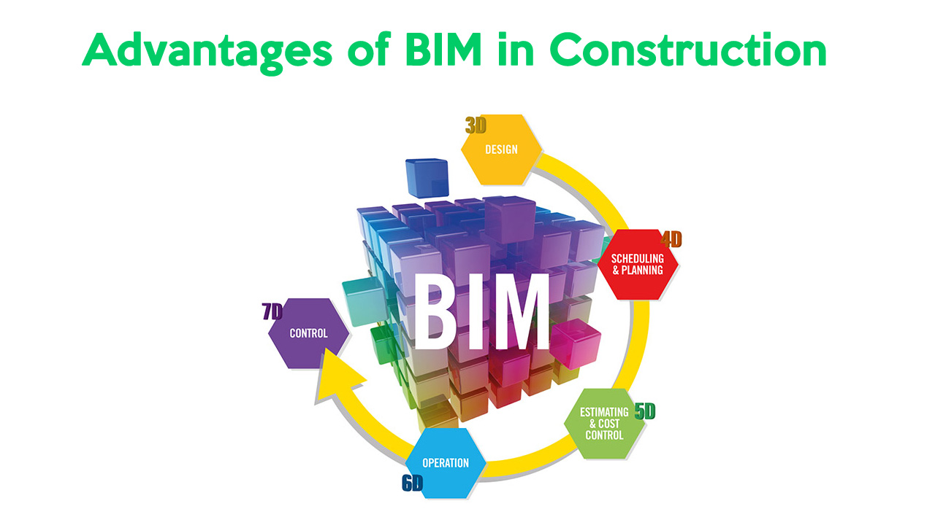
Benefits of BIM
Accurate Modeling.
Saving Time & Cost .
Coordination.
Accurate Quantity Survey .

Slide 7
Methodology
Software's used in project :
Revit & Lumion
Primavera P6
Naviswork.

Slide 8

Quantity Survey by Revit

Slide 9
Introduction for Revit
Outputs from Revit can be divided into
Architectural model
Structural model

Slide 10
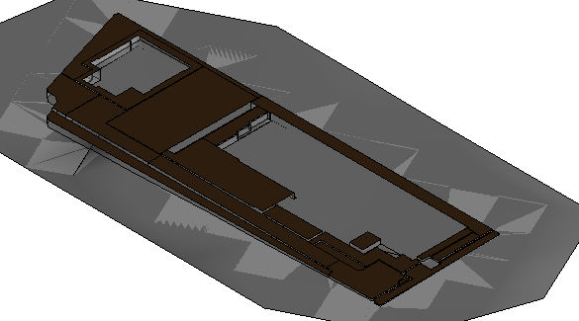
Site Model

Slide 11
Results
Item | Quantity (m3)
Site leveling | 1545.37
Excavation for foundations | 3100
Backfilling with selected material | 2310
Supply and Well Compact Base Course | 4230

Slide 12
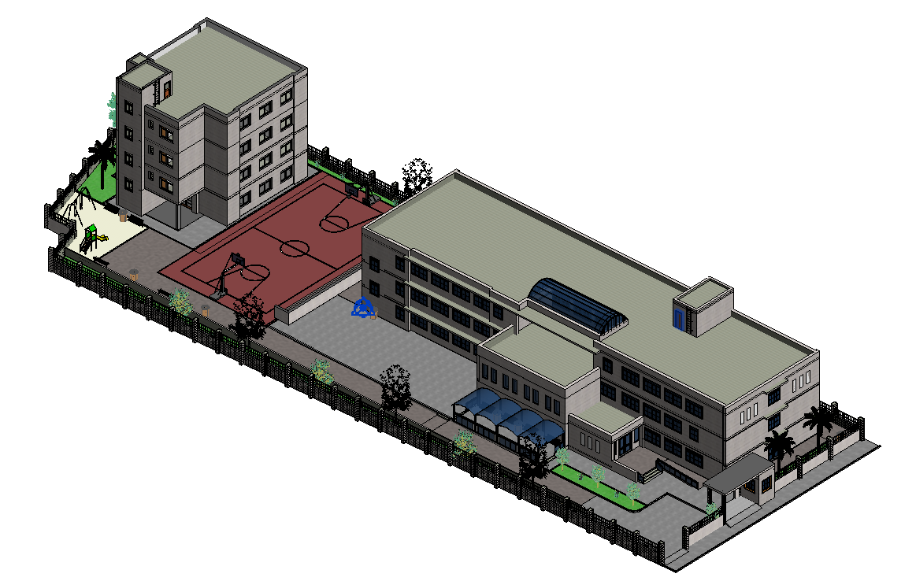
Architectural Model
Architectural elements are the unique details and component parts that, together, form the architectural style of buildings

Slide 13
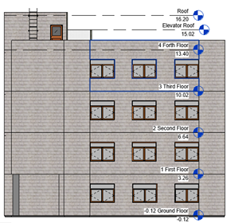
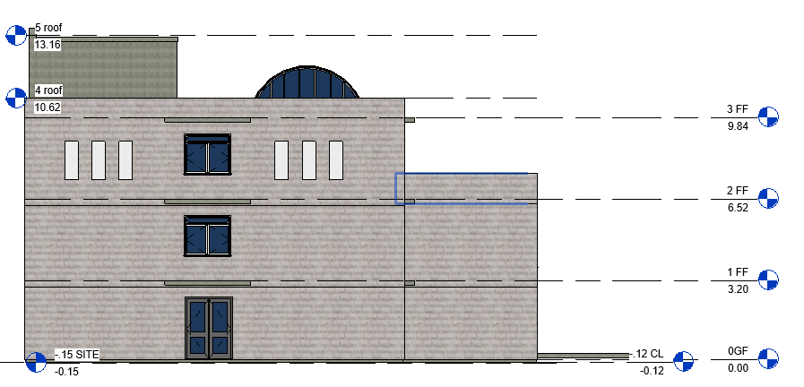
Levels

Slide 14
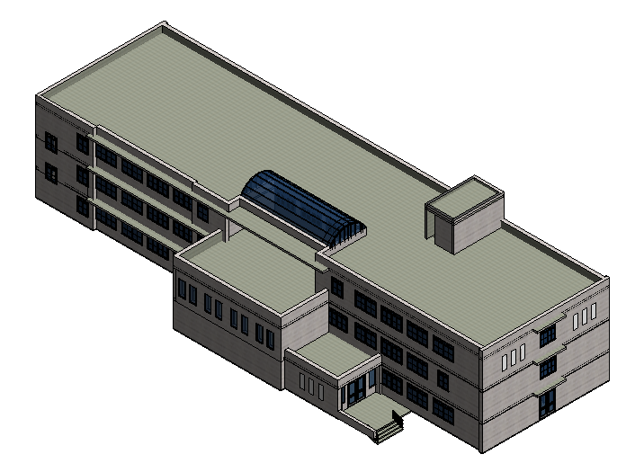
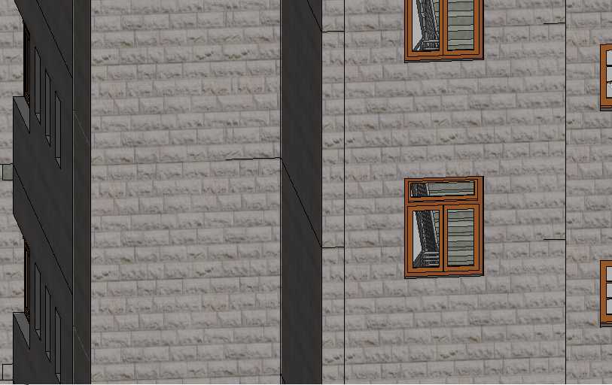
Walls
Exterior Walls

Slide 15
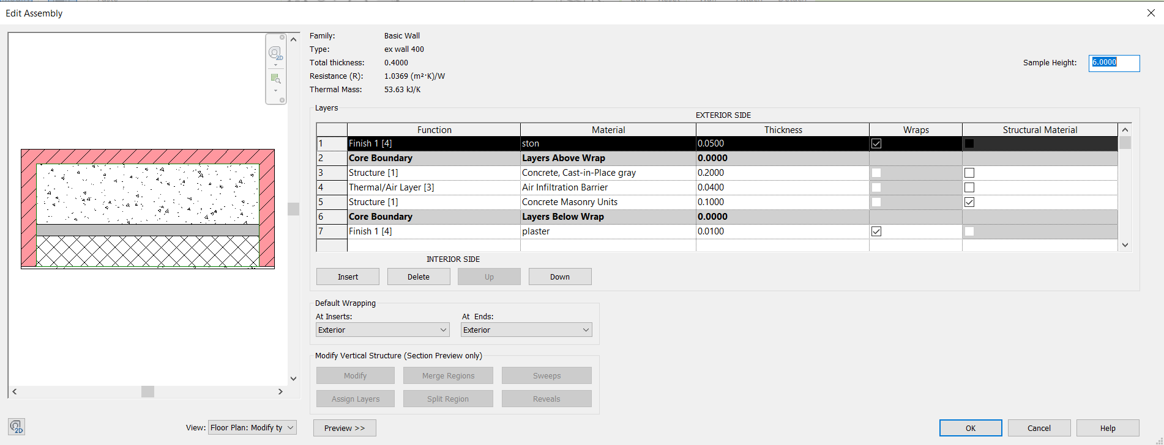

Slide 16
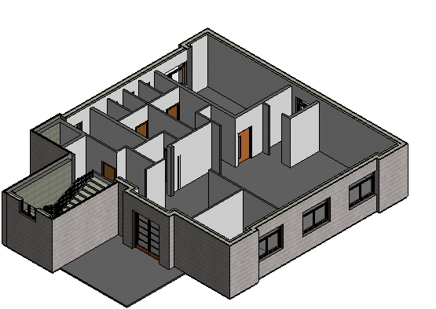
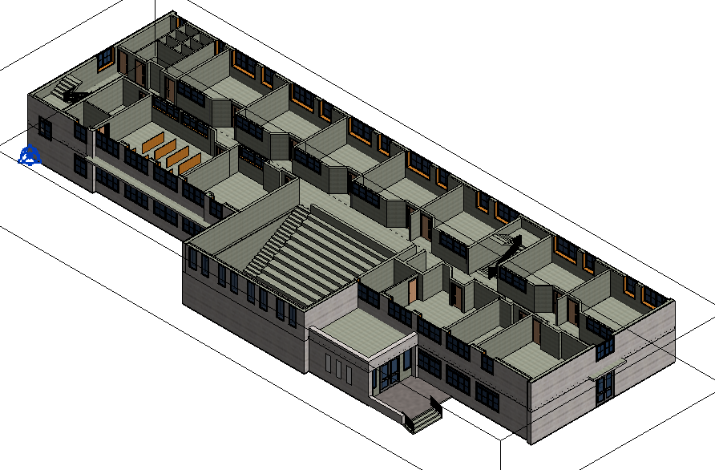
Walls
Interior Walls

Slide 17
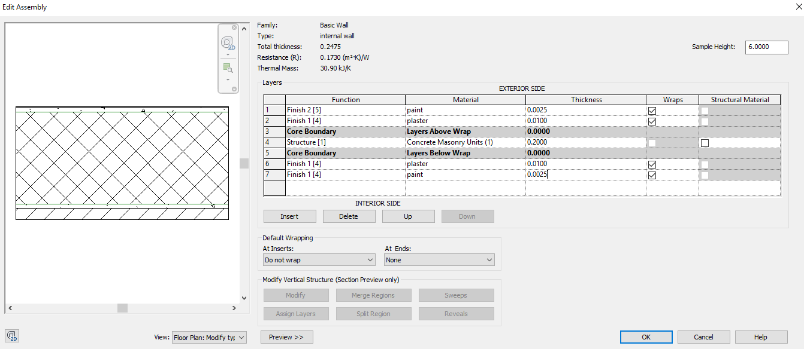

Slide 18
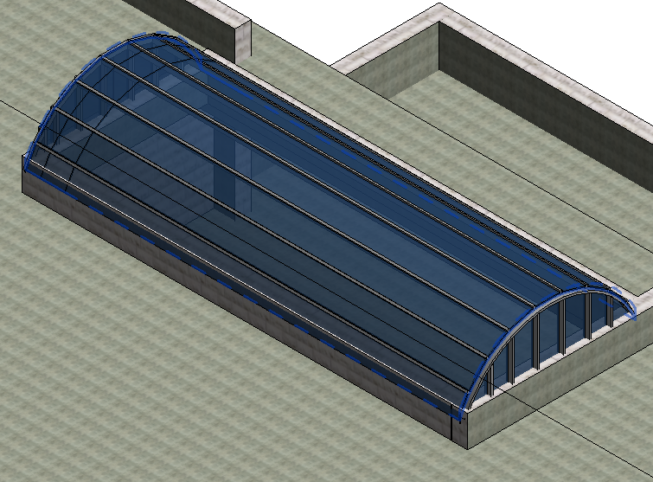
Sky Light

Slide 19
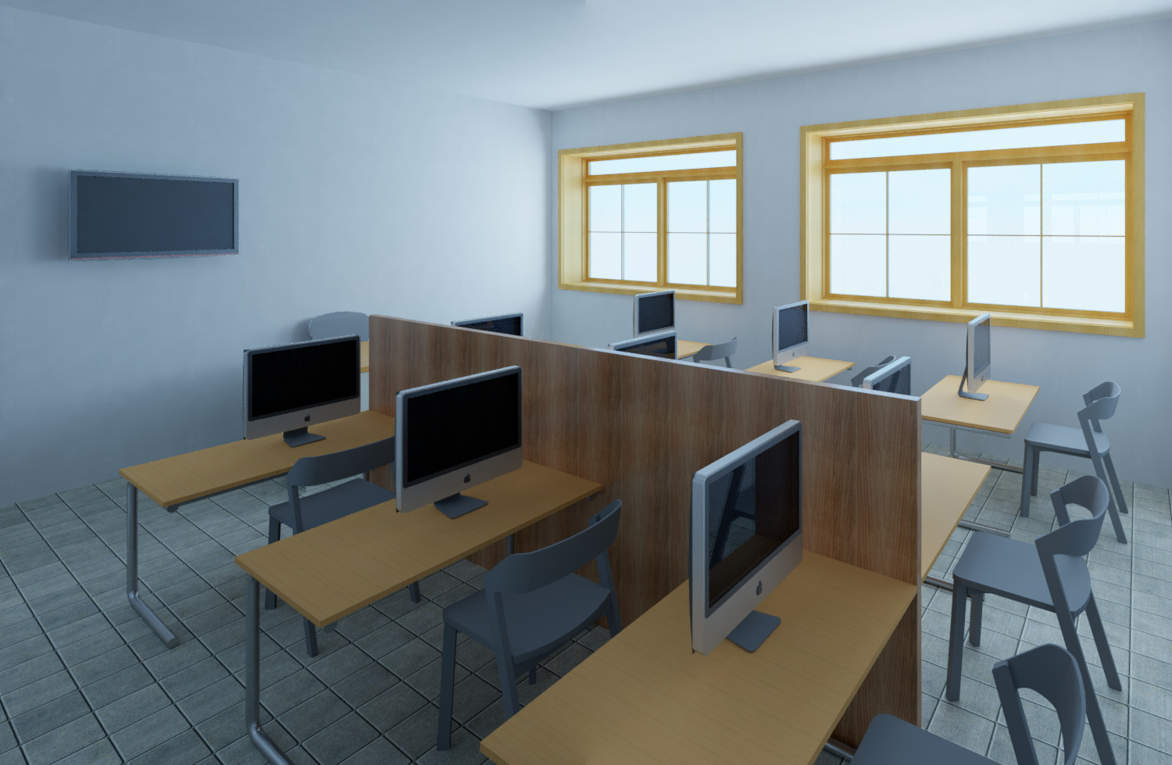

Slide 20
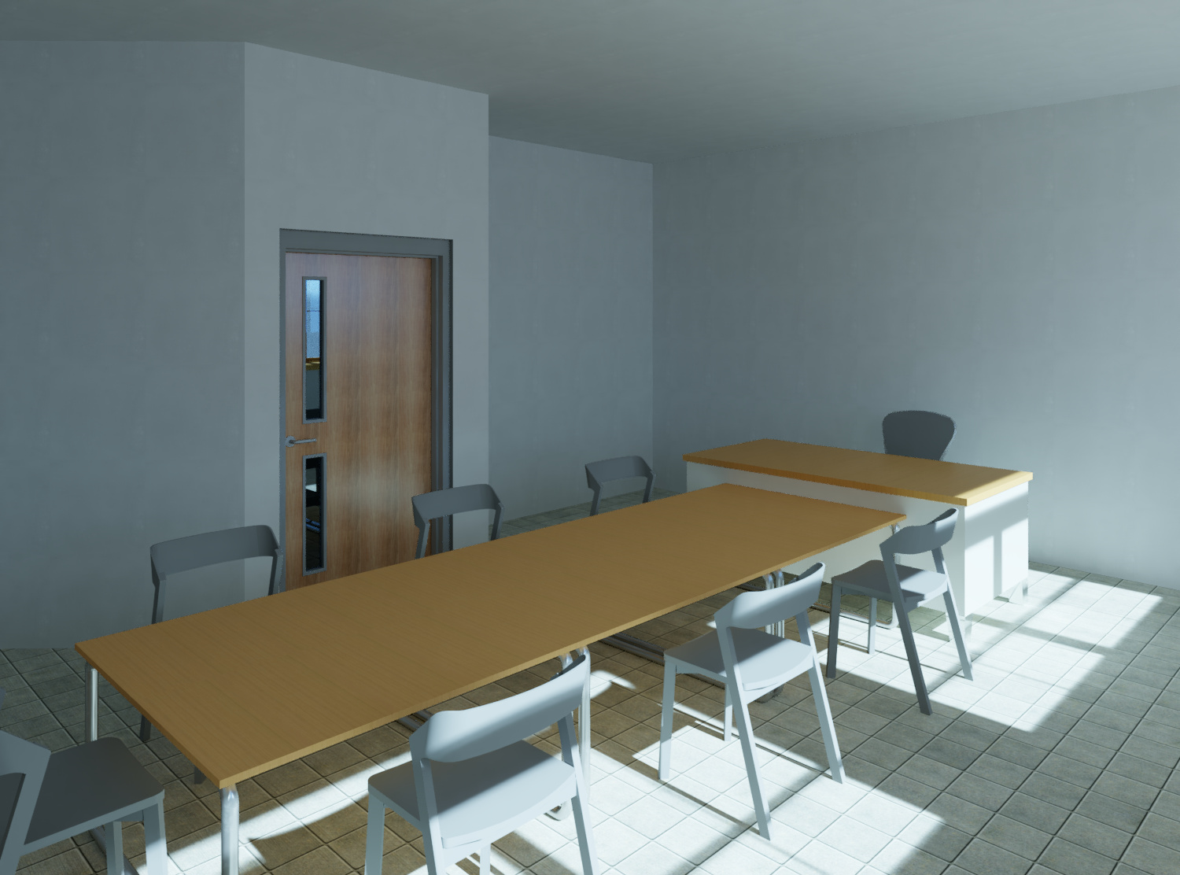

Slide 21
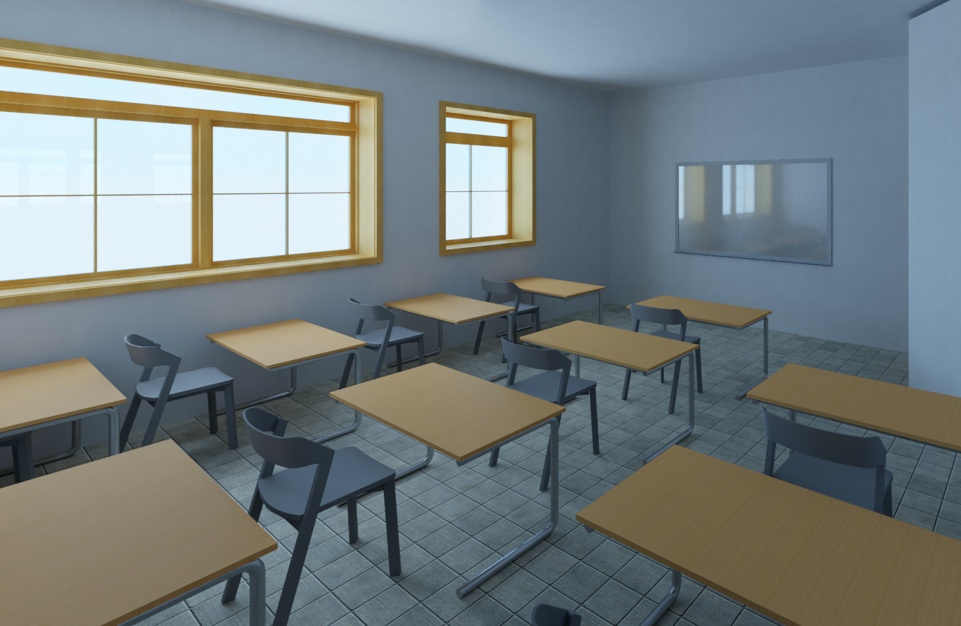

Slide 22
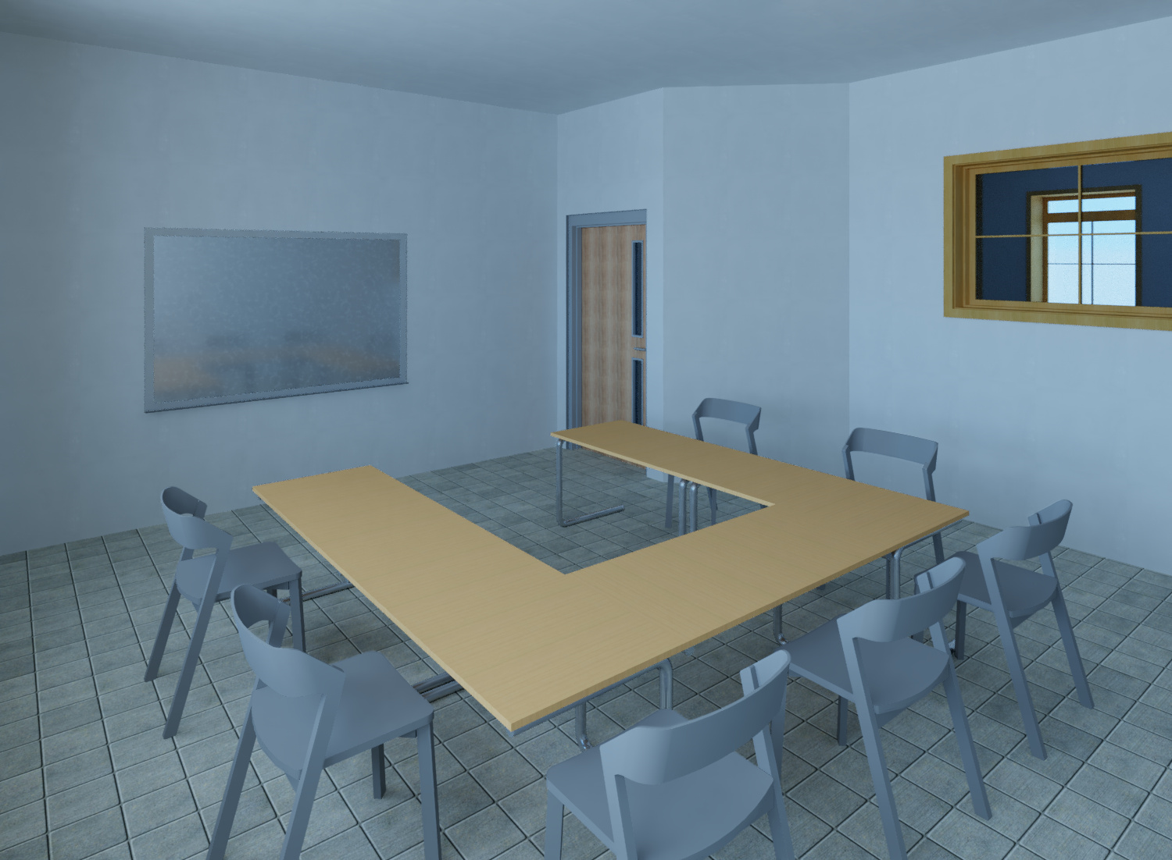

Slide 23
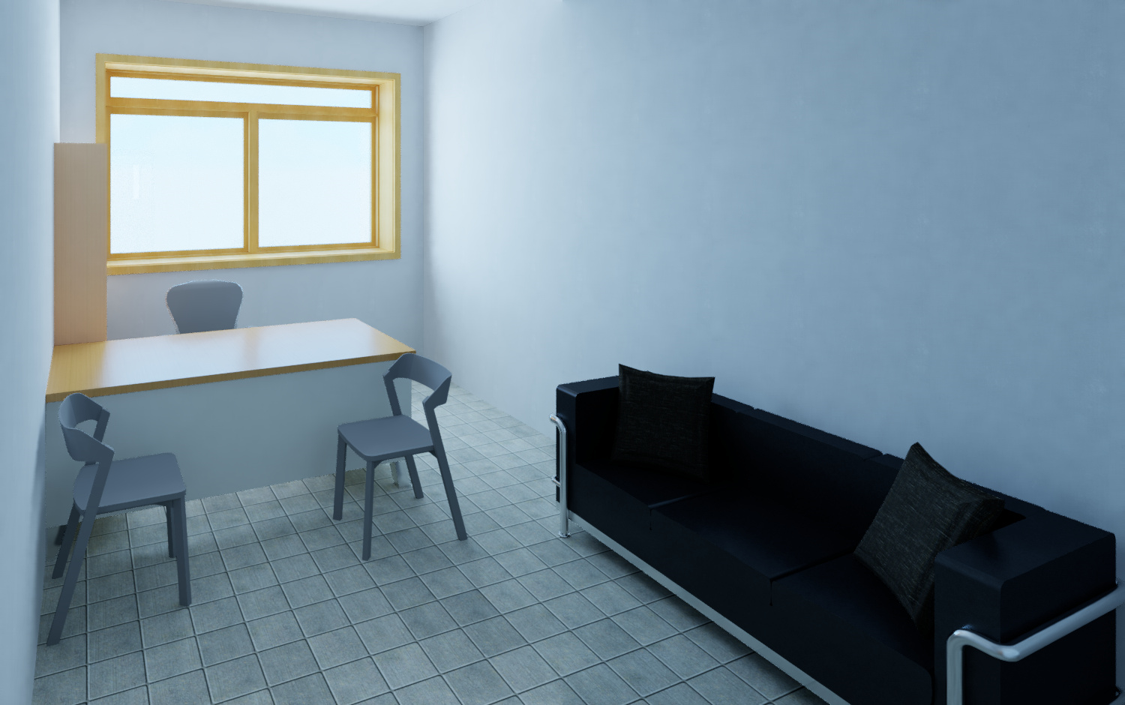

Slide 24


Slide 25
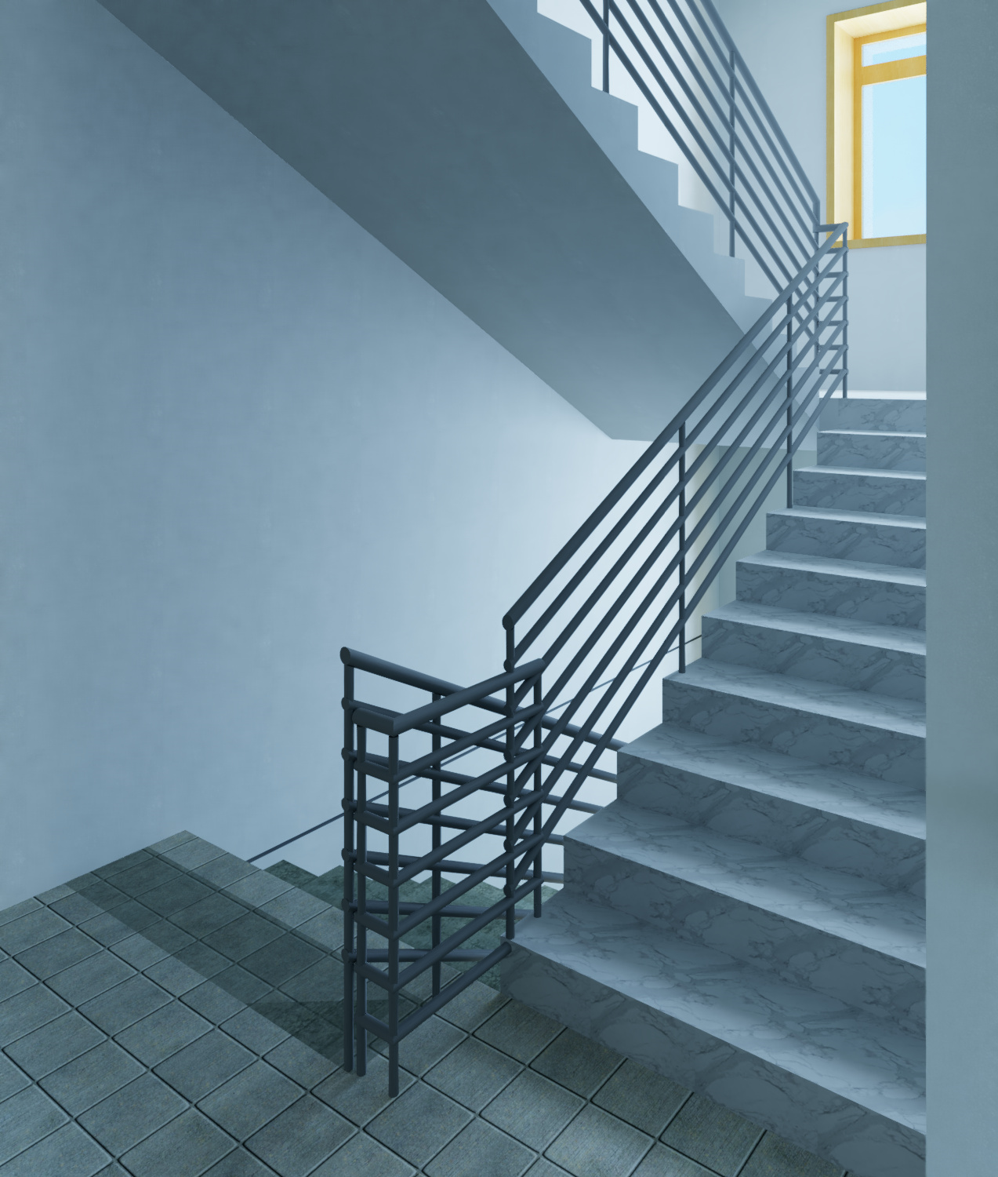

Slide 26
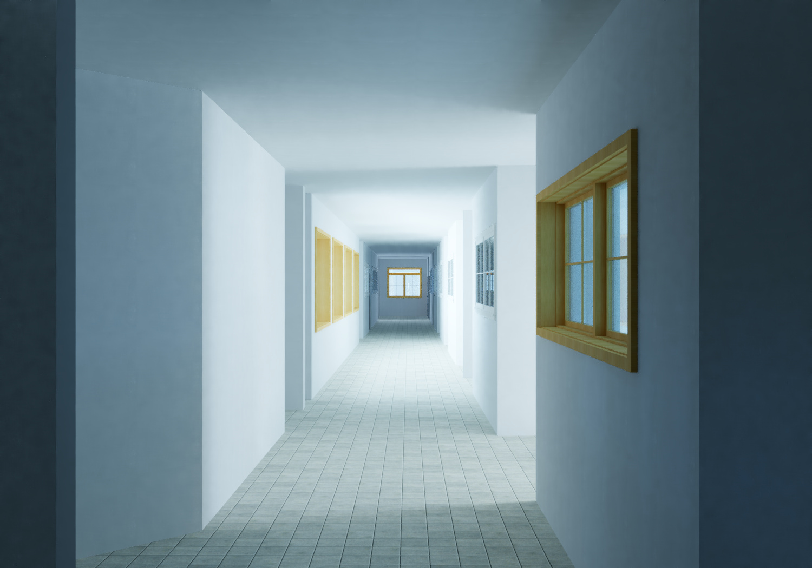

Slide 27
Result
Item | Unit | Quantity | Item | Unit | Quantity
Stone | S.M | 2333 | Painting | S.M | 8787
Block 10 cm | S.M | 2311 | Marble | S.M | 615
Block 20 cm | S.M | 1295 | Railing | M | 160
Plastering | S.M | 10924 | Windows protection | S.M | 354
Tiling | S.M | 4499
Doors | No. | 146
windows | S.M | 407

Slide 28
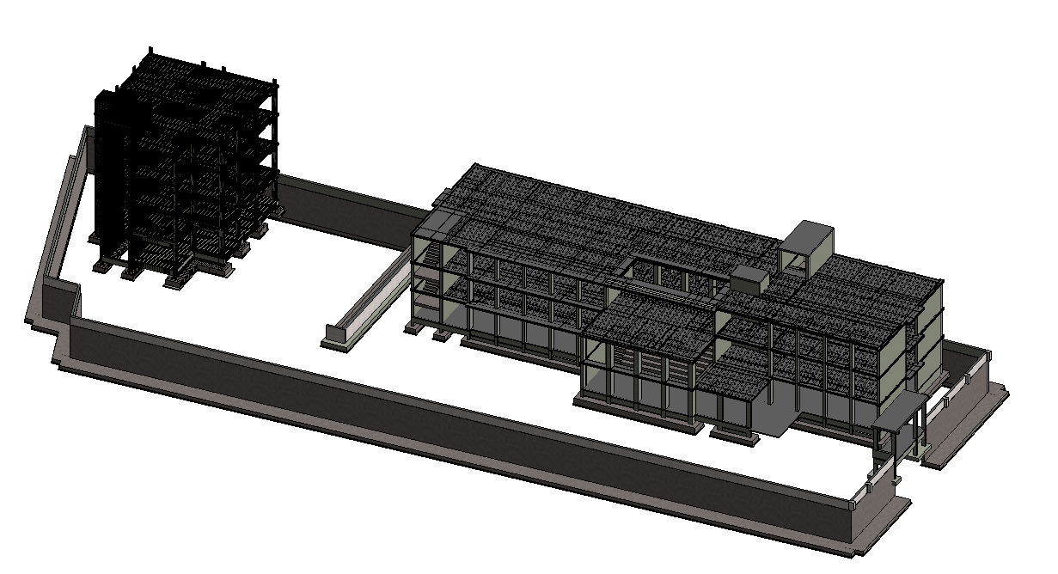
Structural Model

Slide 29
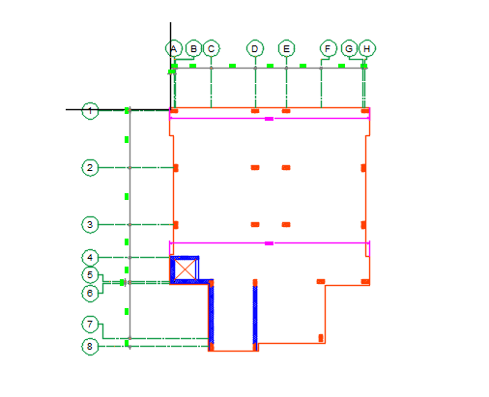
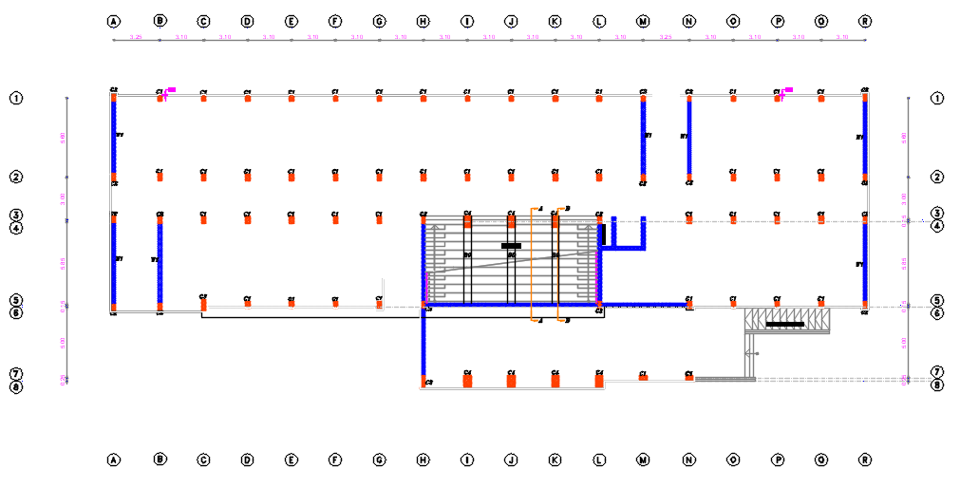
Grid System

Slide 30
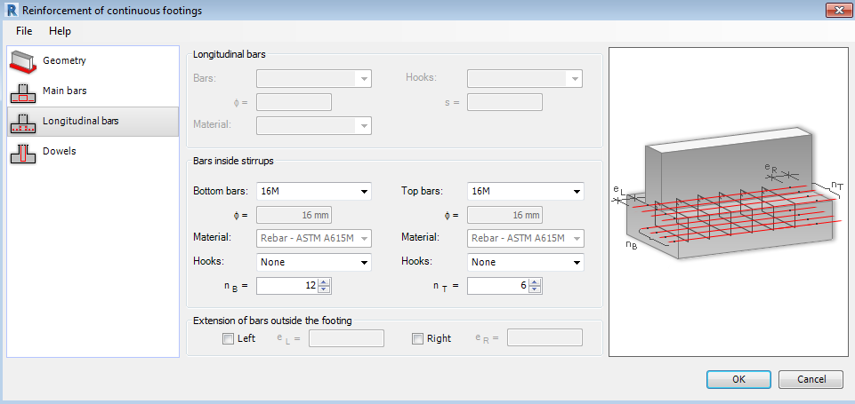
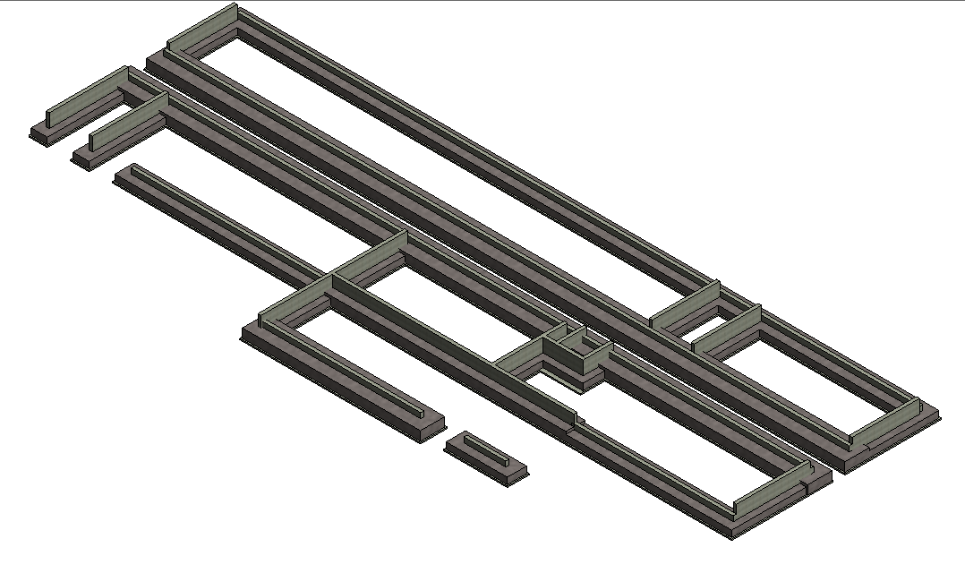
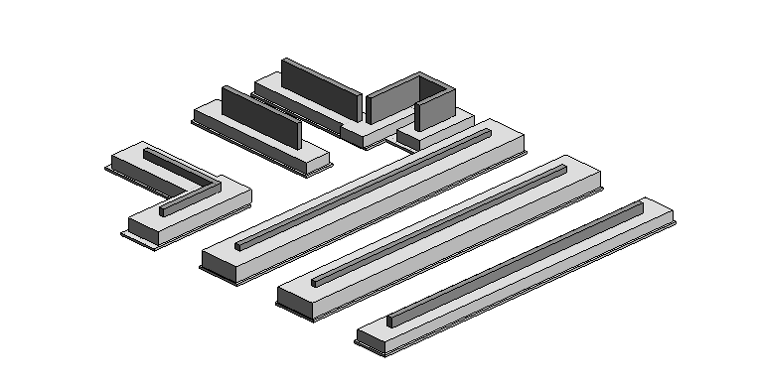
Footings

Slide 31
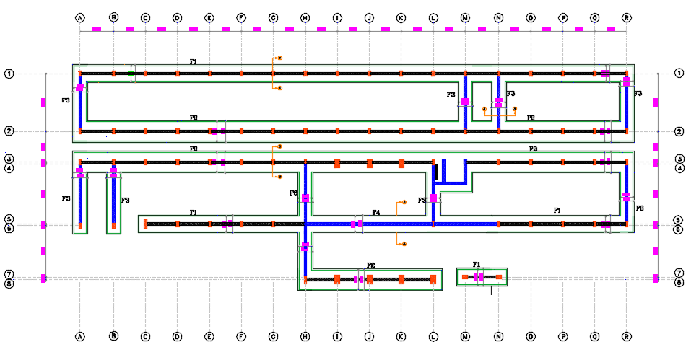
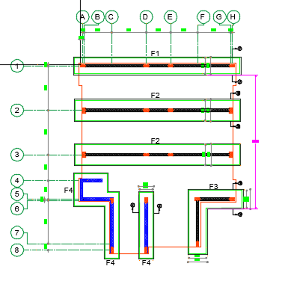

Slide 32
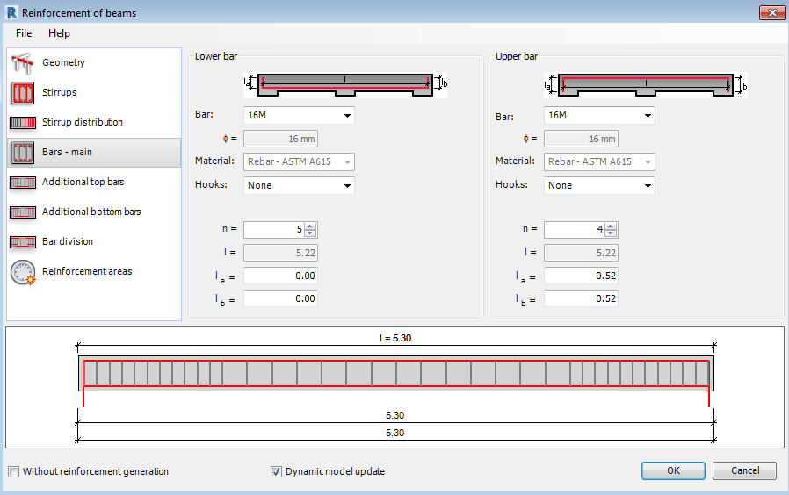
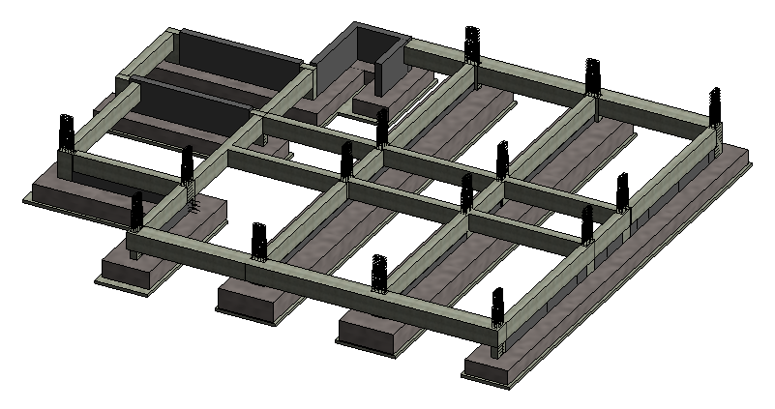
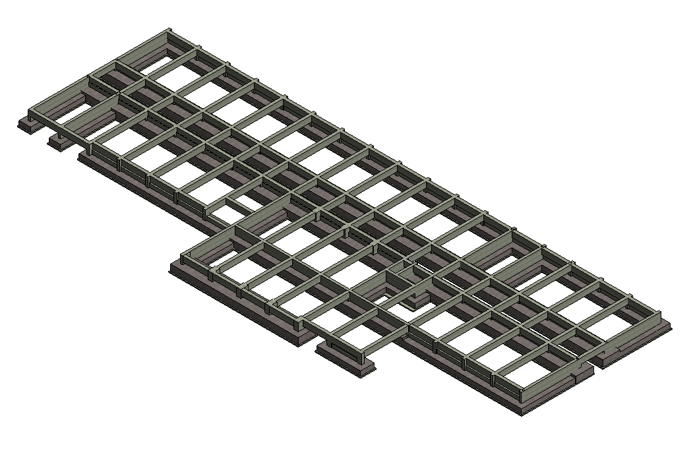
Ground Beams

Slide 33
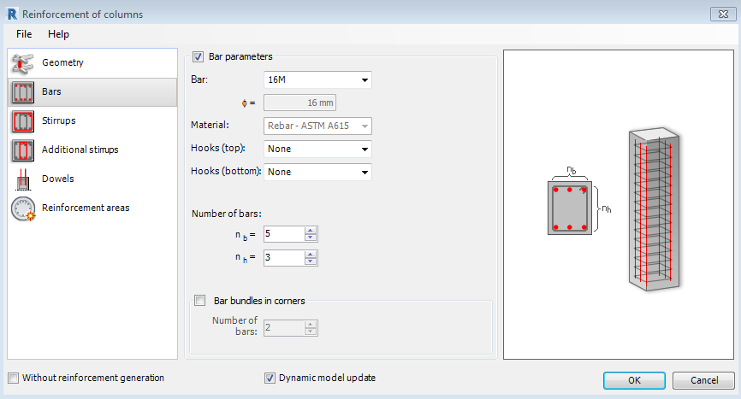
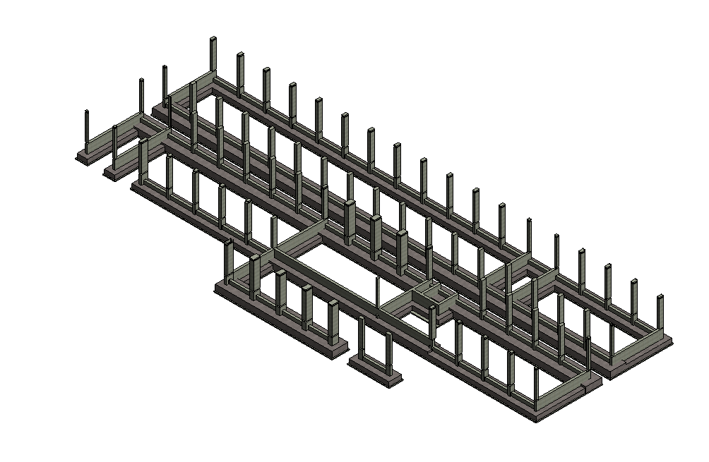
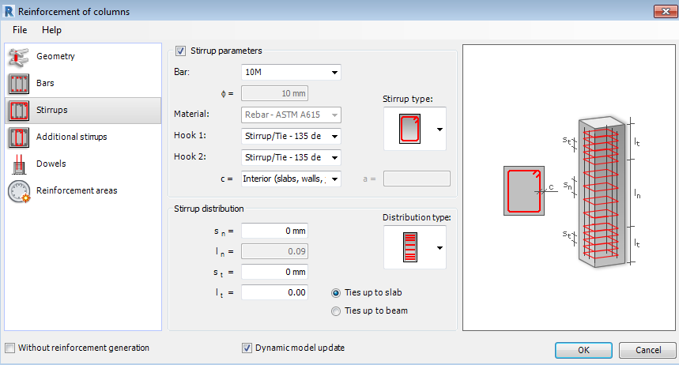
Columns

Slide 34
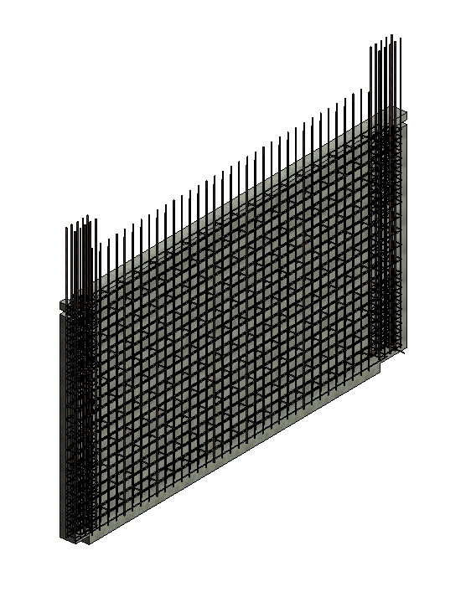
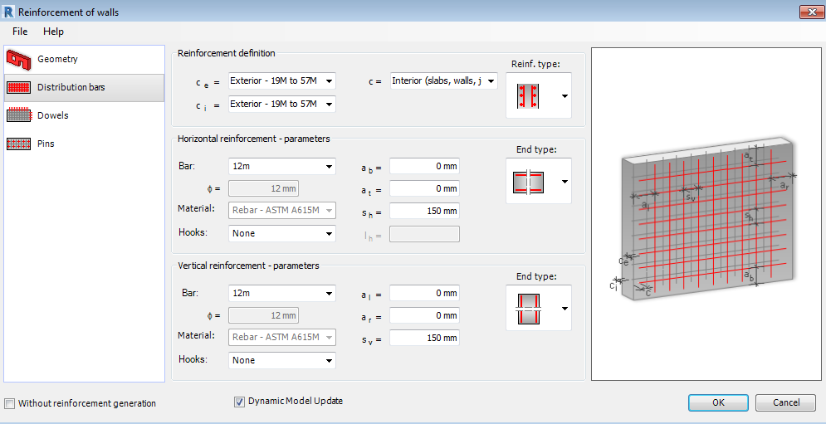
Shear walls

Slide 35
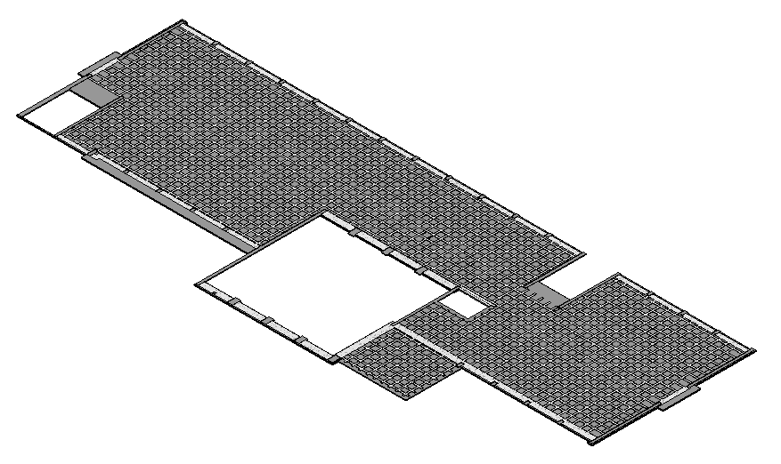
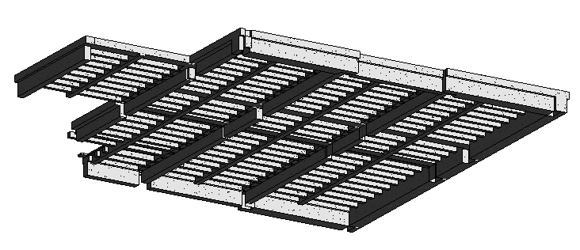
Slabs
Ribbed With Drop Beams
U-Boot With Hidden Beams

Slide 36
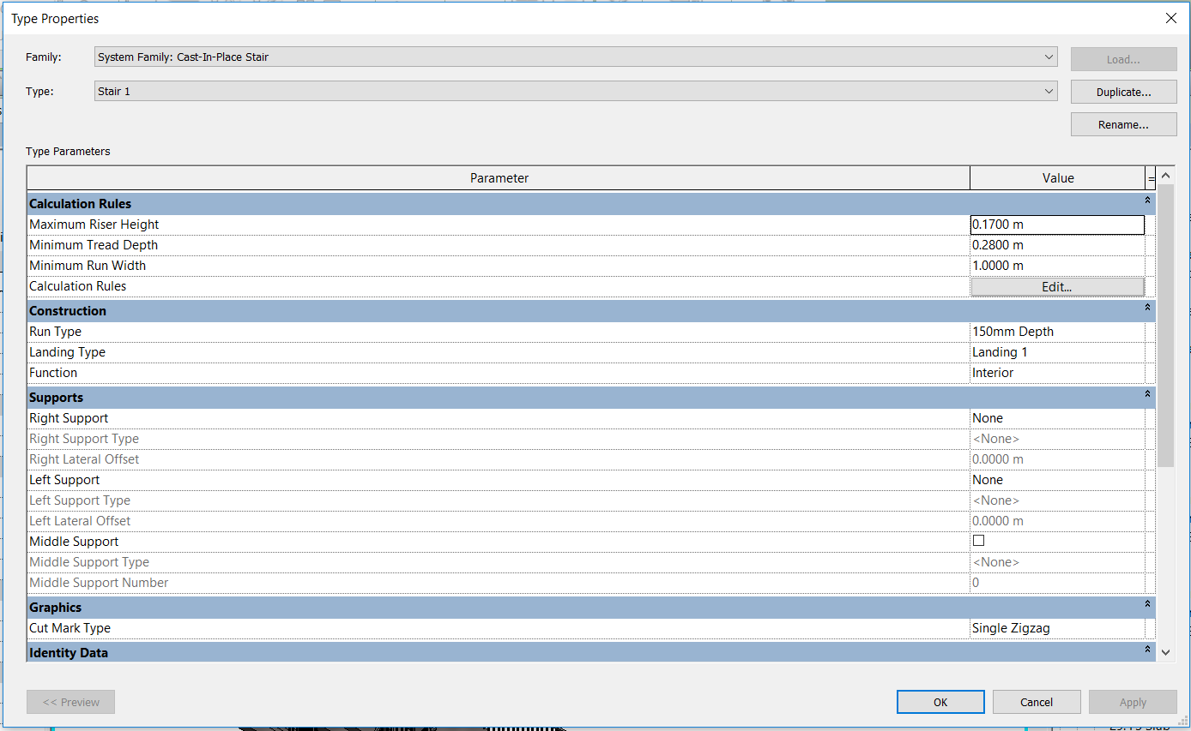
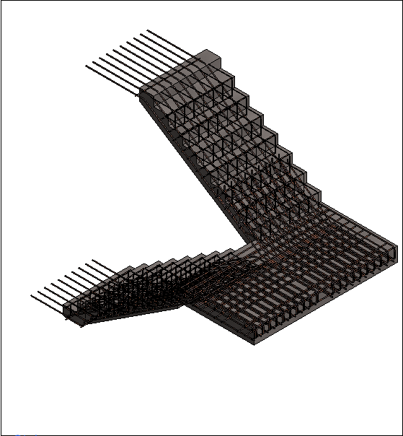
Stairs

Slide 37
Result
Item | Concrete (m³) | Reinforcement (Ton)
Plain Concrete | 124.7 | 0
Strip Footings | 609.25 | 41.72
Column Necks | 10.85 | 4.4
Wall under Slab on grade | 45 | 4.04
Retaining Wall | 305 | 17.75
Boundary Wall | 63.6 | 1.63
Tie Beams | 96.34 | 14
Slab on Grade | 112.06 | 6.3
Columns | 175.68 | 44.87
Shear Walls | 229.1 | 28.02
Stairs | 81.17 | 9.88
Total | 1852.75 | 172.61
Item | Area
U Boot Slabs 24 cm | 3014
U Boot Slabs 30 cm | 88
Ribbed Slab | 214
Solid Slab | 55

Slide 38
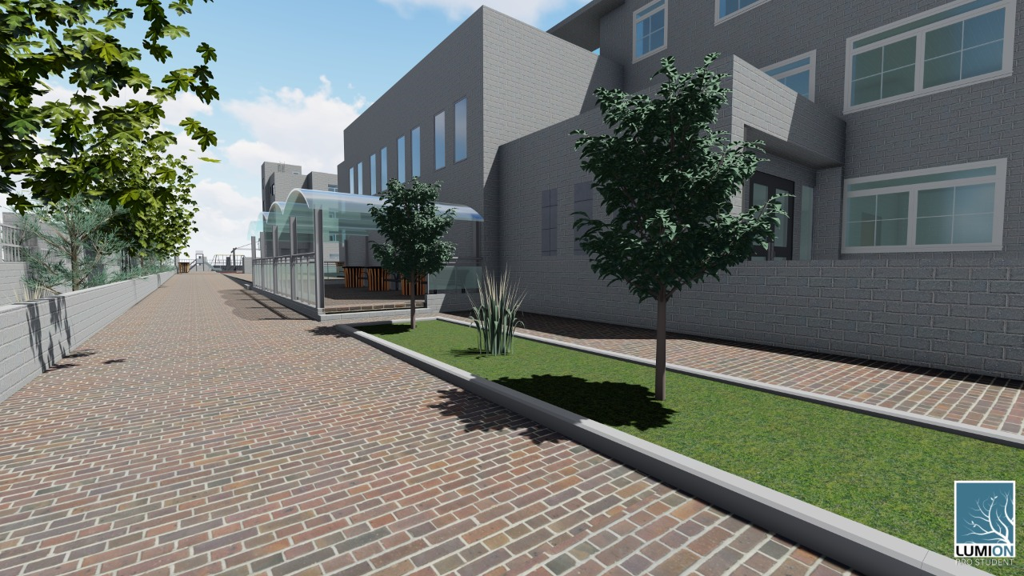
Renders by Lumion
Lumion is a powerful, easy, fun-to-use, effective architectural visualization tool that allows anyone to build a 3D environment and then create beautiful images, impressive video presentations, and live walkthroughs. It is the fastest way to pick up your 3D model and create a scene in a matter of minutes.

Slide 39
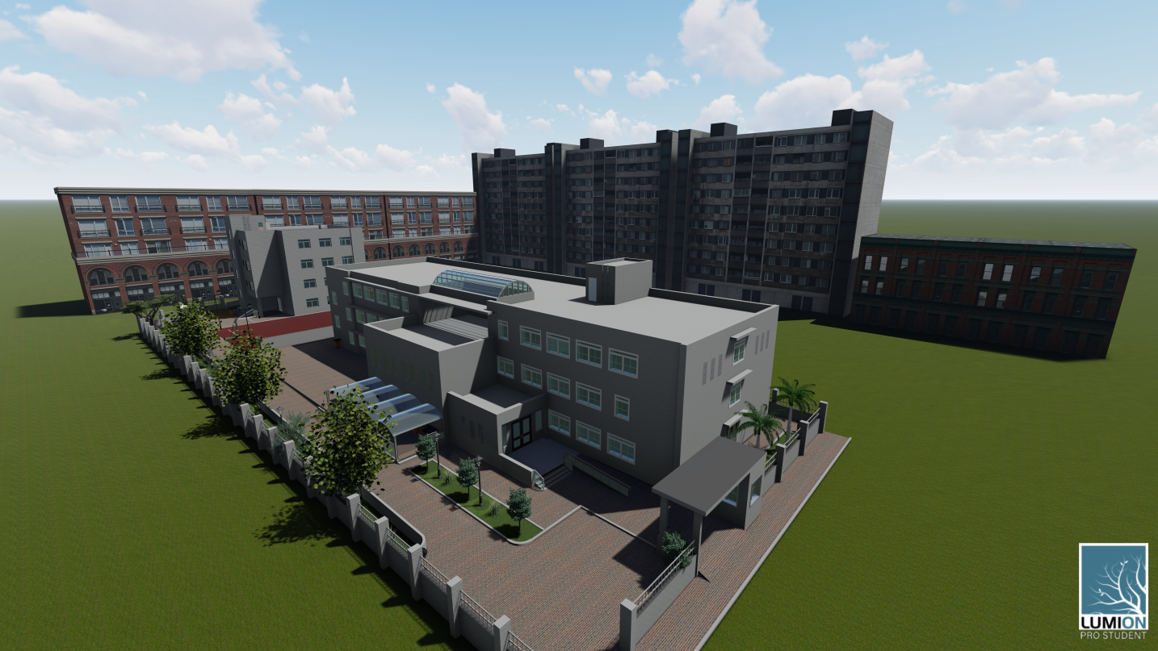
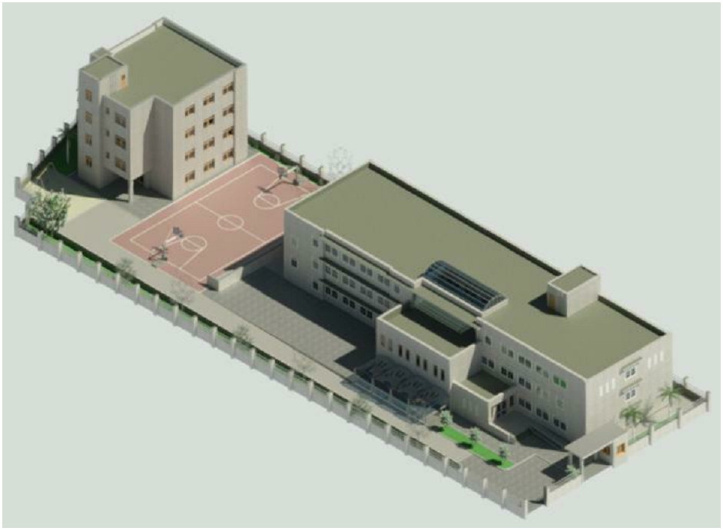
Diffrence between renders in lumion and Revit

Slide 40

Time Schedule Using Primavera Software

Slide 41
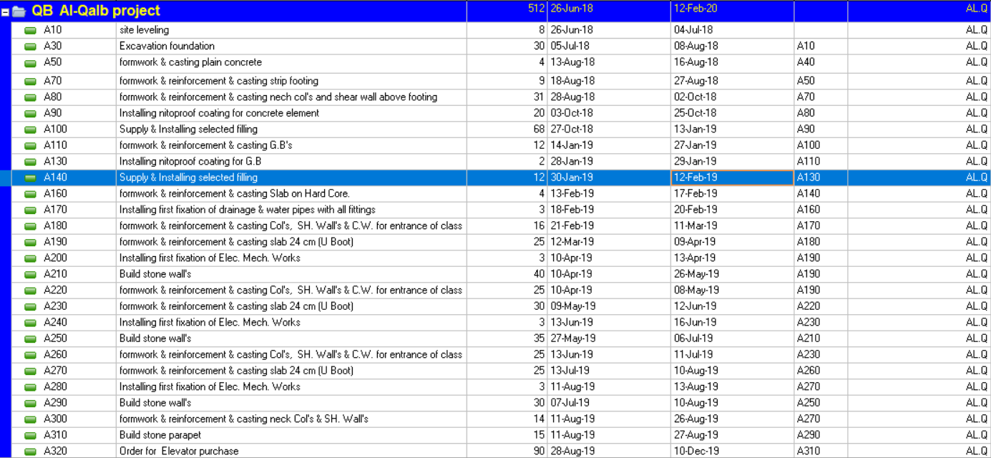
Activities

Slide 42

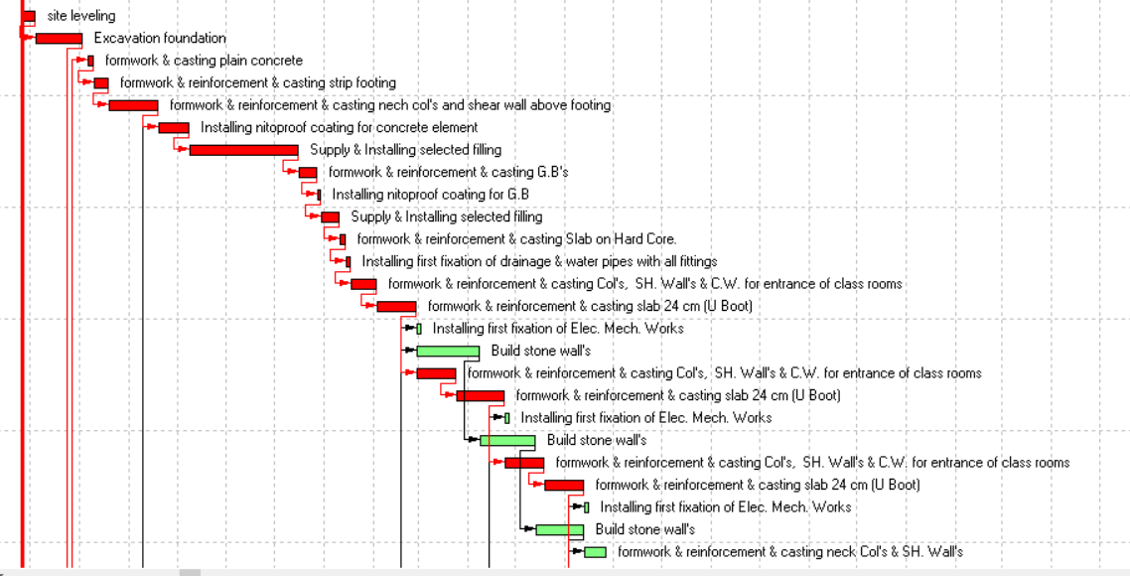
Time Schedule

Slide 43
Cost estimation
Footing
Volume of foundation = width * length * depth
= 1.9 * 15.6 * .7 = 20.75 m3
Total concrete volume = 20.75 m3
Steel weight from revit is 1313.75 kg
Steel weight/C.M= 63.3 kg/C.M
Cost for F2 = ((1*310+ 0.063*3000 +320)*10%)/3.5= 258$/C.M
Columns
Volume of columns (250*500) = width * length * depth
Volume of all columns =140 m3
Steel weight from revit is 40635kg
Steel weight/C.M = 290 kg/C.M
Cost for C.M of columns = ((1*310+ 0.29*3000 +320)*10%)/3.5= 470$/C.M

Slide 44
Cost Summary
Project Parts | Cost ($)
Earth Work | 81590
School | 1011251.67
Dorm | 437443.33
External work | 185710
Total Cost | 1716000
Buildings | Cost/Area ($/S.M)
School | 408.3
Dorm | 473

Slide 45
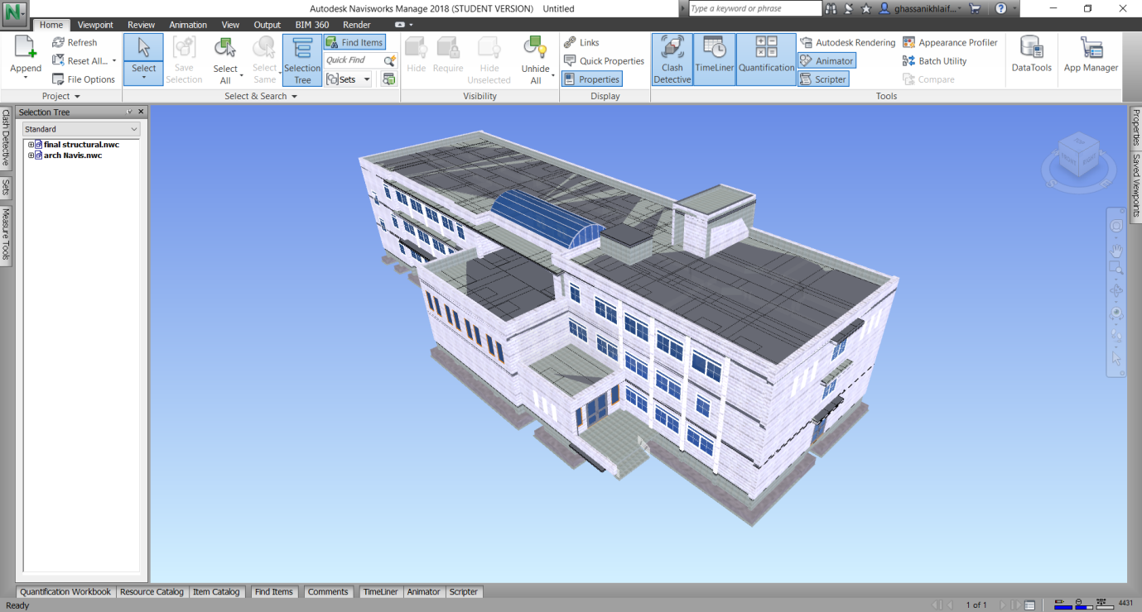
Naviswork

Slide 46
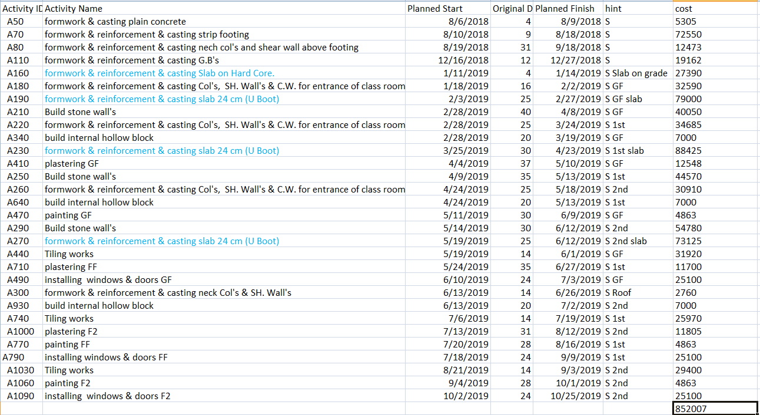
School cost loading

Slide 47
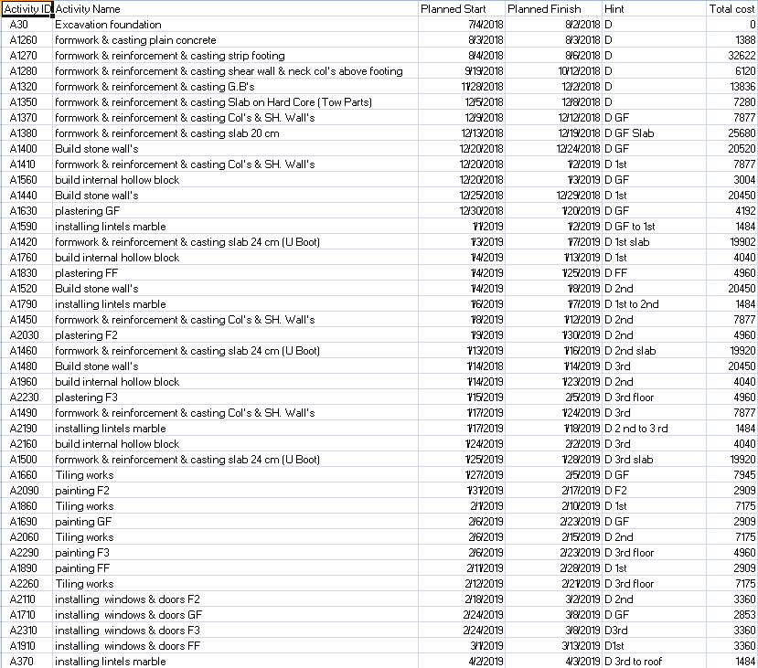
Dorm cost loading

Slide 48
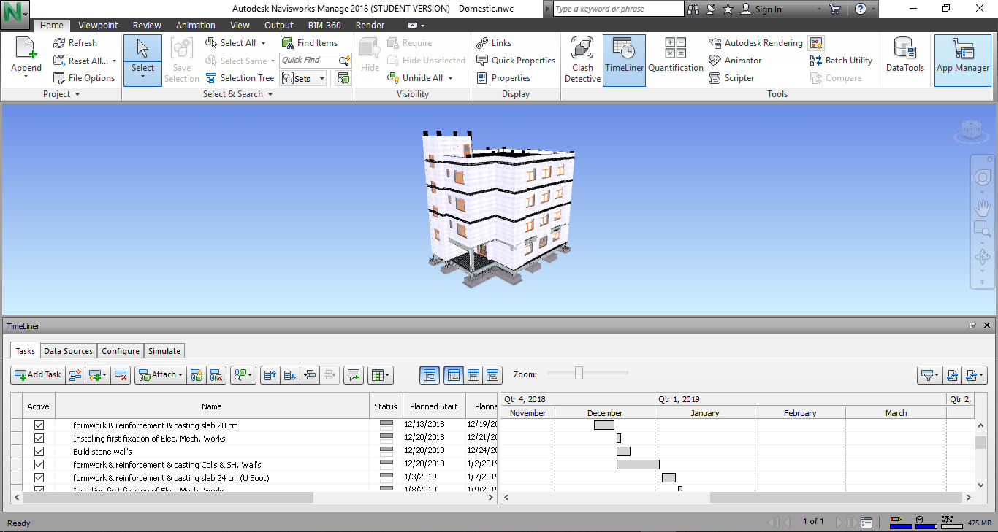
Time liner

Slide 49


