Slide 1
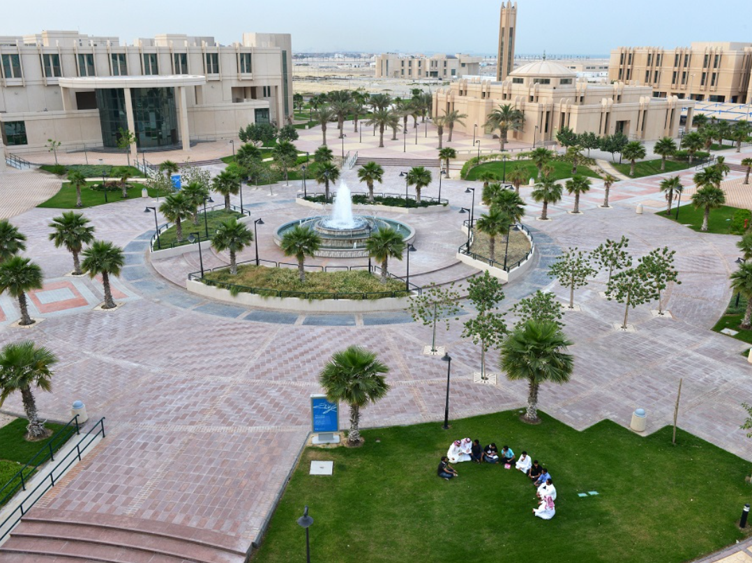
The Potential Of Using Precast Concrete Buildings In Palestine
GRADUATION PROJECT II
Made by (Students):
Ayman kayed
Supervisor:
Dr. Riyad Abdel-Karim

Slide 2

Presentation Content
introduction
Objective
Literature review
Execution Mechanism of Precast Concrete Full Panels systems Buildings on Site
Comparison
Conclusion

Slide 3
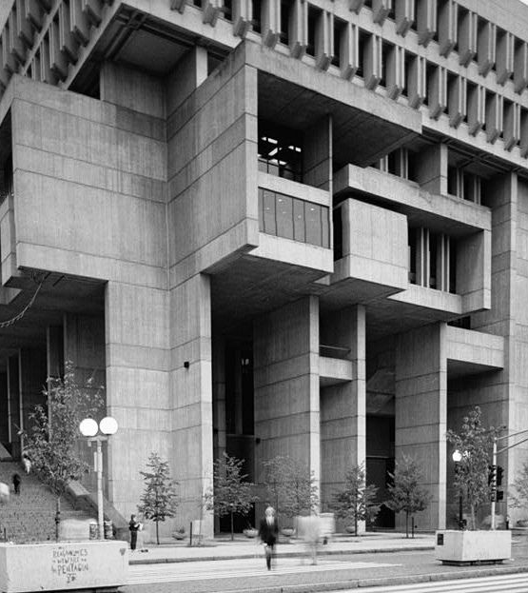

Introduction
What are precast concrete buildings?
And what is its history?
What buildings are cast on site?

Slide 4
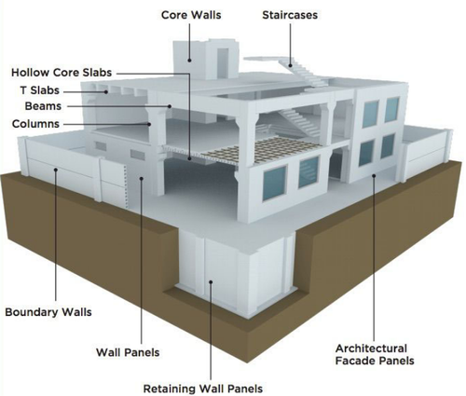
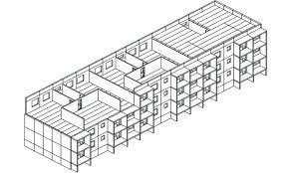
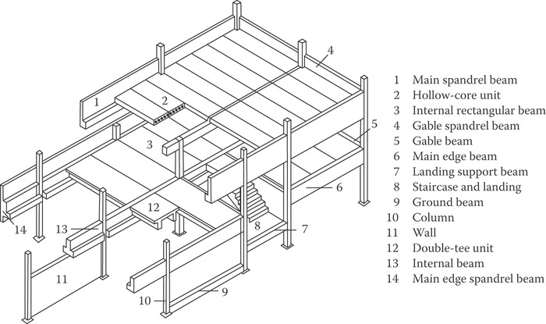
Introduction
What are the types of precast concrete buildings?
slap-column system with shear wall
large panel system
frame system
Notes:
Notes to presenter:
Description of what you learned in your own words on one side.
Include information about the topic
Details about the topic will also be helpful here.
Tell the story of your learning experience. Just like a story there should always be a beginning, middle and an end.
On the other side, you can add a graphic that provides evidence of what you learned.
Feel free to use more than one slide to reflect upon your process. It also helps to add some video of your process.

Slide 5
Objectives
Reviewing scientific papers
Learn about this unconventional system
We made comparisons and analyzed them
Possibility to use

Slide 6
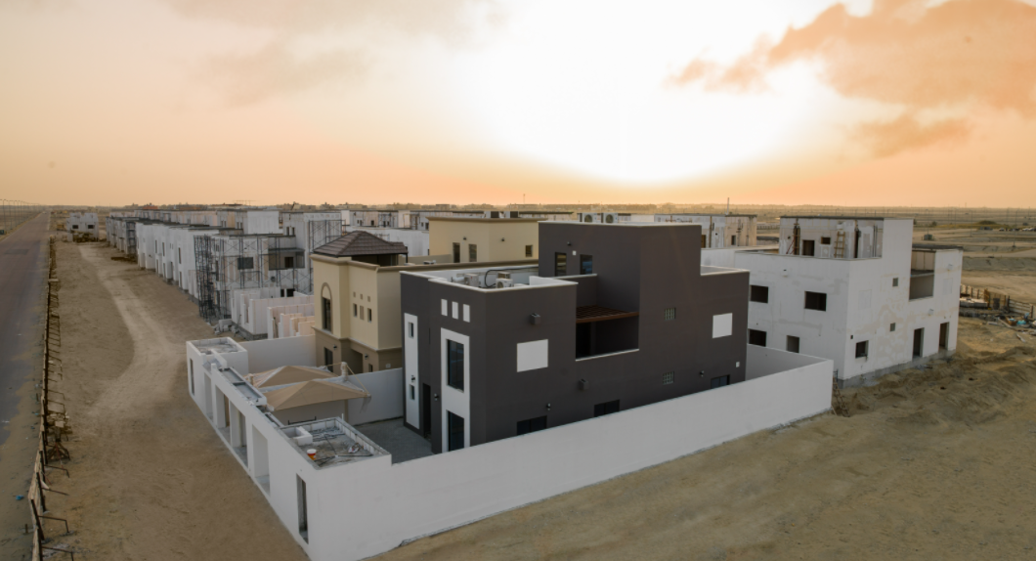
Literature Review
In the factory
Dunning implementa tion and ues
After finishing it
Advantages
Of precast
concrete

Slide 7
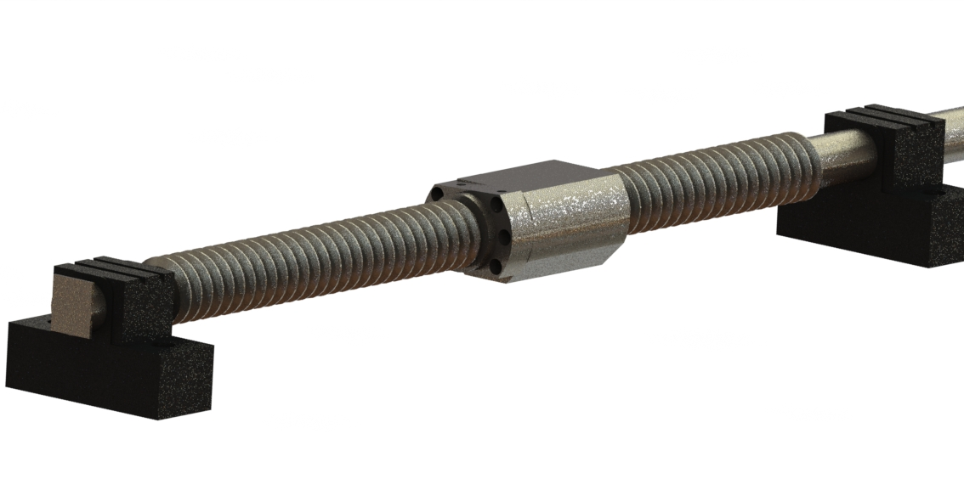
Execution Mechanism of Precast Concrete Full Panels systems Buildings on Site
Benefits of using full panels systems
The structural elements of the system
On-site implementation mechanism

Slide 9
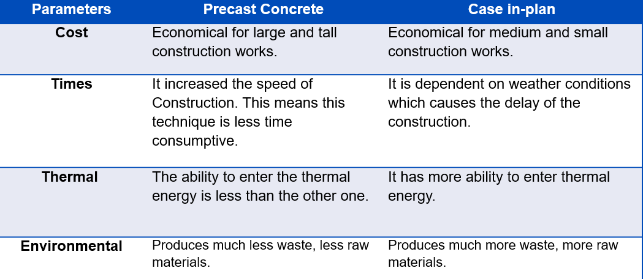
Comparison
Comparison results between the two systems

Slide 10

Conclusion & Recommendations
.

Slide 11
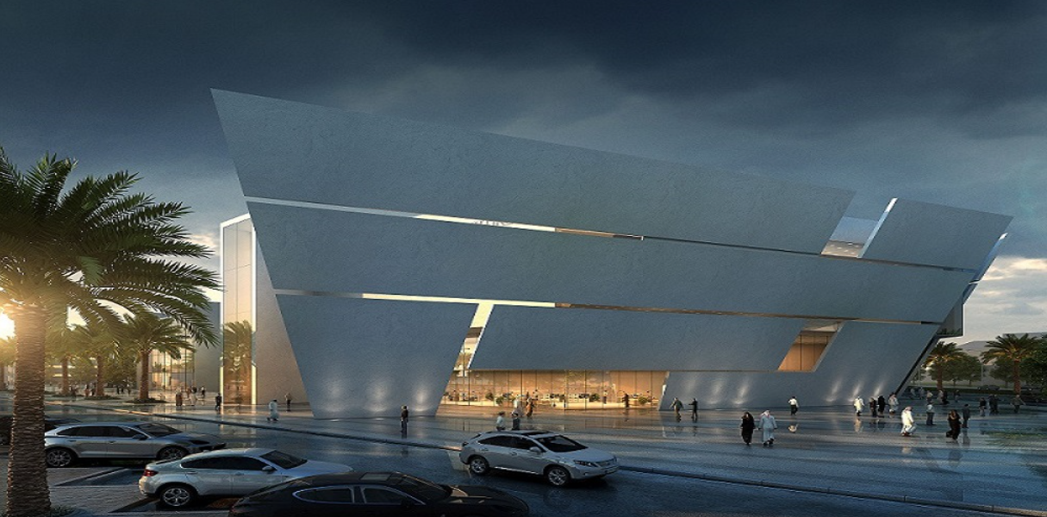
Thanks for your attention
I hope you enjoyed the show

