Slide 1

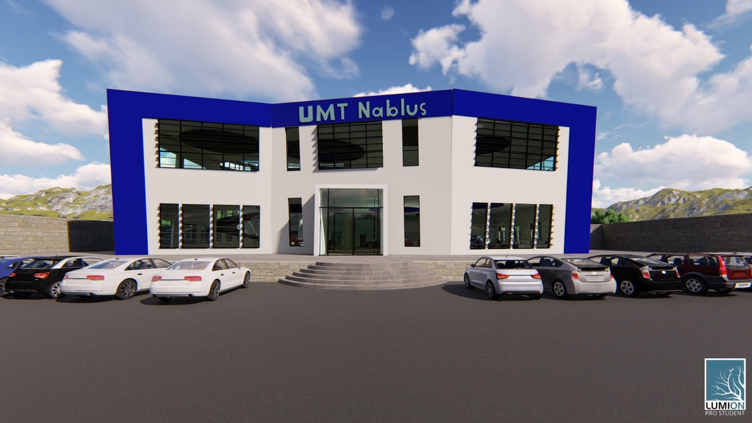
Integrated Re-Design of the United Motor Trade Company in Nablus
Prepared by: Supervised by:
Noor Barahmeh. Eng. Haitham Sawalha.
Wa’d Bustami.
Zaina Abu-Salameh.

Slide 2
Quantity surveying
Site analysis
Architectural design
Structural design
Environmental design
Electrical design
Mechanical design
Outline

Slide 3
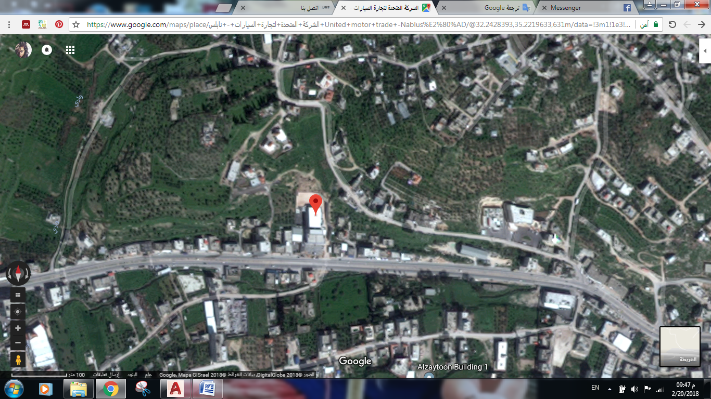
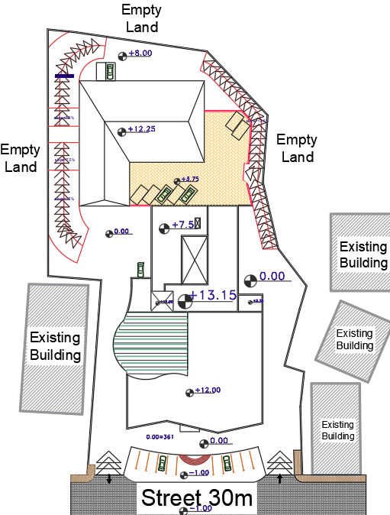
Site analysis
Located in Bait-Iba 4.7m away from Nablus city
Land area = 6,800 m²
Building area = 3,000 m²
Surrounding
Parking

Slide 4
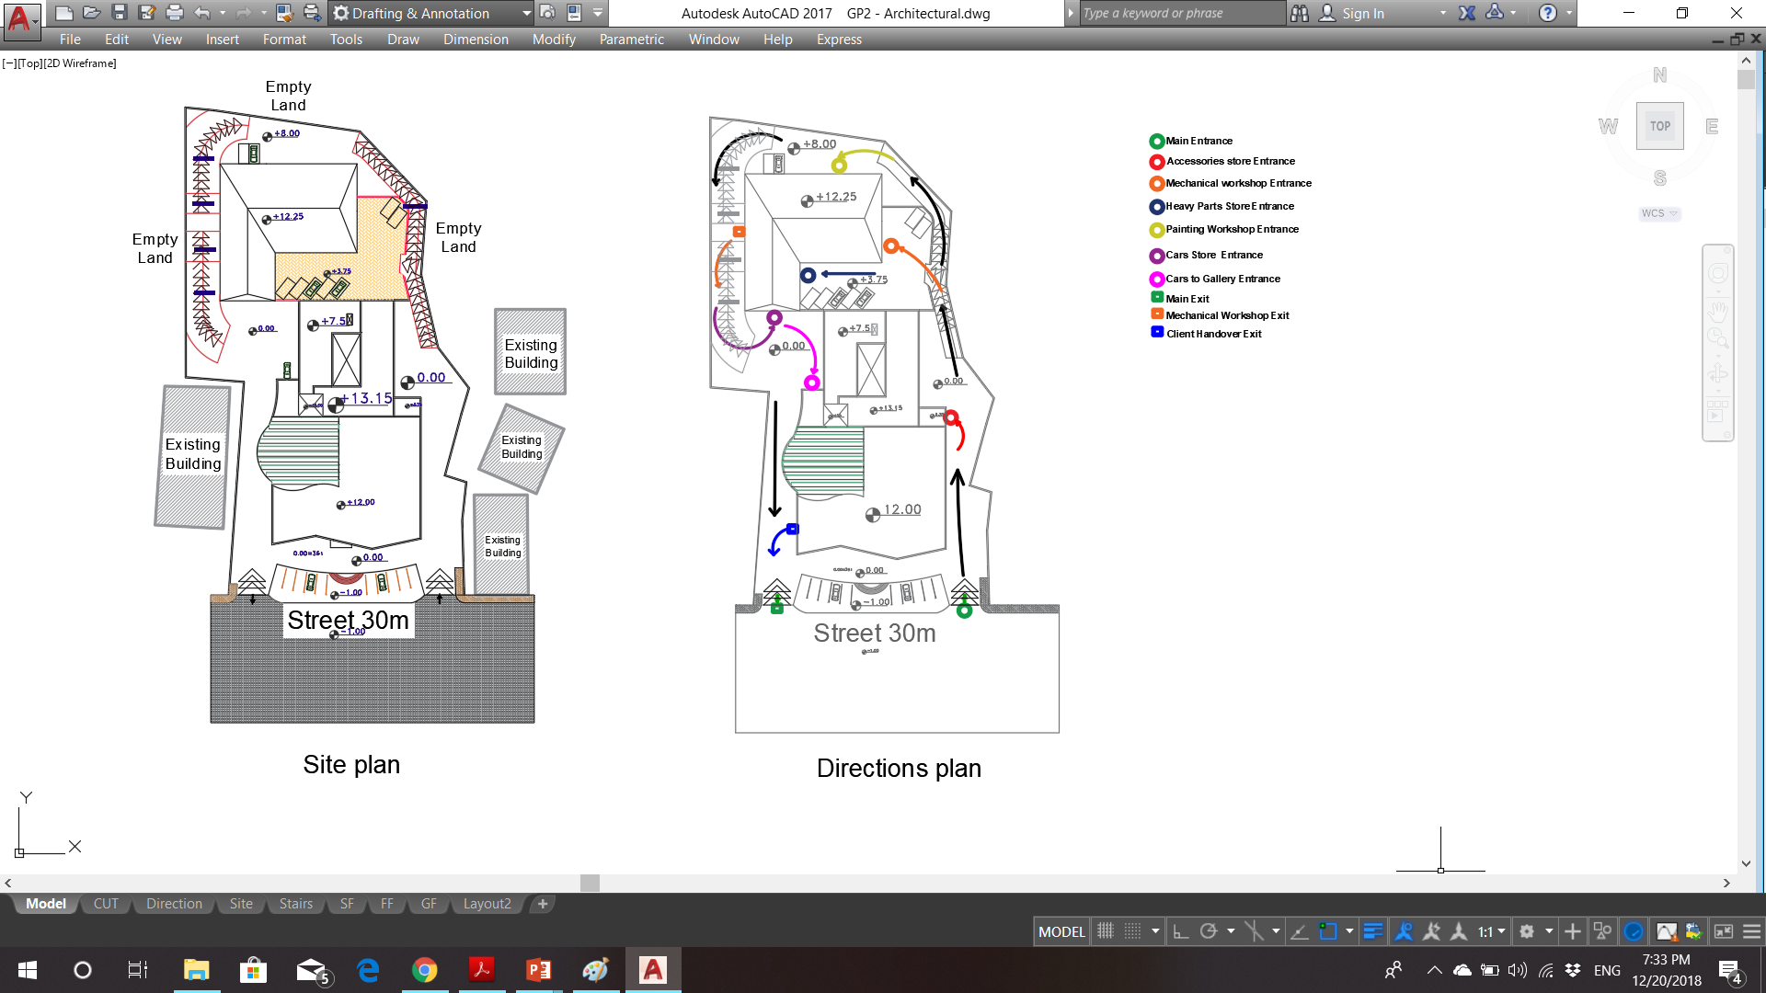
Site analysis
Movement

Slide 5
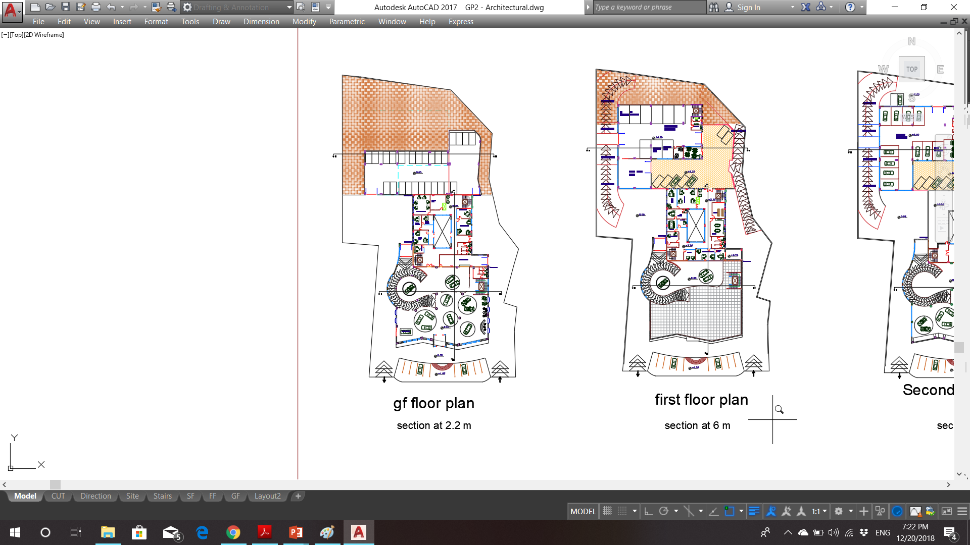
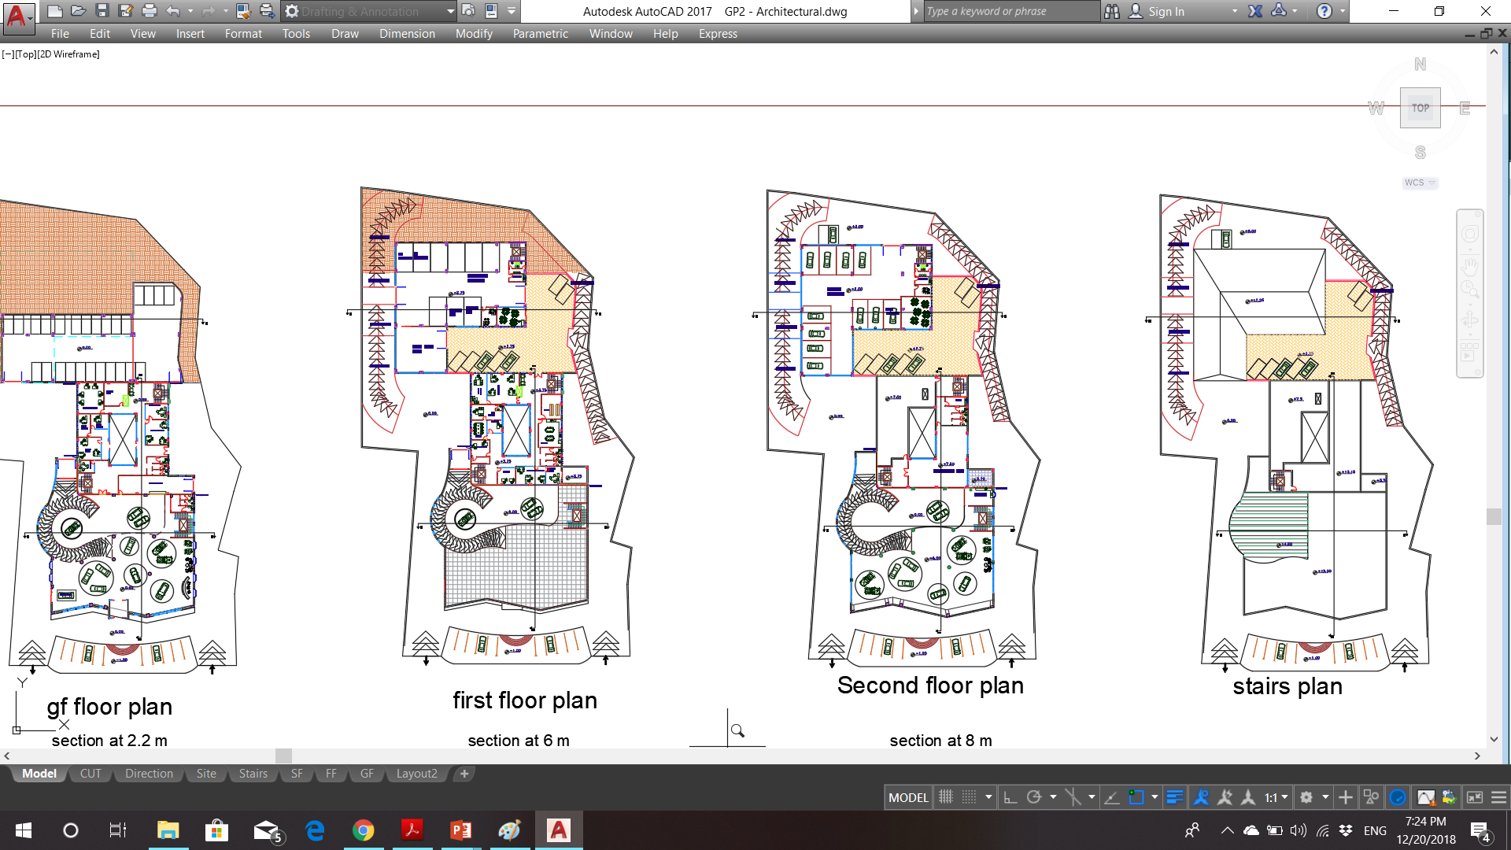
Architectural design
Ground floor plan
First floor plan

Slide 6
Architectural design
Second floor plan

Slide 7
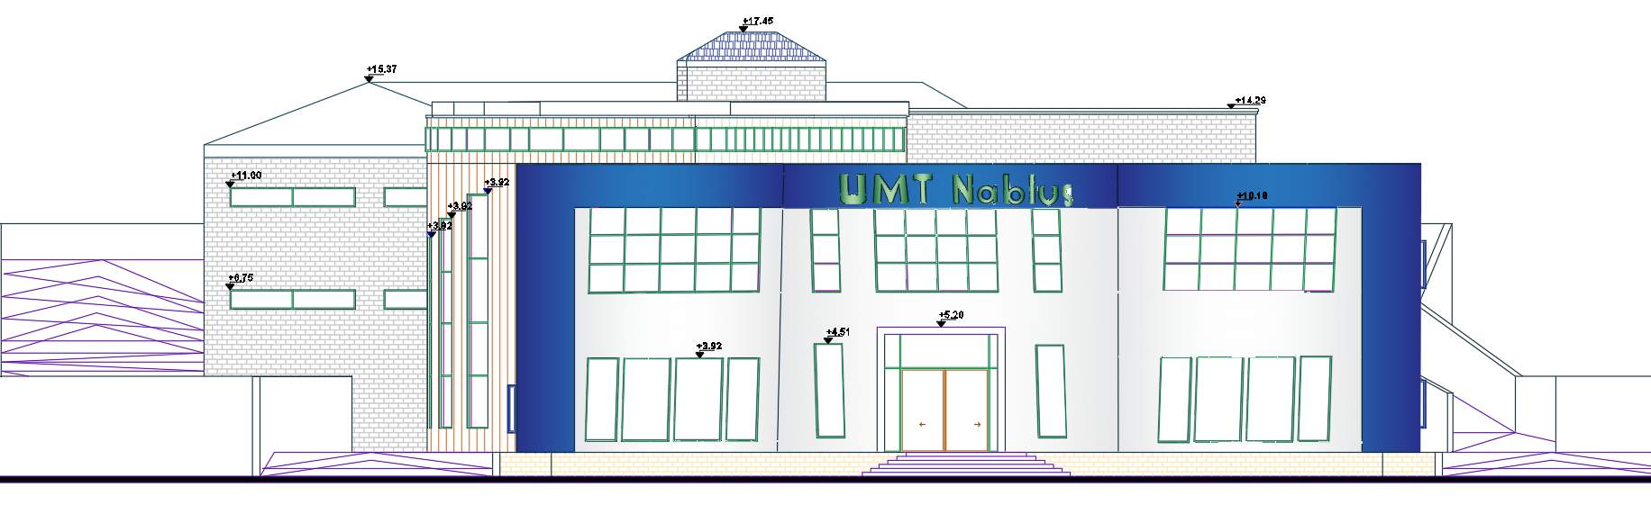
Architectural design
South Elevation

Slide 8
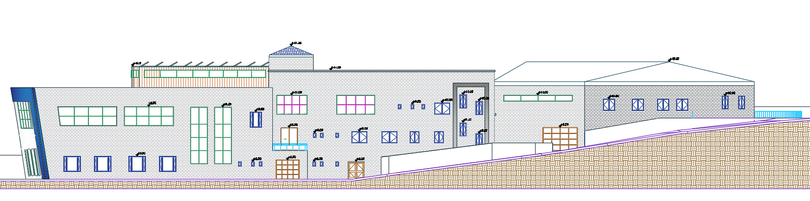
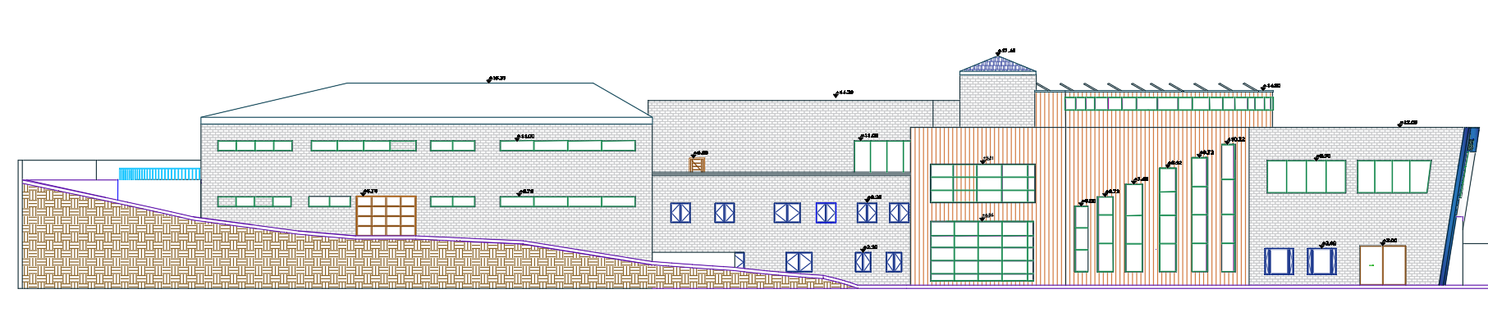
Architectural design
East Elevation and West elevation

Slide 9
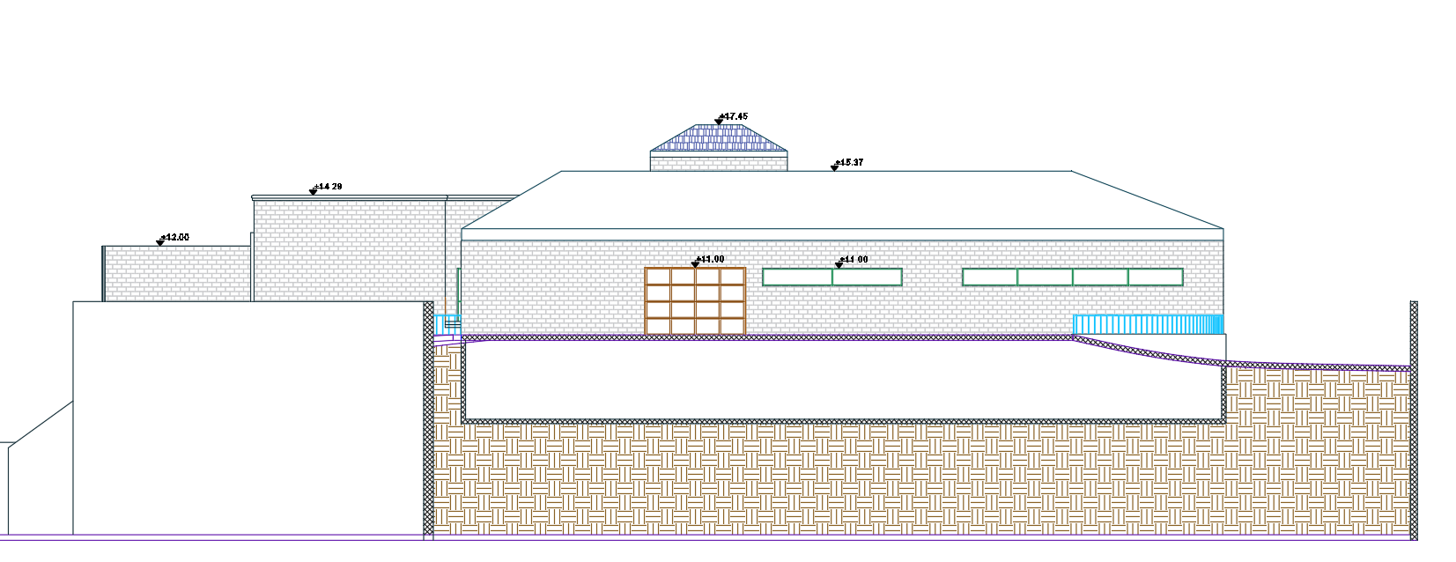
Architectural design
North Elevation

Slide 10
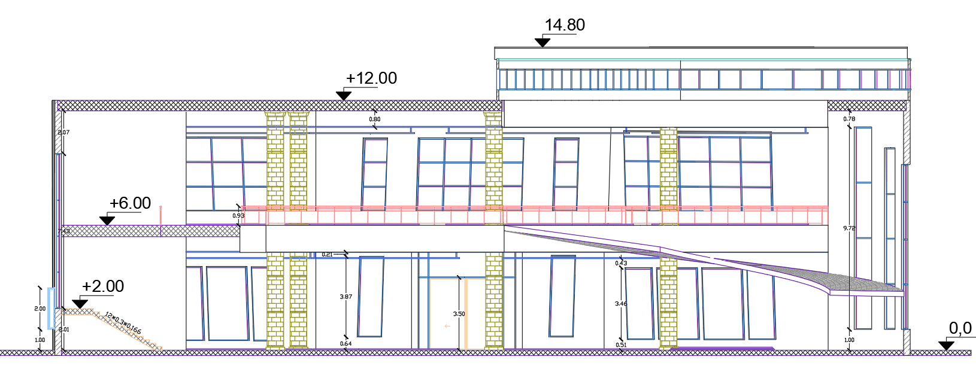
Architectural design
Section A-A

Slide 11
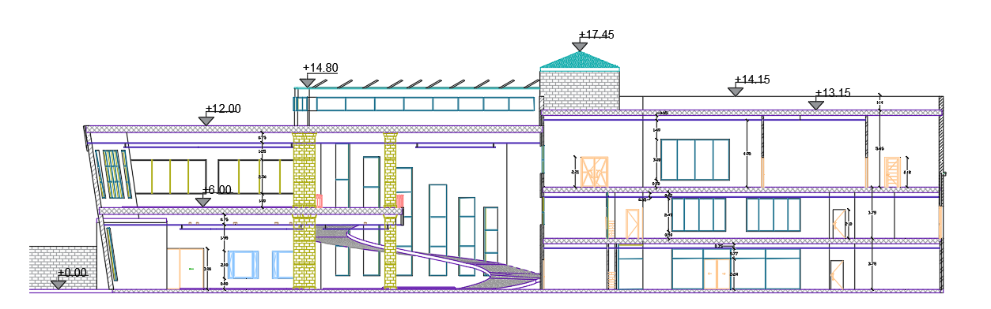
Architectural design
Section B-B

Slide 12
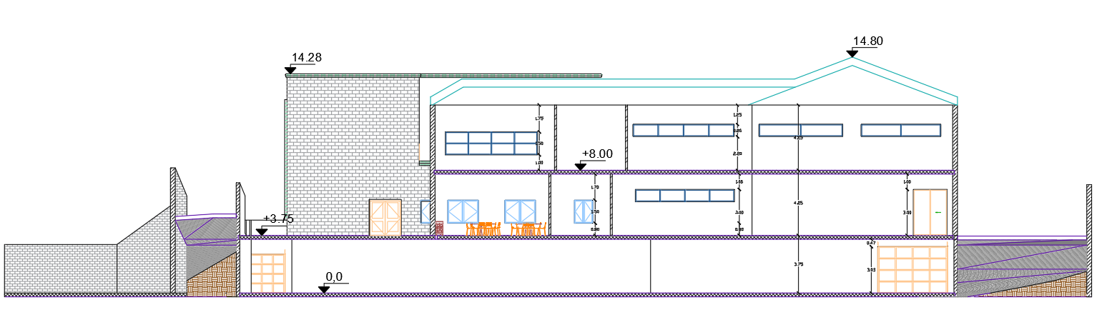
Architectural design
Section C-C

Slide 13
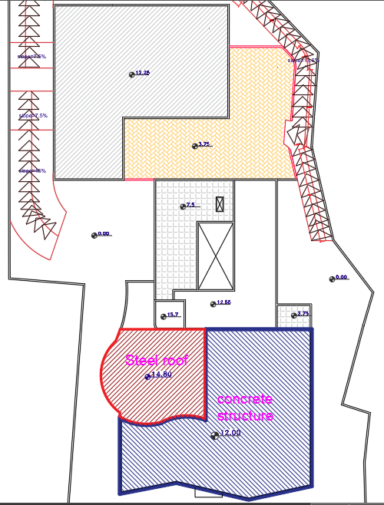
Structural design
Reinforced concrete structure
Steel structure ( Truss system)

Slide 14
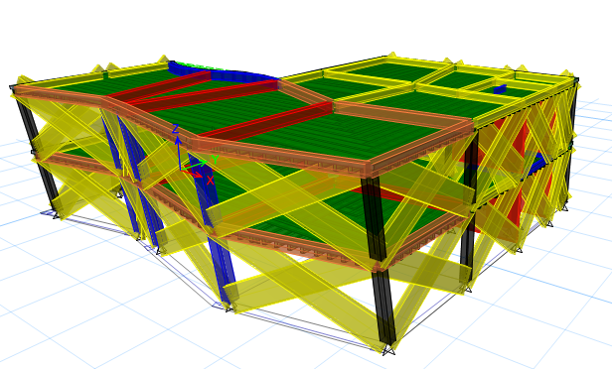
Structural design
Codes:
ACI 318-14
UBC – 97
f’c = 24 MPa
Fy = 420 MPa
Floor height = 6 m
Maximum span length = 14.12 m

Slide 15
Structural design
Gravity loads
Lateral loads
Floor/Load | SD (kN/m²) | Live(kN/m²)
Ground floor slab | 4 | 5
First floor slab | 4 | 3
Nablus city with a zone factor equals 0.2
The soil type is SE which is soft soil. (250 kN/m² soil bearing capacity).
Over strength factor, R=5.5 (for sway intermediate concrete frame structure).
Period (T) equals Ct × building height^{3/4} =0.0488×12^{3/4}= 0.315 second.
Importance factor (I) equals 1
Response spectrum scale factor= (g×I)/R=1784.
Beam/Load | SD (kN/m)
External beams under stone wall | 25
External beams under almost curtain wall | 15

Slide 16
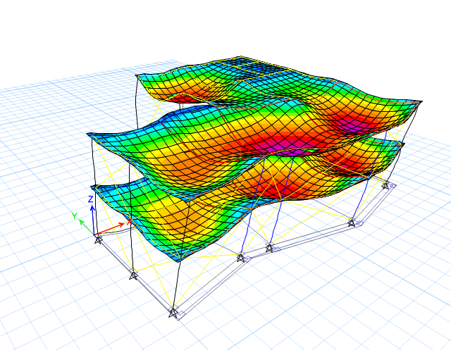
Structural design
Manual checks
Compatibility check
Equilibrium check
Internal forces check ( columns, slabs, beams)
Deflection check
Period check
Drift check
Base shear check

Slide 17
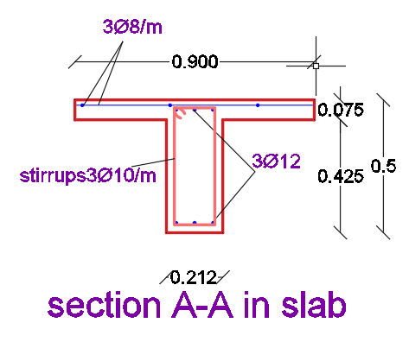
Structural design
Two way waffle slab
Thickness = 50 cm
Shear check :
no shear → 3Ø10 per m in rib

Slide 18
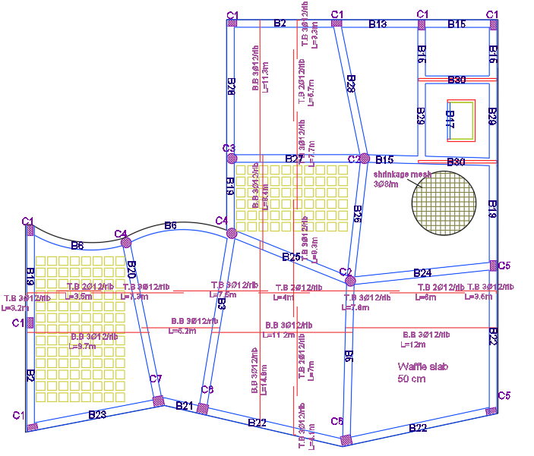
Structural design
Moment design
As = 3Ø12
As shrinkage = 3Ø8/m

Slide 19
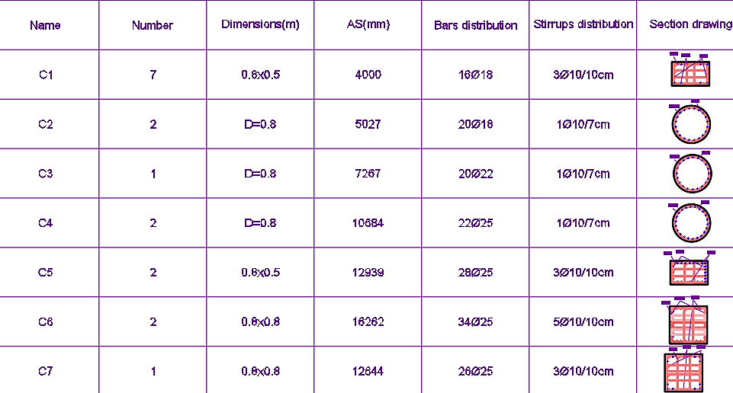
Structural design
Columns’ groups and reinforcement

Slide 20
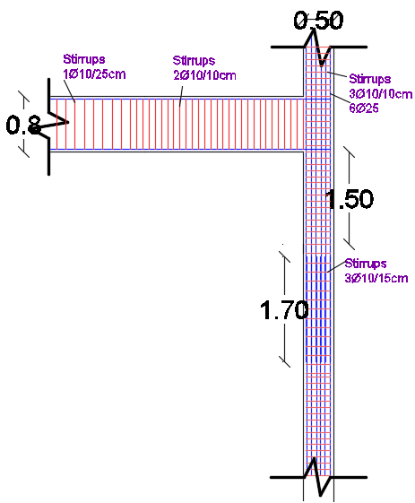
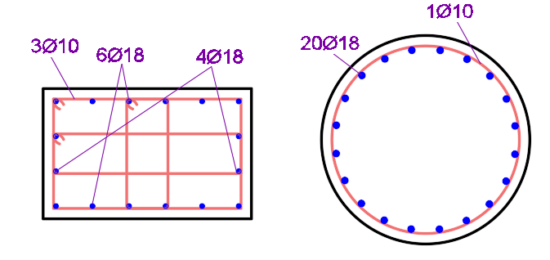
Structural design
Sections for columns

Slide 21
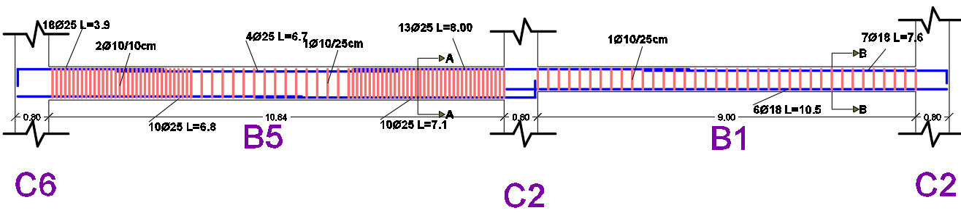
Structural design
Beams design
- Frame B1-B5 as a sample
Name | Depth (cm) | Width (cm)
B1 | 60 | 35
B5 | 80 | 60

Slide 22
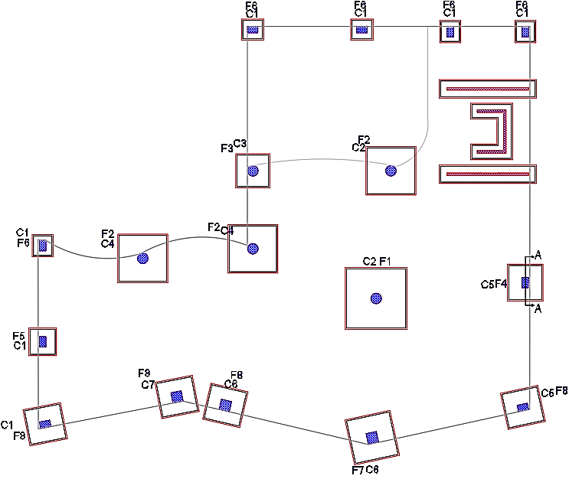
Structural design
Footing design
Isolated footings are used:
Punching shear check
Wide shear check

Slide 23
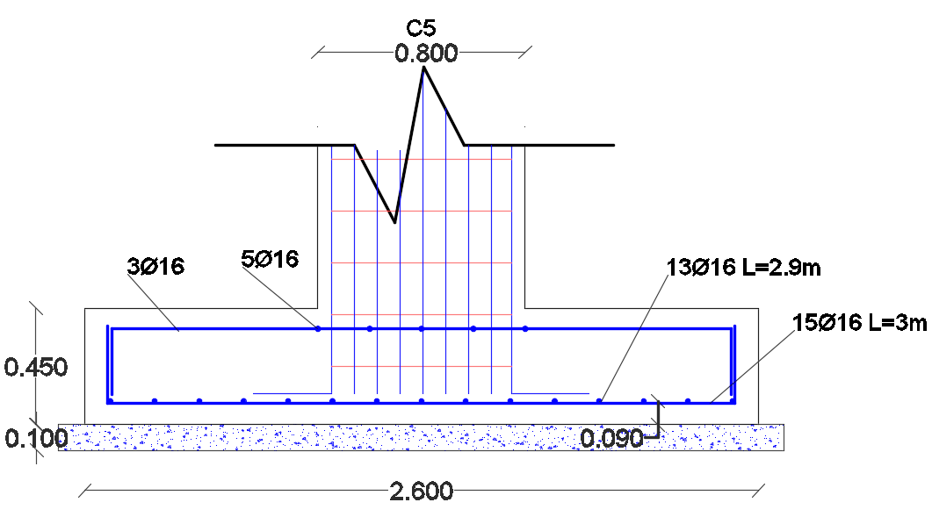
Structural design
Footings’ reinforcement summery
Name | Width (m) | Length (m) | Depth (m) | Bars number parallel to L | Bars number parallel to W
F1 | 4.5 | 4.5 | 1 | 28ø18 | 28ø18
F2 | 3.6 | 3.5 | 0.7 | 22ø16 | 25ø16
F3 | 2.4 | 2.4 | 0.45 | 10ø16 | 10ø16
F4 | 2.6 | 2.5 | 0.45 | 15ø16 | 13ø16
F5 | 1.9 | 1.9 | 0.4 | 7ø16 | 5ø14
F6 | 1.5 | 1.4 | 0.4 | 5ø14 | 3ø14
F7 | 3.3 | 3.3 | 0.55 | 19ø18 | 19ø18
F8 | 2.7 | 2.6 | 0.5 | 12ø16 | 14ø16

Slide 24
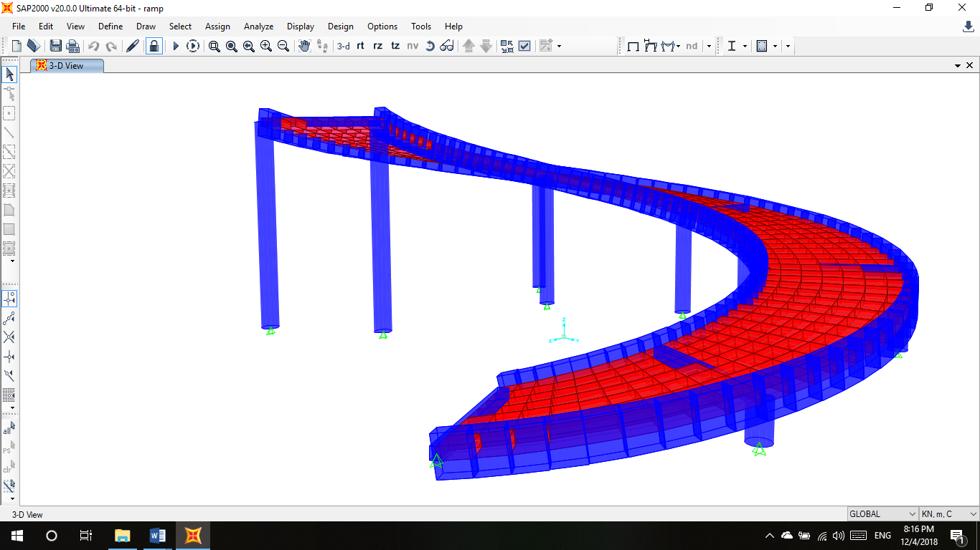
Structural design
Ramp design
-Loads
Name | Load kN/m2
SD | 1
Live | 5
-One way solid slab was used Thickness: 25cm.
Reinforcement : 5∅ 12mm/m

Slide 25
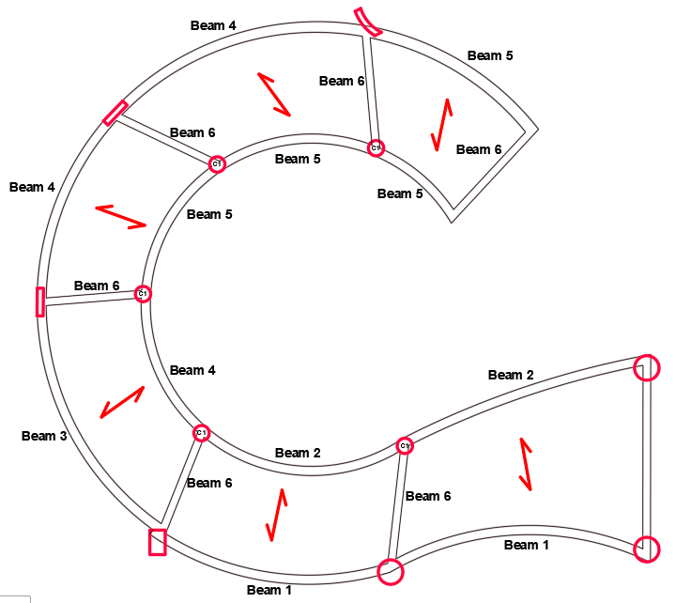
Structural design
Ramp results
Columns:
5 Circular columns (50 cm diameter).
Reinforcement: 10$∅$16
Beams:
4 Main drop beams (80×30cm).
1 hidden secondary beam (25×25 cm).

Slide 26
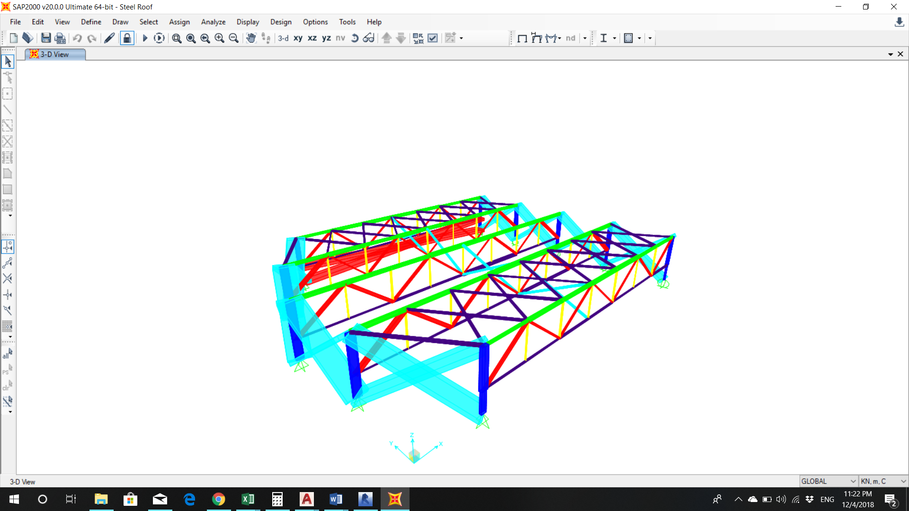
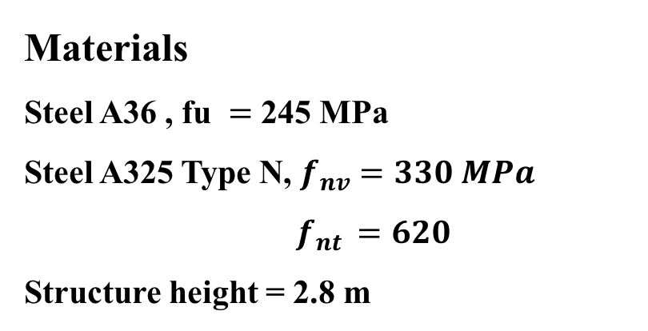
Structural design
Steel coverage roof
Code :
AISE 2010
Materials
Steel A36 , fu $=$ 245 MPa
Steel A325 Type N, $f_{nv}=330 MPa$
$f_{nt }=620$
Structure height = 2.8 m

Slide 27
Structural design
Sections and loads
Member | Section (inch)
Top members | HSS 7$×$7$×$3/16
Bottom members | HSS 7$×$7$×$1/8
Post members | HSS 2$×$2$×$1/8
Inclined members | HSS 6$×$4$×$3/16
Steel bracing | HSS 3$×$3$×$1/8
Steel columns | HSS 18$×$6$×$1/4
Load | walls | Roof (edge) | Roof (center)
D.L (kN/m) | 2.098 | 1.05 | 2.098
L.L (kN/m) | 1 | 1.95 | 3.9
W.L (kN/m) | 0.5 | 1.17 | 2.34
S.L (kN/m) | 2.1 | 4.1 | 8.19

Slide 28
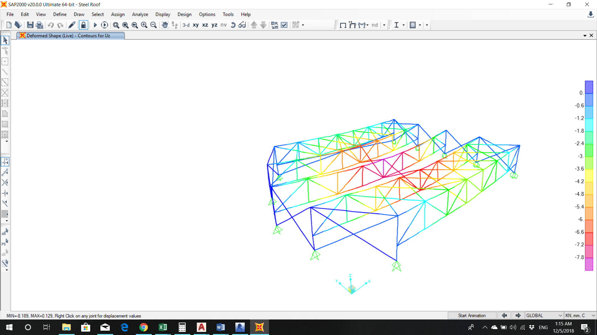
Structural design
Manual checks
Deflection check
Yielding check
Local buckling check
Compression member check

Slide 29
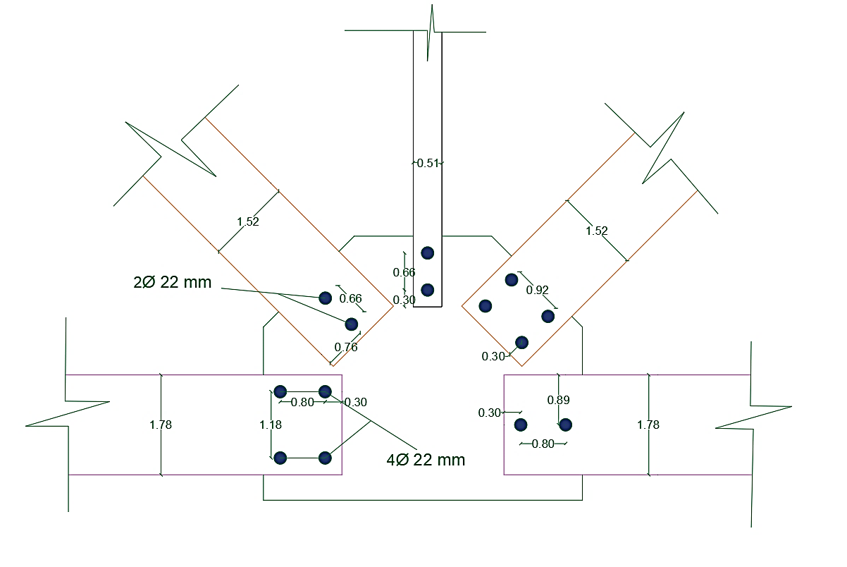
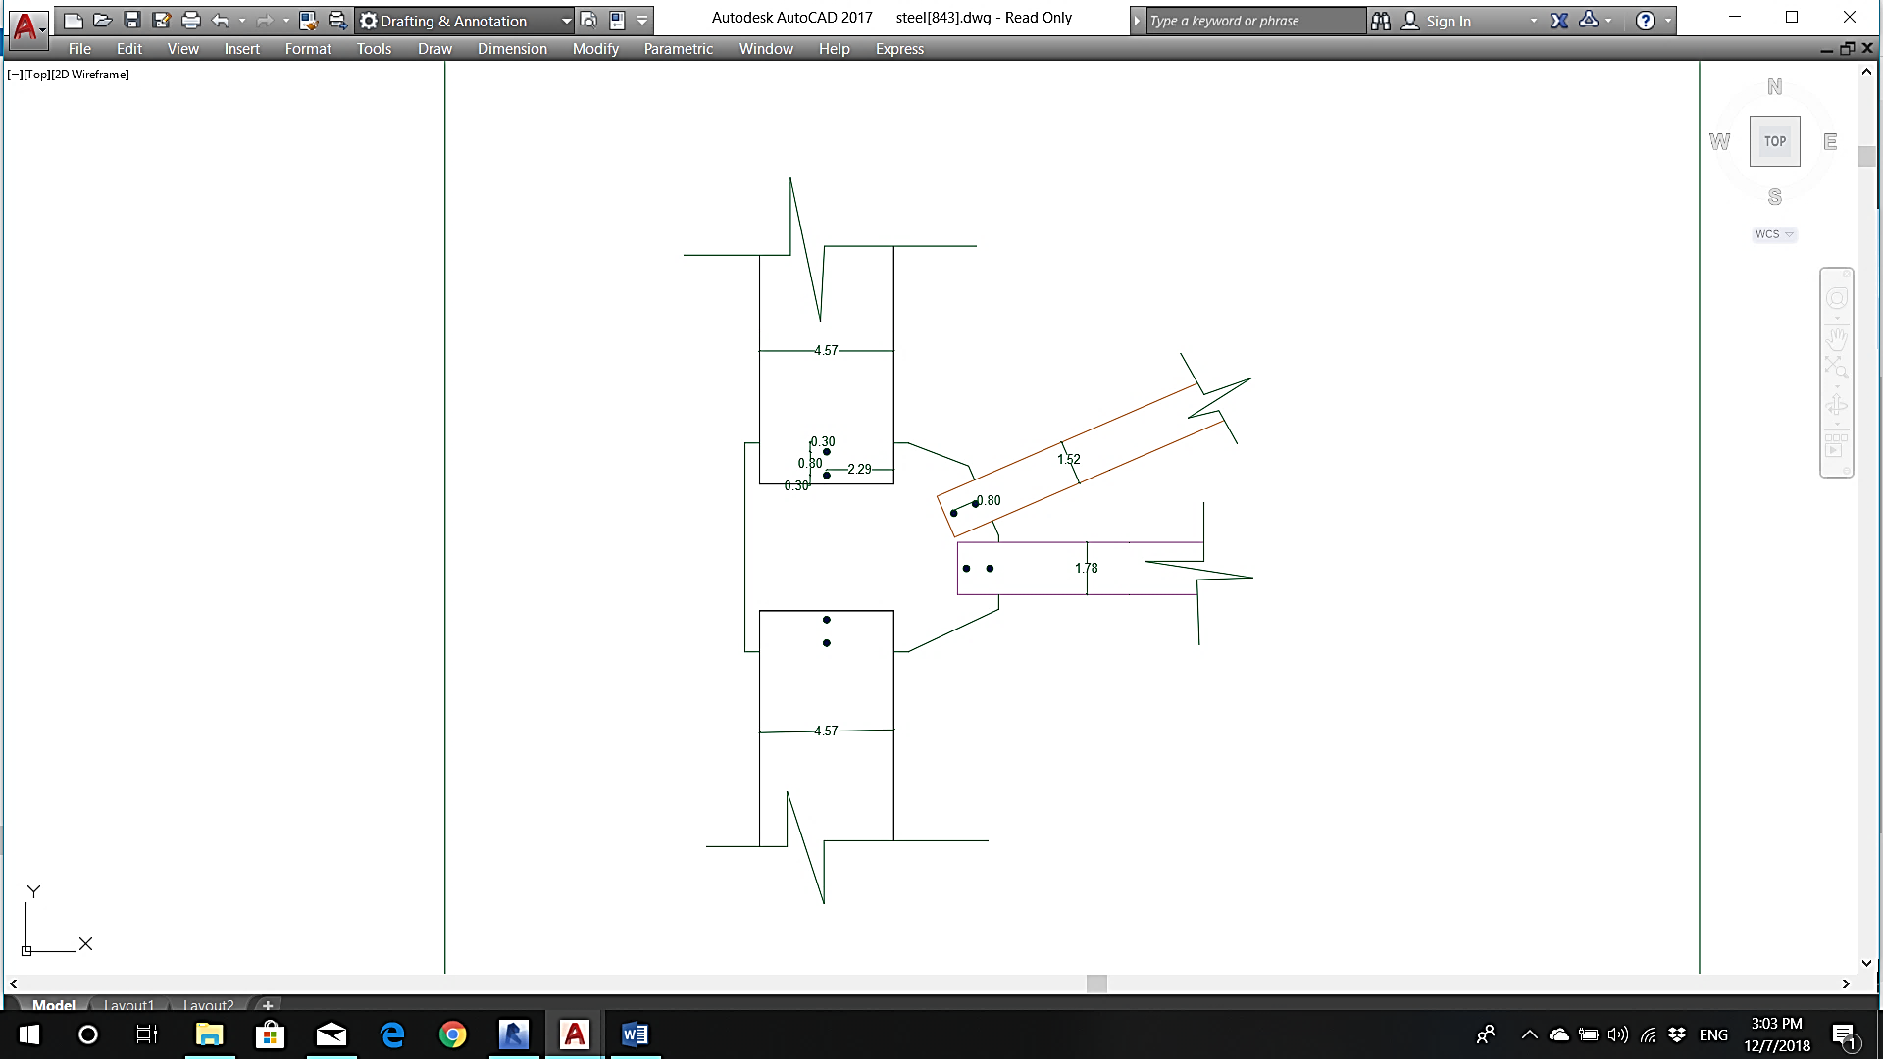
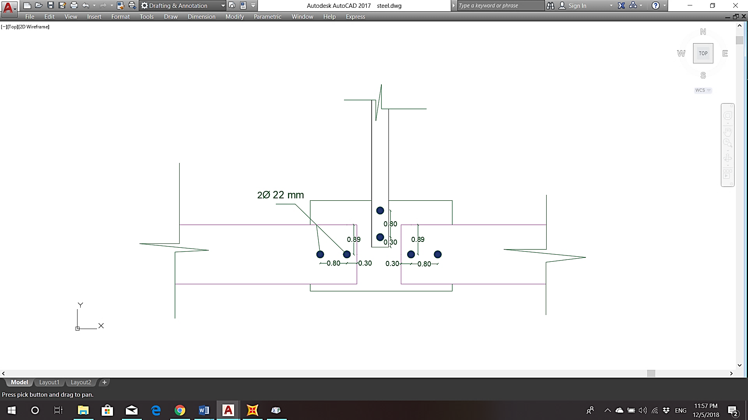
Structural design
Connection design
- Bearing failure
- Tear out failure

Slide 30
Environmental design
Daylighting
Daylight Factor
Shading
Acoustics
RT60
Noise control
Background noise
Thermal
Temperatures
System Loads
Comfort Curves

Slide 31
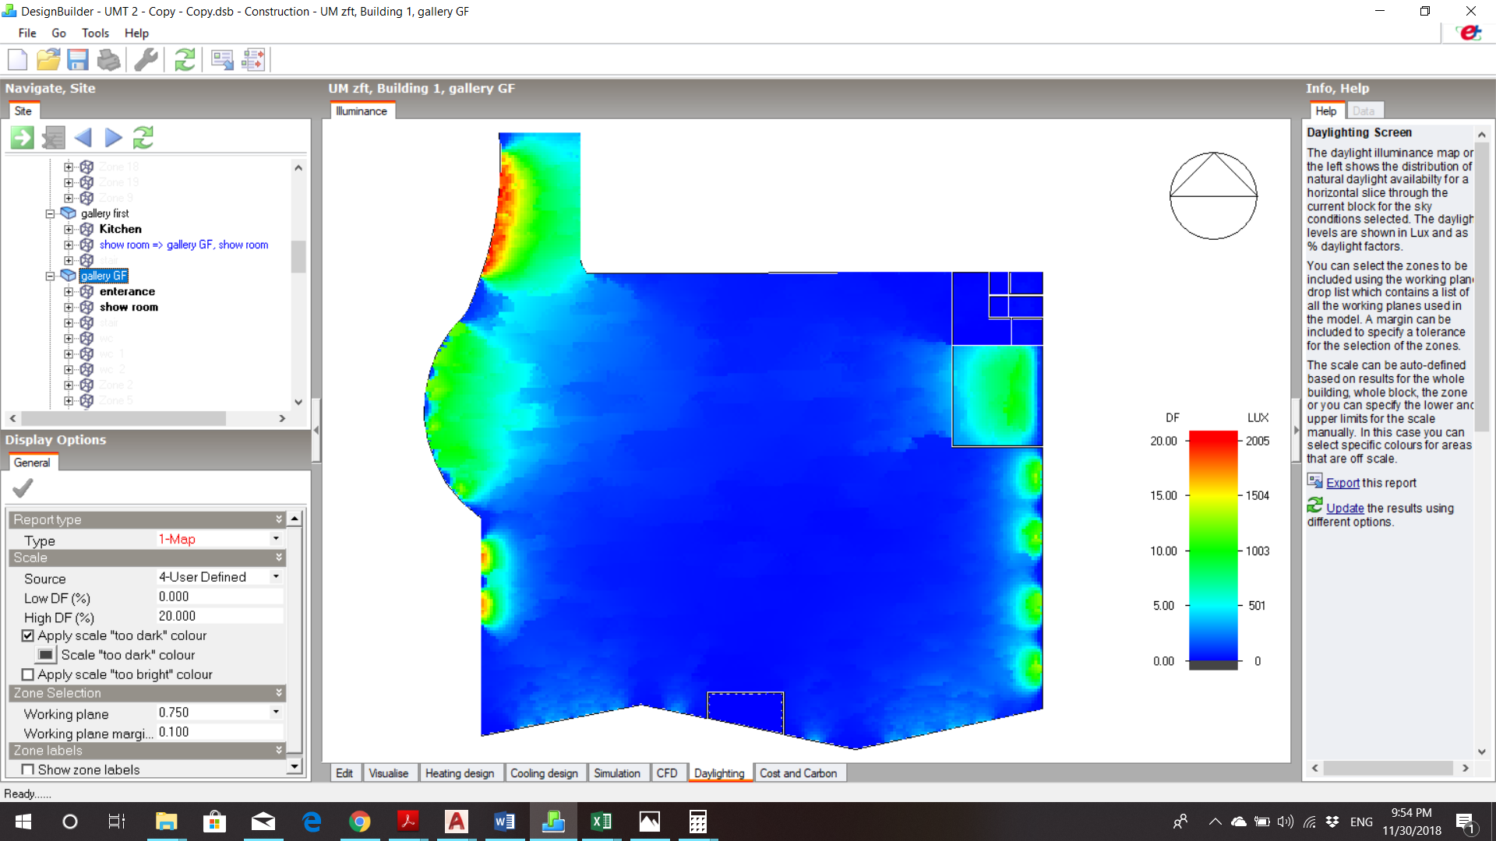
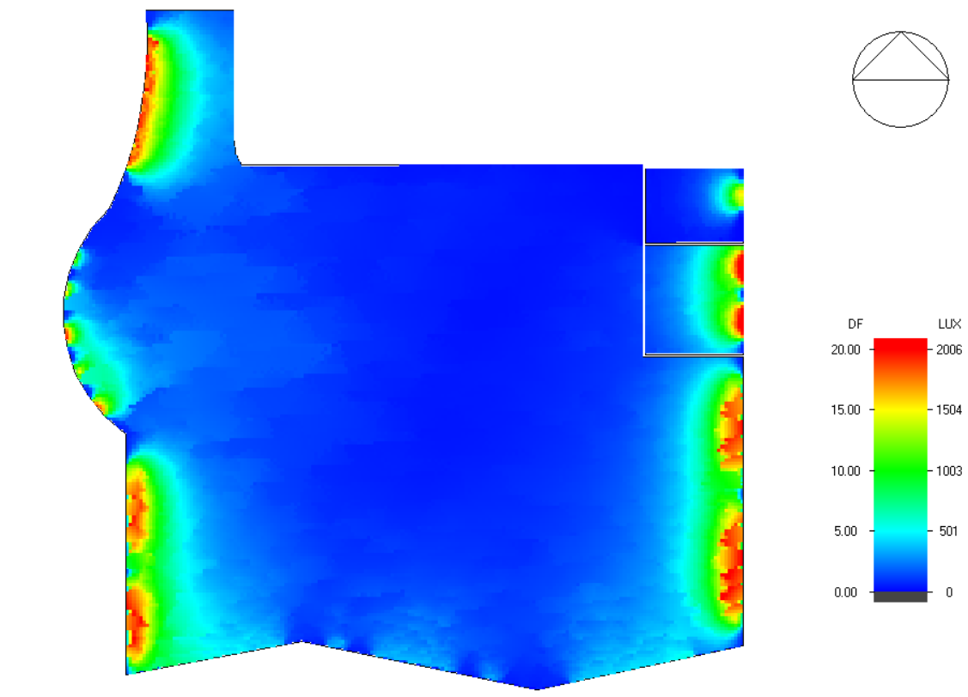
Environmental design
Daylighting (the gallery building)

Slide 32
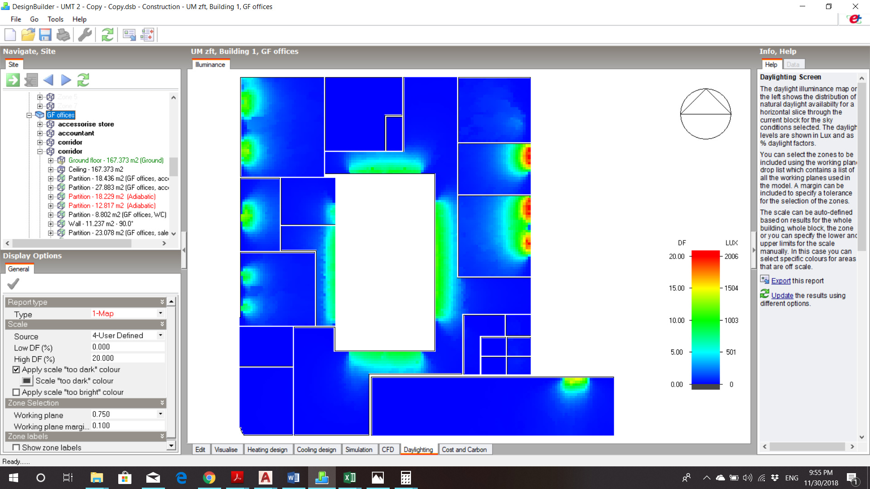
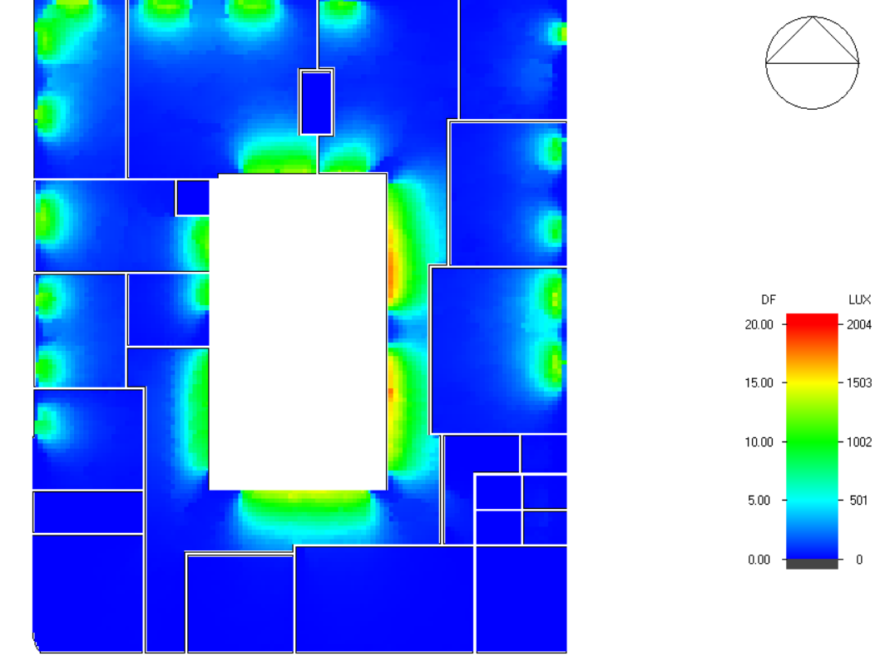
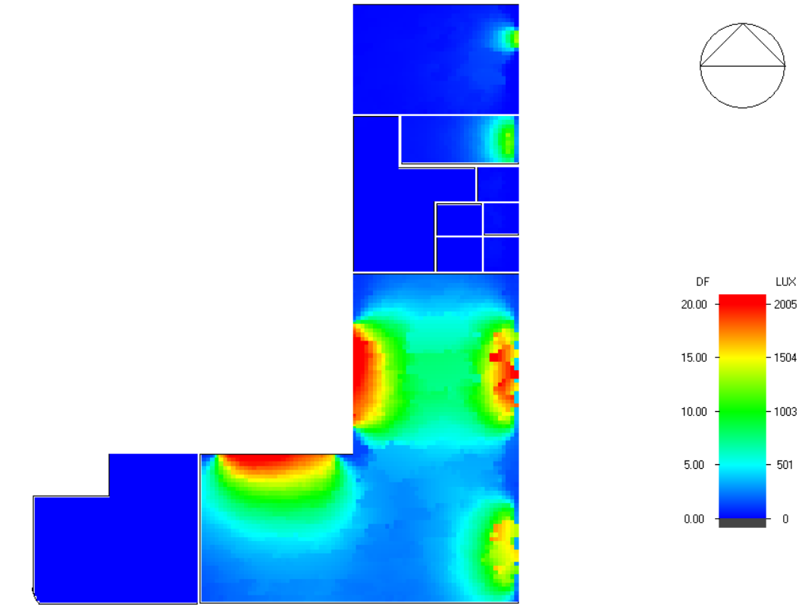
Environmental design
Daylighting (the offices building)

Slide 33
Environmental design
Daylight factor for selected spaces
Zone | Actual DF % | Standard DF % | Comply/Not comply
Show room | 2.61 | (2.5-4) | Comply
Main manager office | 2.74 | (1.5-2.5) | Comply
Office | 2.40 | (1.5-2.5) | Comply
Meeting room | 2.89 | (1.5-2.5) | Comply
Multipurpose room | 6.50 | (2.5-4) | Comply
Cafeteria | 2.60 | (2.5-4) | Comply

Slide 34
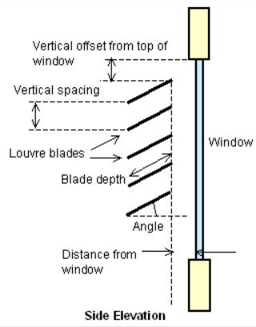
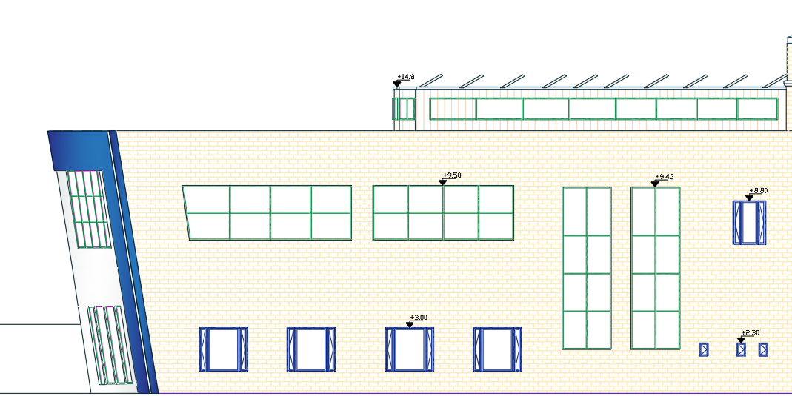
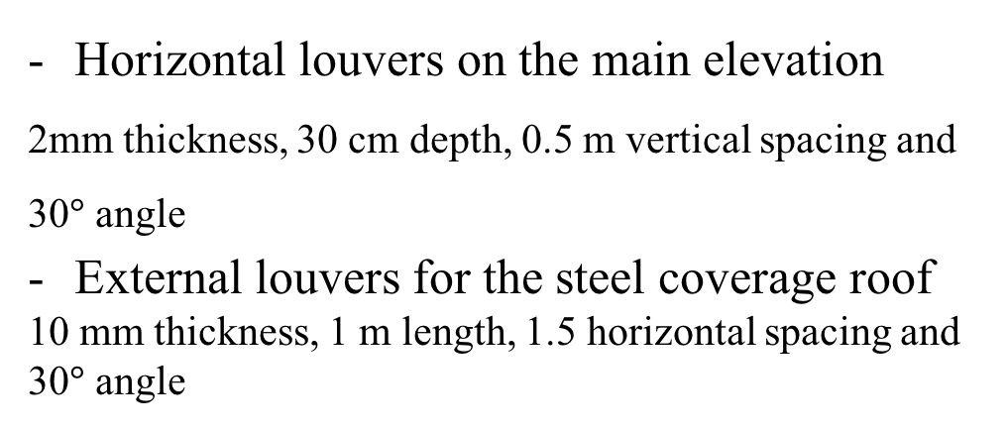
Environmental design
Shading
Horizontal louvers on the main elevation
2mm thickness, 30 cm depth, 0.5 m vertical spacing and 30$°$ angle
External louvers for the steel coverage roof
10 mm thickness, 1 m length, 1.5 horizontal spacing and 30$°$ angle

Slide 35

Environmental design
Acoustical analysis ( ${RT0}_{60}$ )
${RT0}_{60}$ and $∝$ for the gallery building
Frequency | 125 Hz | 250 Hz | 500 Hz | 1000 Hz | 2000 Hz | 4000 Hz
$∝$ (Ceiling: Acoustical tile) | 0.40 | 0.50 | 0.50 | 0.60 | 0.55 | 0.45
$∝$ (Floor: Ceramic) | 0.01 | 0.01 | 0.01 | 0.02 | 0.02 | 0.02
$∝$ (Walls: Painted Plaster) | 0.1 | 0.05 | 0.06 | 0.07 | 0.09 | 0.08
$∝$ (Glass: Double Glass) | 0.1 | 0.05 | 0.03 | 0.03 | 0.02 | 0.02
RT60 (Sec.) (0.85-1.7) | 1.32 | 1.24 | 1.36 | 1.19 | 1.25 | 1.43

Slide 36
Environmental design
${RT0}_{60}$ and $∝$ for the offices building
Frequency | 125 Hz | 250 Hz | 500 Hz | 1000 Hz | 2000 Hz | 4000 Hz
$∝$ (Ceiling: Acoustical tile) | 0.40 | 0.50 | 0.50 | 0.60 | 0.55 | 0.45
$∝$ (Floor: ceramic) | 0.01 | 0.01 | 0.01 | 0.02 | 0.02 | 0.02
$∝$ (Walls: Painted Plaster) | 0.1 | 0.05 | 0.06 | 0.07 | 0.09 | 0.08
$∝$ (Glass: Double Glass) | 0.1 | 0.05 | 0.03 | 0.03 | 0.02 | 0.02
RT60 (Sec.) (0.4-0.7) | 0.58 | 0.58 | 0.52 | 0.54 | 0.41 | 0.40

Slide 37
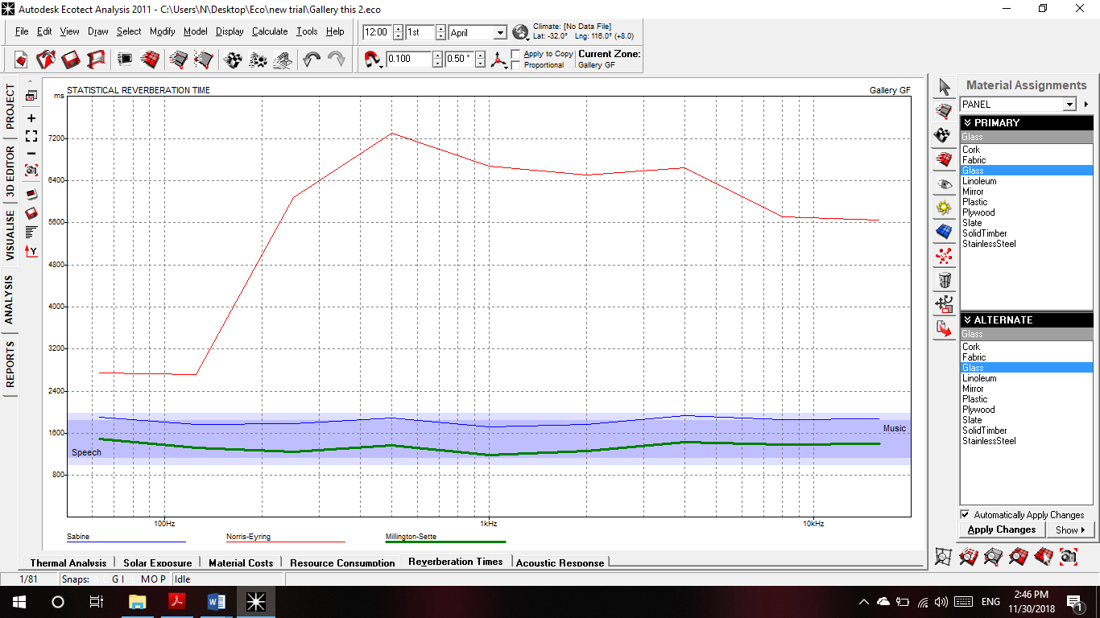
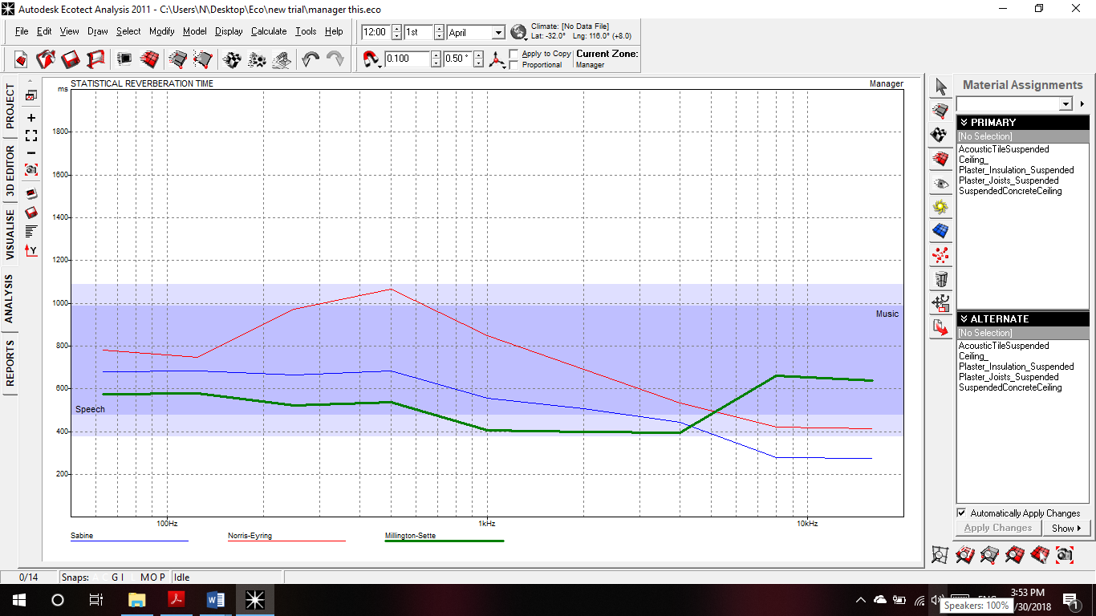
Environmental design
${RT0}_{60}$ for the gallery building
${RT0}_{60}$ for the offices building

Slide 38
Environmental design
Component | STC (dB) | Standard (dB)
The Frontal Alucobond Wall. | 50 | (40-55)
The External Stoned Walls. | 51 | (40-55)
The Block Partition wall. | 43 | (40-55)
Noise control
Component | IIC(dB) | Standard (dB)
Gallery building roof | 78 | >50
Gallery building ceiling | 73 | >50
Offices’ building roof | 71 | >50
Offices’ building ceiling | 69 | >50

Slide 39
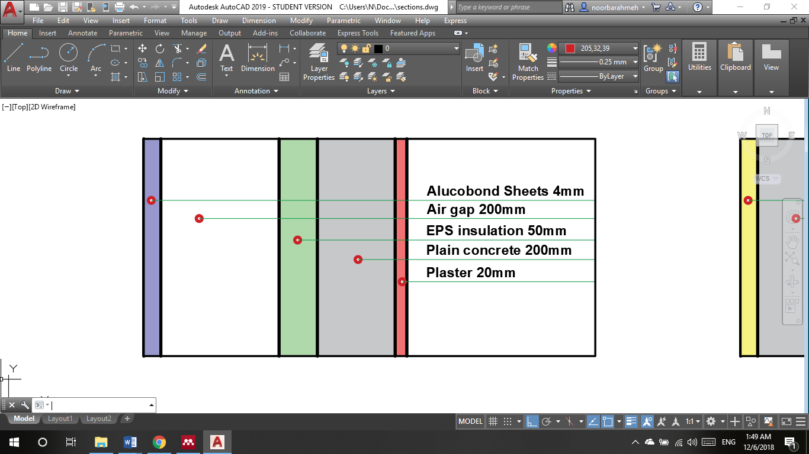
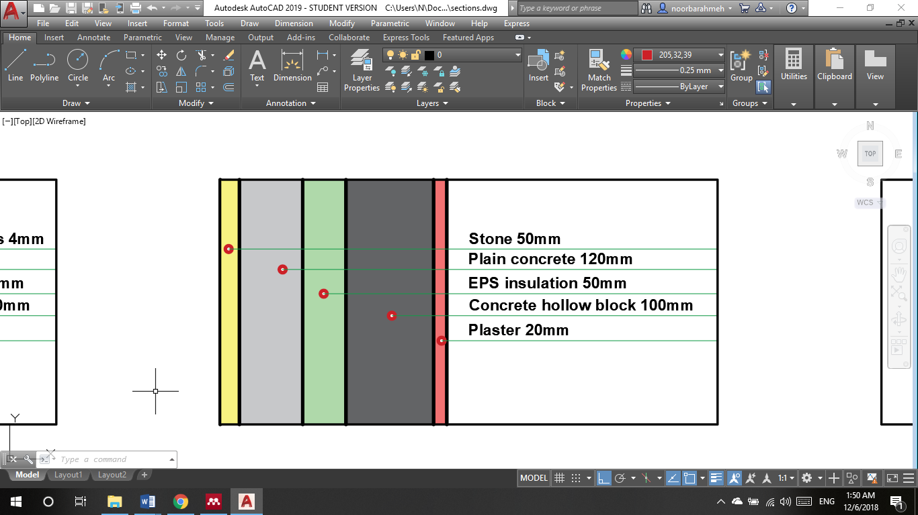
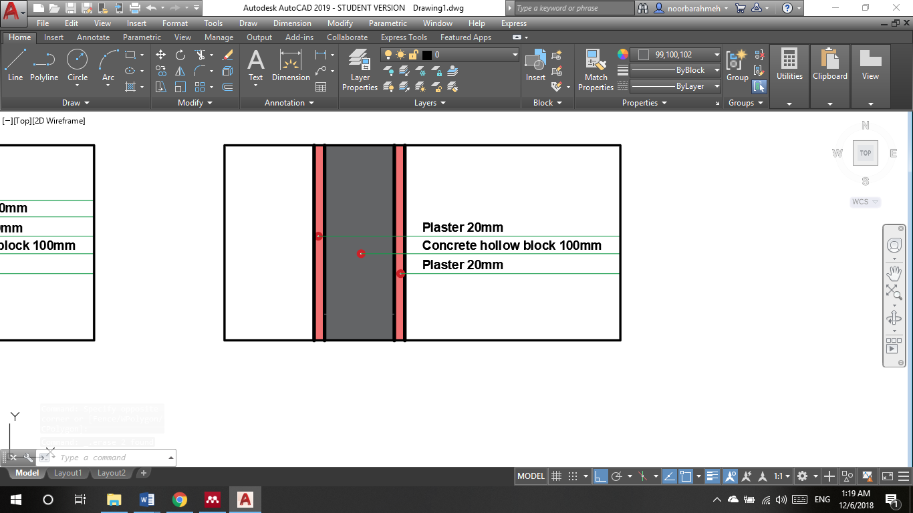
Environmental design
Stoned Wall
Alucobond Wall
Partition

Slide 40
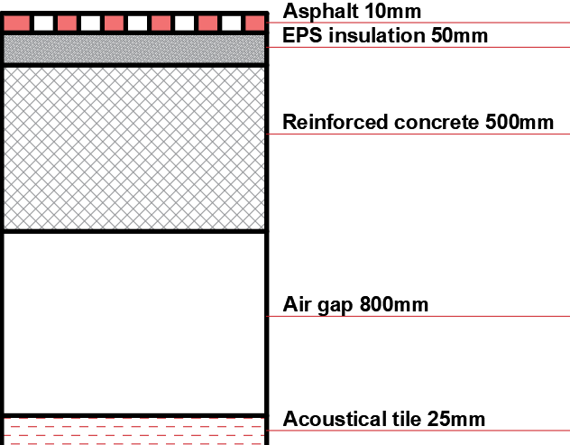
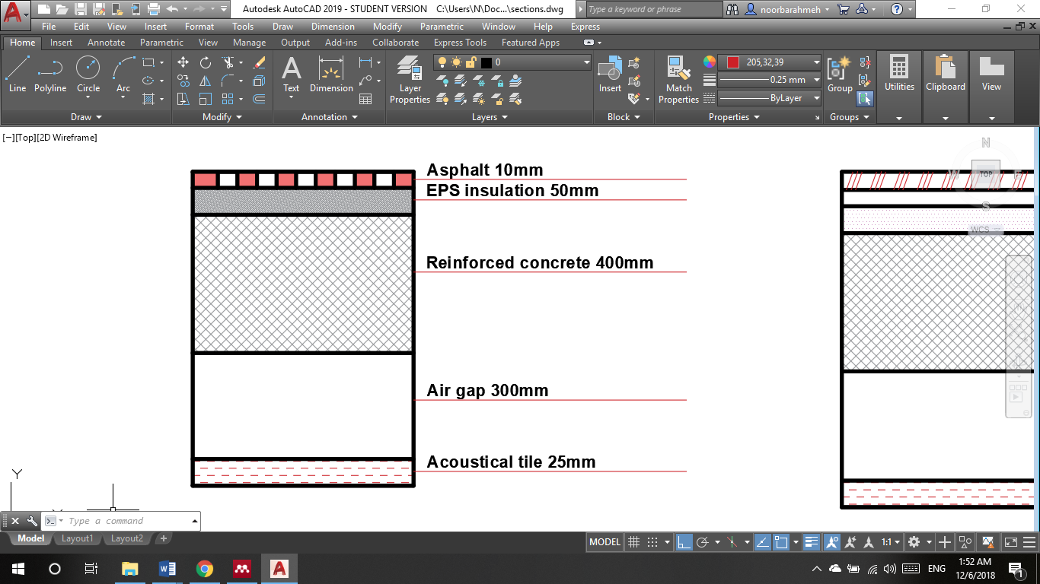
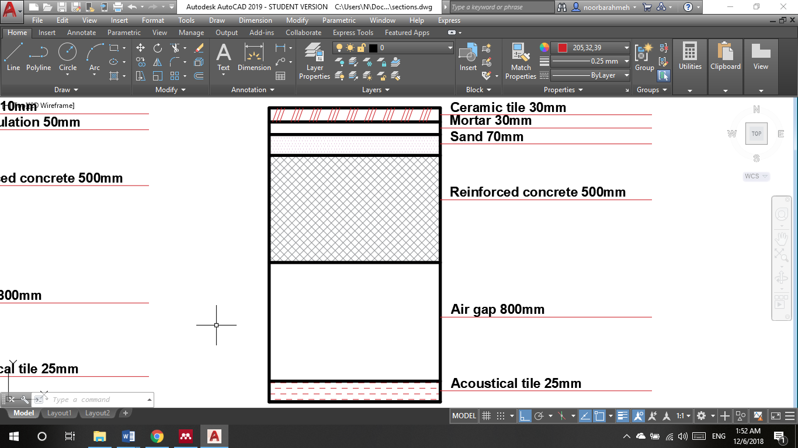
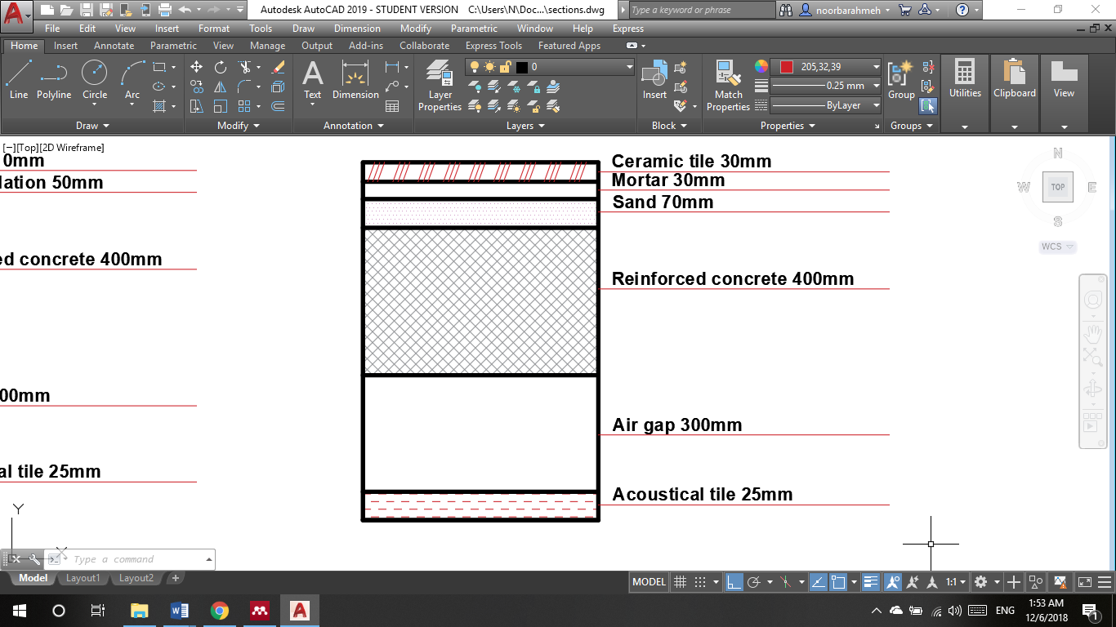
Environmental design
Gallery’s Roof
Offices’ Roof
Offices’ Ceiling
Gallery’s Ceiling

Slide 41
Environmental design
Back ground noise
space | Noise | NR | BN | Standard | OK/not ok
Gallery | 73 | 55 | 18 | < 30 | Ok
Manger office | 73 | 55 | 18 | <30 | Ok

Slide 42
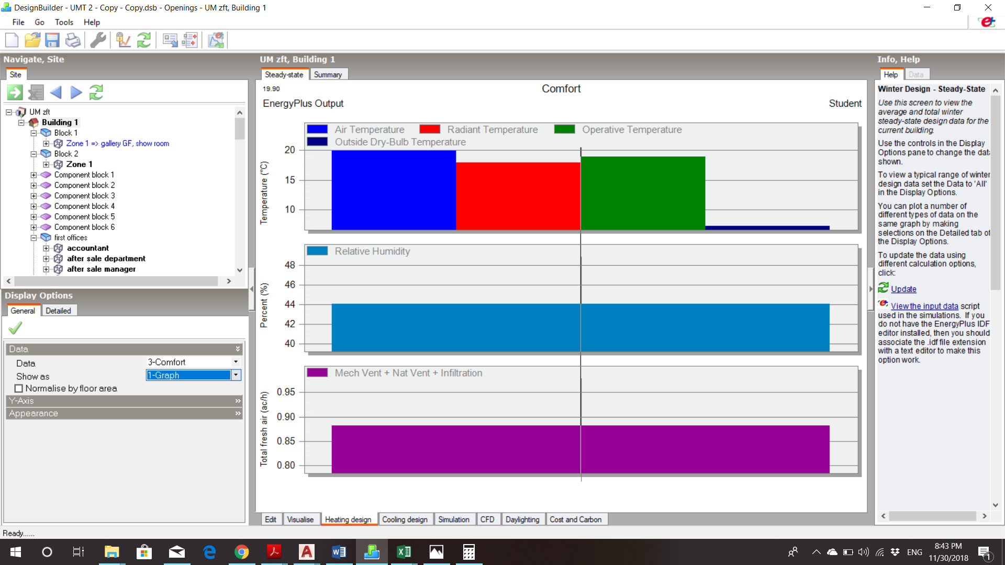
Environmental design
Thermal
Temperatures
Air temperature = 20 °C
Radiant temperature = 17.95 °C
Operative temperature =19 °C
Average RH% = 44.06%

Slide 43

Environmental design
System loads
- Total heating load = 134.25 kW
- Total cooling load = 301 kW

Slide 44

Environmental design
Comfort curves
Temperatures
RH less 70%
Fanger PMV between (-0.5 - 0.5)

Slide 45
Environmental design
The number of uncomfortable hours based on simple ASHRAE 55-2004 equals 2686 hr./year.
Energy consumption = 112.10 kWh/m²

Slide 46
Electrical design
Sockets distribution
Artificial lighting design
Sound reinforcement system design
Electrical boards distribution

Slide 47
Electrical design
Sockets distribution
Power sockets distribution
Un-interrupted Power Source (UPS) distribution

Slide 48


Electrical design
Power
UPS

Slide 49

Electrical design
Artificial lighting

Slide 50

Electrical design
Gallery lighting design
Used luminaires
Spots → ( 100-150 ) Lux
Trackers → (700-1000) Lux
LED panels → (500) Lux
Strip (decorative )
Glare
Maximum | Minimum | limit
17.2 | 14.3 | 22
Surface reflection
Ceiling | walls | Floor
75% | 50% | 25%

Slide 51

Electrical design
Lighting distribution

Slide 52

Electrical design
Manager office lighting distribution
Used luminaires
LED panels → (500) Lux
Maximum | Minimum | Limit
16.1 | <10 | 19
Glare
Surface reflection
Ceiling | walls | Floor
85% | 70% | 25%

Slide 53

Electrical design
Luminaires distribution

Slide 54


Electrical design
Sound reinforcement system design
PRO – 180 RPC – Klipsch Company
θ = ${100}^{°}$
Coverage : $\left\{\begin{aligned}gallery=40 m^{2} \\ offices=14 m^{2}\end{aligned}\right.$

Slide 55

Electrical design
Electrical boards distribution
Offices ground floor EB

Slide 56
Mechanical design
Storm water harvesting
HVAC
Fire fighting
Drainage
Water supply
Emergency exits

Slide 57
Mechanical design
HVAC system
VRV system
Split units
Mechanical fans

Slide 58


Mechanical design
Gallery HVAC system design
Total cooling load in the gallery = 60 kW , 30 kW for each floor
VRV System ( DAIKIN )
Outdoor unit (heat recovery) 30 TR for each floor , connection ration 100%
Indoor unit ( fan coil units connecting with slot units )
Duct sizing
Fresh air fans
Extract air fans
On ground free return diffuser
Refrigeration pipes

Slide 59


Mechanical design
Distribution of slot unit and ducts

Slide 60

Mechanical design
Design of HVAC system for the offices building
VRV system (DAIKIN)
Outdoor unit (heat recovery) 10 TR
Wall mounted indoor unit with different capacity
Refrigerant pipes
Split units

Slide 61
Mechanical design
Cooling capacity for the offices building
Zone | Design Capacity (kW) | TR | Chosen capacity (TR)
GF Offices: Accessories Store | 6.13 | 1.74 | 2
GF Offices: Sales Manager | 2.76 | 0.78 | 1
GF Offices: Sales Department | 4.34 | 1.23 | 1.3
GF Offices: Logic and Parts | 4.58 | 1.30 | 1.3
GF Offices: Service Manager | 1.9 | 0.54 | 0.6
GF Offices: Service Manager1 | 2.04 | 0.58 | 0.6
GF Offices: Service Offices | 3.26 | 0.93 | 1
GF Offices: Accountant | 1.24 | 0.35 | 0.6
First Offices: Financial Manager | 3.03 | 0.86 | 1
First Offices: Accountant | 4.62 | 1.31 | 2
First Offices: Meeting | 2.15 | 0.61 | 1
First Offices: Secretary | 1.27 | 0.36 | 0.6
First Offices: IT Department | 1.91 | 0.54 | 0.6
First Offices: Warranty | 2.01 | 0.57 | 0.6
First Offices: After Sale Department | 3.55 | 1.01 | 1.3
First Offices: After Sale Manager | 1.95 | 0.55 | 0.6
First Offices: Main Manager | 2.75 | 0.78 | 1
Second Offices: Multipurpose hall | 26.22 | 7.46 | 8

Slide 62


Mechanical design

Slide 63
Mechanical design
Design of the workshops ventilation system
Distribution of fresh air fans
Distribution of extract air fan
Ducts
Diffusers
Split units for offices and waiting area

Slide 64


Mechanical design
Painting workshop
Mechanical workshop

Slide 65

Mechanical design
Drainage system
2’’ PVC pipes for gray water (2% slope)
4’’ PVC pipes for black water (1% slope)
CPVC pipes for condensed water
UPVC for pipes between manholes

Slide 66


Mechanical design
Drainage system

Slide 67

Mechanical design
Storm water harvesting
Minimum slope on roofs =0.7%
The capacity of the underground water tank=630 m³

Slide 68

Mechanical design
Water supply system
Diameters of water pipes:
Pipe Diameter (in) | Branch | Horizontal | Vertical
Offices | ¾ | 1.25 | 2
Gallery | ¾ | 1.25 | 2
Workshops | ¾ | 1.25 | 1.5

Slide 69


Mechanical design
Water supply system
35×15 cm water cabinets to simplify the maintenance.
Capacity of the underground water tank =55m³.
(including fire fighting needs)

Slide 70


Mechanical design
Fire fighting system
Fire suppression using:
  Extinguishers
  Sprinklers
  Hose stations
  FM200
Fire detecting and notification using:
  Smoke detectors
  Flame detectors

Slide 71

Mechanical design
Fire suppression system
Extinguishers class ‘A’ for offices
Extinguishers class ‘B’ for workshops
Extinguishers class ‘C’ for electrical rooms

Slide 72


Mechanical design
Fire suppression system
Sprinklers:
Ordinary hazard
Coverage area=37 m²
60 gpm flow rate
28.7 psi pressure

Slide 73

Mechanical design
Fire suppression system
FM200 system for the electrical and technical rooms.

Slide 74


Mechanical design
Fire detecting system
Flame detectors for kitchens and smoke detectors for other spaces:
photoelectric style detectors with LED and sound indicating alarms
Coverage area= 25 m²

Slide 75


Mechanical design
Safety
Emergency signs
Emergency routes

Slide 76
Quantity surveying
Including:
Excavation and backfilling (186,201 NIS).
Structural work (693,426 NIS).
Architectural finishes (2,603,203 NIS).
Mechanical and electrical works (362,893 NIS).
Total gallery’s cost
= 3,939,223 NIS

Slide 77
Conclusion
UMT New Design.
Site analysis
Architectural design
Structural design
Environmental design
Electrical design
Mechanical design

Slide 78


