Slide 1
Experimental Demonstration of Visible Light Communications with OFDM/OQAM Modulation
Prepared By:
Rasha Sawalmeh
Yasmin Damiri
Supervised By:
Dr. Yousef Dama

Slide 2
Outlines
Objectives
Orthogonal Frequency Division Multiplexing (OFDM)
Filter Bank Multicarrier (FBMC)
Visible Light Communications (VLCs)
Conclusions

Slide 3
Objectives
Implement OFDM to see the system’s BER performance.
Enhance the BER by mixing two techniques (Multicarrier and multiple access).
Try to achieve a better spectral efficiency by replacing the conventional OFDM with OFDM/OQAM.

Slide 4
OFDM System
A form of multicarrier modulation.
Used in many wireless applications .
High-rate serial data stream is split up into a set of low-rate sub streams.
Symbols are transmitted on separate parallel subcarriers (SC).

Slide 5
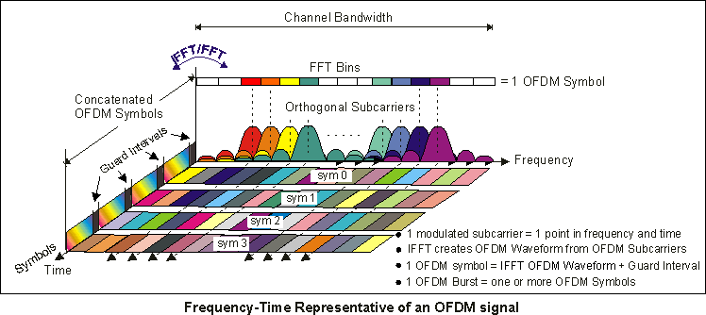
Concept of OFDM
Overlapping spectra, but there’s no ICI due to the orthogonal nature of the signal.

Slide 6
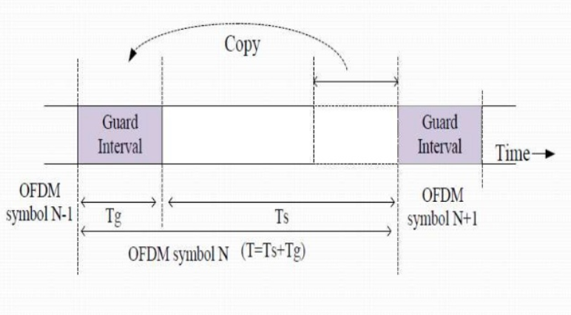
ISI and CP
OFDM is robust against ISI caused by the time dispersion.
Simply inserting a Cyclic Prefix (CP).

Slide 7
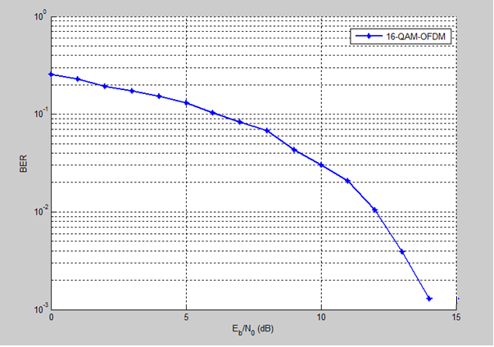
Simulation Result
BER vs. SNR

Slide 8
BER enhancement
Using MCCDMA that combines OFDM with CDMA.
Transmit the same symbol in parallel through different subcarriers.
Improve the system performance in multipath channels.

Slide 9
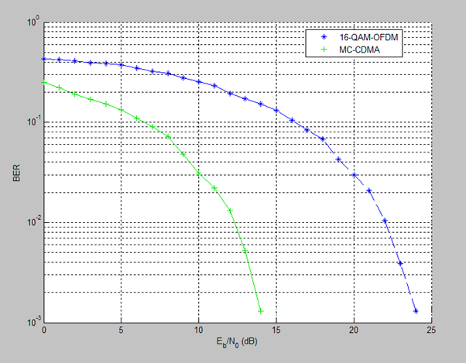
Simulation Result
BER vs. SNR

Slide 10
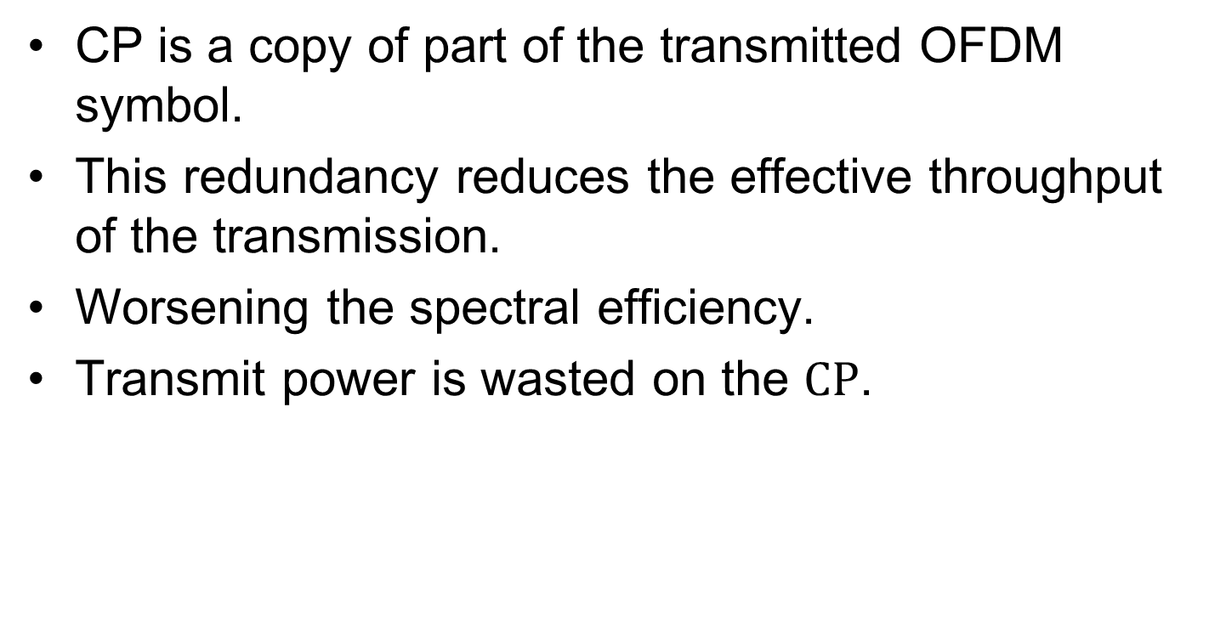
OFDM Disadvantages
CP is a copy of part of the transmitted OFDM symbol.
This redundancy reduces the effective throughput of the transmission.
Worsening the spectral efficiency.
Transmit power is wasted on the $CP$.

Slide 11
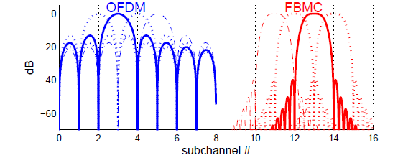
Filter Bank Multicarrier
Motivation:
Increase throughput and spectral efficiency.
Spectra of OFDM and FBMC subchannels

Slide 12
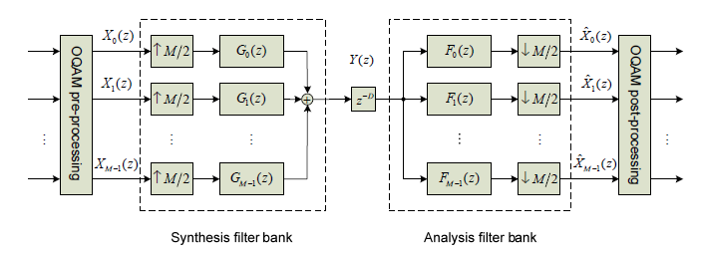
FBMC Main Structure
The core of the FBMC system is the TMUX configuration .
TMUX configuration

Slide 13
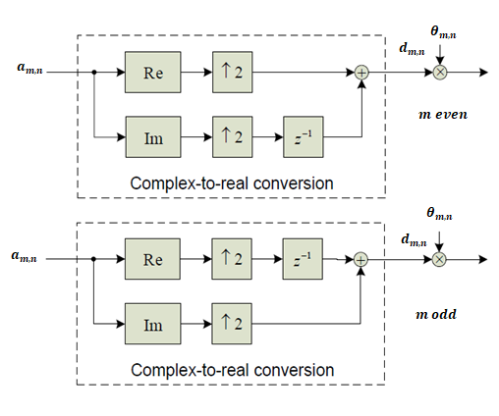
OQAM Pre-Processing

Slide 14
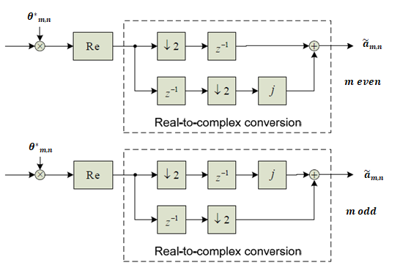
OQAM Post-Processing

Slide 15
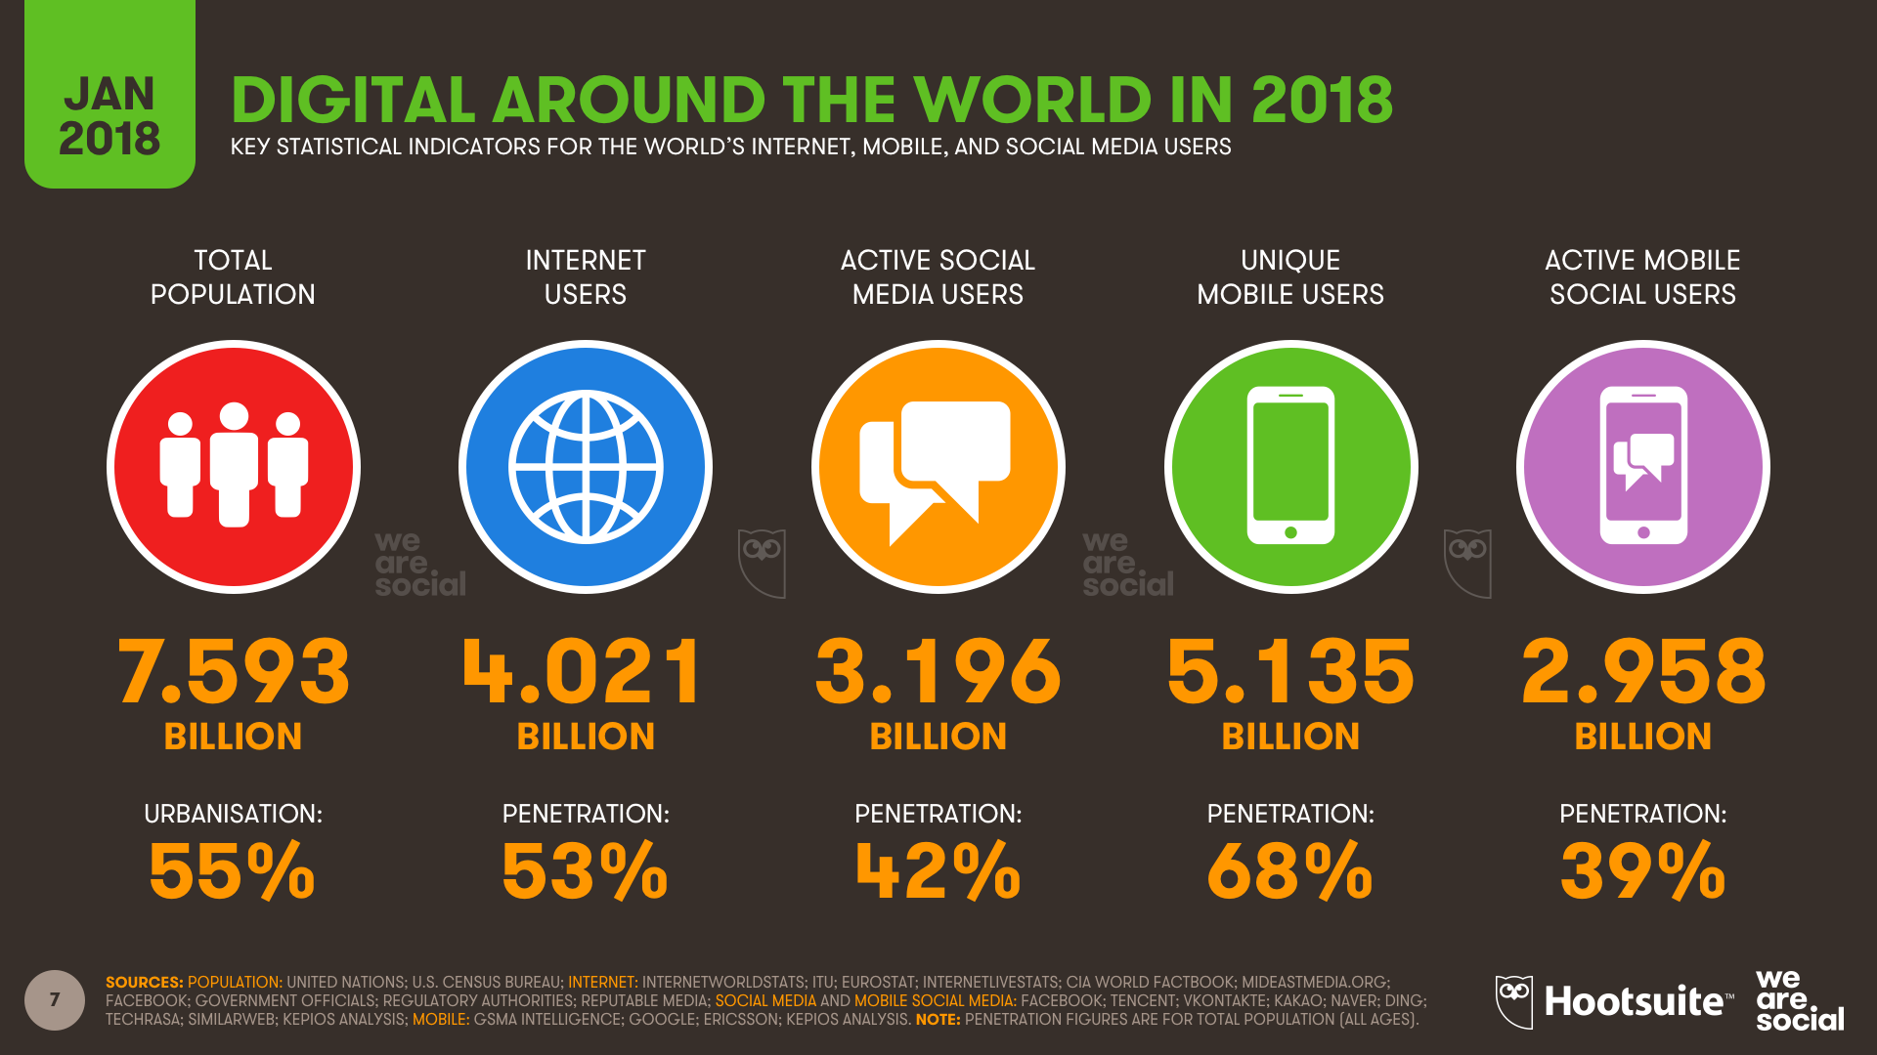
Visible Light Communications
Motivation:

Slide 16
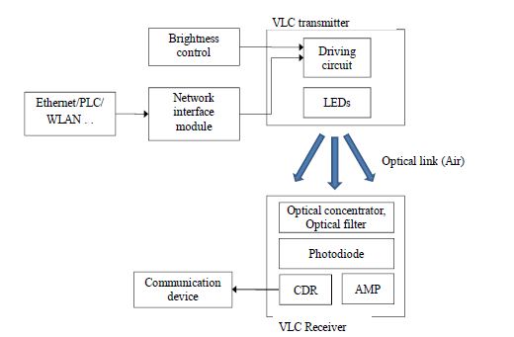
VLC Architecture

Slide 17
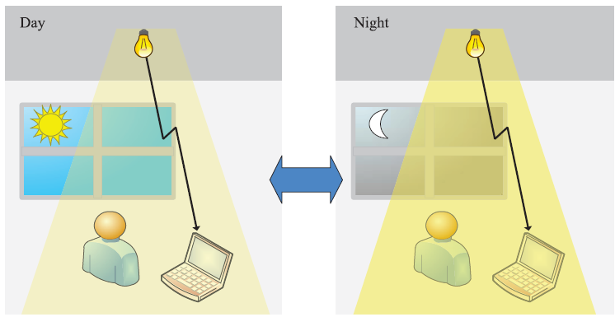
LED Lightning Constrains
Dimming Control

Slide 18
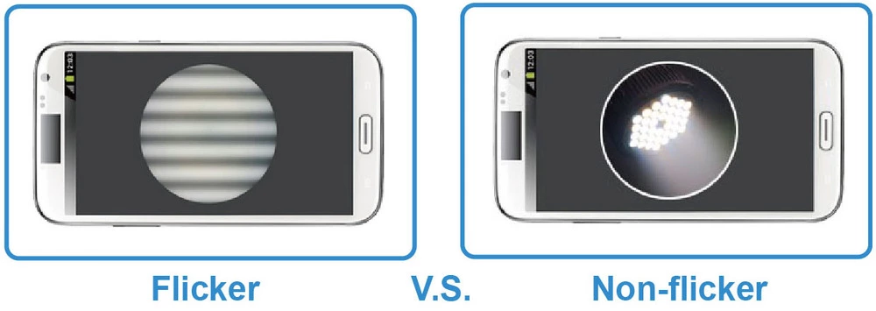
Flicker-Free Communications

Slide 19
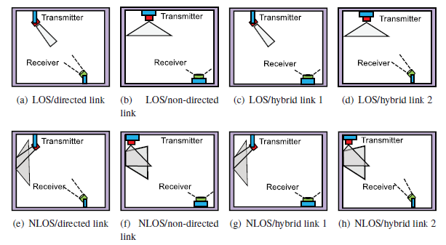
VLC Channel

Slide 20
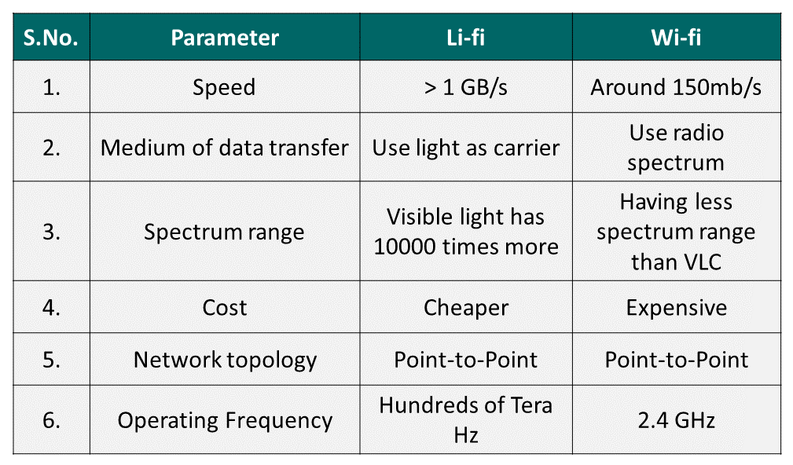
VLC vs. WiFi

Slide 21
Conclusions
An overview of the overall VLC system has been introduced.
Future work will include FBMC implementation and a channel design as well.

