Slide 1

THE HIDDEN SAVIOR
Supervisor Name : Dr.Hekmat Drawsheh
By Ameera Shopaki & Samah Abdalrahman

Slide 2

TABLE OF CONTENT:
1
Intoduction
2
Features & Tools
3
constraints
2
4
Future Work
5
Question & Answer

Slide 3
INTRODUCTION

Slide 4
Why The Hidden Savior?
Suffocation
Due to the recent increase in suffocation incidents inside cars
Accidents and Fires
Dealing with accidents and fires inside cars

Slide 5




Goals and Objectives
Senses oxygen deficiency
Senses Smoke
Senses Fire
Remote control of the car

Slide 6
FEATURES
&
TOOLS

Slide 7
Blynk Server
Esp8266
Blynk App
The Process
Arduino
Inputs and outputs

Slide 8
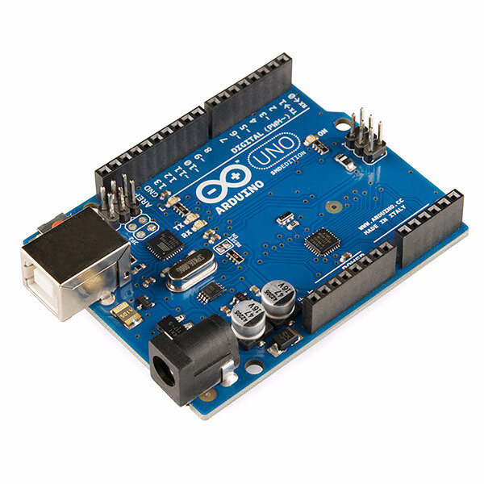
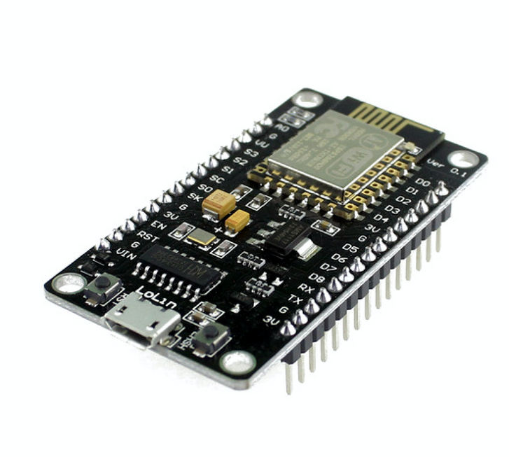
Microcontrollers
Arduino Uno
Esp 8266

Slide 9
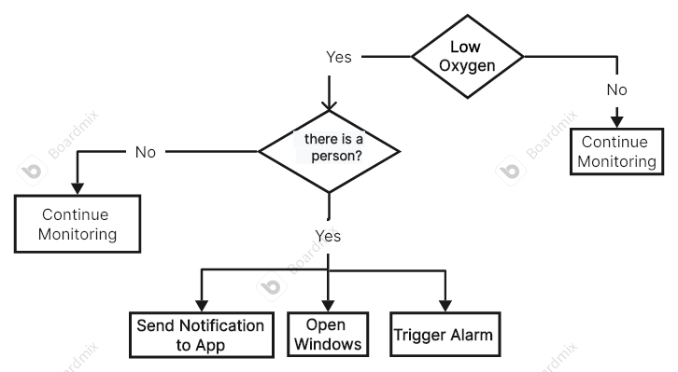
Dealing with low oxygen

Slide 10
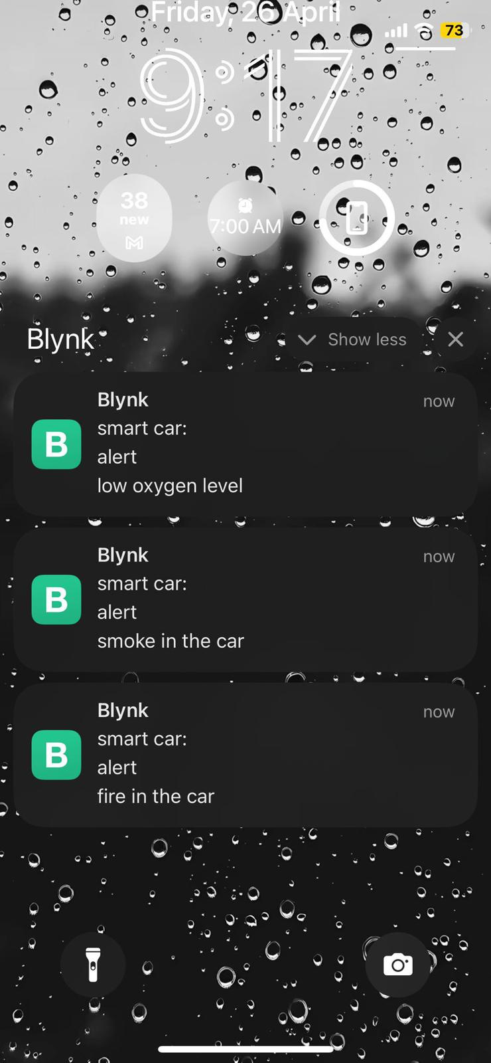
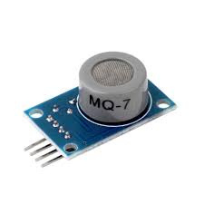
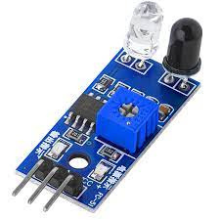
Dealing with low oxygen
Notify Car Owner
Components
Co2 Sensor
IR Sensor

Slide 11
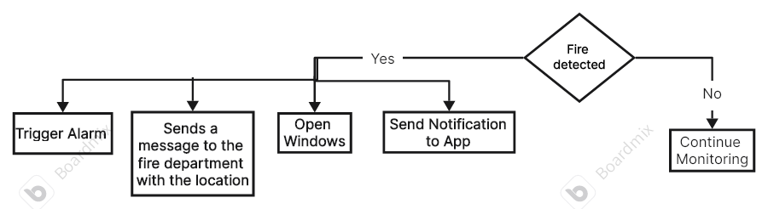
Dealing with fire

Slide 12
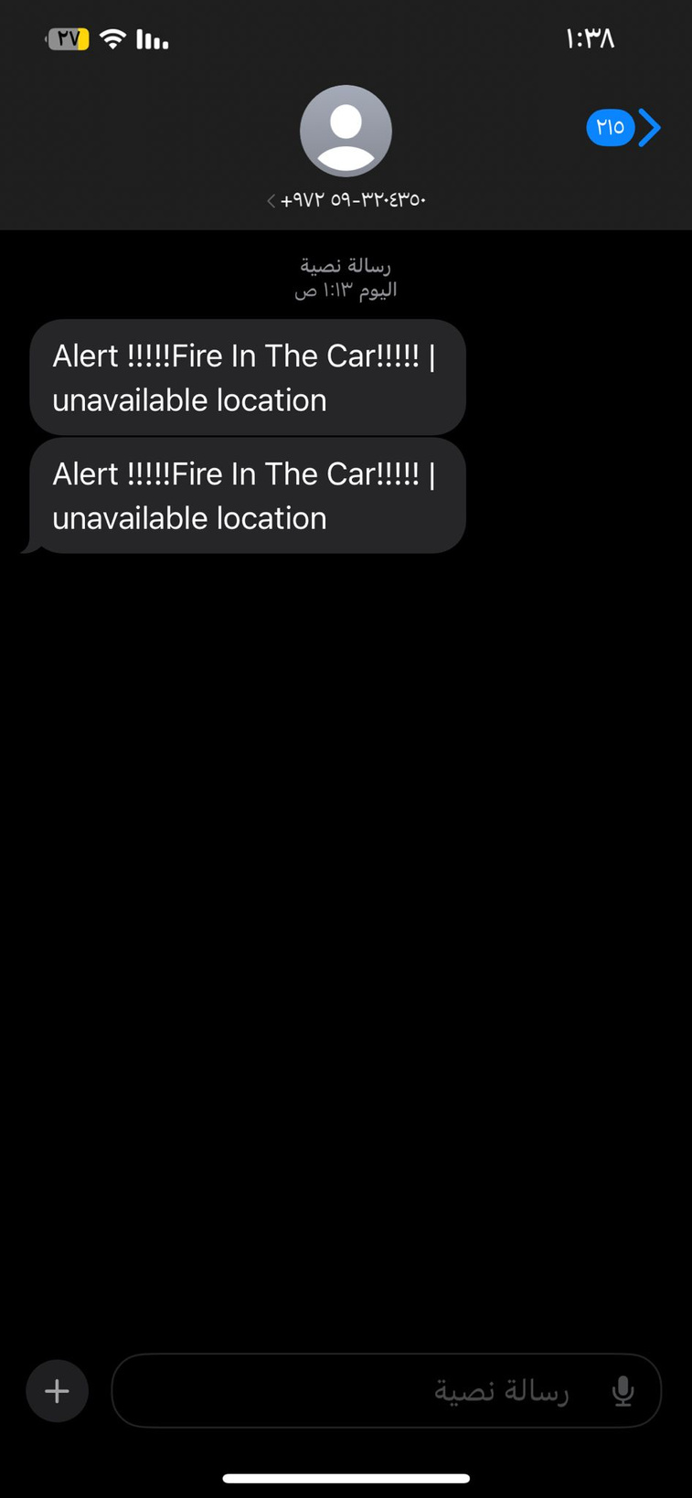
Dealing with fire
Notify Car Owner
Message to Fire Service

Slide 13
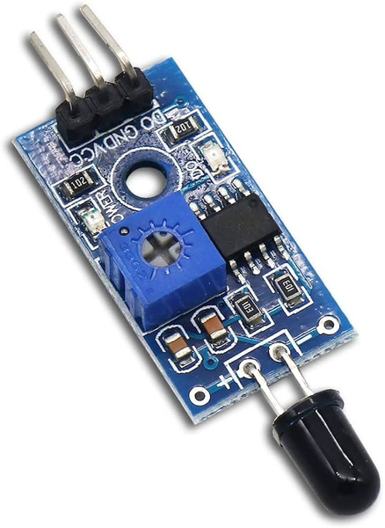
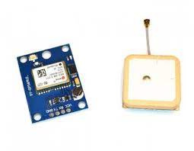
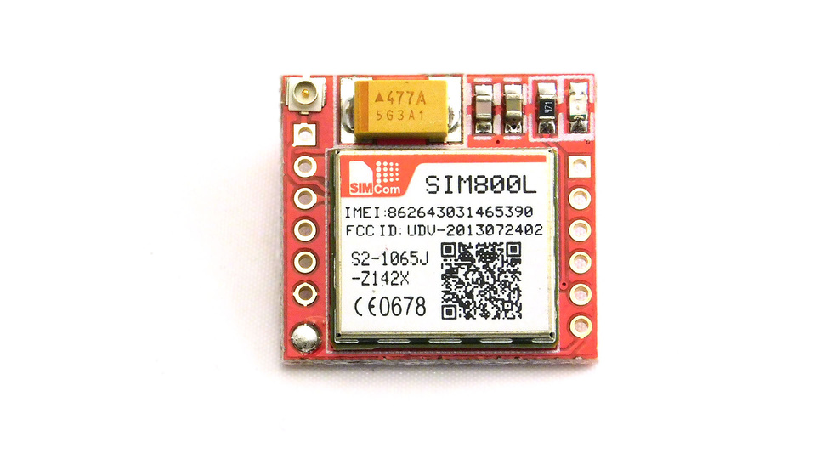
Dealing with fire
Flame
Sensor
GPS
Sim800l

Slide 14
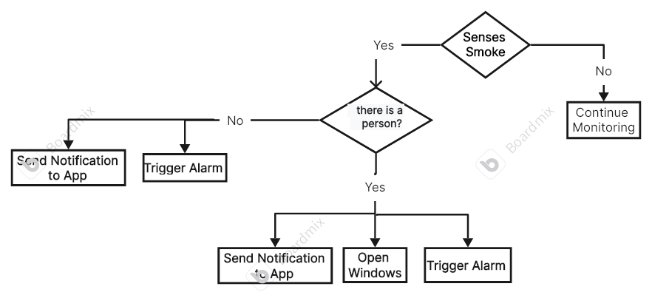
Dealing with smoke

Slide 15
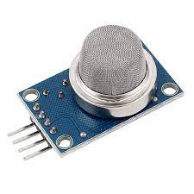
Dealing with smoke
Notify Car Owner
Components :
Smoke
Sensor
IR Sensor

Slide 16
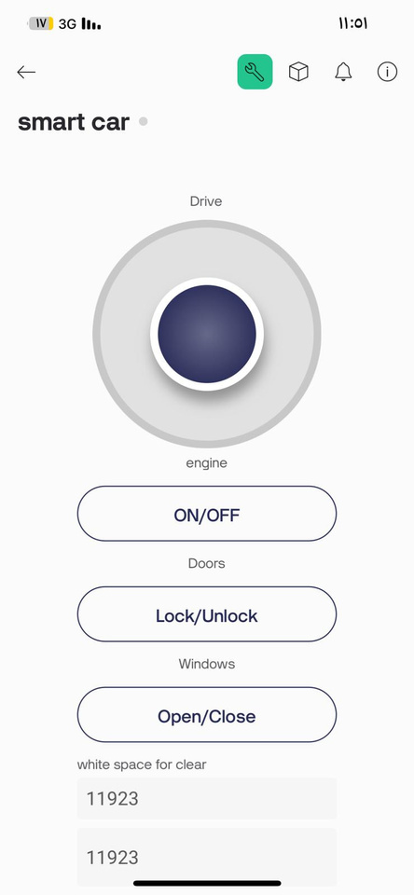
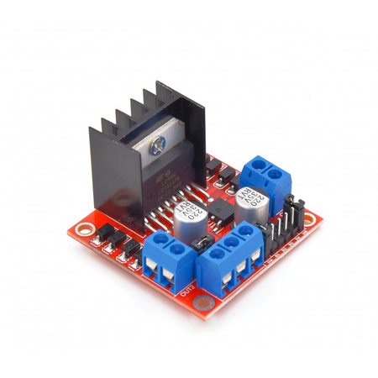

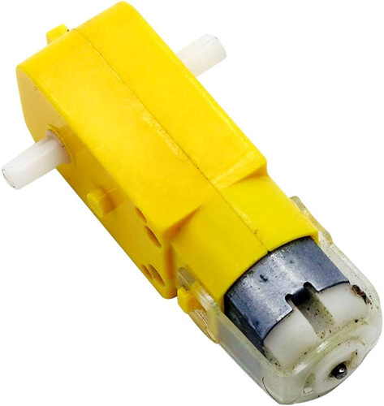
Stopping The Car
H-bridge Motor Driver
Moving the car
Engine control
DC motor

Slide 17

Window control
Window control
Servo motor

Slide 18
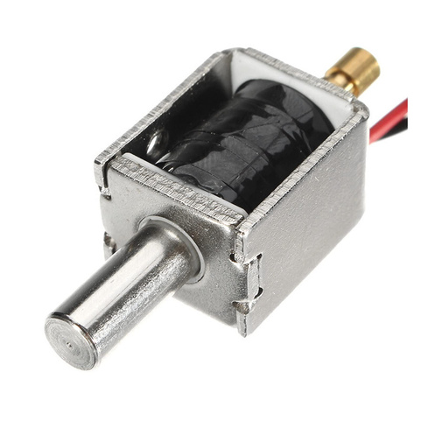
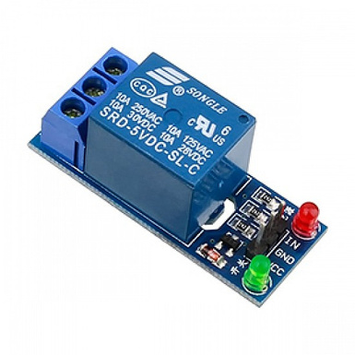
Door lock control
Selenoed lock
Door control
Relay

Slide 19

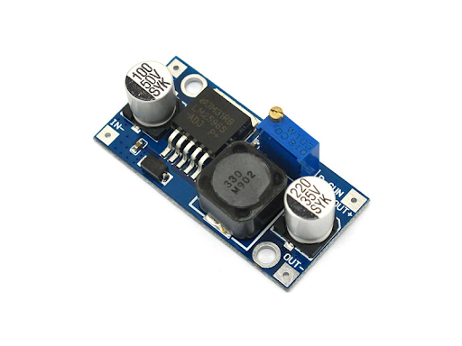
Voltage Regulators
Regulator
7805
Buck
Converter

Slide 20
CONSTRAINTS

Slide 21

01
Limited Time
02
Budget limitations
constraints
03
Unsafe conditions on the roads
04
Difficulty of determining the features on which the system will depend

Slide 22
FUTURE WORK

Slide 23
Future Work
Developing the system to be more safety :
  By collecting data from various sensors for lane departure warning and collision detection, the safety system can provide more accurate and timely responses to potential dangers.
Developing detection of the presence of people :
  Using a better technology to determine if a person is inside the car or not

Slide 24
THANK YOU!
By Samah Abdalrahman & Ameera Shopaki

