Slide 1
Water Resources Management of Tulkarm Governorate

Slide 2
Prepared by:
Dr. Anan Jayyousi
Hiba Salman
Rawan Masarweh
Rasha Jedi
Dalia Kettaneh

Slide 3
Introduction
Study area
Water supply condition in Tulkrum governorate
Future water demand
1.Existing water demand
2.Water gap
Investment plan
1.Packages
2.Cash flow
Future Potential Water Resources
1.Local water recourse
2.Ground water recourse

Slide 4
Introduction
Water is a limited and precious resource and must be managed both for immediate needs and for long-term economic and environmental sustainability. With the effects of climate change now a reality, and increasing demands for water, sound policies are required to ensure a sustainable supply of water for present and future generations.

Slide 5
Water Resources Management aims at optimizing the available natural water flows, including surface water and groundwater, to satisfy these competing needs.
This plan should be included within existing facility operating plans.

Slide 6
Project Objectives
To analyze water resources system for the Governorate.
To study the present conditions and the estimated future water gap for the year 2032.
To decide whether the present water resources are sufficient for the future demand and if not what possible alternative solutions are.
To suggest an investment plan that will include all water network component needed to cover water needs for the next 20 years.

Slide 7
Study Area
north western part of West Bank
lies between 75-500 m above sea level
Bounded by Jenin and Nablus
Population= 168,973

Slide 8
Water Supply Condition
In Tulkarm Governorate
32 communities :
29 served , 3 unserved.
Total existing water supply is around 3.85 Mcm/year.
The average water demand is 80 L/C/day.

Slide 9
Water Supply Resources
Groundwater
Tulkarm Governorate yields approximately 14Mcm/year from Western Aquifer.
No. of municipal wells = 8 .

Slide 10
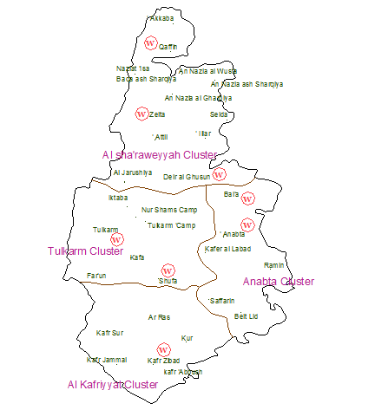

Slide 11
Purchased Water from Mekorot
0.4 million m³/year are purchased from Mekorot for domestic uses.

Slide 12
Clustering
Al sha'raweyyah Cluster
Al Kafriyyat Cluster
Anabta Cluster
Tulkarm Cluster

Slide 13
Future Water Demand
Future Population Estimating
The population growth rates are assumed to be:
3% for years 2010-2017 .
2.5% for years 2017-2022 .
2% for years 2022-2032 .
273000 capita by year 2032.

Slide 14
Future Consumption Rates
Assumptions:
Consumption rates are :
150 l/c/day.
130 l/c/day.
120 l/c/day.

Slide 15
Future demand
In calculating future demands we depend on future population and future consumption rate.
The total water demand by year 2032 approximately equal 21Mcm.

Slide 16
Water gap
Existing water resources
Future water gap
Future water demand

Slide 17
2017
Tulkarm Cluster
Population = 99,102 capita
Water Demand = 6.11 Mcm
Water Gap = 3.84 Mcm
AL sha’raweyyah Cluster
Anabta cluster
Population = 33,000 capita
AL Kafriyyat Cluster
Population = 9,257 capita
Water Demand = 2.02 Mcm
Water Gap = 1.58 Mcm
Water Demand = 0.57 Mcm
Population = 62,023 capita
Water Demand = 3.82 Mcm
Water Gap = 0.45 Mcm
Water Gap = 2.79 Mcm

Slide 18
2022
Tulkarm Cluster
Population = 109,421 capita
Water Demand = 7.39 Mcm
Water Gap = 5.12 Mcm
AL sha’raweyyah Cluster
Anabta cluster
Population = 36,438 capita
AL Kafriyyat Cluster
Population = 10,223capita
Water Demand = 2.43 Mcm
Water Gap = 1.99 Mcm
Water Demand = 0.65 Mcm
Population = 68,486capita
Water Demand = 4.50 Mcm
Water Gap = 0.53 Mcm
Water Gap = 3.48 Mcm

Slide 19
2032
Tulkarm Cluster
Population = 133,386 capita
Water Demand = 10.44 Mcm
Water Gap = 8.17 Mcm
AL sha’raweyyah Cluster
Anabta cluster
Population = 44,421 capita
AL Kafriyyat Cluster
Population = 12,464 capita
Water Demand = 3.41 Mcm
Water Gap = 2.97 Mcm
Water Demand = 0.88 Mcm
Population = 83,491 capita
Water Demand = 6.25 Mcm
Water Gap = 0.77 Mcm
Water Gap = 5.20 Mcm

Slide 20

Future Potential Water Resources

Slide 21
Local Water Resources
Rain Water Harvesting
Rehabilitation of Existing Water Network
Groundwater Wells

Slide 22
Rain Water Harvesting
Cisterns are built to catah and store rain water
Assumption
1. assumed the family size in urban 6 persons, but in rural area 7 persons.
2. Area assumed to be 210 m² , 110 m² , 400 m² for house , floor, villa respectively for all types of area.
3. The number of floors that urban areas have 3 floors in each building but rural areas have 2 floors.

Slide 23
4. Amount of precipitation in each cluster of the Governorate from isohetal map
5. 55% and 50% are the efficiency of potential rain water to be harvested in rural and urban localities respectively.

Slide 24
Volume of rainwater harvesting
average rainfall rate
Average houses area
No. of building

Slide 25
Sample of calculation
Take Al sharaweyyah Cluster with :
38 villa
216 building
1036 houses
Total area = No.of each type*area for each type
=(38*400+216*220+1036*210)=280280 m²
Volume of rainwater harvesting = Total area*average rainfall rate*efficiency factor
=280280*.623*.55=.096 Mcm/year

Slide 26
Rehabilitation of Existing Water Network
Present physical losses 2010
30 %
Losses in 2017
26 %
Losses in 2022
20 %
Losses in 2032
15 %
Assumption

Slide 27
% losses in present
%losses in future
water supplied in 2010
Saved amount of water from rehabilitation

Slide 28
  Cistern volume = 0.049 Mcm
  Reh. volume = 0.25 Mcm
  Remaining gap =3.58 Mcm
  Cistern volume = 0.096 Mcm
  Reh. volume = 0.11Mcm
  Remaining gap = 2.58 Mcm
Tulkarm
AL Sha’raweyyh
2017
Anabta
Al Kafriyyat
  Cistern volume = 0.061 Mcm
  Reh. volume = 0.05 Mcm
  Remaining gap = 1.47 Mcm
  Cistern volume = 0.021 Mcm
  Reh. volume = 0.01 Mcm
  Remaining gap = 0.42 Mcm

Slide 29
  Cistern volume = 0.030 Mcm
  Reh. volume = 0.62 Mcm
  Remaining gap = 4.47 Mcm
  Cistern volume = 0.054 Mcm
  Reh. volume = 0.28Mcm
  Remaining gap = 3.15 Mcm
Tulkarm
AL Sha’raweyyh
2022
Anabta
Al Kafriyyat
  Cistern volume = 0.034 Mcm
  Reh. volume = 0.12 Mcm
  Remaining gap = 1.84 Mcm
  Cistern volume = 0.012 Mcm
  Reh. volume = 0.03 Mcm
  Remaining gap = 0.49 Mcm

Slide 30
  Cistern volume = 0.070 Mcm
  Rrh. volume = 0.93 Mcm
  Remaining gap = 7.17 Mcm
  Cistern volume = 0.124 Mcm
  Reh. volume = 0.42 Mcm
  Remaining gap = 4.66 Mcm
Tulkarm
AL Sha’raweyyh
2032
Anabta
Al Kafriyyat
  Cistern volume = 0.079 Mcm
  Reh. volume = 0. 18Mcm
  Remaining gap = 2.71 Mcm
  Cistern volume = 0.28 Mcm
  Reh. volume = 0.05 Mcm
  Remaining gap = 0.69 Mcm

Slide 31
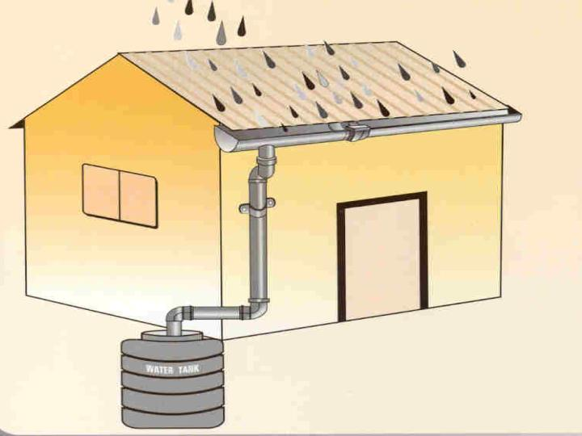
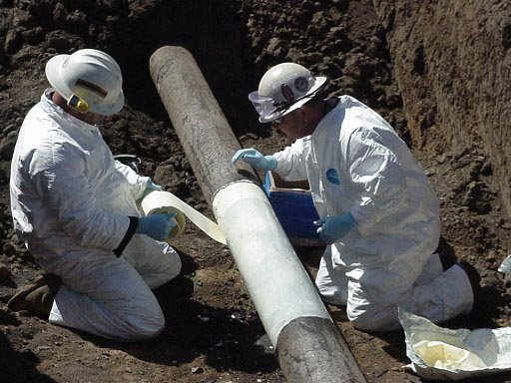
0.3 Mcm/year volume of water
from rain water harvesting in 2032.
1.58 Mcm/year volume of water
from rehabilitation 2032 .
15.23 Mcm/year remaining gap .

Slide 32
Groundwater Wells
Assumption
New 7 wells are poposed to developed in Tulkarm governarate .
Expected annual production = 2.1 Mcm/year
.
Depth of Well vary from 250-500

Slide 33
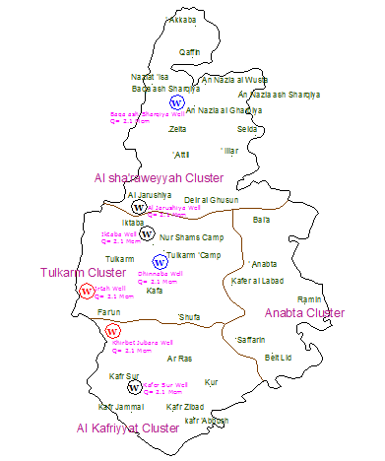

Slide 34

Investment Plan

Slide 35
Packages
To convey water from ground water wells proposed earlier ,additional infrastructure will needded .
Different proposed packages are needded .
Package
Well
Reservoir
Pumps
Transmission pipeline

Slide 36
Assumptions and calculation made to determine the diameter of transmission pipeline, pump power and reservoir volume :
The velocity of the flow rate in transmission pipelines is assumed to be 1m/s.
The diameter of transmission pipeline are calculated using the continuity equation.
Q = V * A
For planning purposes, the head loss in transmission pipeline is calculated using the following equation:
H_{L} = 0.01 L
The pump head calculated using Energy Conservation principle (Bernoulli Equation).
Z₁ ₊ H_{p =} Z₂ ₊ H_{L}

Slide 37

The pump power is calculated using the equation :
Power (watt) =
estimated costs for new WDN approximately equals 200$/capita if the population of localities is less than 5000 person, and 150$/capita for localities that have more than 5000 person .
Rehabilitation of old existing water system must be made, so the cost of rehabilitation according to EIB equal 0.1$/capita.

Slide 39
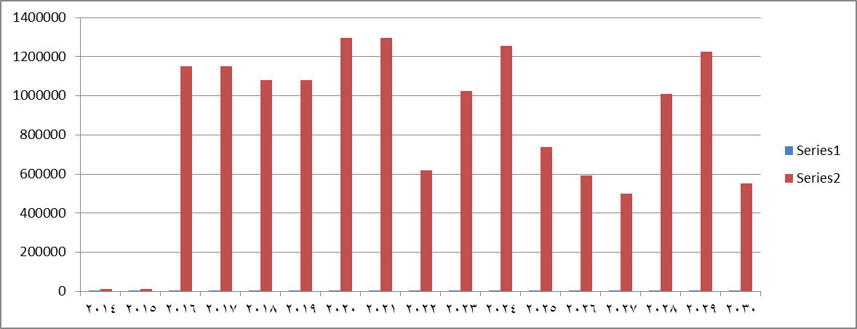
The following cash flow shows the headed investment to implement the plane.

Slide 40
Conclusion
1. all unversed area are served by the end of the design period
2. the amount of gap is bridge by rehabilitation and rain and ground water well
3. To convey water from the ground water wells proposed earlier in this plan, additional infrastructure will be needed. These needed projects are divided into different proposed packages.
4. from this cumulative cash flow we see the following:

Slide 41
Cumulative cash flow

Slide 42

15 M $ 53 M NIS
0.73 Million $/year.
2.6$/capita/year

Slide 43


