Slide 1
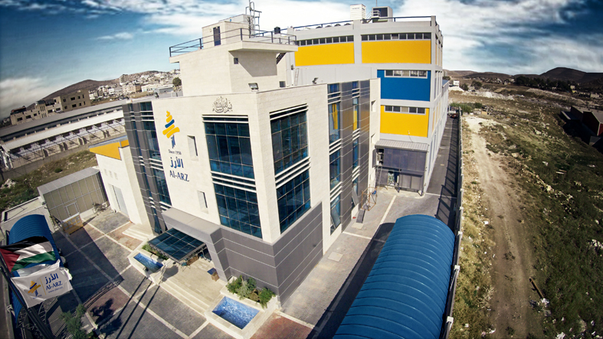
An-Najah National University
Faculty of Engineering & Information Technology
Industrial Engineering Department
Development of a Maintenance Management System at AL ARZ Ice Cream Factory
Supervisor: Dr. Yahya Saleh

Slide 2
Prepared By :
RAGHAD HABAYEB
MAHRAN ABU BASHA
NIDAL AWADEH

Slide 3
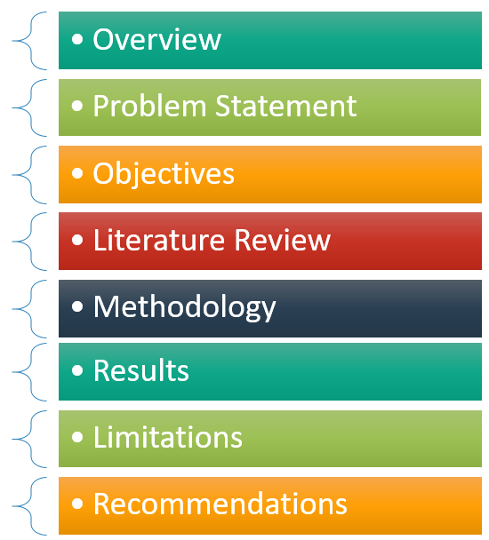
OUTLINE

Slide 4
About AL ARZ
Founded in 1950
2000 m² , 10 000 m² in total
HACCP certificate
4 Million liter of ice cream
Operats 24/7
180 workers
8 production lines

Slide 5
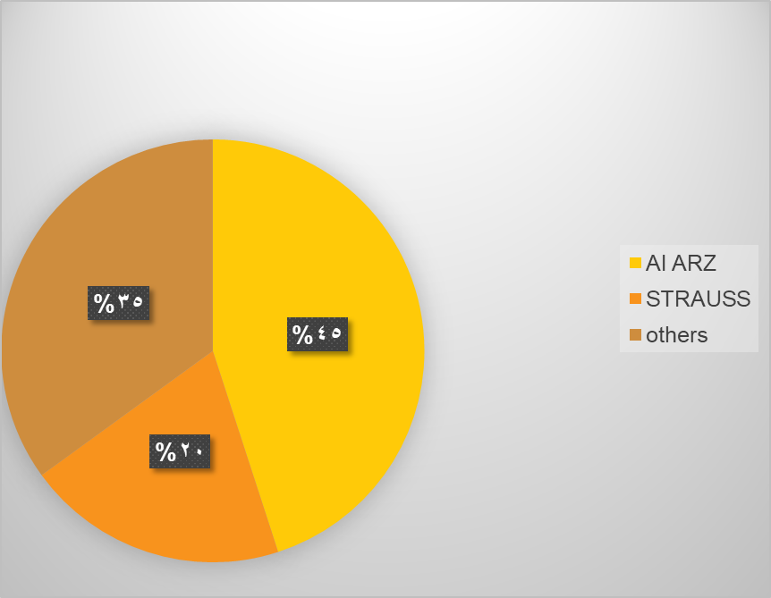
MARKET SHARE

Slide 6
Problem Statement
Few documentation
Incorrect documentation
The lack of maintenance reports
The lack of maintenance procedures
No labeling system for spare parts
No coding system for spare parts
No computerized maintenance system
The lack of maintenance department
Sudden breakdowns
No spare parts management
No spare parts sorting

Slide 7
Objectives
Establish shelf and coding system
Apply spare parts management
.
Establish computerized maintenance system
Improve Maintenance System
Notes:
© Copyright Showeet.com – Free PowerPoint Templates

Slide 8
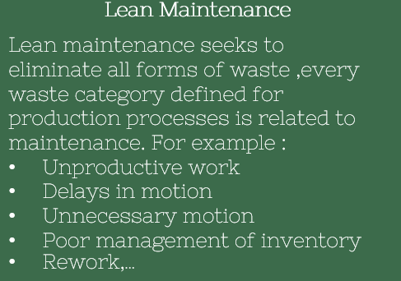
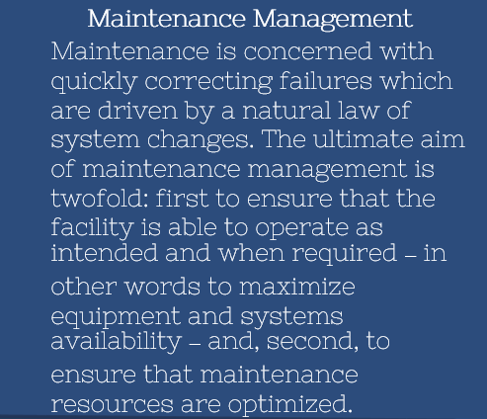
Literature Review

Slide 9

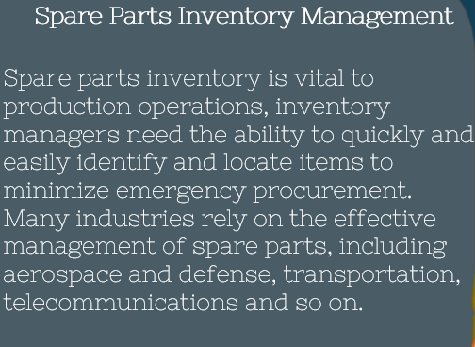

Literature Review
ABC Inventory Classification
Inventory classification using ABC analysis is one of the most widely employed techniques in organizations. Normally, the items are classified based on the annual use value, which is the product of annual demand and average unit price. Class A items are relatively few in number but constitute a relatively large amount of annual use value, while class C items are relatively large in number but not used so often.
SWOT Analysis
Strengths, weaknesses, opportunities and threats (SWOT) analysis is a device that helps business managers to evaluate the strengths, weaknesses, opportunities and threats involved in any business enterprise. A SWOT analysis can help them gain insights into the past and think of possible solutions to existing or potential problems

Slide 10
Methodology
Computerized Maintenance Management System
Shelving System
SWOT Analysis
Spare Parts Management
Availability
Notes:
© Copyright Showeet.com – Free PowerPoint Templates

Slide 11
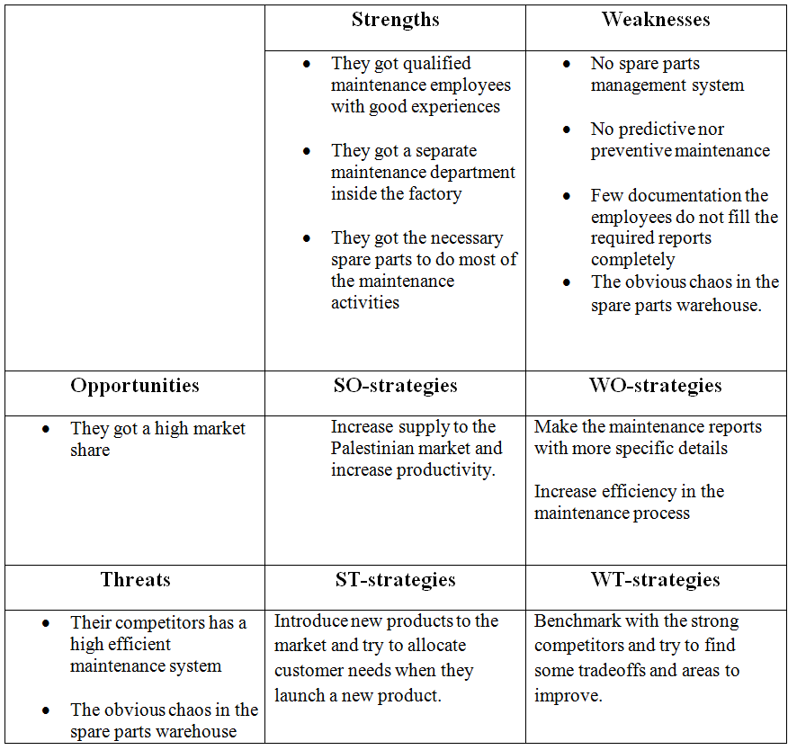
SWOT ANALYSIS
S
W
T
O

Slide 12
CORRECTIVE MAINTENANCE REPORT

Slide 13
RESULTS
ABC ANYLSIS
AVAILABILITY
MAINTENANCE coordinator
FISH AND BONE
SMART
Notes:
© Copyright Showeet.com – Free PowerPoint Templates

Slide 14
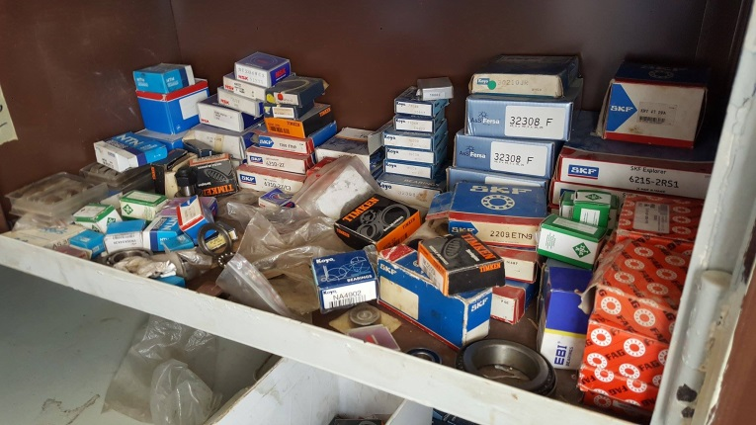
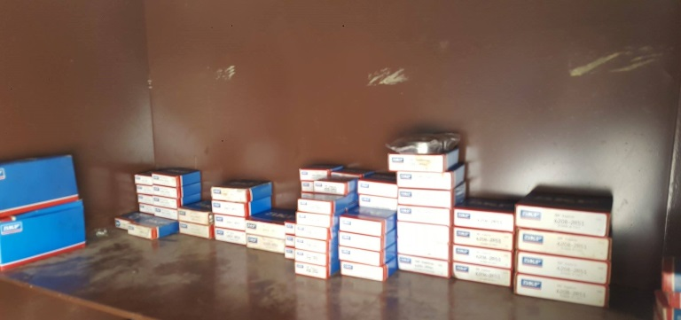
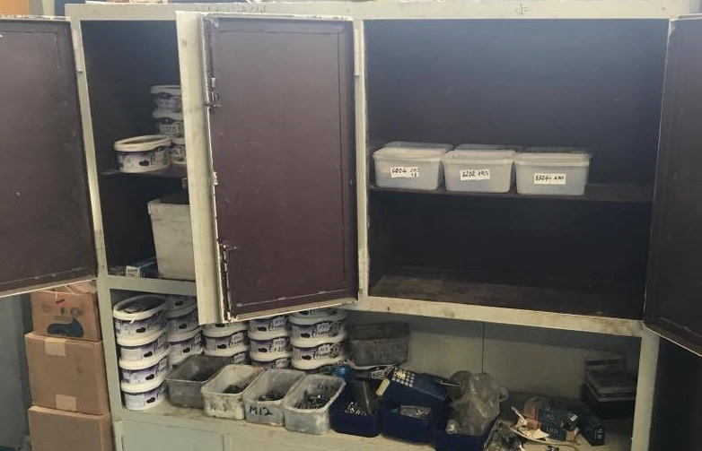
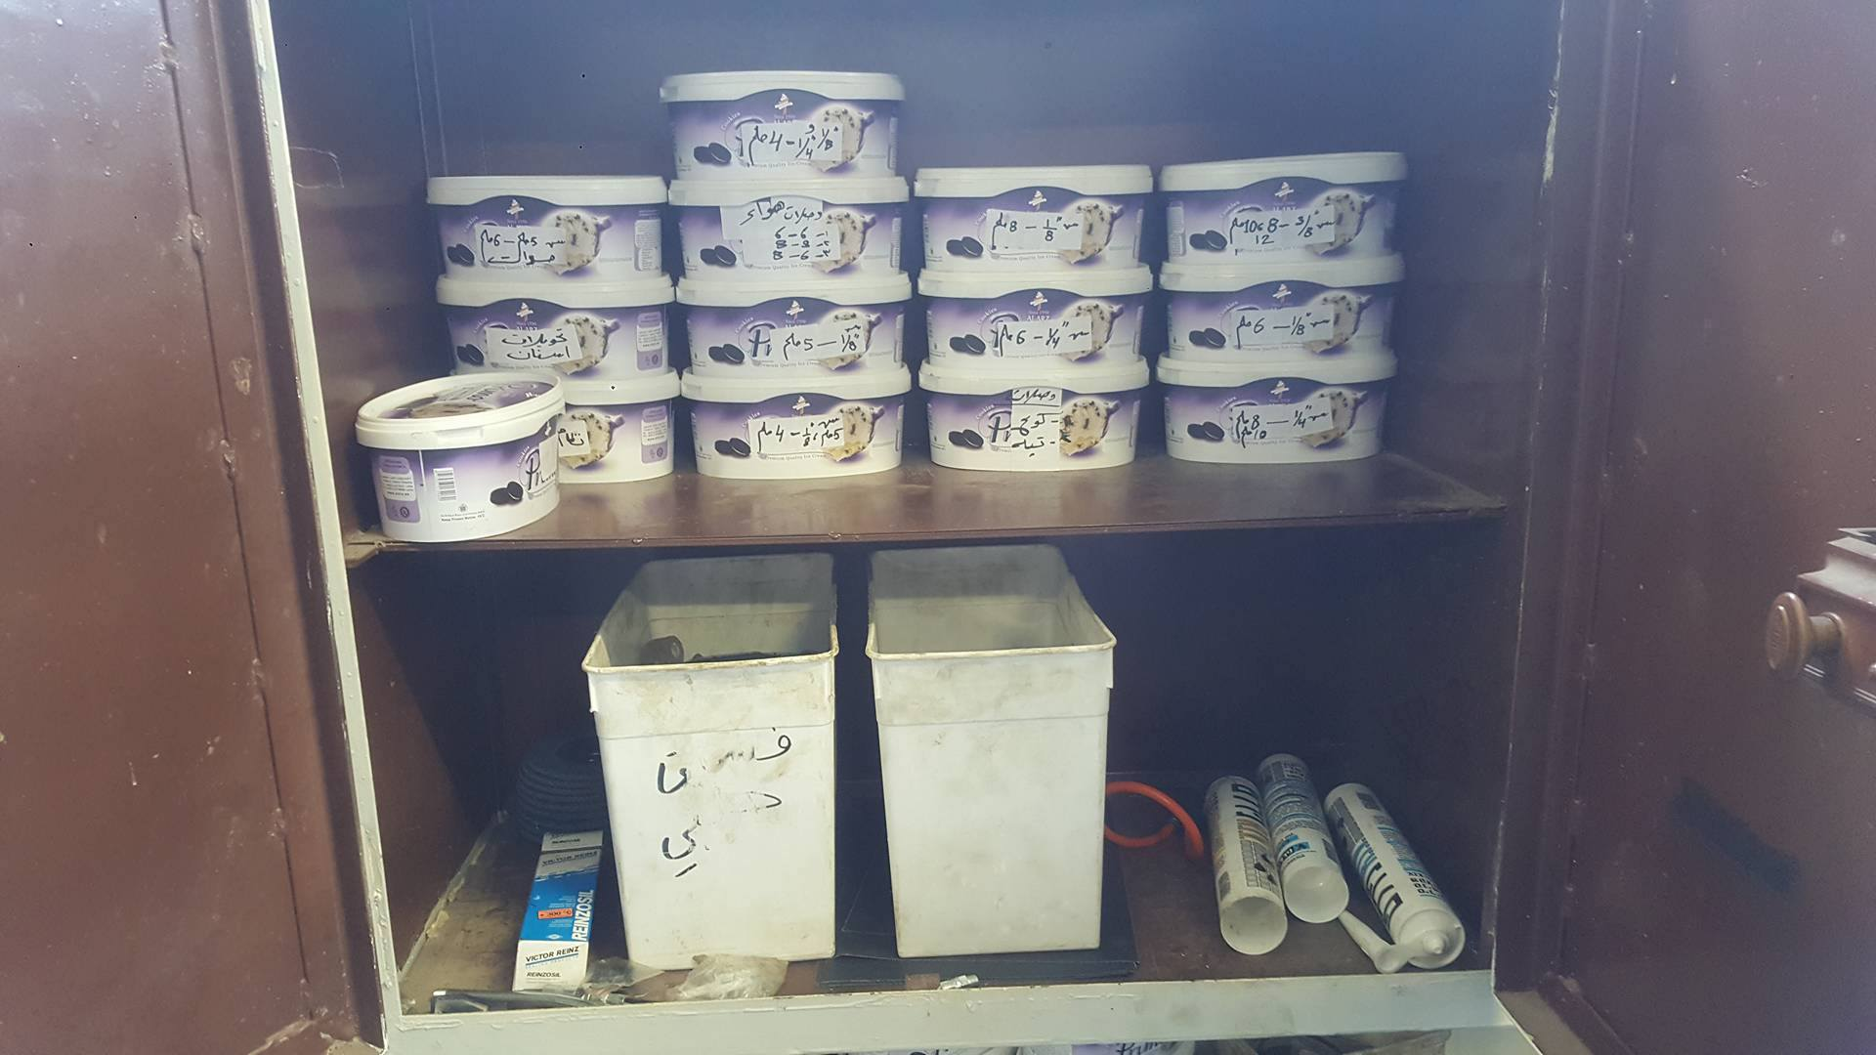
Shelving system

Slide 15
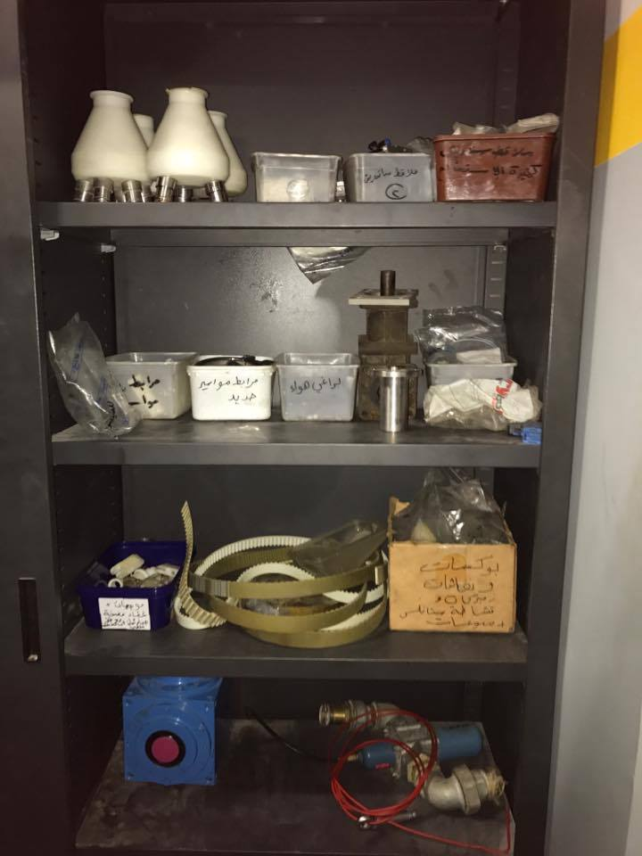
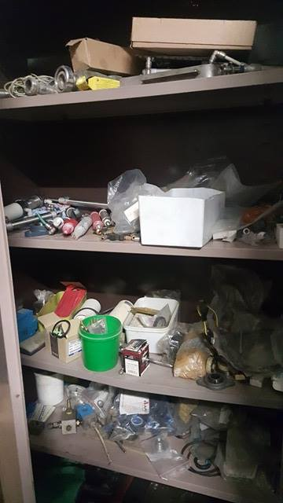

Slide 16
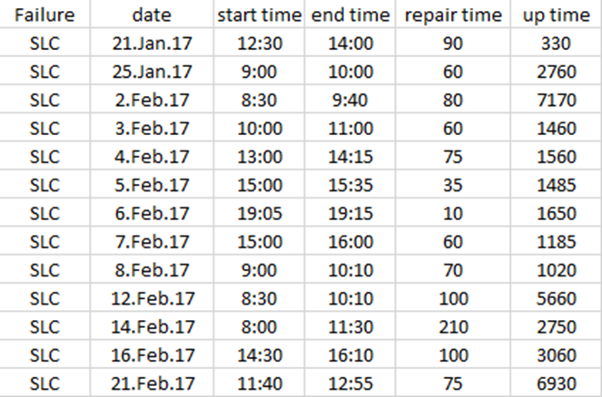
AVAILABILITY
These four distributions were studied for the analysis of the data:
Normal Distribution
Exponential Distribution
Weibull Distribution
Gamma distribution

Slide 17
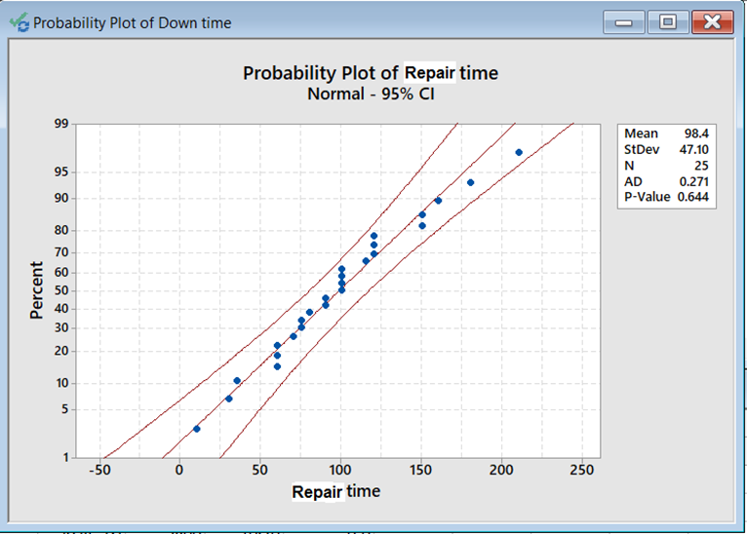
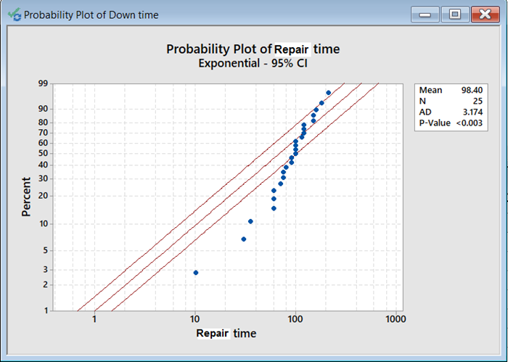
Determining mean time to repair
Normal distribution
Exponential distribution

Slide 18
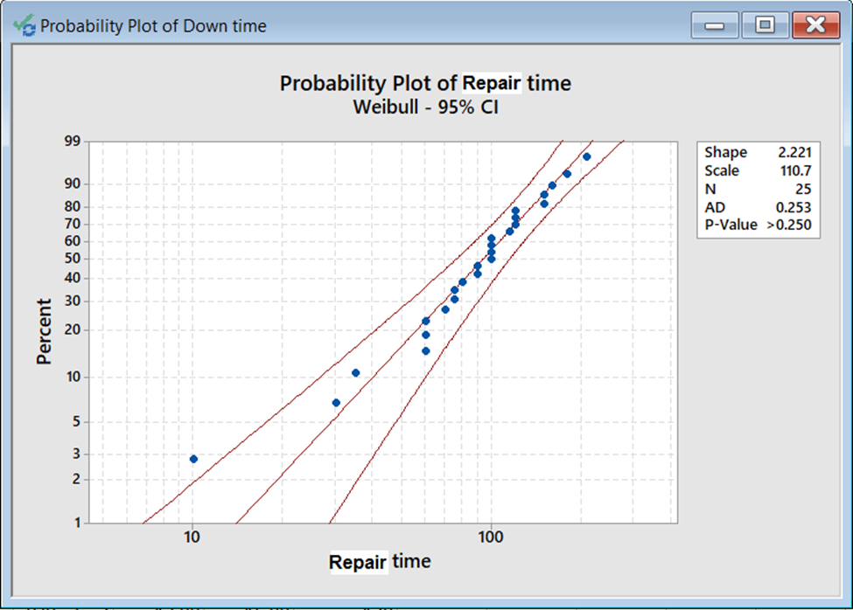
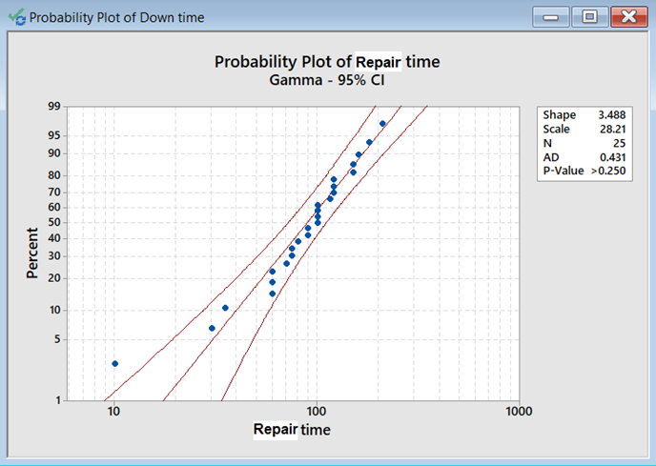
Determining mean time to repair
Weibull distribution
Gamma distribution

Slide 19
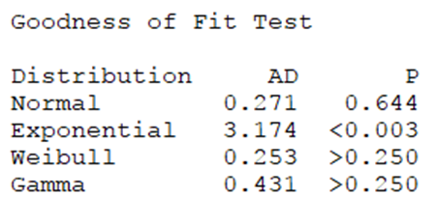
Goodness of fit for repair time
we can judge the best distribution that best represent the repair time data by two perspectives which are:
The P-value: the bigger the less variation and best represent.
Fitting the straight line
As a result, the normal distribution seems to be the best representation of repair time data

Slide 20
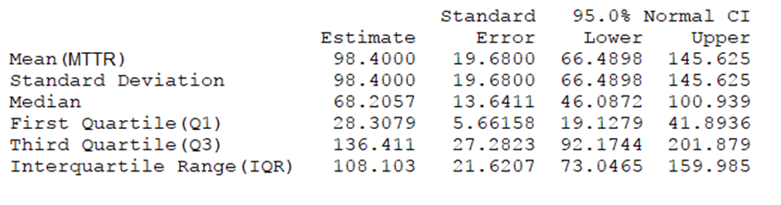
The resulting MTTR of the repair time data is 98.4 mins.

Slide 21
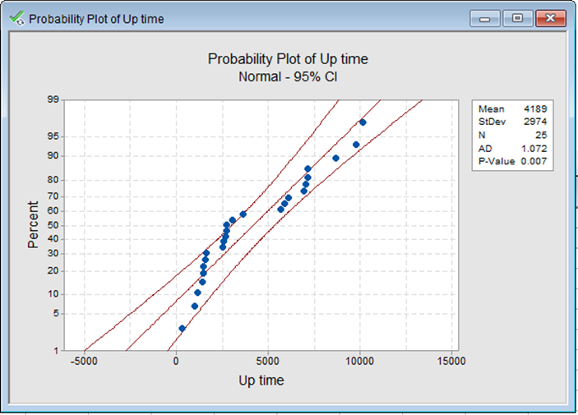
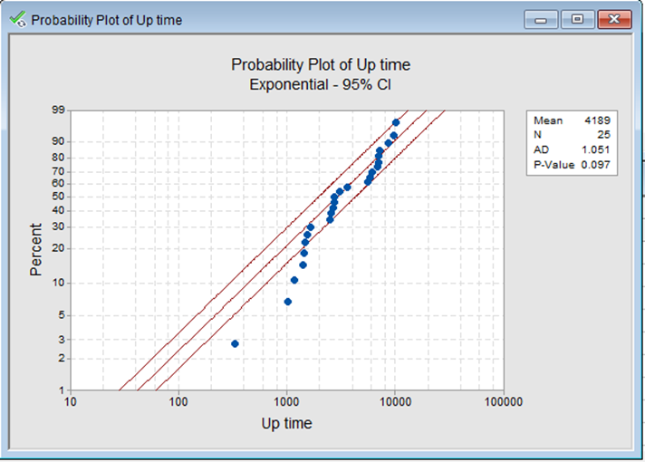
Determining mean time between failure
NORMAL DISTRIBUTION
EXPONENTIOL DISTRIBUTION

Slide 22
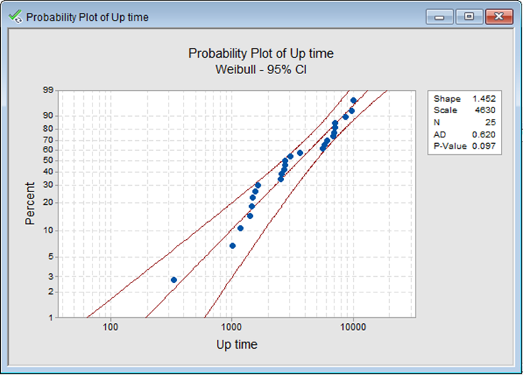
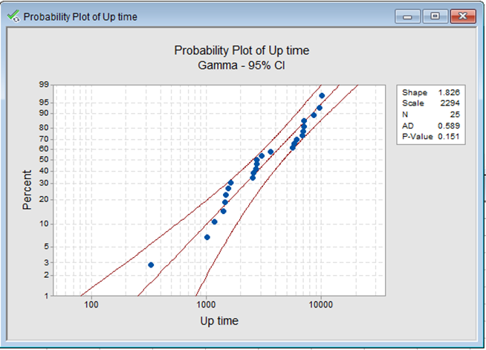
Determining mean time between failure
WEIBULL DISTRIBUTION
WEIBULL DISTRIBUTION

Slide 23
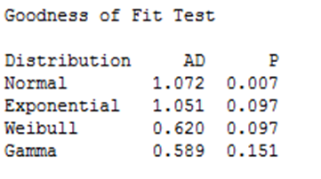
Goodness of fit
Goodness of fit for up time
As a result of the analysis, we can judge the best distribution that best represent the up time data by the same criteria as:
Gamma distribution is the best representation of the up time data.

Slide 24
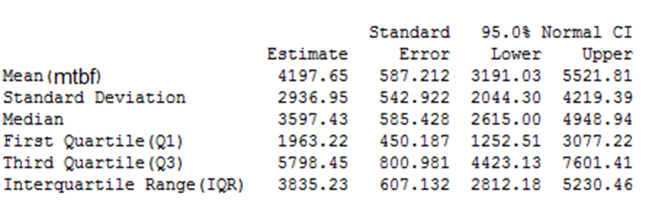
Goodness of fit
The resulting MTBF of the up time data is 4197.65 mins.
The availability of the machines is A = MTBF / (MTBF+MTTR) = 4197.65 / (4197.65 + 98.4)= 97.7 %

Slide 25
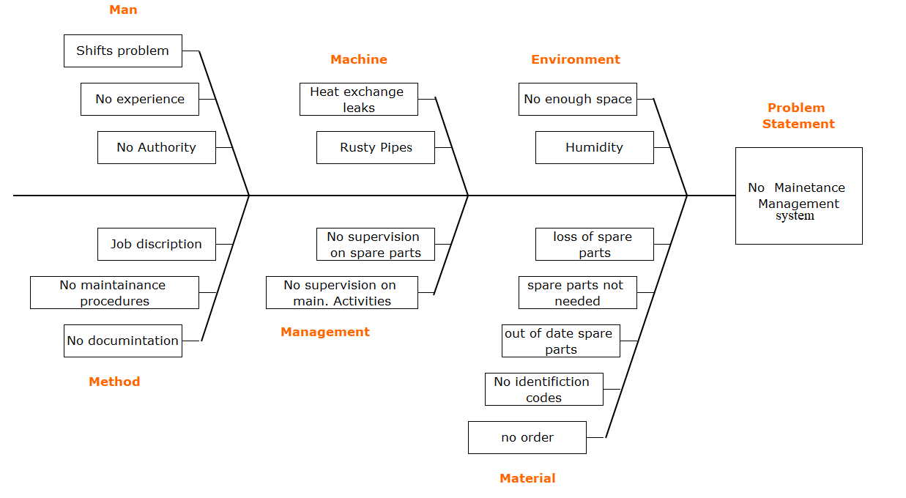
Fish and bone diagram

Slide 26
ABC ANALYSIS
CLASS C
CLASS B
CLASS A
ABC ANALYSIS
Class A
Class B
Class C
About 30% of the spare parts items represent 15% of their consumption
About 50% of the spare parts items represent 5% of their consumption
About 20% of the spare parts items represent 80% of their consumption
Notes:
© Copyright Showeet.com – Free PowerPoint Templates

Slide 27
Description | Total number of parts | Percentage of items in the inventory | Cumulative usage value | Percentage of annual sales value | Cumulative of annual sales value
A | 34 | 21.6561% | 21.6561% | 75% | 75%
B | 53 | 33.7579% | 55.414% | 20% | 95%
C | 70 | 44.586% | 100% | 5% | 100%
Total | 157 | 100% |  | 100%

Slide 28
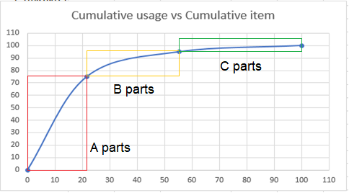
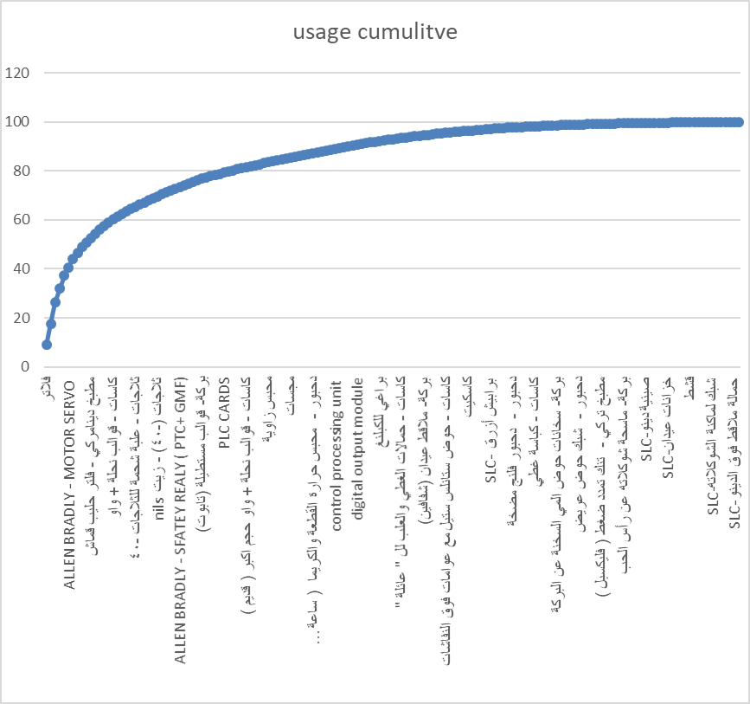

Slide 29
Notes:
© Copyright Showeet.com – Free PowerPoint Templates

Slide 30
ABC ANALYSIS CONTROL
Editable SmartArt Graphic – 3 Gears Max
SAFETY STOCK
SS= Z × σLT × D avg
REORDER POINT
Reorder Point = LEAD TIME DEMAND + SAFETY STOCK = REORDER POINT
Notes:
© Copyright Showeet.com – Free PowerPoint Templates

Slide 31
Based on experience and judgment

Slide 32
COMPUTERIZED MAINTENANCE MANAGEMENT SYSTEM
A Computerized Maintenance Management System is a computer software that helps in keeping records of all the maintenance procedures and maintenance tasks including scheduling and tracking the maintenance steps, it also keeps a historical record of the maintenance work they performed.
Manage spare parts inventory
Reduce downtime and repair costs
BENEFITS OF CMMS
Eliminate paperwork
Increase safety
Plan and schedule preventative maintenance
Manage work orders efficiently
Reduce overtime
Notes:
© Copyright Showeet.com – Free PowerPoint Templates

Slide 33
Maintenance coordinator
Maintenance coordinator is a maintenance management software and it includes:
scheduling for maintenance activities .
purchasing and receiving of spare parts .
listing all possible vendors and contractors .
managing of equipment (machines) and assets .
Inventory management at spare parts warehouse .
creating repair orders .

Slide 34
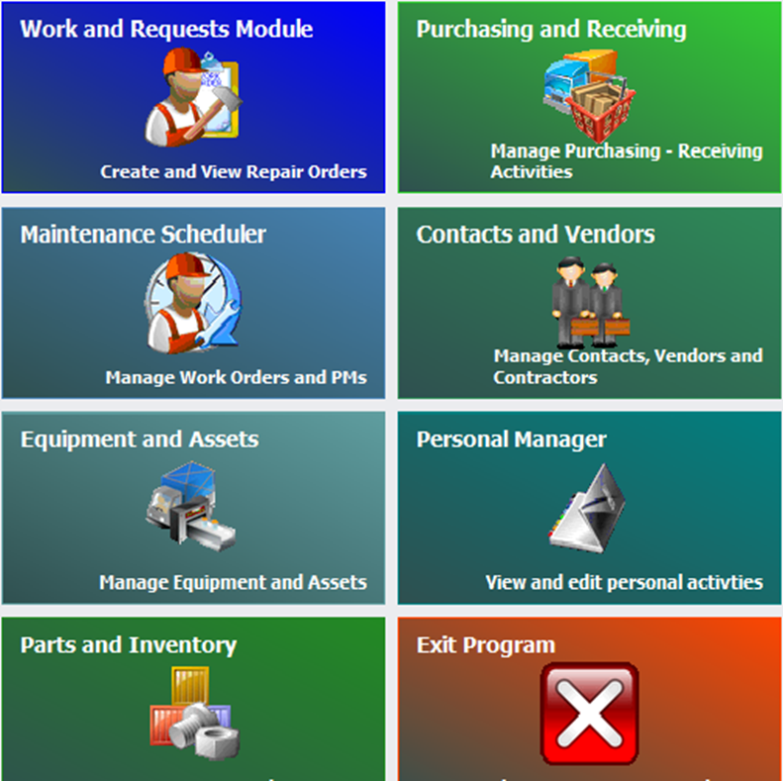
Maintenance coordinator

Slide 35
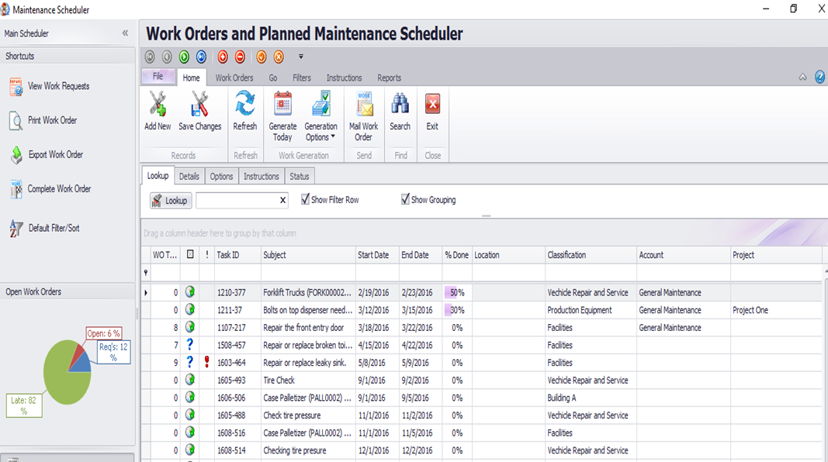
Scheduling for maintenance activities

Slide 36
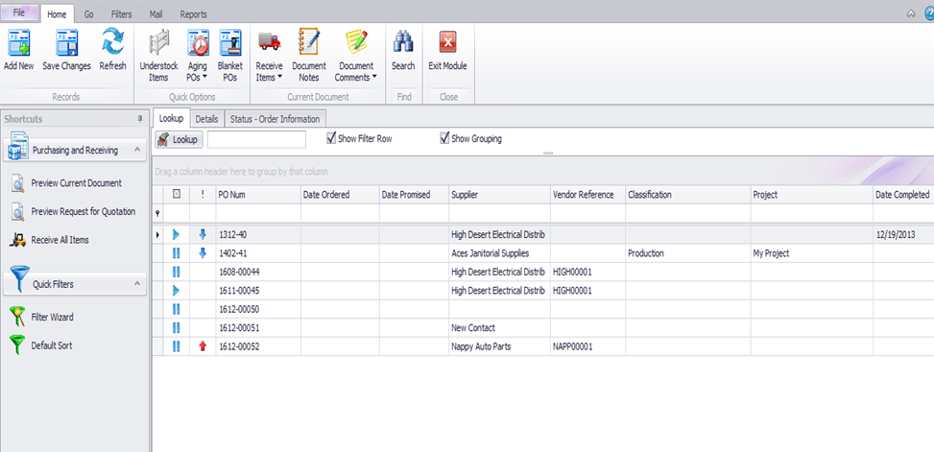
Purchasing and receiving of spare parts

Slide 37
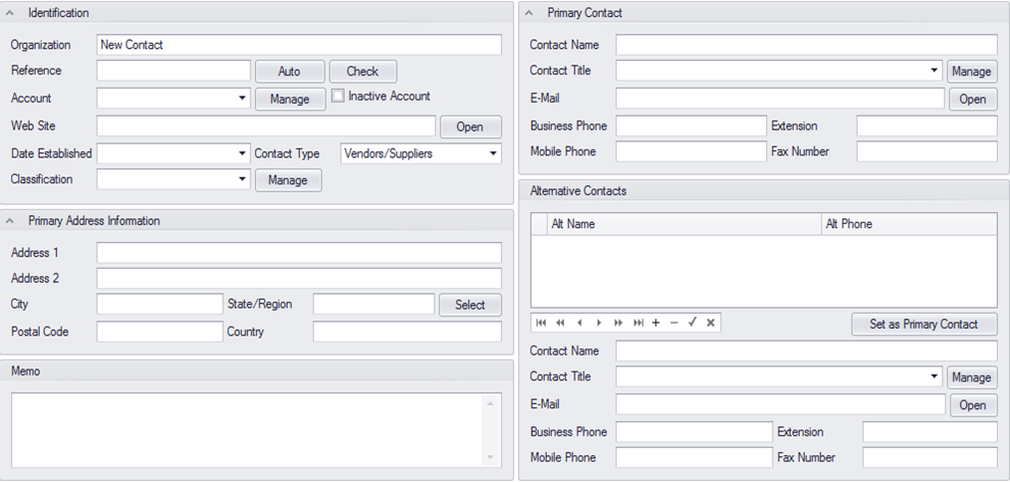
listing all possible vendors and contractors

Slide 38
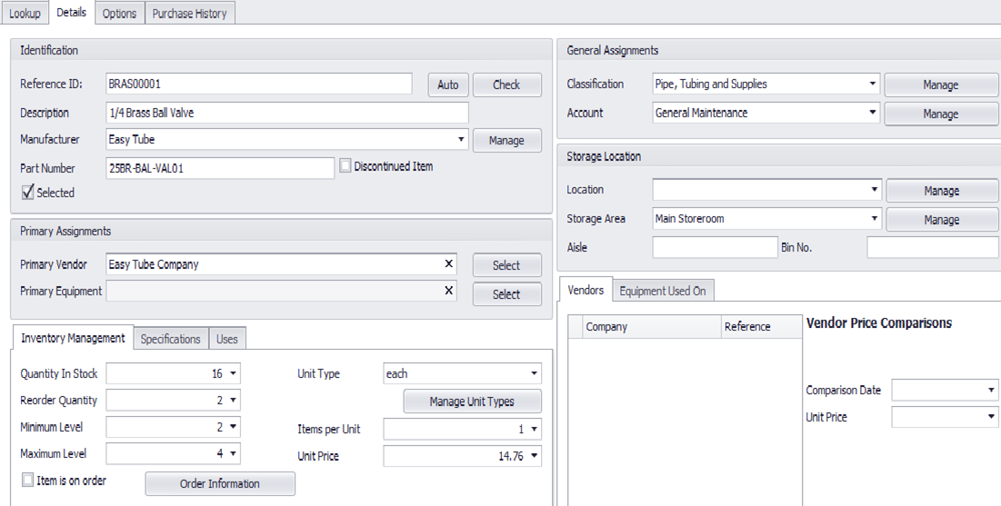
Inventory management at spare parts warehouse

Slide 39
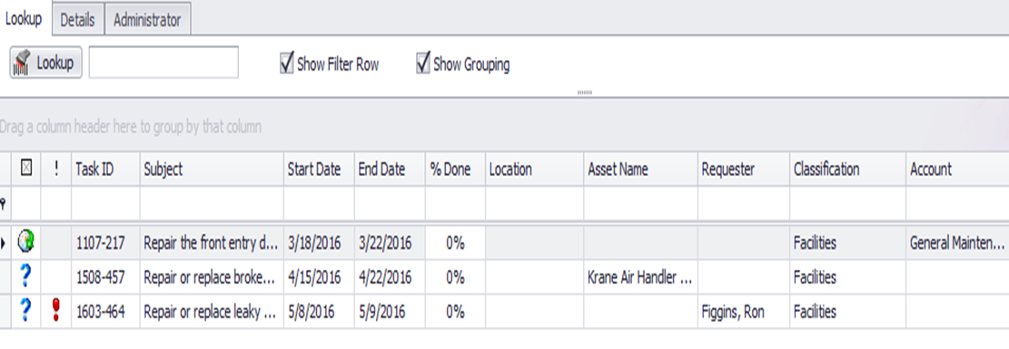
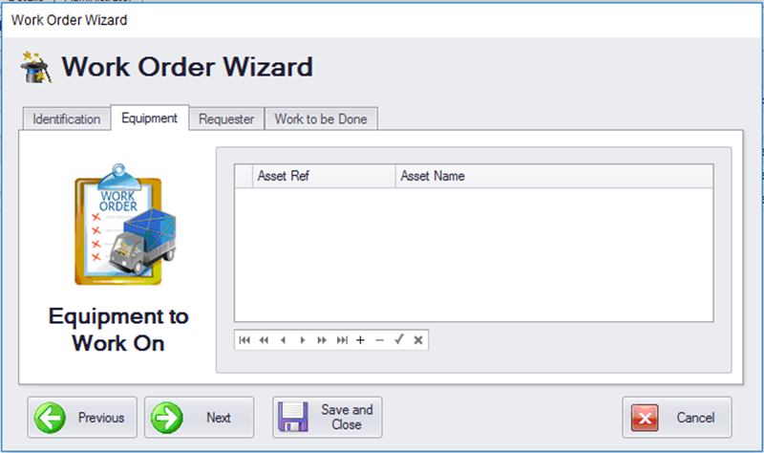
Creating repair orders

Slide 40
ADVANTAGES OF CM
All entered data in each part is registered in the overall system so the system is integrated.
.
Coordination between all parts helps in finding an overall view about every single shot in the maintenance activities.
Notes:
© Copyright Showeet.com – Free PowerPoint Templates

Slide 41
Disadvantages of cm
After spare parts checkout process, if the number of spare parts is low or lower than the minimum level, no warning alert is shown.
Data entering process isn’t easy. It needs the coordination of multiple parts in the system.
Not easily understood for the employees in the maintenance department so more time is required to register the data and activities.
Too much data is required which sometimes isn’t needed and may reduce the efficiency of the process.
Notes:
© Copyright Showeet.com – Free PowerPoint Templates

Slide 42
smart
SMART is a computerized maintenance management system.
Used due to the fast improvement in the manufacturing sector.
SMART system is a new system designed with the newest techniques that insures the continuity of the machines with the highest efficiency and the lowest cost possible.
SMART system includes many different maintenance management branches including:
Client’s information management.
Contracts management.
Warehouse management system.
Maintenance management system.
Machines management.

Slide 43
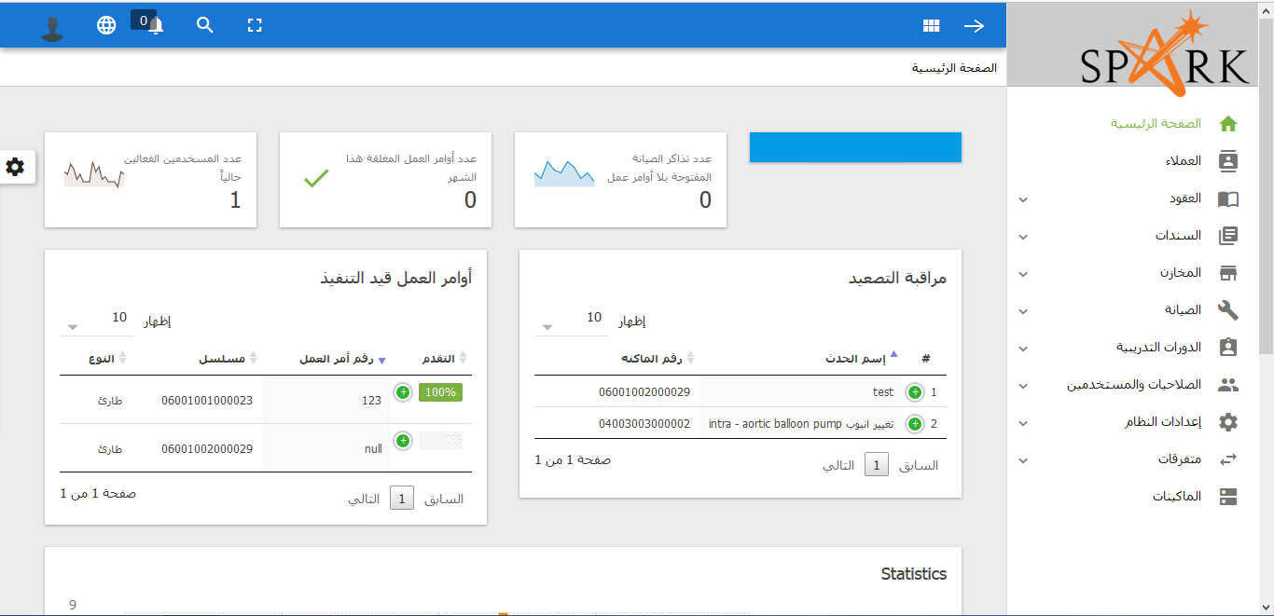
MAIN PAGE

Slide 44
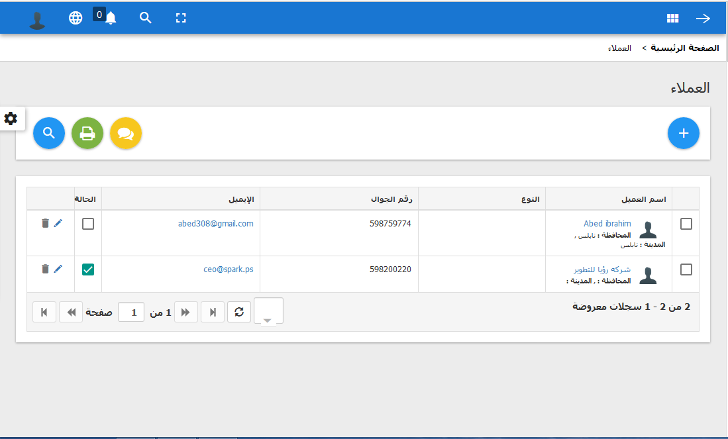
Client’s information management

Slide 45
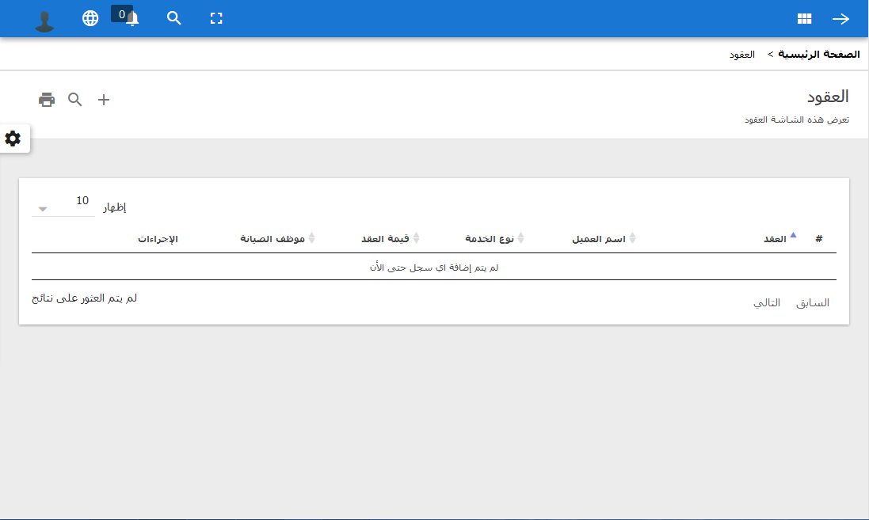
Contracts management.

Slide 46
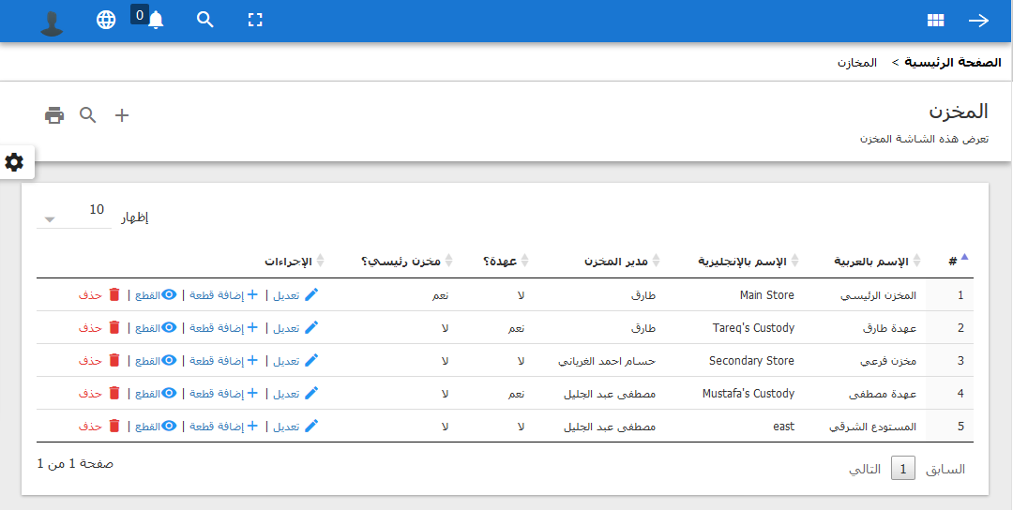
Warehouse management system.

Slide 47
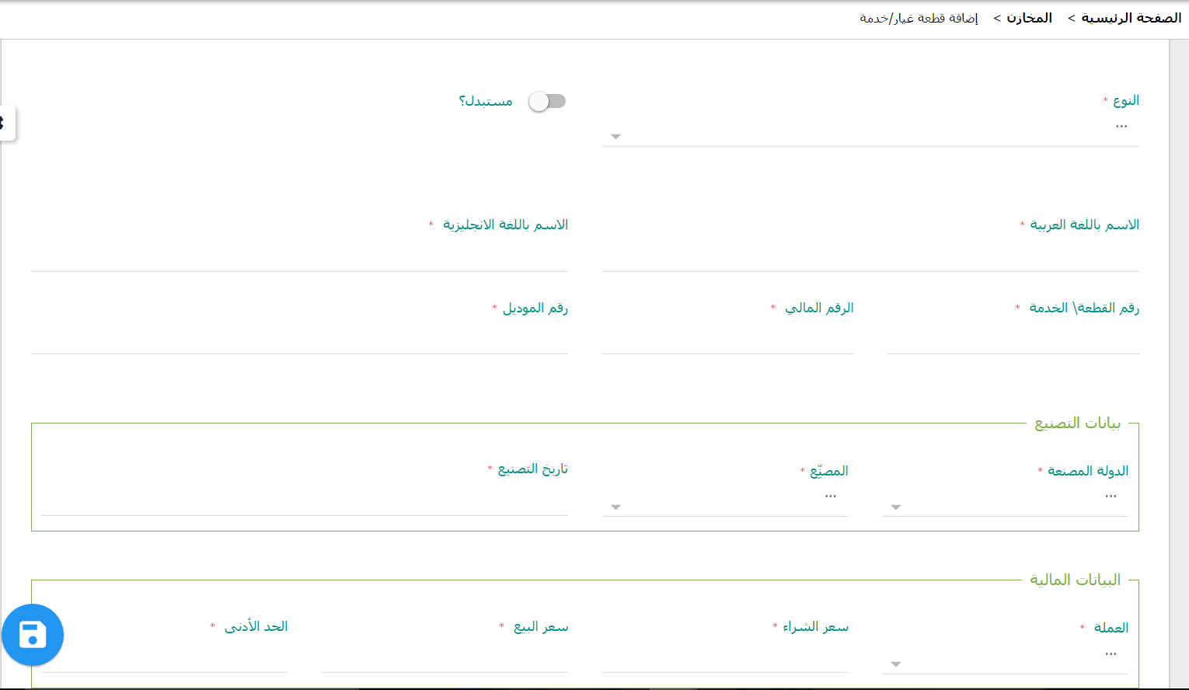
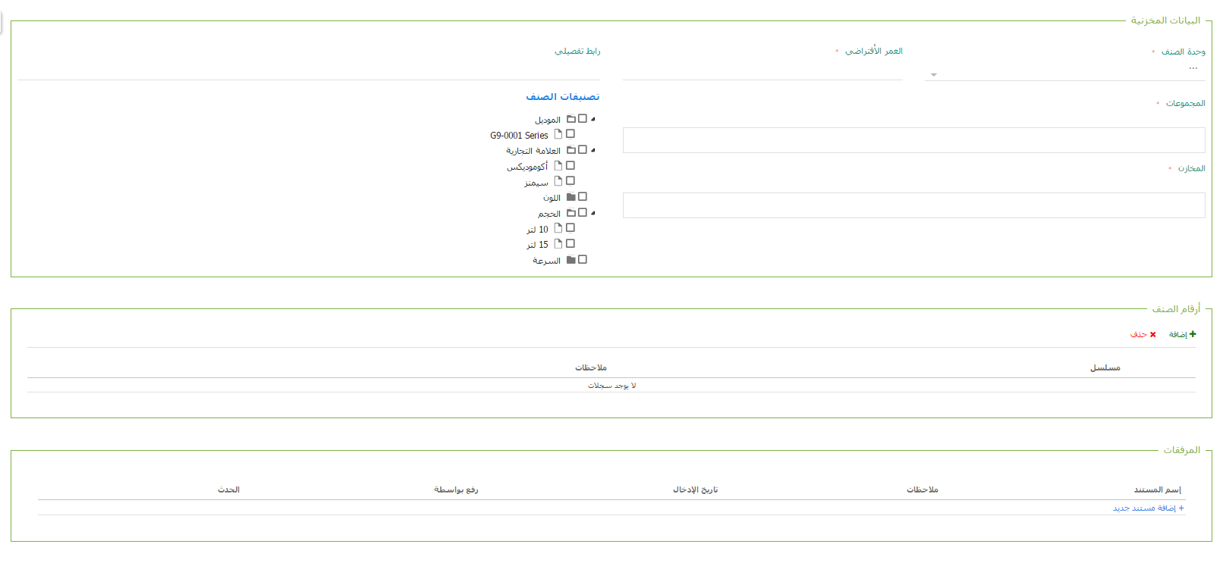
Add a spare part

Slide 48
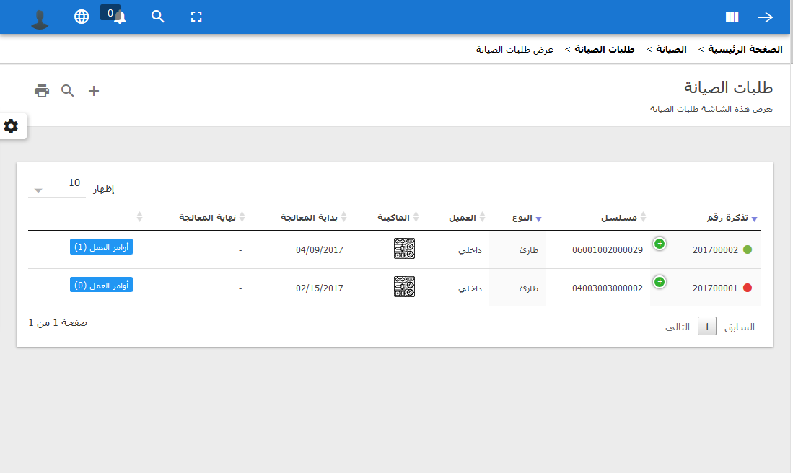
Maintenance management system:

Slide 49
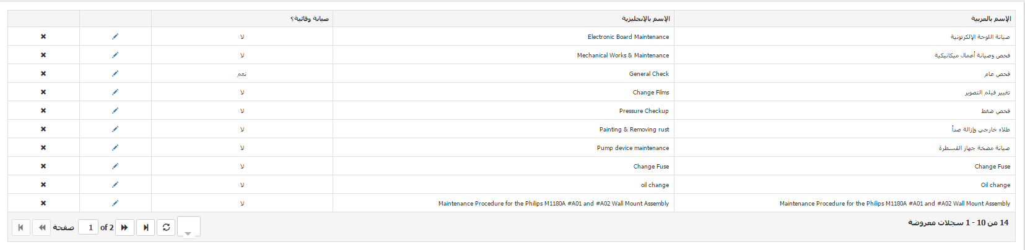
maintenance procedures

Slide 50
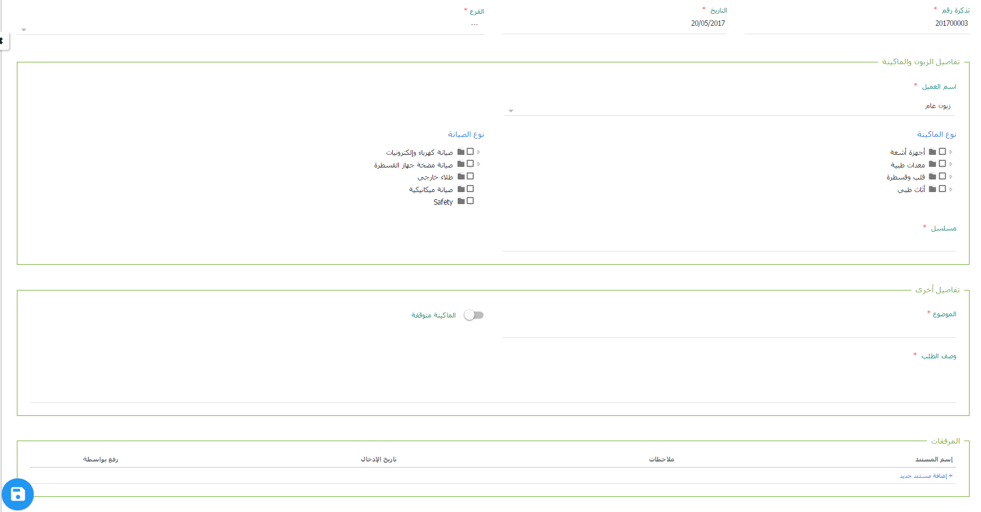
Adding a maintenance procedure

Slide 51
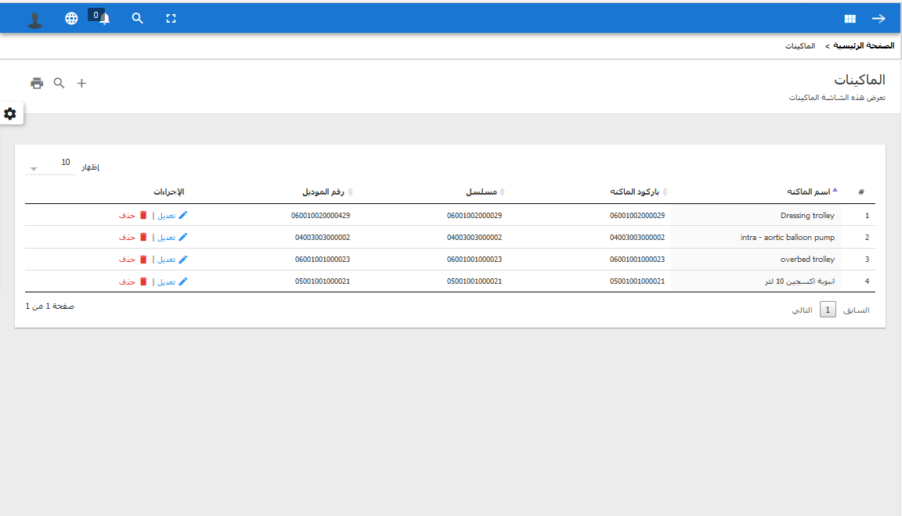
Machines management.

Slide 52
Areas where SMART can be used in
SMART can be used in any field that involves machines, devices, or assets either inside or outside the factory
Machines and factories’ devices
Cars and automobiles
Cell phones
Personal computers, printers, and their accessories
Electronic devises and elevators
Phones and communication devices
Faxes
Electrical devices (fridges, washing machines …etc.)
Streets, conservative wall, and sidewalks
Electricity, water and sewage networks
Notes:
© Copyright Showeet.com – Free PowerPoint Templates

Slide 53
SMART Characteristics:
Multilanguage (English, Arabic)
Ability to control display setting (colors and more)
Flexibility in presenting and printing reports
Easy to understand
Multiuser
The ability to work on many databases
Indexes available in all screens with many different sorting possibilities
Notes:
© Copyright Showeet.com – Free PowerPoint Templates

Slide 54
SMART advantages
Keeps your maintenance cost within appropriate budget
decreases the stoppage time
1
2
3
4
5
6
7
8
Less maintenance operation cost
Decreases the overall maintenance
.
Less overtime cost.
Reduces the paper work and manual work
.
Reduced downtime
Extends equipment life
.
Notes:
© Copyright Showeet.com – Free PowerPoint Templates

Slide 55
limitations
Lack of historical data available at the factory
The resistance of change by some of the maintenance employees.
The messy situation in the maintenance department at the factory.
Many of the maintenance reports weren't delivered
No clear job description was implemented
Notes:
© Copyright Showeet.com – Free PowerPoint Templates

Slide 56
Conclusion
Implementing ABC analysis make it easier to track and monitor spare parts
Using fish and bone diagram helps in determining the possible causes of the problems and helps in solving them .
Implementing a computerized maintenance system helps to manage maintenance effortlessly
Implementing reliability analysis helps determine the availability of the machines which helps in exceeding it’s life
Notes:
© Copyright Showeet.com – Free PowerPoint Templates

Slide 57
RECOMMENDATIONS
Buy the SMART maintenance software as it’s simpler, in Arabic and can be connected with AL SHAMEL
Determine the availability of the other machines and apply reliability analysis
Implement the corrective maintenance report we constructed
To classify the spare parts based on the importance and the usage value as explained by the abc analysis
Determine safety stock and reorder point based on physical data rather than experience
Notes:
© Copyright Showeet.com – Free PowerPoint Templates

Slide 58
Thank You!
Notes:
© Copyright Showeet.com – Free PowerPoint Templates

