Slide 1
Design of a Wastewater Collection Network for Tell Village – Nablus Governorate
By: Bara Rehan
Under supervision of: Dr. Mohammad Almasri
Fall 2021

Slide 2
OUTLINE
INTRODUCTION
OBJECTIVES
STUDY AREA
METHODOLOGY
DESIGN
RESULTS
CONCLUSIONS & RECOMMENDATIONS

Slide 3

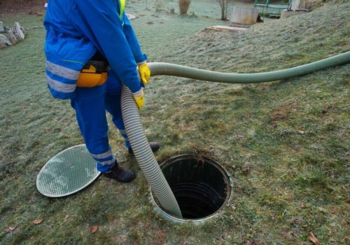
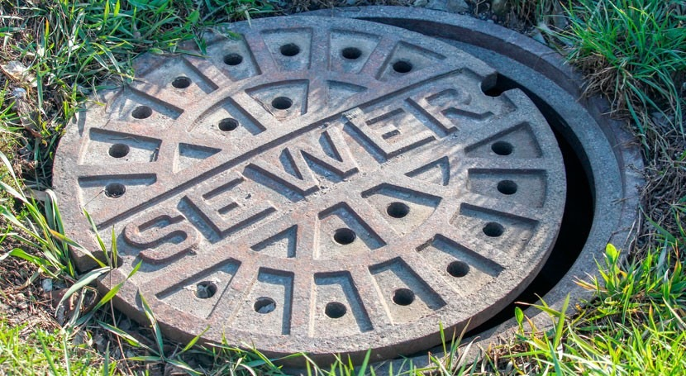
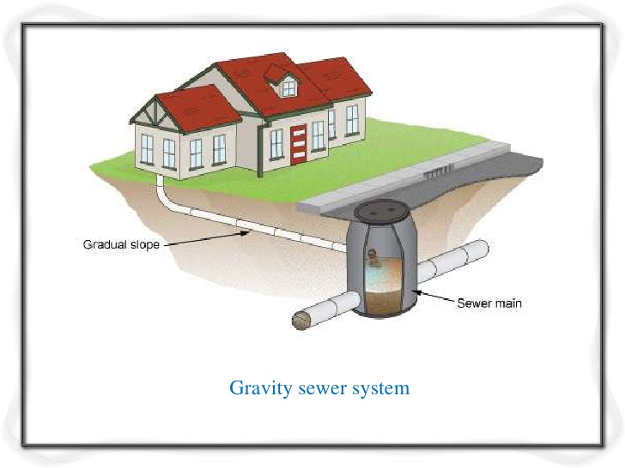
INTRODUCTION

Slide 4
OBJECTIVES
Design of a wastewater collection network for Tell Village and estimate its cost

Slide 5
STUDY AREA
A
Location
Water
Situation
Topography
E
Study Area
B
C
D
Climate
Population

Slide 6
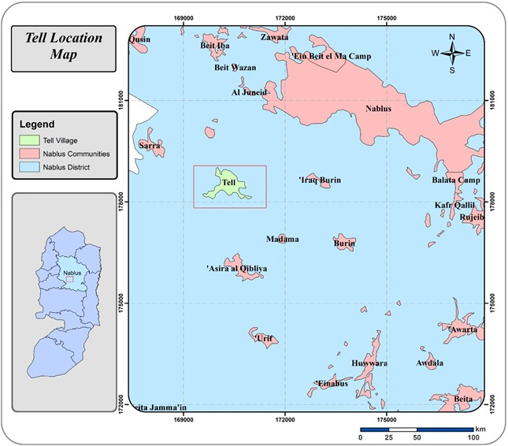
LOCATION

Slide 7
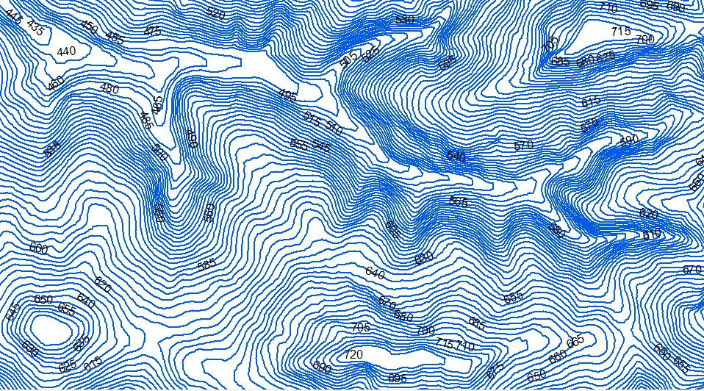
Topography

Slide 8
POPULATION

Slide 9
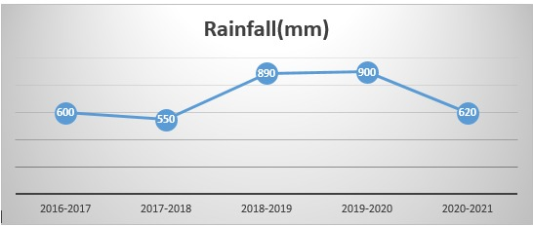
CLIMATE

Slide 10
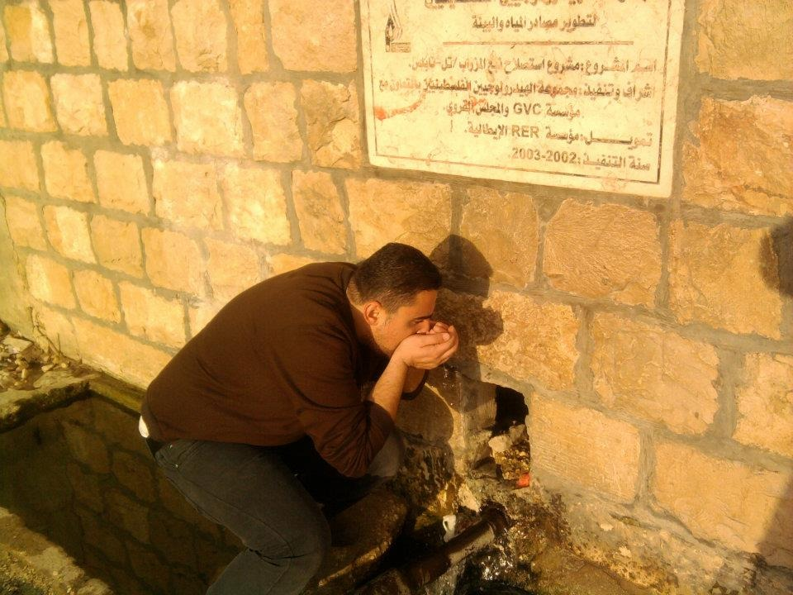
WATER SITUATION

Slide 11
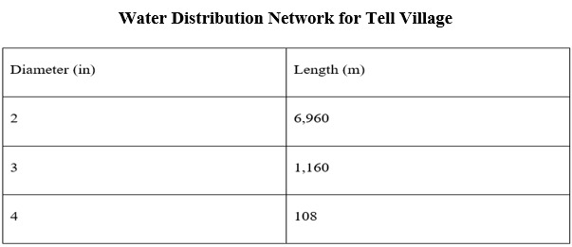
WATER SITUATION
Total Length 8230 m

Slide 12







METHODOLOGY
Estimate WWCN
Design WWCN
Software Programs
Data collection
Select Study Area
Define the Problem

Slide 13
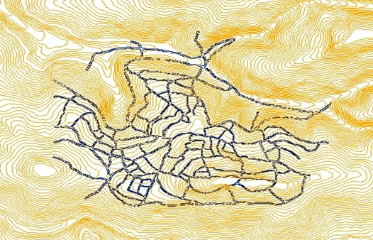
DATA COLLECTION
CONTOUR picture

Slide 14
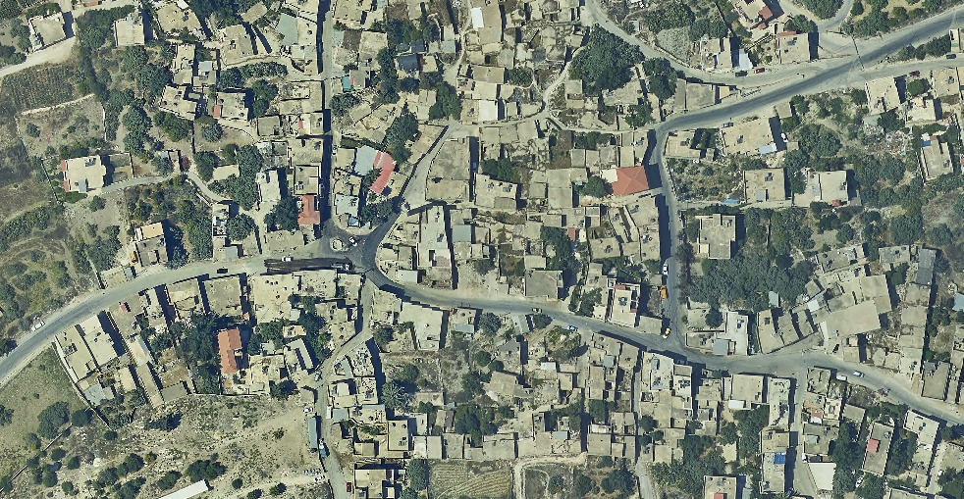
DATA COLLECTION
AIRIAL PHOTO

Slide 15
SOFTWARE PROGRAMS
SewerCAD Program
The modeling software compiler can consider Manning Equation in its computation algorithm Manning Equation:
Manning Equation: V=(R^(2/3) √s)/n Where:
V = velocity (m/s)
n = coefficient of roughness (Dimensionless)
R = hydraulic radius (m)
S = slope of the energy grade line (m/m).

Slide 16
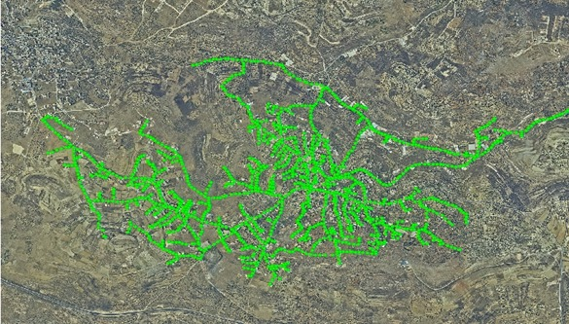
DESIGN
Allocating the manholes location on the aerial photos and master plan using ArcGIS.

Slide 17
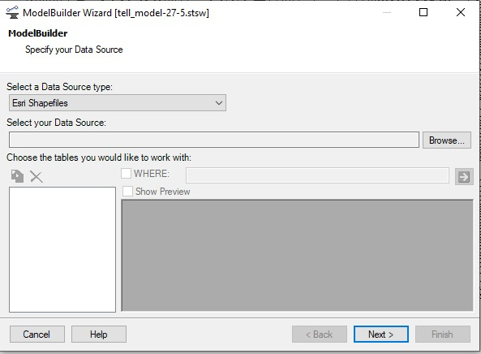
DESIGN
Importing the final manholes location into the SewerCAD by using ModelBuilder Tool.

Slide 18
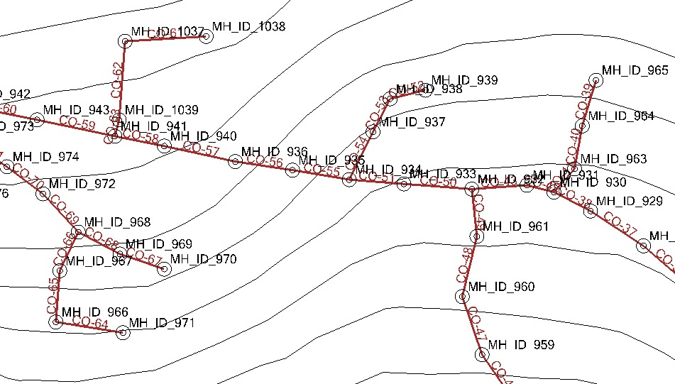
DESIGN
Connecting the conduits between the manholes in SewerCAD.

Slide 19
DESIGN
Defining the manholes and conduit characteristics and assigning the load on each manhole by principals of equally distribution.

Slide 20
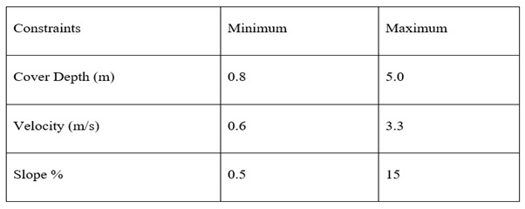
DESIGN
Assigning the design constraints that will be used in our design as the following:

Slide 21
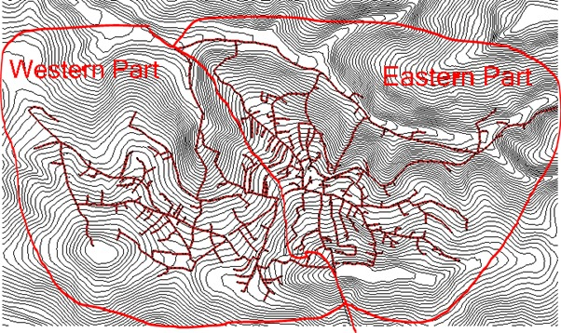
DESIGN
The village was divided into two parts (eastern and western). The eastern part was taken to be designed in this stage.

Slide 22
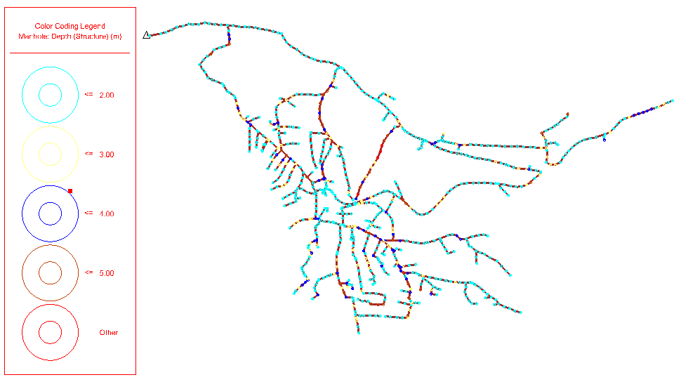
RESULTS
Manhole depths

Slide 23
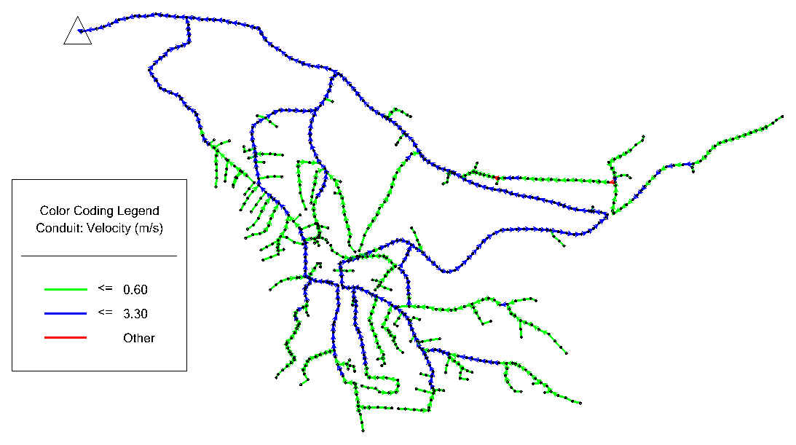
RESULTS
Velocity

Slide 24
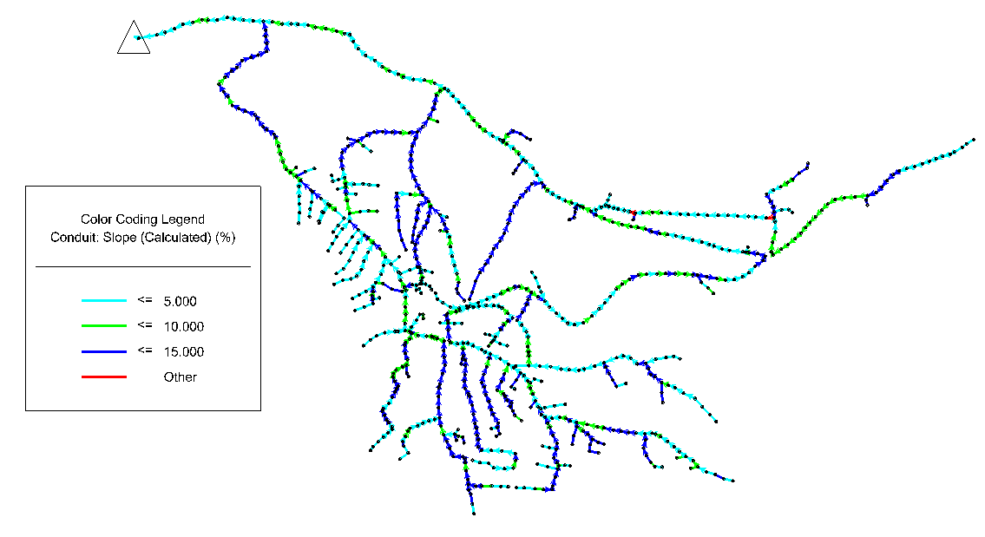
RESULTS
Slope

Slide 25
RESULTS
Sewerage Network Quantities Estimation
Earthwork: excavation, Backfilling, Reinstatement.
Pipe works: delivery and installation counduits.
Manhole concrete works: delivery and installation manhole structure.

Slide 26
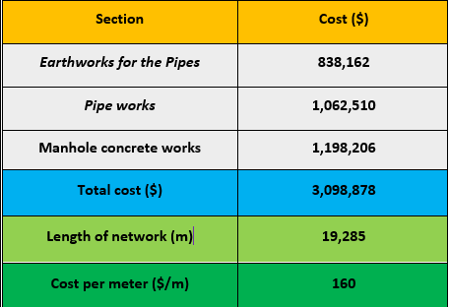
Sewerage Network Quantities Estimation

Slide 27
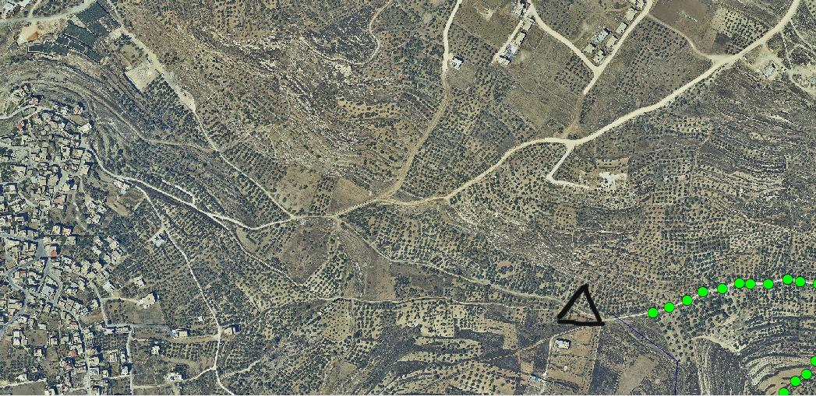

CONCLUSION & RECOMMENDATION
Sarra WWTP
Discharge point

Slide 28
Thank You

