Slide 1

An-Najah National University
Faculty Of Engineering Department Of Computer Engineering
Software Graduation Project (Oregano App )
Shayma abu saada Aseel eyad
Supervisor : Dr. Sufyan Samara
Presented in partial fulﬁllment of the requirements for Bachelor degree in computer engineering

Slide 2
Acknowledgement
We would like to express our deepest appreciation to our families and friends for their huge support during the project. We would also like to extend our deepest gratitude to all teaching staff of Computer Engineering Department .Our success would not have been possible without the support of Dr. Sufyan Samara, thanks wont be enough for his valuable advice and helpful contributions . This project is only a beginning of our journey.

Slide 3
DISCLAIMER
This report was written by student(s) at the Computer Engineering Department, Faculty of Engineering, AnNajah National University. It has not been altered or corrected, other than editorial corrections, as a result of assessment and it may contain language as well as content errors. The views expressed in it together with any outcomes and recommendations are solely those of the student(s). An-Najah National University accepts no responsibility or liability for the consequences of this report being used for a purpose other than the purpose for which it was commissioned.

Slide 4
Contents
Abstract . . . . . . . . . . . . . . . . . . . . . . . . . . . . . . . . . . . . . . . . . . . . . . . . . . . . .
6
1 Introduction
7
2 Constraints, Standards/Codes and Earlier course work
8
2.1 Constraints . . . . . . . . . . . . . . . . . . . . . . . . . . . . . . . . . . . . . . . . . . . . . . .
8
2.2 Standards/Codes . . . . . . . . . . . . . . . . . . . . . . . . . . . . . . . . . . . . . . . . . . .
8
2.3 Earlier course work . . . . . . . . . . . . . . . . . . . . . . . . . . . . . . . . . . . . . . . . .
8
3 Literature Review
8
4 Methodology
9
4.1 Programming Language . . . . . . . . . . . . . . . . . . . . . . . . . . . . . . . . . . . . . .
9
4.1.1 Front End . . . . . . . . . . . . . . . . . . . . . . . . . . . . . . . . . . . . . . . . . . . . .
9
4.1.2 Back End . . . . . . . . . . . . . . . . . . . . . . . . . . . . . . . . . . . . . . . . . . . . . .
9
4.1.3 Server side . . . . . . . . . . . . . . . . . . . . . . . . . . . . . . . . . . . . . . . . . . . . .
9
4.2 Nonfunctional Requirements . . . . . . . . . . . . . . . . . . . . . . . . . . . . . . . . .
10
5 Results and Discussion
11
5.1 Log in / Sign up page . . . . . . . . . . . . . . . . . . . . . . . . . . . . . . . . . . . . . . . .
11
5.2 Home page . . . . . . . . . . . . . . . . . . . . . . . . . . . . . . . . . . . . . . . . . . . . . . . .
13
5.2.1Cooking recipes in Home page . . . . . . . . . . . . . . . . . . . . . . . . . . .
14
5.2.2 Healthy nutritional advice . . . . . . . . . . . . . . . . . . . . . . . . . . . . . . .
14
5.3 Search Pages . . . . . . . . . . . . . . . . . . . . . . . . . . . . . . . . . . . . . . . . . . . . . . .
15
5.4 Add food recipes . . . . . . . . . . . . . . . . . . . . . . . . . . . . . . . . . . . . . . . . . . . .
16

Slide 5
5.5 Setting tab . . . . . . . . . . . . . . . . . . . . . . . . . . . . . . . . . . . . . . . . . . . . . . . . . .
16
5.6 Admin panel . . . . . . . . . . . . . . . . . . . . . . . . . . . . . . . . . . . . . . . . . . . . . . . .
17
5.7 Database and scrapy . . . . . . . . . . . . . . . . . . . . . . . . . . . . . . . . . . . . . . . . .
19
6 Conclusions and Recommendation
25
6.1 Conclusion . . . . . . . . . . . . . . . . . . . . . . . . . . . . . . . . . . . . . . . . . . . . . . . . .
25
6.1 Recommendations . . . . . . . . . . . . . . . . . . . . . . . . . . . . . . . . . . . . . . . . . . .
25
6.2 Future work . . . . . . . . . . . . . . . . . . . . . . . . . . . . . . . . . . . . . . . . . . . . . . . . .
25
List of Figures
5.1 Log in page . . . . . . . . . . . . . . . . . . . . . . . . . . . . . . . . . . . . . . . . . . . . . . . . . . .
8
5.2 Sign up page . . . . . . . . . . . . . . .. . . . . . . . . . . . . . . . . . . . . . . . . . . . . . . . . . .
8
5.3 Home page . . . . . . . . . . . . . . . . . . . . . . . . . . . . . . . . . . . . . . . . . . . . . . . . . .
8
5.4 Cooking recipes in home page . . . . . . . . . . . . . . . . . . . . . . . . . . . . . . . . . . .
8
5.5 Healthy nutritional advice . . . . . . . . . . . . . . . . . . . . . . . . . . . . . . . . . . . . . . .
8
5.6 Search tabs . . . . . . . . . . . . . . . . . . . . . . . . . . . . . . . . . . . . . . . . . . . . . . . . . . .
8
5.7 Add recipes . . . . . . . . . . . . . . . . . . . . . . . . . . . . . . . . . . . . . . . . . . . . . . . . . . .
8
5.8 Setting tab . . . . . . . . . . . . . . . . . . . . . . . . . . . . . . . . . . . . . . . . . . . . . . . . . . .
8
5.9 Admin pages . . . . . . . . . . . . . . . . . . . . . . . . . . . . . . . . . . . . . . . . . . . . . . . . .
8
5.10 Database . . . . . . . . . . . . . . . . . . . . . . . . . . . . . . . . . . . . . . . . . . . . . . . . . . . .
8

Slide 6
Abstract
With the increase in cooking recipes, mothers are confused about cooking! Our Project (Oregano) suggests that mothers cook recipes based on the food substances they choose. Besides suggesting a specific recipe based on the food substances in the refrigerator, Oregano can count calories for every meal and provide tips for people on a diet. Our application serves the Palestinian mothers category, especially those who have no cooking experience.
In the application development process, we need to develop a background service that builds a database using web scraping. The service will use the selenium driver to automatically open URLS, read text and data, follow links, extract underlying HTML code, analyze data, and store the needed information in a database. We are also looking to use React native for mobile applications and build web administrators.

Slide 7
1. Introduction
Many people find it difficult to know the cooking recipes that are near to there experience and to find the recipes that provides how mush calories included .
This report is organized as follows, section two will discuss some of our constraints during the project , section three will discuss the literature review , section four will discuss Experimental procedure in our report , section ﬁve will discuss the results and analysis and section sex will talk about our conclusion .

Slide 8
Constraints, Standards/Codes and Earlier course work
  Constraints
The courses that are taken in the Computer Engineering Department taught us a lot of important ideas and basics that helped us to develop this app, such as Web Programming , Software Engineering , Module View Controller and Object Oriented Programming.
Moreover, we took online courses about React Native, React js, Node.js , Express.js and
web scrapping in python which facilitate the process of implementing and developing our project. So working with new frame works was also challenging and interesting at the same time .
1.2 Earlier work
Preparing the project was one of the most interesting phases , we managed to look for new frameworks which can help us to accomplish our goal. This step helped us to save time learning these frame works and gave us a good idea about the available frame works and techniques used in mobile application development.
2. Literature Review
There is much available application today similar to Oregano like Cookpad and tasty. However, Oregano differs in suggested cooking recipes from things in the house. Calculating the actual time needed in cooking and how many calories the meal also contains many features that make it not just food application.

Slide 9
4. Methodology
The purpose of this chapter is to summarize the developments that took place within the Oregano project and put them in a larger scientiﬁc and technological context.
  Programming Language
    Front End
We use the React Native language where is an open-source mobile application framework created by Facebook.It is used to develop mobile applications for OS and Android Where It’s a JavaScript framework.
    Back End
For the Back End we use:
MySql (MyPHPAdmin) with XAMPP server.Which it is free software tool written in PHP, intended to handle the administration of MySQL over the Web. phpMyAdmin supports a wide range of operations on MySQL and MariaDB. Frequently used operations (managing databases, tables, columns, relations, indexes, users, permissions, etc) can be performed via the user interface, while you still have the ability to directly execute any SQL statement. In our app, we used it for Sign up, Login ,Store product , daily & monthly reports form staff to manger and cart.
4.1.3 Server side:
The server is implemented as MVC[1] . Node.js: It is a server-side open-source platform built on Google Chrome’s JavaScript Engine (V8 Engine). It is used for easily building, fast and scalable network applications. Node.js uses an event-driven, non-blocking I/O model that makes it lightweight, efficient and perfect for data sensitive and real-time applications

Slide 10
4.2 Nonfunctional Requirements
The main non-functional requirements of our Application:
Availability : Oregano can be Downloaded and used by anyone at any time .
Acceptability : Oregano is as easy and clear as possible to use. Also, we worked on the interface in a way that it would be simple, comfortable for the eye, without much extra-details in a page to avoid confusions .
Security : we made sure that all passwords are encrypted .

Slide 11
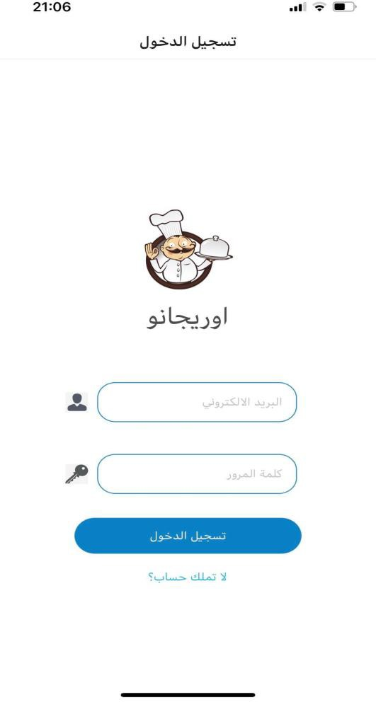
5. Results and Discussion
In this chapter , were going to show and discuss the ﬁnal results of our project. This chapter will discuss a feature or more provided by Oregano app application.
5.1 Log in / Sign up page
This page is one of the ﬁrst pages designed in our application. This page was designed using React native components . We choose logo for Oregano app as show below and we use icon for text input user name and password . Password is encrypted for more security .
Figure 5.1: Oregano app Log in page .

Slide 12
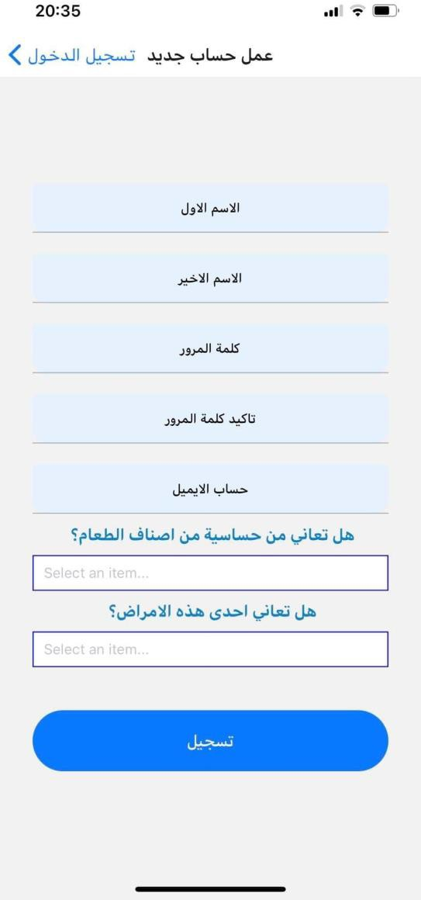
Next we have the sign up functionality , which we implemented as a modal with picker component to collect data about user. The data contain personal information about person's health .
Figure 5.2: Oregano app sign up page .
When you create an account and log in, you will enter the application and move between tab home , setting , add your recipe also we can search for any food recipe you want.

Slide 13
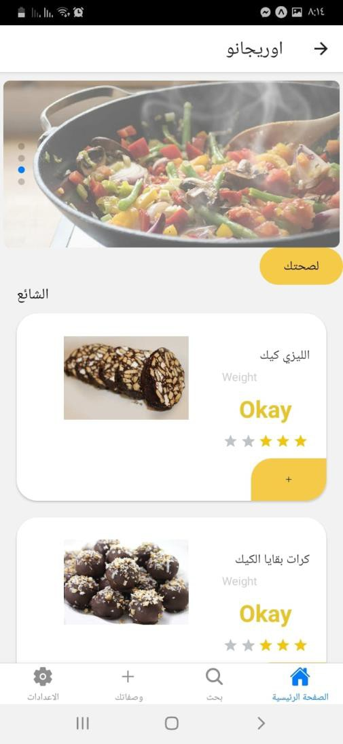
5.2 Home page
The application is implemented to provide tab screen navigation to allow users move easily between screens .Home screen contain Swiper React Native component also contain button for healthy nutritional advice and some cooking recipes. Cooking recipes contain ranking which is a library in react native allow user to rate the recipe .
Figure 5.3: Home page .

Slide 14
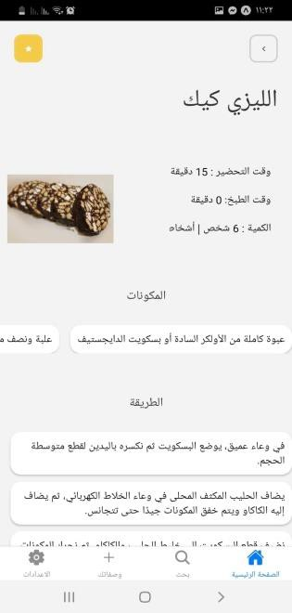
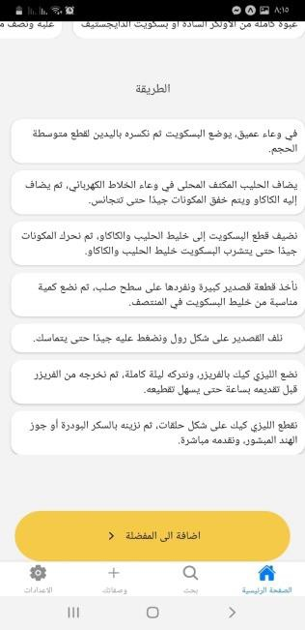

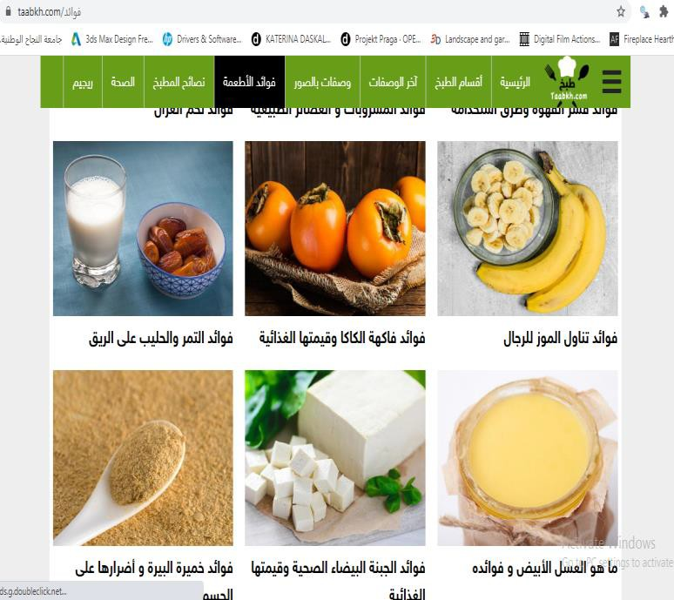
5.2.1 Cooking recipes in home page
Figure 5.4: Cooking recipes in home page .
5.2.2 Healthy nutritional advice
This is one of the most important pages in our application , because we use data collected in webscraping scrapy spider from taabkh [2] website .we store all data return by scraping in our database by writing python code to open all html pages in taabkh website and return the <div> ,< li> , <ul> ,<p> and all tags we need to store data.

Slide 15
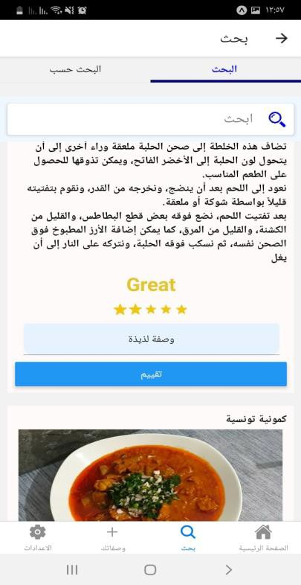
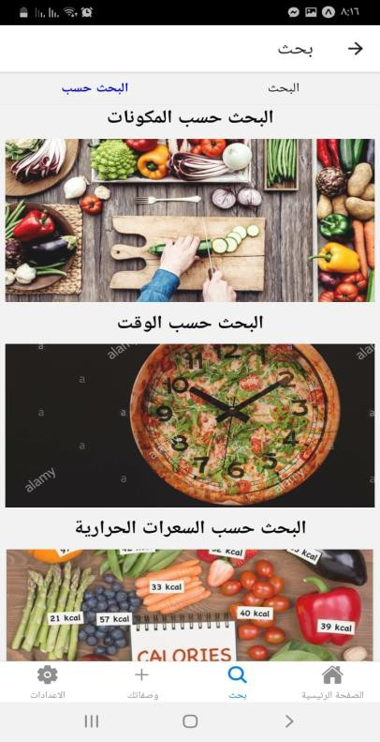
Figure 5.5: Healthy nutritional advice .
5.3 Search pages
The search page has tab screens on top which help users to search depends on names of food recipes, food substances, and calories. All data is also collected by scrapy spider .
Search function implemented by using searchbar react native component and in server side we use sql statement to select the food recipe “like” what we want .
We also added the ability to comment and rate the recipe and store comments on database also it stored in admin panel to see the feedback for users.
Figure 5.6: search pages .

Slide 16
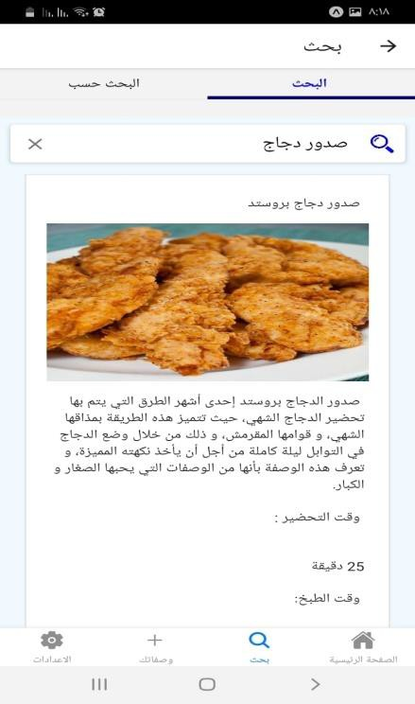
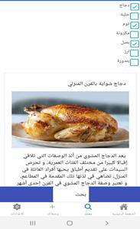
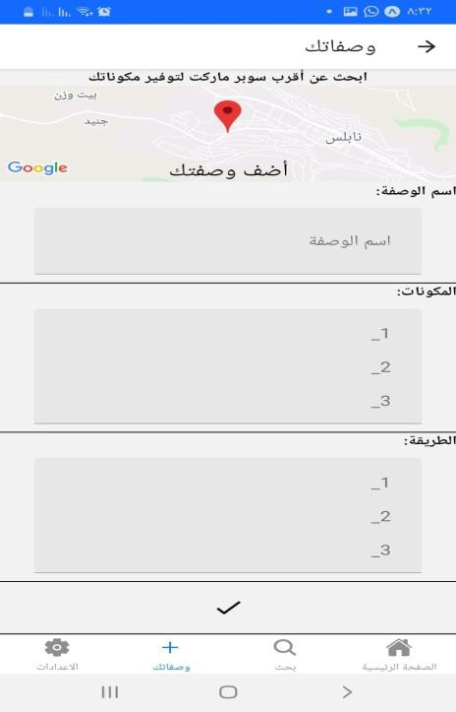
5.4 Add food recipes
Here the user can add food recipes then it added to database for users .
Figure 5.7: Add recipes .
5.5 Setting tab
Setting tab contain user update profile which allow user to update his/her data like name and password also the user can see the recipe that added by him. And there is another simple things in setting like favorite cooking recipe and another .

Slide 17
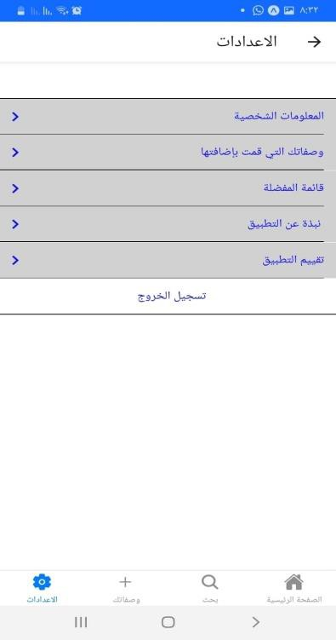
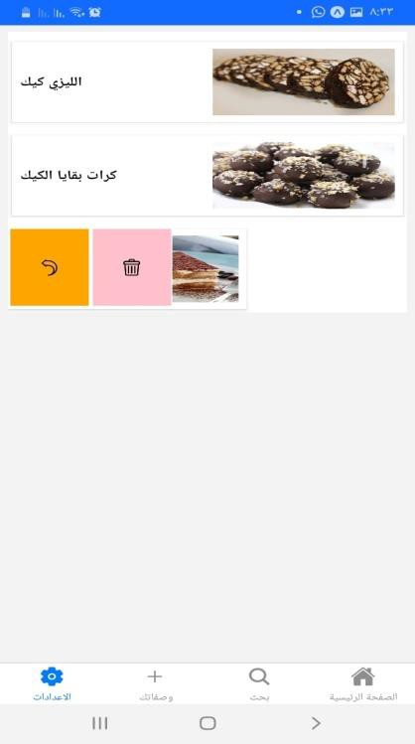
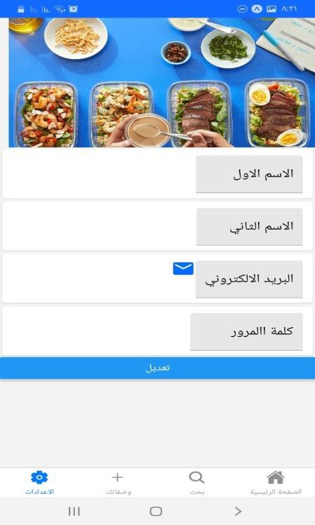
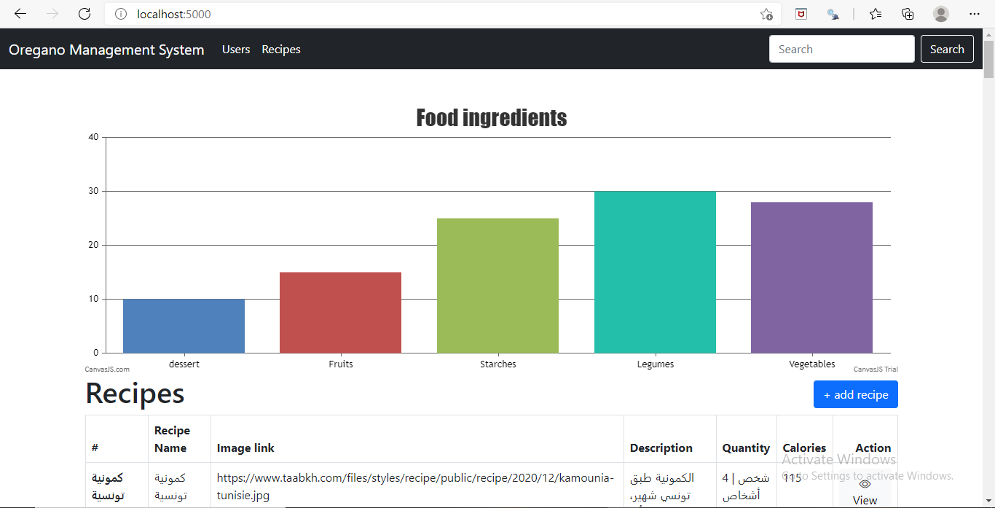
Figure 5.8: Setting tab .
5.6 Admin panel
We decide to implement admin page as small website because it was easier to see users behavior and update users data, update food recipes that added by users ,and that collected by webscraping. We use react js for frontend, Express Handlebars and node js for server side and mysql for database.
What is Handlebars?
Handlebars is one of the most used templating engines for web applications “competing” with other well-known ones like Mustache js, Pug, EJS and others. It’s especially used on the server side along with the express js framework [3].

Slide 18
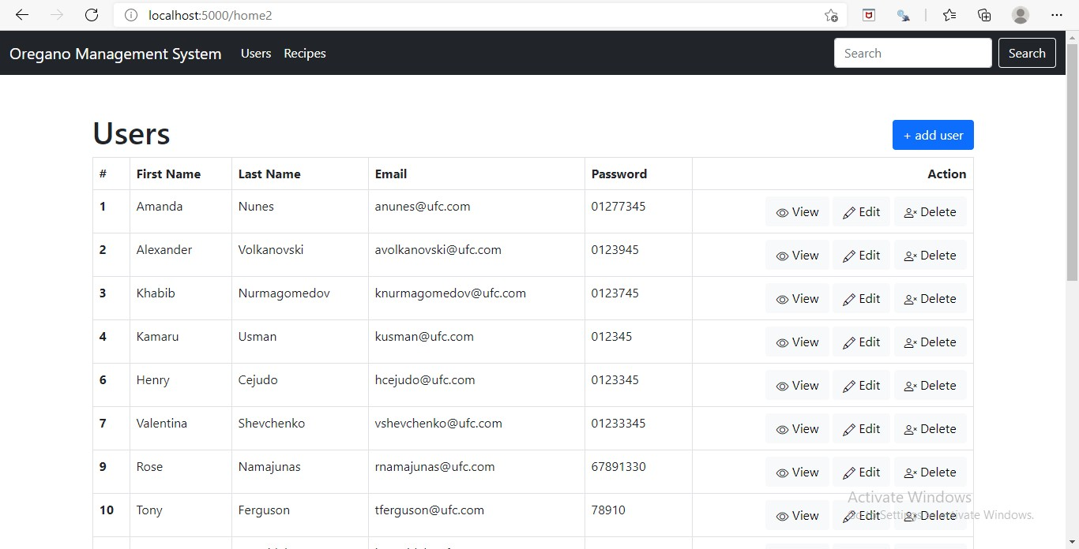
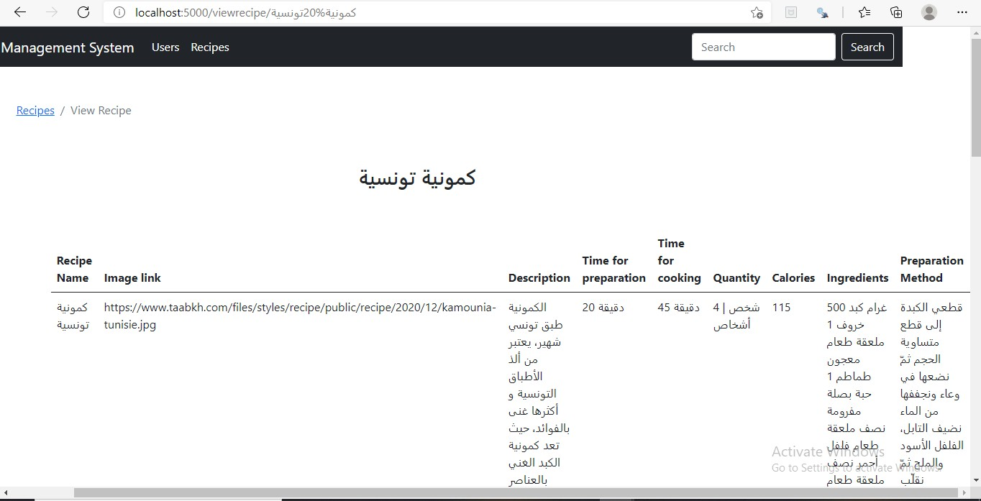

Slide 19
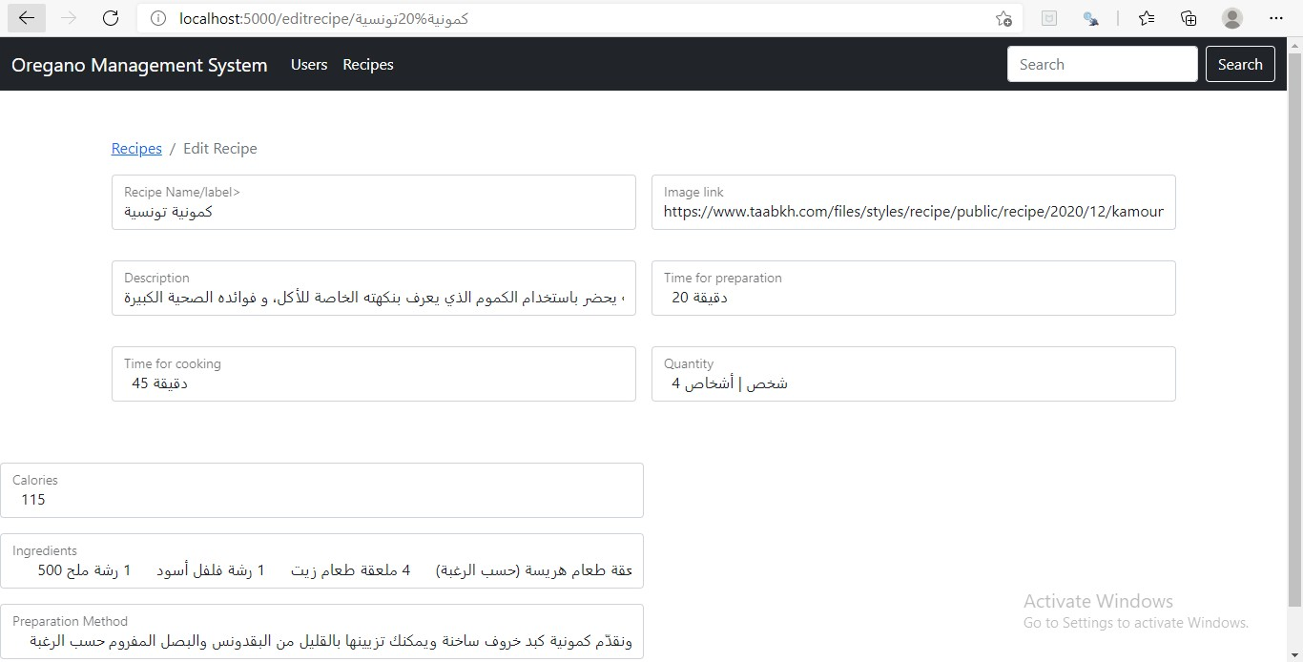
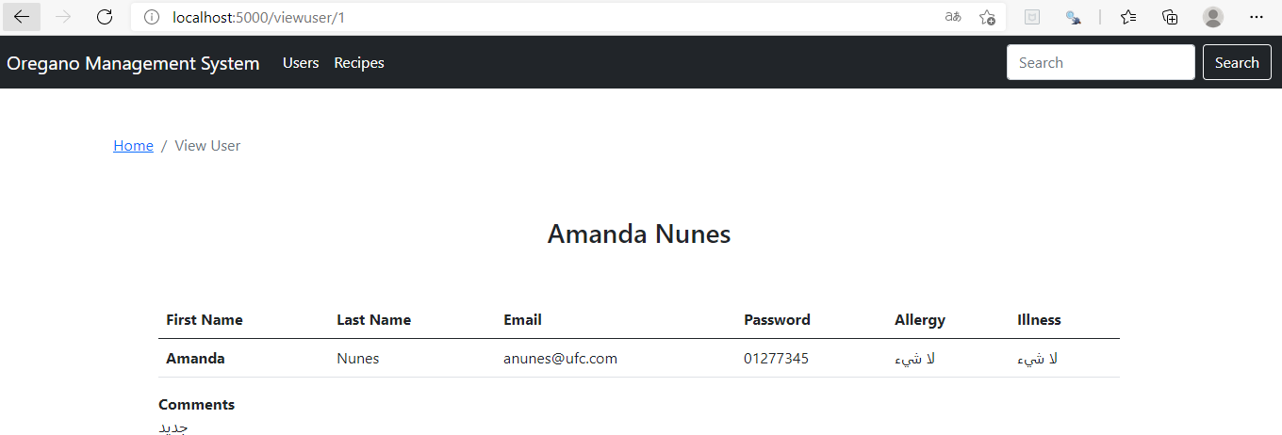
Figure 5.9: Admin pages .
5.7 Database and scrapy
Scrapy is a python framework for large scale web scraping. It gives you all the tools you need to efficiently extract data from websites, process them as you want, and store them in your preferred structure and format [5].We store data in mysql database as below . The technique of collecting data in scrapy is :

Slide 20
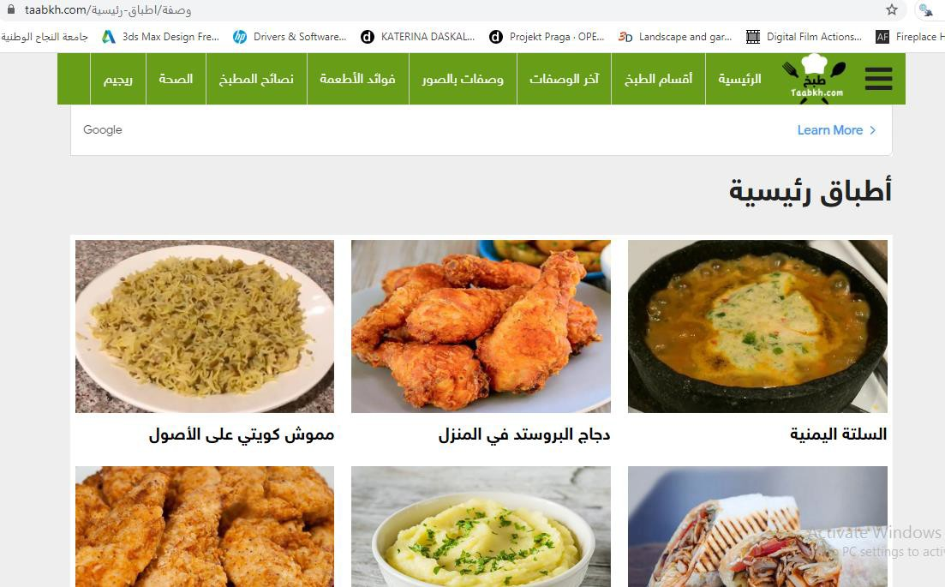
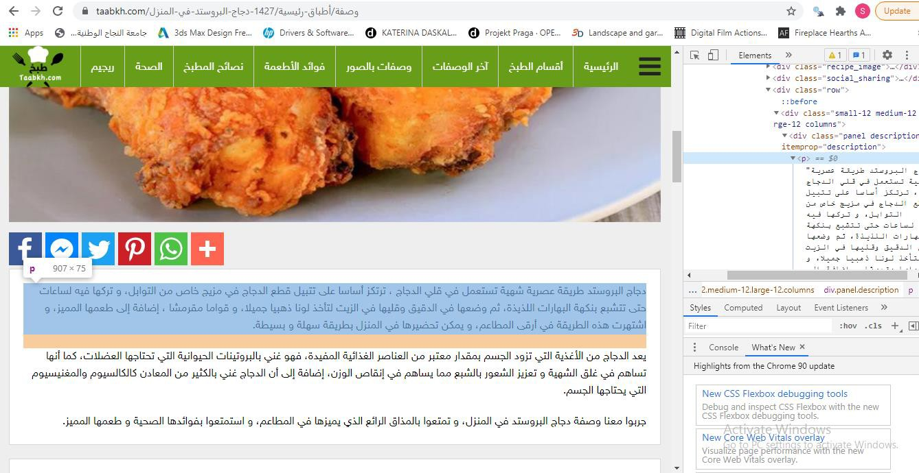
) Firstly detect the ( allowed_domains ) for the website you want to scrap data from it , in our application was www.taabkh.com .
) give the scrapy spider (start_urls) , we gave it the html page which contains all urls for all cooking recipe as shown in figure below :
) the code will go to all links .
) return tags that we want by using XPATH as shown in figure below:
5 ) yield items that you returned and crawl it by scrapy library .

Slide 21
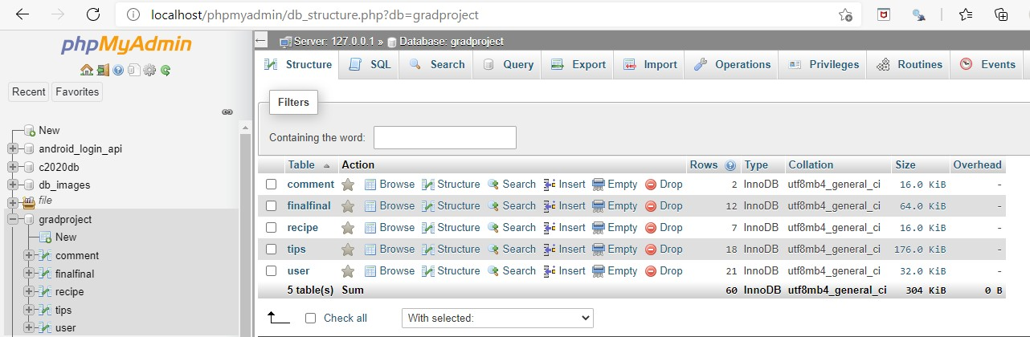
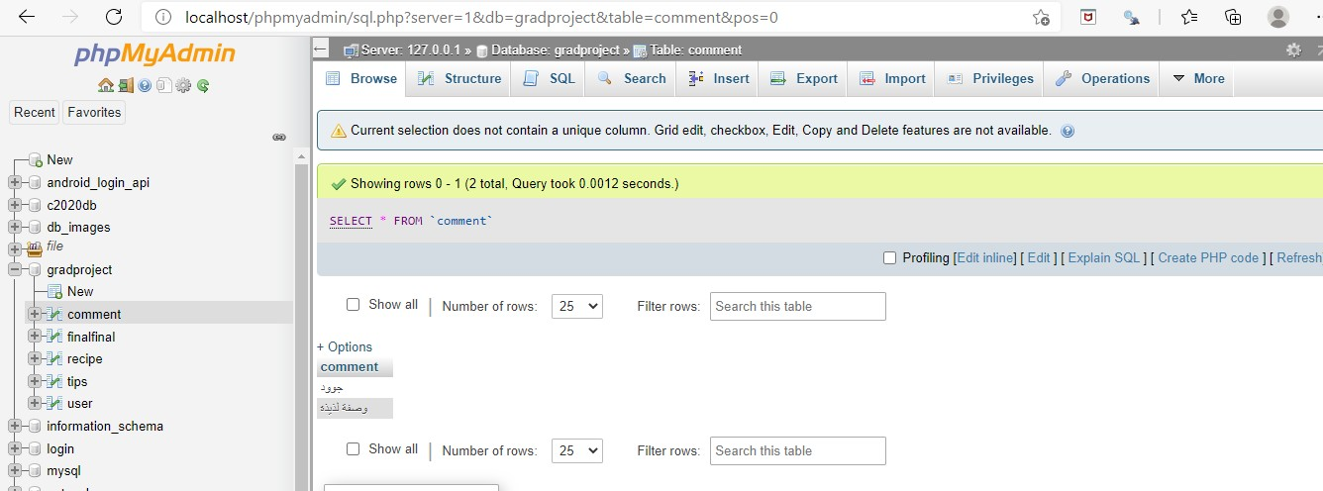
Database:

Slide 22
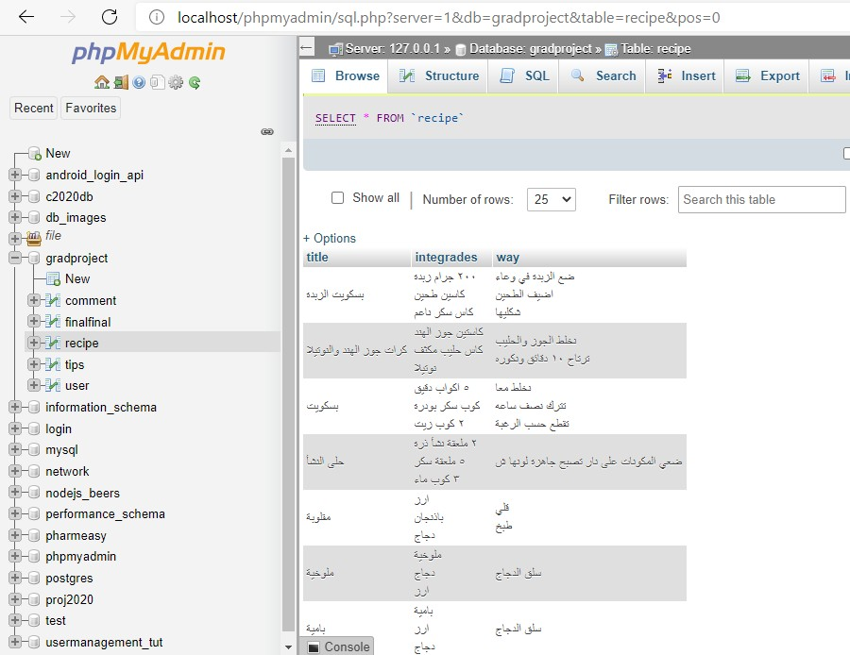
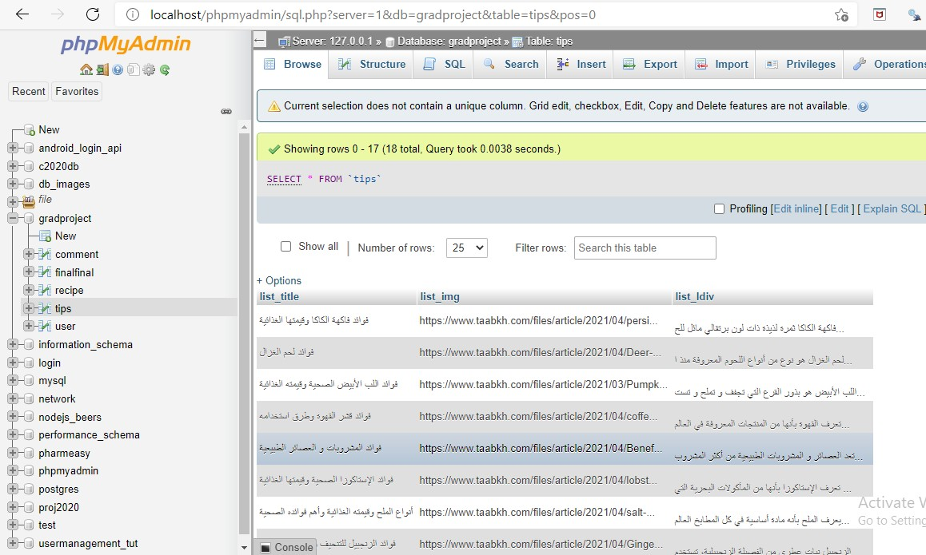

Slide 23
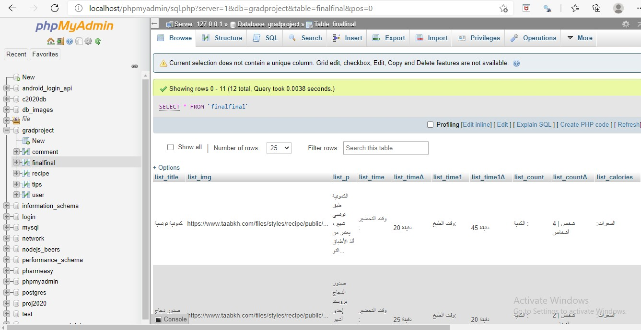
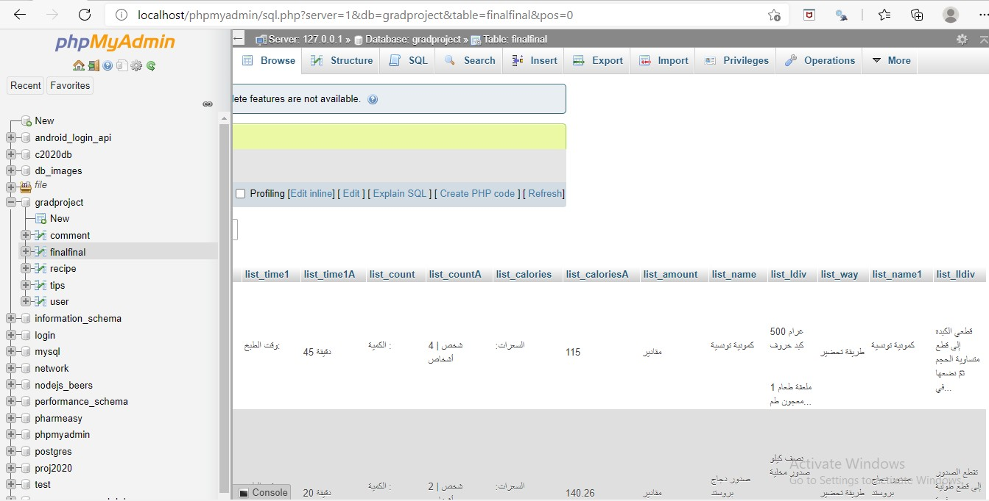

Slide 24
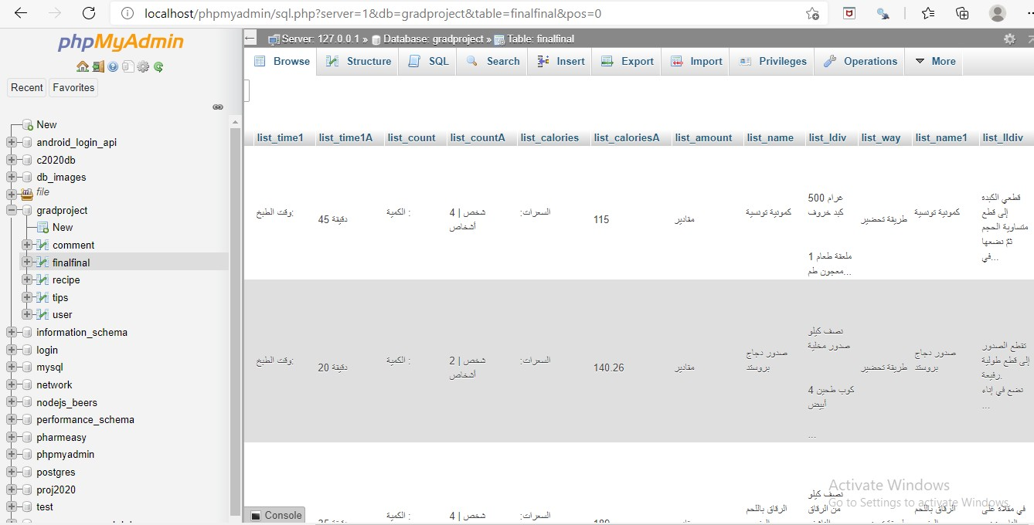
Figure 5.10: Database .

Slide 25
Conclusion and recommendations
  Conclusion
Since we finished developing our application we gained a lot of useful knowledge and skills such as, dealing with several React Native packages to complete our work, implanting back-end by Node.js, learning how to use a scraping in python .
6.2 Recommendations
It is recommended to use React Native for building a cross platform mobile application, because it is easy to learn and has a lot of packages that help in implementing the app.
6.3 Future work
For the short-term future we aim to continue our work by adding more feature and enhancing or ﬁxing any bugs found in our implementation . On the other hand , for the long-term future we aim to scrap more data from more than one website to collect it in our database To make the app serves all user’s needs in cooking.

Slide 26
References
https://en.wikipedia.org/wiki/Model%E2%80%93view%E2%80%93controller
https://www.taabkh.com/
https://waelyasmina.medium.com/a-guide-into-using-handlebars-with-your-express-js- application-22b944443b65
overview of scrapy / https://www.analyticsvidhya.com/blog/2017/07/web-scraping-in- python-using-scrapy/

