Slide 1
“Measuring Palestinian Youth’s awareness level of renewable energy”.
Prepared by :Angham Najjar
Supervisor :Prof. Tamer khatib
Dr. Alia Assali
This research was financially supported by AN-Najah National University, Grant number ANNU-1718-So004.

Slide 2
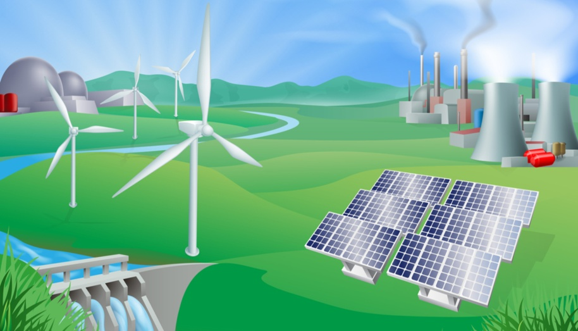
Introduction:
For an occupied state it’s seems impossible to get licenses and allowance to generate electricity from conventional resources. So, the most suitable solution for us is to try using the renewable energy resources with all our strength, since getting the fund in this field is easy. Also, Renewable energy projects strengthen the resilience of residents of remote areas near settlements, these projects have the ability to rehabilitate remote areas, and help in developing and improving many sides in the country.

Slide 3
Research Questions
Are students of An-Najah National University aware of RE potential and its utilization in Palestine?
Are students of An-Najah National University aware of RE laws and acts in Palestine?
Do the students of An-Najah National University have positive attitude toward RE investment and jobs in Palestine?

Slide 4
Pilot Test
Pilot test 1
Pilot test 2
Pilot test 3
cronbach's alpha 0.611
Pilot test 4
Cronbach’s alpha 0.516
Cronbach’s alpha 0.578
cronbach's alpha 0.729
Notes:
a questionnaire was created to determine the relationship between demographic variables and level of knowledge of university students regarding to renewable energy (RE).
According to the analysis cronbach's alpha is 0.729 which shows an acceptable reliability level of the questionnaire.

Slide 5

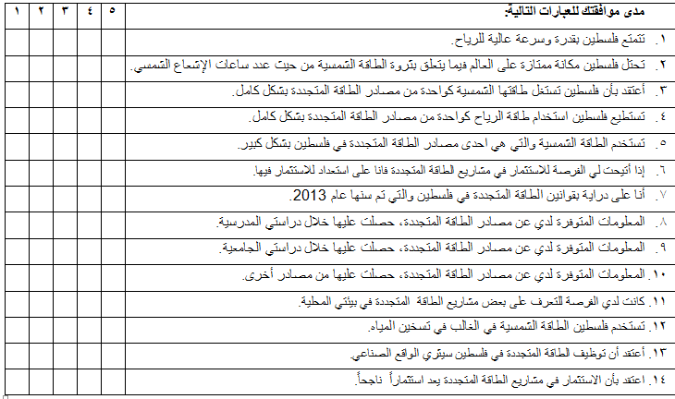
Final form
of
questionnaire
Cronbach’s alpha = 0.729

Slide 6
statistical analysis plan
t-test
Post hoc comparisons
ANOVA test
Tukey HSD test
Chi-square test

Slide 7
Results and discussion:
Figure 1: The distribution of university students according to gender
Figure 2 : Sample distribution according to main faculty
Figure 4 : The distribution of university students according to place of residents
Figure 3: The distribution of gender according to the faculty

Slide 8
Figure 6: student’s responses to RE potential questions
Figure 8: student’s responses to ability to use RE questions
Figure 9: student’s responses to investment in RE questions
Figure 7: student’s responses to solar utilization questions

Slide 9
Figure 10student’s responses to perceived benefits of use RE questions
Figure 12student’s responses to uses of solar energy questions
Figure 11 student’s responses to source of information questions
Figure 13student’s responses to RE Law questions

Slide 10
Table : t-test results according to sexuality.
Item | Gender | N | Mean | Std. Deviation | Df | T | Sig.
Solar utilization(3) | Male | 229 | 2.42 | 1.287 | 568 | -1.045- | .014
 | Female | 341 | 2.53 | 1.139 | 447.663 | -1.020-
Source of information(8) | Male | 229 | 3.41 | 1.25 | 568 | -1.076- | .000
 | Female | 341 | 3.64 | 1.08 | 437.29 | -1.072-
Source of information(9) | Male | 229 | 2.71 | 1.34 | 568 | -1.907- | .014
 | Female | 341 | 2.50 | 1.219 | 454.865 | -1.87-
See RE project(11) | Male | 229 | 2.98 | 1.29 | 568 | -1.87- | .009
 | Female | 341 | 2.79 | 1.13 | 444.1 | -1.82-
Solar uses(12) | Male | 229 | 3.76 | 1.254 | 568 | -.681- | .000
 | Female | 341 | 3.82 | 1.035 | 424.7 | -.656-

Slide 11
Table : ANOVA for students' corresponding to questions about energy in Palestine (p-values).
Table : Students’ RE knowledge: Results of chi-square test for gender, faculty, Education of mother, Education of father and place of residence variables.
Sig.
Item | Gender | University level | Faculty | Edu. of mother | Edu. of father
Q1 | .253 | .352 | .045 | .383 | .097
Q2 | .326 | .127 | .125 | .237 | .255
Q3 | .014 | .589 | .001 | .204 | .529
Q4 | .718 | .406 | .839 | .767 | .475
Q5 | .412 | .606 | .028 | .510 | .692
Q6 | .166 | .336 | .290 | .413 | .144
Q7 | .194 | .791 | .002 | .762 | .955
Q8 | .000 | .002 | .063 | .687 | .327
Q9 | .014 | .066 | .000 | .519 | .231
Q10 | .069 | .481 | .535 | .625 | .846
Q11 | .009 | .837 | .007 | .742 | .966
Q12 | .000 | .043 | .045 | .997 | .530
Q13 | .244 | .553 | .002 | .566 | .496
Q14 | .283 | .320 | .004 | .094 | .375
Overall | 0.193 | 0.3935 | 0.1418 | 0.536 | 0.49414
Place of residence | Edu. of father | Edu. of mother | Faculty | Gender | Item
N.S | N.S | N.S | N.S | N.S | Potential wind 1 Solar 2
N.S | N.S | N.S | .007 | N.S
N.S | N.S | N.S | .000 | .003 | Utilization 3 5
N.S | N.S | N.S | .033 | N.S
N.S | N.S | N.S | N.S | N.S | Ability to use RE 4
.011 | N.S | N.S | N.S | N.S | Investment 6 14
N.S | N.S | N.S | .000 | N.S
N.S | N.S | N.S | .008 | .008 | Laws 7
N.S | N.S | N.S | .002 | .003 | See RE projects 11
N.S | N.S | N.S | N.S | .001 | Solar energy uses 12
N.S | N.S | .048 | .047 | N.S | Benefits 13
N.S | N.S | N.S | N.S | .008 | Information source 8 9 10
N.S | N.S | N.S | .000 | .013
N.S | N.S | N.S | N.S | N.S

Slide 12
Table : The results of ANOVA according to the type of graduated high school of university students.
Table : The relation between place of residence and the level of income.
Item |  |  | Sum of Squares | df | Mean Square | F | Sig.
Solar Potential (2) | Between Groups |  | 20.663 | 4 | 5.166 | 4.056 | .003
 | Within Groups |  | 719.625 | 565 | 1.274
 | Total |  | 740.288 | 569
RE Law (7) | Between Groups |  | 19.053 | 4 | 4.763 | 3.573 | .007
 | Within Groups |  | 753.272 | 565 | 1.333
 | Total |  | 772.325 | 569
asymp. sig.(2-sided) | Value
.000 | 47.437ª | Pearson Chi-Square
.000 | 0.204 | Cramer's V
Table : The results of AVOVA according to University level (university year).
Table : The relation between perceived benefits of using RE and willingness to invest.
 |  | Sum of Squares | Df | Mean Square | F | Sig.
Source of information (8) | Between Groups | 26.955 | 6 | 4.492 | 3.426 | .002
 | Within Groups | 738.170 | 563 | 1.311
 | Total | 765.125 | 569
Solar energy uses (12) | Between Groups | 16.475 | 6 | 2.746 | 2.188 | .043
 | Within Groups | 706.509 | 563 | 1.255
 | Total | 722.984 | 569
asymp. siG.(2-sided) | value
.000 | 97.776ª | Pearson Chi-Square
.000 | 0.207 | Cramer's V

Slide 13
Table : Results of post hoc analysis by faculty.
Mean values | P-values | Pair-wise comparison | Item
(2.84)-(3.45) | .043 | Law-sharia | Wind potential 1
(2.93)-(2.11) | .018 | Sport-science | Solar Utilization 3 5
(2.93)-(2.17) | .023 | Sport-Engineering
(2.63)-(3.31) | .042 | Law-EHS
(2.12)-(2.85) | .040 | Medicine-sport | RE Laws 7
(2.12)-(2.82) | .037 | Medicine-EHS
(3.48)-(2.69) | .033 | Sport-science | See RE projects 11
(3.48)-(2.58) | .005 | Sport-medicine
(3.48)-(2.58) | .011 | Sport-Arts
(4.03)-(3.40) | .048 | Engineering-sharia | Solar energy uses 12
(4.27)-(3.59) | .039 | Science-sharia | Benefits 13
(4.27)-(3.46) | .008 | Science-literature
(4.27)-(3.56) | .032 | Science-EHS
(4.36)-(3.60) | .024 | Science-sharia | Investment 14
(4.36)-(3.62) | .034 | Science-EHS
(1.85)-(2.97) | .000 | Medicine-Eng | Information source 9
(1.85)-(2.6) | .038 | Medicine-science
(1.85)-(2.78) | .005 | Medicine-sport
(1.85)-(2.72) | .005 | Medicine-sharia
(1.85)-(2.98) | .000 | Medicine-Literature
(1.85)-(3.02) | .000 | Medicine-EHS
(2.09)-(2.97) | .003 | Law-Eng.
(2.09)-(2.98) | .007 | Law-literature
(2.09)-(3.02) | .003 | Law-EHS | 10

Slide 14
The overall level of knowledge about RE tested and the final result clearly confirms that the overall average score is 3.18 out of 5, that means students have moderate level of knowledge.

Slide 15

Conclusion
This study showed that there is no correlation between university students’ RES awareness levels and their parent’s education levels,
In addition low level of awareness was showed by students in term of wind potential and using solar energy fully in Palestine.
There is a high level of awareness regarding to solar potential, using solar energy mostly to heat water, investments and perceived benefits of RE to the society and uncertainty regarding to the ability to use RES.
Students awareness and knowledge about using solar energy widely in Palestine and knowing about RE laws was limited.

Slide 16
References:
[1] Anas Zyadin a,*, Antero Puhakka b, Pirkkoliisa Ahponen b, Tarja Cronberg c,d, Paavo Pelkonen aSchool students’ knowledge, perceptions, and attitudes toward renewable energy in Jordan Renewable Energy 45 (2012) 78-85 doi:10.1016/j.renene.2012.02.002,
[2] Jamal O. Jabera,, Wael Awada, Taieseer Abu Rahmeha, Aiman A. Alawina, Suleiman Al-Lubania, Sameh Abu Dalua, Ali Dalabiha, Adnan Al-Bashirb, Renewable energy education in faculties of engineering in Jordan: Relationship between demographics and level of knowledge of senior students’, Renewable and Sustainable Energy Reviews 73 (2017) 452–459, 1-s2.0-S0960148112001267,
[3] Yelda Karatepe a, Seçil Varbak Nes¸ e a, Ali Keçebas¸ b, Mehmet Yumurtacı c,* ,The levels of awareness about the renewable energy sources of university students in Turkey, Renewable Energy 44 (2012) 174-179, 1-s2.0-S0960148112001267,
[4] Assoc. Prof. Dr. Dilek Çelikler, Prof. Dr. Ayhan Yılmaz, Zeynep Aksan, Determining the attitudes towards renewable energy sources of twelfth grade students attending different types of high schools, journal of educational and instructional studies in the world, June 2016, Volume: 6 Special Issue 1 Article: 15 ISSN: 2146-7463,
[5] Aiman A. Alawin, Taieseer Abu Rahmeh, Jamal O. Jaber n, Suliman Loubani, Sameh Abu Dalu, Wael Awad, Ali Dalabih, Renewable energy education in engineering schools in Jordan: Existing courses and level of awareness of senior students, Renewable and Sustainable Energy Reviews 65 (2016) 308–318,
[6] Erdal Irmak, Melike Selcen Ayaz, Suudan Gokce Gok, Almula Busra Sahin Gazi University Renewable Energy Research Group(GURER), erdal@gazi.edu.tr, melikeayaz@gazi.edu.tr, gokcegok@gazi.edu.tr, almula.sahin@ug.bilkent.edu.tr, A Survey on Public Awareness Towards Renewable Energy in Turkey, 3rd International Conference on Renewable Energy Research and Applications, Milwakuee, USA 19-22 Oct 2014,
[7] Spyridon Karytsas*, Helen Theodoropoulou, Socioeconomic and demographic factors that influence publics' awareness on the different forms of renewable energy sources, Renewable Energy 71 (2014) 480-485,
[8] Dilek Çelikler n, Zeynep Aksan, The development of an attitude scale to assess the attitudes of high school students towards renewable energy sources, Renewable and Sustainable Energy Reviews 54 (2016) 1092–1098,
[9] Dilek Çelikler*, Zeynep Aksan, The opinions of secondary school students in Turkey regarding renewable energy, Renewable Energy 75 (2015) 649-653,
[10] Anas Zyadin a,*, Antero Puhakka b, Pirkkoliisa Ahponen b, Paavo Pelkonen a, Secondary school teachers’ knowledge, perceptions, and attitudes toward renewable energy in Jordan, Renewable Energy 62 (2014) 341-348,
[11] Erkan Kacan, Renewable energy awareness in vocational and technical education, Renewable Energy 76 (2015) 126-134,
[12] Dilek Çelikler*, Awareness about renewable energy of pre-service science teachers in Turkey, Renewable Energy 60 (2013) 343-348,
[13] Masoud Yazdanpanah a,b,∗, Nadejda Komendantova b,c, Zahra Namjouyan Shirazi d,
Joanne Linnerooth-Bayer b, Green or in between? Examining youth perceptions of renewable energy in Iran, Energy Research & Social Science 8 (2015) 78–85,
[14] Iwona Ocetkiewicza, Barbara Tomaszewskab, Anna Mróza Renewable energy in education for sustainable development. The Polish experience, Renewable and Sustainable Energy Reviews 80 (2017) 92–97,
[15] O. Nwokocha Cecily, K. Okoro Ugochukwu, I. Usoh Chizomam, Photovoltaics in Nigeria – awareness, attitude and expected benefit based on a qualitative survey across regions, Renewable Energy (2017), doi: 10.1016/j.renene.2017.09.070,

Slide 17
[16] Afnan Mahmood Freije *, Tahani Hussain, Eman Ali Salman, Global warming awareness among the University of Bahrain science students, Journal of the Association of Arab Universities for Basic and Applied Sciences (2016),
[17] Arba’at Hassana, Mohd. Zaid Ismailb*, The infusion of Environmental Education (EE) in chemistry teaching and students’ awareness and attitudes towards environment in Malaysia, Procedia Social and Behavioral Sciences 15 (2011) 3404–3409,
[18] Mehmet Akif Haşıloğlua*, Pınar Ural Keleşb, Süleyman Aydınc, Examining environmental awareness of students from 6th, 7th and 8th classes with respect to several variables: “sample of Agri city”, Procedia - Social and Behavioral Sciences 28 (2011) 1053 – 1060,
[19] Abdurrahman Karabulut a, Engin Gedik b, Ali Keçebas¸ a,*, Mehmet Ali Alkan c, An investigation on renewable energy education at the university level in Turkey, Renewable Energy 36 (2011) 1293e1297.
[20] Roozbeh Kardooni a, n, Sumiani Binti Yusoff b, Fatimah Binti Kari c, Renewable energy technology acceptance in Peninsular Malaysia, Energy Policy 88 (2016) 1–10.
[21] Esra Çakirlar Altuntaş, Salih Levent Turan, Awareness of Secondary School Students About Renewable Energy Sources, Renewable Energy (2017), doi: 10.1016/j. renene.2017.09.034
[22] Rohollah Rezaei, Marjan Ghofranfarid, Rural households’ renewable energy usage intention in Iran: Extending the unified theory of acceptance and use of technology, Renewable Energy (2018), doi: 10.1016/j.renene.2018.02.011,
[23] Ali Hosseini, Mohammad Mahdi Zolfagharzadeh, Ali Asghar Sadabadi, Alireza Aslani & Hoda Jafari (2018) Social Acceptance of Renewable Energy in Developing Countries: Challenges and Opportunities, Distributed Generation & Alternative Energy Journal, 33:1, 31-48, DOI: 10.1080/21563306.2018.11969264
[24] V. P. Khambalkar , S. S. Katkhede , S. Dahatonde , N. D. Korpe & S. M. Nage (2010) Renewable energy: An assessment of public awareness, International Journal of Ambient Energy, 31:3, 133-142, DOI: 10.1080/01430750.2010.9675112.
[25] Eralp Ozil , V. Ismet Ugursal , Ugur Akbulut & Alper Ozpinar (2008) Renewable Energy and Environmental Awareness and Opinions: A Survey of University Students in Canada, Romania, and Turkey, International Journal of Green Energy, 5:3, 174-188, DOI: 10.1080/15435070802107025.
[26] Roozbeh Kardooni, Sumiani Binti Yusoff, Fatimah Binti Kari, Leila Moeenizadeh, Public opinion on renewable energy technologies and climate change in Peninsular Malaysia, Renewable Energy (2017), doi: 10.1016/j.renene.2017.09.073,
[27] Kaijian Li, Guiwen Liu, Asheem Shrestha, Igor Martek, Xiaoling Zhang, The role of local private participation in China's transition to domestically developed renewable energy technologies, Journal of Cleaner Production (2017), doi: 10.1016/j.jclepro.2017.04.125
[28] Raja Akermia*, Sana Tebessi Hachanaa, Abdelfattah Trikib, Conceptualizing civil society attitudes towards the promotion of renewable energy: A case study from Tunisia, 4th International Conference on Power and Energy Systems Engineering, CPESE 2017, 25-29 September 2017, Berlin, Germany. Energy Procedia 141 (2017) 131–137.
[29] Gokhan Guven, Yusuf Sulun, Pre-service teachers' knowledge and awareness about renewable energy, Renewable and Sustainable Energy Reviews 80 (2017) 663–668,
[30] Kiriaki M. Keramitsoglou n, Exploring adolescents’ knowledge, perceptions and attitudes towards Renewable Energy Sources: A colour choice approach, Renewable and Sustainable Energy Reviews 59 (2016) 1159–1169.
[31] ROBERT V. KREJCIE , DARYLE W. MORGAN, DETERMINING SAMPLE SIZE FOR RESEARCH ACTIVITIES, EDUCATIONAL AND PSYCHOLOGICAL MEASUREMENT 30, (1970), 607-610.
[32] Pallant J. , SPSS SURVIVAL MANUAL, 2007.

