Slide 1


An-Najah National University
Building Engineering Department
Environmentally Friendly Indoor Swimming Pool
At An-Najah University
Prepared By :
Essam Nasif Nesreen subeh Tha’er Daragmeh
Supervised by : Dr. Mutasim Baba

Slide 2
Project Contents:
Types of Swimming Pools.
Construction and Structural Aspects of Pools.
Systems and Accessories of Pools.
Environmental Systems of Indoor Swimming Pools.
Our Project: An Najah Indoor Swimming Pool.

Slide 3
Types Of swimming Pools:
According to Usage:
Private Pools
Public Pools
Competition Pools
According to The Surrounding Environment:
Indoor Pools
Outdoor Pools

Slide 4
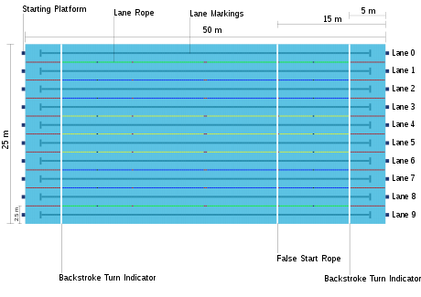
Competition Pools :
Olympic Pools :
FINA Specifications for Olympic size Pools
Length | 50 m
Width | 25 m
Number of lanes | 10
Lane width | 2.5 m
Water temperature | 25–28 °C
Light intensity | minimum 1500 lux
Depth | minimum 2.0 m
Volume | minimum 2,500 (depending on depth)

Slide 5
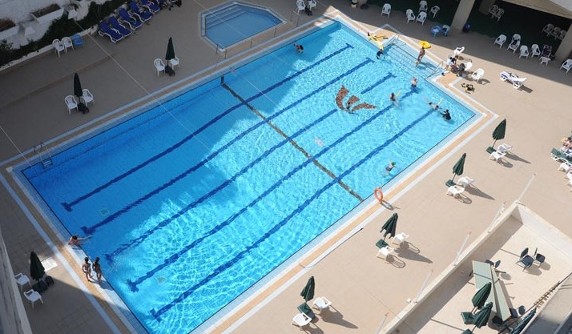
Semi-Olympic Pools :
FINA Specifications for Semi-Olympic size Pools
Length | 25 m
Width | 12.5 m
Number of lanes | 6
Lane width | minimum 2.0 m
Water temperature | 25–28 °C
Light intensity | minimum 1500 lux
Depth | minimum 1.3 m
Volume | minimum 405 m³

Slide 6
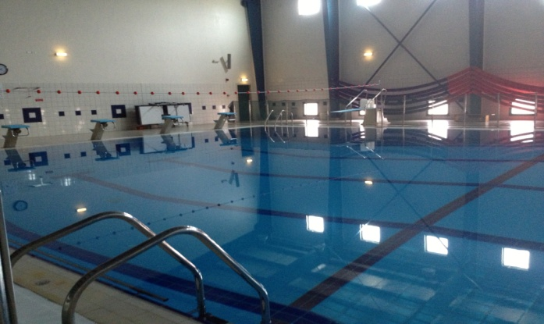
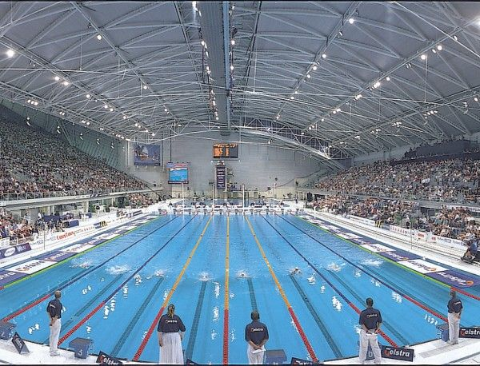
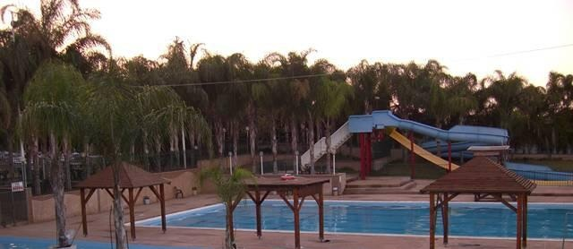
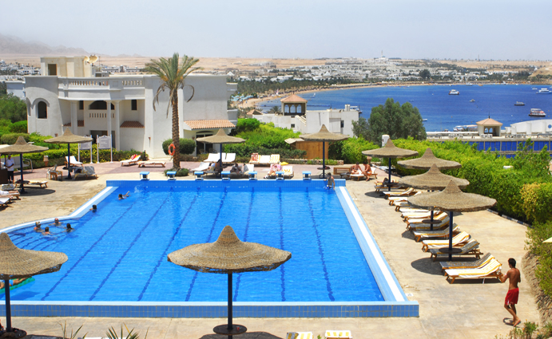
Types of Pools (According To Surrounding Environment ) :
Indoor Pools
Outdoor Pools

Slide 7
Construction And Structural Aspects of Pools
Soil and Earthwork
Soil Problems for Swimming Pools :
Expansive soil
Wet soil
Ground water near the surface
(Temporary or permanent condition)
Rock, sand gravel and solid particles
Loose soil

Slide 8
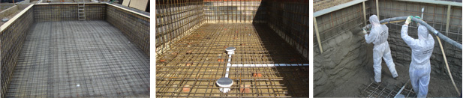
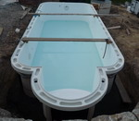
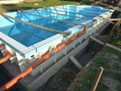
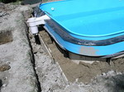
Types of Pools According to Their Construction Systems:
Gunite (Concrete) Pools
Gunite is a dry mixture of cement and sand that is pushed through a "fire hose" via a large compressor.
Finishing Materials: Marble dust, Exposed aggregate finishes, Ceramic tiles.
Fiber Glass Swimming Pools
The pool’s container is made from an extra strong type of glass fibers placed in an excavated hole.

Slide 9
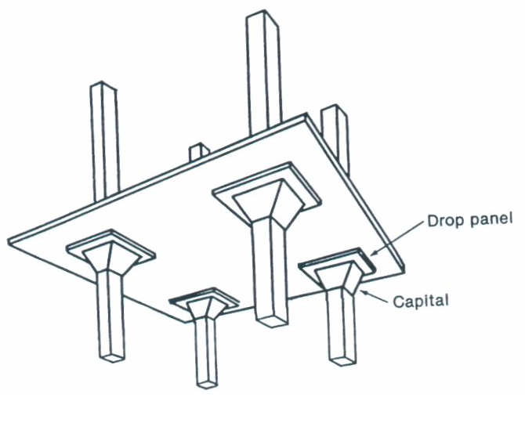
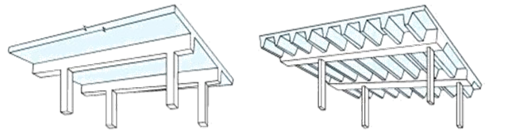
Structural Flooring Systems( For swimming pool’s building ):
Concrete Roofs:
Pros:
Resistant to fire and moisture.
Can be shaped in any way desired.
Extremely durable.
Cheap Maintenance
Cons:
Heavy.
Need columns for long spans.
Types:
Flat Slab.
2. Slab with Beams (One way or two way)

Slide 10
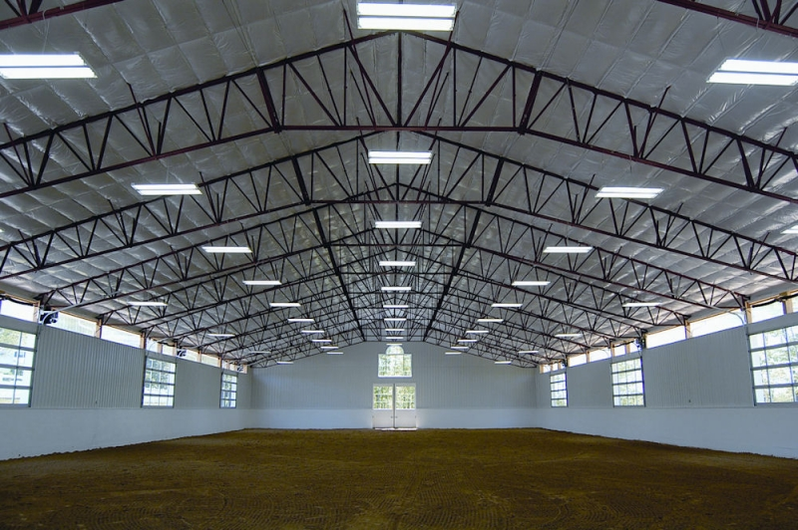
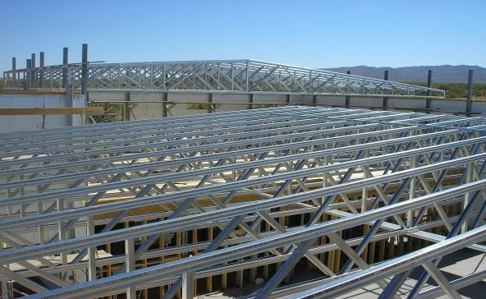
Steel Roofs:
Pros:
Long spans without columns.
Lighter than concrete.
Visually appealing.
Long life span.
Extremely fire-proof.
Requires little maintenance.
Good for fast track projects.
Ductile and resistant to wind loads.
Widely available.
Cons:
Not many workers are familiar with it.
Expensive compared to concrete.
Prone to corrosion if not properly coated.

Slide 11
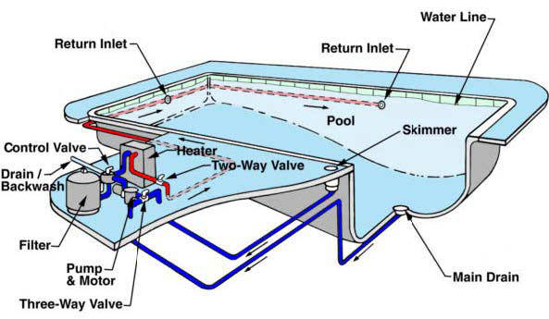
Systems and Accessories Of Pools
The water support system contains a lot of sub systems :
Water supply system
Water filtration and circulation system
Water heating system
Drainage system.

Slide 12
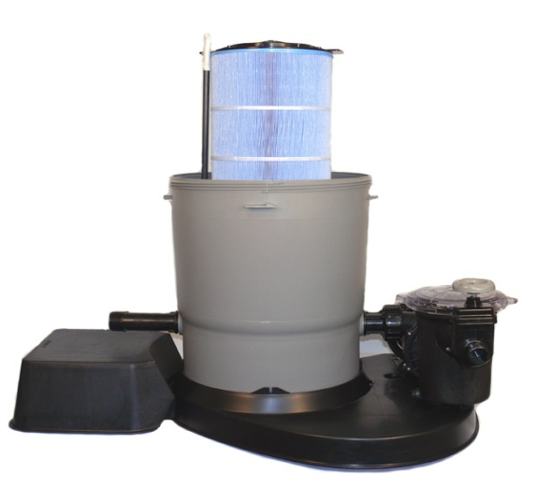
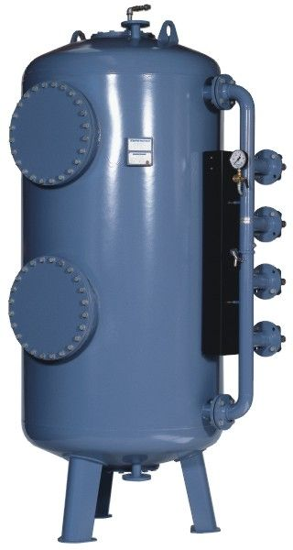
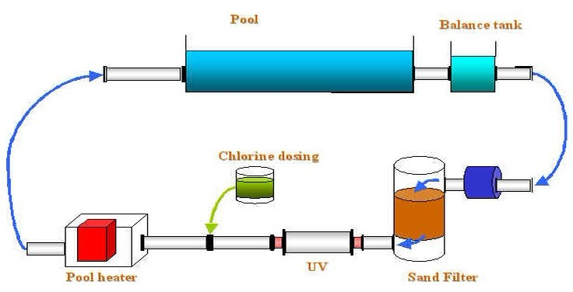
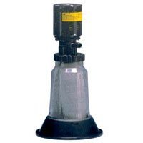
The Filtration System
Composed of four elements:
The filter
The pump and its motor.
The automatic surface skimmers and drains.
The recirculation pipes and fittings.

Slide 13
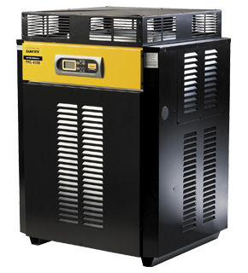
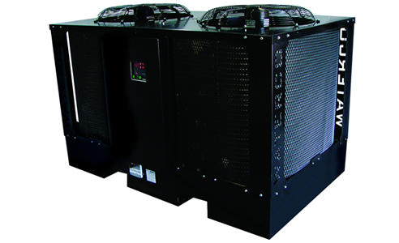
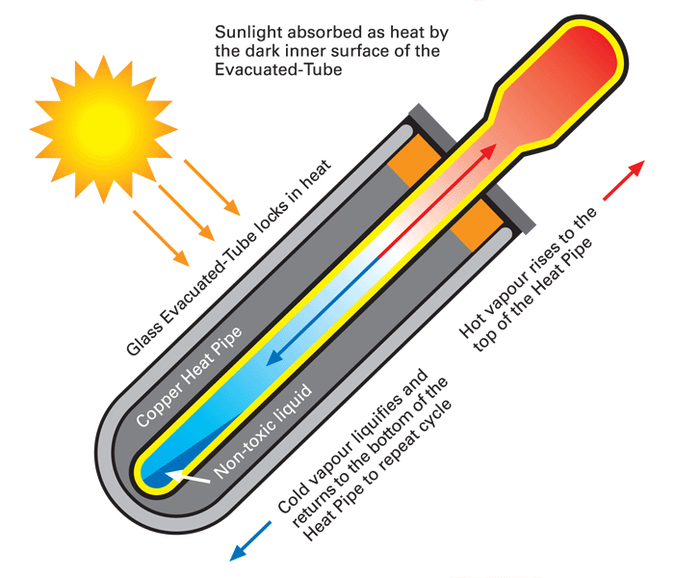
Water Heating Systems:
Gas-fired pool heaters
Electrical pool heaters
Solar pools heaters
(usually evacuated tube collectors )

Slide 14
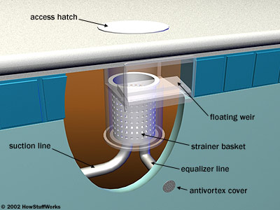
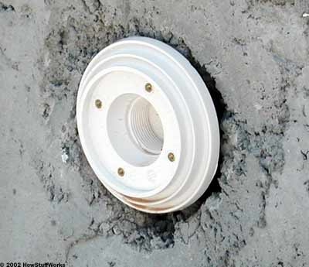
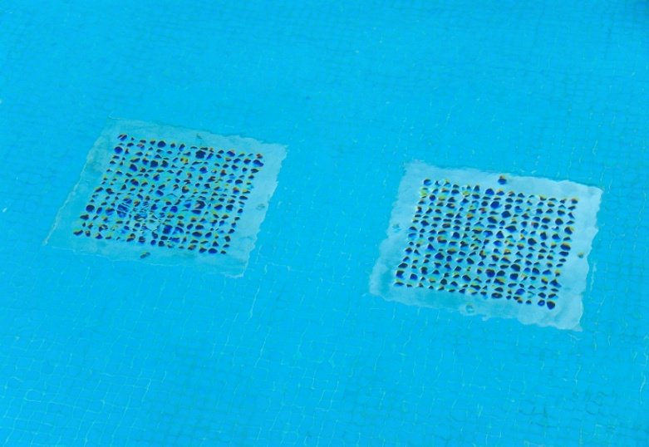
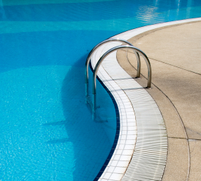
Drainage system
The Skimmers:
The main drains and the overflow drains

Slide 15
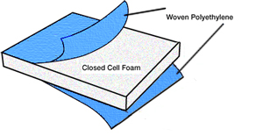
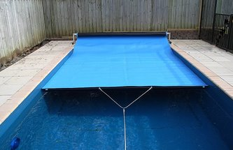
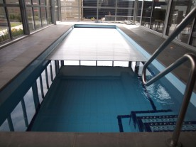
Thermal Pool’s Covers
Construction:
A thick layer of closed cell foam.
The two woven polyethylene layers.
They are strongly recommended for heated pools.

Slide 16
Environmental Systems Of Swimming Pools
Main energy consuming systems for indoor pools (SEDAC):

Slide 17
Main environmental systems
Dehumidification and ventilation system
HVAC system
Indoor lighting system
Underwater lighting system
Acoustical control system

Slide 18
Dehumidification and ventilation system
Since natural ventilation is not the suitable indoor swimming pools, a good dehumidification system to support the air conditioning system of the pool without the enlargement of the heating load of the building is required.
ASHRAE 62 Ventilation Air Standard
For Pool Area: 0.5 cfm / ft2
2.5 liters/s per m2
For Spectator Area: 15 cfm / person
8.0 liters/s per person

Slide 19
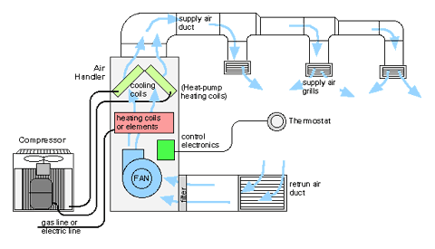
HVAC System of Pools
Proper duct design will :
Minimize air flow requirements.
2. Ensure a comfortable recreation environment.
3. Optimize humidity control

Slide 20
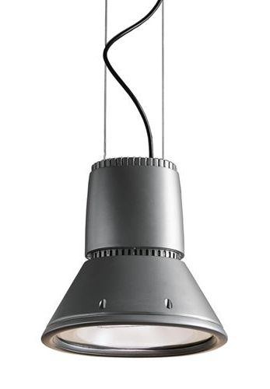
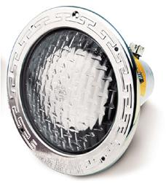
Lighting systems
General indoor lighting system
Underwater Lighting System

Slide 21
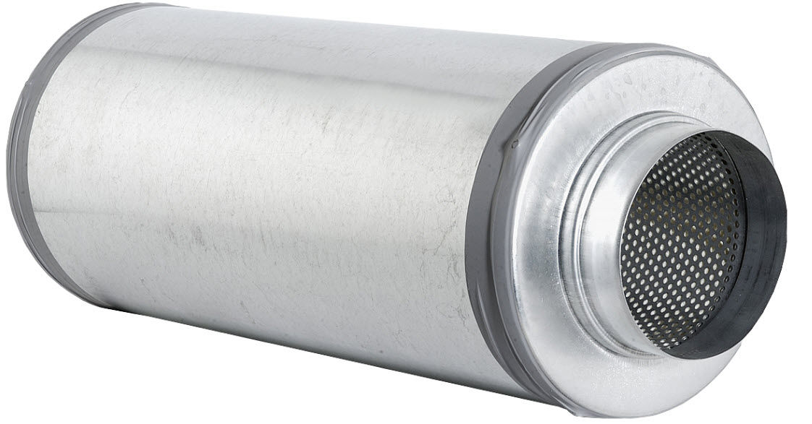
Noise control System
Mechanical-born noise
Related to HVAC system and other mechanical equipments .
Many of reduction techniques are based on the use of :
sound absorbing materials
a prober fixation and selection of the mechanical systems
Standard noise reduction equipment such as ducts silencers

Slide 22
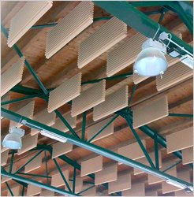
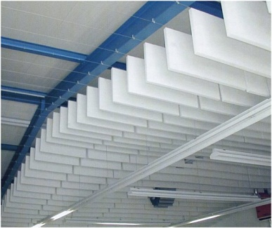
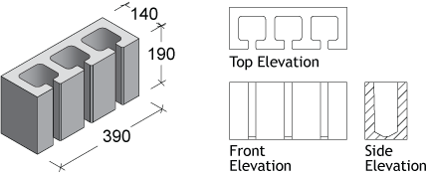
Structural-born Noise
Due to :
High sound reflectance of some materials (water, ceramic tile, glazed finishing materials…)
The lack of the sound absorption materials (fabrics) used in the pool’s hall.
Noise Reduction techniques :
Suspended Acoustical Baffles
Walls’ cavities

Slide 23
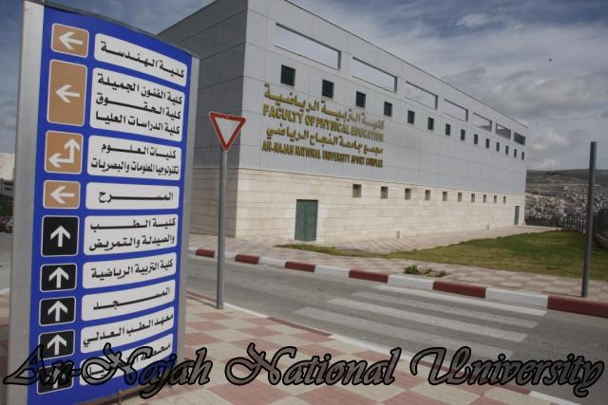
Project’s Case Study: An-Najah University Swimming Pool
General info:
Location: faculty of physical education’s sport complex building-Nablus
Area: 1400 m² (including the pool’s facilities).
Pool’s Dimensions: Semi Olympic (25m x 12.5 m)
Includes a side seating capacity of 340 seats.
Building includes bathrooms,
shower units and a control room.

Slide 24
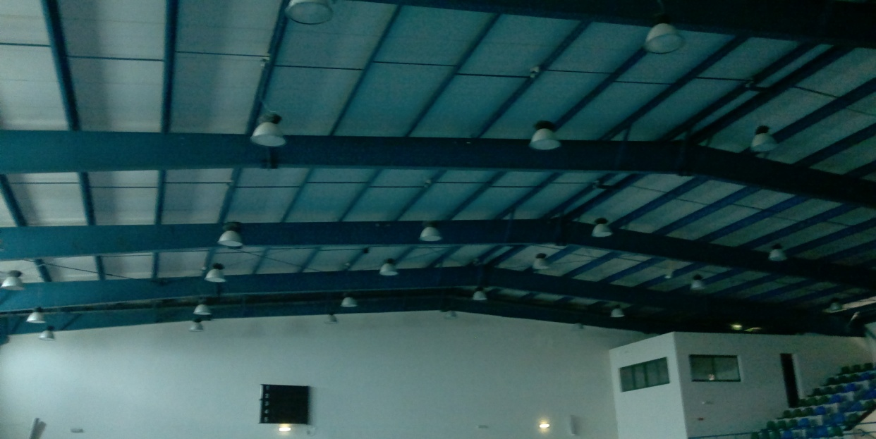
Systems Used in the Building.
Roofing system:
The pool’s roofing system consist of steel beams (I-sections) with covering sheets. Steel columns support the roof.

Slide 25
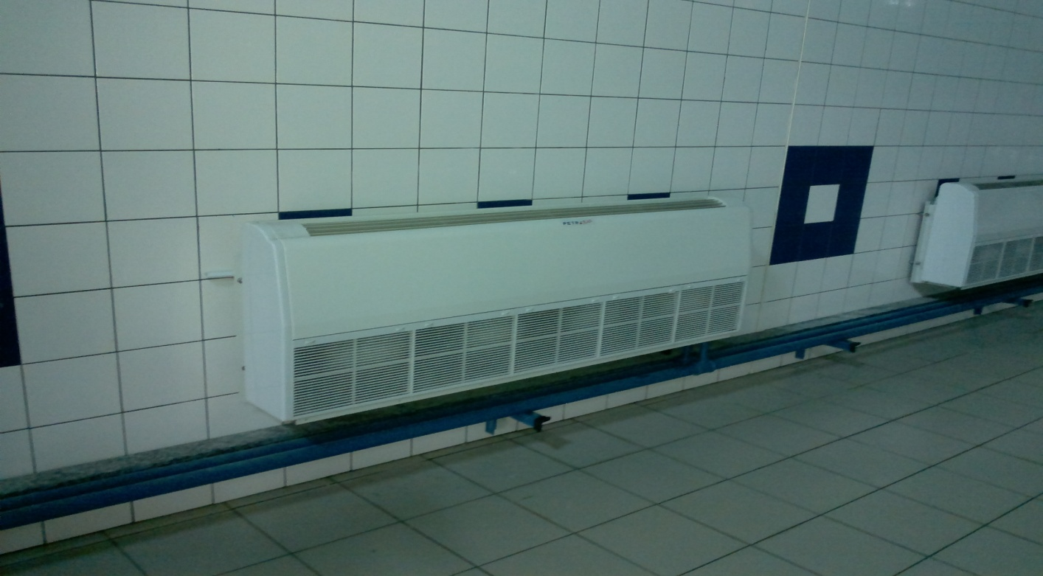
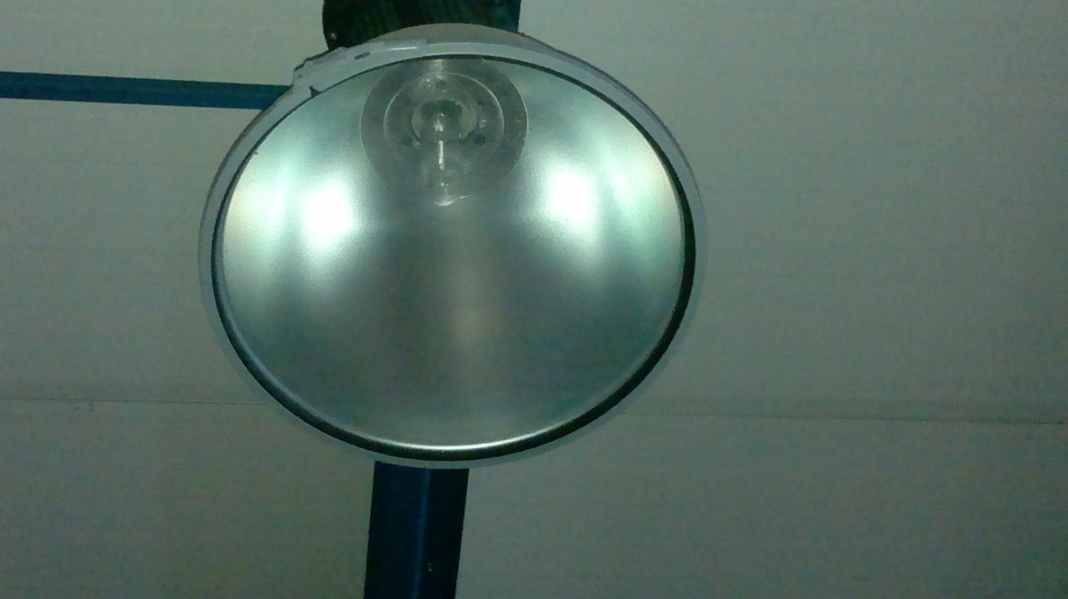
Heating system:
Fan coil units around the pool are used to cover the heating load in the pool’s building.
Lighting system:
Suspended Luminairs (metal halide) lamps

Slide 26
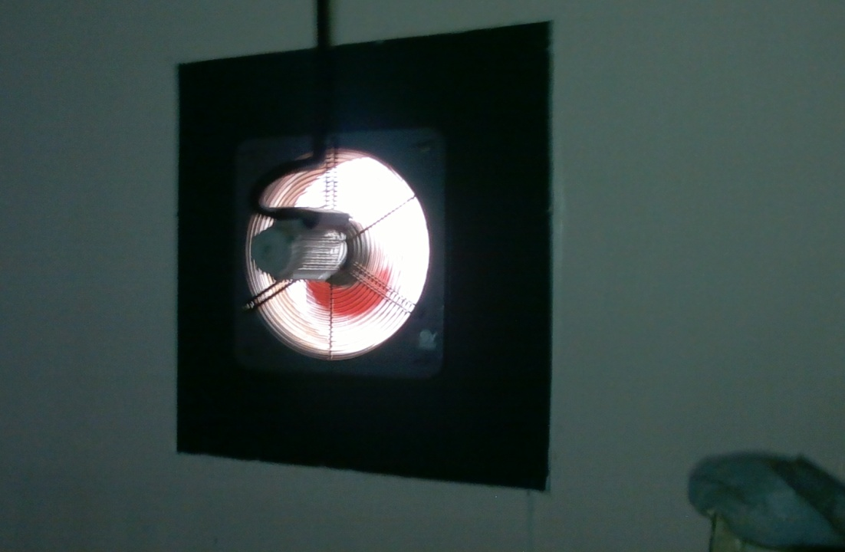
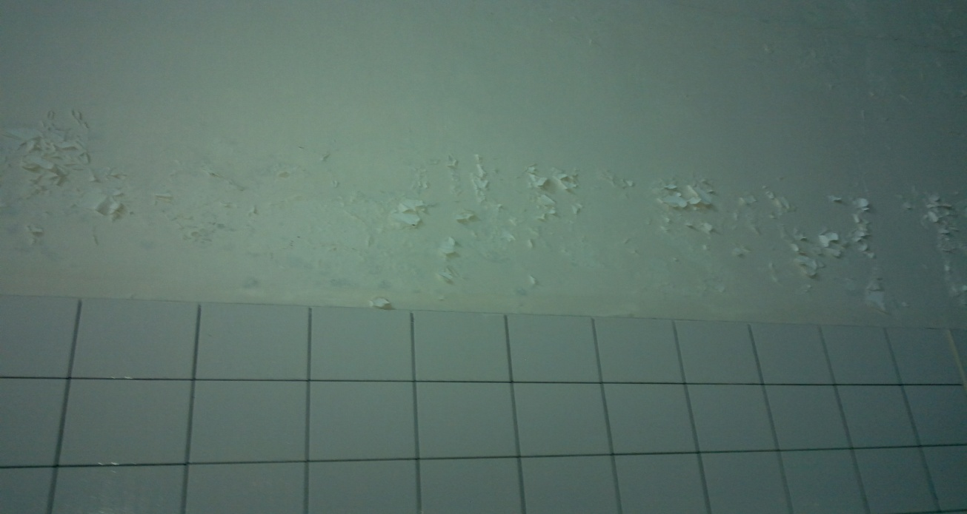
The Main Problems to Be Solved During This Project:
High indoor humidity ratio: causes rust, blistering in paint, dampness, structural deterioration.
Ventilation: Bad ventilation causes respiratory problems.
Acoustical Problems:
-High reverberation time.
-Impact noise on roof.
-Mechanical system noise.
High energy consumption due to heating.

Slide 27
Thank You

