Slide 1

An-Najah National University
Facility of Engineering and Information Technology
Civil Engineering department
Redesign Of Residential Building include seismic loads.
Prepared by: Oday Odeh
Hamza Souqi
Hasan Kmail
Supervised by: Dr. Mahmoud Dwekat

Slide 2
Content:-
01
Introduction
-Project description.
-codes.
-Material.
-Loads.
02
Preliminary Design
-Slab preliminary design.
-Beam preliminary design.
-column preliminary design.
03
Modeling and analysis
-Introduction.
-Define material, sections
modifiers, and loads.
04
Checks
-Introduction.
-Model Checks.
-Design checks.
05
Seismic load calculation
06
- Shear wall design.
-Beam design.
-Column design.
-Slab design.
- Footing design.
Design

Slide 3

01 Introduction
Project description:-
Residential Building located at the middle
Of Huwara-south Nablus.
The building consist of 10 floors, with total area of the building = ${557 m}^{2}$, and Hight of story = 3.0 m.
Soil bearing capacity= 350 KN/ $m^{2}$

Slide 4
Changes in original plans
The owner of the building complain that the corridors of the building are wide, Therefor we change the width of the corridors and get smaller, because of that some column location changed to fit the drawing.
The ground floor contain stores at the front of the building. All other stories have the same architectural plane.
The same elevation on area of the same floor.
Bracing system used instead of stone wall.

Slide 5
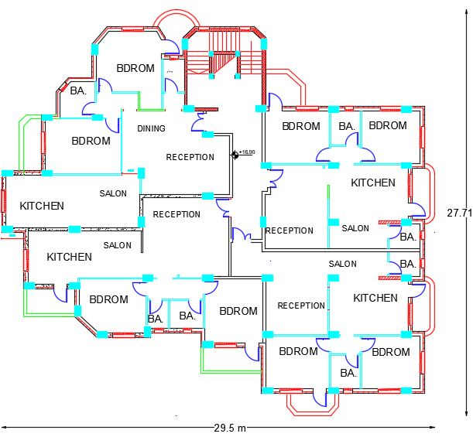
Project description:-
Figure-1: floor plan.

Slide 6
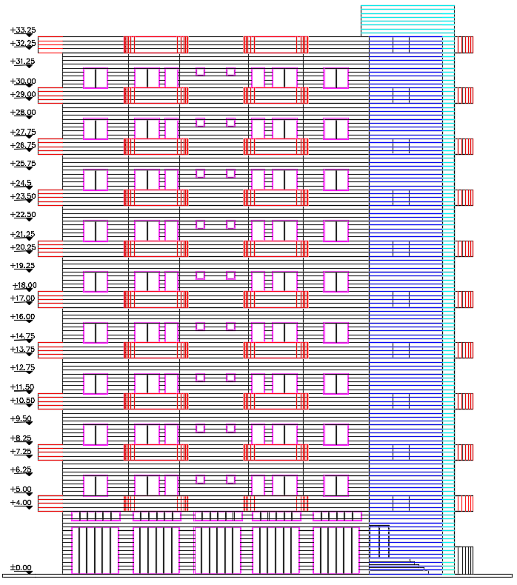
Project description:-
Figure-2: north east view.

Slide 7
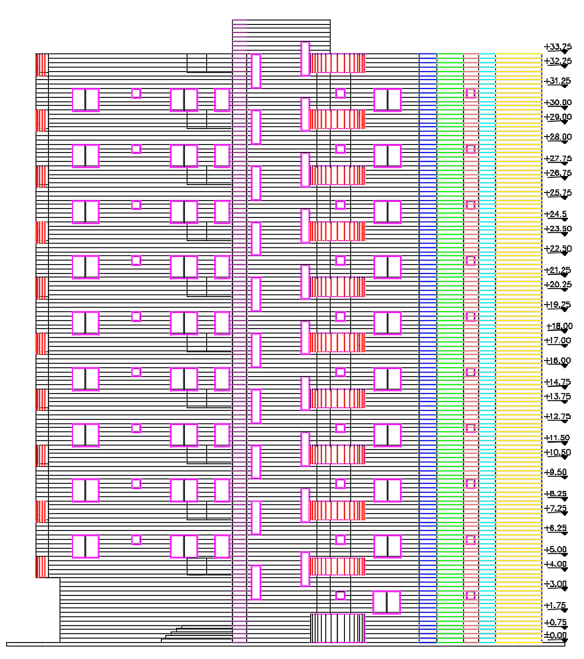
Project description:-
Figure-3: North-west view.

Slide 8
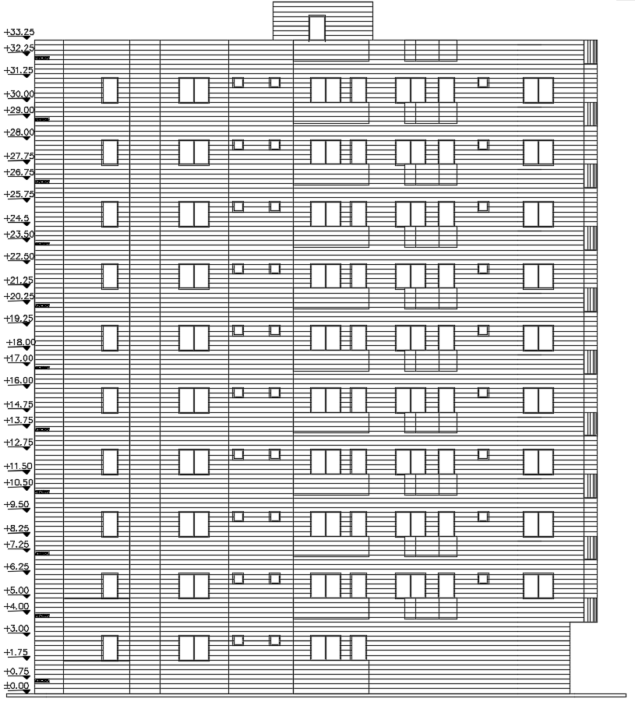
Project description:-
Figure-4: South-east view

Slide 9
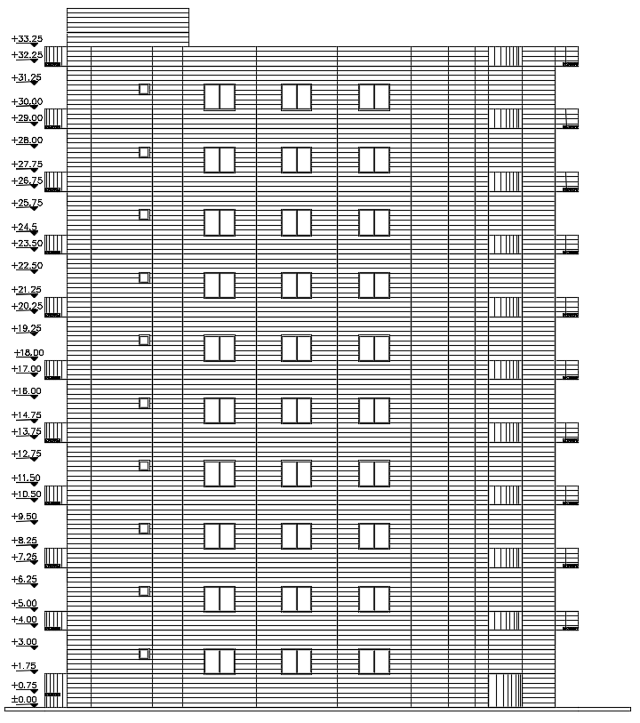
Project description:-
Figure-5: West-south view

Slide 10
01 Introduction
Codes and Standard:-
ACI 318-14 for design the elements of the structure.
ASTM for material properties and specification.
ASCE 7-10 for loads applied on the structure.
UBC 97: Uniform Building code used for seismic design
IBC 2012: International Building code used for seismic design

Slide 11
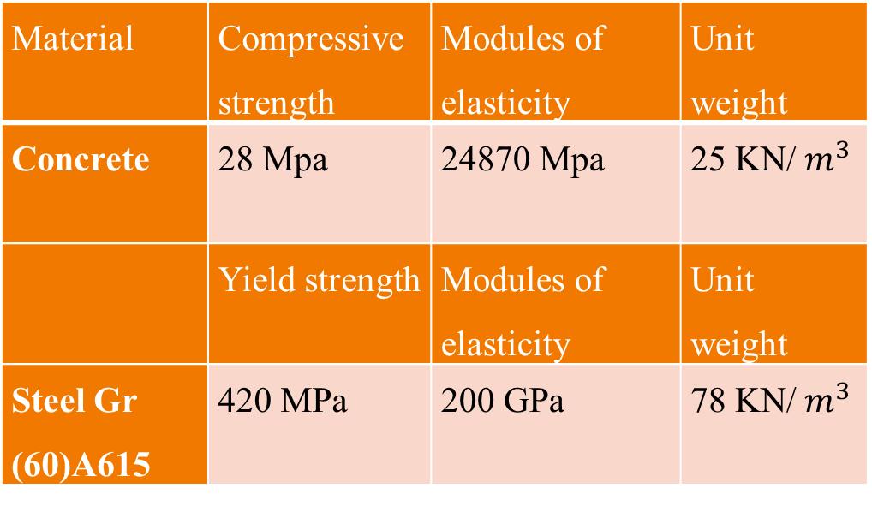
01 Introduction
Material:-
Material used in structural element and modeling the structure.
Material | Compressive strength | Modules of elasticity | Unit weight
Concrete | 28 Mpa | 24870 Mpa | 25 KN/$m^{3}$
 | Yield strength | Modules of elasticity | Unit weight
Steel Gr (60)A615 | 420 MPa | 200 GPa | 78 KN/${ m}^{3}$

Slide 12
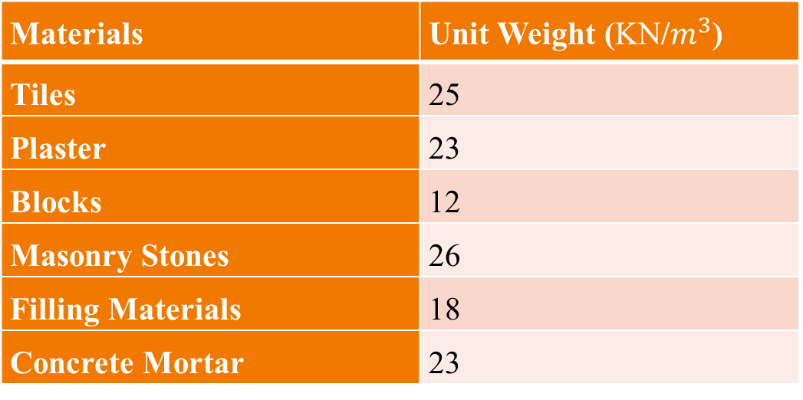
Material:-
Material used in superimposed dead load calculation and shall be used in budling construction.
Materials | Unit Weight (KN/$m^{3}$)
Tiles | 25
Plaster | 23
Blocks | 12
Masonry Stones | 26
Filling Materials | 18
Concrete Mortar | 23

Slide 13

01 Introduction
Loads :-
Gravity loads: live and dead loads.
Live loads for first two stories = 4 KN/$m^{2}$ and for all other stories = 2 KN/m.
Dead load composed of own weight of structure
And distributed load 13.5 KN/m as linear load Represent weight of exterior wall.
Superdead from tiles, mortar , portions and plaster equal 4.05 KN/$m^{2}$

Slide 14
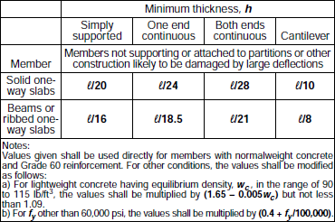
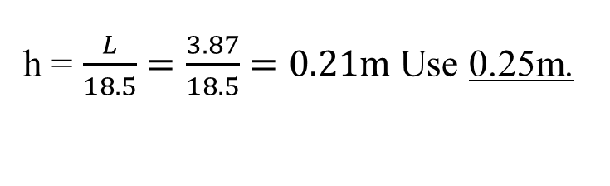
02 Preliminary design
Slabs preliminary design:-
Type of slabs are Ribbed slabs, the floor has two system of Ribbed slabs
One Way Ribbed slab and Two Way-Ribbed slab.
Thickness of slab determined according to ACI code as shown in table 11:
For one-way ribbed slab
Table-3: Minimum thickness of slab.
h = $\frac{L}{18.5}=\frac{3.87}{18.5}=0.21m$ Use 0.25m.

Slide 15
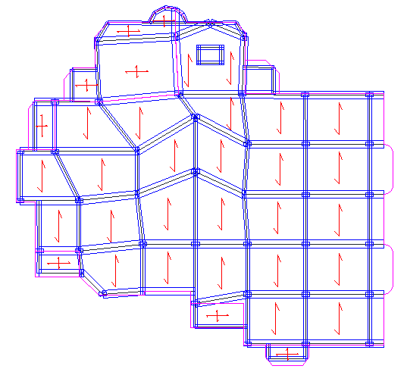
slab distribution plane:-
Figure- slab distribution plane.

Slide 16
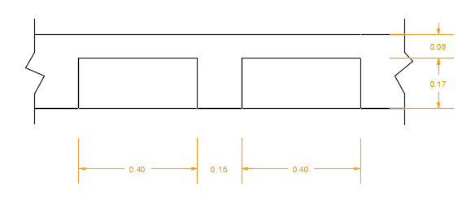
02 Preliminary design
Beam preliminary design:-
For Tow Way-Ribbed slab
Thickness the same as one way-ribbed slab
Slabs section dimensions
Stem width = 150 mm
Overall depth = 250 mm
Slab thickness = 80 mm
Block width = 400 mm
Rib spacing = 550 mm, for two-way ribbed in both direction.
Figure- section in slab

Slide 17
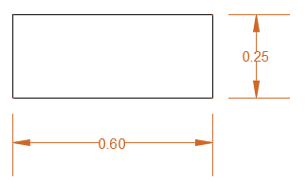
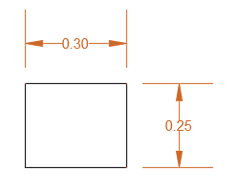
02 Preliminary design
beam preliminary design:-
System of beam used is hidden beams between all columns.
Dimension of beam will be determine as the following:
Figure main beam dimension
Thickness h as the thickness of slab = 25 cm
b = 2*d = 0.50 m.
Dimension of secondary beam used 0.25 X 0.3 m
Figure secondary beam dimension

Slide 18
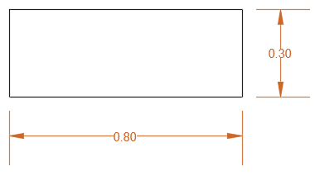

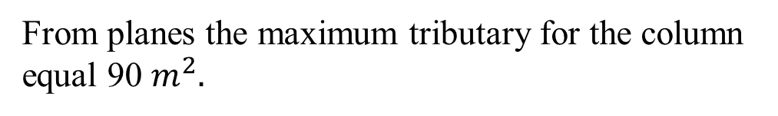
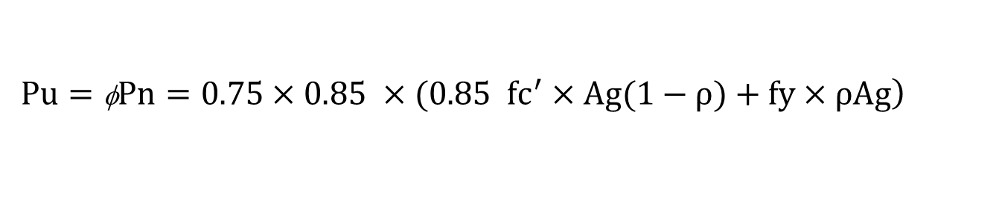


02 Preliminary design
column preliminary design:-
From planes the maximum tributary for the column equal 90 $m^{2}.$
$Pu=1.2D+1.6L$
column demotion
$$Pu=\text{3333}KN$$
$$\left.Pu=\text{φ}Pn=0.75×0.85 ×(0.85 fc^{′}×Ag(1−ρ)+fy×ρAg\right)$$
$$Ag=250896.4{mm}^{2}$$
Therefore, column 70*40 cm used with area = 240000 mm²

Slide 19

02 Preliminary design
Bracing dimension :-
Bracing used instead of stone walls
$$Width = 20 cm which is the real thickness of wall$$
Depth = L/8 = 3.6/8 = 0.45 m
$$Where L: the diagonal length$$

Slide 20
03 Modeling and analysis
Introduction:-
Modeling and analysis will performed by using ETABS 18 program.
All supports will be model as pin support.
Exterior partition as linear load and interior partition as distributed load.
All joint will assumed as fixed joint.
Bracing used instead of exterior stone wall.

Slide 21
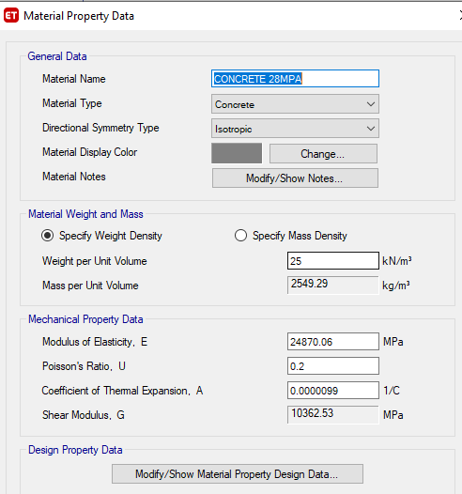
03 Modeling and analysis
Define material and sections and loads:-
Figure-8 Material Property

Slide 22
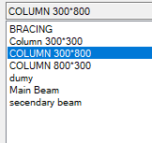
Sections:
Figure-9 sections used

Slide 23
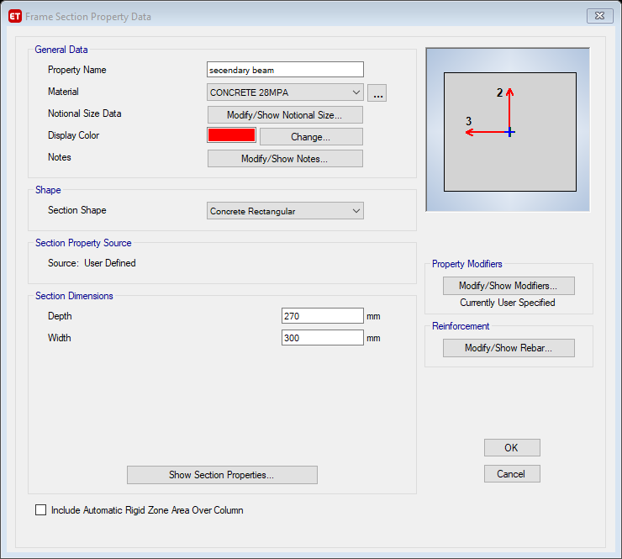
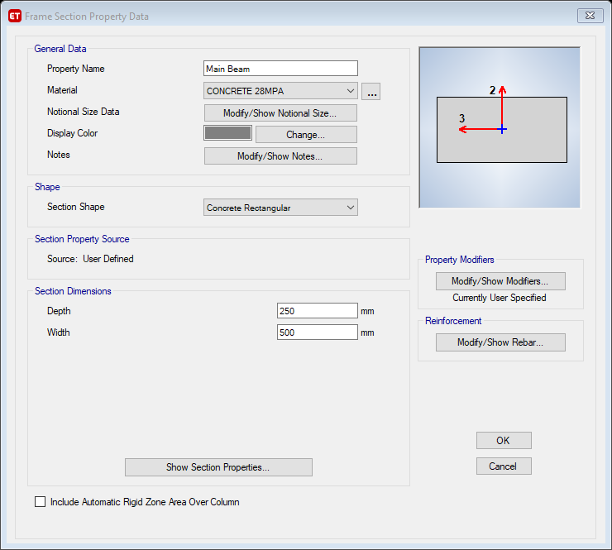
Sections:
Figure-10 Main beam section
Figure-11 secondary beam section

Slide 24
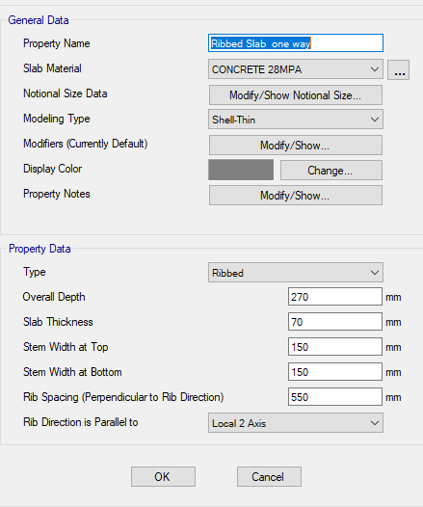
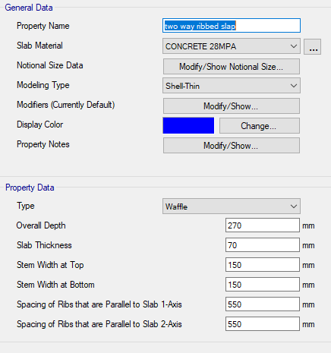
Sections:
Figure-12 One-way ribbed Slab sections
Figure-13 Two-way ribbed Slab sections

Slide 25
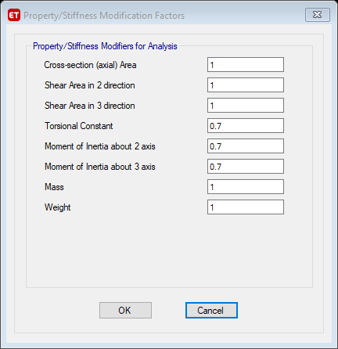
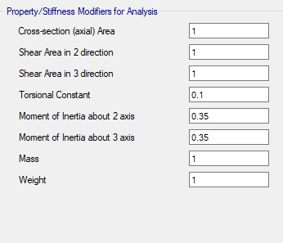
Modifiers
Figure-14 Column modifiers.
Figure-15 beams modifiers

Slide 26
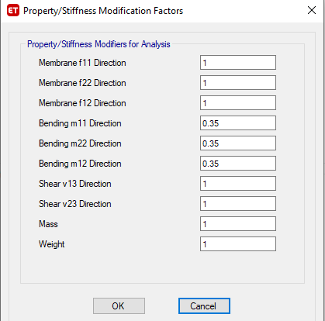
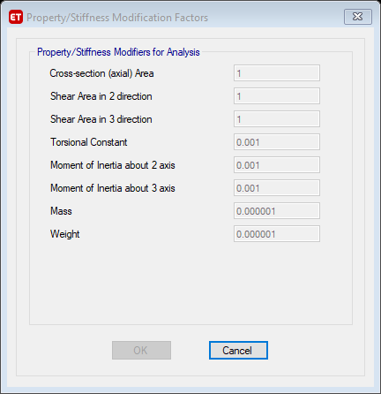
Modifiers
Figure-16 Slabs modifiers
Figure-17 Bracing modifiers

Slide 27
04 Checks
Introduction:-
The Checks which will be discussed in this section include:
Preliminary design checks.
Model checks, compatibility, equilibrium, internal force checks.
Deflection check
Design checks

Slide 28
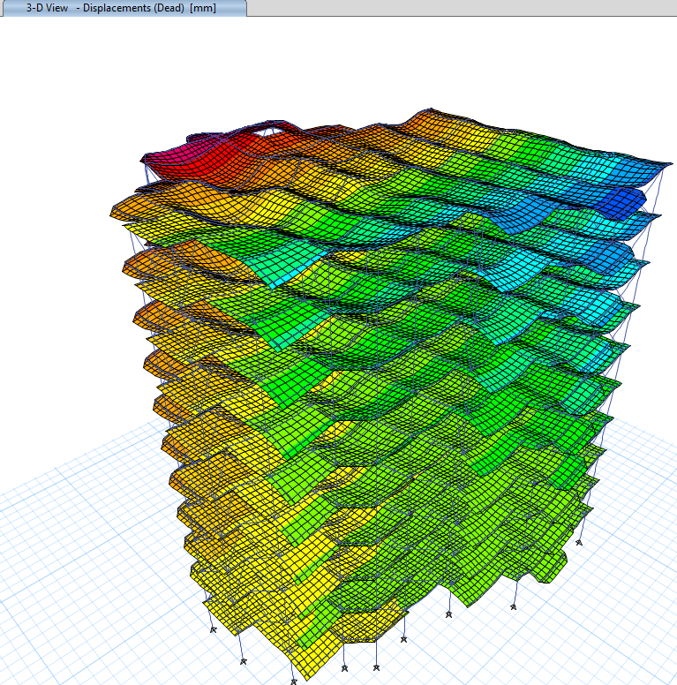
Model checks:-
compatibility check:
Figure‑23: compatibility animation.

Slide 29
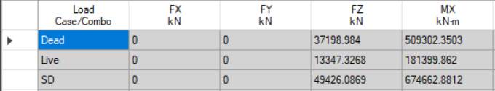
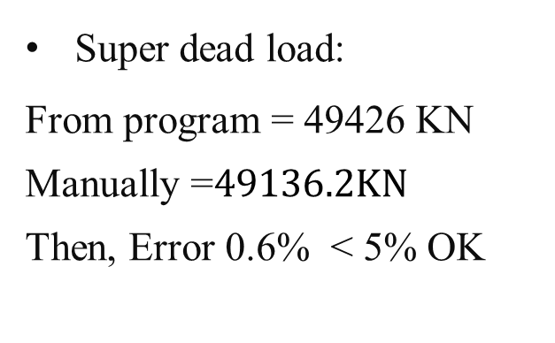
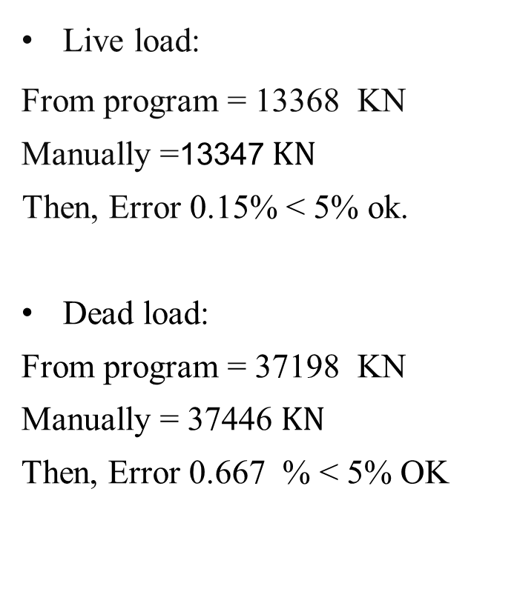
Model checks:-
Equilibrium check:
Super dead load:
From program = 49426 KN
Manually =$49136.2KN$
Then, Error 0.6% < 5% OK
Live load:
From program = 13368 KN
Manually =13347$KN$
Then, Error 0.15% < 5% ok.
Dead load:
From program = 37198 KN
Manually = 37446 $KN$
Then, Error 0.667 % < 5% OK
Figure-24 etaps loads

Slide 30
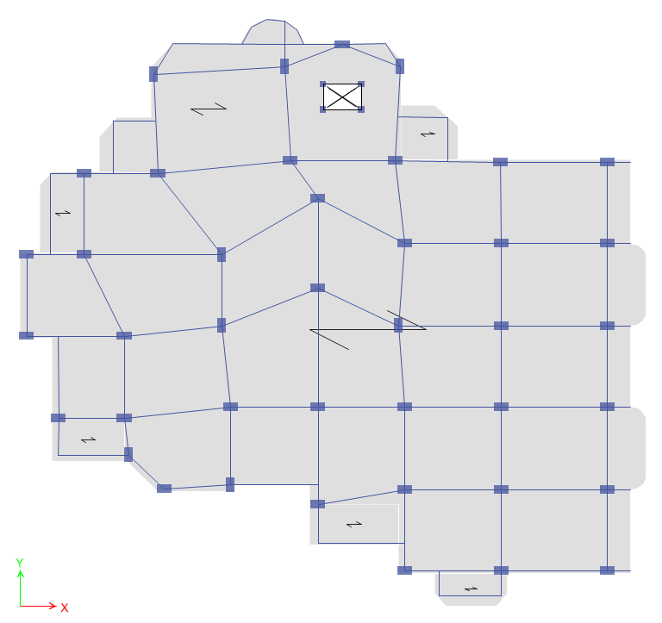
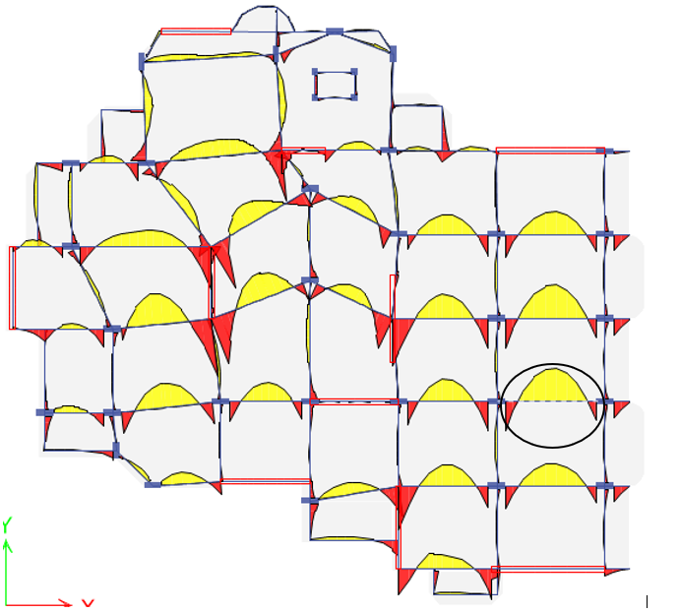
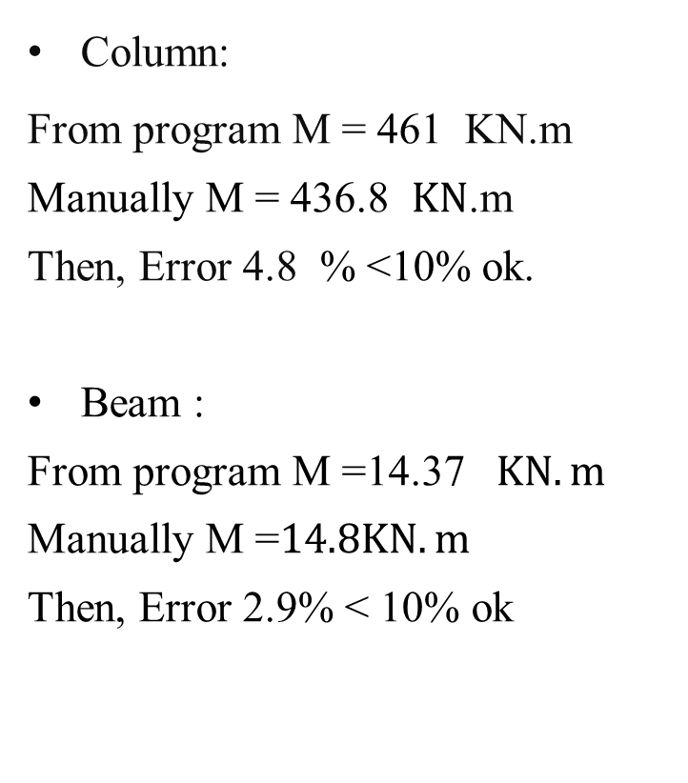
Model checks:-
3- Internal force check:
Column:
From program M = 461 KN.m
Manually M = 436.8 $KN$.m
Then, Error 4.8 % <10% ok.
Beam :
From program M =14.37 $KN.m$
Manually M =$14.8KN.m$
Then, Error 2.9% < 10% ok
Figure-25: Column location.
Figure-26: Beam location.

Slide 31
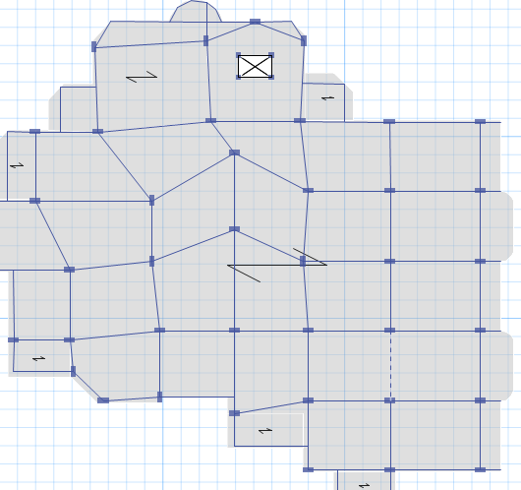
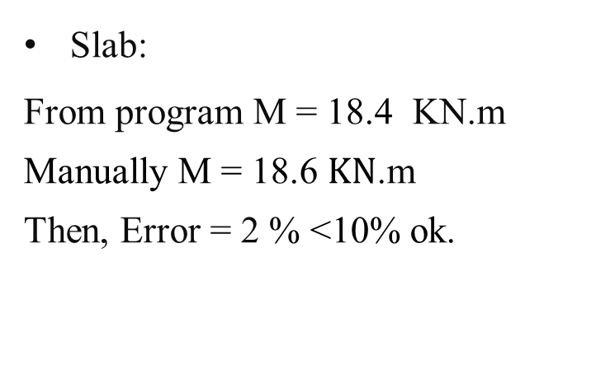
Model checks:-
3- Internal force check:
Slab:
From program M = 18.4 KN.m
Manually M = 18.6 $KN$.m
Then, Error = 2 % <10% ok.
Figure-27: Slab location.

Slide 32
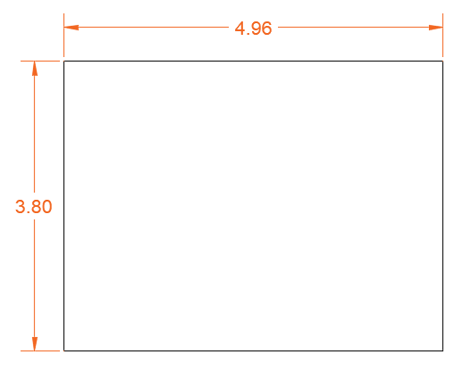
Design checks:-
4-Deflection check:
Largest panel which has the maximum deflection
Shown in the figure
Longest side = 4962 mm
Deflection = l/240 = 4962 /240 = 21 mm
Figure-29 Largest panel.

Slide 33
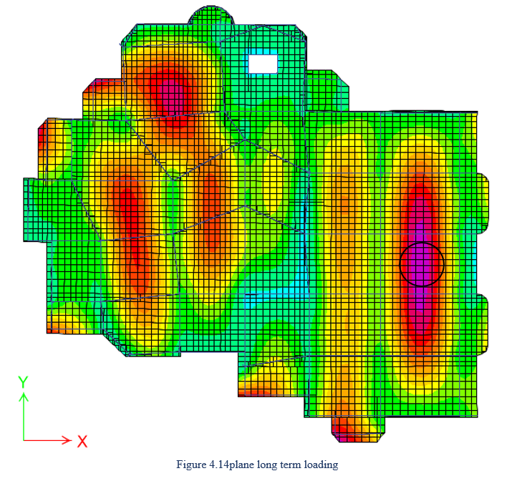
Design checks:-
4-Deflection check:
To consider sustained live load
Using long-term load combination 2D+2S.D+1.25L
Maximum deflection from etaps = 38.5 mm
Calculated maximum deflection = 27 mm
Reduction factor 1.4
27/1.4 = 19.2 mm
L.T all = 4962/240 = 21 > 19.2 OK
Figure-30 Deflection plan view.

Slide 34
05 Seismic Load Calculation
Introduction:-
Seismic load calculation done acceding to UBC,IBC, and ASCE codes.
Analysis procedures used for the design of building is Response Spectrum Analysis.

Slide 35
load combinations:-
Qx = EQx + 0.3 EQy
Qy = 0.3 EQx + Eqy
Variability factor = 1.3 , E = Eh + Ev
Ev = 0.12D , Eh = ρEQ
E = 0.12D + 1.3 EQx + 0.39EQy
E = 0.12D + 1.3 EQy + 0.39EQx

Slide 36


load combinations:-
Load combination used with according to ASCE7-10 :
Strength design combination
$$1.4D$$
(1.12)
$$1.2D+1.6L$$
(1.13)
1.2D + 1.0E + 1.0L
(1.21)
0.9D + 1.0E
(1.22)
0.9D + 1.0E
(1.23)

Slide 37


Loads and load combinations:-
Load combination used with according to ASCE7-10 :
Allowable design combination
$$D$$
(1.24)
$$D+L$$
(1.25)
D + 0.7E
(1.26)
D+0.75L + 0.252E
(1.27)
0.6D + 0.7E
(1.27)

Slide 38

Loads and load combinations:-
Load combination used with according to ASCE7-10 :
Envelope service combination
$$D + (D+L) + (D + 0.7E) + (D+0.75L + 0.252E) + (0.6D + 0.7E)$$
(1.12)
Envelope ultimate combination
$$D + (D+L) + (D + 0.7E) + (D+0.75L + 0.252E) + (0.6D + 0.7E)$$
Deflection combination
$$2D + 1.25 L$$

Slide 39
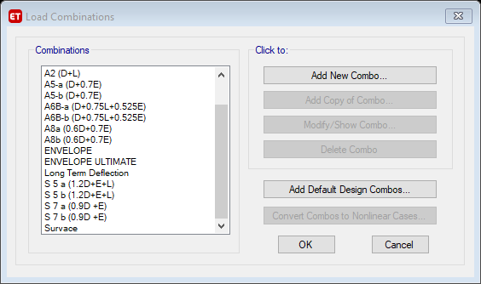
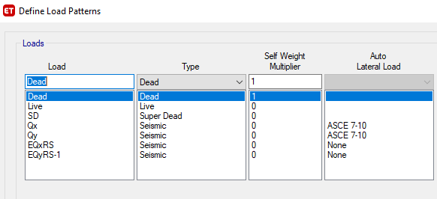
Figure-21 load patterns
Figure-22 load combination

Slide 40
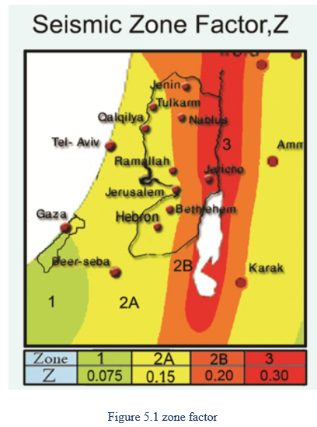
Determine The Peak Ground Acceleration
Z = 0.2g
Ss = 2.5Z = 0.5
S1 = 1.25Z = 0.25
These equation based on 10% probability of exceedance.

Slide 41
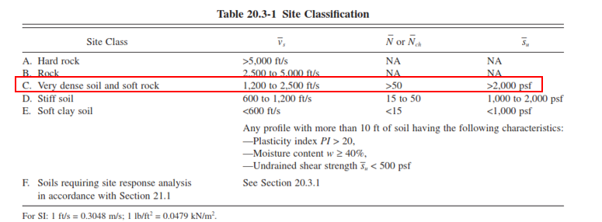
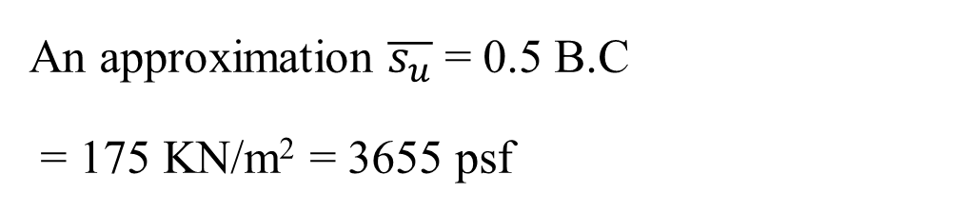
Determine Site Class
Z = 0.2g
Ss = 2.5Z = 0.5
S1 = 1.25Z = 0.25
An approximation $\overline{s_{u}}$ = 0.5 B.C
= 175 KN/m² = 3655 psf
site class for area of project is C.

Slide 42
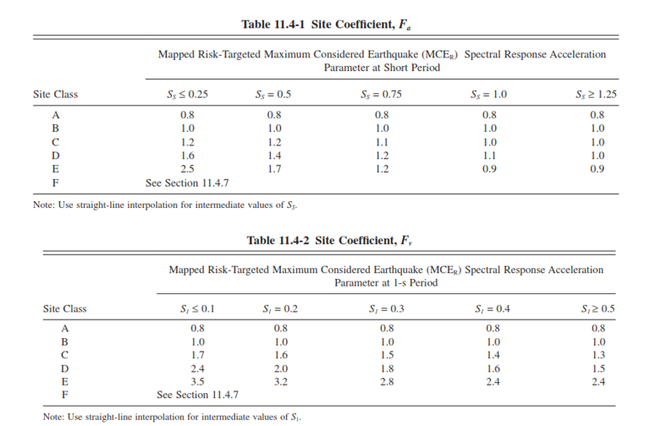
Sms at short period and Sm1at long period
SMS = Fa Ss
SM1 = Fv S1
Determine site coefficient
Fa and Fv from Table 11.4-1
and Table 11.4-2
SMS = Fa Ss = 0.6
SM1 = Fv S1 = 0.3875
site class for area of project is C.

Slide 43
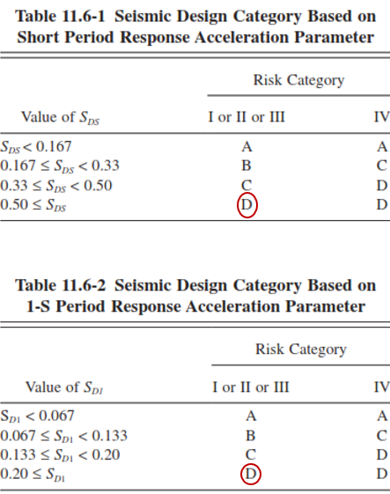
Determine Design Category SDC
Risk category for the building is II, which give seismic important factor = 1.00
There is no need to convert
S_{DS} = 0.6
S_{D1} = 0.3875
The seismic calculation done based on 10% probability of exceedance. no need to multiply by 2/3 to convert to 2% .
Seismic design category for the building is D

Slide 44
Determine of the seismic base shear
The permitted and used in the project Analysis Procedures are equivalent lateral & response spectrum methods.
There is no vertical and structural irregularity in the building.
The vertical load taken by frames and lateral load taken by shear wall. Hence, the structural system is building frame system.
Seismic Force-Resisting System is Special reinforced shear walls

Slide 45
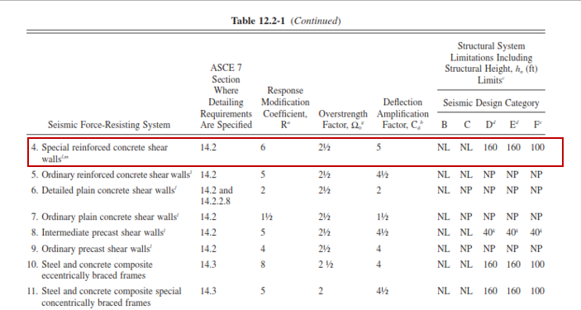
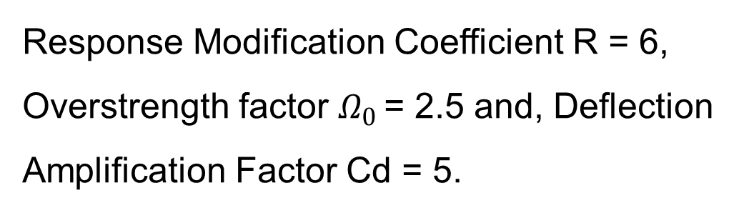
Response Modification Coefficients
Response Modification Coefficient R = 6, Overstrength factor $Ω_{0 }$= 2.5 and, Deflection Amplification Factor Cd = 5.

Slide 46
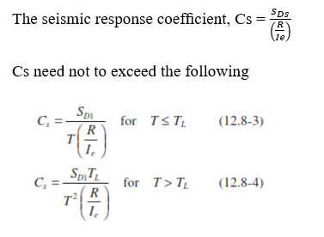
Equivalent Lateral Force
The seismic base shear = V = CsW
According to ASCE equations Cs = 0.1
The effective seismic weight, W, of a structure:
W = D + SD + 1.25L
W = 37446.35 + 49136.2 + 13368 *0.25 = 89924.6 KN
V = 0.1 * 89924.6 = 8992.46 KN

Slide 47
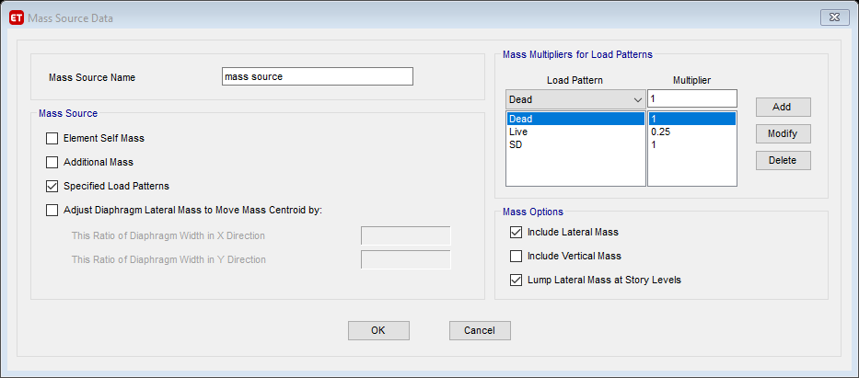
Seismic design using etaps
For Equivalent Lateral Force
a-Define mass source

Slide 48
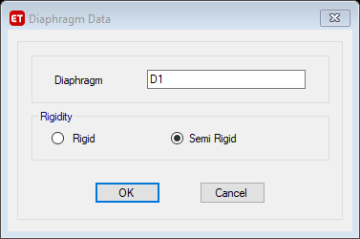
Seismic design using etaps
b-Define diaphragm for all stories

Slide 49
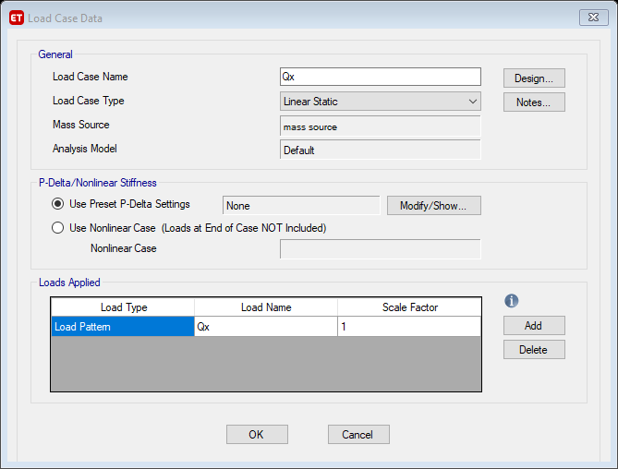

Seismic design using etaps
c-Define load cases in X and Y

Slide 50

Seismic design using etaps
d-Define load pattern in X and Y.

Slide 51

Seismic design using etaps

Slide 52

Seismic design using etaps
e-Check etaps Equivalent Lateral Force by comparing it with hand calculation
Etaps value = 8910.1 KN
Calculated = 8992.5 KN
Error = 0.9 % OK

Slide 53
Seismic design using etaps
Define response spectrum to etaps.
a-Define response spectrum function
b-Define load cases for response spectrum in X and Y.
Scale factor = g * I/R = 9806.65 *1 /6 = 1634.44

Slide 54

Response spectrum function

Slide 55

Load case in X for Eq. Analysis

Slide 56

Load case in Y for Eq. Analysis

Slide 57
Seismic design using etaps
According to ASCE 7-10 the difference between RS and EQ methods need to be less than 15% If not modification factor shall be used the following table show the results of RS and the modification factor
Axis | RS | EQ | difference | %diff | modification FACTOR
x | 6683.01 | 8910.1 | 2227 | 24.9951 | 1.13
y | 6679.885 | 8910.1 | 2230 | 25.0302 | 1.13
Scale factor become 1853
Difference < 15% ok

Slide 58



Model Seismic Checks
Period check.
Ta = Ct * h_{n}^{x}
Ct = 0.0488
X = 0.75
Then Ta = 0.625 s
Cu = 1.44
Tetaps = 0.67 s
Cu * Ta = 1.44*0.625 = 0.9s
0.67<0.9 Okay

Slide 59

Model Seismic Checks
Model participation mass ratio check
In first 11 model in X 95.97% and in Y 94.6% > 90 % ok

Slide 60


Model Seismic Checks
Drift check
According to ASCE 7-10 allowable drift as shown in table below
Allowable drift = 0.02h
Δ = $\frac{Cd∗δmax}{I}$ = 5*0.001508 =
0.00754 < 0.02 ok

Slide 61



Model Seismic Checks
P-Delta Effects
stability coefﬁcient (θ) as determined by the following equation is equal to or less than 0.10
Maximum 𝜃 in X=0.0055
Maximum 𝜃 in Y=0.0079
θ<10 % ok

Slide 62



Model Seismic Checks
Ampliﬁcation of Accidental Torsional
torsional ampliﬁcation factor (Ax)
If Ax < 1 then no need to multiply by amplification factor
All δmax/δavg values are < 1.2
No need to multiply by amplification factor.

Slide 63
05 Design
Introduction:-
Preliminary dimensions of the different structural members were found. Now, after finishing the model, these members will be tested and evaluated to see if they are adequate or not.
Design checks and full detailed drawing developed include, slabs, beams, columns, shear walls, footing.

Slide 64

Preliminary design checks.
This check doing to ensure all element are adequate. Any element shows as red color is not adequate.
Figure‑23: Preliminary design checks.
.

Slide 65
Shear walls reinforcement.
Shear walls checks.
Check the need for special boundary elements at the edges of structural walls
hw = 3m, minimum lw=2m
hw/lw = 1.5 m < 2 then no need for boundary elements.
constraints
The longitudinal spacing of transverse reinforcement at the wall boundary shall not exceed the lesser of 8 in. and 8db of the smallest.
If Vu > Acvλ $\sqrt{f^{′}}$ horizontal reinforcement shall be used.

Slide 66

Shear walls reinforcement.
Shear walls checks.
There is no coupling beam in our structure since Ln/h > 4 in all connecting beam with two wall structure.
Design check
select a sample of shear wall to check result as shown in
figure

Slide 67
Shear walls reinforcement.
Shear walls checks.
There is no coupling beam in our structure since Ln/h > 4 in all connecting beam with two wall structure.
Design check
select a sample of shear wall to check result as shown in
figure

Slide 68

Design check
Rebar value from etap ρl = 0.016 > 0.0025 OK
Figure 6.25 shear wall section in section designer
Use 1 Ø16/ 100 mm
S ≤ 200, 128
Determine Capacity

Slide 69


Design check
Interaction diagram for M3 and M2 capacity of section as shown in figure.
Figure 6.27 axial and moment 2 capacity
Figure 6.28 axial and moment 3 capacity

Slide 70

Shear wall checks
Axial capacity = 12962.97 KN
Moment 3 capacity =589.5 KN.m
Moment 2 capacity = 9424.5 KN.m
By section cut at the base of the shear walls give the forces in table below.
Figure 6.29 section cut in shear wall
WALL | Vx(KN) | Vy(KN) | Mx(KN.m) | My(KN.m) | P(KN)
W2 | 1.60 | 2162.47 | 5897.74 | 0.79 | 9979.76
all of value of loads (axial, moment2 and moment3) are less than value of capacity OK.

Slide 71

Shear wall checks
check Vx
ØVc = 461.15
WALL | f'c | Lw | t | ØVc | Vx | check
W2 | 28 | 3.32 | 0.25 | 461.15 | 1.6 | ok
Design for shear in y direction
ØVcy= $\frac{1}{6}∗\sqrt{28 }∗0.25∗\left(0.8∗3320\right)$ = 585.593 KN
Vs = 2162.5/0.75 – 585.6 = 2297.7 KN < Vsmax = 4 * ØVcy = 2342.4 KN OK
WALL | f'c | Lw | t | Vcy | Vuy | Vs | Vs max
W2 | 28 | 3.32 | 0.25 | 585.5 | 2162. | 2297 | 2342

Slide 72

Shear wall checks
$\frac{Av}{S}$ $2.06 mm>\frac{Av}{s}min$
$$ρt0.0082>0.0025 OK$$
Use 1Ø12 / 100 mm in each side
Check the need for additional horizontal reinforcement
Vu ≤ Avc * ƛ $\sqrt{ꝭc }$
2162.5 ≤ 250 * 3320 * 1 *$\sqrt{28 }$ = 4392 KN

Slide 73


Slide 74


Slide 75


Slide 76


Slide 77

Beam Design
1-Check that beam Pu ≤ 0.1 Ag f’c
For main beam = 0.1 * 0.25*500*28 = 350 KN
For secondary beam = 0.1 * 0.25*300*28 = 210 KN
2-Clear span of beam ≥ min {0.3h ,250 mm},
where:
h = total depth
Minimum span length of beam = 1.3 m ≥ 0.3 *250 = 0.075 m OK
≥ 250 mm OK
3-Width of beam ≤ width of supporting column + x
Where x = min {least column dimention ,0.75 maximum column dimention}
Width of supporting column = 35 cm
Width of beam = 50 cm, 50 ≤ 70 OK

Slide 78

Beam Design
4-At least two top and bottom bars shall be continuous and extend ld in the columns
2Ø14 used in place where in major reinforcement needed
5-Steel ratio at any section shall not to exceed 0.025
6-The beam shall be designed to resist Vu taken as shown in the figure:
Vn = Vc + Vs = 260.16 + = 73 + 285 = 359 KN
Vu = VuETAB + (Mnr+Mnl)/2
VuETAB = 128 KN
Mn = 92.73
Vu = 91.92 + 92.73 = 185 KN
ØVn ≥ Vu OK

Slide 79

Beam Design
Design for flexural
Check etaps design results
For selected beam M(middle) = 74.4 KN.m give ρ = 0.01
ρ from etaps = 0.0099
Error = 1 % OK
As = 1089 mm2 use bottom steel 4Ø20
ρ end top = 0.73% As = 803 mm2 →use 4Ø14

Slide 80


Beam Design
design for torsion and shear
Maximum axial force = 33 KN < 0.05*500*250*28 = 175 KN OK
Vu from strength combination = 128.7 KN
Shear due to earth quick = 1 KN <<128 OK
Vc= 97 KN
Vu from strength combination = 128.7 KN
Vs = Vu/0.75 – Vc = 128.7/0.75 – 97 = 74.6 KN
Tth = 41.34 KN.m
Tu from etaps = 1.6 KN.m << 41.3 KN.m no need for torsion reinforcement

Slide 81


Slide 82


Slide 83
Design check for column
requirement for intermediate column
Columns (Pu > 0.1 Ag f’c)
0.1*750*350 =26.25 all column satisfy this condition
If c1 and c2 are the dimensions of column cross section, c1≥c2, then:
– c2 shall be ≥ 300 mm, 350 > 300 OK
– c2 shall be ≥ 0.4 c1, 350 > 0.4*750=300 OK
Lap splice of bars shall be used at mid-height of the column with lap splice length,
ls = 1.3 ld.

Slide 84



Design check for column
•Stirrups shall be computed based on shear force Vu and shall have a maximum spacing as shown in the figure
•Within area of congested transverse reinforcement (ends of columns), crossties shall be used as shown in the figure below:

Slide 85

design column for flexure
slenderness check for column
Slenderness ratio = (k*Lu)/r ≤ 22
$\frac{1∗3.0}{0.26}$ = 11.5 < 22 we do not consider slender
From Etabs longitudinal steel:
As = 0.01*750*350 = 2625 mm
12Ø18

Slide 86


Design for shear in column
Design for shear in column
ØVc = 158.7
Vu from etaps = 1.4 KN < ØVc
From Etabs shear reinforcement as in the figure:
$\left(\frac{Av}{s}\right)$min = max [0.062*$\sqrt{fc}∗\frac{bw}{fyt}$ , $\frac{0.35bw}{fyt}$] = Max [0.6, 0.63]
Minimum tie will used S_{o} = 100 mm and S₁ = 150 mm

Slide 87

Design for shear in column
For transfer reinforcement

Slide 88

Design for shear in column
Ash1 = Max {$\frac{0.3∗100∗720∗28}{414}$ ($\frac{750∗350}{720∗320}−1), \frac{0.09∗100∗720∗28}{414}$} = 438.2 mm² $⇒4Ø12$
Ash2 = Max {$\frac{0.3∗100∗320∗28}{414}$ ($\frac{750∗350}{720∗320}−1), \frac{0.09∗100∗320∗28}{414}$} = 195 mm² $⇒2Ø12$
L_{d} = Max [3000/6 = 500 mm, 750, 450] then l_{d} = 750mm
L_{s} = 1.3 l_{d} = 975 mm $⇒$ use 1 m

Slide 89


Slide 90



Slide 91


Slab reinforcement design
We use ETABS program to distribute slab steel.
Assume:
2φ12 for top and bottom
As = 226.2 mm²
Mu = ($\frac{b∗d^{2}∗fc}{2.61}$)*(1 - (1 - $\frac{As∗fy}{0.85∗b∗d∗fc}$)²)
= ($\frac{150∗{210}^{2}∗28}{2.61}$)*(1 - (1 - $\frac{226.2∗420}{0.85∗150∗210∗28}$)²) = 16.85 kN.m
For one rib Mu = 16.85/0.55 = 30.64 kN.m/m
We compare this value with ETABS and we use different steel section so there is no problems and the design is economical.

Slide 92

Slab reinforcement design

Slide 93


Slide 94


Slide 95


Hock at ends for top steel:
According to figure:
The largest diameter of steel we use φ24 so:
Hock length = 24*19 = 456 mm use 460 mm

Slide 96


Shear design:
φVc = (0.75*b*d)/6 = (0.75*$\sqrt{28}$*150*210)/(6*1000) = 20.8 kN
for one rib = 20.8/0.55 = 37.88 kN/m
There is some values more than 37.88 kN/m so we will design for shear

Slide 97

Shear design:
Assuming to put stirrups φ10
Av = 5²*π*2 = 157 mm²
S = 300 mm … 4 φ10 /m
Vs = (Av/S)*fy*d = ((157/300)*420*210)/1000 = 46.16 kN
and for one meter = 46.16*4 = 184.6 kN/m
The value that we will check in Safe = 184.6 + 37.88 = 222.5 kN/m

Slide 98

Footing design:
We use Safe program to design footings, first we transfer the load on base and combinations from ETABS to Safe.

Slide 99

Foundation checks:
Geotechnical checks:
Settlement check ∆ < ∆ all = 25 mm
We show service gravity with Earth Quick combination

Slide 100

Foundation checks:
Bearing capacity check:
BC = 350 kN/m²
We show service gravity with Earth Quick combination
According to the figures we see that all values < 350 kN/m² and all values have minus sign …. Ok

Slide 101


Foundation checks:
Structural checks:
Punching check:
All values < 1 …. Ok
Max design shear stress < concrete shear stress capacity (for all columns)

Slide 102


Foundation checks:
Wide beam shear check:
φVc = (0.75*$\sqrt{fc}$*b*d)/6 =
(0.75*$\sqrt{24}$*1000*750)/(6*1000) = 459 kN/m
Assuming to put stirrups φ10
Av = 5²*π*2 = 157 mm²
Using S = 300mm ... 4 φ10 /m
Vs = (Av/S)*fy*d = 164.85 kN and for one meter = 164.85*4 = 659.4 kN /m
The value that we will check in Safe = 659.4 + 459 = 1118.4 kN/m

Slide 103

Foundation checks:

Slide 104

Foundation Reinforcement

Slide 105


Slide 106


Slide 108


Slide 109


Slide 110


Slide 111
Thank you

