Slide 1

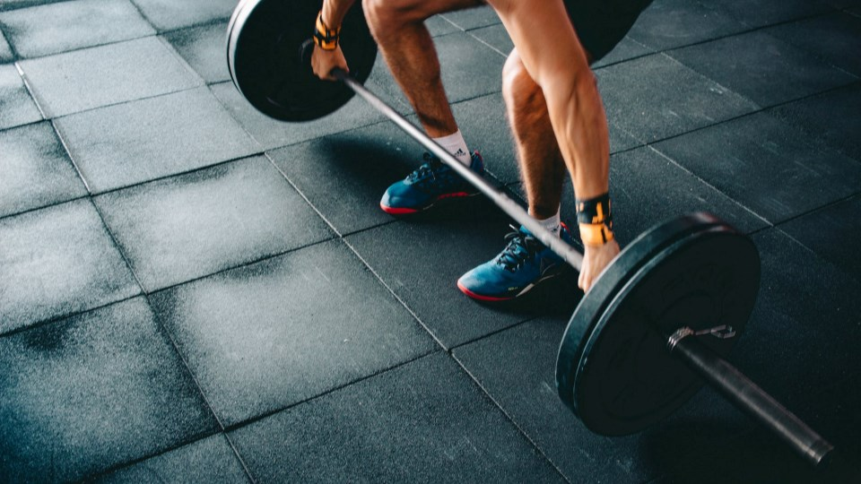
PULSE GYM
Yusuf Bilal Quzmar
Adel Mohammed Adel Shreim
Khaled mahmoud adel awartani
Dr. Imad Saadeh

Slide 2



problem

Slide 3




Objectives
01
Using web technologies and modern electronic services in the service of sports clubs.
Knowing the feasibility of booking services and receiving reservations through an integrated web system without the need for traditional systems.
Raising the level of competitiveness among other sports clubs through the features provided by the website, such as calculators for nutrients and calories.
02
03

Slide 4




Development and Design

Slide 5

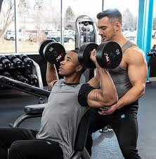
Target Audiences
coach
trainees

Slide 6

How to get an account on the site?
The members and trainees can create their own account and enter the site

Slide 7

Admin Control Panel
Total number of coaches
Total number of members
Total number of services

Slide 8

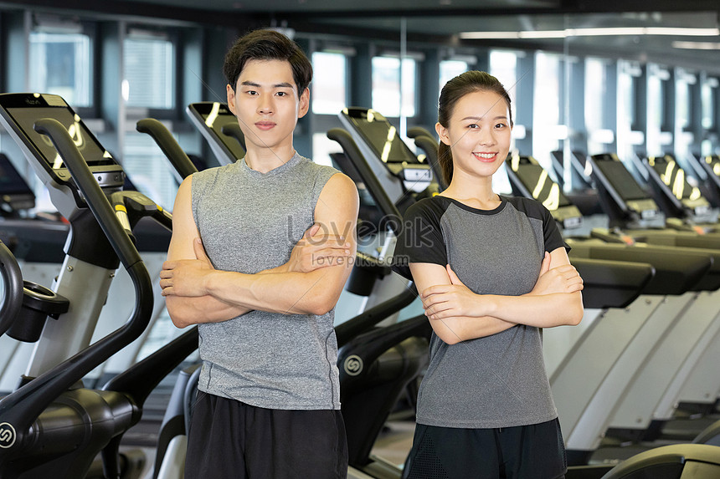
Manage Booking requests
Service Management
Coaches management
Members management
View messages using email

Slide 9

Members Services page
View all services and classes
send messages
Reservation and payment
Use of calculators

Slide 10
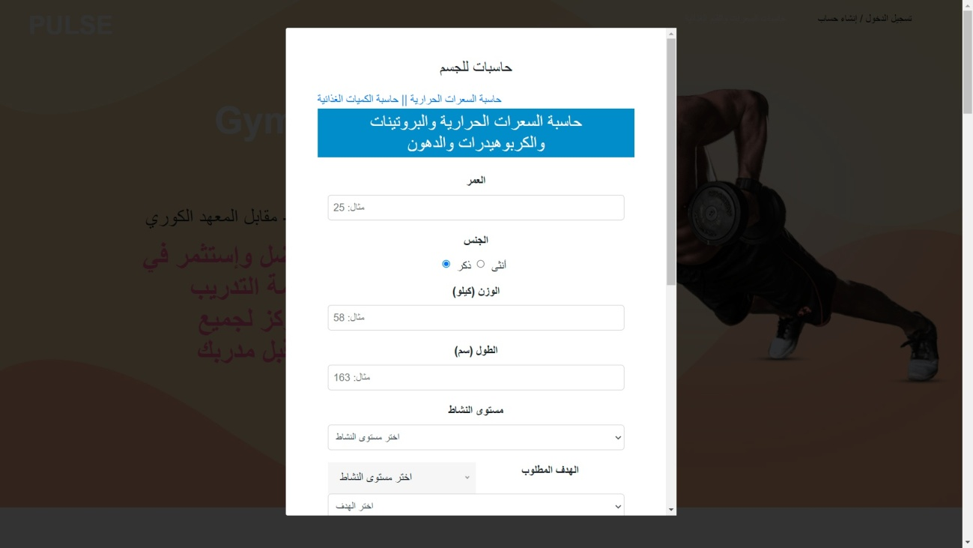
calculators

Slide 11
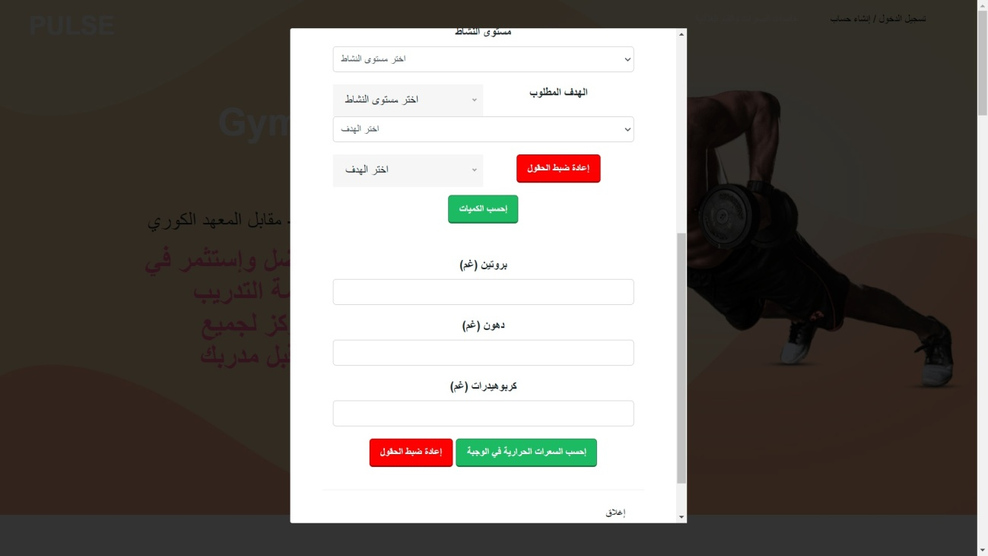

Slide 12
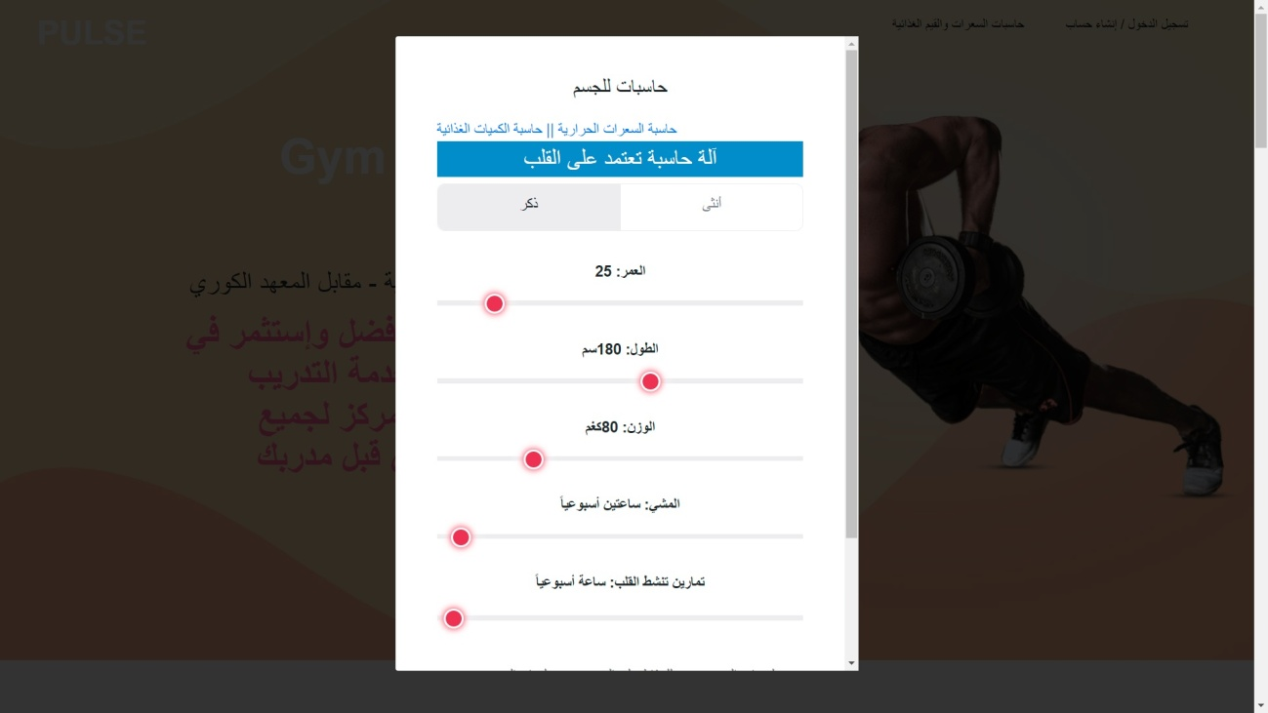

Slide 13
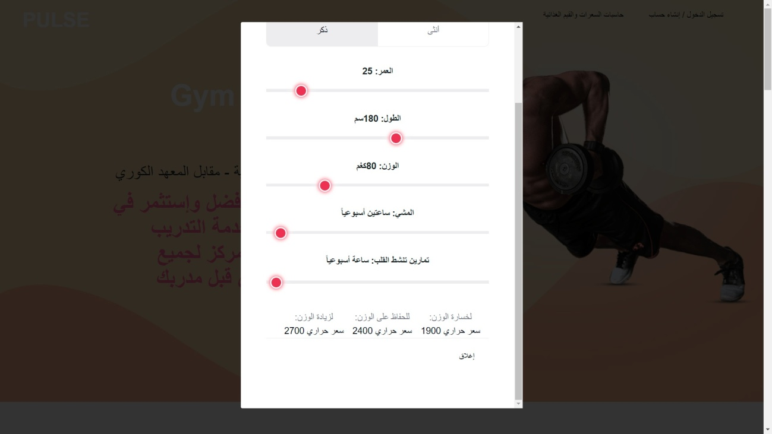

Slide 14
How calculate?
The first calculator
The second calculator
Women:
CB = T * (0.4472*H - 0.1263*W + 0.074*A - 20.4022) / 4.184
Men:
CB = T * (0.6309*H + 0.1988*W + 0.2017*A - 55.0969) / 4.184
Where:
CB is the number of calories burned;
T is the duration of exercise in minutes;
H is your average heart rate in beats per minute;
W is your weight in kilograms; and
A is your age in years.
For women – BMR = 655.1 + (9.563 * weight in kg) + (1.850 * height in cm) - (4.676 * age) . For men – BMR = 66.5 + (13.75 * weight in kg) + (5.003 * height in cm) - (6.75 * age)
Women:
(1.20 x BMI) + (0.23 x Age) - 5.4 = Body Fat Percentage
Men:
(1.20 x BMI) + (0.23 x Age) - 16.2 = Body Fat Percentage

Slide 15
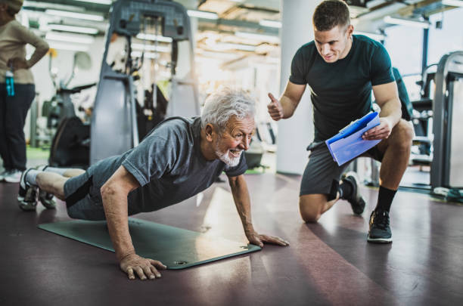
coach page
Profile
Dashboard

Slide 16
Dashboard
In the dashboard for each coach, a statistic of their usage, members is displayed for each of the services

Slide 17
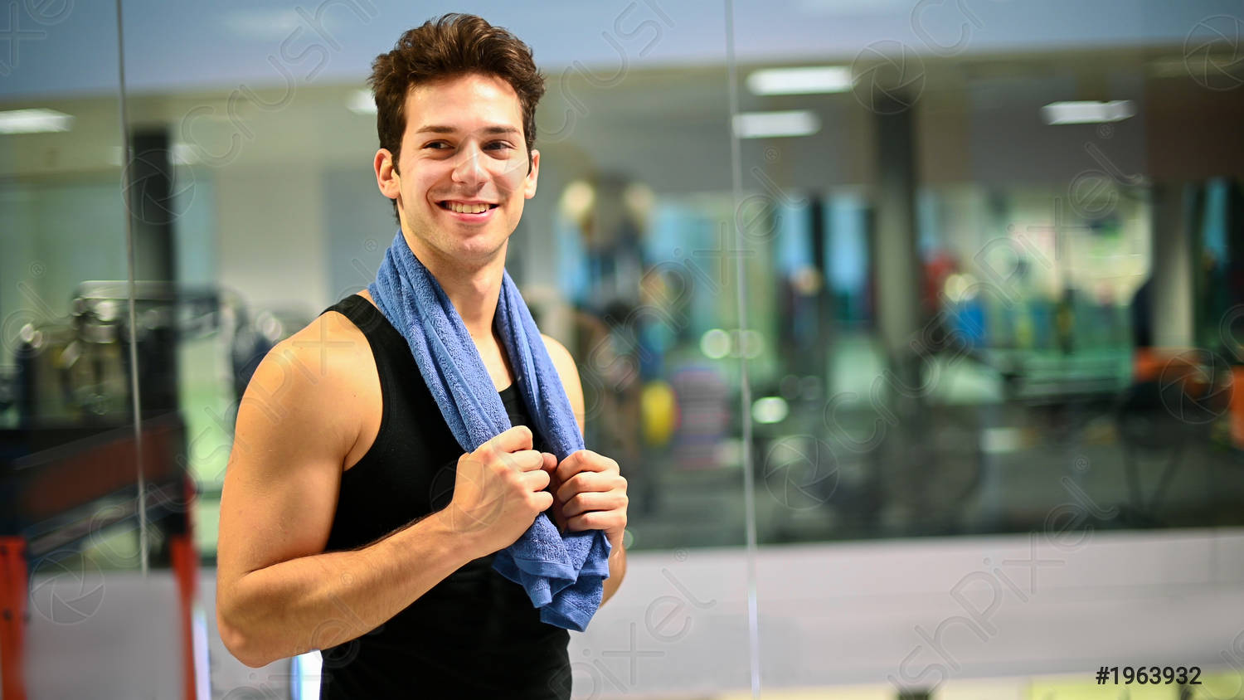

Are you nervous about going to the gym?
In the Users' opinions, there is a solution

Slide 18

The Website is controlled by the administrator Ipsum
The administrator controls all services provided by the site

Slide 19
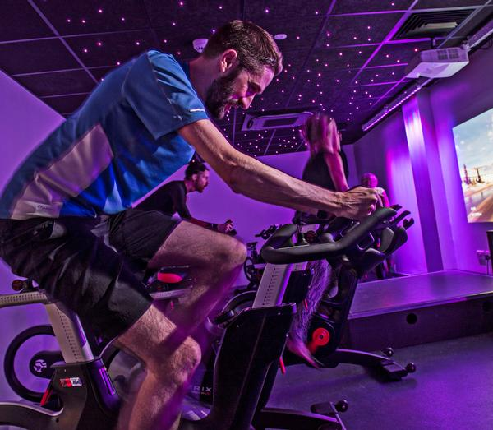
Future Work
01
include paid advertisements
02
paid user accounts, and the electronic payment feature and multilingual feature will be added.
03
Developing the website after graduation and adopting it as a website for the Pulse Sports Club.

Slide 20


