Slide 1


Faculty Of Engineering
Civil Engineering Department
Design of a Wastewater and Stormwater Collection Networks for Part of Ya’bad Village
Graduation Project 2
Prepared by:
Alaa’ M. Hirzallah
Noor M. Alshiekh
Supervised by:
Dr. Mohammad N. Almasri

Slide 2
Outline :
Introduction.
Objectives and justifications of the project.
Methodology (SewerCAD and StormCAD)
Hydraulic background
Design
Results
Recommendations

Slide 3

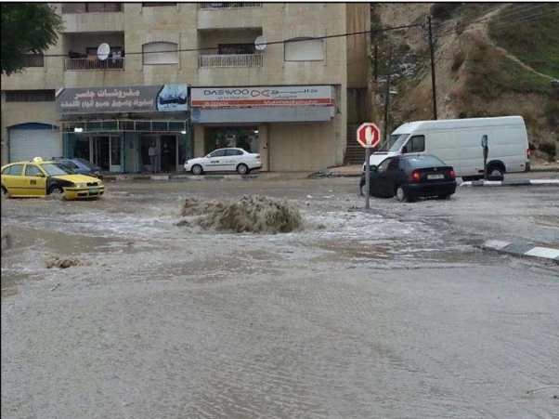
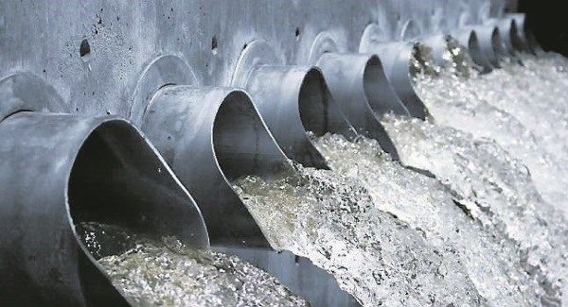
Introduction:
Water is the vain of life .

Slide 4
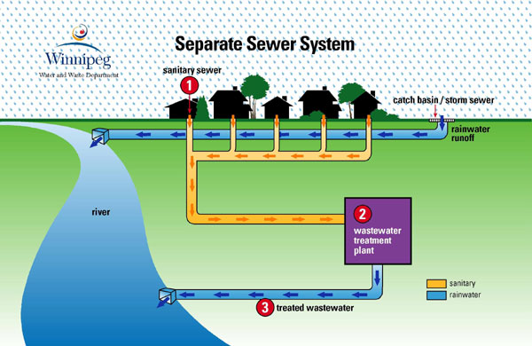
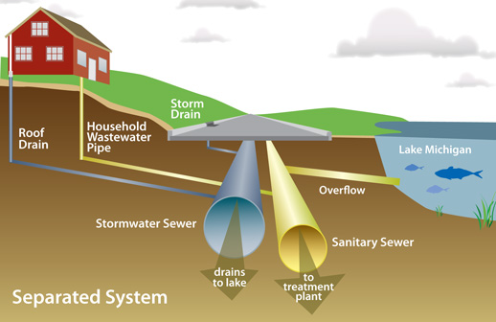
Objectives:
Stormwater Collection Network
Wastewater Collection Network

Slide 5
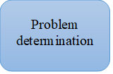
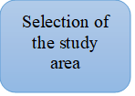


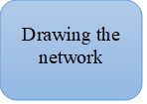
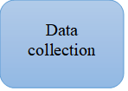


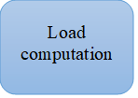
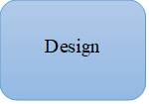

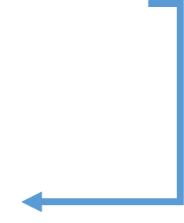
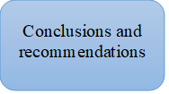
Methodology

Slide 6
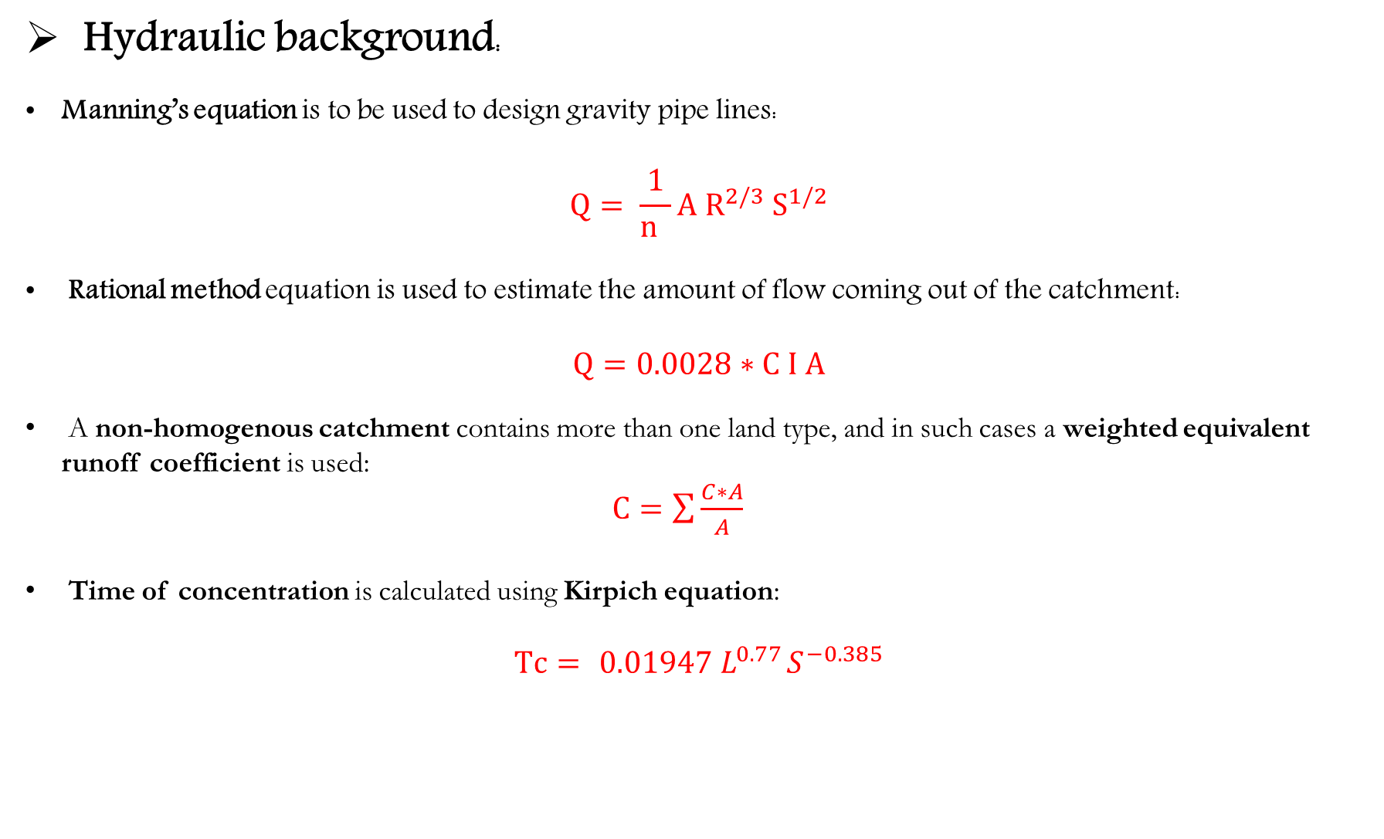
Hydraulic background:
Manning’s equation is to be used to design gravity pipe lines:
$$Q= \frac{1}{n }A R^{2/3} S^{1/2}$$
Rational method equation is used to estimate the amount of flow coming out of the catchment:
$$Q=0.0028∗C I A$$
A non-homogenous catchment contains more than one land type, and in such cases a weighted equivalent runoff coefficient is used:
$C=\sum{\frac{C∗A}{A}}$
Time of concentration is calculated using Kirpich equation:
$$Tc={ 0.01947 L}^{0.77}S^{−0.385}$$

Slide 7
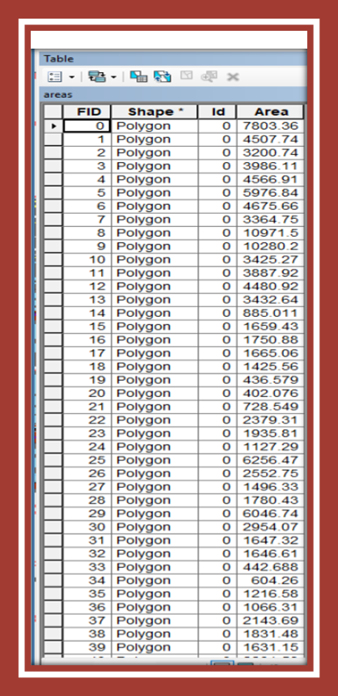
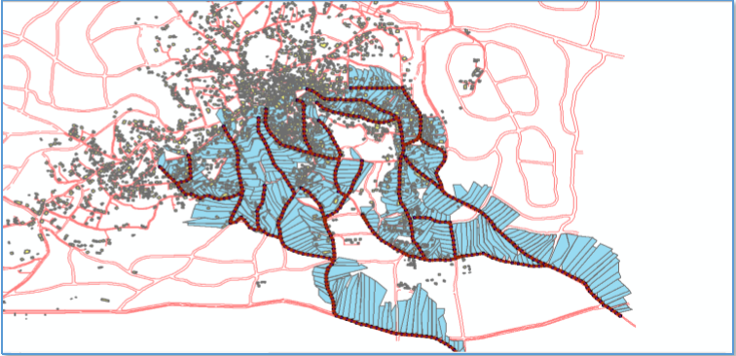
How did we calculate the loads ?
Using GIS, we drew sewersheds for each manhole in the network.
We calculated each area served by using the Calculation Geometry function in GIS.

Slide 8
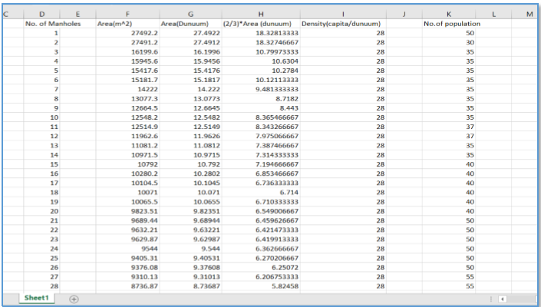
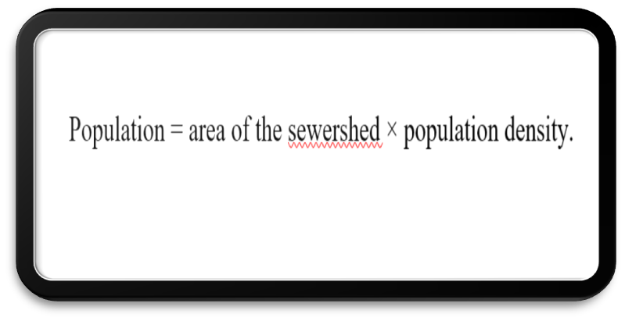
How did we calculate the loads(For WW collection network) ?

Slide 9
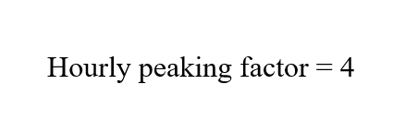
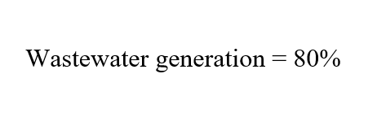
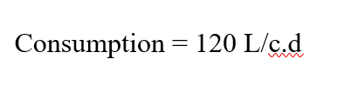
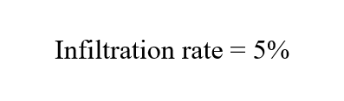
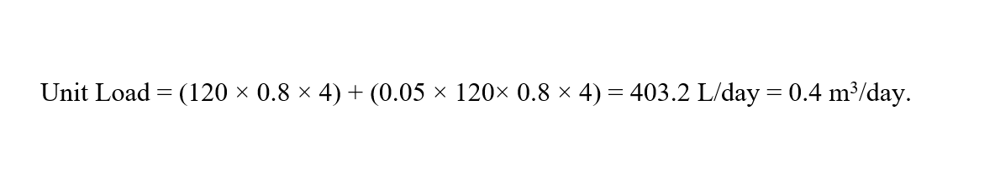
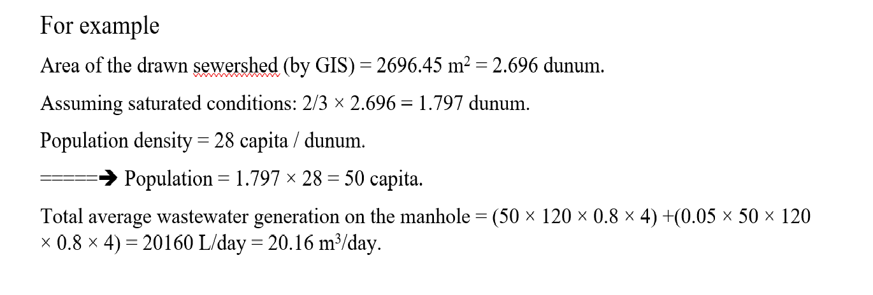

Slide 10
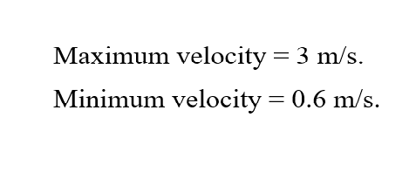
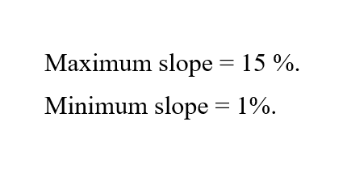
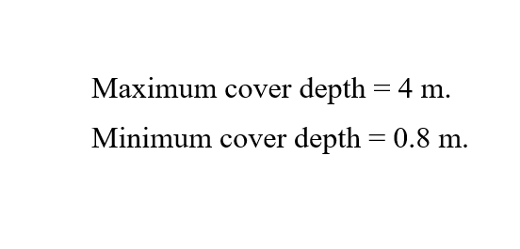
Constrains (For WW collection network ):

Slide 11
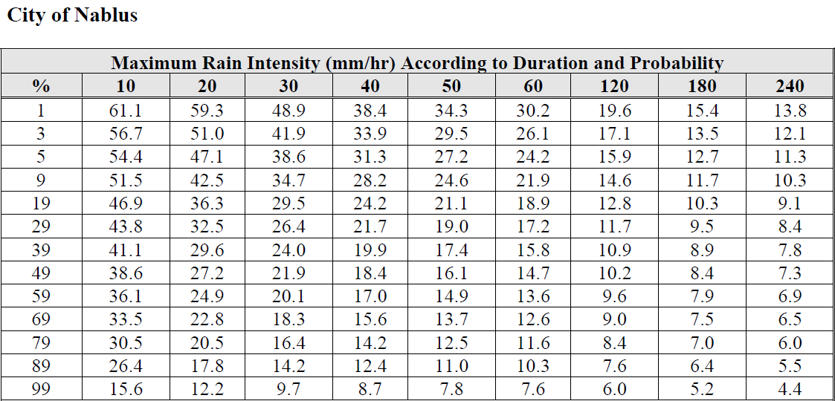
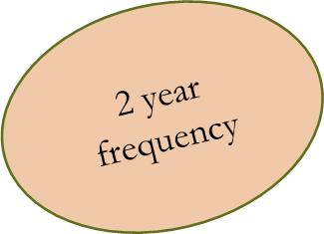
Rational Method:
The rational method is a simple formula for the estimation of peak flow rate from small urban and rural catchment areas such as Ya’bad Village.
It depends on :
Frequency.
Rainfall intensity
Runoff coefficient
Rainfall Intensity:

Slide 12
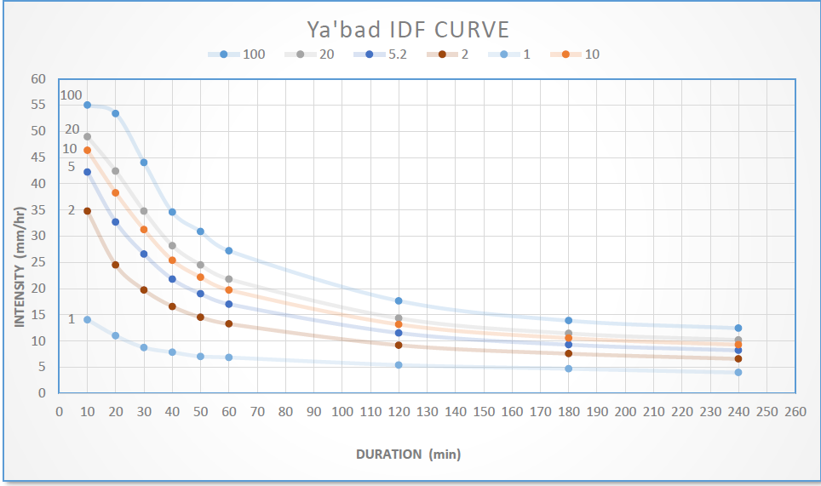

Slide 13
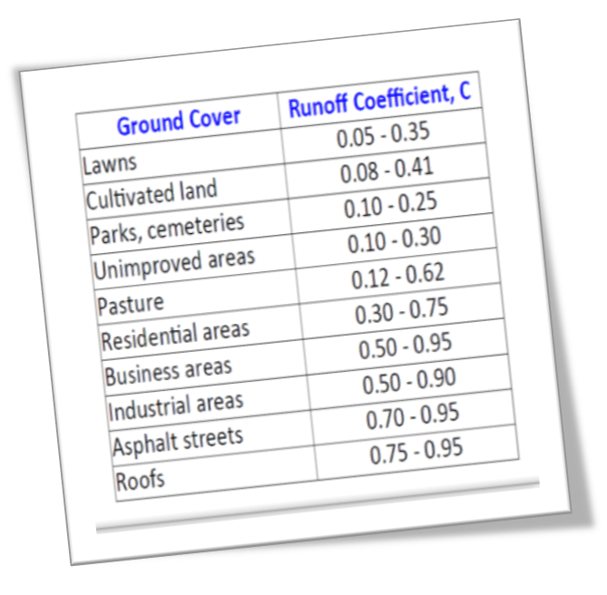
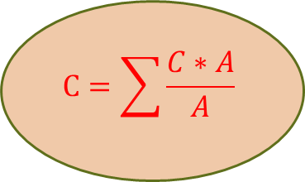
Runoff coefficient:
Is a ratio between the runoff volume and the average rate of rainfall depth over a given duration.
The C values we used in our design:
Streets = 0.8
Olive trees = 0.3
Residential areas = 0.7
Cemeteries = 0.2
$$C=\sum{\frac{C∗A}{A}}$$

Slide 14
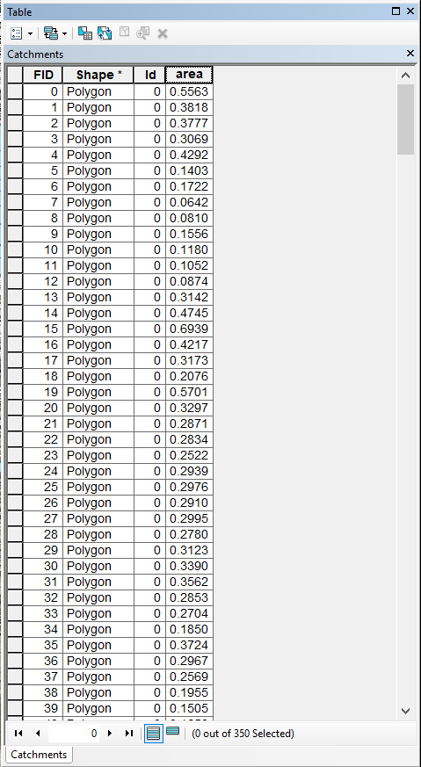
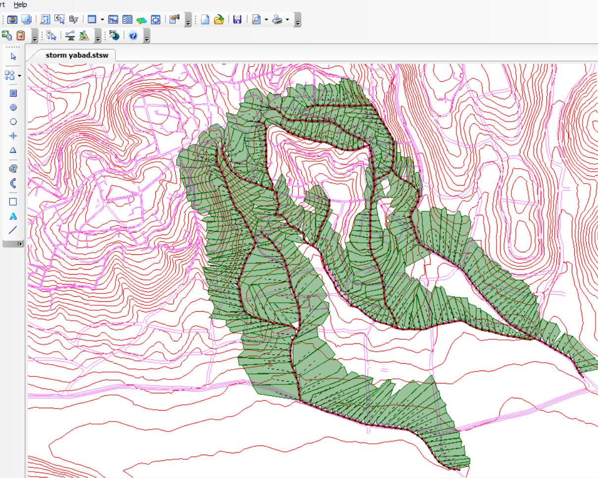
How did we calculate the loads(For stormwater network ) ?
Using GIS, we drew catchments for each catch basin in the network depending on elevations, in order to calculate their areas.
We calculated each area using the Calculation Geometry function in GIS.

Slide 15
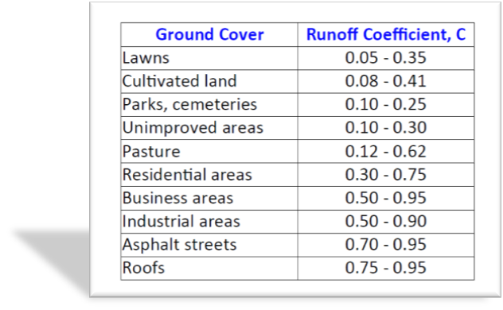
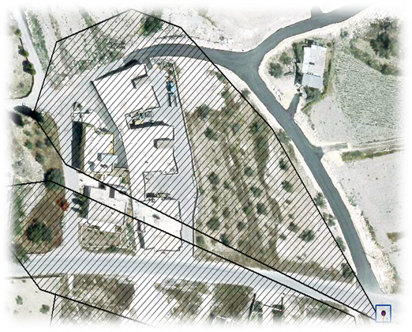
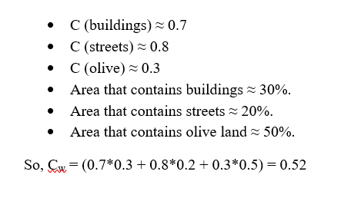
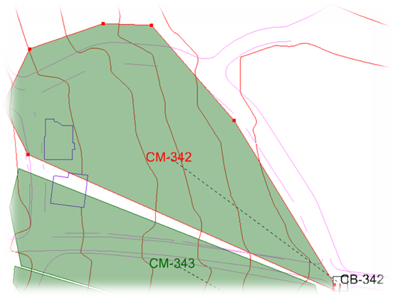
Calculating Runoff Coefficient, C

Slide 16
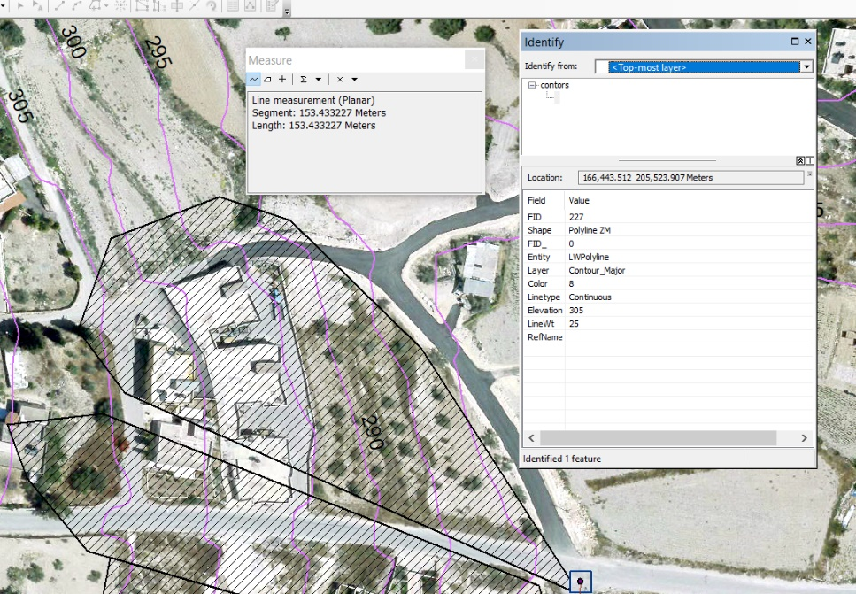
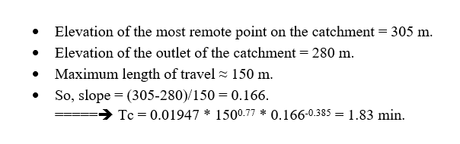
Calculating time of concentration, Tc

Slide 17
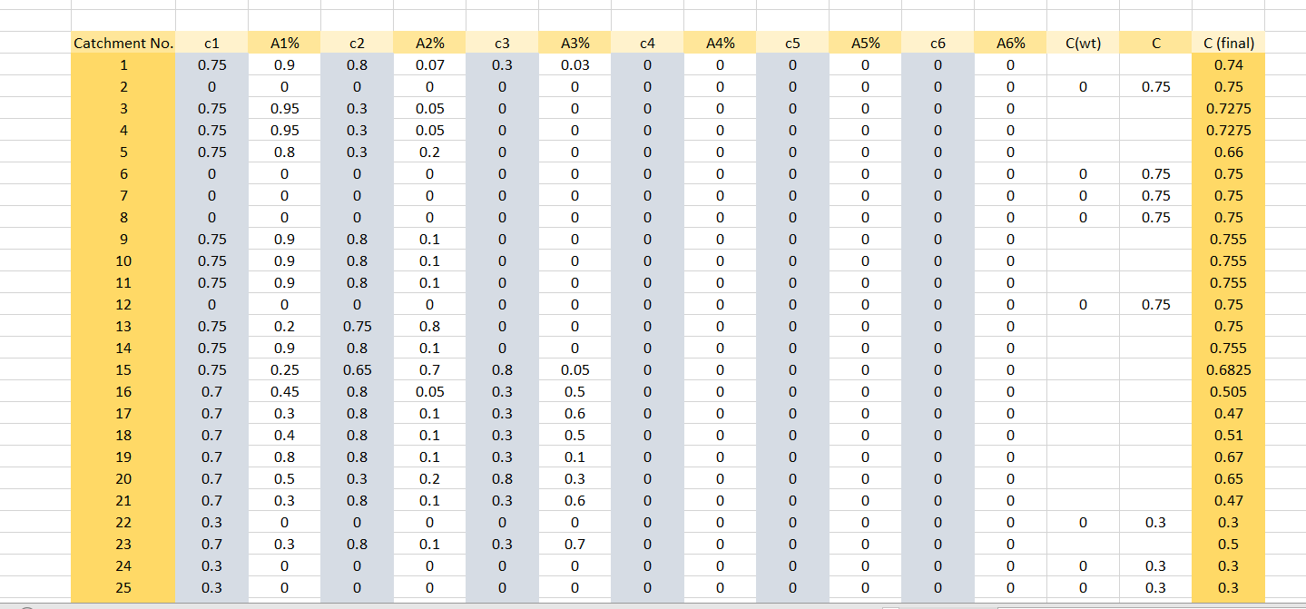
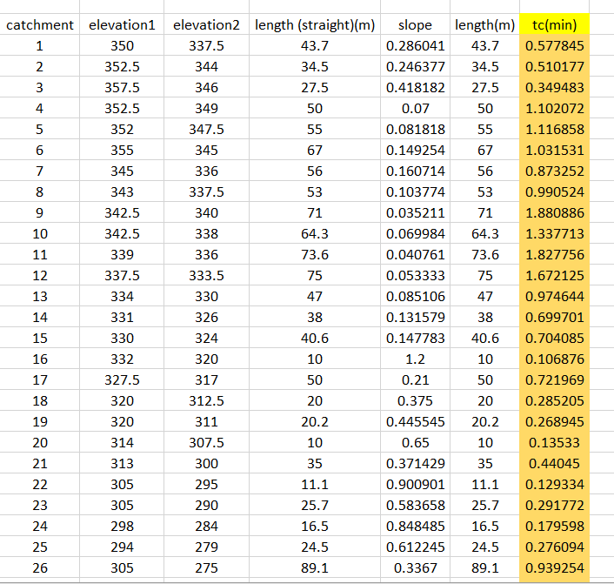
Time of concentration Excel table
Runoff coefficient Excel table

Slide 18
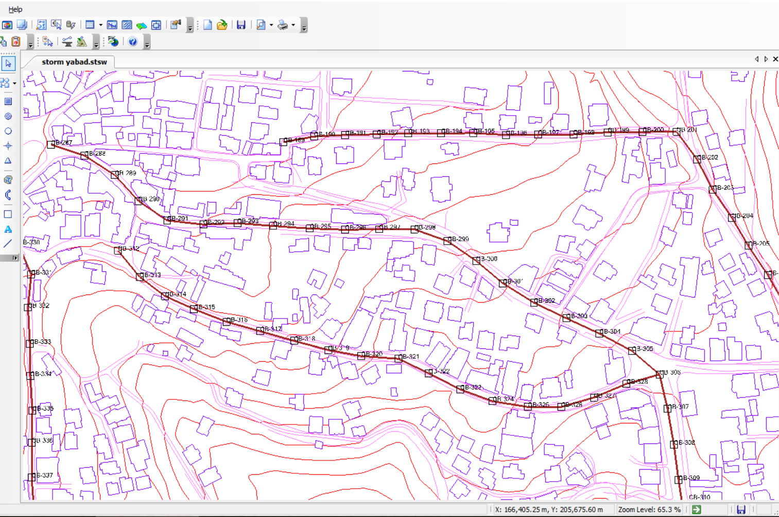
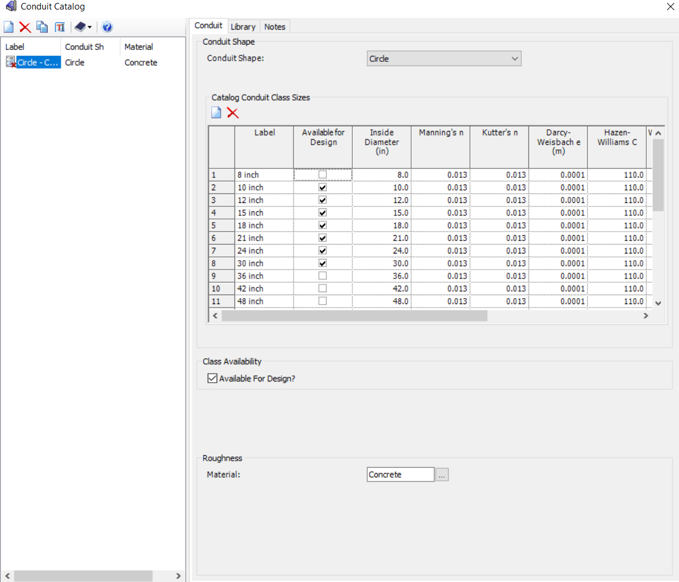
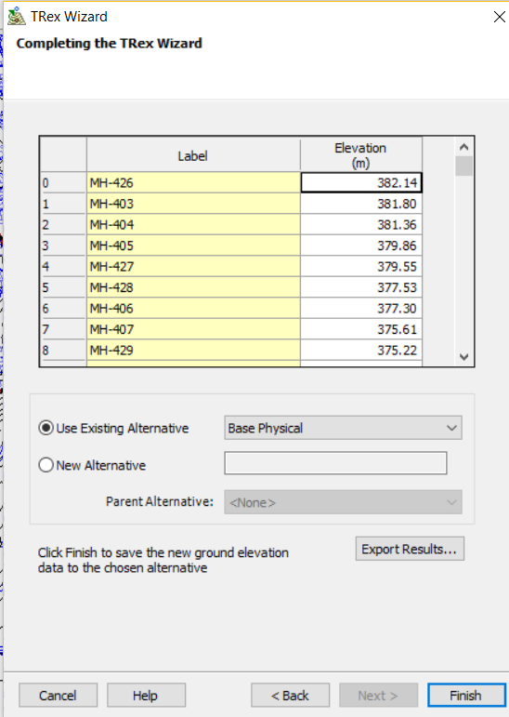
Input data in StormCAD:
1. Started by placing the catch basins and connecting them with conduits.
2. Identified the ground elevations of the catch basins by TRex function using the contour shapefile.
3. Identified sizes of the diameters for the conduits, cross-section type and the material used for the conduits.

Slide 19
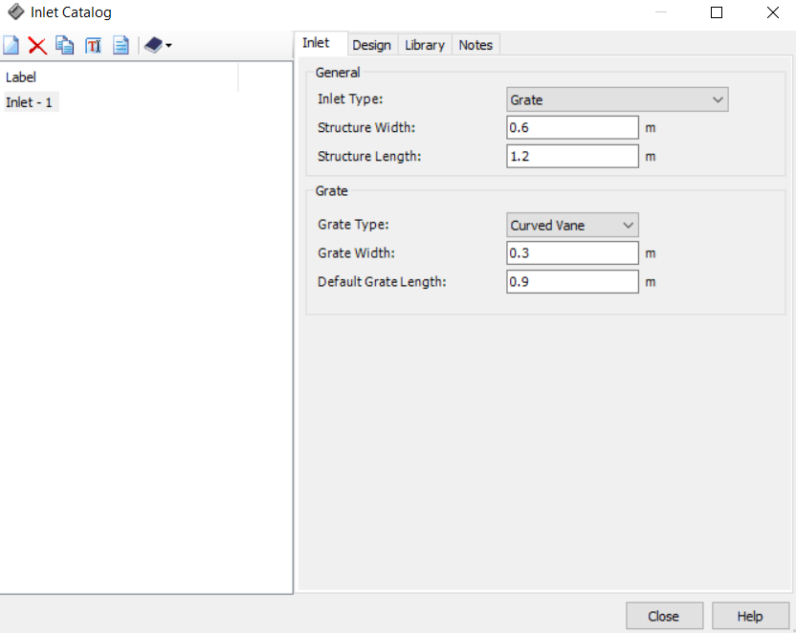

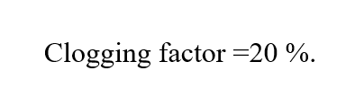


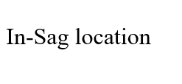
4. Identified an Inlet from the inlet catalog, where we used Grate for inlet type.

Slide 20
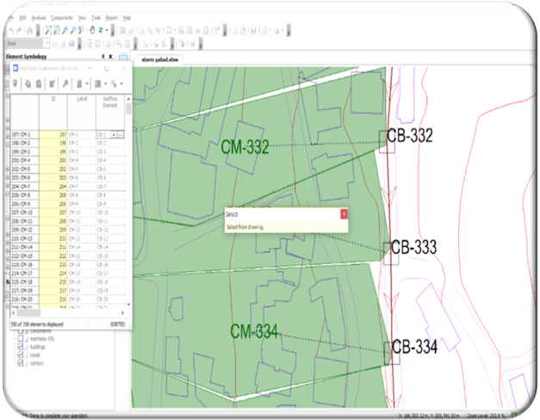
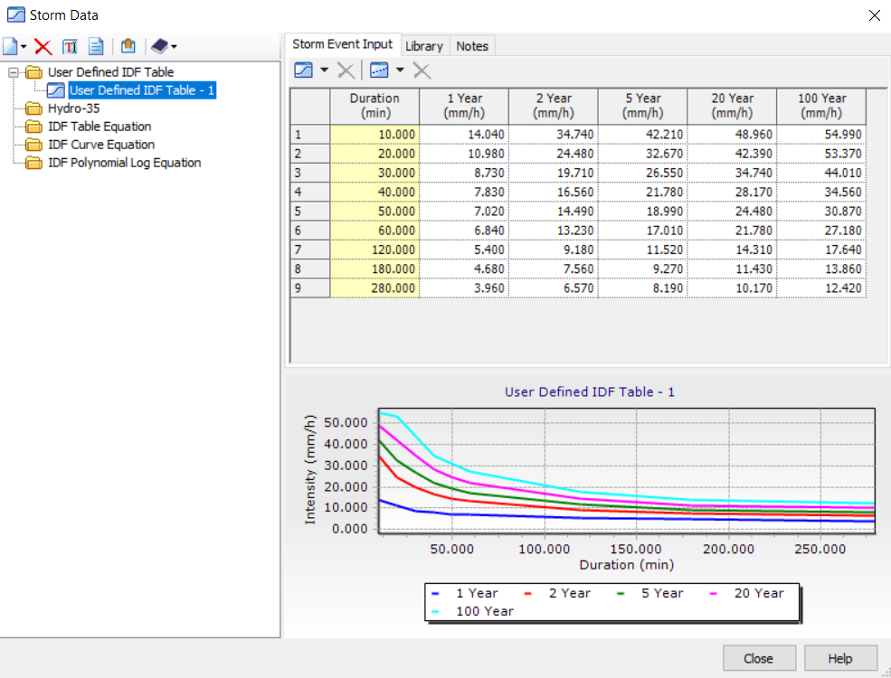
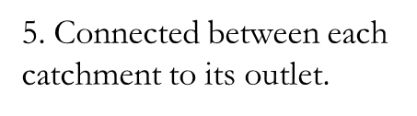

6. Entered the IDF table for Ya’bad Village
7. Chose the Global Storm Event to occur every 2 years

Slide 21



Constrains ( For Stormwater collection network):

Slide 22





Results (Wastewater Collection network):

Slide 23



Slide 24





Slide 25





Results (Stormwater Collection Network):

Slide 26



Slide 27



Slide 28

Profiles:

Slide 29
Recommendations:
Based on the results we obtained, we recommend to use the data collected and processed when considering to apply a design of a wastewater and a stormwater collection networks.
We recommend to study and select a location for a wastewater treatment plant and design it.
We recommend to study the obstacles that could be faced during the construction of the network.

Slide 30
Thank You

